Slide 1

Lecture 2: Environments, Virtual Machines and Containers
AC295
AC295
Advanced Practical Data Science
Pavlos Protopapas

Slide 2
Outline
1: Class organization
2: Virtual environments
3: Virtual machines
4: Containers
5: Advanced topics

Slide 3
Class organization
Github for this class (Michael)
Group formation
Presentation schedule
Review class flow
Auditors

Slide 4
Outline
1: Class organization
2: Virtual environments
3: Virtual machines
4: Containers
5: Advanced topics

Slide 5
Why should we use virtual environment?
Virtual environments help to make development and use of code more streamlined.
Virtual environments keep dependencies in separate “sandboxes” so you can switch between both applications easily and get them running.
Given an operating system and hardware, we can get the exact code environment set up using different technologies. This is key to understand the trade off among the different technologies presented in this class.

Slide 6
Why should we use virtual environment?
Maggie took cs109a, she used to run her Jupyter notebooks from anaconda prompt. Every time she installed a module it was placed in the either of bin, lib, share, include folders and she could import it in and used it without any issue.
lib1
lib2
lib3
bins
Operating System
$ which python
/c/Users/maggie/Anaconda3/python
Maggie

Slide 7
Why should we use virtual environment?
Maggie starts taking ac295 and she thinks that would be good to isolate the new environment from the previous enviroments avoiding any conflict with the installed packages. She adds a layer of abstraction called virtual environment that helps her keep the modules organized and avoid misbehaviors while developing a new project.
lib1
lib2
bins
lib1
lib2
lib3
env_ac295
bins
Operating System
$ which python
/c/Users/maggie/Anaconda3/envs/env_ac295/python
Maggie

Slide 8
Why should we use virtual environment?
Maggie collaborates with John for the final project and shares with him the environment she is working on through .yml file.
lib1
lib2
lib1
lib2
bins
bins
lib1
lib2
lib3
env_ac295
env_ac295
bins
Operating System
Operating System
Maggie
John

Slide 9
Why should we use virtual environment?
John experiments a new method he learned in another class and adds a new library to the working environment. After seeing a tremendous improvements he sends Maggie back his code and a new .yml file. She can now update her environment and replicate the experiment.
lib1
lib2
lib3
lib1
lib2
lib3
lib1
lib2
lib3
bins
bins
bins
lib1
lib2
lib3
env_ac295
env_ac295
env_am207
bins
Operating System
Operating System
Maggie
John

Slide 10
Why should we use virtual environment?
What could go wrong? Unfortunately, Maggie and John reproduce different results and they think the issue relates to their operating systems. Indeed while Maggie has a MacOS, John uses a Win10.
lib1
lib2
lib3
lib1
lib2
lib3
lib1
lib2
lib3
bins
bins
bins
lib1
lib2
lib3
env_ac295
env_ac295
env_am207
bins
Operating System (MacOs)
Operating System (Win10)
Maggie
John

Slide 11
Virtual environments
Pros
Reproducible research
Explicit dependencies
Improved engineering collaboration
Broader skill set
Cons
Difficulty setting up your environment
Not isolation
Does not work across different OS

Slide 12
What are virtual environments then?
A virtual environment is a directory with the following components:
- site_packages/ directory where third-party libraries are installed
- links [really symlinks] to the executables on your system
- some scripts that ensure that the code uses the interpreter and site packages in the virtual environment
> Adapted from CS207 <

Slide 13
Virtual environments: virtualenv vs conda
virtualenv
virtual environments manager embedded in Python
incorporated into broader tools such as pipenv
allow to install modules using pip package manager
how to use virtualenv
create an environment within your project folder virtualenv your_env_name
it will add a folder called environment_name in your project directory
activate environment: source env/bin/activate
install requirements using: pip install package_name=version
deactivate environment once done: deactivate

Slide 14
Virtual environments in practice (virtualenv vs conda)
conda environment
virtual environments manager embedded in Anaconda
allow to use both conda and pip to manage and install packages
how to use conda
create an environment conda create --name your_env_name python=3.7
it will add a folder located within your anaconda installation /Users/your_username /anaconda3/envs/your_env_name
activate environment conda activate your_env_name (should appear in your shell)
install requirements using conda install package_name=version
deactivate environment once done conda deactivate
duplicate your environment using YAML file conda env export > my_environment.yml
to recreate the environment now use conda env create -f environment.yml

Slide 15
More on Virtual environments
Further readings
For detailed discussions on similarities and differences among virtualenv and conda https://jakevdp.github.io/blog/2016/08/25/conda-myths-and-misconceptions/
More on venv and conda environments https://towardsdatascience.com/virtual-environments-104c62d48c54 https://towardsdatascience.com/getting-started-with-python-environments-using-conda-32e9f2779307

Slide 16
Outline
1: Class organization
2: Virtual environments
3: Virtual machines
4: Containers
5: Advanced topics

Slide 17
Why should we use virtual machines?
Motivation
we have our isolated systems and after we set up a similar environment into our colleagues' machines we should get similar results, right? Unfortunately, it is not always the case. Why? Most likely because we run it on different operating system.
even though by using virtual environments we are isolating our computations, we might need to use the same operating system which requires to run "like if" we are in a different machines.
How can we run the same experiment? Virtual Machines!
Isolation!

Slide 18
Why should we use virtual machines?(cont)
Advantages
full autonomy: it works like a separate computer system, it is like run a computer within a computer.
very secure: the software inside the virtual machines can't affect the actual computer.
lower costs: buy one machine and run multiple operating systems.

Slide 19
What are virtual machines?
virtual machines have their own virtual hardware: CPUs, memory, hard drives, etc.
you need a hypervisor that manages different virtual machines on server
hypervisor can run as much virtual machines as you wish
operating system is called the "host" while those running in a virtual machine are called "guest“
You can install a completely different operating system on this virtual machine
https://towardsdatascience.com/how-to-install-a-free-windows-virtual-machine-on-your-mac-bf7cbc05888
App1
App2
App3
Bins/lib
Bins/lib
Bins/lib
Guest
OS
Guest
OS
Guest
OS
Hypervisor
Infrastructure
Machine Virtualization

Slide 20
Limitations
Uses hardware in your local machine
There is overhead associated with virtual machines
guest is not as fast as the host system (and take some time to start up)
may not have the same graphics capabilities

Slide 21
Outline
1: Class organization
2: Virtual environments
3: Virtual machines
4: Containers
5: Advanced topics

Slide 22
Why should we use containers?
It has the best of the two worlds because it allows:
to create isolate environment using the preferred operating system
to run different operating system without sharing hardware
The advantage of using containers is that they only virtualize the operating system and do not require dedicated piece of hardware because they share the same kernel of the hosting system.
Containers give the impression of a separate operating system however, since they're sharing the kernel, they are much cheaper than a virtual machine.
App
App
Libraries
Libraries
App
App
Libraries
Libraries
Kernel
Containers

Slide 23
Why should we use containers? (cont)
With container images, we confine the application code, its runtime, and all its dependencies in a pre-defined format.
With the same image, you can reproduce as much containers as you wish. Think about the image as the recipe, and the container as the cake ;-) you can make as many cakes as you like with a given recipe.
A container orchestrator (see next lecture) is a single controller/management unit that connects multiple nodes together.
You can create a container on a Window but install an image of a Linux OS inside that container. The container still works on the Window
App
App
Libraries
Libraries
App
App
Libraries
Libraries
Kernel
Containers

Slide 24
Why should we use containers? (cont)
Containers are application-centric methods to deliver high-performing, scalable applications on any infrastructure of your choice
Containers are best suited to deliver microservices by providing portable, isolated virtual environments for applications to run without interference from other running applications
Containers encapsulate microservices and their dependencies but do not run them directly
Containers run container images, it bundles the application along with its runtime and dependencies
Because they're so lightweight, you can have many containers running at once on your system.
Containers are lightweight (they cost an order of magnitude less than a virtual machine in memory footprint).
App
App
Libraries
Libraries
App
App
Libraries
Libraries
Kernel
Containers

Slide 25
Why containers recap?
Their startup time is on the order of seconds (vs. minutes for Virtual Machines).
They provide pseudo-isolation. This means they're still pretty secure, but not as secure at a Virtual Machines.
A container is deployed from the container image offering an isolated executable environment for the application
Containers can be deployed from a specific image on many platforms, such as workstations, Virtual Machines, public cloud, etc.
Containers are extremely popular, and their popularity is growing
One of the first widely used containers was provided by Docker
Docker containers can be used to run websites and web applications
Multiple containers can be managed by a service called Kubernetes (see next lecture)

Slide 26
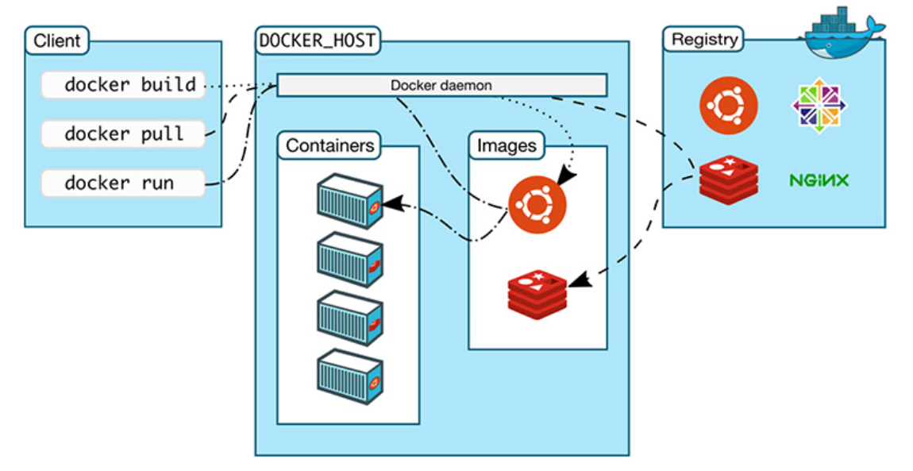
The Docker Ecosystem
The client allows to run various Docker commands (installed in any OS).
The registry is place to find and download Docker images.
The docker host is the server running the Docker daemon.
https://nickjanetakis.com/blog/understanding-how-the-docker-daemon-and-docker-cli-work-together

Slide 27
Hands on Containers
Exercise set up
Exercise 1: pull, modify, and push a Docker image from Docker Hub
Exercise 2: build a Docker Image and push it to Docker Hub

Slide 28


Exercise 1: pull, modify, and push an image
CLIENT
DOCKER HOST
REGISTRY
docker pull
Docker daemon
docker run
Containers
Images
docker push
https://nickjanetakis.com/blog/understanding-how-the-docker-daemon-and-docker-cli-work-together

Slide 29
Exercise 2: build a Docker Image
CLIENT
DOCKER HOST
REGISTRY
docker build
Docker daemon
Containers
Images
https://nickjanetakis.com/blog/understanding-how-the-docker-daemon-and-docker-cli-work-together

Slide 30
Hands on Containers | Instructions
Exercise set up
install docker (https://hub.docker.com/)
have docker up and running
create a class repository in docker hub (yourhubusername/ac295_playground)
Exercise 1: modify images from Docker Hub
Step 1 | pull image pavlosprotopapas/ac295_l2:latest
Step 2 | run container in interactive mode (-it)
Step 3 | open README file and follow instructions to modify image
Step 4 | push modified image (pavlosprotopapas/ac295_l2)
Exercise 2: Docker Do It Yourself
Step 1 | pull course repository and cd to lecture2/exercises/exercise1
Step 2 | build an image using Dockerfile (for MacOs)
Step 3 | push image to docker hub (yourhubusername/ac295_playground)

Slide 31
Outline
1: Class organization
2: Virtual environments
3: Virtual machines
4: Containers
5: Advanced topics

Slide 32
Advanced Topic
Dirk Merkel, Docker: Lightweight Linux Containers for Consistent Development and Deployment Light
“Dependency hell”: conflicting and missing dependencies, platform differences
Docker under the hood (worth reading)
Containers vs. Other Types of Virtualization
Docker Workflow
Ákos Kovács , Comparison of Different Linux Containers
Measure containers performance (including Singularity container system)
Containers considered 1) LXC (Linux Containers), 2) Docker, 3) Singularity (HPC container platform), and measurement: CPU and Networking benchmark
Containers are almost at the level of the native performance. Containers are also hardening the security. The networking performances are also satisfying, but the greatest area of improvement.

Slide 33
Advanced Topic (cont)
Carlos Arango, Remy Dernat, John Sanabria, Performance Evaluation of Container-based Virtualization for High Performance Computing Environments
Same containers and measurement used by Kovács
Singularity containers are more suitable for HPC implementation than Docker or LXC
For I/O-intensive workloads, Container images can be much more optimal than running against shared storage
Message: choose technology based on the use
Gregory M. Kurtzer, Vanessa Sochat, Michael W. Bauer, Singularity: Scientific containers for mobility of compute
Game changer for computational sciences
The goals of singularity are to Mobility of compute, Reproducibility. User freedom. Support on existing traditional HPC resources.
Example use cases: academic researcher, server administrator, eliminate redundancy in container technology, running at scale
Take away is security. No root access.

Slide 34
THANK YOU
AC295
Advanced Practical Data Science
Pavlos Protopapas

