Slide 1

Lecture #1: Introduction
AC295
Advanced Practical Data Science
Pavlos Protopapas

Slide 2
Outline
1 : Why you should take this class and why not
2: Who are we
3: Course structure and activities
4: Expectations
5: Workload
6: Logistics
7: Grades

Slide 3
Why you should take this class and why not
Learn how to:
Put your model in production
Integrate and orchestrate applications
Deploy increasing amount of data
Take advantage of available models
Evaluate and debug model using visualization
If you have attended ComputeFest and found it interesting and want to know more, this will be an interesting class

Slide 4
UNK: from Data Science Series to Real World
Data Science Series
Real World
Manage larger database
Learn packages to process larger amount of data
Handle complex team dynamics and orchestrate applications
Ask Question
Collect Data
CSV file, images,
scraping
EDA
Notebook
Methodology
Multiple tasks
Story-telling
Webpage, blogs,
posts

Slide 5


UNK: Real World Example
Fragmented
database
Multitude
requirements and applications
Recombine and deploy
Developer 1
Developer 2
Developer 3

Slide 6

UNK: Real World Example EDA
Developer 1
Huge
database or task (i.e. Ensemble)
Recombine
results
Present results
Developer 3
Developer 2

Slide 7
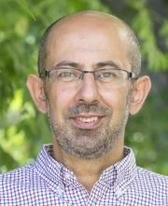
2: Who
Pavlos Protopapas
Scientific Director of the Institute for Applied Computational Science (IACS). Teaches CS109(a/b), the data science capstone course, and AC295 (advanced practical data science).
Research in astrostatistics: machine learning, statistical learning, big data for astronomical problems.
He has picked some new hobbies besides 109 and eating:
Going to BSO (see you there), cross country ski (completed Engadin skimarathon), cheese making and being a TikToker (check me out @pavlosprotopapas)

Slide 8
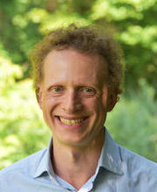
2: Who
Michael S. Emanuel
After 17 years in finance, mainly fixed income portfolio management, Michael started a second career and is completing the Masters of Data Science program at Harvard. He is a father of two small children who occasionally crash IACS events and enjoys distance running and classical music.

Slide 9
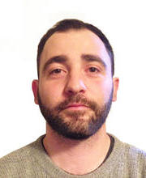
2: Who
Andrea Porelli
Urban planner turned into data hacker. He likes to break things just for the sake of putting them back together (most of the time). Committed to apply Data Science to change something. So far, he managed to change himself the most –thanks IACS- and look forward to pass it over.

Slide 10
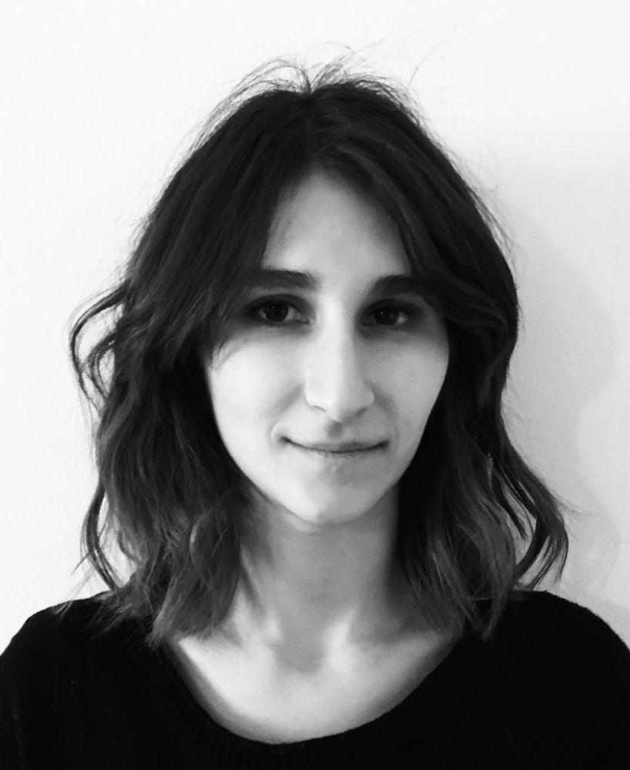
2: Who
Giulia Zerbini
Data Designer. Creative technologist at The Visual Agency in Milan, MA Graduate at Politecnico di Milano. Designing and developing visualizations and interfaces based on data. Passionate about using visualizations for discovering patterns in data and communicating information in intuitive terms to a broad audience.

Slide 11
3: Course Structure and Activities
Modules: 1. Deploy data science (integration + scalability)
2. Transfer learning and distillation
3. Visualization as investigative tool
Activities: lectures, reading discussions, practicums, projects
Lectures: Tuesday and Thursday 4:30‐5:45 pm in Cruft 309
> Calendar <

Slide 12
3: Course Structure and Activities
Regular week schedule
M T W T F
Lecture
Reading
Release
Reading List
Exercise
Quiz + Presentation*
due next week by the beginning of the lecture
*one per module per group

Slide 13
4: Expectations
How to read and present class material
> Link to Guidelines <

Slide 14
5: Workload
Regular Week
3 hours in class
3 hours reading
2 hours exercise
2 hours presentation*
~ 10 hours/week
* 1 presentation per module per group (3 total)
Practicum and Project Week
~ 15 hours/week**
* 3 practicums and 1 final project (2 weeks long)

Slide 15
6: Logistics
Fill up forms
Make group *
Sign-up presentation**
* Fill group components in each row
** Each group should pick one slot in each module

Slide 16
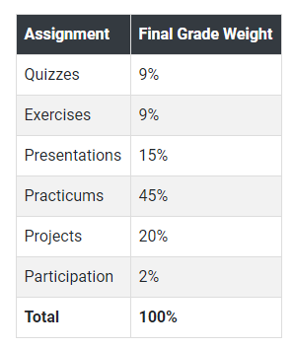
7: Grades

Slide 17
AC295
Advanced Practical Data Science
Pavlos Protopapas

