Slide 1

Lecture 1: Introduction
AC295
AC295
Advanced Practical Data Science
Pavlos Protopapas

Slide 2
Outline
1 : Why you should take this class and why not
2: Who are we
3: Course structure and activities
4: Expectations
5: Workload
6: Logistics
7: Grades

Slide 3
Why you should take this class
Because you want to learn how to:
Put your model in production
Integrate and orchestrate applications
Deploy increasing amount of data
Take advantage of available models
Evaluate and debug model using visualization
If you have attended ComputeFest and found the topics interesting this class will also be interesting

Slide 4
Why you shouldn’t take this class
You are not familiar with most of the concepts covered in CS109A/B
For example:
Basic Machine Learning
CNNs, RNNs, Autoencoders, GANs, etc
Basic linux commands
Remember, this course will be offered again in the fall!

Slide 5
Data Science Series to Real World
Data Science Series 109A/B
Real World
Manage larger database
Learn packages to process larger amount of data
Handle complex team dynamics and orchestrate applications
Ask Question
Collect Data
CSV file, images,
scraping
EDA
Notebook
Methodology
Multiple tasks
Story-telling
Webpage, blogs,
posts

Slide 6


Data Science Series to Real World (cont)
Fragmented
database
Multitude
requirements and applications
Recombine and deploy
Developer 1
Developer 2
Developer 3

Slide 7

Data Science Series to Real World (cont)
Developer 1
Multiple tasks or models (i.e. Ensemble)
Recombine
results
Present results
Developer 3
Developer 2

Slide 8
Data Science Series to Real World (cont)
Model too expensive to train
Or not enough training data
Use pre-trained model
Model
Final Results
Present results
Pre Trained Model

Slide 9
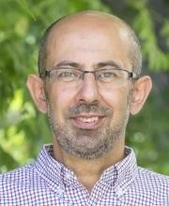
Who?
Pavlos Protopapas
Teaches CS109(a/b), the data science capstone course, and AC295 (advanced practical data science). Research in astrostatistics: machine learning, statistical learning, big data for astronomical problems.
He has picked some new hobbies besides 109s and eating:
Going to BSO (see you there), cross country ski (completed Engadin skimarathon), cheese making and being a TikToker (check me out @pavlosprotopapas)

Slide 10
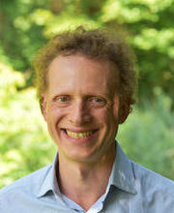
Who? (cont)
Michael S. Emanuel
After 17 years in finance, mainly fixed income portfolio management, Michael started a second career and is completing the Masters of Data Science program at Harvard. He is a father of two small children who occasionally crash IACS events and enjoys distance running and classical music.

Slide 11
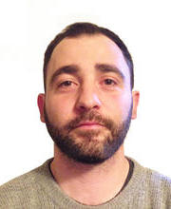
Who? (cont)
Andrea Porelli
Urban planner turned into data hacker. He likes to break things just for the sake of putting them back together (most of the time). Committed to apply Data Science to change something. So far, he managed to change himself the most –thanks IACS- and look forward to pass it over.

Slide 12
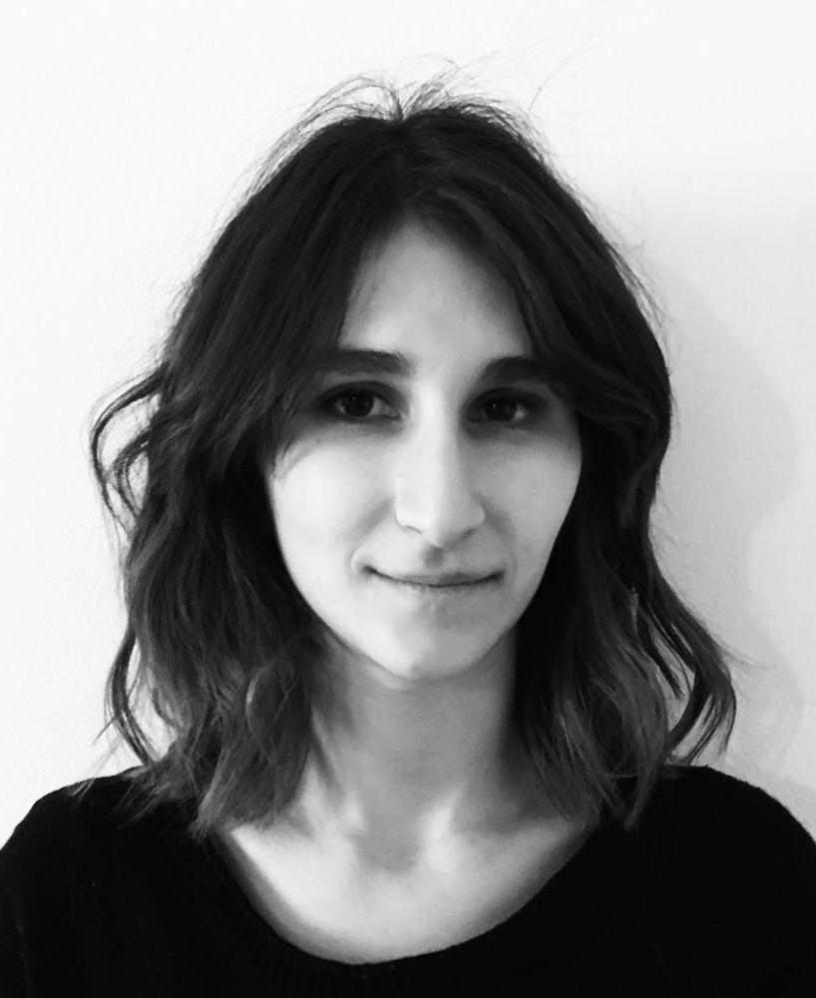
Who? (cont)
Giulia Zerbini
Data Designer. Creative technologist at The Visual Agency in Milan, MA Graduate at Politecnico di Milano. Designing and developing visualizations and interfaces based on data. Passionate about using visualizations for discovering patterns in data and communicating information in intuitive terms to a broad audience.

Slide 13
Course Structure and Activities
Modules:
1. Deploy data science (integration + scalability)
2. Transfer learning and distillation
3. Visualization as investigative tool
Activities:
lectures, reading discussions, exercises, quizzes, practicums, projects
Lectures: Tuesday and Thursday 4:30‐5:45 pm in Cruft 309
Office Hours: TBD

Slide 14
Topics
Deploy data science (integration + scalability)
Virtual Environments, Virtual Boxes, and Containers
Kubernetes
Dask

Slide 15
Topics (cont)
Transfer learning and distillation
Basic Transfer Learning and SOTA Models
Transfer Learning across Tasks
Distillation and Compression

Slide 16
Topics (cont)
Visualization as investigative tool
Introduction and Overview of Viz for Deep Models
Convolutional Neural Networks for Image Data
Recurrent Neural Networks for Text Data

Slide 17
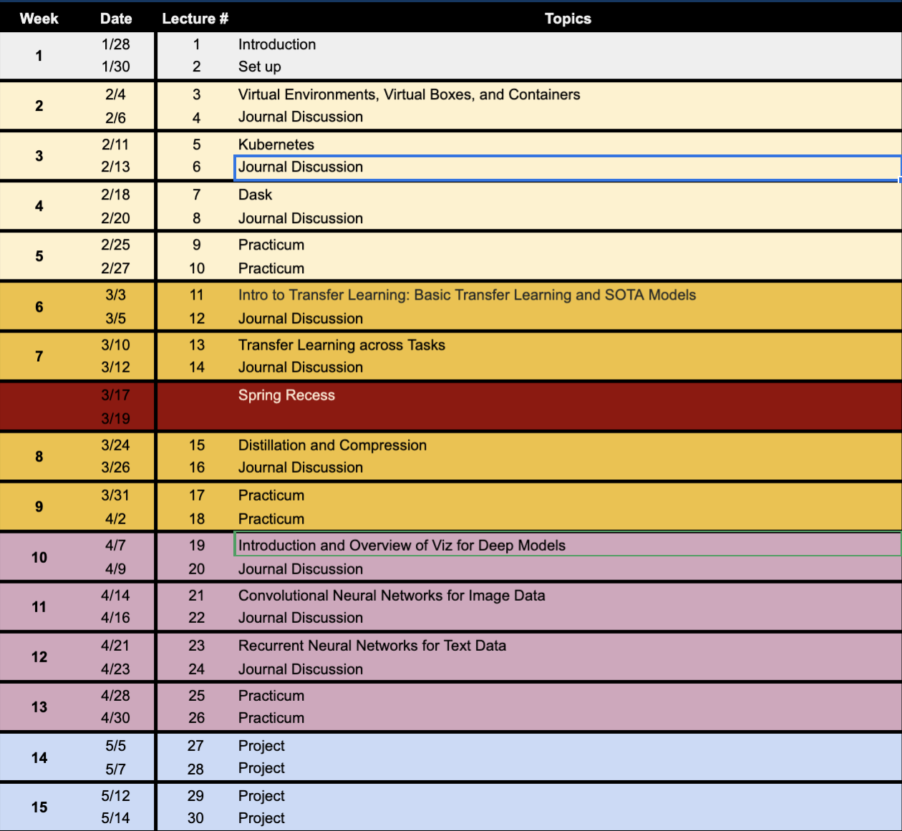
Calendar
> Link to Calendar <

Slide 18
Course Structure and Activities
Regular week schedule
F
M T W T F
Lecture
Reading
Release
Final Reading List
Exercise
Quiz + Presentation*
due next week by the beginning of the lecture
*one per module per group

Slide 19
Workload
Regular Week
3 hours in class
3 hours reading
2 hours exercise
4 hours presentation*
~ 12 hours/week
* 1 presentation per module per group (3 total)
Practicum and Project Week
~ 15 hours/week**
** 3 practicums and 1 final project (2 weeks long)
We will be asking for your feedback on the workload

Slide 20
Expectations
How to read and present class material
> Link to Reading Guidelines <
> Link to Presentation Guidelines <

Slide 21
Logistics
Fill up forms
Make group *
Sign-up presentation**
* Fill group components in each row
** Each group should pick one slot (white background) in each module

Slide 22
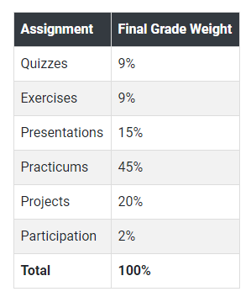
Grades

Slide 23
Final Details
We will be using ED for discussions, announcements and quizzes.
Submissions for exercises, reports, presentations etc we will be using github (details soon).

Slide 24
This is the first time we are offering the course, so your feedback will be vital in tuning it this year and improving it for future years.
However, we are making every effort to have a well organized course and we promise you an exciting semester full of learning!
THANK YOU
AC295
Advanced Practical Data Science
Pavlos Protopapas

