Slide 1

Lecture #1: Introduction
AC295
Advanced Practical Data Science
Pavlos Protopapas

Slide 2
Outline
1 : Why you should take this class and (why not)
2: Who
3: Course Structure and Activities
4: Expectations
5: Workload
6: Logistics
7: Grades

Slide 3
1 : Why you should take this class and (why not)
Learn how to:
> put your model in production
> integrate and orchestrate applications
> deploy increasing amount of data
> take advantage of available models
> evaluate and debug model using visualization
> Syllabus <

Slide 4
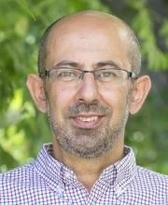
2: Who
Scientific Director IACS
…

Slide 5

2: Who
Michael

Slide 6

2: Who
Andrea

Slide 7
2: Who
Giulia
Placeholder for profile picture

Slide 8
3: Course Structure and Activities
> Modules: 1. Deploy data science (integration + scalability)
2. Transfer learning and distillation
3. Visualization as investigative tool
> Activities: lectures, reading discussions, practicums, projects
> Lectures: Tuesday and Thursday 4:30‐5:45 pm in Cruft 309
> Calendar <

Slide 9
3: Course Structure and Activities
> Regular week schedule <
M T W T F
Lecture
Reading
Release
Reading List
Exercise
Quiz + Presentation*
due next week by the beginning of the lecture
*one per module per group

Slide 10
4: Expectations
> How to read class material (scientific paper)
> How to present
> Exercise?
> TODO add links to guidelines

Slide 11
5: Workload
Regular Week
3 hours in class
3 hours reading
2 hours exercise
2 hours presentation*
~ 10 hours/week
* 1 presentation per module per group (3 total)
Practicum and Project Week
~ 15 hours/week**
* 3 practicums and 1 final project (2 weeks long)

Slide 12
6: Logistics
> Fill up forms <
Make group *
Sign-up presentation**
* Fill group components in each row
** Each group should pick one slot in each module

Slide 13
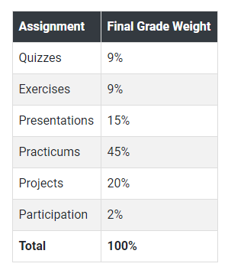
7: Grades

Slide 14
UNK: from Data Science Series to Real World
>Data Science Series<
>Real World<
Manage larger database
Learn packages to process larger amount of data
Handle complex team dynamics and orchestrate applications
Ask Question
Collect Data
CSV file, images,
scraping
EDA
Notebook
Methodology
Multiple tasks
Story-telling
Webpage, blogs,
posts

Slide 15


UNK: Real World Example
Fragmented
database
Multitude
requirements and applications
Recombine and deploy
Developer 1
Developer 2
Developer 3

Slide 16
AC295
Advanced Practical Data Science
Pavlos Protopapas

