Slide 1

Introduction to CS109B a.k.a. STAT121B, AC209B, CSCI E-109B
Data Science 2: Advanced Topics in Data Science
Pavlos Protopapas, Mark Glickman, and Chris Tanner

Slide 2
Lecture Outline
From 109A to 109B
Who are we?
A walk through the syllabus (i.e., the rules of the road!)
Second half of today’s lecture starts the new course material!

Slide 3
CS109A
Basic statistics, visualization
Regression with continuous outcome
Regression with a binary outcome
Ethics
PCA
Decision trees and ensemble methods
Basics of Neural Nets
Experimental Design

Slide 4
CS109B
Smoothing, basis functions, generalized additive models
Unsupervised learning
Crash course in Bayesian statistics
Text Analysis
Neural Networks:
CNNs
RNNs
Generative models
Reinforcement Learning

Slide 5
AC209B
Transfer Learning including distillation and compression
Segmentation Techniques
Echo State Networks
Variational Inference
Cycle GANS and other GANS techniques
Deep Reinforcement Learning

Slide 6
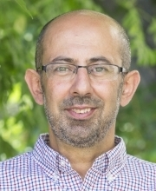
Who?
Pavlos Protopapas
Scientific Director of the Institute for Applied Computational Science (IACS)
Teaches CS109(a/b), the data science capstone course and AC295 (advanced practical data science).
Research in astrostatistics: machine learning, statistical learning, big data for astronomical problems.
He has picked some new hobbies besides 109 and eating: Going to BSO (see you there), cross country ski (completed Engadin skimarathon), cheese making and being a TikToker (check me out @pavlosprotopapas)

Slide 7
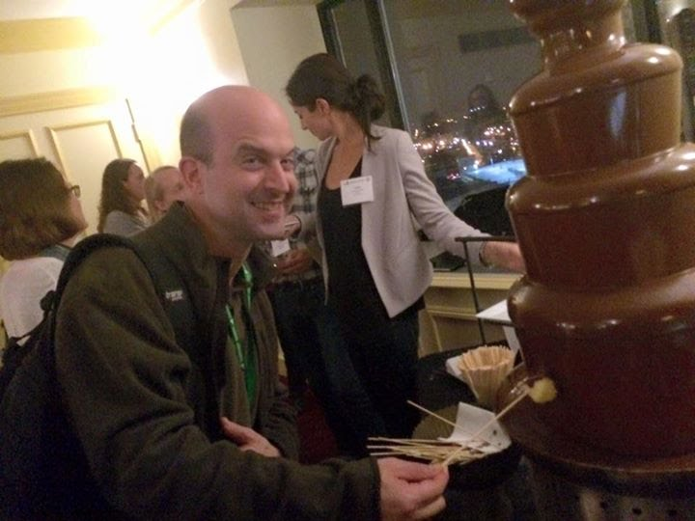
Who?
Mark Glickman
Senior Lecturer in Statistics
Chess master, inventor of Glicko and Glicko-2 rating systems for head-to-head competition
Director of the Harvard Sports Analytics Laboratory
Fellow of the American Statistical Association
Board of Directors member of the American Statistical Association (ASA); Co-Chair of the Ad Hoc Advisory Committee on Data Science of the ASA.
Plays in a rock band called “Errors in Bars” with three other statisticians.

Slide 8
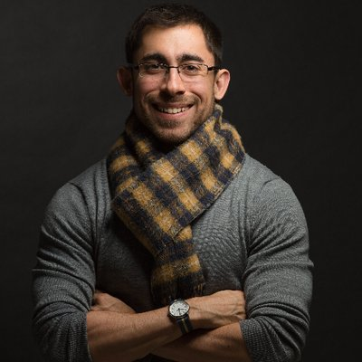
Who? Instructor
Chris Tanner
Lecturer at IACS, teaching CS109A and AC297R (capstone) now, and CS109B in the Spring.
Research interests are within Natural Language Processing and Deep Learning.
Hobbies include hiking and camping, designing/sewing hiking bags, and photography.

Slide 9
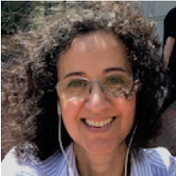
Who? Lab instructors
Eleni Kaxiras
Eleni is the assist. Director for Data Science and Computation at SEAS. She has been this course’s Head TF for the last 3 years and she is now a lab instructor. She is currently a doctoral student. She is interested in the application of deep learning in analyzing biological signals.
She owns olive trees in the island of Crete.

Slide 10
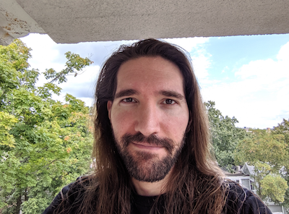
Who? Head TF
Chris Gumb
Chris is currently working towards a graduate degree in Data Science from Harvard Extension School with a particular focus on NLP.
His other interests and hobbies include: music theory & jazz improvisation; and film history.

Slide 11
Who? Teaching Fellows/Lab Instructors
Marios Matthaiakis
Cecilia Garrafo
Cedric Flamant
Javier Zazo
Jin Yun
Ethan Cowan
Rachel Moon
Robert Struyven
Ioana Zelko
Rashmi Banthia
Brandon Walker
Evan MacKay
Sol Girouard
Javier Machin
Alex Spiride
Ani Suresh

Slide 12

Magical Mystery Tour of the 109B syllabus

Slide 13

Help

Slide 14
Help
The process to get help is:
Post the question in Ed and hopefully your peers will answer. We monitor the posts and we will respond within 8 hours from the posting time.
Go to Office Hours, this is the best way to get help.
For private matters send an email to the Helpline: cs109b2020@gmail.com. The Helpline is monitored by all the instructors and TFs.
For personal matters send an email to Pavlos, Mark and Chris.
Sundays will be slow days, so please be patient!

