Slide 1

Lecture 3: Kubernetes
AC295
AC295
Advanced Practical Data Science
Pavlos Protopapas

Slide 2
Outline
1: Communications
2: Recap
3: Introduction to Kubernetes
4: Creating and Running Containers | Review
5: Anatomy of a Kubernetes Cluster
6: Deploying a Kubernetes Cluster
7: Common kubectl Commands

Slide 3
Communications
Exercise week 1 due today
Exercise week 2 will be released today

Slide 4
Outline
1: Communications
2: Recap
3: Introduction to Kubernetes
4: Creating and Running Containers | Review
5: Anatomy of a Kubernetes Cluster
6: Deploying a Kubernetes Cluster
7: Common kubectl Commands

Slide 5
Recap
Virtual Environment
Pros: remove complexity
Cons: does not isolate from OS
Virtual Machines
Pros: isolate OS guest from host
Cons: intensive use hardware
Containers
Pros: lightweight
Cons: issues with security, scalability, and control
microservices
Monolithic
container
How to manage microservices?

Slide 6
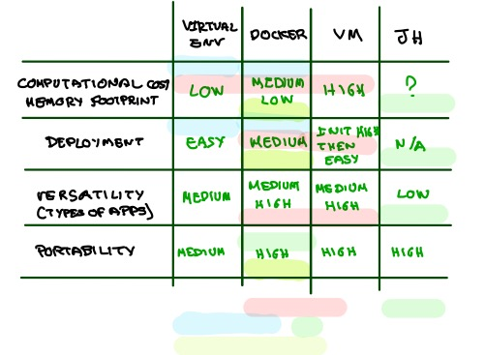
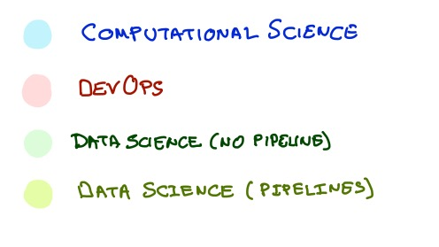
Recap

Slide 7
Recap
We talked about pros/cons of environments (removed complexity/does not isolate from OS), virtual machines (isolate OS guest from host/intensive use of the hardware), and containers (lightweight/issue with security, scalability, and control)
Goal: find effective ways to deploy our apps (more difficult than we might initially imagine) and to break down a complex application into smaller ones (i.e. microservices)
Issues we have fixed so far:
conflicting/different operating system
different dependencies
"inexplicable" strange behavior

Slide 8
Outline
1: Communications
2: Recap
3: Introduction to Kubernetes
4: Creating and Running Containers | Review
5: Anatomy of a Kubernetes Cluster
6: Deploying a Kubernetes Cluster
7: Common kubectl Commands

Slide 9
Use Microservice Architecture to build App
Microservice 1
User Interface UI
Service 1
Service 1
<database>
HTML
REST
API
Gateway
Browser
REST
Service 2
Service 2
<database>
REST
Mobile Device
Service 3
Service 3
<database>
TODO > define better application to tell the story:
Service 1 does: a), b), c)
Service 2 does: a), b), c)
Service 2 does: a), b), c)

Slide 10
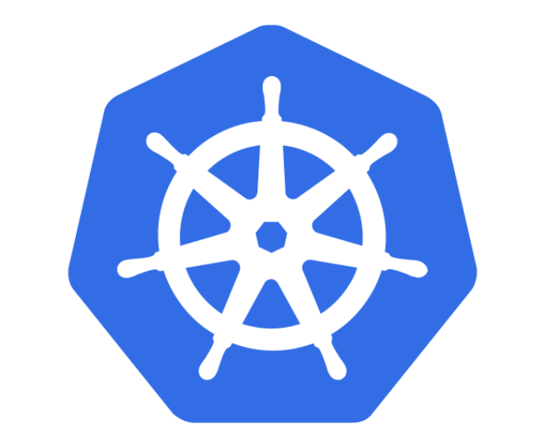
Kubernetes to the Rescue <K8s>
K8s is an orchestration tool for managing distributed services or containerized applications across a distributed cluster of nodes.
K8s itself follows a client-server architecture with a master and worker nodes. Core concepts in Kubernetes include pods, services (logical pods with a stable IP address) and deployments (a definition of the desired state for a pod or replica set).
K8s users define rules for how container management should occur, and then K8s handles the rest!

Slide 11
How do we build it with K8s? Components & Architecture
Maggie Is going to develop a cool application for AC295. She decided to use K8s to build the Online Store (?) Application
<Worker Node 1>
<docker>
<Worker Node 2>
<docker>
CLI
<kubectl>
<Master Node>
<Worker Node 3>
Maggie
<docker>
The master server consists of various components including a
kube-apiserver,
etcd storage
kube-controller-manager,
cloud-controller-manager
kube-scheduler,
and a DNS server for Kubernetes services.
Node components include kubelet and kube-proxy on top of Docker.
Notes:
API server contains various methods to directly access the Kubernetes
Scheduler assigns to each worker node an application
Controller manager
3a) Keeps track of worker nodes
3b) Handles node failures and replicates if needed
3c) Provide endpoints to access the application from the outside world
4) Cloud controller communicates with cloud provide regarding resources such as nodes and IP addresses
5) Etcd works as backend for service discovery that stores the cluster’s state and its configuration
A worker node consists of:
1) Container runtime that pulls a specified Docker image and deploys it on a worker node
2) Kubelet talks to the API server and manages containers on its node
3) Kube-proxy load-balances network traffic between application components and the outside world

Slide 12
How do we build it with K8s?
<Master Node>
The master node has:
API server contains various methods to directly access the Kubernetes
etcd works as backend for service discovery that stores the cluster’s state and its configuration
CLI
<kubectl>
API server
<kube-apiserver>
Maggie
etcd
To learn more click here

Slide 13
How do we build it with K8s?
<Master Node>
controller manager
scheduler
Scheduler assigns to each worker node an application
Controller manager:
Keeps track of worker nodes
Handles node failures and replicates if needed
Provide endpoints to access the application from the outside world
CLI
<kubectl>
API server
<kube-apiserver>
Maggie
etcd
To learn more click here

Slide 14
How do we build it with K8s?
<Master Node>
cloud-controller manager
cloud provider API
controller manager
scheduler
Cloud controller communicates with cloud provide regarding resources such as nodes and IP addresses
CLI
<kubectl>
API server
<kube-apiserver>
Maggie
etcd
To learn more click here

Slide 15
How do we build it with K8s?
A worker node consists of:
1) Container runtime that pulls a specified Docker image and deploys it on a worker node
2) Kubelet talks to the API server and manages containers on its node
3) Kube-proxy load-balances network traffic between application components and the outside world
Maggie Is going to develop a cool application for AC295. She decided to use K8s to build the Online Store (?) Application
<Master Node>
To learn more click here
cloud-controller manager
cloud provider API
controller manager
scheduler
<Worker Node x>
<docker>
pod 1
pod 2
CLI
<kubectl>
API server
<kube-apiserver>
container 1
container 1
kubelet
container 2
container 2
container n
container n
Maggie
etcd
The worker node consists of:
Kubelet talks to the API server and manages containers on its node

Slide 16
How do we build it with K8s?
A worker node consists of:
1) Container runtime that pulls a specified Docker image and deploys it on a worker node
2) Kubelet talks to the API server and manages containers on its node
3) Kube-proxy load-balances network traffic between application components and the outside world
Maggie Is going to develop a cool application for AC295. She decided to use K8s to build the Online Store (?) Application
<Master Node>
To learn more click here
cloud-controller manager
cloud provider API
controller manager
scheduler
<Worker Node x>
<docker>
kube-proxy
pod 1
pod 2
CLI
<kubectl>
API server
<kube-apiserver>
container 1
container 1
kubelet
container 2
container 2
container n
container n
Maggie
etcd
Kube-proxy load-balances network traffic between application components and the outside world

Slide 17

Advantages of using Kubernetes
There are many reasons why people come to use
containers and container APIs like Kubernetes:
Velocity
Scaling (of both software and teams)
Abstracting the infrastructure
Efficiency
k8s
API
<kube-service>
User

Slide 18
Advantages of using Kubernetes: Velocity
It is the speed with which you can respond to innovations developed by others (e.g. change in software industry from shipping CDs to delivering over the network)
Velocity is measured not in terms of the number of things you can ship while maintaining a highly available service
ML Application
K8s
API
<kubectl>
K8s <nodes>
VM
<database>
VM
<model1>
VM
<frontend>
VM
<model2>
Maggie

Slide 19
Velocity <cont>
Velocity is enabled by:
Immutable system: you can't change running container, but you create a new one and replace it in case of failure (allows for keeping track of the history and load older images)
K8s <nodes>
VM
<database>
VM
<model_v2.0>
VM
<frontend>
VM
<model_v1.0>

Slide 20
Velocity <cont>
Velocity is enabled by:
Declarative configuration: you can define the desired state of the system restating the previous declarative state to go back. Imperative configuration are defined by the execution of a series of instructions, but not the other way around.
K8s <nodes>
YAML
<app.yaml>
2 database
1 model
1 frontend
VM
<database>
VM
<database>
VM
<model_v1.0>
VM
<frontend>

Slide 21
Velocity <cont>
Velocity is enabled by:
Online self-healing systems: k8s takes actions to ensure that the current state matches the desired state (as opposed to an operator enacting the repair)
K8s <nodes>
YAML
<app.yaml>
2 database
1 model
1 frontend
VM
<database>
VM
<database>
VM
<model_v2.0>
VM
<frontend>
VM
< database >

Slide 22
Velocity <recap>
Velocity is enabled by:
Immutable system
Declarative configuration
Online self-healing systems
All these aspects relate to each other to speed up process that can reliably deploy software.

Slide 23
Advantages of using Kubernetes: Scaling
As your product grows, it’s inevitable that you will need to scale:
Software
Team/s that develop it

Slide 24
Scaling
Kubernetes provides numerous advantages to address scaling:
Decoupled architectures: each component is separated from other components by defined APIs and service load balancers.
Easy scaling for applications and clusters: simply changing a number in a configuration file, k8s takes care of the rest (part of declarative).
Scaling development teams with microservices: small team is responsible for the design and delivery of a service that is consumed by other small teams (optimal group size: 2 pizzas team).

Slide 25
Scaling <cont>
k8s
Microservice 1
Container 1
API
Team Maggie
LOAD BALANCER
Microservice 2
API
Container 2
Z
Team John

Slide 26
Scaling <cont>
Kubernetes provides numerous abstractions and APIs that help building these decoupled microservice architectures:
Pods can group together container images developed by different teams into a single deployable unit (similar to docker-compose)
Other services to isolate one microservice from another such (e.g. load balancing, naming, and discovery)
Namespaces control the interaction among services
Ingress combine multiple microservices into a single externalized API (easy-to-use frontend)
K8s provides full spectrum of solutions between doing it “the hard way” and a fully managed service

Slide 27
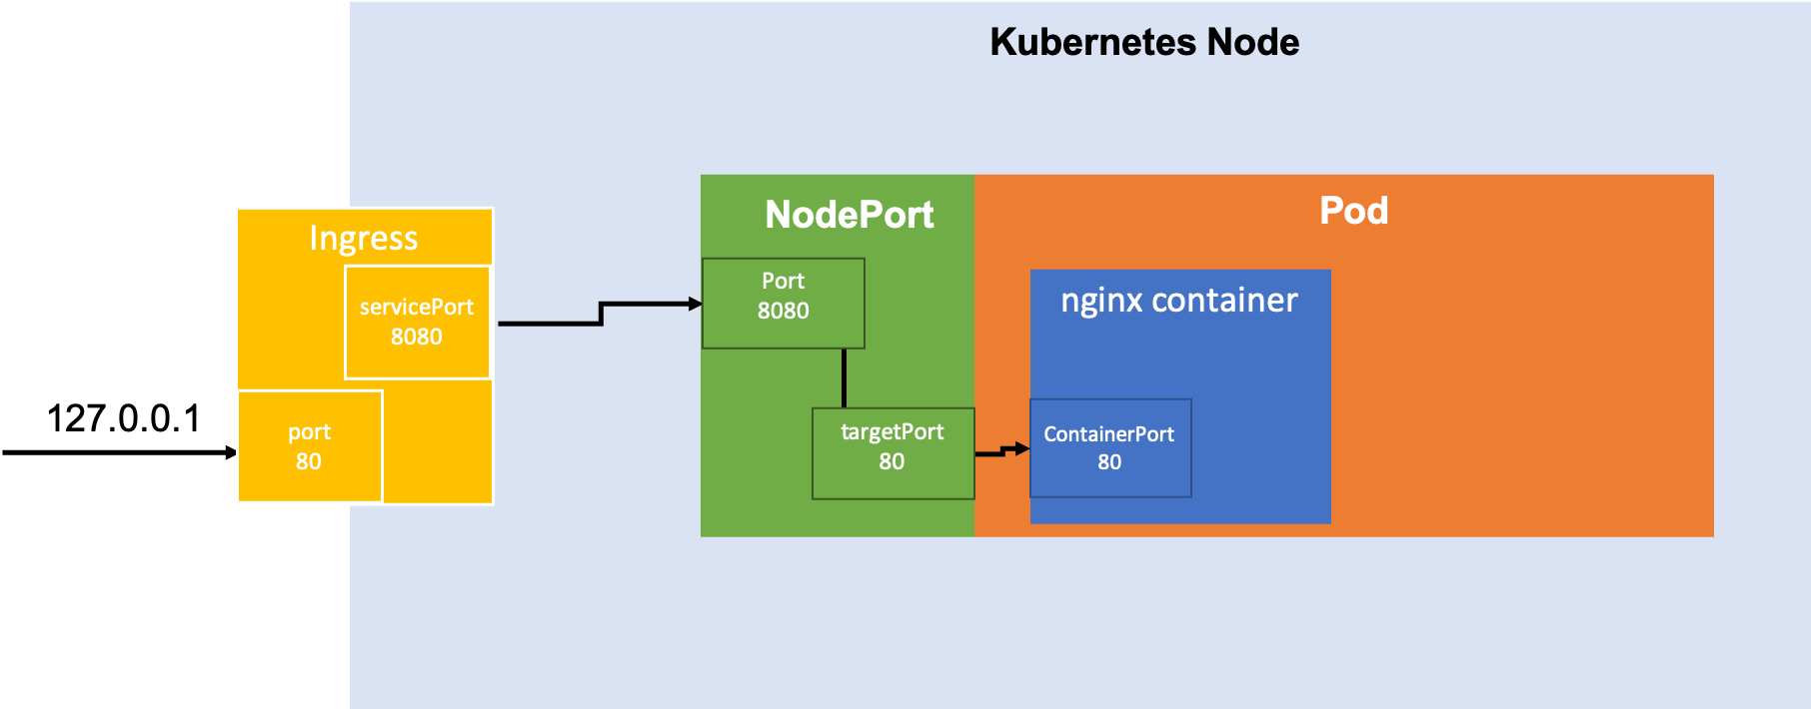
Scaling <cont>

Slide 28
Abstracting your infrastructure
Kubernetes allows to build, deploy, and manage your application in a way that is portable across a wide variety of environments. The move to application-oriented container APIs like Kubernetes has two concrete benefits:
separation: developers from specific machines
portability: simply a matter of sending the declarative config to a new cluster

Slide 29
Efficiency
There are concrete economic benefit to the abstraction because tasks from multiple users can be packed tightly onto fewer machines:
Consume less energy (ratio of the useful to the total amount)
Limit costs of running a server (power usage, cooling requirements, datacenter space, and raw compute power)
Create quickly a developer’s test environment as a set of containers
Reduce cost of development instances in your stack, liberating resources to develop others that were cost-prohibitive

Slide 30
Outline
1: Communications
2: Recap
3: Introduction to Kubernetes
4: Creating and Running Containers | Review
5: Anatomy of a Kubernetes Cluster
6: Deploying a Kubernetes Cluster
7: Common kubectl Commands

Slide 31
Creating and Running Containers | Review
We have already seen how to package an application using the Docker image format and how to start an application using the Docker container runtime:
We discussed what containers are and what you should use them
How to build images and update an existing image using Docker (i.e. Dockerfile)
How to store images in a remote registry (i.e. tag and push to DockerHub)
How to run container with Docker (generally in Kubernetes containers are launched by a daemon on each node called the kubelet)

Slide 32
Outline
1: Communications
2: Recap
3: Introduction to Kubernetes
4: Creating and Running Containers | Review
5: Anatomy of a Kubernetes Cluster
6: Deploying a Kubernetes Cluster
7: Common kubectl Commands

Slide 33
Anatomy of Kubernetes Cluster
K8s works on a cluster of machines/nodes
This could be VMs on your local machine or a group of machines through a cloud provider
The cluster includes one master node and at least one worker node

Slide 34
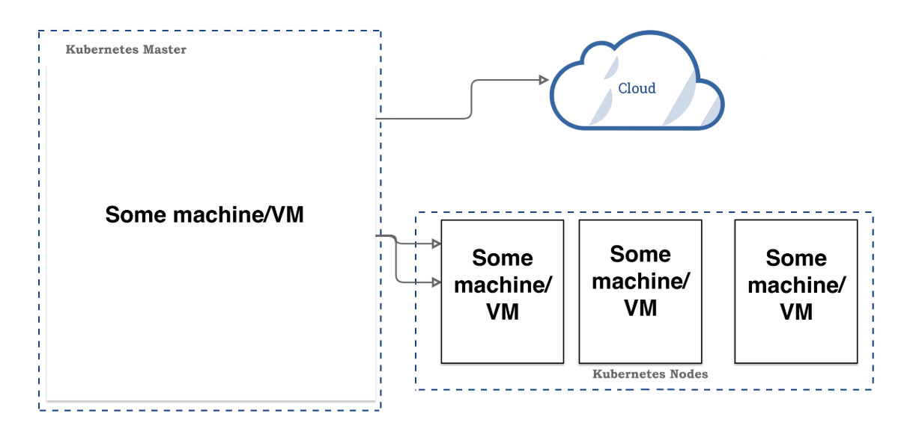
Anatomy of Kubernetes Cluster <cont>

Slide 35
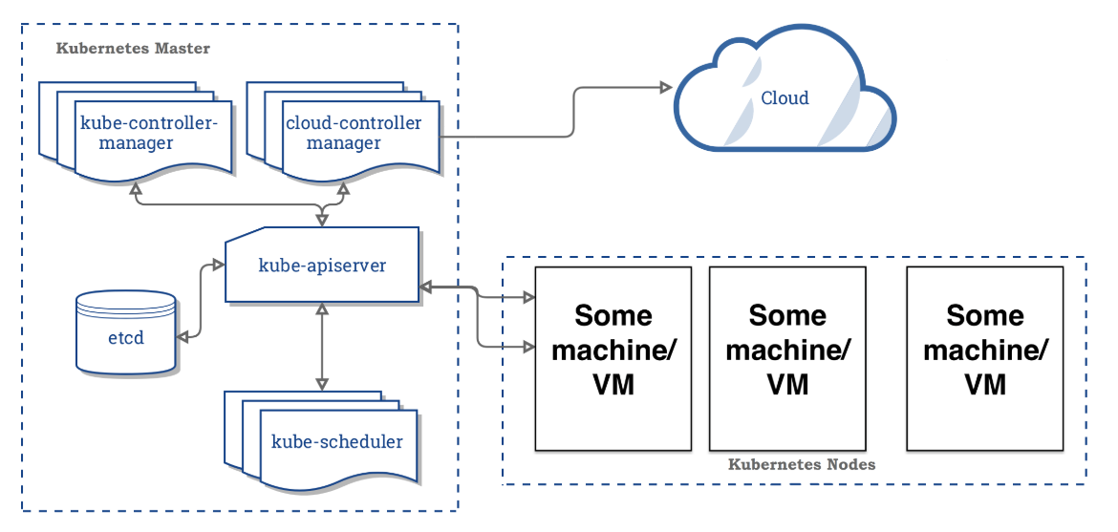
Anatomy of Kubernetes Cluster | Master Node
> to learn more on etcd <
Notes:
API server contains various methods to directly access the Kubernetes
Scheduler assigns to each worker node an application
Controller manager
3a) Keeps track of worker nodes
3b) Handles node failures and replicates if needed
3c) Provide endpoints to access the application from the outside world
4) Cloud controller communicates with cloud provide regarding resources such as nodes and IP addresses
5) Etcd works as backend for service discovery that stores the cluster’s state and its configuration

Slide 36
Anatomy of Kubernetes Cluster | Master Node
Master node main task is to manage the worker node(s) to run an application
The master node consists of:
API server contains various methods to directly access the Kubernetes
Scheduler assigns to each worker node an application
Controller manager
3a) Keeps track of worker nodes
3b) Handles node failures and replicates if needed
3c) Provide endpoints to access the application from the outside world
4) Cloud controller communicates with cloud provide regarding resources such as nodes and IP addresses
5) Etcd works as backend for service discovery that stores the cluster’s state and its configuration

Slide 37
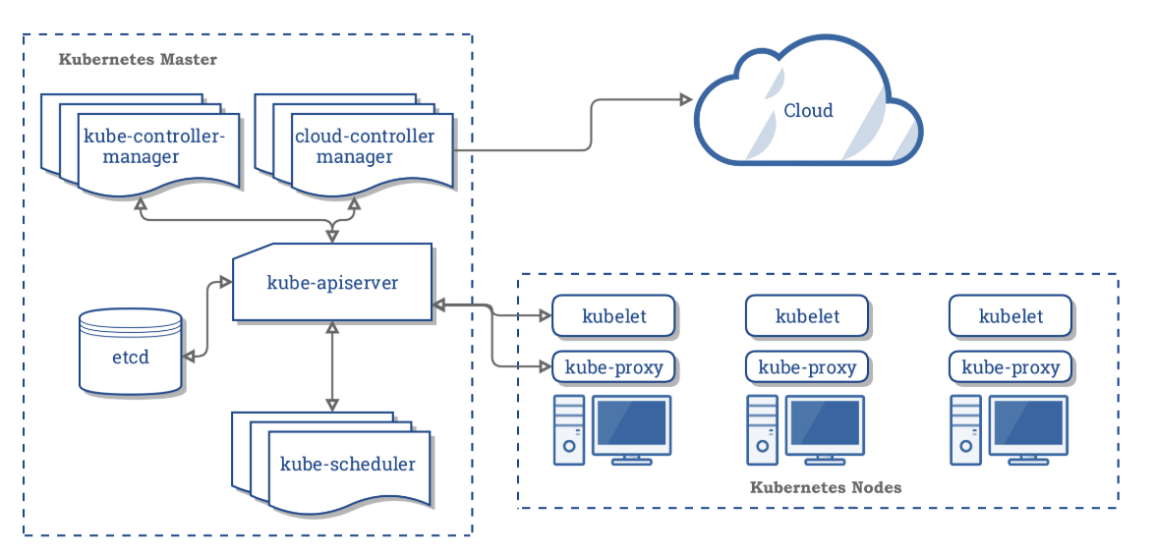
Anatomy of Kubernetes Cluster | Worker Nodes

Slide 38
Anatomy of Kubernetes Cluster | Worker Nodes
A worker node consists of:
Container runtime that pulls a specified Docker image and deploys it on a worker node
2) Kubelet talks to the API server and manages containers on its node
3) Kube-proxy load-balances network traffic between application components and the outside world
Notes:
A worker node consists of:
Container runtime that pulls a specified Docker image and deploys it on a worker node
2) Kubelet talks to the API server and manages containers on its node
3) Kube-proxy load-balances network traffic between application components and the outside world

Slide 39
Outline
1: Communications
2: Recap
3: Introduction to Kubernetes
4: Creating and Running Containers | Review
5: Anatomy of a Kubernetes Cluster
6: Deploying a Kubernetes Cluster
7: Common kubectl Commands

Slide 40
Deploying a Kubernetes Cluster
To deploy your cluster you must install Kubernetes. In the exercise you are going to use minikube to deploy a cluster in local mode.
After installing minikube, use start to begin your session creating a virtual machine, stop to interupt it, and delete to remove the VM. Below are the commands to execute these tasks:
$ minikube start
$ minikube stop
$ minikube delete

Slide 41
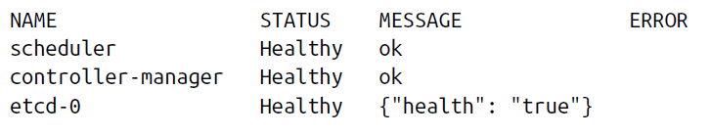
Deploying a Kubernetes Cluster
You can easily access the Kubernetes Client using the following command:
to check your cluster status use:
$ kubectl get componentstatuses
and should see output below:

Slide 42
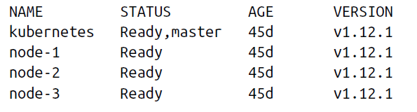
Deploying a Kubernetes Cluster
You can easily access the Kubernetes Client using the following command:
to list the nodes in your cluster use:
$ kubectl get nodes
and should see output below:

Slide 43
Outline
1: Communications
2: Recap
3: Introduction to Kubernetes
4: Creating and Running Containers | Review
5: Anatomy of a Kubernetes Cluster
6: Deploying a Kubernetes Cluster
7: Common kubectl Commands

Slide 44
Common kubectl Commands
Let’s practice Kubernetes! Access the exercise using the link below:
> LINK TO EXERCISE <
> LINK TO RESOURCES <

Slide 45
Common kubectl Commands
Useful commands to complete the exercise:
$ kubectl create -f app-db-deploymnet.yaml
$ kubectl get deployment
$ kubectl get pods
$ kubectl get pods /
-o=custom-columns=NAME:.metadata.name,IP:.status.podIP
$ kubectl create -f app-server-deploymnet.yaml
$ kubectl expose deployment /
app-deployment --type=LoadBalancer --port=8080
$ kubectl get services
$ kubectl delete service app-deployment
$ kubectl delete deployment app-server-deployment
$ kubectl delete deployment app-db-deployment

Slide 46
Outline
1: Communications
2: Recap
3: Introduction to Kubernetes
4: Creating and Running Containers | Review
5: Anatomy of a Kubernetes Cluster
6: Deploying a Kubernetes Cluster
7: Common kubectl Commands

Slide 47
Pods
Pods represent the atomic unit of work in a Kubernetes cluster. Pods are comprised of one or more containers working together symbiotically.
To create a Pod, you write a Pod manifest and submit it to the Kubernetes API server by using the command-line tool or (less frequently) by making HTTP and JSON calls to the server directly.
Once you’ve submitted the manifest to the API server, the Kubernetes scheduler finds a machine where the Pod can fit and schedules the Pod to that machine.
Once scheduled, the kubelet daemon on that machine is responsible for creating the containers that correspond to the Pod, as well as performing any health checks defined in the Pod manifest.
Once a Pod is scheduled to a node, no rescheduling occurs if that node fails. Additionally, to create multiple replicas of the same Pod you have to create and name them manually.
In a later chapter we introduce the ReplicaSet object and show how you can automate the creation of multiple identical Pods and ensure that they are recreated in the event of a node machine failure.

Slide 48
Labels and Annotations
Labels are used to identify and optionally group objects in a Kubernetes cluster.
Labels are also used in selector queries to provide flexible runtime grouping of objects such as Pods.
Annotations provide object-scoped key/value storage of metadata that can be used by automation tooling and client libraries. Annotations can also be used to hold configuration data for external tools such as third-party schedulers and monitoring tools.
Labels and annotations are vital to understanding how key components in a Kubernetes cluster work together to ensure the desired cluster state.
Using labels and annotations properly unlocks the true power of Kubernetes’s flexibility and provides the starting point for building automation tools and deployment workflows.

Slide 49
THANK YOU
AC295
Advanced Practical Data Science
Pavlos Protopapas

