Slide 1

Lecture 1: Introduction: Virtual Environments, Virtual Machines
AC295
AC295
Advanced Practical Data Science
Pavlos Protopapas

Slide 2
Outline
1 : Why you should take this class and why not?
2: Who are we?
3: Course structure and activities?
4: Class organization (Workload, Logistics, Grades).
5: Virtual environments.
6: Virtual machines.

Slide 3
Outline
1 : Why you should take this class and why not?
2: Who are we?
3: Course structure and activities?
4: Class organization (Workload, Logistics, Grades).
5: Virtual environments.
6: Virtual machines.

Slide 4
Why you should take this class
Because you want to learn how to:
Put your model in production
Integrate and orchestrate applications
Deploy increasing amount of data
Take advantage of available models
Evaluate and debug model using visualization
If you have attended ComputeFest 2020 and found the topics interesting this class will also be interesting

Slide 5
Why you shouldn’t take this class
You are not familiar with most of the concepts covered in CS109A/B
For example:
Basic Machine Learning
CNNs, RNNs, Autoencoders, GANs, etc
Basic linux commands

Slide 6
Data Science Series to Real World
Data Science Series 109A/B
Real World
Manage larger database
Learn packages to process larger amount of data
Handle complex team dynamics and orchestrate applications
Ask Question
Collect Data
CSV file, images,
scraping
EDA
Notebook
Methodology
Multiple tasks
Story-telling
Webpage, blogs,
posts

Slide 7


Data Science Series to Real World (cont)
Fragmented
database
Multitude
requirements and applications
Recombine and deploy
Developer 1
Developer 2
Developer 3

Slide 8

Data Science Series to Real World (cont)
Developer 1
Multiple tasks or models (i.e. Ensemble)
Recombine
results
Present results
Developer 3
Developer 2

Slide 9
Data Science Series to Real World (cont)
Model too expensive to train
Or not enough training data
Use pre-trained model
Model
Final Results
Present results
Pre Trained Model

Slide 10
Outline
1 : Why you should take this class and why not?
2: Who are we?
3: Course structure and activities?
4: Class organization (Workload, Logistics, Grades).
5: Virtual environments.
6: Virtual machines.

Slide 11
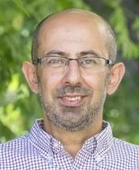
Who?
Pavlos Protopapas
Teaches CS109(a/b), the data science capstone course, and AC295 (advanced practical data science). Research in astrostatistics: machine learning, statistical learning, big data for astronomical problems.
He has picked some new hobbies besides 109s and eating:
Going to BSO (well not anymore), cross country ski (completed Engadin skimarathon), cheese making and being a TikToker (check me out @pavlosprotopapas)

Slide 12


Who? (cont)
Rashmi Banthia
TF for many Data Science classes here at Harvard including CS109A/B.
Andrea Porelli
Master’s CSE from IACS.

Slide 13
Outline
1 : Why you should take this class and why not?
2: Who are we?
3: Course structure and activities?
4: Class organization (Workload, Logistics, Grades).
5: Virtual environments.
6: Virtual machines.

Slide 14
Course Structure and Activities
Modules:
1. Deploy data science (integration + scalability)
2. Transfer learning and distillation
3. Visualization as investigative tool * [no presentations or exercises here]
Activities:
lectures, reading discussions, exercises, forum, practicums, projects
Lectures online: Tuesday and Thursday 10:30‐11:45 am (repeat 6:00‐7:15 pm )
Office Hours: TBD

Slide 15
Topics
Deploy data science (integration + scalability)
Virtual Environments, Virtual Boxes, and Containers
Kubernetes
Dask

Slide 16
Topics (cont)
Transfer learning and distillation
Intro to Transfer Learning: basics and Convolutional Neural Networks review
Transfer Learning across Tasks for images and SOTA Models
Language Models and Transfer Learning with Text Data
Attention and Transformers
Distillation and Compression

Slide 17
Topics (cont)
Visualization as investigative tool
Introduction and Overview of Viz for Deep Models: lime and shapley
CNN for Image Data, Activation Maximization and Saliency Maps
Attention for Debugging Language Models

Slide 18
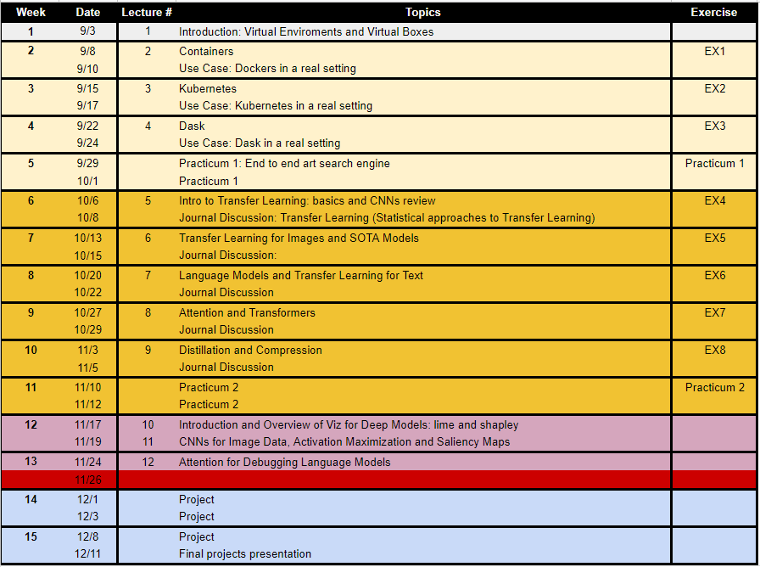
Calendar
> Link to Calendar <

Slide 19
Course Structure and Activities
Regular week schedule
F
M T W T F
Lecture
Reading
Release
Final Reading List
Exercise
Forum
Presentation*
due next week by the beginning of the lecture
*two per semester

Slide 20
Outline
1 : Why you should take this class and why not?
2: Who are we?
3: Course structure and activities?
4: Class organization (Workload, Logistics, Grades).
5: Virtual environments.
6: Virtual machines.

Slide 21
Workload
Regular Week
3 hours in class
5 hours reading
5 hours exercise
1 hour forum questions
3 hours presentation*
~ 16 hours/week
* 1 presentation per module per group (2 total)
Practicum and Project Week
~ 16 hours/week**
** 2 practicums and 1 final project (2 weeks long)
We will be asking for your feedback on the workload

Slide 22
Expectations
How to read and present class material
> Link to Reading Guidelines <
> Link to Presentation Guidelines <

Slide 23
Logistics
Fill up forms
TODO >> REVIEW FORMS
Make group *
Sign-up presentation**
* Fill group components in each row
** Each group should pick one slot (white background) in each module

Slide 24
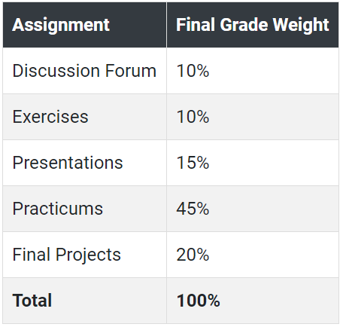
Grades

Slide 25
Final Details
We will be using ED for discussions, announcements and surveys.
Submissions for exercises, reports, presentations etc we will be using github (details soon).

Slide 26
Outline
1 : Why you should take this class and why not?
2: Who are we?
3: Course structure and activities?
4: Class organization (Workload, Logistics, Grades).
5: Virtual environments.
6: Virtual machines.

Slide 27
Why should we use virtual environment?
Virtual environments help to make development and use of code more streamlined.
Virtual environments keep dependencies in separate “sandboxes” so you can switch between both applications easily and get them running.
Given an operating system and hardware, we can get the exact code environment set up using different technologies. This is key to understand the trade off among the different technologies presented in this class.

Slide 28
Why should we use virtual environment?
Maggie took cs109a, she used to run her Jupyter notebooks from anaconda prompt. Every time she installed a module it was placed in the either of bin, lib, share, include folders and she could import it in and used it without any issue.
lib1
lib2
lib3
bins
Operating System
$ which python
/c/Users/maggie/Anaconda3/python
Maggie

Slide 29
Why should we use virtual environment?
Maggie starts taking ac295 and she thinks that would be good to isolate the new environment from the previous enviroments avoiding any conflict with the installed packages. She adds a layer of abstraction called virtual environment that helps her keep the modules organized and avoid misbehaviors while developing a new project.
lib1
lib2
bins
lib1
lib2
lib3
env_ac295
bins
Operating System
$ which python
/c/Users/maggie/Anaconda3/envs/env_ac295/python
Maggie

Slide 30
Why should we use virtual environment?
Maggie collaborates with John for the final project and shares with him the environment she is working on through .yml file.
lib1
lib2
lib1
lib2
bins
bins
lib1
lib2
lib3
env_ac295
env_ac295
bins
Operating System
Operating System
Maggie
John

Slide 31
Why should we use virtual environment?
John experiments a new method he learned in another class and adds a new library to the working environment. After seeing a tremendous improvements he sends Maggie back his code and a new .yml file. She can now update her environment and replicate the experiment.
lib1
lib2
lib3
lib1
lib2
lib3
lib1
lib2
lib3
bins
bins
bins
lib1
lib2
lib3
env_ac295
env_ac295
env_am207
bins
Operating System
Operating System
Maggie
John

Slide 32
Why should we use virtual environment?
What could go wrong? Unfortunately, Maggie and John reproduce different results and they think the issue relates to their operating systems. Indeed while Maggie has a MacOS, John uses a Win10.
lib1
lib2
lib3
lib1
lib2
lib3
lib1
lib2
lib3
bins
bins
bins
lib1
lib2
lib3
env_ac295
env_ac295
env_am207
bins
Operating System (MacOs)
Operating System (Win10)
Maggie
John

Slide 33
Virtual environments
Pros
Reproducible research
Explicit dependencies
Improved engineering collaboration
Broader skill set
Cons
Difficulty setting up your environment
Not isolation
Does not work across different OS

Slide 34
What are virtual environments then?
A virtual environment is a directory with the following components:
- site_packages/ directory where third-party libraries are installed
- links [really symlinks] to the executables on your system
- some scripts that ensure that the code uses the interpreter and site packages in the virtual environment
> Adapted from CS207 <

Slide 35
Virtual environments: virtualenv vs conda
virtualenv
virtual environments manager embedded in Python
incorporated into broader tools such as pipenv
allow to install modules using pip package manager
how to use virtualenv
create an environment within your project folder virtualenv your_env_name
it will add a folder called environment_name in your project directory
activate environment: source env/bin/activate
install requirements using: pip install package_name=version
deactivate environment once done: deactivate

Slide 36
Virtual environments in practice
conda environment
virtual environments manager embedded in Anaconda
allow to use both conda and pip to manage and install packages
how to use conda
create an environment
conda create --name your_env_name python=3.7
it will add a folder located within your anaconda installation
/Users/your_username /anaconda3/envs/your_env_name
activate environment conda activate your_env_name (should appear in your shell)
install requirements using conda install package_name=version
deactivate environment once done conda deactivate
duplicate your environment using YAML file conda env export > my_environment.yml
to recreate the environment now use conda env create -f environment.yml

Slide 37
how to use conda
find which environment you are using
conda env list
create an environment
conda create --name your_env_name python=3.7
it will add a folder located within your anaconda installation
/Users/your_username/[opt]/anaconda3/envs/your_env_name
activate environment
conda activate your_env_name (should appear in your shell)
install requirements using
conda install package_name=version
deactivate environment once done
conda deactivate
duplicate your environment using YAML file conda env export > my_environment.yml
to recreate the environment now use conda env create -f environment.yml

Slide 38
More on Virtual environments
Further readings
For detailed discussions on similarities and differences among virtualenv and conda https://jakevdp.github.io/blog/2016/08/25/conda-myths-and-misconceptions/
More on venv and conda environments https://towardsdatascience.com/virtual-environments-104c62d48c54 https://towardsdatascience.com/getting-started-with-python-environments-using-conda-32e9f2779307

Slide 39
Outline
1 : Why you should take this class and why not?
2: Who are we?
3: Course structure and activities?
4: Class organization (Workload, Logistics, Grades).
5: Virtual environments.
6: Virtual machines.

Slide 40
Why should we use virtual machines?
Motivation
We have our isolated systems, and after we set up the environment with our colleagues' machine, we expect to get identical results, right? Unfortunately, it is not always the case. Why? Most likely because we run on a different operating system.
Even though by using virtual environments, we isolate our computations, we might need to use the same operating system that requires running "like if" we are in different machines.
How can we run the same experiment? Virtual Machines!
Isolation!

Slide 41
Why should we use virtual machines? (cont)
Advantages
Full autonomy: it works like a separate computer system; it is like running a computer within a computer.
Very secure: the software inside the virtual machine cannot affect the actual computer.
Lower costs: buy one machine and run multiple operating systems.

Slide 42
What are virtual machines?
virtual machines have their own virtual hardware: CPUs, memory, hard drives, etc.
you need a hypervisor that manages different virtual machines on server
hypervisor can run as many virtual machines as you wish
operating system is called the "host" while those running in a virtual machine are called "guest“
You can install a completely different operating system on this virtual machine
https://towardsdatascience.com/how-to-install-a-free-windows-virtual-machine-on-your-mac-bf7cbc05888
App1
App2
App3
Bins/lib
Bins/lib
Bins/lib
Guest
OS
Guest
OS
Guest
OS
Hypervisor
Infrastructure
Machine Virtualization

Slide 43
Limitations
Uses hardware in your local machine
There is an overhead associated with virtual machines
Guest is not as fast as the host system
Takes a long time to start up
It may not have the same graphics capabilities

Slide 44
This is the second time we are offering the course, so your feedback will be vital in tuning it this year and improving it for future years.
However, we are making every effort to have a well-organized course and we promise you an exciting semester full of learning!
THANK YOU
AC295
Advanced Practical Data Science
Pavlos Protopapas

