Slide 1
Lists

Slide 2


Lists [ ]
What is a python list?
An ordered collection
That is resizable
And contain elements of different types
# Create a list
num_list = [3, 1, 2]
# A list can have all types
mix_list = ['hello',1,True]

Slide 3
How to access elements of a list ?

Slide 4
List Indexing
How do we access elements of a list ?
0 1 2 3 4 5 6
# Make a list of fruits
>>> fruits = ['tangerine', 'apple', 'pear', 'banana', 'kiwi', 'apple', 'banana']
🍎
🍊
🍎
🍎
🍊
🍐
🥝
🍌
🍐
🍌
🍌
-7 -6 -5 -4 -3 -2 -1
List[start:stop:(Optional)step]

Slide 5
List Indexing
0 1 2 3 4 5 6
# Make a list of fruits
>>> fruits = ['tangerine', 'apple', 'pear', 'banana', 'kiwi', 'apple', 'banana']
🍊
🍎
🍐
🍌
🥝
🍎
🍌
-7 -6 -5 -4 -3 -2 -1
fruits[0:4] =
🍊
🍎
🍐
🍌

Slide 6
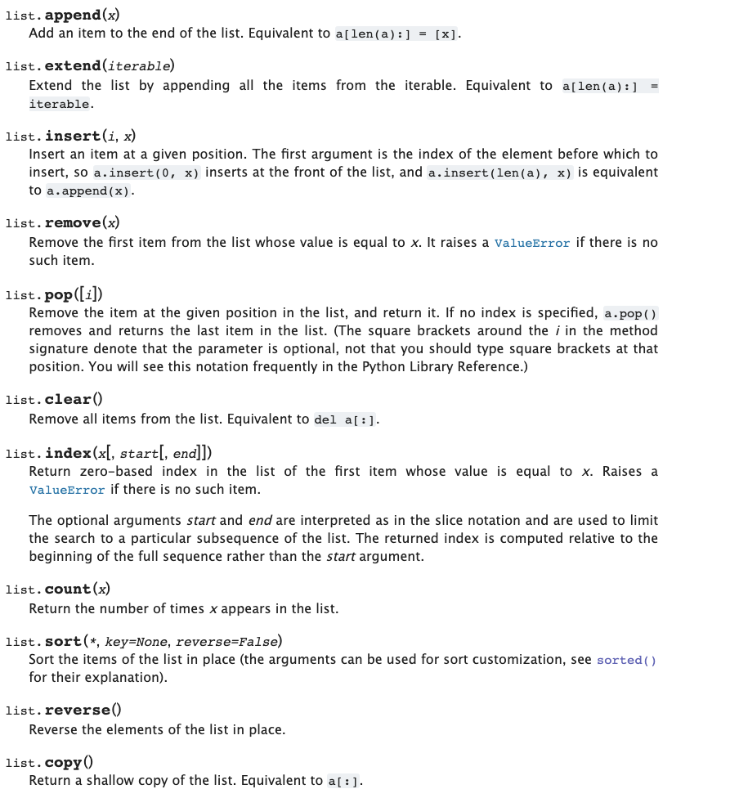
List Methods
add to a list
extend with another list
remove from
the list
insert an item in list
get location of an item
count an item
sort the list
6

Slide 7
List Methods

Slide 8
List methods
# Make a list of fruits
>>> fruits = ['tangerine', 'apple', 'pear', 'banana', 'kiwi', 'apple', 'banana']
🍊
🍎
🍐
🍌
🥝
🍎
🍌

Slide 9
List methods
# Make a list of fruits
>>> fruits = ['tangerine', 'apple', 'pear', 'banana', 'kiwi', 'apple', 'banana']
>>> len(fruits)
7
🍊
🍎
🍐
🍌
🥝
🍎
🍌

Slide 10
Count()
# Make a list of fruits
>>> fruits = ['tangerine', 'apple', 'pear', 'banana', 'kiwi', 'apple', 'banana']
>>> fruits.count('apple')
2
🍊
🍎
🍐
🍌
🥝
🍎
🍌

Slide 11
Count()
# Make a list of fruits
>>> fruits = ['tangerine', 'apple', 'pear', 'banana', 'kiwi', 'apple', 'banana']
>>> fruits.count('apple')
2
>>> fruits.count('tangerine')
1
🍊
🍎
🍐
🍌
🥝
🍎
🍌

Slide 12
Index()
# Make a list of fruits
>>> fruits = ['tangerine', 'apple', 'pear', 'banana', 'kiwi', 'apple', 'banana']
>>> fruits.index('banana')
3
🍊
🍎
🍐
🍌
🥝
🍎
🍌

Slide 13
Index()
# Make a list of fruits
>>> fruits = ['tangerine', 'apple', 'pear', 'banana', 'kiwi', 'apple', 'banana']
>>> fruits.index('banana')
3
>>> fruits.index('banana', 4) # Find next banana starting a position 4
6
🍊
🍎
🍐
🍌
🥝
🍎
🍌

Slide 14
Index()
# Make a list of fruits
>>> fruits = ['tangerine', 'apple', 'pear', 'banana', 'kiwi', 'apple', 'banana']
>>> fruits.index('banana')
3
>>> fruits.index('banana', 4) # Find next banana starting a position 4
6
🍊
🍏
🍐
🍌
🥝
🍎
🍌

Slide 15
Reverse()
# Make a list of fruits
>>> fruits = ['tangerine', 'apple', 'pear', 'banana', 'kiwi', 'apple', 'banana']
>>> fruits.reverse()
>>> fruits
['banana', 'apple', 'kiwi', 'banana', 'pear', 'apple', 'tangerine']
🍌
🍎
🥝
🍌
🍐
🍏
🍊

Slide 16
List methods
# Make a list of fruits
>>> fruits = ['tangerine', 'apple', 'pear', 'banana', 'kiwi', 'apple', 'banana']
🍊
🍏
🍐
🍌
🥝
🍎
🍌
🍇

Slide 17
List methods – append()
# Make a list of fruits
>>> fruits = ['tangerine', 'apple', 'pear', 'banana', 'kiwi', 'apple', 'banana']
>>> fruits.append('grape')
>>> fruits
['tangerine', 'apple', 'pear', 'banana', 'kiwi', 'apple', 'banana', 'grape']
🍊
🍏
🍐
🍌
🥝
🍎
🍌
🍇

Slide 18
List methods – pop()
>>> fruits.pop('grape')
🍊
🍏
🍐
🍌
🥝
🍎
🍌
🍇

Slide 19
List methods – pop()
>>> fruits.pop('grape')
>>> fruits
['tangerine', 'apple', 'pear', 'banana', 'kiwi', 'apple', 'banana']
🍊
🍏
🍐
🍌
🥝
🍎
🍌

Slide 20
List methods
# Make a list of fruits
>>> fruits = ['tangerine', 'apple', 'pear', 'banana', 'kiwi', 'apple', 'banana']
🍊
🍏
🍐
🍌
🥝
🍎
🍌
🍇

Slide 21
List methods – insert()
# Make a list of fruits
>>> fruits = ['tangerine', 'apple', 'pear', 'banana', 'kiwi', 'apple', 'banana']
>>> fruits.insert(1,'grape')
>>> fruits
['tangerine', 'grape', 'apple', 'pear', 'banana', 'kiwi', 'apple', 'banana']
🍊
🍇
🍏
🍐
🍌
🥝
🍎
🍌

Slide 22
List methods – remove()
>>> fruits.remove('grape')
>>> fruits
['tangerine','apple', 'pear', 'banana', 'kiwi', 'apple', 'banana']
🍊
🍏
🍐
🍌
🥝
🍎
🍌

Slide 23
List methods – sort()
>>> fruits.sort()
🍊
🍏
🍐
🍌
🥝
🍎
🍌
🍇

Slide 24
List methods – sort()
>>> fruits.sort()
>>> fruits
['apple', 'apple', 'banana', 'banana', 'grape', 'kiwi', 'pear', 'tangerine']
🍏
🍎
🍌
🍌
🍇
🥝
🍐
🍊

Slide 25
List methods
>>> fruits = ['tangerine', 'apple', 'pear', 'banana', 'kiwi', 'apple', 'banana']
>>> fruits.count('apple')
2
>>> fruits.count('tangerine')
1
>>> fruits.index('banana')
3
>>> fruits.index('banana', 4) # Find next banana starting a position 4
6
>>> fruits.reverse()
>>> fruits
['banana', 'apple', 'kiwi', 'banana', 'pear', 'apple', 'tangerine']
>>> fruits.append('grape')
>>> fruits
['banana', 'apple', 'kiwi', 'banana', 'pear', 'apple', 'tangerine', 'grape']
>>> fruits.sort()
>>> fruits
['apple', 'apple', 'banana', 'banana', 'grape', 'kiwi', 'pear', 'tangerine']
>>> fruits.pop()
'tangerine'

Slide 26
Copying a List

Slide 27
List Aliasing
Aliasing means giving another name to the existing object. It doesn’t mean copying.
a = [10, 20, 30, 40, 50]
b = a
Modification in a will affect b and vice versa.
a
10 | 20 | 30 | 40 | 50
[0] | [1] | [2] | [3] | [4]
b

Slide 28
Copy a list
When we copy a list a separate copy of all the elements is stored in another list. Both the lists are independent.
a = [10, 20, 30, 40, 50]
b = a.copy()
Modification in a will not affect b and vice versa.
a
10 | 20 | 30 | 40 | 50
[0] | [1] | [2] | [3] | [4]
b
10 | 20 | 30 | 40 | 50

Slide 29


List Comprehension
List Comprehension is a Pythonic way for making lists and loops.
List = [expression for item in iterable]
# Storing a list of numbers
>>> A = [1,2,3,4]
# Running a For Loop to get a list containing their # squares
>>> B = []
>>> for number in A:
.... B.append(number**2)
>>> print(B)
[2,4,9,16]
1
2
3
A
Square Machine
1
B

Slide 30
List Comprehension
List Comprehension is a Pythonic way for making lists and loops.
List = [expression for item in iterable]
1
2
3
# Storing a list of numbers
>>> A = [1,2,3,4]
# Running a List Comprehension to get a list containing their # squares
>>> B = [ number**2 for number in A ]
>>> print(B)
[2,4,9,16]
A
1
Square Machine
B

Slide 31
List Comprehension
List Comprehension is a Pythonic way for making lists and loops.
List = [expression for item in iterable]
# Storing a list of numbers
>>> A = [1,2,3,4]
# Running a For Loop to get a list containing their # squares
>>> B = []
>>> for number in A:
.... B.append(number**2)
>>> print(B)
[2,4,9,16]
# Storing a list of numbers
>>> A = [1,2,3,4]
# Running a List Comprehension to get a list containing their # squares
>>> B = [ number**2 for number in A ]
>>> print(B)
[2,4,9,16]
expression
item
iterable

Slide 32
List Comprehension
List Comprehension with if conditional
List = [expression for item in iterable if conditional]
# Storing a list of numbers
>>> A = [1,2,3,4]
# Running a For Loop to get a list containing their # squares – Condition: square the number only if even
>>> B = []
>>> for number in A:
.... if number % 2 == 0:
.... B.append(number**2)
>>> print(B)
[4,16]
# Storing a list of numbers
>>> A = [1,2,3,4]
# Running a List Comprehension to get a list containing their squares – condition: even number
>>> B = [ number**2 for number in A if number %2 == 0]
>>> print(B)
[2,4,9,16]
expression
item
iterable
conditional

Slide 33
List Comprehension
List Comprehension with if & else conditional
List = [expression1 (if conditional) else expression2 for item in iterable]
# Storing a list of numbers
>>> A = [1,2,3,4]
# Running a For Loop to get a list
#containing their # squares – Condition: square the number only if even, else divide the number by 2
>>> B = []
>>> for number in A:
.... if number % 2 == 0:
.... B.append(number**2)
.... else:
.... B.append(number / 2)
>>> print(B)
[4,16]
# Storing a list of numbers
>>> A = [1,2,3,4]
# Running a List Comprehension to get a list containing their
squares – condition: even number
>>> B = [ number**2 if number%2 == 0 else number / 2 for number in A]
>>> print(B)
[2,4,9,16]
expression1
expression2
item
iterable
If conditional

