Slide 1
Regular Expressions

Slide 2
Regular Expressions
?
!
^$
Why
Regular Expressions?
What
are they?
How
to use them?

Slide 3
Regular Expressions
?
Why
Regular Expressions?

Slide 4
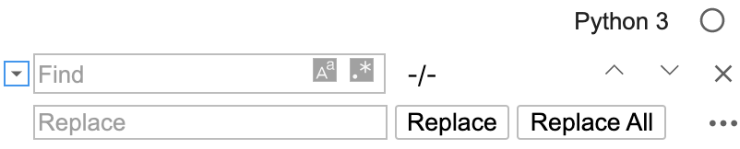
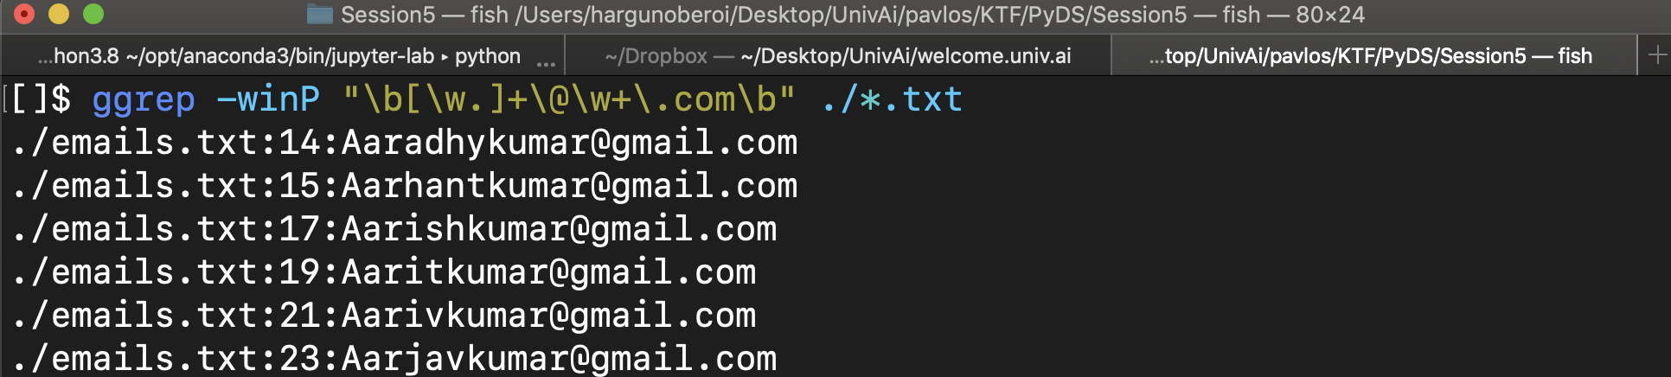
Why Regular Expressions ?
The .* option allows you to search with regular expressions
The grep command allows you to search on the command line

Slide 5
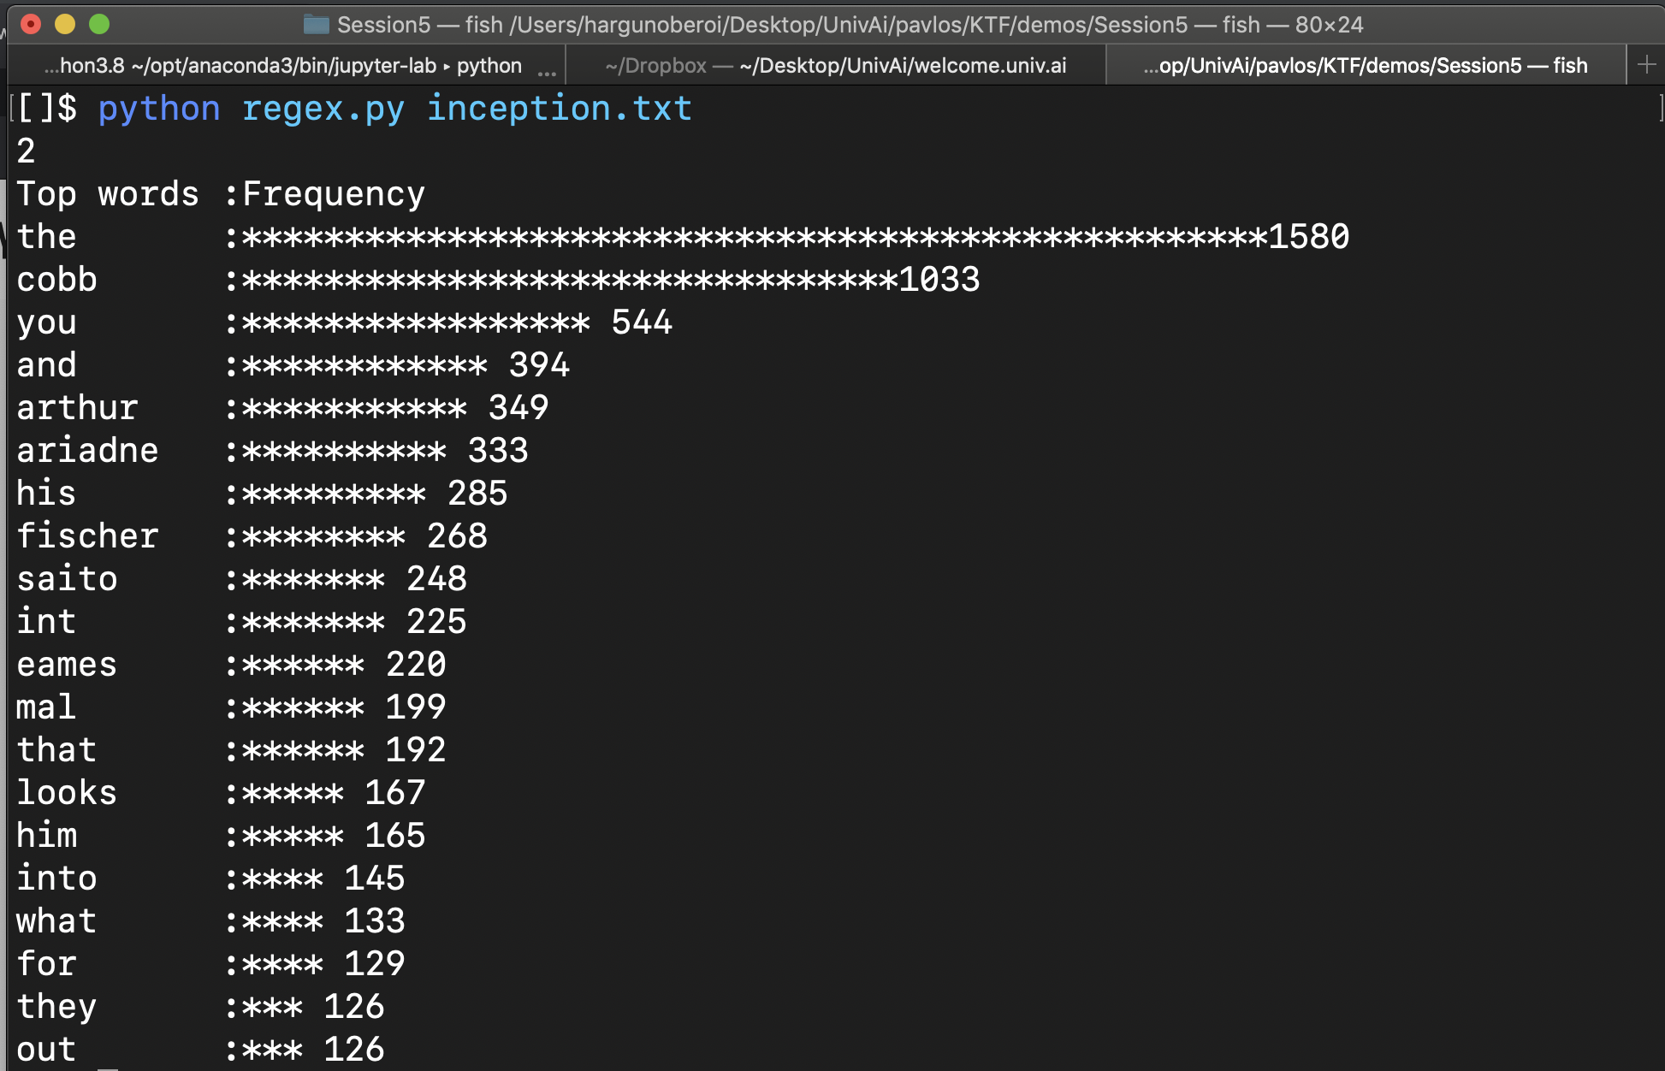
20th century Data Science with Regular Expressions

Slide 6

Regular Expresssions
"Pavlos Protopapas"
Dr. Pavlos Protopapas is the Scientific Program Director, Institute for Applied Computational Science (IACS) at Harvard University, and leads the Data Science Masters program at Harvard. Pavlos has had a long and distinguished career as a scientist and data science educator, and today teaches the CS109 series for basic and advanced data science, as well as the capstone course (industry-sponsored data science projects) for the IACS masters program at Harvard

Slide 7
Regular Expressions
"([A-Z]\w+\s){0,}[A-Z]\w+"
Dr. Pavlos Protopapas is the Scientific Program Director, Institute for Applied Computational Science (IACS) at Harvard University, and leads the Data Science Masters program at Harvard. Pavlos has had a long and distinguished career as a scientist and data science educator, and today teaches the CS109 series for basic and advanced data science, as well as the capstone course (industry-sponsored data science projects) for the IACS masters program at Harvard

Slide 8
Regular Expressions
A sequence of characters that define a search pattern, mainly for use in pattern matching with strings, or string matching, i.e. "find and replace"-like operations.
Pavlos Protopapas
Applied Computational Science
Data Science Masters
Harvard University
"([A-Z]\w+\s){0,}[A-Z]\w+"

Slide 9
Regular Expressions
!
What
are they?

Slide 10
Regular Expressions
'Room (528-491)'
character class | Represents | Example | Result
\d | Any numeric digit from 0 to 9. | '\d\d\d' | ['528,'491']
\D | Any character that is not a numeric digit from 0 to 9. | \D\D\D\D' | ['Room']
\w | Any letter, numeric digit, or the underscore character. (Think of this as matching “word” characters.) | '\w\w\w' | ['Roo', '528', '491']
\W | Any character that is not a letter, numeric digit, or the underscore character. | '\W\W\W' | [' (']
\s | Any space, tab, or newline character. (Think of this as matching “space” characters.) | '\s\s' | [' ']
\S | Any character that is not a space, tab, or newline. | '\S\S\S' | ['Roo', '(52', '8-4', '91)']

Slide 11
Regular Expressions
Character | Description | Example | Result
? | Match zero or one repetitions of preceding | "ab?" | "a" or "ab"
* | Match zero or more repetitions of preceding | "ab*" | "a", "ab", "abb", "abbb"...
+ | Match one or more repetitions of preceding | "ab+" | "ab", "abb", "abbb"... but not "a"
{n} | Match n repetitions of preeeding | "ab{2}" " | "abb"
{m,n} | Match between m and n repetitions of preceding | "ab{2,3}" | "abb" or "abbb"

Slide 12
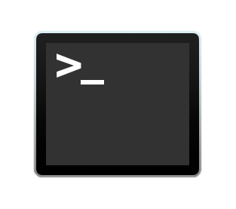
Regular Expressions
Making your own character classes
These classes may be limiting, for e.g., if you need to match only letters from the alphabet
\d
\w
\s
[...]

Slide 13
Regular Expressions
^$
How to use them?

Slide 14
Regular Expressions
import re
regex = re.compile(r'\d{10}')
regex.findall('My number is 7775978484')
>>>['7775978484']

Slide 15
Regular Expressions
import re
regex = re.compile(r'\d{10}')
regex.findall('My number is 7775978484')
>>>['7775978484']

Slide 16
Regular Expressions
import re
regex = re.compile(r'\d{10}')
regex.findall('My number is 7775978484')
>>>['7775978484']

Slide 17
Regular Expressions
import re
regex = re.compile(r'\d{10}')
regex.findall('My number is 7775978484')
>>>['7775978484']

