Slide 1
Batch Norm

Slide 2
Feature Normalization
Good practice to normalize features before applying learning algorithm:
Features in same scale: mean 0 and variance 1
Feature vector
Vector of mean feature values
Vector of SD of feature values

Slide 3


Feature Normalization
Speeds up learning
$$L(W)$$
$$L(W)$$
Before normalization
After normalization

Slide 4
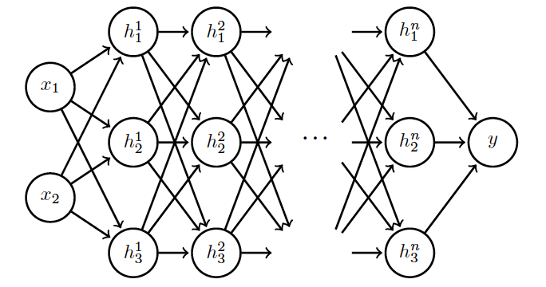
Internal Covariance Shift
Each hidden layer changes distribution of inputs to next layer: slows down learning
…
Normalize inputs to layer 2
Normalize inputs to layer n

Slide 5
Batch Normalization
Training time:
Batch of activations for a layer to normalize
For a given hidden layer
N data points in batch
K hidden units activations

Slide 6


Batch Normalization
Training time:
Batch of activations for a layer to normalize
$$μ_{k}$$
$H_{ik}^{′}= \frac{H_{ik}−μ_{k}}{σ_{k}}$

Slide 7

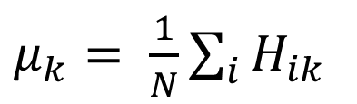
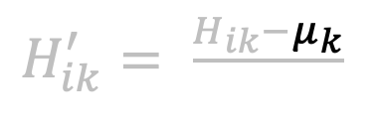
Batch Normalization
Training time:
Mini-batch of activations for a layer to normalize
$H_{ik}^{′}= \frac{H_{ik}−μ_{k}}{σ_{k}}$
$$σ_{k}$$
$μ_{k}= \frac{1}{N}\sum_{i}{H_{ik}}$
Mean activations across mini-batch for node k.

Slide 8

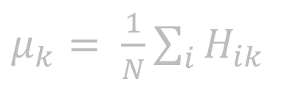
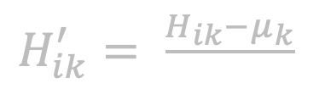
Batch Normalization
Training time:
Mini-batch of activations for a layer to normalize
$H_{ik}^{′}= \frac{H_{ik}−μ_{k}}{σ_{k}}$
$$σ_{k}$$
$μ_{k}= \frac{1}{N}\sum_{i}{H_{ik}}$
Mean activations across mini-batch for node k.
$σ_{k}= \frac{1}{N}\sum_{i}{{\left(H_{ik}−μ_{k}\right)}^{2}+δ}$
SD of each unit across mini-batch

Slide 9
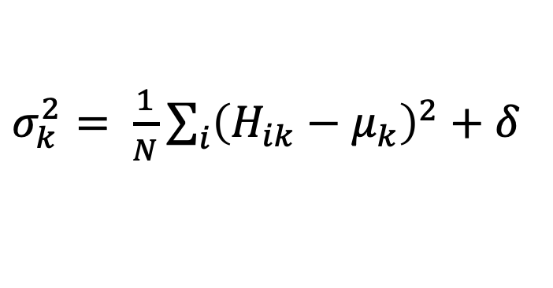
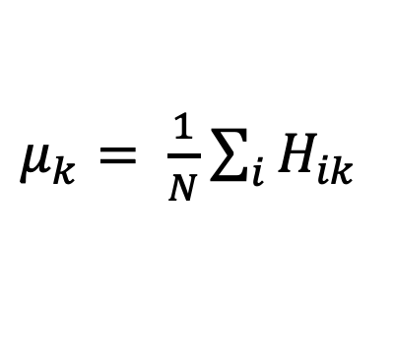
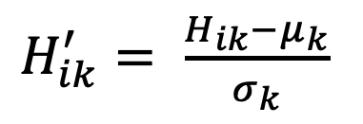
Batch Normalization
Training time:
Mini-batch of activations for a layer to normalize
$H_{ik}^{′}= \frac{H_{ik}−μ_{k}}{σ_{k}}$
$μ_{k}= \frac{1}{N}\sum_{i}{H_{ik}}$
Mean activations across mini-batch for node k.
$σ_{k}^{2}= \frac{1}{N}\sum_{i}{{\left(H_{ik}−μ_{k}\right)}^{2}+δ}$
SD of each unit across mini-batch

Slide 10
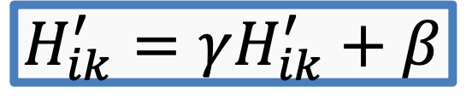
Batch Normalization
Training time:
Normalization can reduce expressive power
Instead use:
Allows network to control range of normalization
$$H_{ik}^{′}=γH_{ik}^{′}+β$$
Learnable parameters

Slide 11
Batch Normalization
Batch 1
…..
Add normalization operations for layer 1
Batch N

Slide 12
Batch Normalization
Batch 1
…..
Add normalization operations for layer 2 and so on …
Batch N

Slide 13

Evaluation
We saw how batch normalization works during training, but what about evaluation phase when we do not have a complete batch!

Slide 14
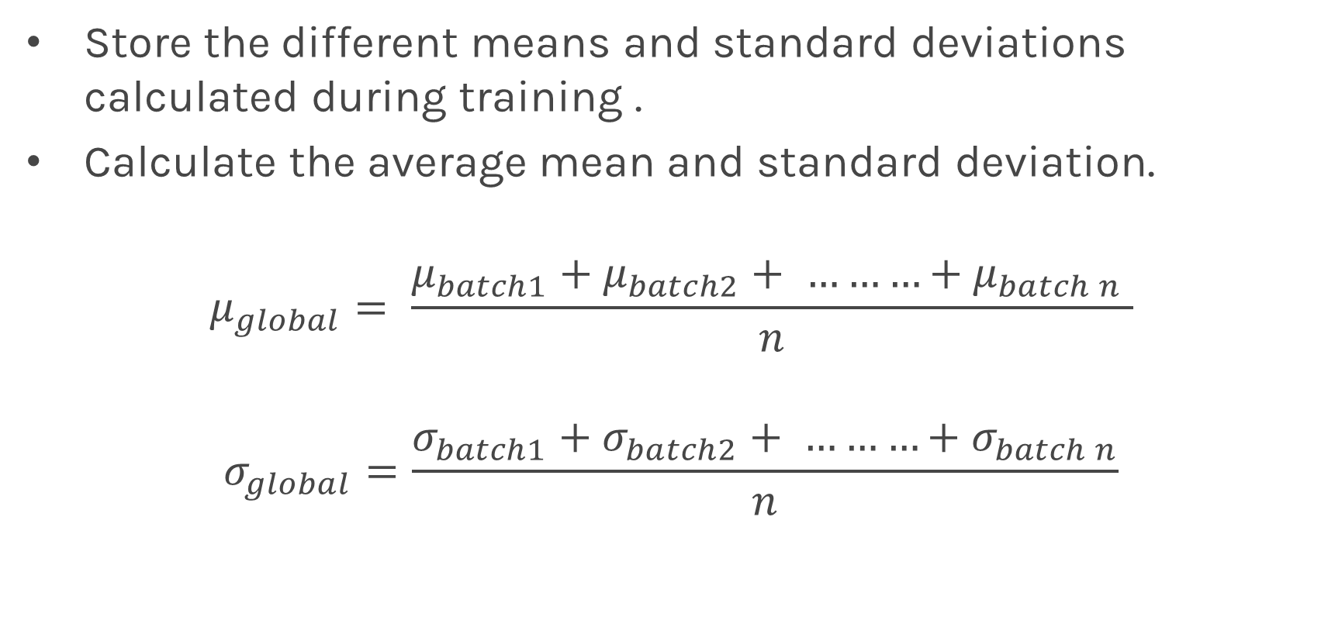
Evaluation
Store the different means and standard deviations calculated during training .
Calculate the average mean and standard deviation.
$$μ_{global}= \frac{μ_{batch1}+μ_{batch2}+ ………+μ_{batch n} }{n}$$
$$σ_{global}=\frac{σ_{batch1}+σ_{batch2}+ ………+σ_{batch n}}{n}$$
Use this for evaluation

