Slide 1
Fitting Neural Networks Stochastic Gradient Descent

Slide 3
Gradient Descent Considerations
We still need to calculate the derivatives.
We need to set the learning rate.
Local vs global minima.
The full likelihood function includes summing up all individual ‘errors’. Sometimes this includes hundreds of thousands of examples.

Slide 4
Stochastic Gradient Descent
Deep learning models crave data, and therefore datasets could be huge. The more the data, the more chances of a model to be good.
In Stochastic Gradient Descent (SGD), we consider just one example at a time to take a single step. We do the following steps in one epoch for SGD:
Take one example
Feed it to Neural Network
Calculate its gradient
Use the gradient we calculated in step 3 to update the weights
Repeat steps 1–4 for all the examples in training dataset

Slide 5
Stochastic Gradient Descent
Epoch:
one forward pass and one backward pass of all the training examples
Why is this stochastic?
Order the algorithm sees data is random

Slide 6
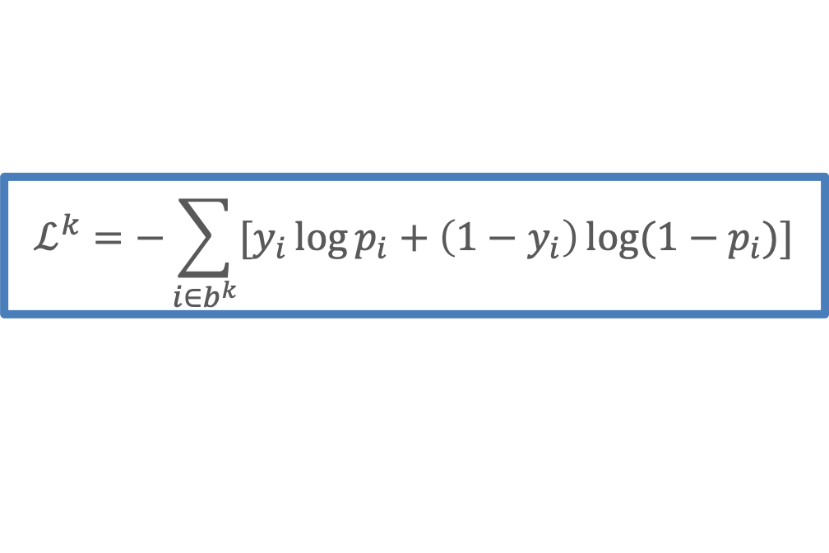

Mini-Batch Stochastic Gradient Descent
$$ℒ_{i}=−y_{i}\log{p_{i}+\left(1−y_{i}\right)\log{(1−p_{i})]}}$$
Instead of using one examples for every step, use a subset of them which we call mini batch.
We use only the points in the mini batch to calculate the loss function:
which approximates the full loss function.
$$ℒ^{k}=−\sum_{i∈b^{k}}{[y_{i}\log{p_{i}+\left(1−y_{i}\right)\log{(1−p_{i})]}}}$$

Slide 7
Divide data into mini-batches
Pick a mini-batch
Feed it to Neural Network
Calculate the mean gradient of the mini-batch
Use the mean gradient we calculated in step 3 to update the weights
Repeat steps 1–4 for the mini-batches we created

Slide 8

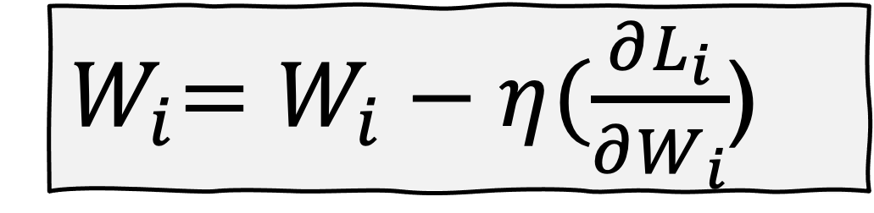
MINI
BATCH 1
MINI
BATCH 2
MINI
BATCH 3
MINI
BATCH …
MINI
BATCH …
MINI
BATCH …
MINI
BATCH …
INPUT
LOSS FUNCTION
$${ L}_{i}$$
MINI BATCH
${ W}_{i}=W_{i}−η(\frac{∂L_{i}}{∂W_{i}}$)
REPEAT

Slide 9
Mini-Batch Stochastic Gradient Descent
PSEUDO-CODE
Divide data into mini-batches
Pick a mini-batch
Feed it to Neural Network
Calculate the mean gradient of the mini-batch
Use the mean gradient we calculated in step 4 to update the weights
Repeat steps 2–5 for the mini-batches we created
One epoch

Slide 10
Batch and Stochastic Gradient Descent
Full Likelihood:
L
Batch Likelihood:
𝛉

Slide 11
Batch and Stochastic Gradient Descent
Full Likelihood:
L
Batch Likelihood:
𝛉

Slide 12
Batch and Stochastic Gradient Descent
Full Likelihood:
L
Batch Likelihood:
𝛉

Slide 13
Batch and Stochastic Gradient Descent
Full Likelihood:
L
Batch Likelihood:
𝛉

Slide 14
Batch and Stochastic Gradient Descent
Full Likelihood:
L
Batch Likelihood:
𝛉

Slide 15
Batch and Stochastic Gradient Descent
Full Likelihood:
L
Batch Likelihood:
𝛉

Slide 16
Batch and Stochastic Gradient Descent
Full Likelihood:
L
Batch Likelihood:
𝛉

Slide 17
Batch and Stochastic Gradient Descent
Full Likelihood:
L
Batch Likelihood:
𝛉

Slide 18
Batch and Stochastic Gradient Descent
Full Likelihood:
L
Batch Likelihood:
𝛉

Slide 19
Mini-Batch Stochastic Gradient Descent
Mini-batch size:
Often called batch size. In general, we choose powers of 2 and that is because of memory considerations, especially if we use GPUs
Large batch size it is equivalent to gradient descent (aka as batch gradient descent).
Very small batch size is like the vanilla SGD though is very jumpy but can avoid local minima.

