Slide 1

Bias Corrections In Adam
Pavlos Protopapas

Slide 2
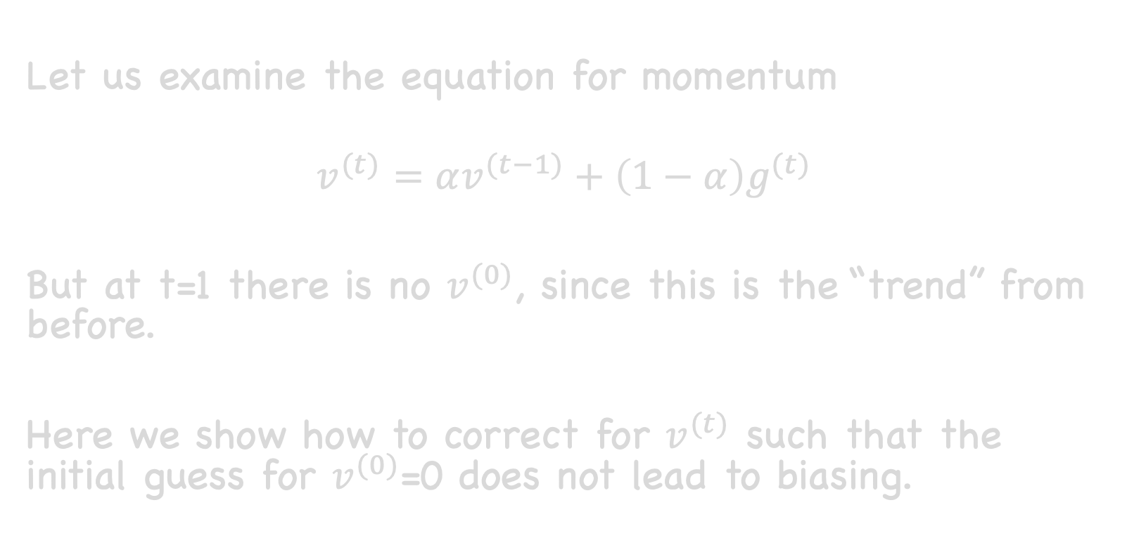
Let us examine the equation for momentum
$$v^{(t)}=αv^{(t−1)}+\left(1−α\right)g^{(t)}$$
But at t=1 there is no $v^{(0)}$, since this is the “trend” from before.
Here we show how to correct for $v^{(t)}$ such that the initial guess for $v^{(0)}$=0 does not lead to biasing.

Slide 3
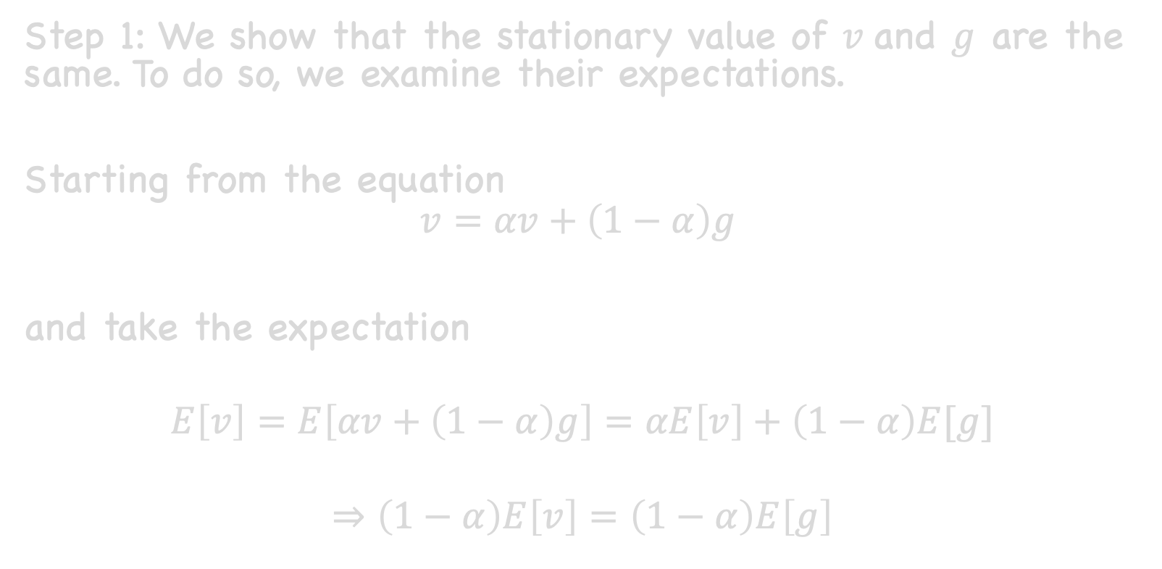

Step 1: We show that the stationary value of $v$and $g$ are the same. To do so, we examine their expectations.
Starting from the equation
$$v=αv+\left(1−α\right)g$$
and take the expectation
$$E\left[v\right]=E\left[αv+\left(1−α\right)g\right]=αE\left[v\right]+\left(1−α\right)E[g]$$
$$⇒\left(1−α\right)E\left[v\right]=\left(1−α\right)E\left[g\right]$$
$$E\left[v\right]=E[g]$$

Slide 4
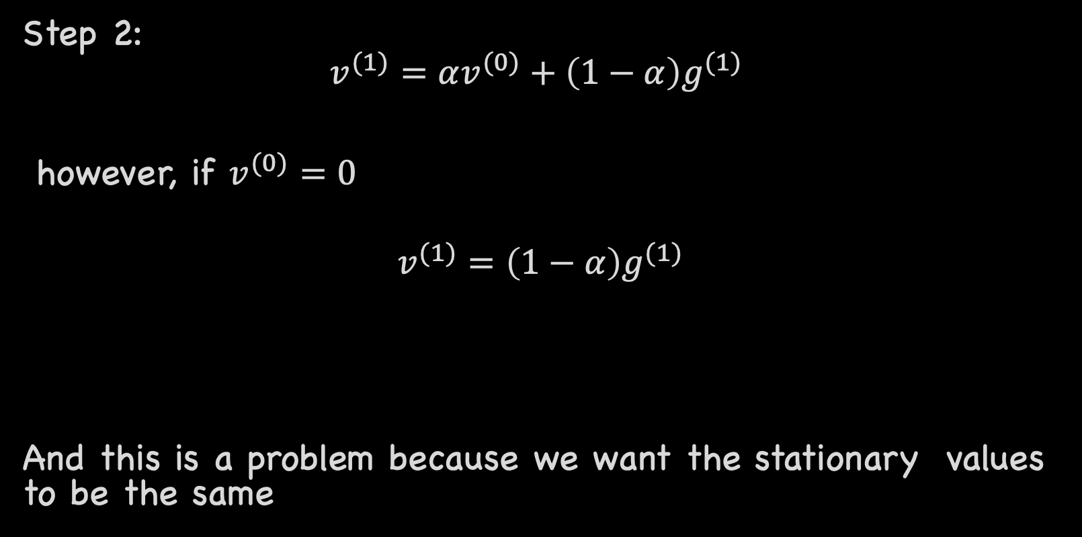
Step 2:
$$v^{(1)}=αv^{(0)}+\left(1−α\right)g^{(1)}$$
however, if $v^{(0)}=0$
$$v^{(1)}=\left(1−α\right)g^{(1)}$$
And this is a problem because we want the stationary values to be the same

Slide 5
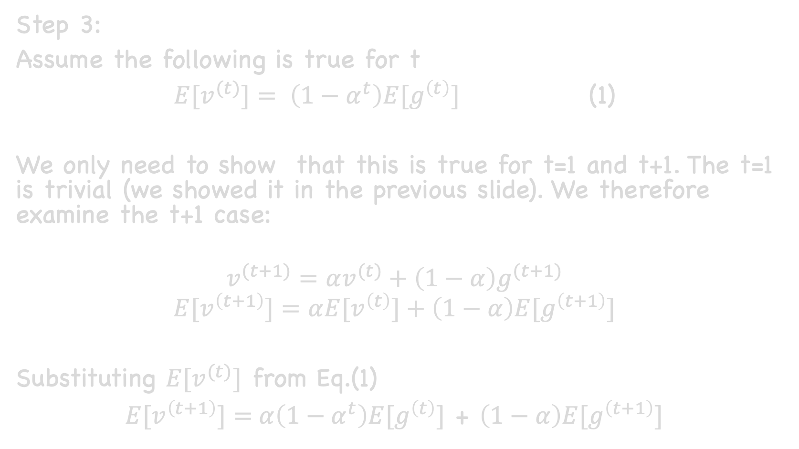
Step 3:
Assume the following is true for t
${E[v}^{(t)}]= \left(1−α^{t}\right)E[g^{\left(t\right)}]$ (1)
We only need to show that this is true for t=1 and t+1. The t=1 is trivial (we showed it in the previous slide). We therefore examine the t+1 case:
$$v^{(t+1)}=αv^{(t)}+\left(1−α\right)g^{(t+1)}$$
$$E[v^{\left(t+1\right)}]=α{E[v}^{\left(t\right)}]+\left(1−α\right){E[g}^{\left(t+1\right)}]$$
Substituting ${E[v}^{(t)}]$ from Eq.(1)
$E[v^{\left(t+1\right)}]=$ $α\left(1−α^{t}\right)E[g^{\left(t\right)}]$ + $\left(1−α\right){E[g}^{\left(t+1\right)}]$

Slide 6
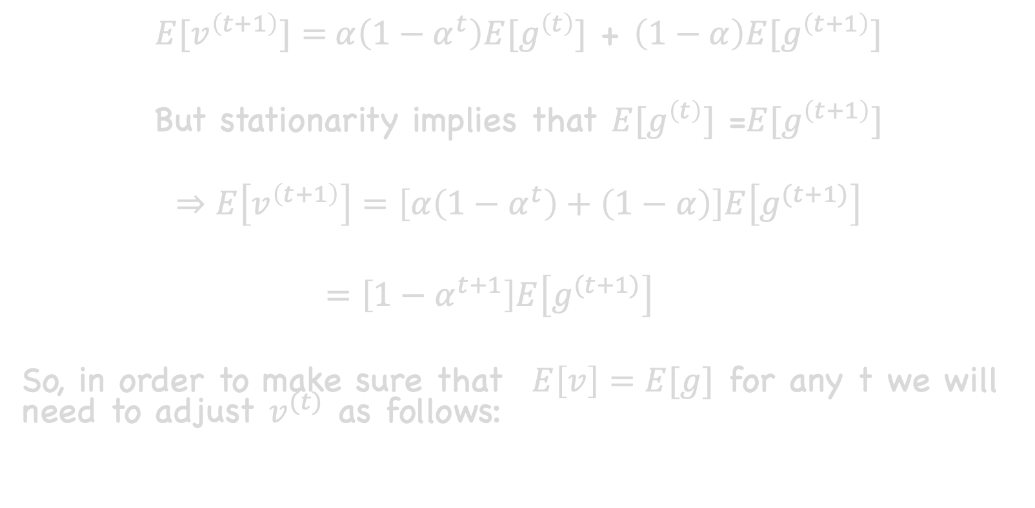
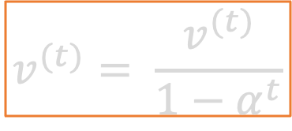
$E[v^{\left(t+1\right)}]=$ $α\left(1−α^{t}\right)E[g^{\left(t\right)}]$ + $\left(1−α\right){E[g}^{\left(t+1\right)}]$
But stationarity implies that $E[g^{\left(t\right)}]$ =${E[g}^{\left(t+1\right)}]$
$$⇒E\left[v^{\left(t+1\right)}\right]=\left[α\left(1−α^{t}\right)+\left(1−α\right)\right]E\left[g^{(t+1)}\right]$$
$=\left[1−α^{t+1}\right]E\left[g^{(t+1)}\right]$
So, in order to make sure that $E\left[v\right]=E[g]$ for any t we will need to adjust $v^{(t)}$ as follows:
So
$$v^{(t)}= \frac{v^{(t)}}{1−α^{t}}$$

