Slide 1
Parameter Initialization

Slide 2
Parameter Initialization
Aim:
Break symmetry between units to ensure each unit computes a different function
For this, initialize all weights (not biases) randomly – Gaussian or Uniform
Effects of scale of initialization
Large
Small
Exploding Gradients
Vanishing Gradients

Slide 3
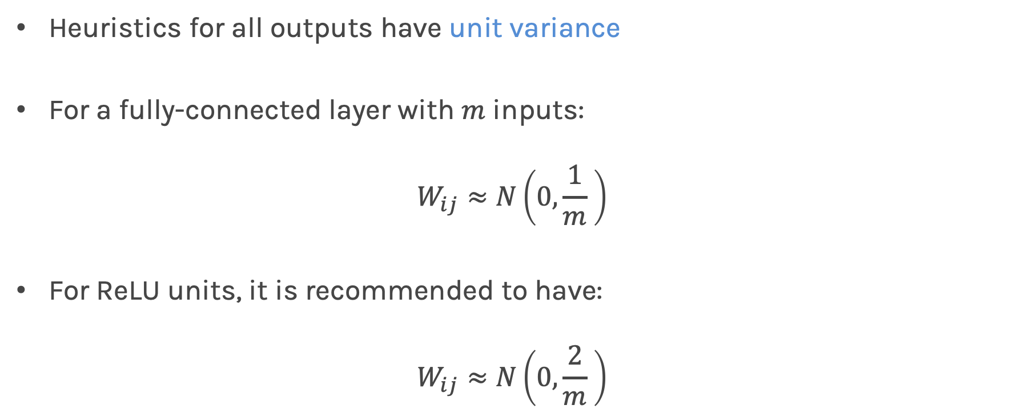
Xavier Initialization
Heuristics for all outputs have unit variance
For a fully-connected layer with $m$ inputs:
$$W_{ij}≈N\left(0, \frac{1}{m} \right)$$
For ReLU units, it is recommended to have:
$$W_{ij}≈N\left(0, \frac{2}{m} \right)$$

Slide 4
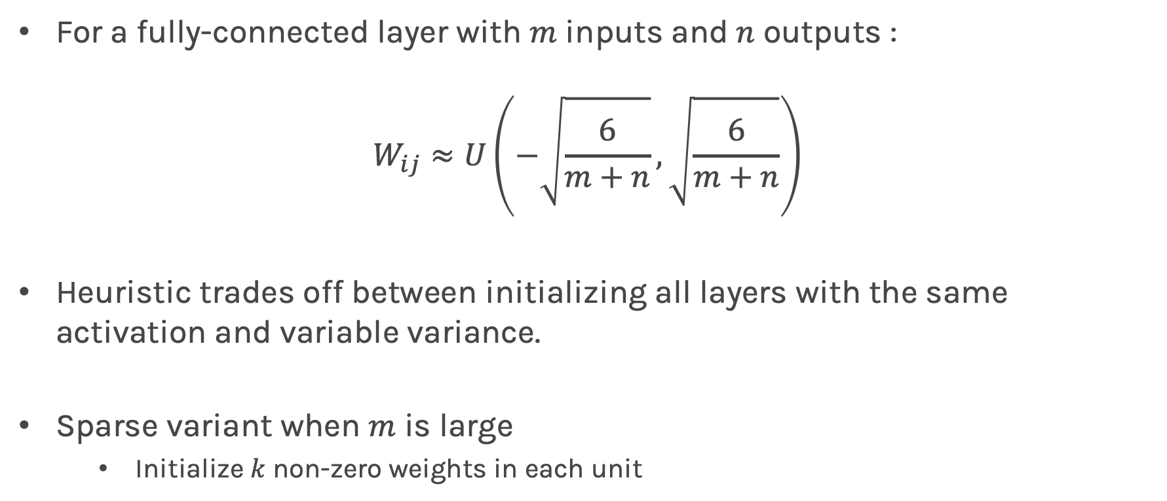
Normalized Initialization - Kaiming He initialization
For a fully-connected layer with $m$ inputs and $n$ outputs :
$$W_{ij}≈U\left(−\sqrt{\frac{6}{m+n}},\sqrt{\frac{6}{m+n}}\right)$$
Heuristic trades off between initializing all layers with the same activation and variable variance.
Sparse variant when $m$ is large
Initialize $k$ non-zero weights in each unit
The variance of a W_{ij} is different for different m’s and n’s

Slide 5
Bias Initialization
Output unit bias
Marginal statistics of the output in the training set
Hidden unit bias
Avoid saturation at initialization
Ex: In ReLU, initialize bias to 0.001 instead of 0

Slide 6
Bias Initialization
Output unit bias
Marginal statistics of the output in the training set
Hidden unit bias
Avoid saturation at initialization
Ex: In ReLU, initialize bias to 0.001 instead of 0
Unit controlling participation of other units
Set bias to allow participation at initialization

Slide 7
Bias Initialization
Output unit bias
Marginal statistics of the output in the training set
Hidden unit bias
Avoid saturation at initialization
Ex: In ReLU, initialize bias to 0.001 instead of 0
This ensures that all ReLU units fire in the beginning and therefore obtain and propagate some gradient

Slide 8
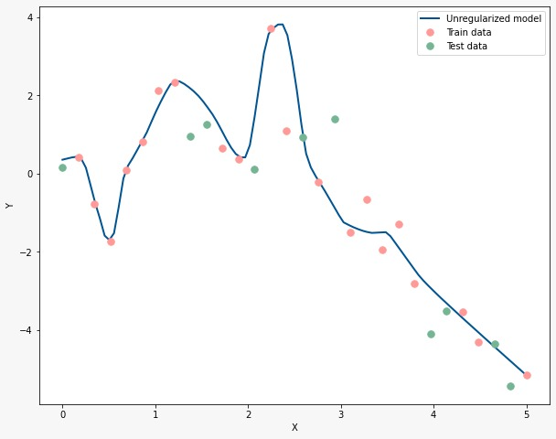
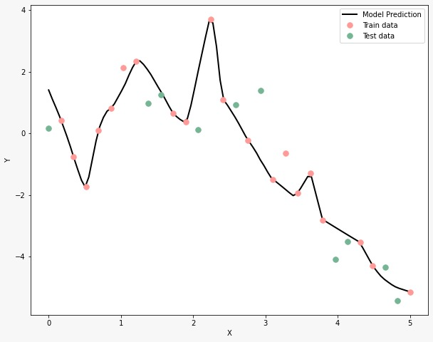


Synthetic data generated using $y=x\sin{x}+ε$, $ε\sim N(0,1)$
Data fitted with a FCNN with 3 hidden layers with 100 nodes per layer, using tanh activation
Parameter initialization with Normalized initialization:
$W\sim U[−1,1]$
Parameter initialization with Normalized initialization:
$W\sim U[−5,5]$

Slide 9
Synthetic data generated using $y=x\sin{x}+ε$, $ε\sim N(0,1)$
Data fitted with a FCNN with 3 hidden layers with 100 nodes per layer, using tanh activation
This area is not well well fitted. At x>1 the derivatives are zero, so learning is not happening!
Parameter initialization with Normalized initialization:
$W\sim U[−1,1]$
Parameter initialization with Normalized initialization:
$W\sim U[−5,5]$

