Slide 1


Lecture 9: Self-Attention
From Attention to Self-Attention
Harvard
AC295/CS287r/CSCI E-115B
Chris Tanner

Slide 2
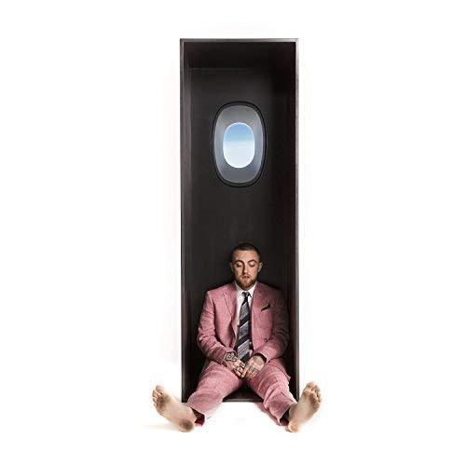

Self [Attention]
-- Mac Miller (2018)
https://wellness.huhs.harvard.edu/alcohol-substance-use
basics@huhs.harvard.edu

Slide 3
ANNOUNCEMENTS
HW1 is being graded double-blind. Solutions are posted on Canvas -> Files
HW2 is due next Tues, Oct 5 @ 11:59pm! Determine your mystery language.
Research Proposals are due tonight, Sept 30 @ 11:59pm.
If submitting w/ others, please see the updated Canvas instructions

Slide 4
RESEARCH PROJECTS
Most research experiences/opportunities are “top-down”
You’re all creative and fully capable.
Allow yourselves to become comfortable with the unknown.
It’s okay if your Phase 1 Proposals aren’t perfect ideas. The point is to gain practice with the inquisition and overall process of executing your ideas.
After Phase 1 we will filter projects, give feedback, help you find the optimal project partners, offer TF support, etc

Slide 5
RESEARCH PROJECTS
I’ll filter projects by rating them according to:
researchy vs application
how grounded/well-reasoned it is
technical difficulty (there’s a sweet spot)
feasibility (e.g., required compute power, data availability, metrics)
interestingness / significance

Slide 6
















RECAP: L8
seq2seq models
$${\hat{y}}_{1}$$
$${\hat{y}}_{2}$$
$${\hat{y}}_{3}$$
$${\hat{y}}_{4}$$
$${\hat{y}}_{5}$$
$${\hat{y}}_{6}$$
are a general-purpose encoder-decoder architecture
can be implemented with RNNs (or Transformers even)
Allow for n → m predictions
Natural approach to Neural MT
If implemented end-to-end can be good but slow
$$h_{1}^{E}$$
$$h_{2}^{E}$$
$$h_{3}^{E}$$
$$h_{4}^{E}$$
$$h_{1}^{D}$$
$$h_{2}^{D}$$
$$h_{3}^{D}$$
$$h_{4}^{D}$$
$$h_{5}^{D}$$
$$h_{6}^{D}$$
Hidden layer
Input layer
The
brown
dog
ran
<s>
Le
chien
brun
a
couru
ENCODER RNN
DECODER RNN

Slide 7

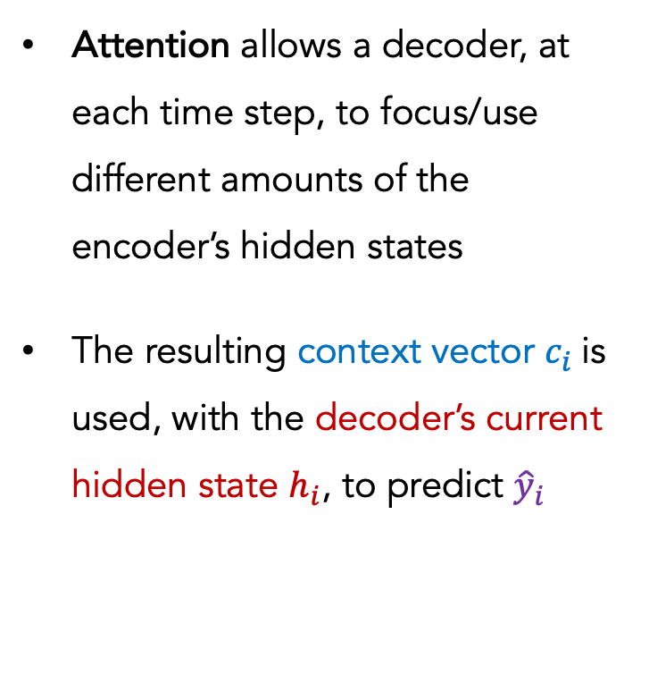




RECAP: L8
seq2seq models
$$c_{5}^{D}$$
$${\hat{y}}_{1}$$
$${\hat{y}}_{2}$$
$${\hat{y}}_{3}$$
$${\hat{y}}_{4}$$
$${\hat{y}}_{5}$$
$${\hat{y}}_{6}$$
Attention allows a decoder, at each time step, to focus/use different amounts of the encoder’s hidden states
The resulting context vector $c_{i}$is used, with the decoder’s current hidden state $h_{i}$, to predict ${\hat{y}}_{i}$
$$a_{1}^{5}$$
$$a_{2}^{5}$$
$$a_{3}^{5}$$
$$a_{4}^{5}$$
$$h_{1}^{E}$$
$$h_{2}^{E}$$
$$h_{3}^{E}$$
$$h_{4}^{E}$$
$$h_{1}^{D}$$
$$h_{2}^{D}$$
$$h_{3}^{D}$$
$$h_{4}^{D}$$
$$h_{5}^{D}$$
$$h_{6}^{D}$$
Hidden layer
Input layer
The
brown
dog
ran
<s>
Le
chien
brun
a
couru
ENCODER RNN
DECODER RNN

Slide 8
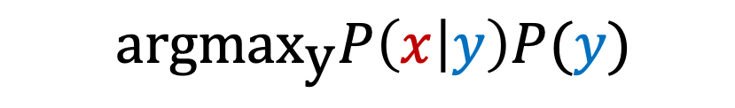
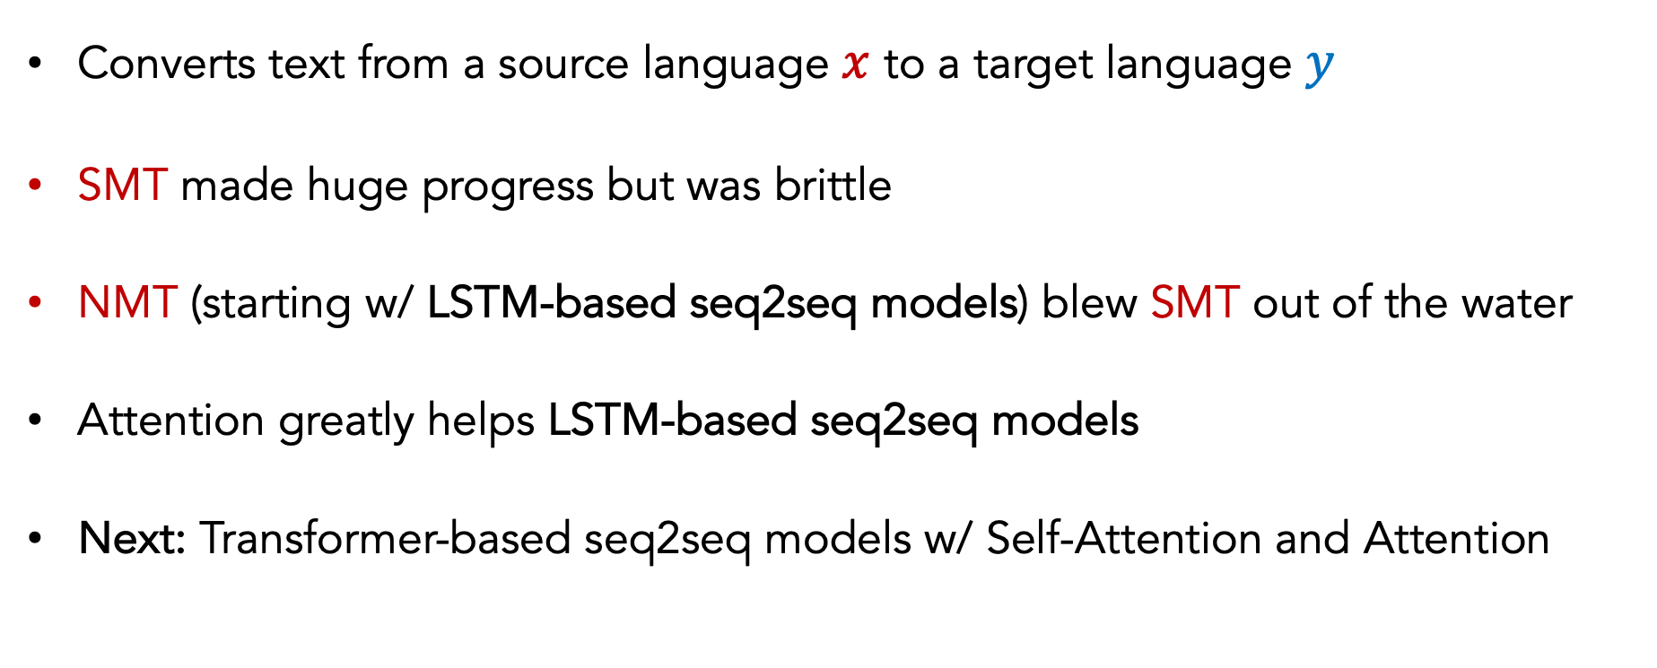
RECAP: L8
MT
$$\text{argma}{\text{x}}_{\text{y}}P\left(x | y\right)P(y)$$
Converts text from a source language $x$ to a target language $y$
SMT made huge progress but was brittle
NMT (starting w/ LSTM-based seq2seq models) blew SMT out of the water
Attention greatly helps LSTM-based seq2seq models
Next: Transformer-based seq2seq models w/ Self-Attention and Attention

Slide 9
Outline
seq2seq + Attention
Self-Attention

Slide 10
Outline
seq2seq + Attention
Self-Attention

Slide 11









seq2seq + Attention
Q: How do we determine how much to pay attention to each of the encoder’s hidden layers?
A: Let’s base it on our decoder’s current hidden state (our current representation of meaning) and all of the encoder’s hidden layers!
$$h_{1}^{E}$$
$$h_{2}^{E}$$
$$h_{3}^{E}$$
$$h_{4}^{E}$$
$$h_{1}^{D}$$
$$e_{1}$$
$$1.5$$
Hidden layer
$$h_{1}^{E}$$
$$h_{1}^{D}$$
Separate FFNN
Input layer
The
brown
dog
ran
<s>
ENCODER RNN
DECODER RNN

Slide 12



seq2seq + Attention
Q: How do we determine how much to pay attention to each of the encoder’s hidden layers?
A: Let’s base it on our decoder’s current hidden state (our current representation of meaning) and all of the encoder’s hidden layers!
$$h_{1}^{E}$$
$$h_{2}^{E}$$
$$h_{3}^{E}$$
$$h_{4}^{E}$$
$$h_{1}^{D}$$
$$e_{2}$$
$$0.9$$
Hidden layer
$$h_{2}^{E}$$
$$h_{1}^{D}$$
Separate FFNN
Input layer
The
brown
dog
ran
<s>
ENCODER RNN
DECODER RNN

Slide 13



seq2seq + Attention
Q: How do we determine how much to pay attention to each of the encoder’s hidden layers?
A: Let’s base it on our decoder’s current hidden state (our current representation of meaning) and all of the encoder’s hidden layers!
$$h_{1}^{E}$$
$$h_{2}^{E}$$
$$h_{3}^{E}$$
$$h_{4}^{E}$$
$$h_{1}^{D}$$
$$e_{3}$$
$$0.2$$
Hidden layer
$$h_{3}^{E}$$
$$h_{1}^{D}$$
Separate FFNN
Input layer
The
brown
dog
ran
<s>
ENCODER RNN
DECODER RNN

Slide 14



seq2seq + Attention
Q: How do we determine how much to pay attention to each of the encoder’s hidden layers?
A: Let’s base it on our decoder’s current hidden state (our current representation of meaning) and all of the encoder’s hidden layers!
$$h_{1}^{E}$$
$$h_{2}^{E}$$
$$h_{3}^{E}$$
$$h_{4}^{E}$$
$$h_{1}^{D}$$
$$e_{4}$$
$$−0.5$$
Hidden layer
$$h_{4}^{E}$$
$$h_{1}^{D}$$
Separate FFNN
Input layer
The
brown
dog
ran
<s>
ENCODER RNN
DECODER RNN

Slide 15








seq2seq + Attention
Q: How do we determine how much to pay attention to each of the encoder’s hidden layers?
A: Let’s base it on our decoder’s current hidden state (our current representation of meaning) and all of the encoder’s hidden layers!
Attention (raw scores)
$$h_{1}^{E}$$
$$h_{2}^{E}$$
$$h_{3}^{E}$$
$$h_{4}^{E}$$
$$h_{1}^{D}$$
$$e_{1}$$
$$1.5$$
$$e_{2}$$
$$0.9$$
$$e_{3}$$
$$0.2$$
Hidden layer
$$e_{4}$$
$$−0.5$$
Input layer
The
brown
dog
ran
<s>
ENCODER RNN
DECODER RNN

Slide 16
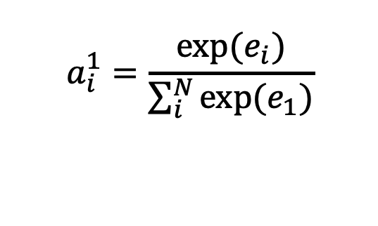
seq2seq + Attention
Q: How do we determine how much to pay attention to each of the encoder’s hidden layers?
A: Let’s base it on our decoder’s current hidden state (our current representation of meaning) and all of the encoder’s hidden layers!
Attention (raw scores)
$$h_{1}^{E}$$
$$h_{2}^{E}$$
$$h_{3}^{E}$$
$$h_{4}^{E}$$
$$h_{1}^{D}$$
$$e_{1}$$
$$1.5$$
$$e_{2}$$
$$0.9$$
$$e_{3}$$
$$0.2$$
Hidden layer
$$e_{4}$$
$$−0.5$$
Attention (softmax’d)
$$a_{i}^{1}=\frac{exp⁡(e_{i})}{\sum_{i}^{N}{{exp⁡(e}_{1})}}$$
Input layer
The
brown
dog
ran
<s>
ENCODER RNN
DECODER RNN

Slide 17




seq2seq + Attention
Q: How do we determine how much to pay attention to each of the encoder’s hidden layers?
A: Let’s base it on our decoder’s current hidden state (our current representation of meaning) and all of the encoder’s hidden layers!
Attention (raw scores)
$$h_{1}^{E}$$
$$h_{2}^{E}$$
$$h_{3}^{E}$$
$$h_{4}^{E}$$
$$h_{1}^{D}$$
$$e_{1}$$
$$1.5$$
$$e_{2}$$
$$0.9$$
$$e_{3}$$
$$0.2$$
Hidden layer
$$e_{4}$$
$$−0.5$$
Attention (softmax’d)
$$a_{1}^{1}=0.51$$
Input layer
The
brown
dog
ran
<s>
$$a_{2}^{1}=0.28$$
$$a_{3}^{1}=0.14$$
ENCODER RNN
DECODER RNN
$$a_{3}^{1}=0.07$$

Slide 18



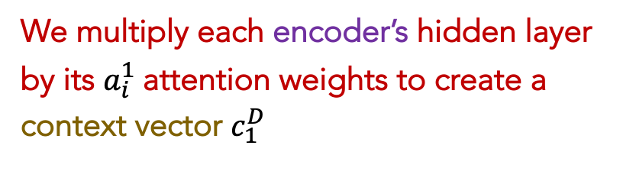


seq2seq + Attention
$$c_{1}^{D}$$
We multiply each encoder’s hidden layer by its $a_{i}^{1}$attention weights to create a context vector $c_{1}^{D}$
$$a_{1}^{1}$$
$$a_{3}^{1}$$
$$a_{4}^{1}$$
$$a_{2}^{1}$$
$$h_{1}^{E}$$
$$h_{2}^{E}$$
$$h_{3}^{E}$$
$$h_{4}^{E}$$
$$h_{1}^{D}$$
Hidden layer
Attention (softmax’d)
$$a_{1}^{1}=0.51$$
Input layer
The
brown
dog
ran
<s>
$$a_{2}^{1}=0.28$$
$$a_{3}^{1}=0.14$$
ENCODER RNN
DECODER RNN
$$a_{3}^{1}=0.07$$

Slide 19
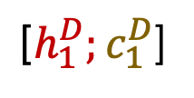


seq2seq + Attention
REMEMBER: each attention weight $a_{i}^{j}$ is based on the decoder’s current hidden state, too.
$$c_{1}^{D}$$
Le
$${\hat{y}}_{1}$$
$$a_{1}^{1}$$
$$a_{3}^{1}$$
$$a_{4}^{1}$$
$$a_{2}^{1}$$
$$h_{1}^{E}$$
$$h_{2}^{E}$$
$$h_{3}^{E}$$
$$h_{4}^{E}$$
${\text{[}h}_{1}^{D};c_{1}^{D}$]
Hidden layer
Input layer
The
brown
dog
ran
<s>
ENCODER RNN
DECODER RNN

Slide 20




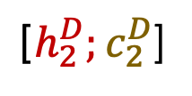


seq2seq + Attention
REMEMBER: each attention weight $a_{i}^{j}$ is based on the decoder’s current hidden state, too.
$$c_{2}^{D}$$
Le
chien
$${\hat{y}}_{1}$$
$${\hat{y}}_{2}$$
$$a_{1}^{2}$$
$$a_{3}^{2}$$
$$a_{4}^{2}$$
$$a_{2}^{2}$$
$$h_{1}^{E}$$
$$h_{2}^{E}$$
$$h_{3}^{E}$$
$$h_{4}^{E}$$
${\text{[}h}_{1}^{D};c_{1}^{D}$]
${\text{[}h}_{2}^{D};c_{2}^{D}$]
Hidden layer
Input layer
The
brown
dog
ran
<s>
Le
ENCODER RNN
DECODER RNN

Slide 21



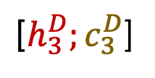



seq2seq + Attention
REMEMBER: each attention weight $a_{i}^{j}$ is based on the decoder’s current hidden state, too.
$$c_{3}^{D}$$
Le
chien
brun
$${\hat{y}}_{1}$$
$${\hat{y}}_{2}$$
$${\hat{y}}_{3}$$
$$a_{1}^{3}$$
$$a_{3}^{3}$$
$$a_{4}^{3}$$
$$a_{2}^{3}$$
$$h_{1}^{E}$$
$$h_{2}^{E}$$
$$h_{3}^{E}$$
$$h_{4}^{E}$$
${\text{[}h}_{1}^{D};c_{1}^{D}$]
${\text{[}h}_{2}^{D};c_{2}^{D}$]
${\text{[}h}_{3}^{D};c_{3}^{D}$]
Hidden layer
Input layer
The
brown
dog
ran
<s>
Le
chien
ENCODER RNN
DECODER RNN

Slide 22





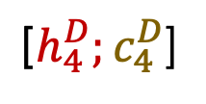

seq2seq + Attention
REMEMBER: each attention weight $a_{i}^{j}$ is based on the decoder’s current hidden state, too.
$$c_{4}^{D}$$
Le
chien
brun
a
$${\hat{y}}_{1}$$
$${\hat{y}}_{2}$$
$${\hat{y}}_{3}$$
$${\hat{y}}_{4}$$
$$a_{1}^{4}$$
$$a_{3}^{4}$$
$$a_{4}^{4}$$
$$a_{2}^{4}$$
$$h_{1}^{E}$$
$$h_{2}^{E}$$
$$h_{3}^{E}$$
$$h_{4}^{E}$$
${\text{[}h}_{1}^{D};c_{1}^{D}$]
${\text{[}h}_{2}^{D};c_{2}^{D}$]
${\text{[}h}_{3}^{D};c_{3}^{D}$]
${\text{[}h}_{4}^{D};c_{4}^{D}$]
Hidden layer
Input layer
The
brown
dog
ran
<s>
Le
chien
brun
ENCODER RNN
DECODER RNN

Slide 23

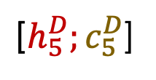





seq2seq + Attention
REMEMBER: each attention weight $a_{i}^{j}$ is based on the decoder’s current hidden state, too.
$$c_{5}^{D}$$
Le
chien
brun
a
couru
$${\hat{y}}_{1}$$
$${\hat{y}}_{2}$$
$${\hat{y}}_{3}$$
$${\hat{y}}_{4}$$
$${\hat{y}}_{4}$$
$$a_{1}^{5}$$
$$a_{3}^{5}$$
$$a_{4}^{5}$$
$$a_{2}^{5}$$
$$h_{1}^{E}$$
$$h_{2}^{E}$$
$$h_{3}^{E}$$
$$h_{4}^{E}$$
${\text{[}h}_{1}^{D};c_{1}^{D}$]
${\text{[}h}_{2}^{D};c_{2}^{D}$]
${\text{[}h}_{3}^{D};c_{3}^{D}$]
${\text{[}h}_{4}^{D};c_{4}^{D}$]
${\text{[}h}_{5}^{D};c_{5}^{D}$]
Hidden layer
Input layer
The
brown
dog
ran
<s>
Le
chien
brun
a
ENCODER RNN
DECODER RNN

Slide 24
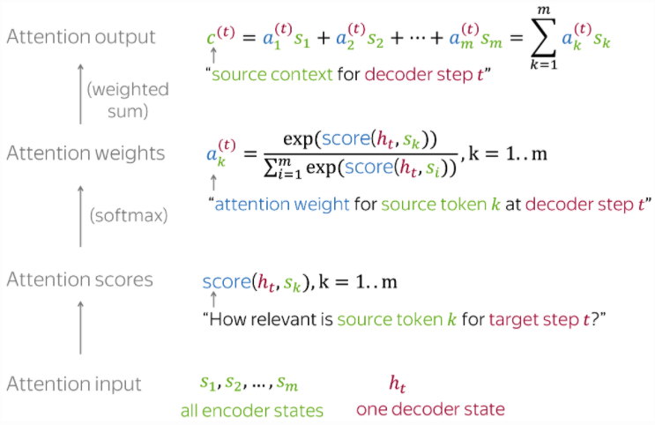
For convenience, here’s the Attention calculation summarized on 1 slide
Photo credit: https://lena-voita.github.io/nlp_course/seq2seq_and_attention.html

Slide 25
For convenience, here’s the Attention calculation summarized on 1 slide
The Attention mechanism that produces scores doesn’t have to be a FFNN like I illustrated. It can be any function you wish.
Photo credit: https://lena-voita.github.io/nlp_course/seq2seq_and_attention.html

Slide 26
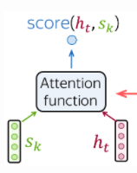
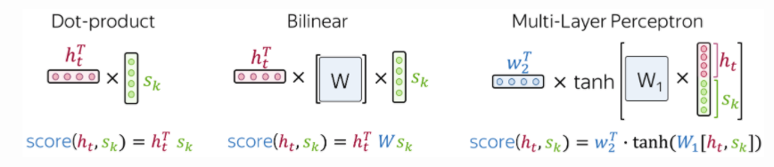
Popular Attention Scoring functions:
Photo credit: https://lena-voita.github.io/nlp_course/seq2seq_and_attention.html

Slide 27
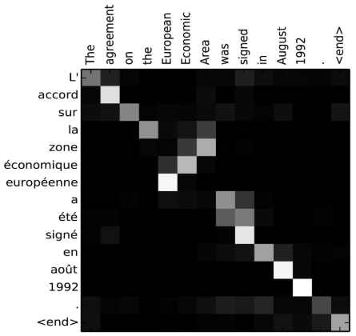
seq2seq + Attention
Attention:
greatly improves seq2seq results
allows us to visualize the contribution each encoding word gave for each decoder’s word
Image source: Fig 3 in Bahdanau et al., 2015

Slide 28
seq2seq + Attention
Takeaway:
Having a separate encoder and decoder allows for n → m length predictions.
Attention is powerful; allows us to conditionally weight our focus
Attention:
greatly improves seq2seq results
allows us to visualize the contribution each encoding word gave for each decoder’s word
Image source: Fig 3 in Bahdanau et al., 2015

Slide 29

CHECKPOINT
seq2seq doesn’t have to use RNNs/LSTMs
seq2seq doesn’t have to be used exclusively for NMT
NMT doesn’t have to use seq2seq (but it’s natural and the best we have for now)

Slide 30
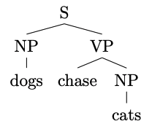
Constituency Parsing
Input: dogs chase cats
Output:
or a flattened representation

Slide 31
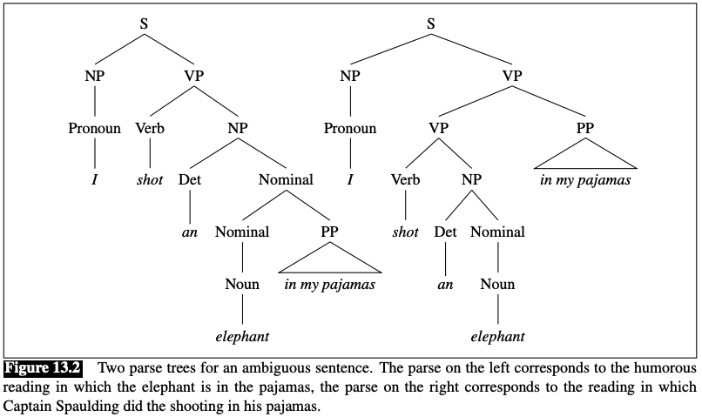
Constituency Parsing
Input: I shot an elephant in my pajamas
Output:
https://web.stanford.edu/~jurafsky/slp3/13.pdf

Slide 32
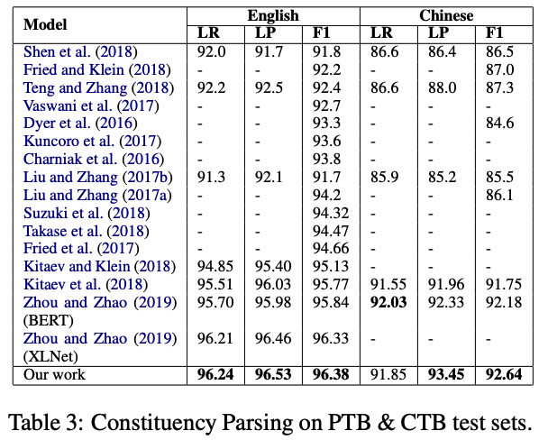
Results
https://aclanthology.org/2020.findings-emnlp.65.pdf

Slide 33
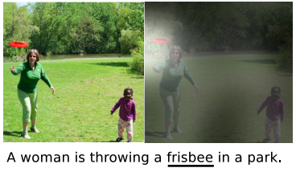
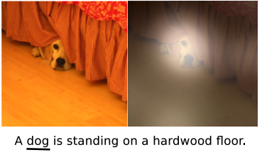
Image Captioning
Input: image
Output: generated text
Show, Attend and Tell: Neural Image Caption Generation with Visual Attention. Xu et al. CVPR (2016)

Slide 34
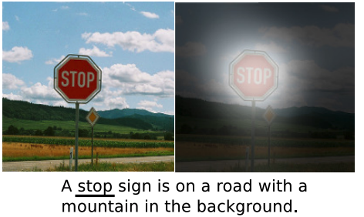
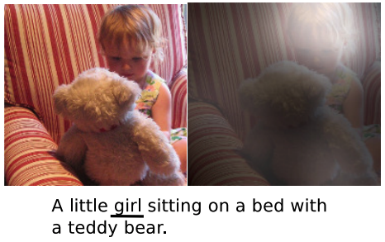
Image Captioning
Input: image
Output: generated text
Show, Attend and Tell: Neural Image Caption Generation with Visual Attention. Xu et al. CVPR (2016)

Slide 35
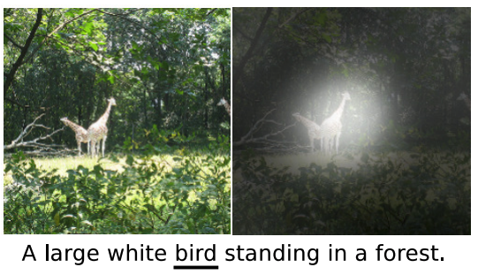
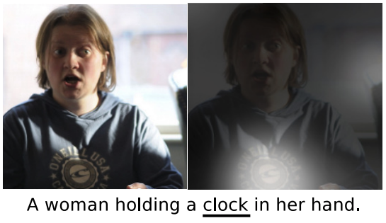
Image Captioning
Show, Attend and Tell: Neural Image Caption Generation with Visual Attention. Xu et al. CVPR (2016)

Slide 36
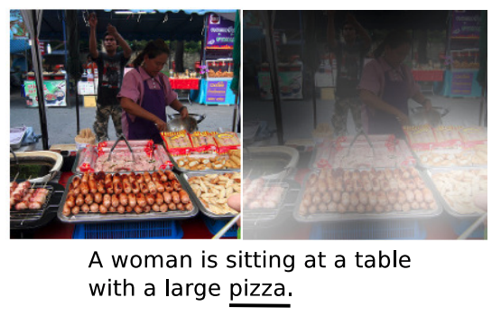
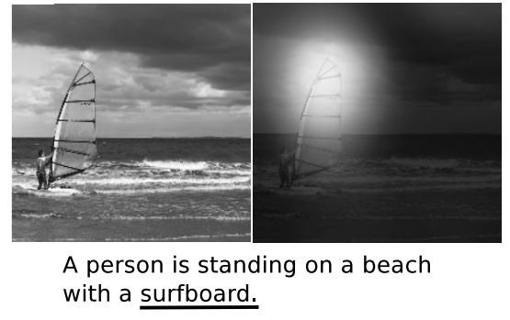
Image Captioning
Show, Attend and Tell: Neural Image Caption Generation with Visual Attention. Xu et al. CVPR (2016)

Slide 37
SUMMARY
LSTMs yielded state-of-the-art results on most NLP tasks (2014-2018)
seq2seq+Attention was an even more revolutionary idea (Google Translate used it)
Attention allows us to place appropriate weight to the encoder’s hidden states
But:

Slide 38
SUMMARY
LSTMs are sequential in nature (prohibits parallelization). Very wasteful.
No explicit modelling of long- and short- range dependencies
Language is naturally hierarchical (can we do better than Stacked LSTMs?)
Can we apply the concept of Attention to improve our representations? (i.e., contextualized representations)
Ashish Vaswani (2019)

Slide 39
Outline
seq2seq + Attention
Self-Attention

Slide 40
Outline
seq2seq + Attention
Self-Attention

Slide 41
Goals
Each word in a sequence to be transformed into a rich, abstract representation (context embedding) based on the weighted sums of the other words in the same sequence (akin to deep CNN layers)
Inspired by Attention, we want each word to determine, “how much should I be influenced by each of my neighbors”
Want positionality

Slide 42
Self-Attention
z₁
z₂
z₃
z₄
Output representation
Self-Attention’s goal is to create great representations, z_{i}, of the input
??????
Input vectors
The
brown
dog
ran
x₁
x₂
x₃
x₄

Slide 43




Self-Attention
z₁
Output representation
Self-Attention’s goal is to create great representations, z_{i}, of the input
z₁ will be based on a weighted contribution of x₁, x₂, x₃, x₄
$$a_{1}^{1}$$
$$a_{2}^{1}$$
$$a_{3}^{1}$$
$$a_{4}^{1}$$
Input vectors
The
brown
dog
ran
x₁
x₂
x₃
x₄

Slide 44
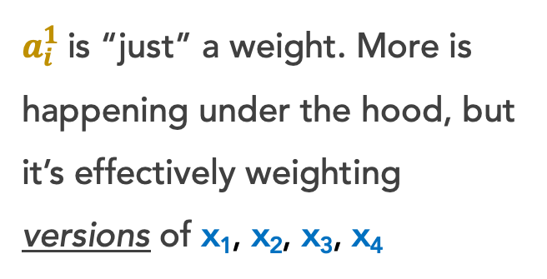
Self-Attention
z₁
Output representation
Self-Attention’s goal is to create great representations, z_{i}, of the input
z₁ will be based on a weighted contribution of x₁, x₂, x₃, x₄
$$a_{1}^{1}$$
$$a_{2}^{1}$$
$$a_{3}^{1}$$
$$a_{4}^{1}$$
$a_{i}^{1}$is “just” a weight. More is happening under the hood, but it’s effectively weighting versions of x₁, x₂, x₃, x₄
Input vectors
The
brown
dog
ran
x₁
x₂
x₃
x₄

Slide 45

Self-Attention
z₁
Under the hood, each x_{i} has 3 small, associated vectors. For example, x₁ has:
Query q_{i}
Key k_{i}
Value v_{i}
Output representation
$$a_{1}^{1}$$
$$a_{2}^{1}$$
$$a_{3}^{1}$$
$$a_{4}^{1}$$
Input vectors
The
brown
dog
ran
x₁
x₂
x₃
x₄

Slide 46
Self-Attention
Under the hood, each x_{i} has 3 small, associated vectors. For example, x₁ has:
Query q₁
Key k₁
Value v₁
Step 1: Our Self-Attention Head has just 3 weight matrices W_{q}, W_{k}, W_{v} in total. These same 3 weight matrices are multiplied by each x_{i} to create all vectors:
q_{i} = w_{q} x_{i}
k_{i} = w_{k} x_{i}
v_{i} = w_{v} x_{i}
q₁
k₁
v₁
q₂
k₂
v₂
q₃
k₃
v₃
q₄
k₄
v₄
The
brown
dog
ran
x₁
x₂
x₃
x₄

Slide 47

Self-Attention
Step 2: For word x₁, let’s calculate the scores s₁, s₂, s₃, s₄, which represent how much attention to pay to each respective ”word” v_{i}
s₁ = q₁$⋅$k₁ = 112
q₁
k₁
v₁
q₂
k₂
v₂
q₃
k₃
v₃
q₄
k₄
v₄
The
brown
dog
ran
x₁
x₂
x₃
x₄
Notes:
A given word’s query vector should be more similar to word’s key vector than it is to any other word’s key vector.
We take the dot product, so their magnitudes should be higher than the others.
The v vector for each word will likely be similar to the original word vector, since we ultimately weight these vectors, not our original x vectors.

Slide 48

Self-Attention
Step 2: For word x₁, let’s calculate the scores s₁, s₂, s₃, s₄, which represent how much attention to pay to each respective ”word” v_{i}
s₂ = q₁$⋅$k₂ = 96
s₁ = q₁$⋅$k₁ = 112
q₁
k₁
v₁
q₂
k₂
v₂
q₃
k₃
v₃
q₄
k₄
v₄
The
brown
dog
ran
x₁
x₂
x₃
x₄
Notes:
A given word’s query vector should be more similar to word’s key vector than it is to any other word’s key vector.
We take the dot product, so their magnitudes should be higher than the others.
The v vector for each word will likely be similar to the original word vector, since we ultimately weight these vectors, not our original x vectors.

Slide 49

Self-Attention
Step 2: For word x₁, let’s calculate the scores s₁, s₂, s₃, s₄, which represent how much attention to pay to each respective ”word” v_{i}
s₃ = q₁$⋅$k₃ = 16
s₂ = q₁$⋅$k₂ = 96
s₁ = q₁$⋅$k₁ = 112
q₁
k₁
v₁
q₂
k₂
v₂
q₃
k₃
v₃
q₄
k₄
v₄
The
brown
dog
ran
x₁
x₂
x₃
x₄
Notes:
A given word’s query vector should be more similar to word’s key vector than it is to any other word’s key vector.
We take the dot product, so their magnitudes should be higher than the others.
The v vector for each word will likely be similar to the original word vector, since we ultimately weight these vectors, not our original x vectors.

Slide 50

Self-Attention
Step 2: For word x₁, let’s calculate the scores s₁, s₂, s₃, s₄, which represent how much attention to pay to each respective ”word” v_{i}
s₄ = q₁$⋅$k₄ = 8
s₃ = q₁$⋅$k₃ = 16
s₂ = q₁$⋅$k₂ = 96
s₁ = q₁$⋅$k₁ = 112
q₁
k₁
v₁
q₂
k₂
v₂
q₃
k₃
v₃
q₄
k₄
v₄
The
brown
dog
ran
x₁
x₂
x₃
x₄
Notes:
A given word’s query vector should be more similar to word’s key vector than it is to any other word’s key vector.
We take the dot product, so their magnitudes should be higher than the others.
The v vector for each word will likely be similar to the original word vector, since we ultimately weight these vectors, not our original x vectors.

Slide 51




Self-Attention
Step 3: Our scores s₁, s₂, s₃, s₄ don’t sum to 1. Let’s divide by $√len(k_{i})$ and softmax it
s₄ = q₁$⋅$k₄ = 8
a₄ = $σ(s_{4}/8)$ = 0
s₃ = q₁$⋅$k₃ = 16
$\text{a}\text{3}\text{ =} σ(s_{3}/8)$ = .01
s₂ = q₁$⋅$k₂ = 96
a₂ = $σ(s_{2}/8)$ = .12
s₁ = q₁$⋅$k₁ = 112
a₁ = $σ(s_{1}/8)$ = .87
q₁
k₁
v₁
q₂
k₂
v₂
q₃
k₃
v₃
q₄
k₄
v₄
The
brown
dog
ran
x₁
x₂
x₃
x₄
Notes:
We then normalize these attention scores

Slide 52
Self-Attention
Step 3: Our scores s₁, s₂, s₃, s₄ don’t sum to 1. Let’s divide by $√len(k_{i})$ and softmax it
s₄ = q₁$⋅$k₄ = 8
a₄ = $σ(s_{4}/8)$ = 0
Instead of these a_{i} values directly weighting our original x_{i} word vectors, they directly weight our v_{i} vectors.
s₃ = q₁$⋅$k₃ = 16
$\text{a}\text{3}\text{ =} σ(s_{3}/8)$ = .01
s₂ = q₁$⋅$k₂ = 96
a₂ = $σ(s_{2}/8)$ = .12
s₁ = q₁$⋅$k₁ = 112
a₁ = $σ(s_{1}/8)$ = .87
q₁
k₁
v₁
q₂
k₂
v₂
q₃
k₃
v₃
q₄
k₄
v₄
The
brown
dog
ran
x₁
x₂
x₃
x₄

Slide 53


Self-Attention
Step 4: Let’s weight our v_{i} vectors and simply sum them up!
z₁
z₁ = a₁$⋅$v₁ + a₂$⋅$v₂ + a₃$⋅$v₃ + a₄$⋅$v₄
= 0.87$⋅$v₁ + 0.12$⋅$v₂ + 0.01$⋅$v₃ + 0$⋅$v₄
q₁
k₁
v₁
q₂
k₂
v₂
q₃
k₃
v₃
q₄
k₄
v₄
The
brown
dog
ran
x₁
x₂
x₃
x₄

Slide 54

Self-Attention
Step 5: We repeat this for all other words, yielding us with great, new z_{i} representations!
z₂
z₂ = a₁$⋅$v₁ + a₂$⋅$v₂ + a₃$⋅$v₃ + a₄$⋅$v₄
q₁
k₁
v₁
q₂
k₂
v₂
q₃
k₃
v₃
q₄
k₄
v₄
The
brown
dog
ran
x₁
x₂
x₃
x₄

Slide 55

Self-Attention
Step 5: We repeat this for all other words, yielding us with great, new z_{i} representations!
z₃
z₃ = a₁$⋅$v₁ + a₂$⋅$v₂ + a₃$⋅$v₃ + a₄$⋅$v₄
q₁
k₁
v₁
q₂
k₂
v₂
q₃
k₃
v₃
q₄
k₄
v₄
The
brown
dog
ran
x₁
x₂
x₃
x₄

Slide 56

Self-Attention
Step 5: We repeat this for all other words, yielding us with great, new z_{i} representations!
z₄
z₄ = a₁$⋅$v₁ + a₂$⋅$v₂ + a₃$⋅$v₃ + a₄$⋅$v₄
q₁
k₁
v₁
q₂
k₂
v₂
q₃
k₃
v₃
q₄
k₄
v₄
The
brown
dog
ran
x₁
x₂
x₃
x₄

Slide 57

Let’s illustrate another example:
z₂
z₂ = a₁$⋅$v₁ + a₂$⋅$v₂ + a₃$⋅$v₃ + a₄$⋅$v₄
Remember, we use the same 3 weight matrices W_{q}, W_{k}, W_{v} as we did for computing z₁.
This gives us q_{2,} k_{2,} v₂

Slide 58
Self-Attention
Under the hood, each x_{i} has 3 small, associated vectors. For example, x₁ has:
Query q₁
Key k₁
Value v₁
Step 1: Our Self-Attention Head l has just 3 weight matrices W_{q}, W_{k}, W_{v} in total. These same 3 weight matrices are multiplied by each x_{i} to create all vectors:
q_{i} = w_{q} x_{i}
k_{i} = w_{k} x_{i}
v_{i} = w_{v} x_{i}
q₁
k₁
v₁
q₂
k₂
v₂
q₃
k₃
v₃
q₄
k₄
v₄
The
brown
dog
ran
x₁
x₂
x₃
x₄

Slide 59

Self-Attention
Step 2: For word x₂, let’s calculate the scores s₁, s₂, s₃, s₄, which represent how much attention to pay to each respective ”word” v_{i}
s₁ = q₂$⋅$k₁ = 92
q₁
k₁
v₁
q₂
k₂
v₂
q₃
k₃
v₃
q₄
k₄
v₄
The
brown
dog
ran
x₁
x₂
x₃
x₄

Slide 60

Self-Attention
Step 2: For word x₂, let’s calculate the scores s₁, s₂, s₃, s₄, which represent how much attention to pay to each respective ”word” v_{i}
s₂ = q₂$⋅$k₂ = 124
s₁ = q₂$⋅$k₁ = 92
q₁
k₁
v₁
q₂
k₂
v₂
q₃
k₃
v₃
q₄
k₄
v₄
The
brown
dog
ran
x₁
x₂
x₃
x₄

Slide 61

Self-Attention
Step 2: For word x₂, let’s calculate the scores s₁, s₂, s₃, s₄, which represent how much attention to pay to each respective ”word” v_{i}
s₃ = q₂$⋅$k₃ = 22
s₂ = q₂$⋅$k₂ = 124
s₁ = q₂$⋅$k₁ = 92
q₁
k₁
v₁
q₂
k₂
v₂
q₃
k₃
v₃
q₄
k₄
v₄
The
brown
dog
ran
x₁
x₂
x₃
x₄

Slide 62

Self-Attention
Step 2: For word x₂, let’s calculate the scores s₁, s₂, s₃, s₄, which represent how much attention to pay to each respective ”word” v_{i}
s₄ = q₂$⋅$k₄ = 8
s₃ = q₂$⋅$k₃ = 22
s₂ = q₂$⋅$k₂ = 124
s₁ = q₂$⋅$k₁ = 92
q₁
k₁
v₁
q₂
k₂
v₂
q₃
k₃
v₃
q₄
k₄
v₄
The
brown
dog
ran
x₁
x₂
x₃
x₄

Slide 63


Self-Attention
Step 3: Our scores s₁, s₂, s₃, s₄ don’t sum to 1. Let’s divide by $√len(k_{i})$ and softmax it
s₄ = q₂$⋅$k₄ = 8
a₄ = $σ(s_{4}/8)$ = 0
s₃ = q₂$⋅$k₃ = 22
$\text{a}\text{3}\text{ =} σ(s_{3}/8)$ = .01
s₂ = q₂$⋅$k₂ = 124
a₂ = $σ(s_{2}/8)$ = .91
s₁ = q₂$⋅$k₁ = 92
a₁ = $σ(s_{1}/8)$ = .08
q₁
k₁
v₁
q₂
k₂
v₂
q₃
k₃
v₃
q₄
k₄
v₄
The
brown
dog
ran
x₁
x₂
x₃
x₄

Slide 64
Self-Attention
Step 3: Our scores s₁, s₂, s₃, s₄ don’t sum to 1. Let’s divide by $√len(k_{i})$ and softmax it
s₄ = q₂$⋅$k₄ = 8
a₄ = $σ(s_{4}/8)$ = 0
Instead of these a_{i} values directly weighting our original x_{i} word vectors, they directly weight our v_{i} vectors.
s₃ = q₂$⋅$k₃ = 22
$\text{a}\text{3}\text{ =} σ(s_{3}/8)$ = .01
s₂ = q₂$⋅$k₂ = 124
a₂ = $σ(s_{2}/8)$ = .91
s₁ = q₂$⋅$k₁ = 92
a₁ = $σ(s_{1}/8)$ = .08
q₁
k₁
v₁
q₂
k₂
v₂
q₃
k₃
v₃
q₄
k₄
v₄
The
brown
dog
ran
x₁
x₂
x₃
x₄

Slide 65


Self-Attention
Step 4: Let’s weight our v_{i} vectors and simply sum them up!
z₂
z₂ = a₁$⋅$v₁ + a₂$⋅$v₂ + a₃$⋅$v₃ + a₄$⋅$v₄
= 0.08$⋅$v₁ + 0.91$⋅$v₂ + 0.01$⋅$v₃ + 0$⋅$v₄
q₁
k₁
v₁
q₂
k₂
v₂
q₃
k₃
v₃
q₄
k₄
v₄
The
brown
dog
ran
x₁
x₂
x₃
x₄

Slide 66
Self-Attention
Tada! Now we have great, new representations z_{i} via a self-attention head
z₁
z₂
z₃
z₄
Self-attention Head
q₁
k₁
v₁
q₂
k₂
v₂
q₃
k₃
v₃
q₄
k₄
v₄
The
brown
dog
ran
x₁
x₂
x₃
x₄

Slide 67
Self-Attention
Tada! Now we have great, new representations z_{i} via a self-attention head
Takeaway:
Self-Attention is powerful; allows us to create great, context-aware representations
z₁
z₂
z₃
z₄
q₁
k₁
v₁
q₂
k₂
v₂
q₃
k₃
v₃
q₄
k₄
v₄
The
brown
dog
ran
x₁
x₂
x₃
x₄

