Slide 1


Lecture 4: Neural Language Models
An introduction with word2vec
Harvard
AC295/CS287r/CSCI E-115B
Chris Tanner

Slide 2
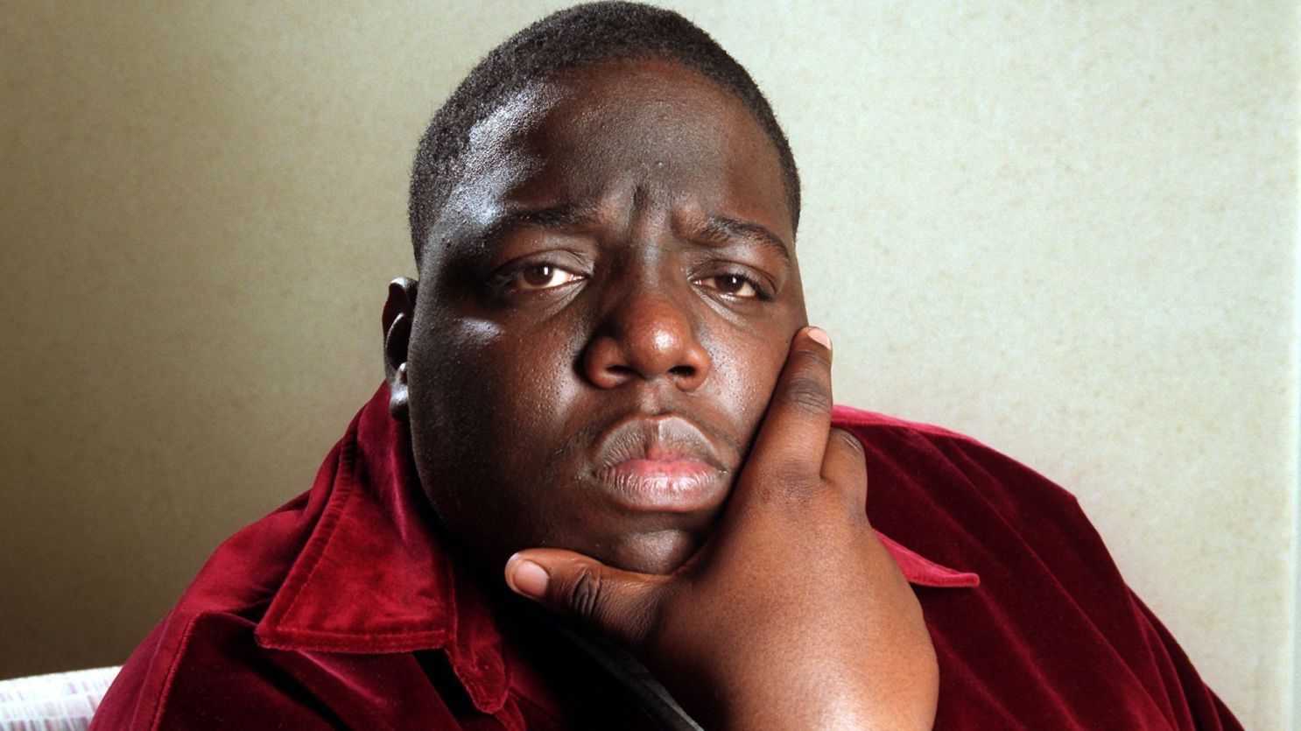
“It was all a dream, I used to read [word2vec] magazine; [skip-gram] and [CBOW] up in the limousine”
— Christopher Wallace

Slide 3
ANNOUNCEMENTS
Keep an eye on the HW1 Errata, posted on Ed. HW1 is due in 1 week!
We now have a Slack workspace, mostly for lively discussion and research work
Ed is still our main forum for all official communication, questions you may have, and remote Quizzes.
Office Hours change a little:
Mon @ 1pm – 3pm Mon @ 1:30pm – 3:30pm
Sat @ 10am – 11am Sun @ 10am – 11am

Slide 4
ANNOUNCEMENTS
Research Project:
Add your ideas and name/info to Research Brainstorming spreadsheet
Phase 1 is due Sept 30. Write a 1-page proposal for one of your ideas listed on Research Brainstorming. Afterwards, we’ll refine the list to ~25 projects and determine teams.
Phase 2 is due Oct 14. This will lock-in all 20 projects and teammates.

Slide 5
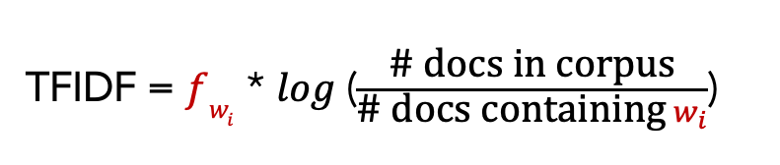
RECAP: L2
a
t
e
Default character-level representations aren’t useful
Simple document-level representations (e.g., BoW and TFIDF) can be useful but have weaknesses:
Context-insensitive (“the horse ate” = “ate the horse”)
Curse of Dimensionality (vocab could be over 100k)
Orthogonality: no concept of semantic similarity at the word-level
61
74
65
TFIDF = $fw_{i}$ * $log⁡$($\frac{\text{\# }\text{docs} \text{in} \text{corpus}}{\text{\# }\text{docs} \text{containing}{ w}_{i}}$)

Slide 6
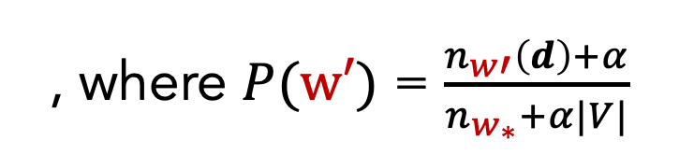
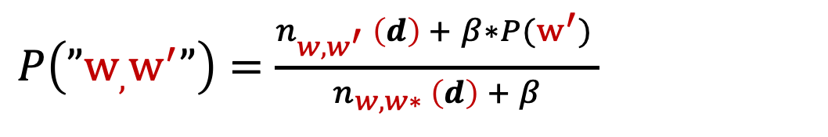
RECAP: L3
Language Modelling is a core NLP task and highly useful for many other tasks.
n-gram models (count-based) can be surprisingly useful but have weaknesses:
Must handle OOV words (all LMs must do this)
Unsustainable approach to handling increasingly larger contexts
No semantic information is conveyed by the counts (e.g., vehicle vs car)
Perplexity is the canonical evaluation metric for LMs
Bi-gram model with alpha-beta smoothing
$P\left(”w_{,}w^{′}”\right)=$ $\frac{n_{{w,w^{′}}_{ }}\left(d\right) + β∗P(w^{′}) }{n_{{w,w∗}_{ }}\left(d\right) + β}$
, where $P(w′)$ = $\frac{n_{w′}\left(d\right)+α}{n_{w_{∗}}+α|V|}$

Slide 7
Outline
Featurized, Linear Model
Neural Models
Bengio (2003)
word2vec (2013)
Evaluation
Remaining challenges

Slide 8
Outline
Featurized, Linear Model
Neural Models
Bengio (2003)
word2vec (2013)
Evaluation
Remaining challenges

Slide 9

Remaining Issues
1. More context while avoiding sparsity, storage, and compute issues
2. No semantic information conveyed by counts (e.g., vehicle vs car)
New goals!
3. Cannot leverage non-consecutive patterns
Dr. West ____
Dr. Cornell West ____
Occurred 25 times
Occurred 3 times
4. Cannot capture combinatorial signals (i.e., non-linear prediction)
P(Chef cooked food)
high
P(Customer cooked food)
low
low
P(Chef ate food)
P(Customer ate food)
high
Slide adapted from or inspired by Graham Neubig’s CMU NLP 2021
Notes:
The last point is the biggest goal, as it kind of hinges on both 1, 2, and ideally 3, too. N-gram’s only chance of capturing 4 is if “n” is large enough and if it’s seen the exact sequence plenty of times before. It’s not leveraging any interesting, non-linear patterns. It’s just memorizing.

Slide 10
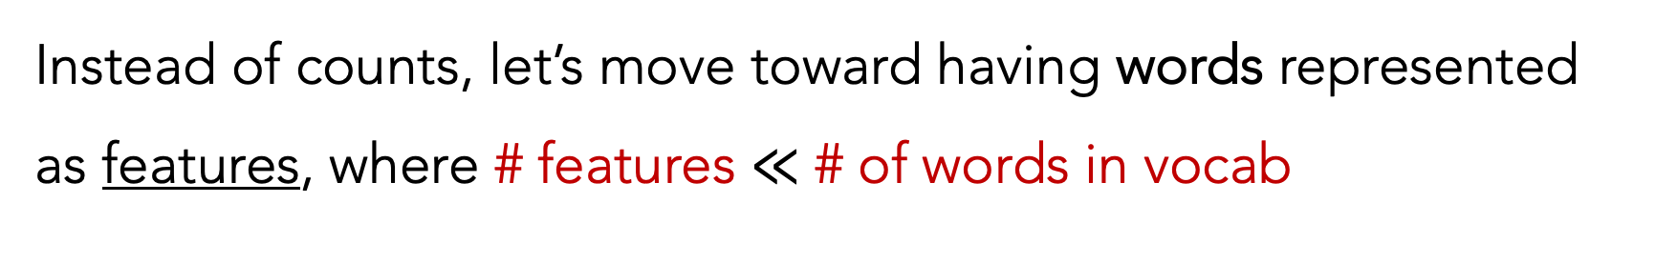
Featurized Model
Instead of counts, let’s move toward having words represented as features, where # features $≪$ # of words in vocab
We can develop a very simple linear model that calculates word probabilities
Slide adapted from or inspired by Graham Neubig’s CMU NLP 2021
Notes:
Since our vocabulary can grow large and we don’t want sparse representation, it’s natural that the size of our features should be much less than the vocab size

Slide 11
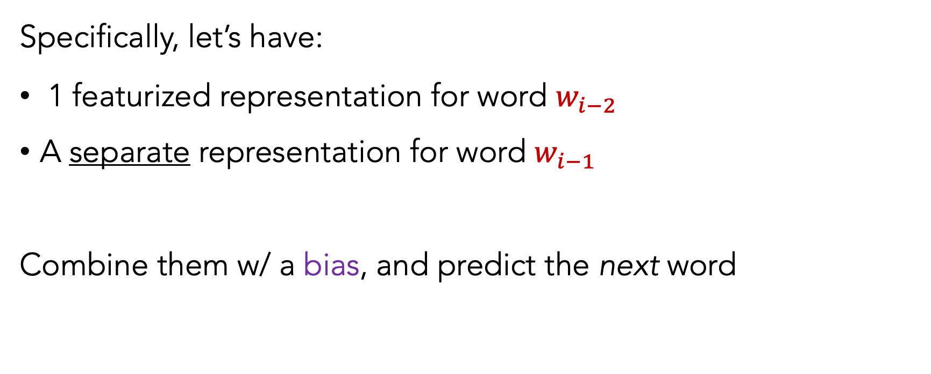
Featurized Model
Specifically, let’s have:
1 featurized representation for word $w_{i−2}$
A separate representation for word $w_{i−1}$
Combine them w/ a bias, and predict the next word
Slide adapted from or inspired by Graham Neubig’s CMU NLP 2021
Notes:
Since our vocabulary can grow large and we don’t want sparse representation, it’s natural that the size of our features should be much less than the vocab size

Slide 12





Featurized Model
”passing a _____”
$$w_{i−2}$$
$$w_{i−1}$$
$$w_{i}$$
Vx1
Vx1
Vx1
Vx1
Vx1
quiz
ball
car
kidney
..
..
+
+
=
softmax
=
bias
raw scores
word probs
Lookup table($w_{i−2}$)
Lookup table($w_{i−1}$)
passing
a
Slide adapted from or inspired by Graham Neubig’s CMU NLP 2021

Slide 13
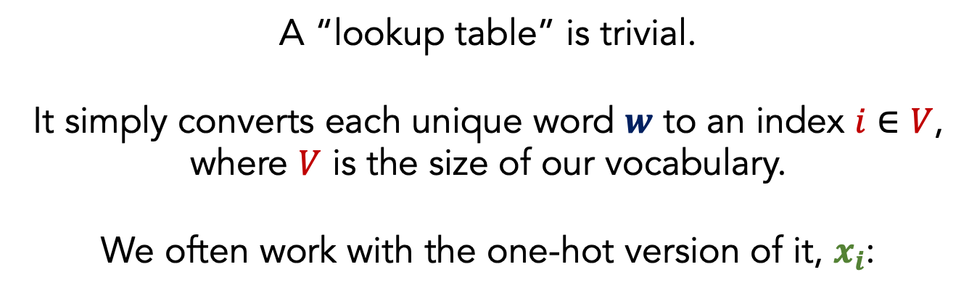


Featurized Model
”passing a _____”
A “lookup table” is trivial.
It simply converts each unique word $w$ to an index $i∈V$, where $V$ is the size of our vocabulary.
We often work with the one-hot version of it, $x_{i}$:
$$w_{i−2}$$
$$w_{i−2}$$
$$w_{i}$$
$$w_{i−1}$$
$$w_{i}$$
$$w_{i−1}$$
Vx1
Vx1
Vx1
Vx1
Vx1
Vx1
Vx1
Vx1
Vx1
Vx1
quiz
ball
car
kidney
..
..
+
+
+
=
=
softmax
=
=
+
softmax
Vx1
bias
raw scores
word probs
$$x_{i}$$
Lookup table($w_{i−2}$)
Lookup table_{i-1}($w_{i−1}$)
passing
a
Slide adapted from or inspired by Graham Neubig’s CMU NLP 2021

Slide 14


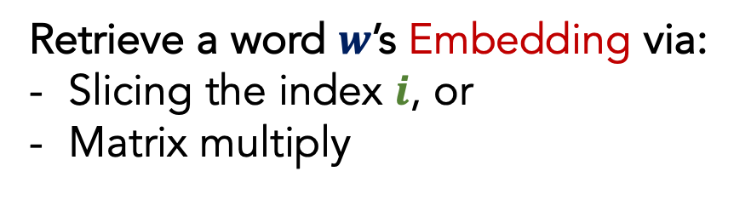
Featurized Model
”passing a _____”
Embedding/ feature matrix $ν$ is an “input word matrix”. Each column of $ν$ corresponds to each unique word type $w$
$$w_{i−2}$$
$$w_{i−2}$$
$$w_{i}$$
$$w_{i−1}$$
$$w_{i}$$
$$w_{i−1}$$
Retrieve a word $w$’s Embedding via:
Slicing the index $i$, or
Matrix multiply
Vx1
Vx1
Vx1
Vx1
Vx1
vector size N
Vx1
Vx1
Vx1
Vx1
Vx1
quiz
ball
car
kidney
..
..
+
+
+
=
=
softmax
=
=
+
$$vi=νx_{i}$$
softmax
# word types
bias
raw scores
word probs
Lookup table($w_{i−2}$)
Lookup table($w_{i−1}$)
passing
a
Slide adapted from or inspired by Graham Neubig’s CMU NLP 2021

Slide 15


Featurized Model
”passing a _____”
Embedding/ feature matrix $ν$ is an “input word matrix”. Each column of $ν$ corresponds to each unique word type $w$
$$w_{i−2}$$
$$w_{i−2}$$
$$w_{i}$$
$$w_{i−1}$$
$$w_{i}$$
$$w_{i−1}$$
Retrieve a word $w$’s Embedding via:
Slicing the index $i$, or
Matrix multiply
Vx1
Vx1
Vx1
Vx1
Vx1
vector size N
Vx1
Vx1
Vx1
Vx1
Vx1
quiz
ball
car
kidney
..
..
+
+
+
=
=
softmax
=
=
+
$$vi=νx_{i}$$
softmax
# word types
Nx1
$$=$$
NxV * Vx1
bias
raw scores
word probs
Lookup table_{i-2}($w_{i−2}$)
Lookup table_{i-1}($w_{i−1}$)
passing
a
Slide adapted from or inspired by Graham Neubig’s CMU NLP 2021

Slide 16
Featurized Model
”passing a _____”
$$w_{i−2}$$
$$w_{i−1}$$
$$w_{i}$$
Vx1
Vx1
Vx1
Vx1
Vx1
quiz
ball
car
kidney
..
..
+
+
=
softmax
=
bias
raw scores
word probs
Lookup table($w_{i−2}$)
Lookup table($w_{i−1}$)
passing
a
Slide adapted from or inspired by Graham Neubig’s CMU NLP 2021

Slide 17
Featurized Model
”passing a _____”
$$w_{i−2}$$
$$w_{i−1}$$
$$w_{i}$$
These are the only 3 components of our model.
Vx1
Vx1
Vx1
Vx1
Vx1
quiz
ball
car
kidney
..
..
+
+
=
softmax
=
bias
raw scores
word probs
Lookup table($w_{i−2}$)
Lookup table($w_{i−1}$)
passing
a

Slide 18
Featurized Model
”passing a _____”
$$w_{i−2}$$
$$w_{i−1}$$
$$w_{i}$$
We know that each word vector $x_{i}$ is selected from its larger matrix:
Vx1
Vx1
Vx1
Vx1
Vx1
VxV
quiz
ball
car
kidney
..
..
+
+
=
softmax
=
passing
bias
raw scores
word probs
Lookup table($w_{i−2}$)
Lookup table($w_{i−1}$)
VxV
passing
a
a

Slide 19
Featurized Model
”passing a _____”
$$w_{i−2}$$
$$w_{i−1}$$
$$w_{i}$$
How we do train a model to learn these 2 matrices, and the bias vector?
Vx1
Vx1
Vx1
Vx1
Vx1
VxV
quiz
ball
car
kidney
..
..
+
+
=
softmax
=
passing
bias
raw scores
word probs
Lookup table($w_{i−2}$)
Lookup table($w_{i−1}$)
VxV
passing
a
a

Slide 20
Featurized Model
Train the model using gradient descent:
Use our output probabilities
Calculate the cross-entropy loss
Use backprop to calculate gradients
Update the 2 embedding matrices and bias via GD

Slide 21
Featurized Model
What does it mean to “update” these Embedding matrices? How? Where are the weights?!
See chalkboard for details.

Slide 22
Unknown Words
We still need to handle UNK words. Always.
Language is always evolving
Zipfian distribution
Larger vocabularies require more memory and compute time
How can we handle UNK words in a neural model?

Slide 23
Unknown Words
Common ways to amend the data:
Frequency threshold (e.g., UNK <= 2)
Remove bottom N%
Represent each word as sub-words (e.g., byte-pair encodings)
Common neural modelling approaches:
Add an UNK token to your vocabulary (just like for n-grams)

Slide 24
Evaluation
Very Important:
Any given LM must be able to generate the test set (at least). Otherwise, it cannot be fairly evaluated (OOV problem).
When comparing multiple LMs to each other, their vocabularies must be the same (e.g., words, sub-words, characters).
Slide adapted from or inspired by Graham Neubig’s CMU NLP 2021

Slide 25

Remaining Issues
1. More context while avoiding sparsity, storage, and compute issues
2. No semantic information conveyed by counts (e.g., vehicle vs car)
New goals!
3. Cannot leverage non-consecutive patterns
Dr. West ____
Dr. Cornell West ____
Occurred 25 times
Occurred 3 times
4. Cannot capture combinatorial signals (i.e., non-linear prediction)
P(Chef cooked food)
high
P(Customer cooked food)
low
low
P(Chef ate food)
P(Customer ate food)
high
Slide adapted from or inspired by Graham Neubig’s CMU NLP 2021
Notes:
Linear models obviously can’t handle feature combinations. The feature space would explode if we allowed all combinations of indices

Slide 26
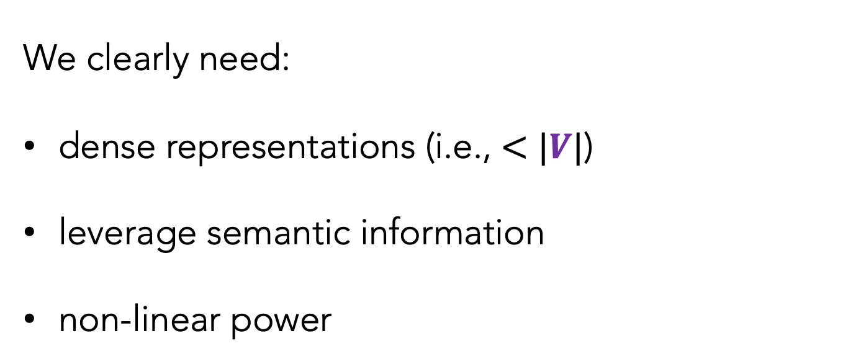
We clearly need:
dense representations (i.e., $<$ $|V|$)
leverage semantic information
non-linear power
Neural models, here we come!

Slide 27
Outline
Featurized, Linear Model
Neural Models
Bengio (2003)
word2vec (2013)
Evaluation
Remaining challenges

Slide 28
Outline
Featurized, Linear Model
Neural Models
Bengio (2003)
word2vec (2013)
Evaluation
Remaining challenges

Slide 29
Neural Network Motivation
Non-linear power: using non-linear activation functions can allow us to capture rich, combinatorial attributes of language

Slide 30
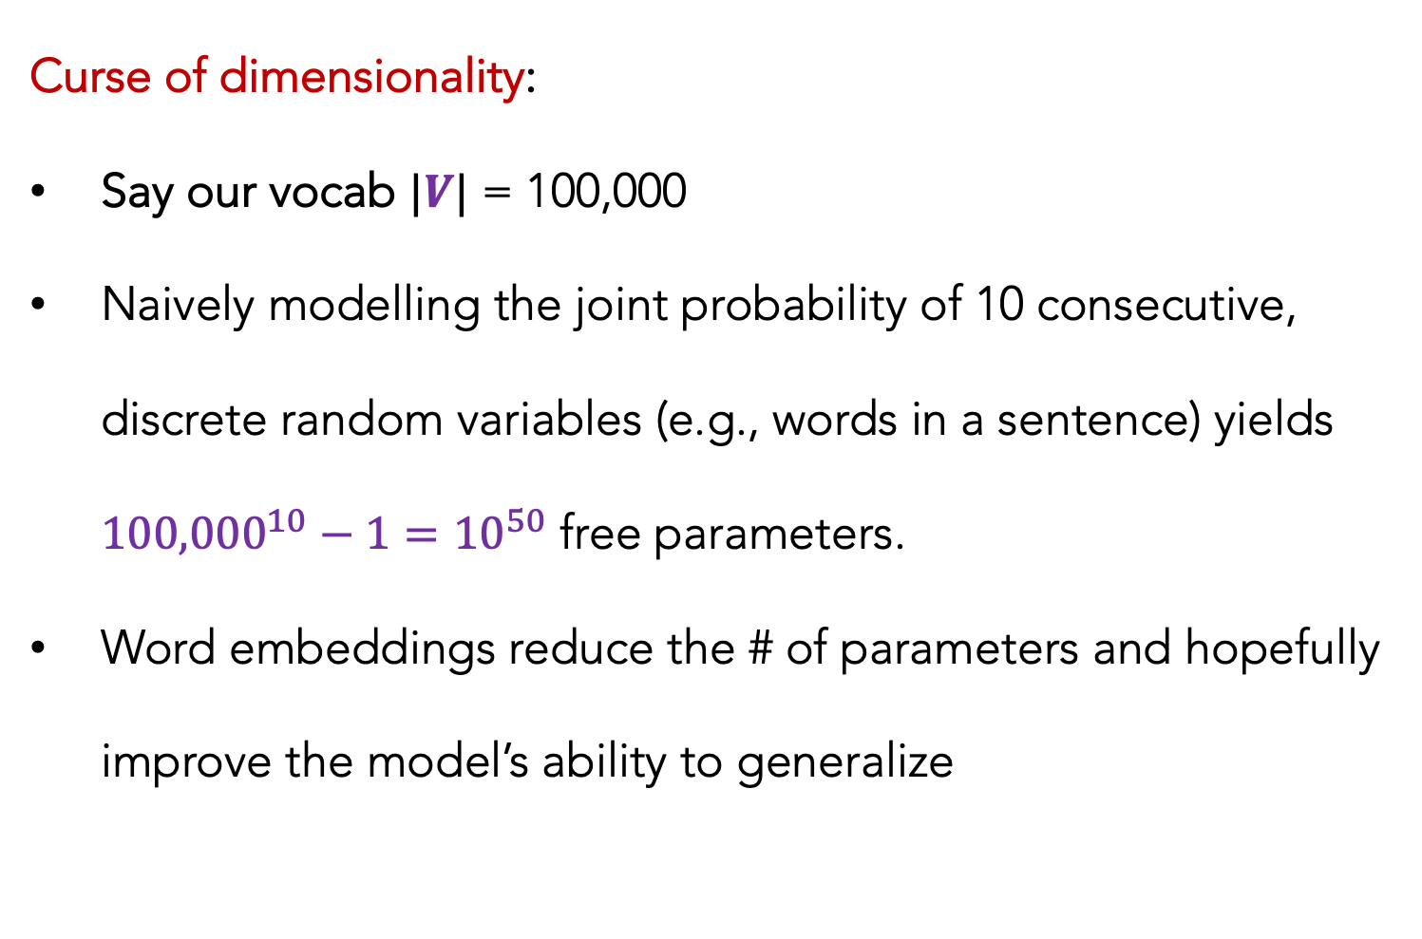
Neural Network Motivation
Curse of dimensionality:
Say our vocab $|V|$ = 100,000
Naively modelling the joint probability of 10 consecutive, discrete random variables (e.g., words in a sentence) yields ${100,000}^{10}−1={10}^{50}$ free parameters.
Word embeddings reduce the # of parameters and hopefully improve the model’s ability to generalize
Slide adapted from or inspired by Ryan Cotterell ETH-Zurich 2021

Slide 31
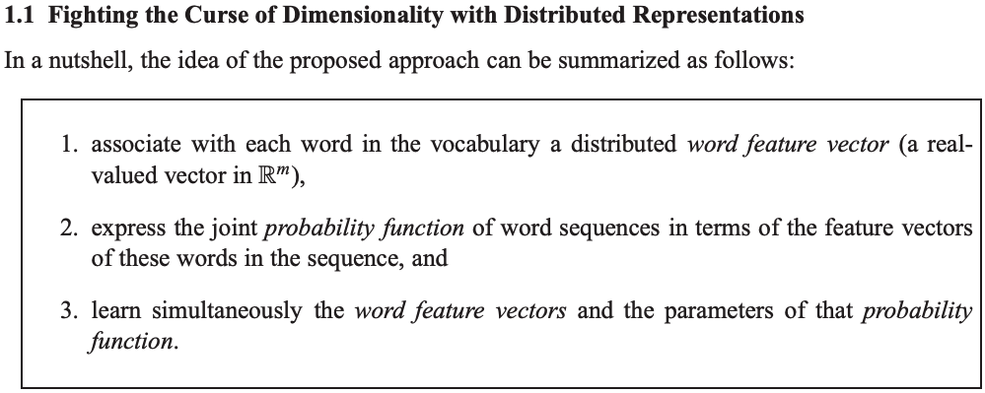
Bengio (2003)
A Neural Probabilistic Language Model. Bengio et al. JMLR (2003)

Slide 32
Bengio (2003)
A Neural Probabilistic Language Model. Bengio et al. JMLR (2003)

Slide 33
Bengio (2003)
Simultaneously learn the representation and do the modelling!
man
woman
table

Slide 34
Bengio (2003)
Simultaneously learn the representation and do the modelling!
Each circle is a specific floating point scalar
Words that are more semantically similar to one another will have embeddings that are proportionally similar, too
man
woman
table

Slide 35
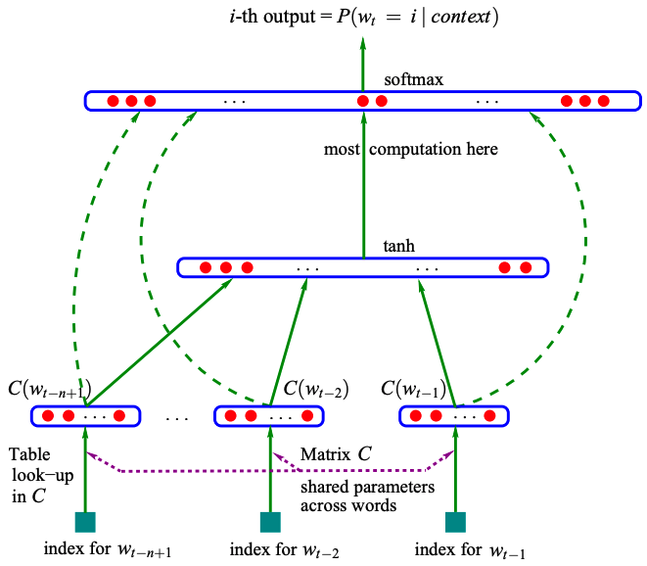



Bengio (2003)
$$y=b+Wx\text{ +}U\text{tanh}(d+Hx)$$
$$x=[C\left(w_{t−3}\right),C\left(w_{t−2}\right),C\left(w_{t−1}\right)]$$
$$θ=\{b, W,U,d,H,C\}$$

Slide 36

Bengio (2003)
$$y=b+Wx\text{ +}U\text{tanh}(d+Hx)$$
$$x=[C\left(w_{t−3}\right),C\left(w_{t−2}\right),C\left(w_{t−1}\right)]$$
$$θ=\{b, W,U,d,H,C\}$$
predict the most likely word w, via softmax

Slide 37

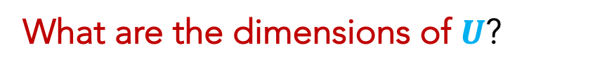



Bengio (2003)
$$y=b+Wx\text{ +}U\text{tanh}(d+Hx)$$
$$U$$
$$x=[C\left(w_{t−3}\right),C\left(w_{t−2}\right),C\left(w_{t−1}\right)]$$
$$θ=\{b, W,U,d,H,C\}$$
h x 1
$$H$$
h x 3m
What are the dimensions of $U$?
$$x$$
3m x 1
$$C$$
m x V

Slide 38
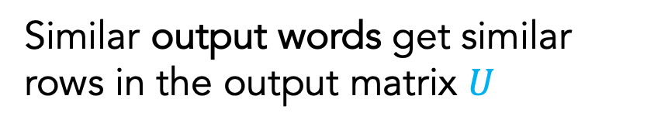
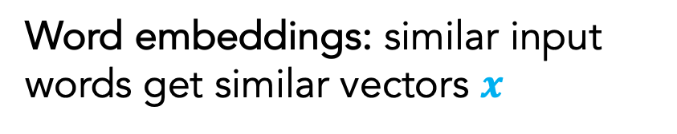
Bengio (2003)
Word embeddings: similar input words get similar vectors $x$
$$y=b+Wx\text{ +}U\text{tanh}(d+Hx)$$
$$U$$
$$x=[C\left(w_{t−3}\right),C\left(w_{t−2}\right),C\left(w_{t−1}\right)]$$
Similar contexts get similar hidden states
$$θ=\{b, W,U,d,H,C\}$$
h x 1
Similar output words get similar rows in the output matrix $U$
$$H$$
h x 3m
$$x$$
3m x 1
$$C$$
m x V
Slide adapted from or inspired by Graham Neubig’s CMU NLP 2021

Slide 39
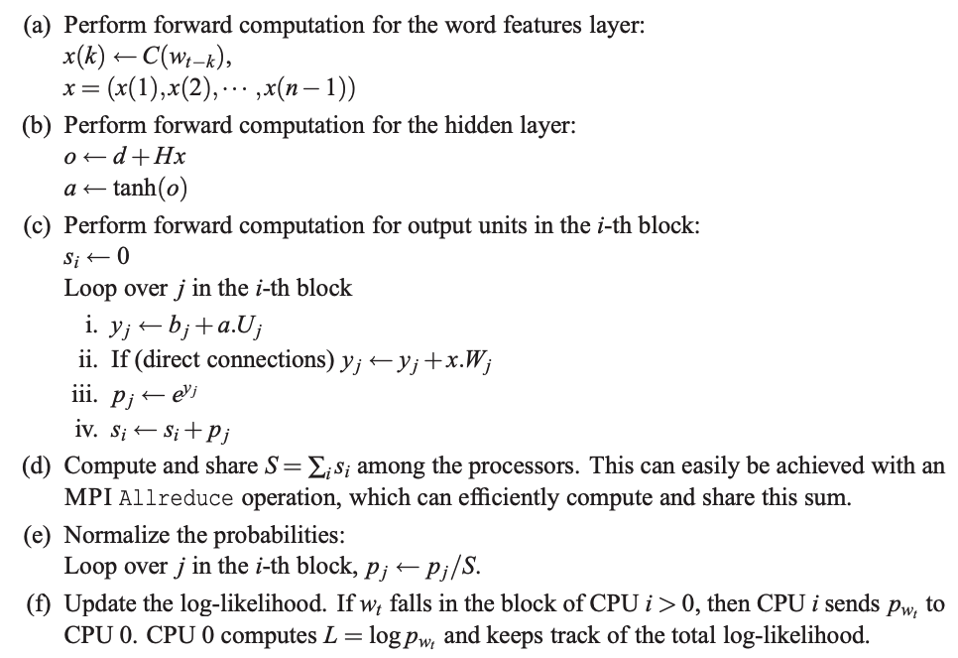
Bengio (2003)
FORWARD PASS

Slide 40
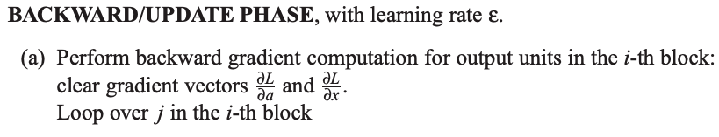
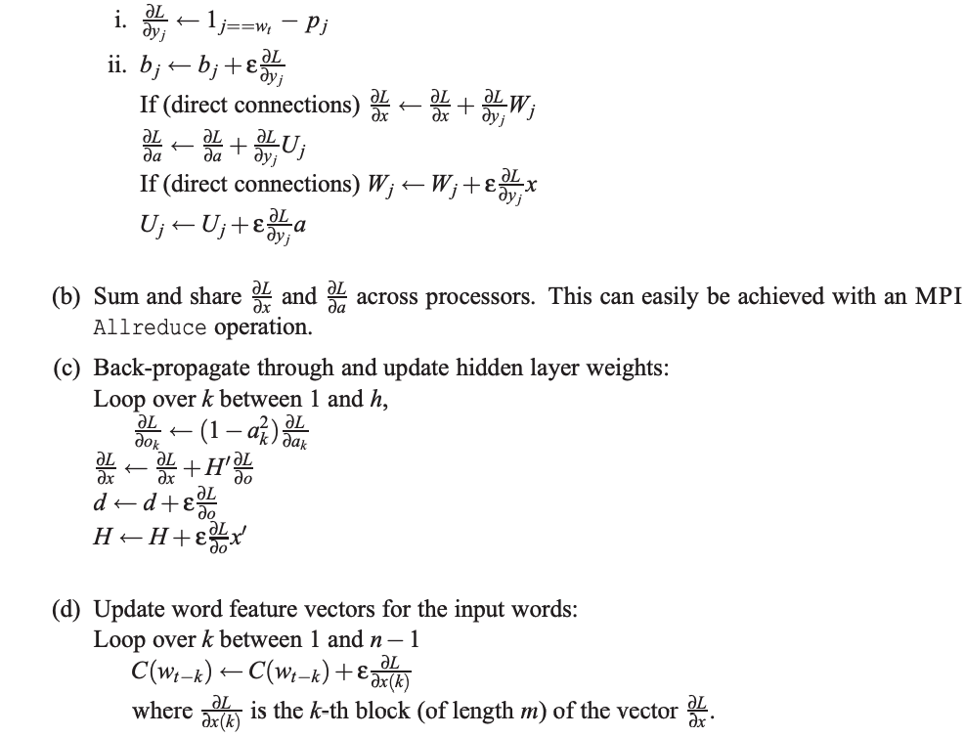
Bengio (2003)
BACKWARD PASS

Slide 41
Bengio (2003)
Train the model using gradient descent:
Use our output probabilities
Calculate the cross-entropy loss
Use backprop to calculate gradients
Update all weight matrices and bias via GD
SAME AS WE DO FOR ALL OF OUR NEURAL NETS

Slide 42
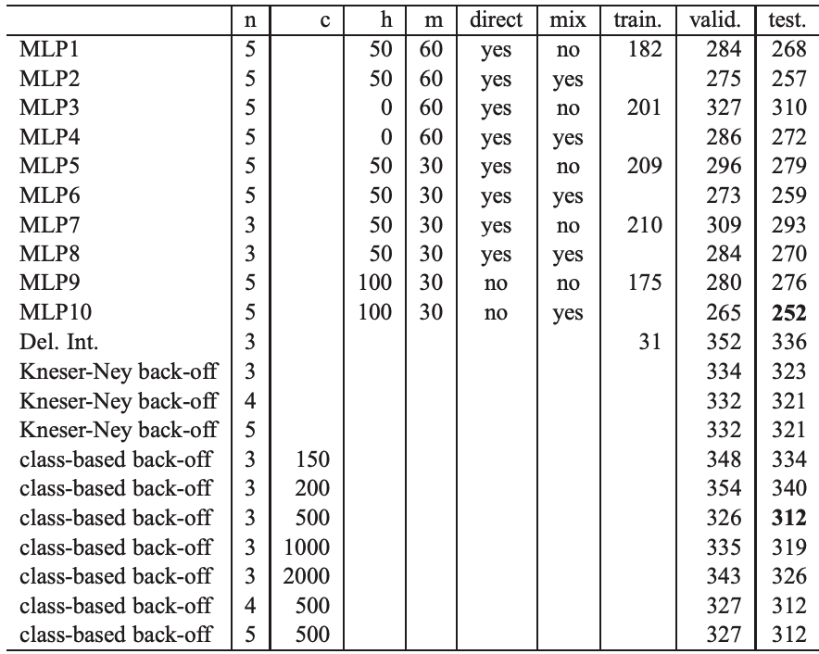
Bengio (2003)
RESULTS

Slide 43
Bengio (2003) Remaining Issues
1. More context while avoiding sparsity, storage, and compute issues
2. No semantic information conveyed by counts (e.g., vehicle vs car)
New goals!
3. Cannot leverage non-consecutive patterns
Dr. West ____
Dr. Cornell West ____
Occurred 25 times
Occurred 3 times
4. Cannot capture combinatorial signals (i.e., non-linear prediction)
P(Chef cooked food)
high
P(Customer cooked food)
low
low
P(Chef ate food)
P(Customer ate food)
high
Slide adapted from or inspired by Graham Neubig’s CMU NLP 2021

Slide 44
Bengio (2003) Remaining Issues
This was not the first neural language model, but it was the first, highly compelling model with great results (e.g., beating n-grams)
The softmax output layer is annoyingly slow

Slide 45
Outline
Featurized, Linear Model
Neural Models
Bengio (2003)
word2vec (2013)
Evaluation
Remaining challenges

Slide 46
Outline
Featurized, Linear Model
Neural Models
Bengio (2003)
word2vec (2013)
Evaluation
Remaining challenges

Slide 47
Distributional Semantics
Distributional: meaning is represented by the contexts in which its used
“Distributional statements can cover all of the material of a language without requiring support from other types of information”
-- Zellig Harris. Distributional Structure. (1954)
“You shall know a word by the company it keeps”
-- John Rupert Firth. A Synopsis of Linguistics Theory. (1957)

Slide 48
Auto-regressive language models
I bought a _____
Good morning, _____
I got my ______

Slide 49
Masked language models
I bought a _____ from the bakery
Good morning, _____. Rise and shine!
I got my ______ license last week

Slide 50
word2vec
Two approaches:
Continuous Bag-of-Words (CBOW)
Skip-gram w/ negative sampling

Slide 51
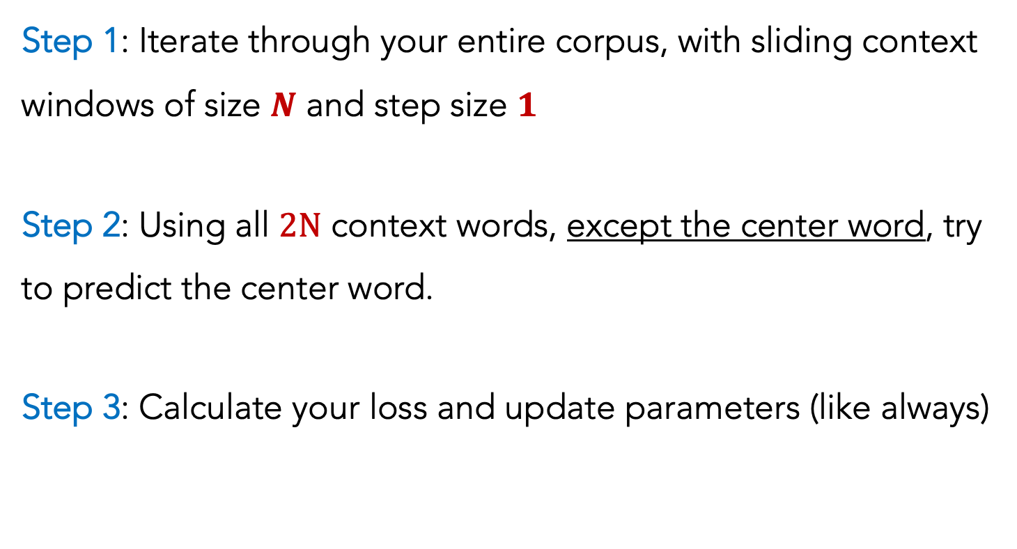
word2vec: CBOW
Step 1: Iterate through your entire corpus, with sliding context windows of size $N$ and step size $1$
Step 2: Using all $2N$ context words, except the center word, try to predict the center word.
Step 3: Calculate your loss and update parameters (like always)

Slide 52
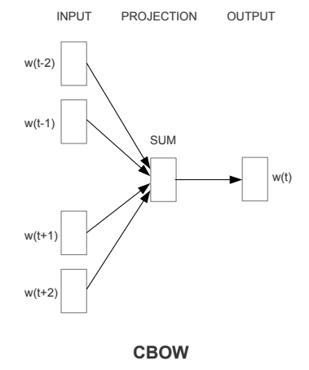
word2vec: CBOW

Slide 53


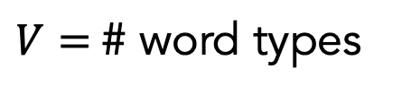

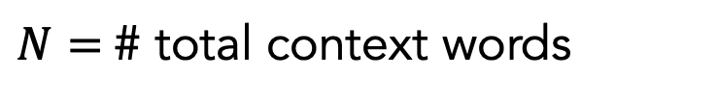
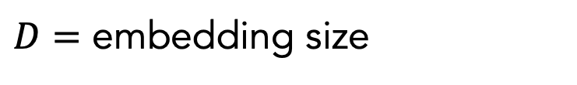


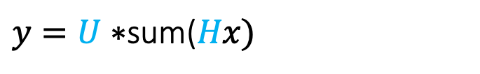

word2vec: CBOW
$y=U∗$sum($Hx\text{)}$
$$x=\left[w_{t−2},w_{t−1} ,w_{t+1} ,w_{t+2}\right]$$
$$y$$
$$U$$
$N=$# total context words
$$P$$
V x D
V x 1
$D=$ embedding size
D x 1
$$H$$
$V=$# word types
D x V
$$x$$
V x 1

Slide 54
word2vec: CBOW
Linear projection layer
Non-linear output layer (softmax)
Training in batches helps a lot

Slide 55
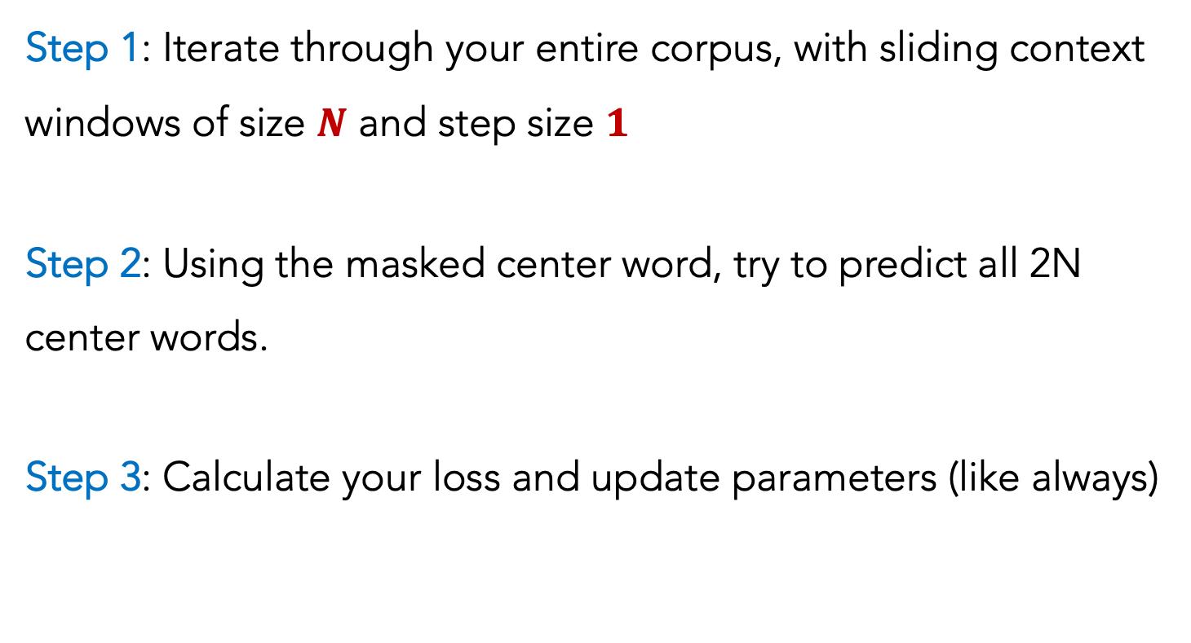
word2vec: skip-gram
Step 1: Iterate through your entire corpus, with sliding context windows of size $N$ and step size $1$
Step 2: Using the masked center word, try to predict all 2N center words.
Step 3: Calculate your loss and update parameters (like always)

Slide 56
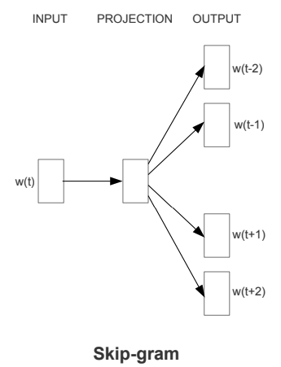
word2vec: skip-gram

Slide 57
word2vec: skip-gram
In practice, this softmax is painfully slow.
Instead, flip the modelling to be pairs of words:
e.g., (center word, context word_{i})
It would learn to always predict 1. So, probabilistically sample negative examples based on their frequencies

Slide 58
word2vec: results
Smaller window sizes yield embeddings such that high similarity scores indicates that the words are interchangeable
Larger window sizes (e.g., 15+) yield embeddings such that high similarity is more indicative of relatedness of the words.

Slide 59
word2vec: results
Words that appear in the same contexts are forced to gravitate toward having the same embeddings as one another
Imagine two words, w₁ and w₂, that never appear together, but they each, individually have the exact same contexts with other words. w₁ and w₂ will have ~identical embeddings!
“The” appears the most. What do you imagine its embedding is like?

Slide 60
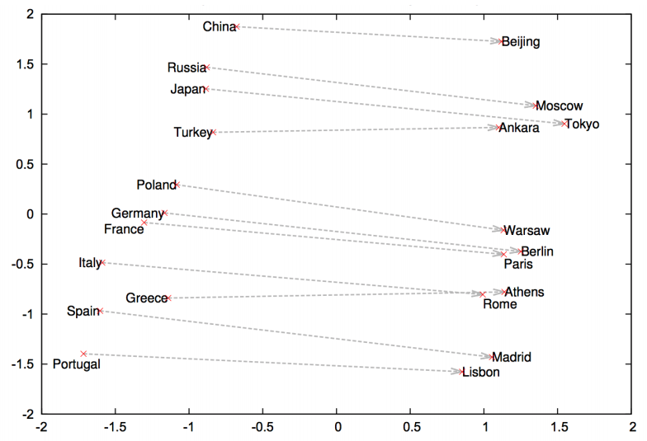
word2vec results

Slide 61
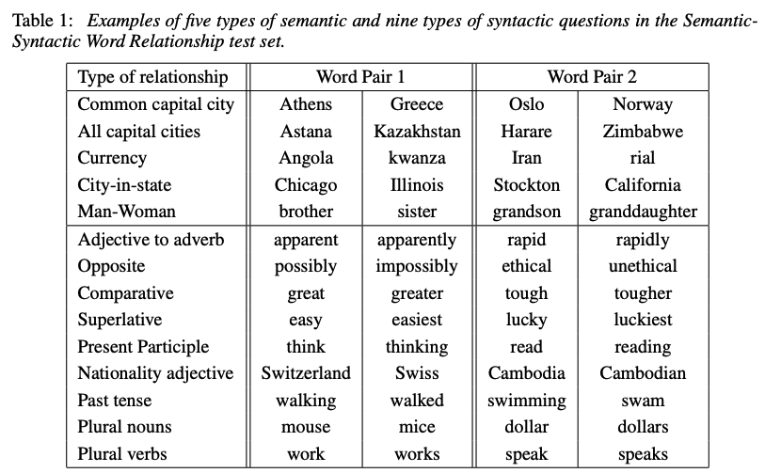

Slide 62
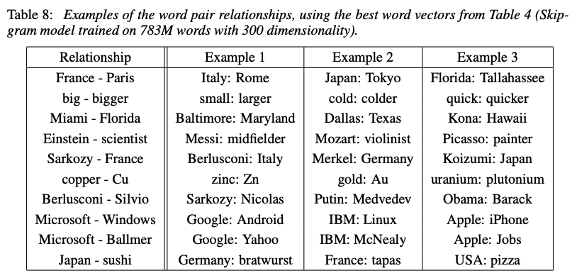

Slide 63
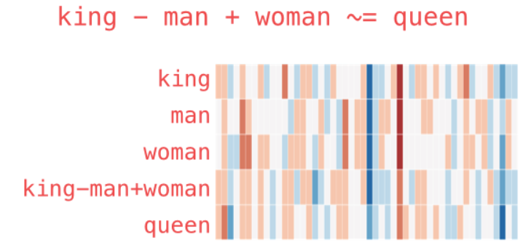
word2vec results
Incredible finding!!

Slide 64
word2vec results
Disclaimer: As a heads-up, no models create embeddings such that the dimensions actually correspond to linguistic or real-world phenomenon.
The embeddings are often really great and useful, but no single embedding (in the absence of others) is interpretable.

Slide 65
Outline
Featurized, Linear Model
Neural Models
Bengio (2003)
word2vec (2013)
Evaluation
Remaining challenges

Slide 66
Outline
Featurized, Linear Model
Neural Models
Bengio (2003)
word2vec (2013)
Evaluation
Remaining challenges

Slide 67
Evaluation
We cheated by looking ahead, so it’s unfair to measure perplexity against n-gram or other auto-regressive LM
Intrinsic evaluation:
Word similarity tasks
Word analogy tasks
Extrinsic evaluation:
Apply to downstream tasks (e.g., Natural language inference, entailment, question answering, information retrieval)

Slide 68
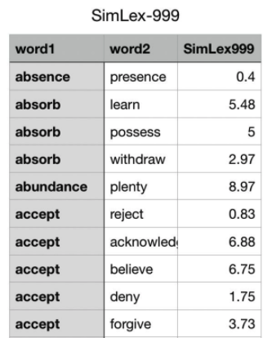
Evaluation
Word Similarity
Slide adapted from or inspired by Sam Bowman’s NYU NLP 2021

Slide 69

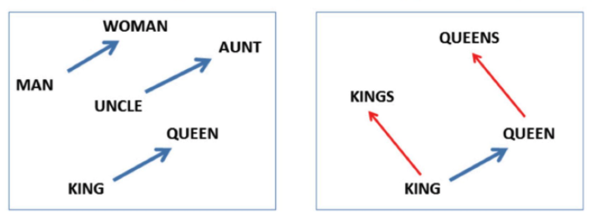
Evaluation
Word Analogy
Slide adapted from or inspired by Sam Bowman’s NYU NLP 2021

Slide 70
Outline
Featurized, Linear Model
Neural Models
Bengio (2003)
word2vec (2013)
Evaluation
Remaining challenges

Slide 71
Outline
Featurized, Linear Model
Neural Models
Bengio (2003)
word2vec (2013)
Evaluation
Remaining challenges

Slide 72
Remaining Challenges
Still can’t handle long-range dependencies.
Each decision is independent of the previous!
Having a small, fixed window that repeats is a bit forced and awkward

