Slide 1
AI Pronunciation feedback system
Phoneme-Level Mispronunciation Detection

Slide 2

Problem
Lack of specific feedback
Unclear error identification
limited corrective guidance
Learners receive overall scores but not phoneme-level correction.
Users cannot tell which sound or syllable is incorrect.
Current tools rarely explain how to fix pronunciation errors.

Slide 3
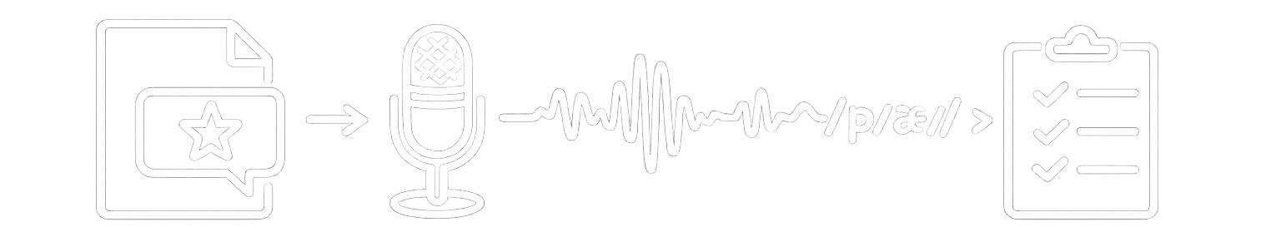
Project goal
Prompts a word
records speech
Displays a target word for the user to pronounce.
Captures the user’s spoken pronunciation through a microphone.
Detects mispronounced phonemes
Provides corrective feedback
Identifies specific sounds that differ from the correct pronunciation.
Highlights errors and suggests how to improve pronunciation.

Slide 4
Contents of this template
You can delete this slide when you’re done editing the presentation
Fonts | To view this template correctly in PowerPoint, download and install the fonts we used
Used and alternative resources | An assortment of graphic resources that are suitable for use in this presentation
Thanks slide | You must keep it so that proper credits for our design are given
Colors | All the colors used in this presentation
Icons and infographic resources | These can be used in the template, and their size and color can be edited
Editable presentation theme | You can edit the master slides easily. For more info, click here
For more info:
SLIDESGO | SLIDESGO AI TOOLS | BLOG | FAQs
You can visit our sister projects:
FREEPIK AI TOOLS | FREEPIK LIBRARY RESOURCES

Slide 5
1
Table of contents
2
3
Name of the section
You can describe the topic of the section here
Name of the section
You can describe the topic of the section here
Name of the section
You can describe the topic of the section here

Slide 6
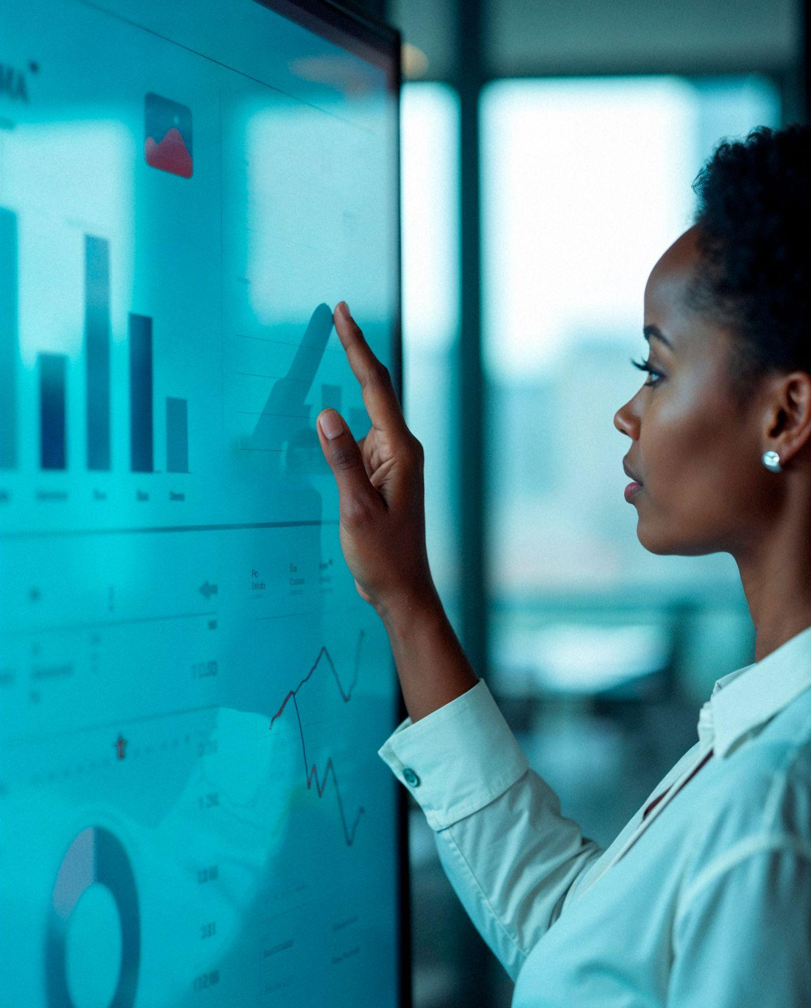
The slide title goes here!
Do you know what helps you make your point clear?
Lists like this one:
They’re simple
You can organize your ideas clearly
You’ll never forget to buy milk!
You can replace the image. Just right-click on it and select “Replace image

Slide 7
1
Name of the section
You can enter a subtitle here if you need it

Slide 8
Let’s have a look
Mercury is the closest planet to the Sun and the smallest one in the entire Solar System. This planet’s name has nothing to do with the liquid metal, since Mercury was named after the Roman messenger god.
Despite being closer to the Sun than Venus, its temperatures aren't as terribly hot as that planet’s. Its surface is quite similar to that of Earth’s Moon, which means there are a lot of craters and plains.
Speaking of craters, many of them were named after artists or authors who made significant contributions to their respective fields. Mercury takes a little more than 58 days to complete its rotation, so try to imagine how long days must be there!

Slide 9
Two ideas
Let’s take a look at Venus
Let’s learn about Mercury
Venus has a beautiful name and is the second planet from the Sun. It’s terribly hot, even hotter than Mercury, and its atmosphere is extremely poisonous
Mercury is the closest planet to the Sun and the smallest one in the Solar System. This planet’s name has nothing to do with the liquid metal

Slide 10
Three ideas
Some facts about Mercury
Discover more about Mars
Let’s take a look at Venus
Mercury is the closest planet to the Sun and the smallest one in the Solar System
Despite being red, Mars is actually a cold place. It’s full of iron oxide dust
Venus has a beautiful name and is the second planet from the Sun

Slide 11
Six different ideas
Why is Venus so unique?
Why is Jupiter so massive?
Venus has a beautiful name and is the second planet from the Sun
Jupiter is a gas giant and the biggest planet in the Solar System
Discover more about Mars
Why is Mercury so interesting?
It’s full of iron oxide dust, which gives the planet its reddish cast
It is the closest planet to the Sun and the smallest one in the Solar System
What’s special about Neptune?
Saturn and its iconic rings
It’s also the fourth-largest planet by diameter in the Solar System
It was named after the Roman god of wealth and agriculture

Slide 12
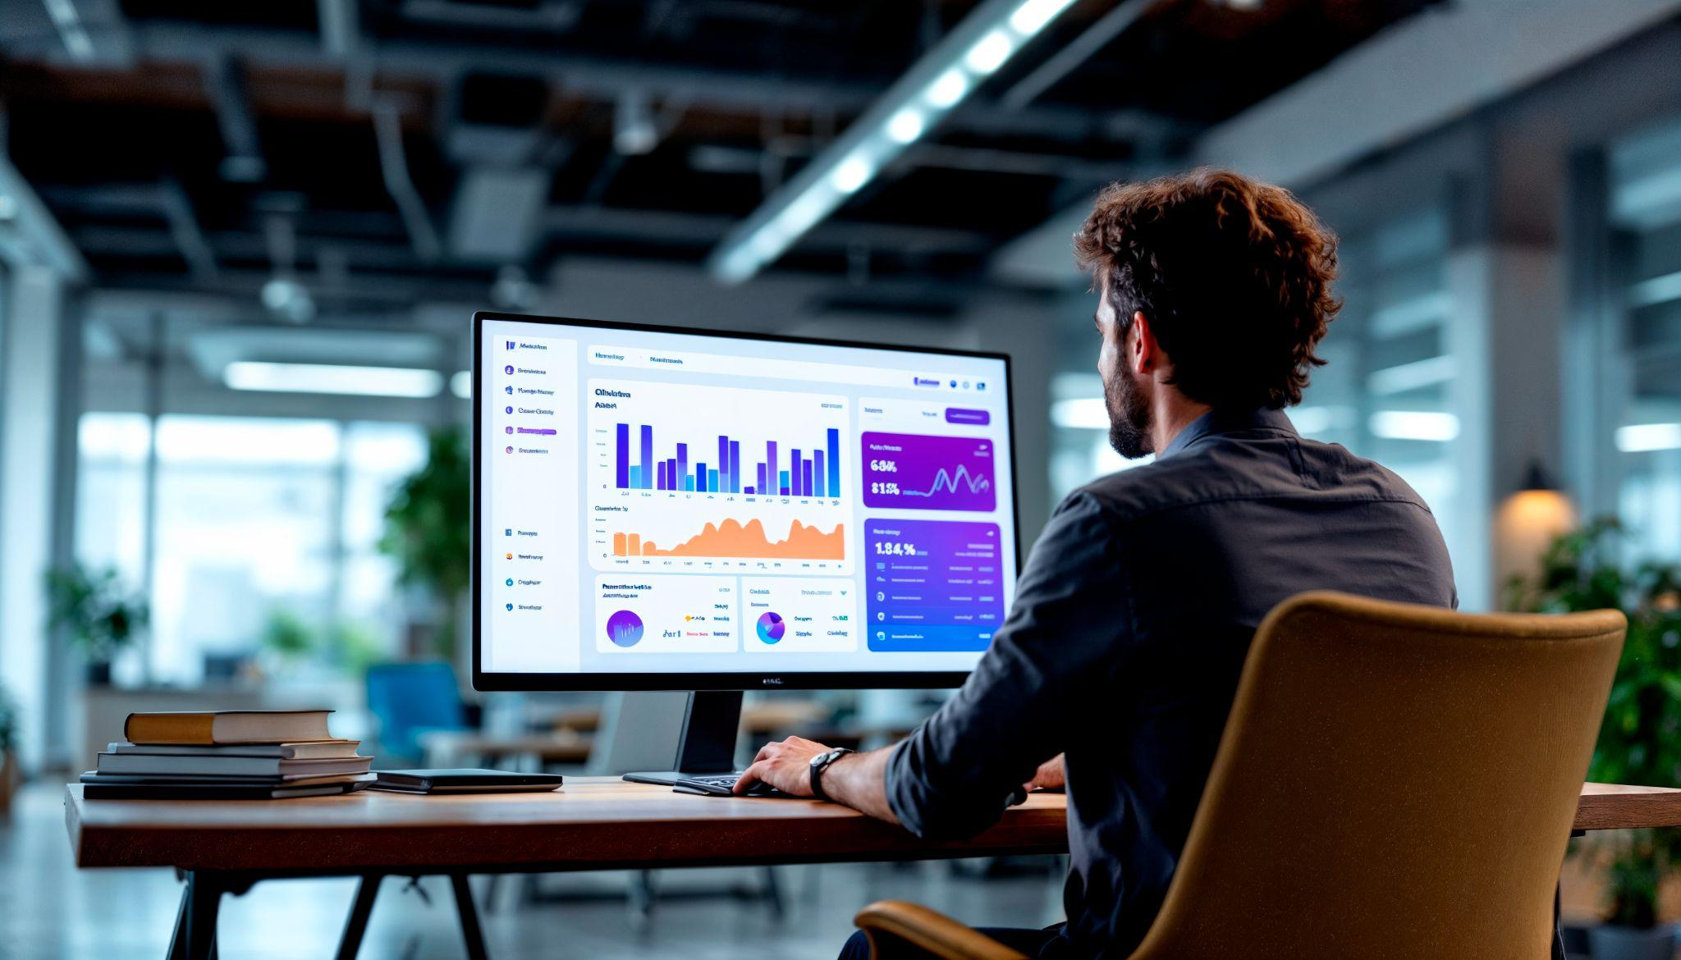
A picture is worth a thousand words

Slide 13
Our history
20xx
20xx
20xx
It’s full of iron oxide dust, which gives the planet its reddish cast
Venus has a beautiful name and is the second planet from the Sun
Earth is the third planet from the Sun and the only one that harbors life
20xx
20xx
20xx
Jupiter is a gas giant and the biggest planet in the Solar System
Mercury is the closest planet to the Sun and the smallest one
Saturn is the second-largest planet in the Solar System

Slide 14
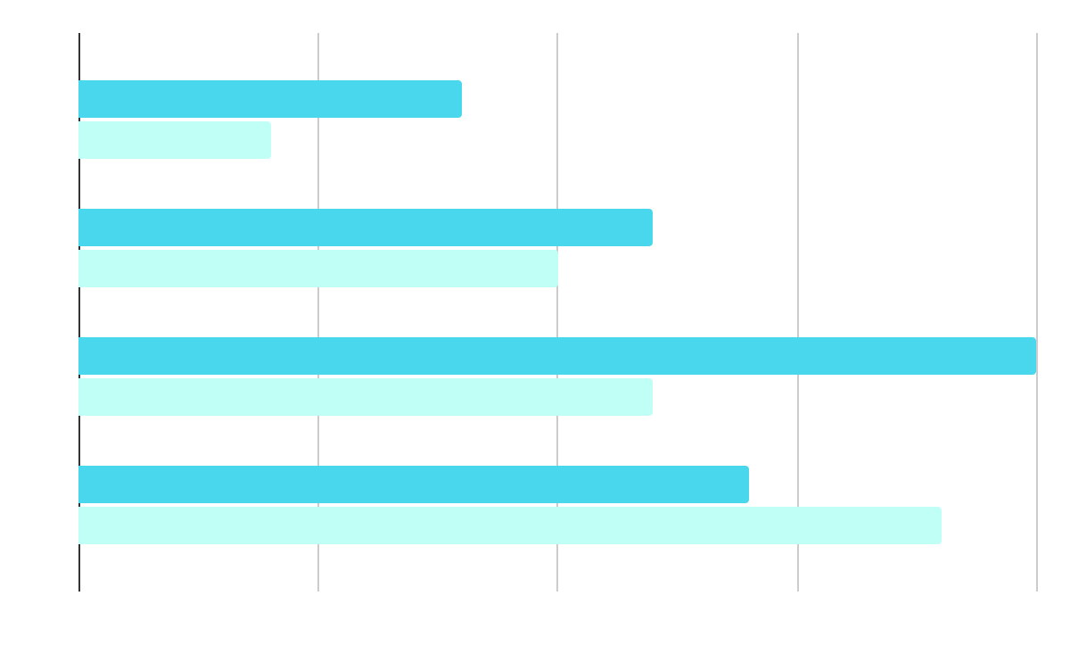
Represent your data here
Venus
Saturn
Venus is the second planet from the Sun
It is a gas giant and has several rings
Year | Venus | Saturn
q1 | $0.30 | $31.90
q2 | $3.90 | $15.40
q3 | $157.30 | $492.80
q4 | $3,368.20 | $13,929.80
Follow the link in the graph to modify its data and then paste the new one here. For more info, click here

Slide 15
333,000
386,000 km
Distance between Earth and the Moon
The Sun’s mass compared to Earth’s

Slide 16
Thanks!
Do you have any questions?
youremail@freepik.com
+34 654 321 432
yourwebsite.com
Please keep this slide for attribution

Slide 17
alternative resources
Here’s an assortment of alternative resources whose style fits that of this template:
ILLUSTRATIONS
Gradient abstract blurred covers collection

Slide 18
resources
Did you like the resources used in this template? Get them on these websites:
illustrations
Gradient abstract blurred covers collection
Photos
A man is working on a computer with a graph on the screen
Businesswoman analyzing data on a touchscreen

Slide 19
Instructions for use
If you have a free account, in order to use this template, you must credit Slidesgo by keeping the Thanks slide
As a Free user, you are allowed to:
Modify this template
Use it for both personal and commercial projects
You are not allowed to:
Sublicense, sell or rent any of Slidesgo Content
Distribute Slidesgo Content unless it has been expressly authorized by Slidesgo
Include Slidesgo Content in an online or offline database or file
Offer Slidesgo templates (or modified versions of Slidesgo templates) for download
Acquire the copyright of
Slidesgo Content
For more information about editing slides, please read our FAQs or visit our blog

Slide 20
Instructions for use (premium users)
As a Premium user, you can use this template without attributing Slidesgo or keeping the Thanks slide
You are allowed to:
Modify this template
Use it for both personal and commercial projects
Share this template in an
editable format
Hide or delete the “Thanks” slide and the mention to Slidesgo in the credits
You are not allowed to:
Sublicense, sell or rent any of Slidesgo Content
Distribute Slidesgo Content unless it has been expressly authorized by Slidesgo
Use any of the elements that are part in a separated way
Register any of the elements as a trademark or logo in an intellectual property registry
For more information about editing slides, please read our FAQs or visit our blog

Slide 21
Fonts
Colors
This presentation has been made using the following fonts:
All the colors used in this presentation
Click on the button of the link to the fonts
#ffffff
#0f0e68
#3833cb
Bebas Neue
#2a67d1
#379dd8
#47d2fb
Anek Malayalam
To view this template correctly in PowerPoint, download and install the fonts we used
#48d7ec
#bffff6

Slide 22
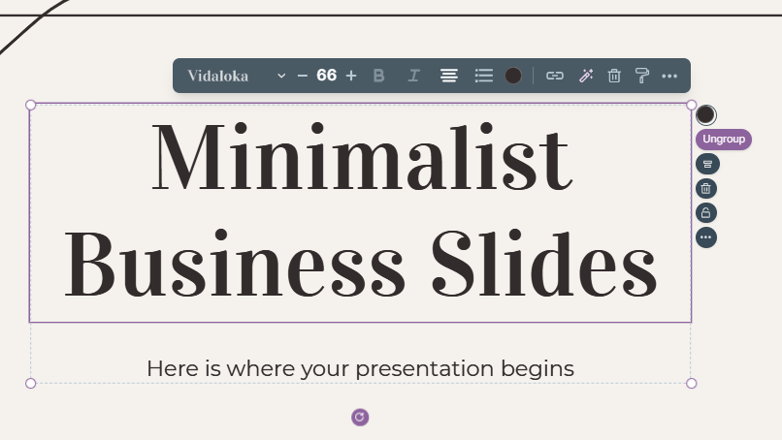
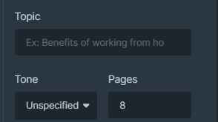
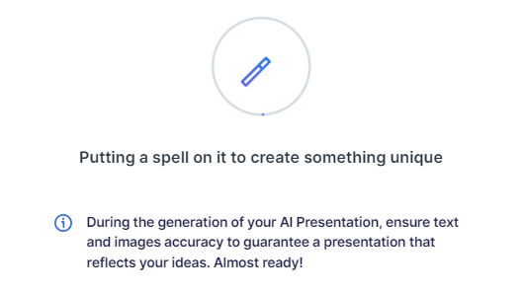
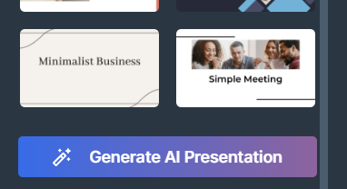
Presentation Maker
Slidesgo introduces its latest feature: the Presentation Maker. Enjoy two main functionalities - firstly, with a few clicks, create marvelous presentations with Artificial Intelligence that adapt to your needs. And it's completely free
Generate AI Presentation

Slide 23
Use our editable graphic resources...
You can easily resize these resources without losing quality. To change the color, just ungroup the resource and click on the object you want to change. You can also look for more infographics on Slidesgo

Slide 26
 | Jan | Feb | Mar | Apr | Jun
Task 1
Task 2
Task 3
 | No | Yes | Yes | No | Yes
 | Yes | No | Yes | No | Yes
 | Yes | Yes | No | Yes | No
 | Jan | Feb | Mar | Apr | Jun
Task 1
Task 2
Task 3

Slide 28
6/10 | 8/10 | 7/10 | 4/10

Slide 29
...and our sets of editable icons
You can resize these icons without losing quality
You can change the stroke and fill color; just select the icon and click on the paint bucket/pen
In Google Slides, you can also use Flaticon’s extension, allowing you to customize and add even more icons

Slide 30
Educational icons
Medical icons

Slide 31
Business icons
Teamwork icons

Slide 32
Help & support icons
Avatar icons

Slide 33
Creative process icons
Performing arts icons

Slide 34
Nature icons

Slide 35
SEO & marketing icons

Slide 36


