Slide 1
Evaluation of ZNS and FDP
Howard Huang · CS2640
Notes:
[~30 seconds] Hi everyone. Today I'm presenting my CS2640 final project: an evaluation of two next-generation NVMe storage protocols — Zoned Namespaces and Flexible Data Placement — with a focus on how they perform in real cloud database workloads. The core question I set out to answer: can these specs meaningfully reduce the write amplification that plagues log-structured systems like RocksDB and MongoDB? Let's start with the problem they're designed to solve.

Slide 2
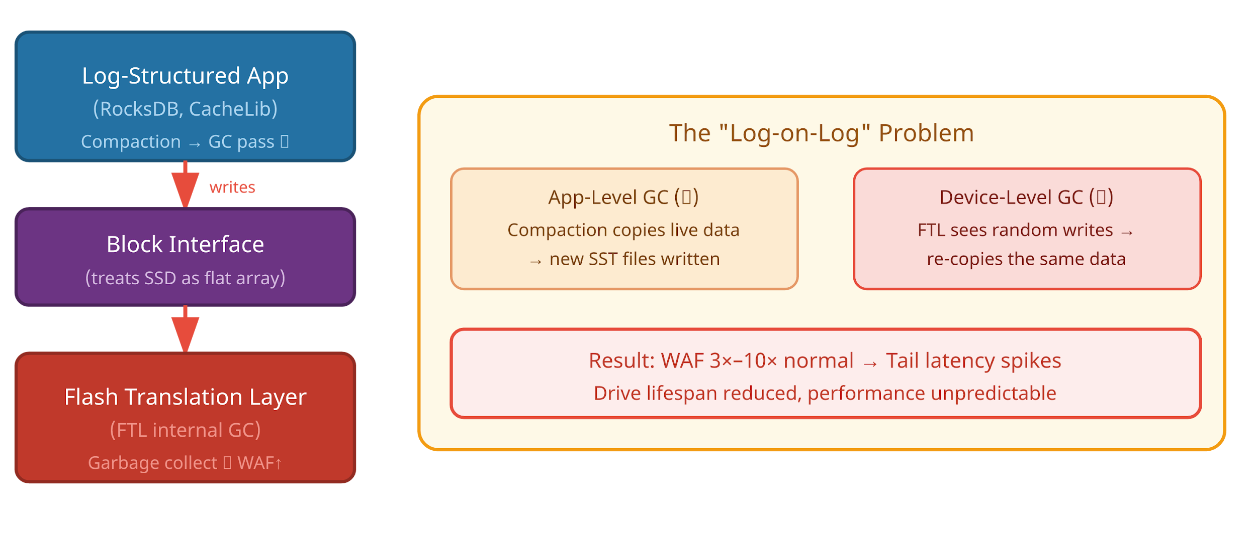
The Problem: The Semantic Gap
Legacy Block Interface Treats SSDs as uniform, updatable arrays — ignores flash physics.
NAND Reality Flash requires out-of-place writes & coarse-grained erase blocks.
Log-on-Log Problem App GC + FTL GC independently copy the same data → WAF 3-10×.
Consequence Tail latency spikes, degraded throughput, reduced drive lifespan.
Notes:
[~60 seconds] If you've worked with SSDs you've likely heard of the semantic gap. Here's the core tension. The traditional block interface treats an SSD as a flat, uniformly updatable array of sectors. But that's not how flash memory actually works. NAND requires out-of-place writes — you can't overwrite in-place — and erases happen at the coarse granularity of an entire erase block. The result for log-structured applications like RocksDB is the log-on-log problem. The app does its own compaction — moving live data into new SST files. Simultaneously, the SSD's Flash Translation Layer sees those writes as random and runs its own garbage collection pass, re-copying that same data. Two GC engines, copying the same bytes independently. Write Amplification Factors of 3x to 10x are common. That means tail latency spikes, degraded throughput, and a drive that wears out far faster than it should.

Slide 3
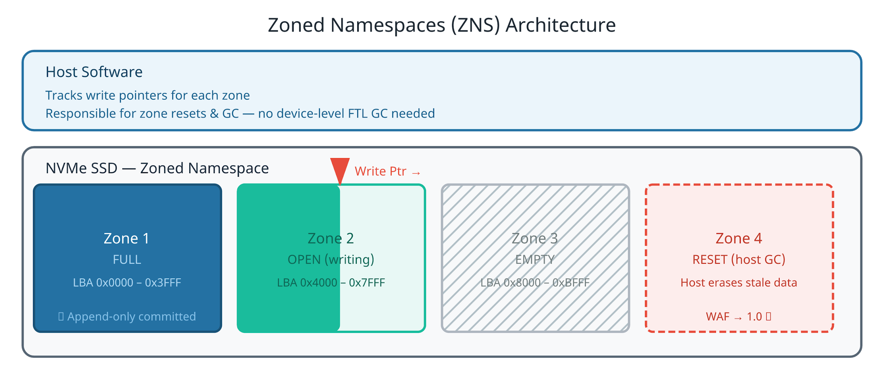
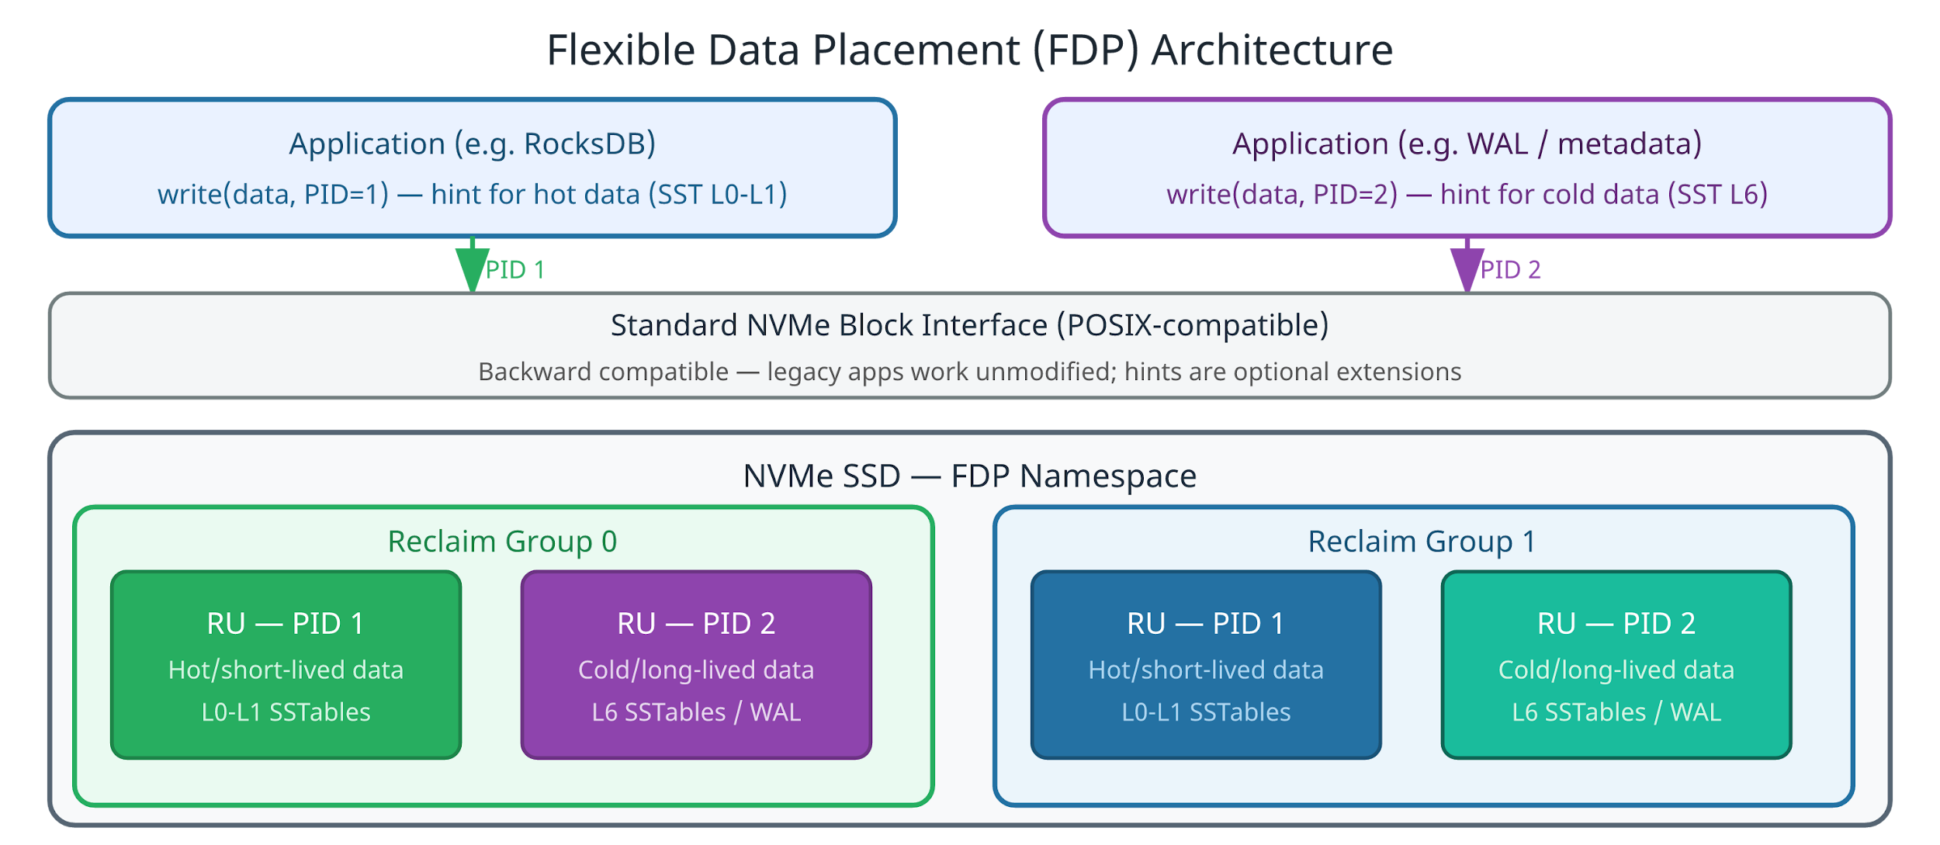
Bridging the Gap: Two Paradigms
Zoned Namespaces (ZNS)
Flexible Data Placement (FDP)
• Strict append-only zones
• Host manages Write Pointers
✓ WAF approaches 1.0 (no FTL GC)
✗ Full software rewrite required
• Maintains standard block interface
• Host passes Placement ID hints
✓ ~90% WAF reduction, zero friction
✓ Backward-compatible, POSIX-native
Notes:
[~75 seconds] Two NVMe specifications have emerged to fix this, and they represent opposite ends of the design philosophy spectrum. On the left: Zoned Namespaces, or ZNS. The drive is divided into strict append-only zones. The host software tracks a Write Pointer per zone and is entirely responsible for zone resets and garbage collection. There is literally no FTL GC happening on the device. WAF drops to exactly 1.0. That's the ceiling. The cost? You can't run ext4. Your entire software stack — filesystem, database engine — must be rewritten to understand zones. On the right: Flexible Data Placement, FDP. The block interface stays completely standard. POSIX works. ext4 works. The only addition is that writes can optionally carry a Placement Identifier hint. The drive uses that hint to group data with similar lifespans into Reclaim Units within a Reclaim Group, dramatically reducing how much garbage collection it has to do. You get roughly 90% of ZNS's WAF benefit with near-zero code changes. These diagrams show the architectural difference — ZNS at the bottom manages physical zones explicitly, while FDP layers hints on top of the existing interface.

Slide 4
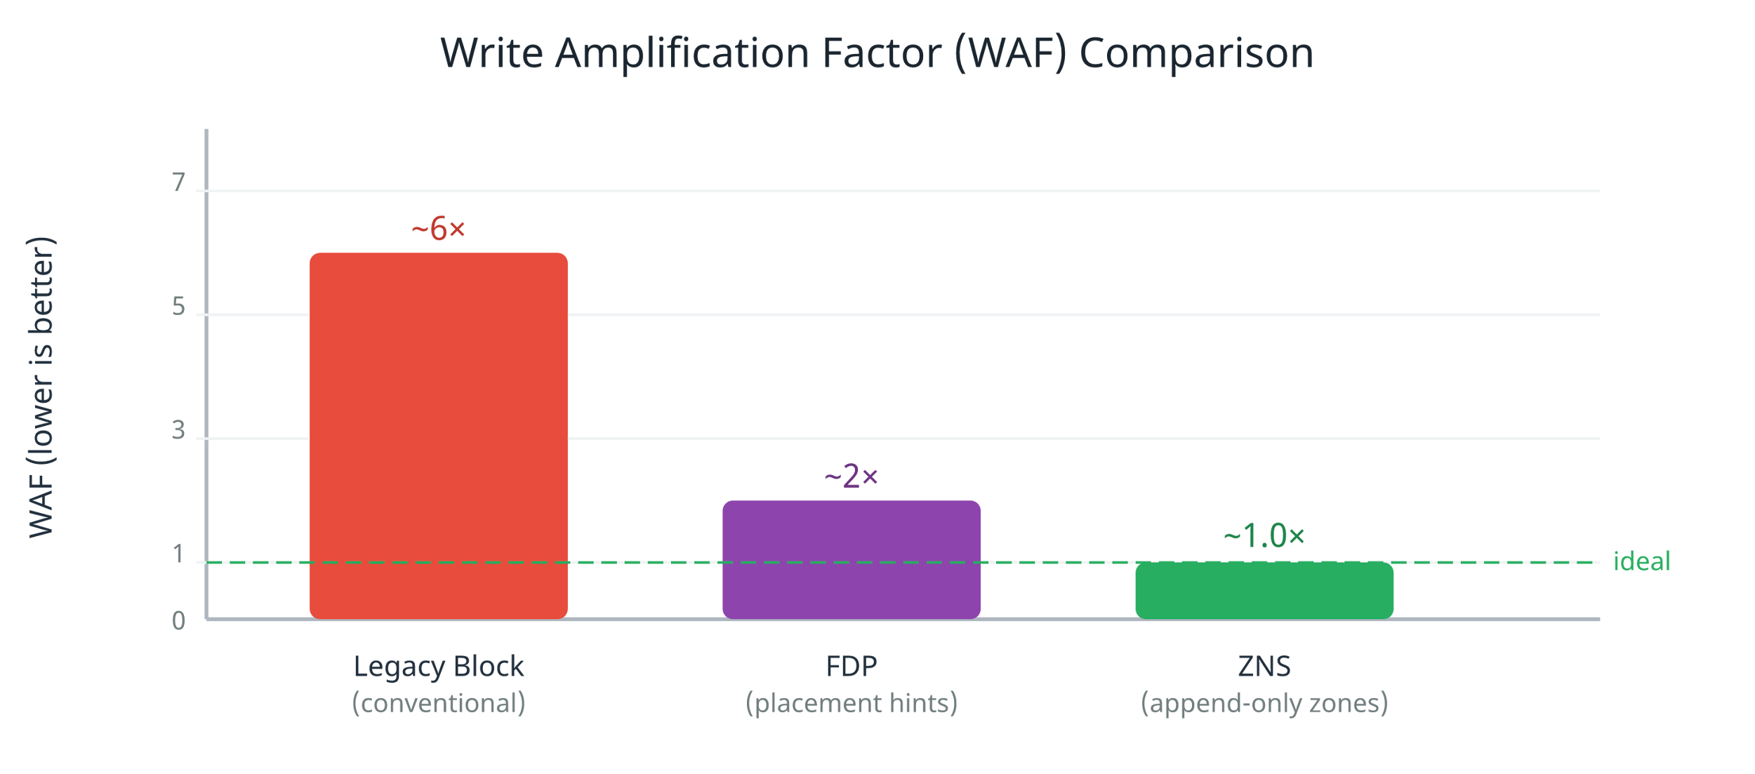
Why It Matters: Write Amplification
3×–10× Legacy WAF
~2× FDP WAF
1.0× ZNS WAF
Reducing WAF from 6× to 1× means 6× more write bandwidth
and dramatically longer SSD lifespan.
Notes:
[~45 seconds] To make the stakes concrete: look at this WAF comparison. A conventional SSD running a log-structured workload easily hits 6x write amplification. Every byte your app logically writes causes six bytes of actual flash writes. That burns through drive endurance and saturates the internal write bus. FDP brings that down to roughly 2x through lifetime-aware placement. ZNS hits the theoretical minimum of 1.0. Going from 6x to 1x means your write bandwidth is effectively 6 times larger, and your drive lasts six times longer under the same workload. That's not an academic improvement — at datacenter scale, that's tens of millions of dollars in hardware.

Slide 5
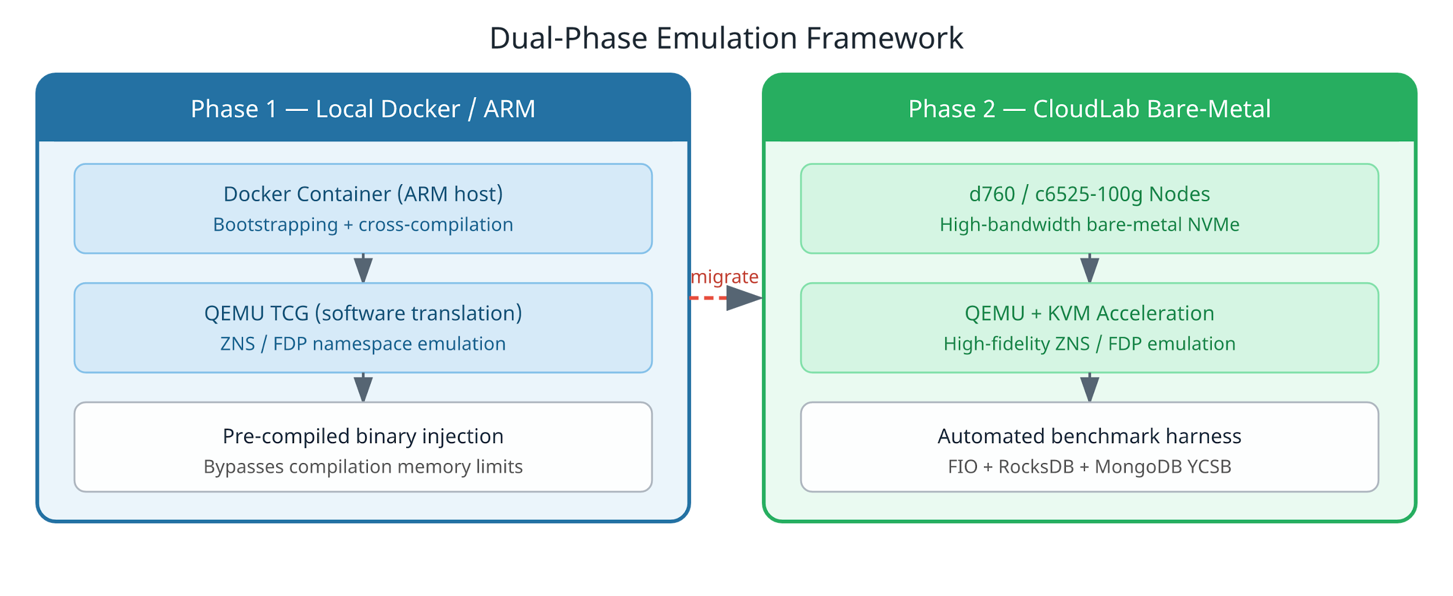
Emulation Methodology
Challenge: Physical Gen 5 SSDs with ZNS/FDP firmware are extremely scarce.
CloudLab nodes: d760 & c6525-100g — high-bandwidth NVMe with KVM acceleration for high-fidelity emulation
Notes:
[~50 seconds] The biggest practical challenge in this project wasn't the benchmarking — it was the hardware. Physical PCIe Gen 5 drives with native ZNS or FDP firmware are essentially unavailable right now. So I built a two-phase emulation pipeline. Phase one: local Docker on ARM hardware using QEMU's software translation mode — TCG. This let me bootstrap the environment and validate compilation, but TCG is slow, and I hit memory limits building large projects like RocksDB. I bypassed this by injecting pre-compiled binaries directly. Phase two: I migrated to CloudLab bare-metal nodes — specifically the d760 and c6525-100g configurations. These give real high-bandwidth NVMe for the native baseline. On top of that, I ran QEMU backed by KVM acceleration to emulate ZNS and FDP namespaces with much higher fidelity.

Slide 6
Benchmark Workloads
FIO Synthetic Traces
01
Simulates CacheLib CDN workloads using io_uring_cmd NVMe passthrough. Validates device-level WAF approaches 1.0 on ZNS.
RocksDB — db_bench
02
Key-value store benchmarks: fillseq, fillrandom, readrandom, overwrite. Stresses LSM-tree compaction and GC behavior.
MongoDB — YCSB
03
1,000,000 document records across 4 YCSB workloads (A/B/C/F). Evaluates filesystem-layer overhead under mixed read/write ratios.
Notes:
[~40 seconds] The automated test harness runs three layers of workloads. First, FIO synthetic traces modeled after Meta's CacheLib CDN traffic, using the io_uring_cmd NVMe passthrough interface. This validated that device-level WAF really does approach 1.0 on ZNS — the emulation is working correctly. Second, RocksDB's db_bench tool: sequential fills, random fills, random reads, and overwrites. These stress LSM-tree compaction and expose GC interference directly. Third, the Yahoo Cloud Serving Benchmark against MongoDB — one million document records across four workload profiles ranging from write-heavy to read-only. This is where filesystem and OS overhead matters most.

Slide 7
Results: RocksDB Throughput
Native 610k ops/sec peak on fillseq — the baseline ceiling.
ZNS +62% vs Emulated Conv — zero internal GC amplification.
FDP Bridges the gap without append-only constraints.
Notes:
[~55 seconds] The RocksDB results tell a clear story. Native NVMe, as expected, dominates — peaking at 610,000 ops per second on sequential fills. That's our ceiling, the best possible result on this hardware. The critical comparison is among the emulated namespaces. Conventional block emulation suffers from FTL GC interference. ZNS, by eliminating that entirely, outperformed conventional emulation by about 62% on fillseq. FDP sat comfortably between the two. Notice that on fillrandom and overwrite, all emulated configurations pull closer together. Random writes are inherently harder to place efficiently, so the WAF advantages compress — but ZNS and FDP still consistently lead Conv. The emulation tax is visible too: Native vs emulated is a large gap driven by CPU overhead in QEMU, not by the protocols themselves.

Slide 8
Results: MongoDB YCSB
Filesystem Overhead ZNS requires f2fs (host-side translation). Under QEMU software emulation this incurs a CPU penalty. FDP advantage POSIX ops pass through natively with transparent PID injection — no filesystem overhead.
Key Insight FDP pulls ahead of ZNS in filesystem-heavy workloads while maintaining simpler integration.
Notes:
[~55 seconds] MongoDB shows a slightly different story, and it highlights an important practical consideration. ZNS falls back relative to its RocksDB performance. The reason: ZNS cannot run ext4. It requires a zone-aware filesystem like f2fs to provide host-side address translation. Under QEMU software emulation, that host-side translation layer adds a non-trivial CPU penalty, and it shows up here. FDP, by contrast, allows MongoDB to use standard ext4 with POSIX I/O. The PID hints are injected transparently without changing the filesystem path at all. In workloads B and C — which are read-heavy — FDP pulls slightly ahead of ZNS precisely because of this lower overhead. The takeaway: in filesystem-dependent workloads, FDP's pragmatic design actually beats ZNS, even though ZNS has the theoretically superior WAF profile.

Slide 9
Learnings & Limitations
The Virtualization Tax is Real
⚠️
QEMU introduces non-trivial I/O wait times that distort raw µs latency metrics vs bare silicon. Throughput ceilings reflect CPU emulation, not flash cell limits.
Hypervisor Maturity Gap
🔧
QEMU 6.2 on CloudLab lacks native FDP argument support, requiring complex proxying workarounds. Newer hypervisors and firmware are needed for clean benchmarks.
The Clear Trade-Off
⚖️
ZNS offers absolute WAF control (1.0×) but demands complete software rearchitecture. FDP delivers ~90% of the benefit with practically zero integration friction.
Notes:
[~45 seconds] Three key learnings from this project. First: the virtualization tax is real and significant. QEMU introduces I/O wait that inflates latency numbers and caps throughput at CPU emulation limits rather than flash cell limits. Any latency metrics in microseconds from this setup should be interpreted with that caveat. Second: QEMU 6.2 on CloudLab has immature FDP support. Getting FDP to work required complex workarounds — newer hypervisors and firmware will make this much cleaner. Third, and most importantly: the trade-off between ZNS and FDP is now extremely clear. ZNS gives you absolute WAF control but demands a complete software rearchitecture. FDP delivers roughly 90% of the benefit for near-zero engineering cost. For most production systems today, FDP is the right call.

Slide 10
Future Work
01 Hardware Acquisition
02 eBPF Auto-Placement Module
Deploy the test harness directly onto physical PCIe Gen 5 SSDs with native ZNS/FDP firmware. • Capture unadulterated latency distributions • Eliminate the QEMU virtualization tax • Validate emulation model accuracy
Kernel-level eBPF module that intercepts
I/O calls and
autonomously injects FDP
Placement Identifiers
based on file descriptor. • Trace file descriptors at the kernel level • Route I/O threads to correct FDP PIDs • Zero application-level code modifications
Goal: Legacy applications utilize next-gen SSDs with zero source code modifications
Notes:
[~45 seconds] Looking ahead, two concrete next steps. The immediate priority is hardware. I want to run this exact harness on physical PCIe Gen 5 drives with native firmware — no emulation layer — to get ground-truth latency distributions at nanosecond granularity. The more ambitious goal — what I called the 125% proposal — is an eBPF auto-placement module. Instead of requiring developers to manually inject FDP placement hints into their application code, I want to write a kernel-level eBPF program that intercepts file descriptor I/O at the syscall layer and autonomously routes writes to the correct Placement Identifier based on access patterns. The end goal: a legacy application like an unmodified MongoDB or PostgreSQL gets the full FDP benefit with zero source code changes. Just load the eBPF module and walk away.

Slide 11
Key Takeaways
The semantic gap is real — FTL GC + app GC creates WAF 3–10×, degrading perf & lifespan.
ZNS = maximum control — WAF → 1.0× but requires complete software rearchitecture.
FDP = maximum pragmatism — ~90% WAF reduction with full backward compatibility.
eBPF unlocks the future — Zero-modification legacy app integration via kernel-level PID injection.
Howard Huang · CS2640 Final Project
Notes:
[~20 seconds] To summarize the four key points: the semantic gap is real and expensive. ZNS solves it completely but at an enormous engineering cost. FDP solves it pragmatically with near-zero friction. And eBPF auto-placement is the path to making that benefit universally accessible. Thank you — happy to take questions.

