Slide 1
Appendix
Backup slides — open only if asked.

Slide 2
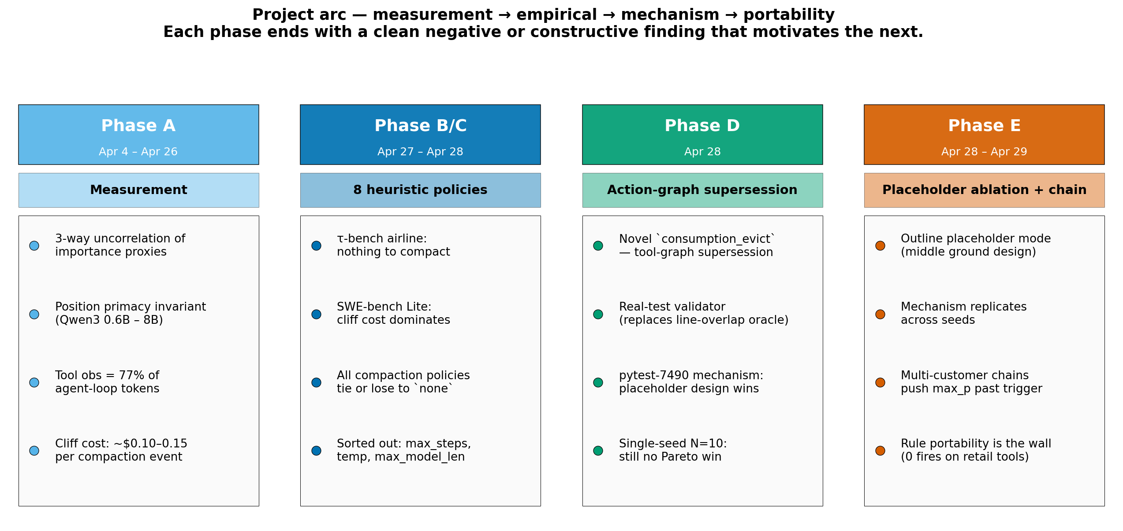
The project — four phases, one negative-with-a-twist result
Phase A: measurement → Phase B: τ-bench → Phase C: SWE-bench → Phase D: mechanism finding.
AdaptiveCache · Vlad Cainamisir · Harvard
Backup 2 / 18

Slide 3
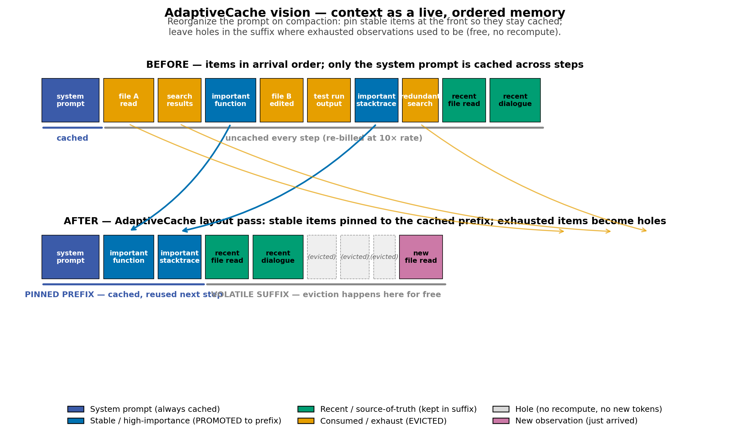
AdaptiveCache vision — context as a live, ordered memory
Reorganize the prompt on compaction: pin stable items at the front; leave evictable holes in the suffix.
AdaptiveCache · Vlad Cainamisir · Harvard
Backup 3 / 18

Slide 4
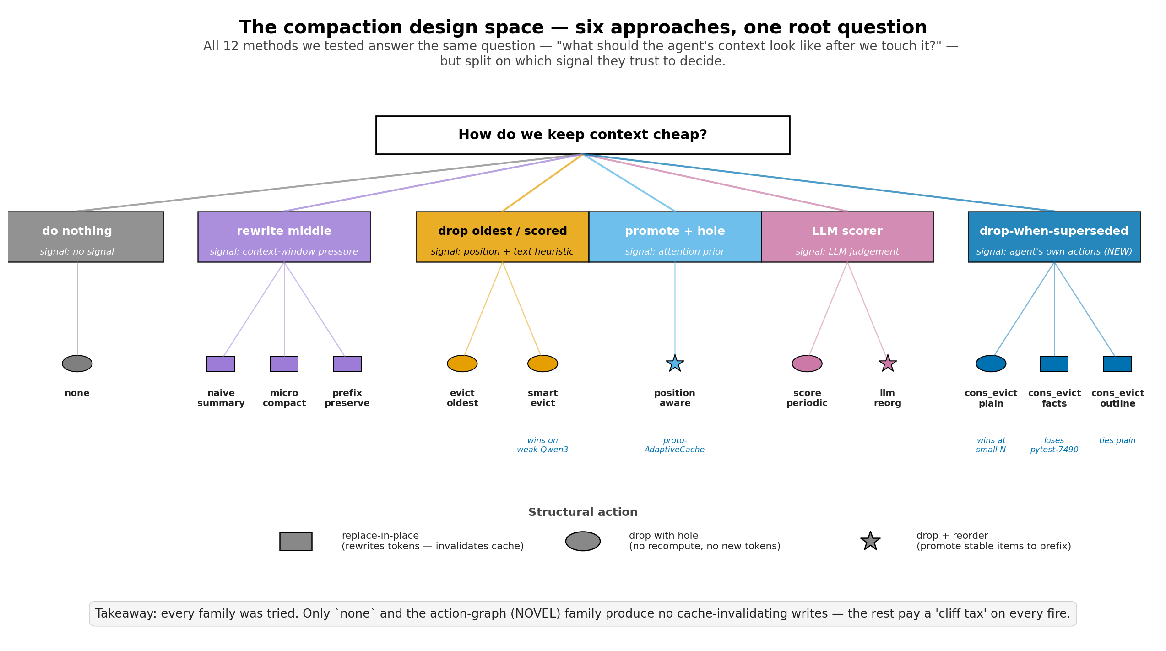
The compaction design space — 6 families, 12 methods
All 12 policies we tested split on which signal they trust to decide what to drop.
AdaptiveCache · Vlad Cainamisir · Harvard
Backup 4 / 18

Slide 5
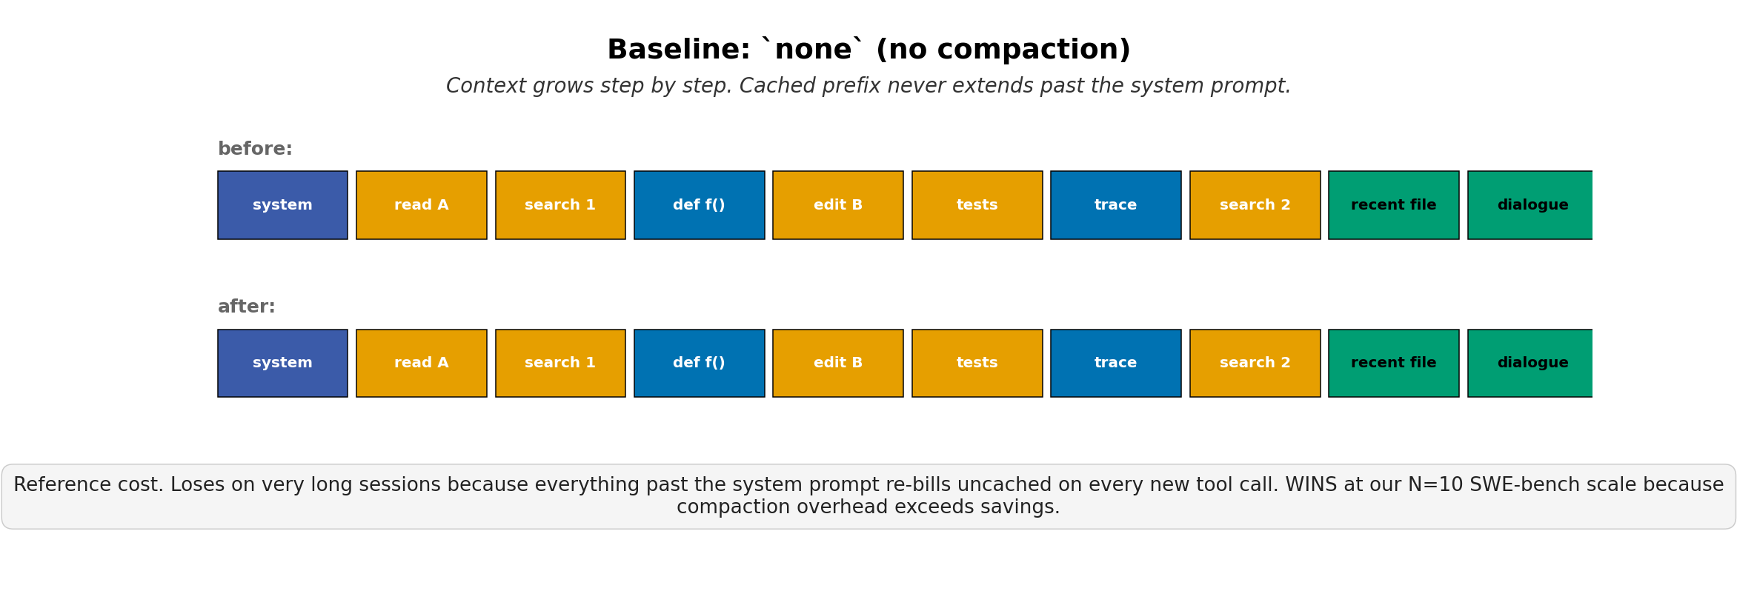
BASELINE
none
Pareto-dominates on N=10 SWE-bench Lite (Haiku 4.5)
84+ trajectories · 20 phases
AdaptiveCache · Vlad Cainamisir · Harvard
Backup 5 / 18

Slide 6
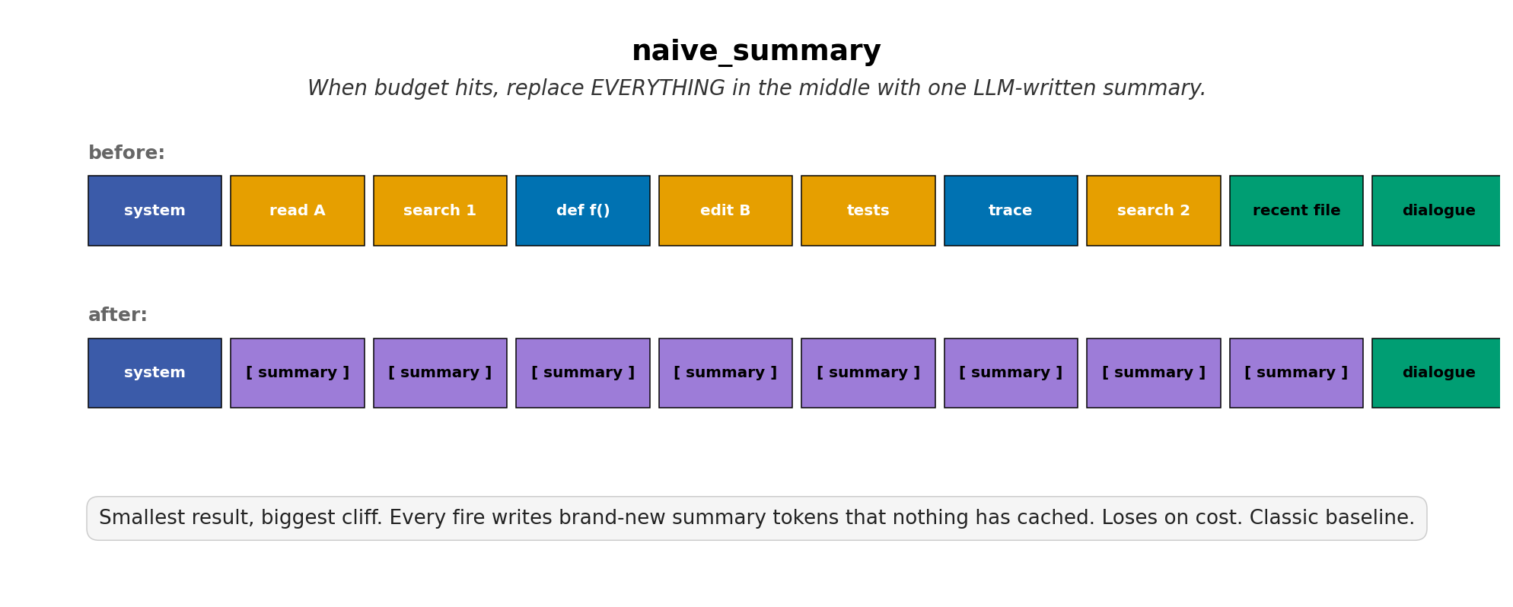
SUMMARIZE
naive_summary
Always loses on cost — every fire writes uncached tokens
tested on τ-bench airline + SWE-bench Lite
AdaptiveCache · Vlad Cainamisir · Harvard
Backup 6 / 18

Slide 7
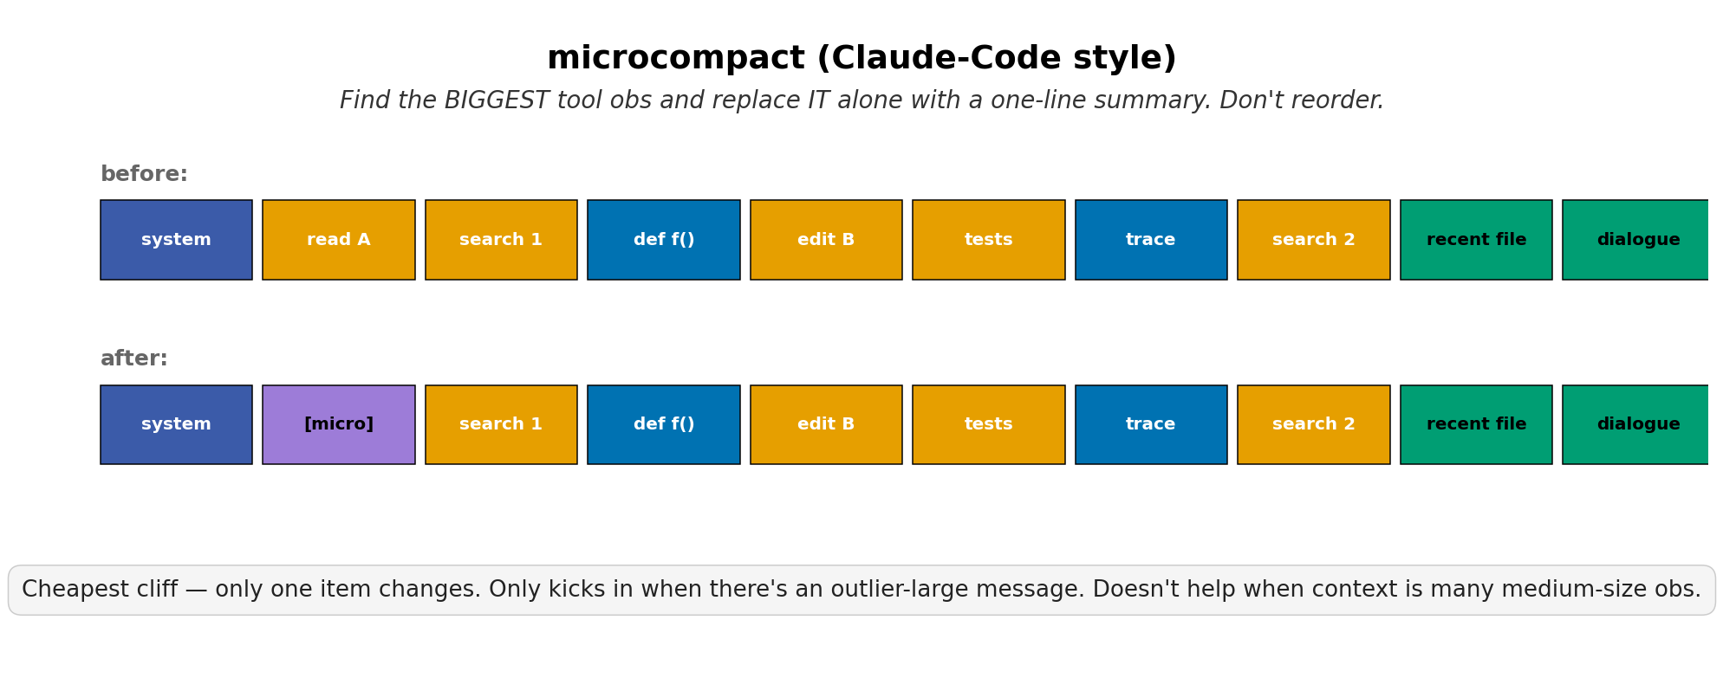
SUMMARIZE
microcompact
Rarely fires — needs an outlier-large observation
10 trajectories · Phase B + C
AdaptiveCache · Vlad Cainamisir · Harvard
Backup 7 / 18

Slide 8
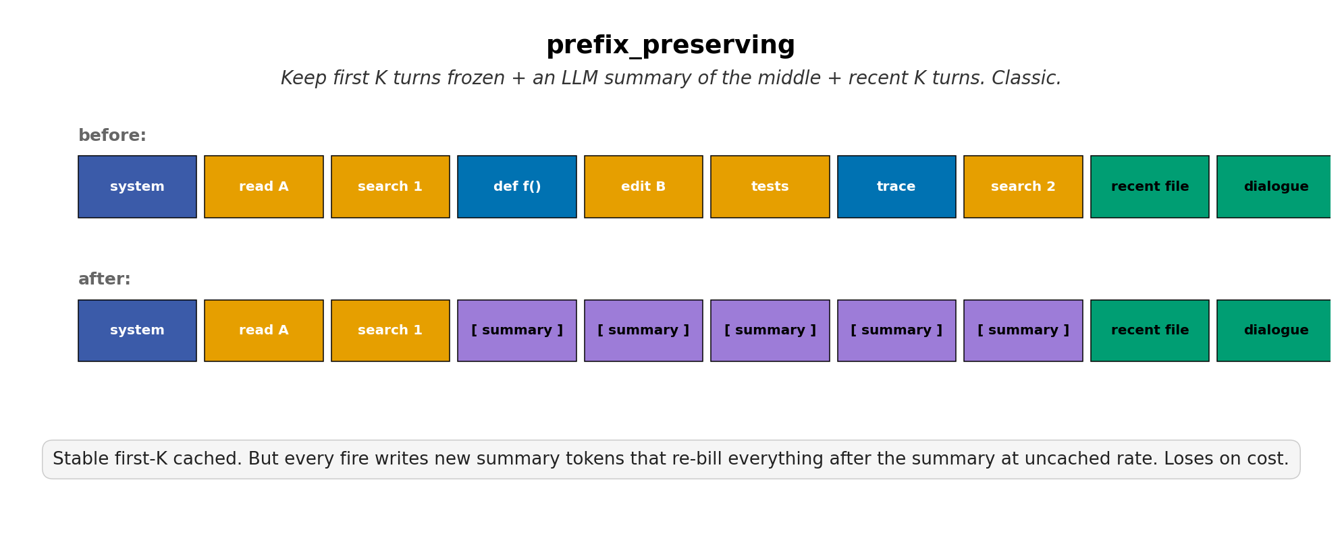
SUMMARIZE
prefix_preserving
Stable cliff cost; loses ~30% on cost vs none
28 trajectories · 7 phases
AdaptiveCache · Vlad Cainamisir · Harvard
Backup 8 / 18

Slide 9
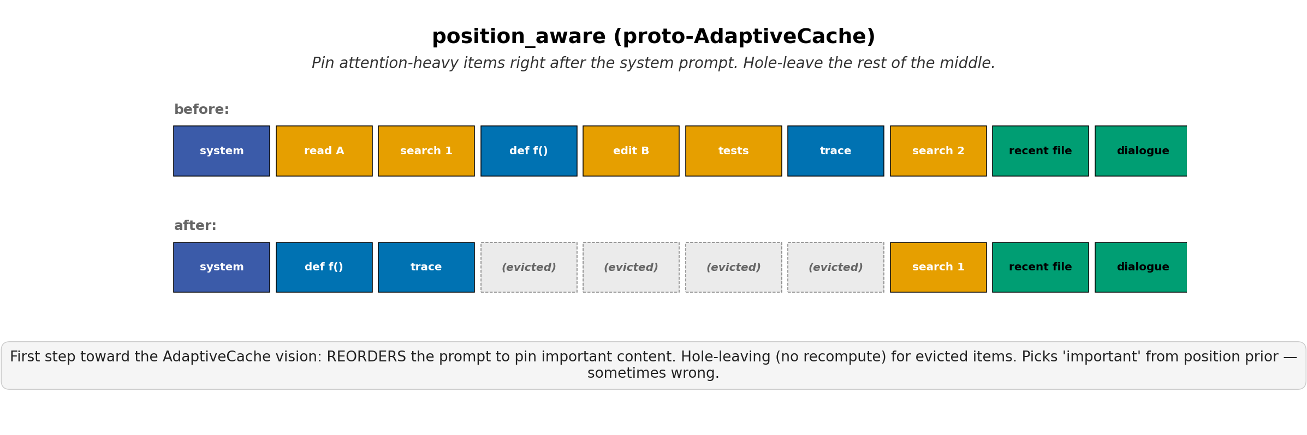
REORDER
position_aware
Proto-AdaptiveCache layout; no cost win at our scale
12 trajectories · Phase A + C
AdaptiveCache · Vlad Cainamisir · Harvard
Backup 9 / 18

Slide 10
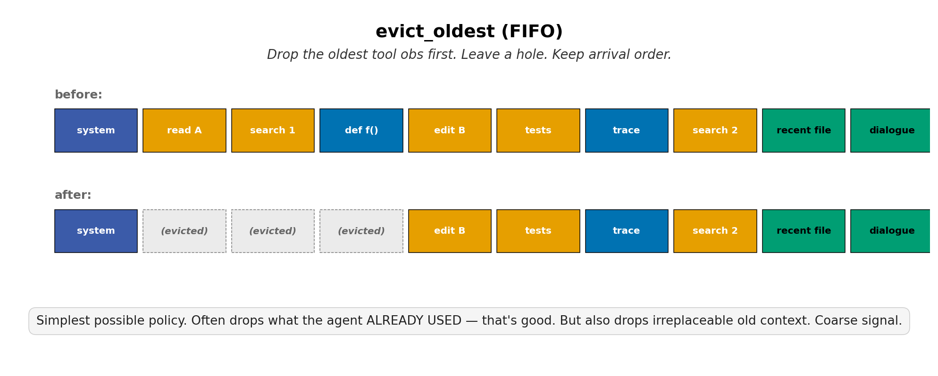
HEURISTIC
evict_oldest
FIFO baseline — drops irreplaceable old context too
6 trajectories · Phase C
AdaptiveCache · Vlad Cainamisir · Harvard
Backup 10 / 18

Slide 11
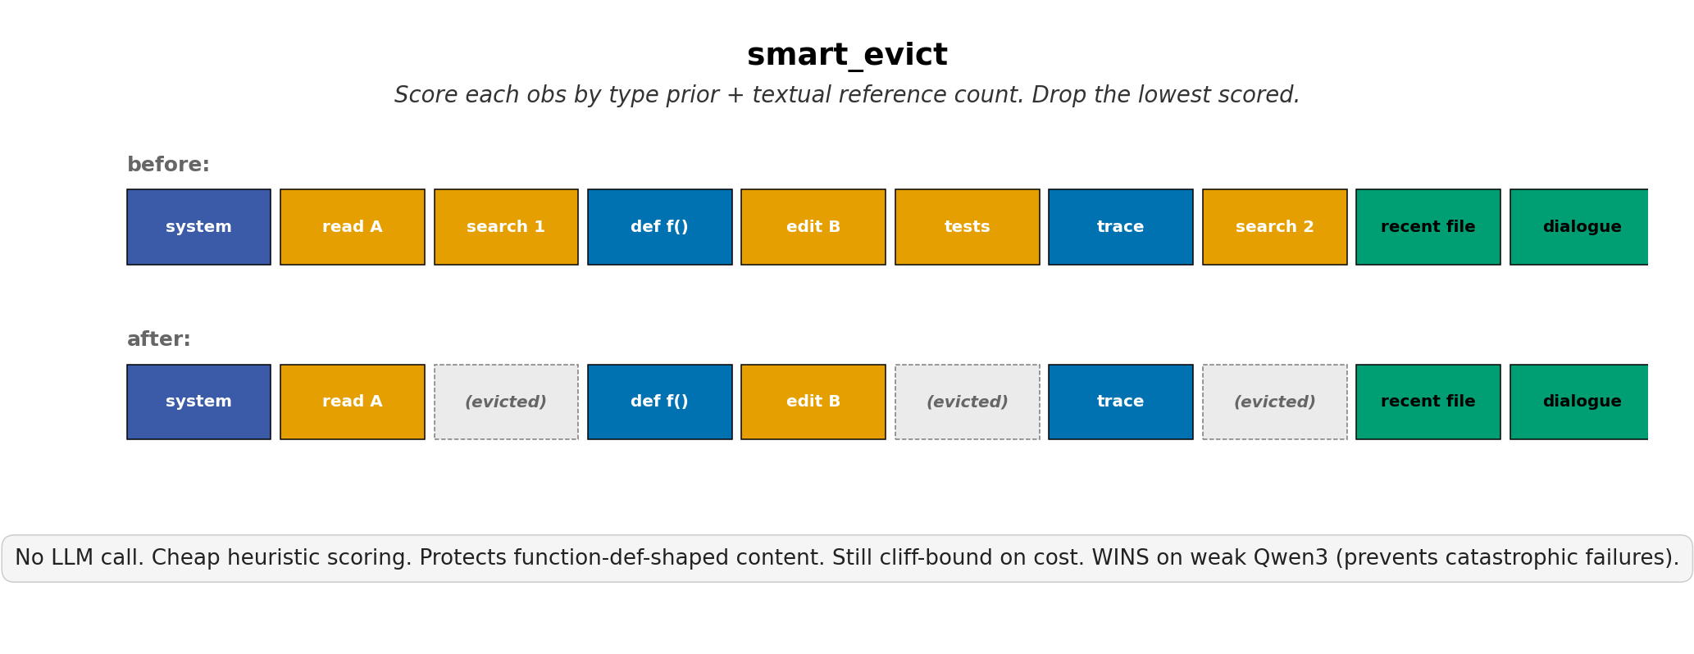
HEURISTIC
smart_evict
WINS on weak Qwen3 — prevents catastrophic OOC failures
59 trajectories · 14 phases
AdaptiveCache · Vlad Cainamisir · Harvard
Backup 11 / 18

Slide 12
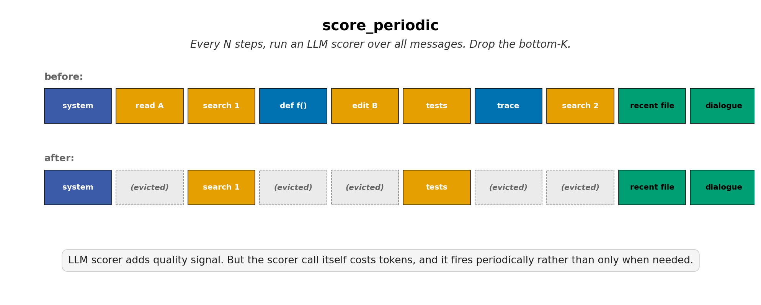
LLM-SCORED
score_periodic
LLM scorer overhead exceeds bytes saved
limited tests · Phase C v8
AdaptiveCache · Vlad Cainamisir · Harvard
Backup 12 / 18

Slide 13
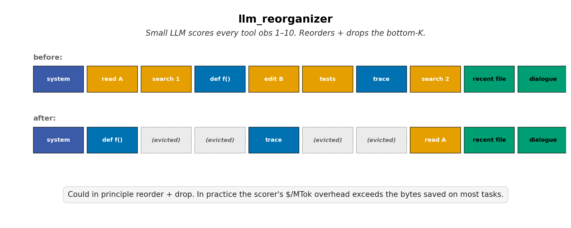
LLM-SCORED
llm_reorganizer
Reorder + score — same overhead problem
30 trajectories · 9 phases
AdaptiveCache · Vlad Cainamisir · Harvard
Backup 13 / 18

Slide 14
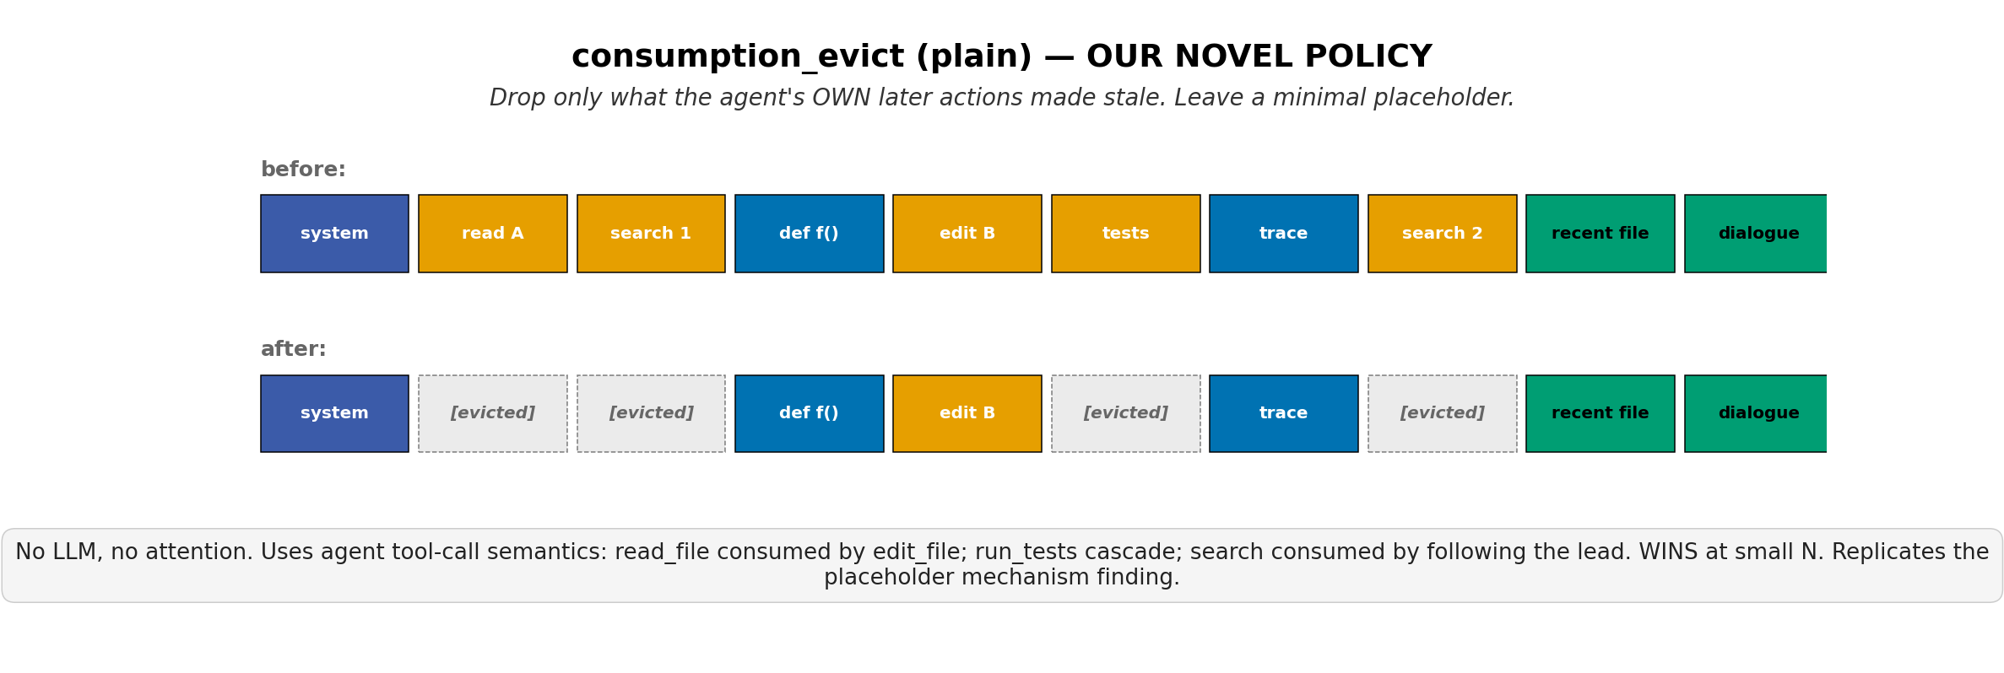
ACTION-GRAPH
consumption_evict_plain
WINS pytest-7490 in 4 edits · ties on retail chain (5/10)
Phase D 2× + Phase E (10 customers)
AdaptiveCache · Vlad Cainamisir · Harvard
Backup 14 / 18

Slide 15
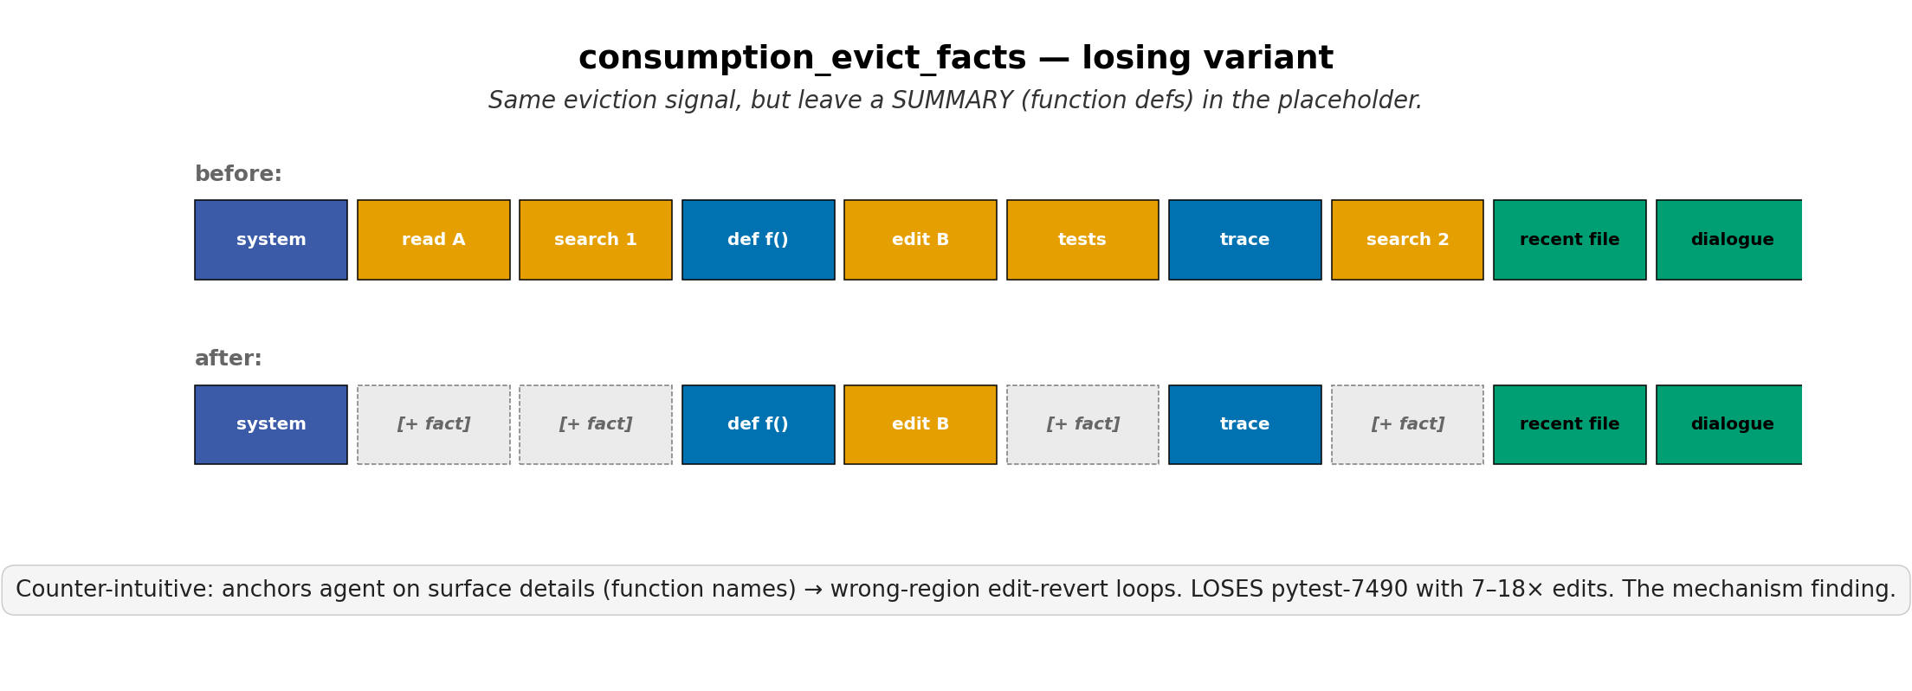
ACTION-GRAPH
consumption_evict_facts
LOSES pytest-7490 — 18 edits, 0/2 success (mechanism finding)
Phase D 2×
AdaptiveCache · Vlad Cainamisir · Harvard
Backup 15 / 18

Slide 16
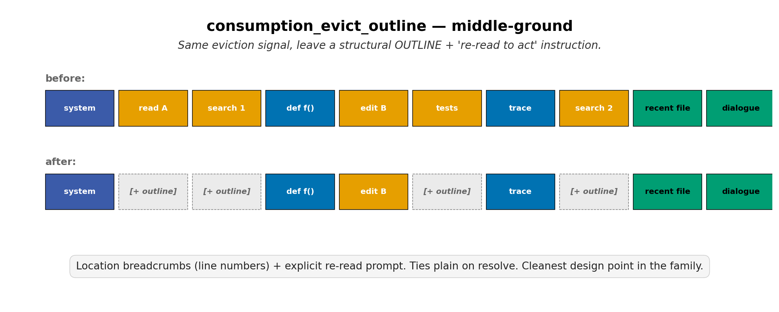
ACTION-GRAPH
consumption_evict_outline
Ties plain on retail chain (5/10) — cleanest design point
Phase E (10 customers)
AdaptiveCache · Vlad Cainamisir · Harvard
Backup 16 / 18

Slide 17
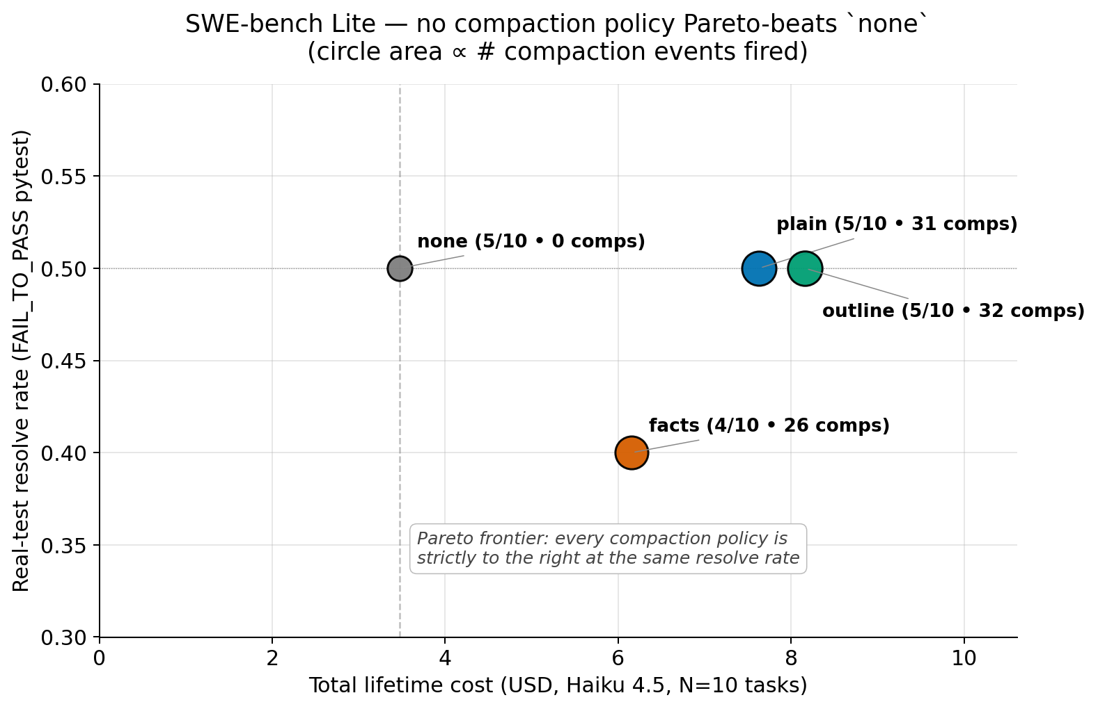
Headline result — none dominates on N=10 SWE-bench Lite
The training-free heuristic-compaction Pareto frontier vs. no-compaction baseline.
AdaptiveCache · Vlad Cainamisir · Harvard
Backup 17 / 18

Slide 18
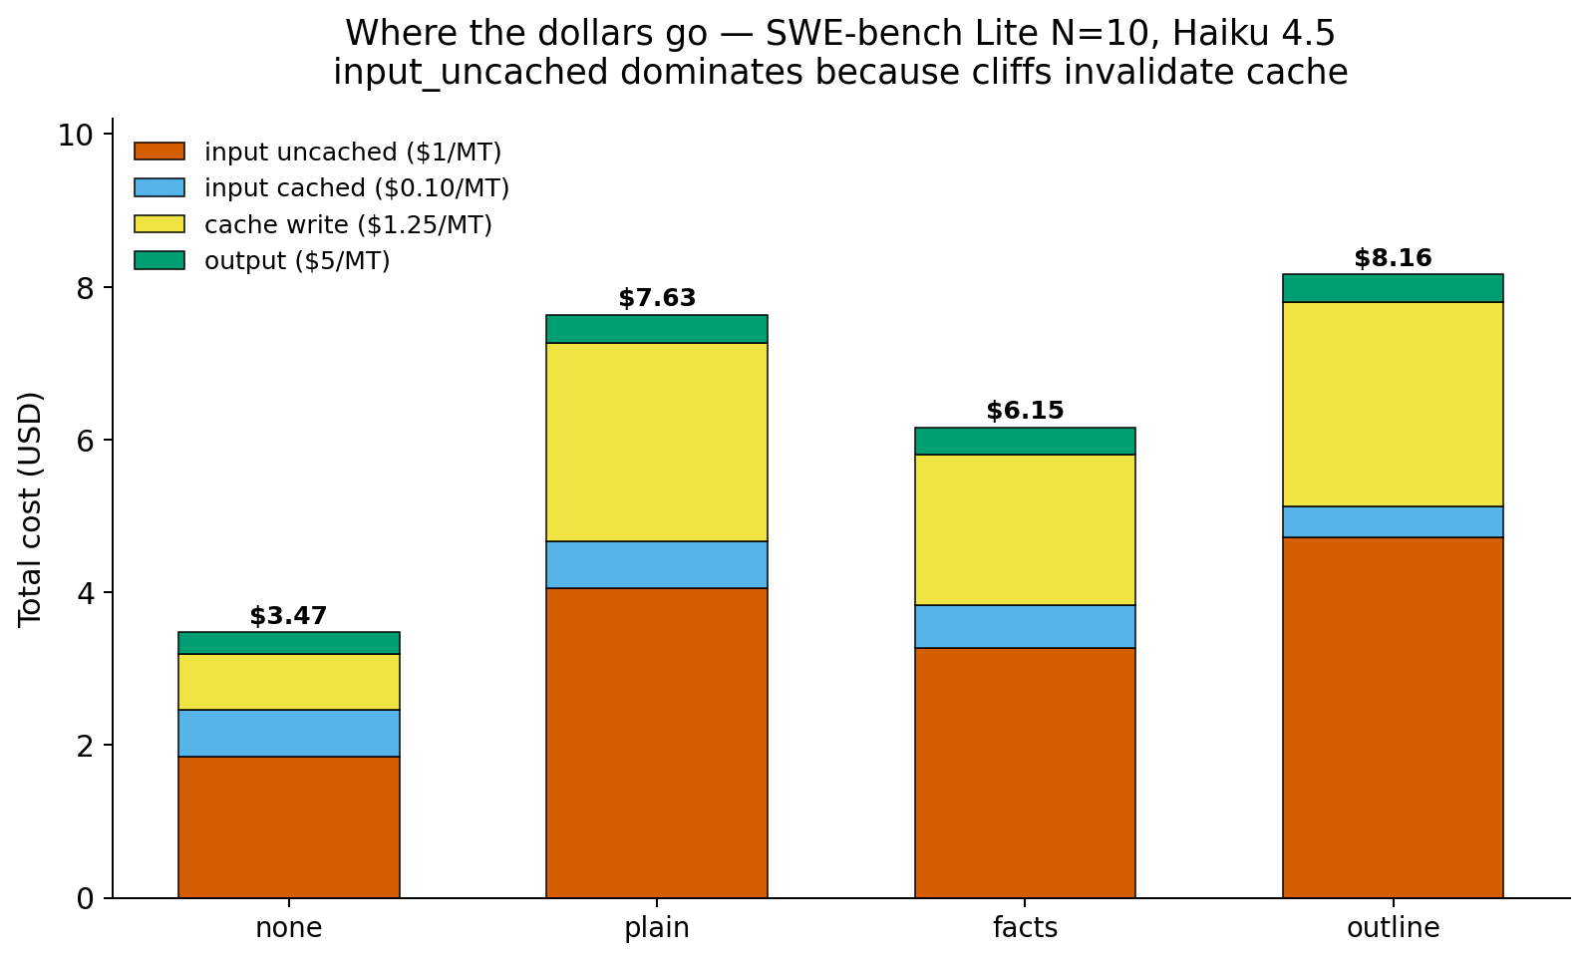
Cost decomposition — uncached input tokens dominate after cliffs
Each compaction event invalidates the prefix cache → uncached re-billing dominates.
AdaptiveCache · Vlad Cainamisir · Harvard
Backup 18 / 18

Slide 19
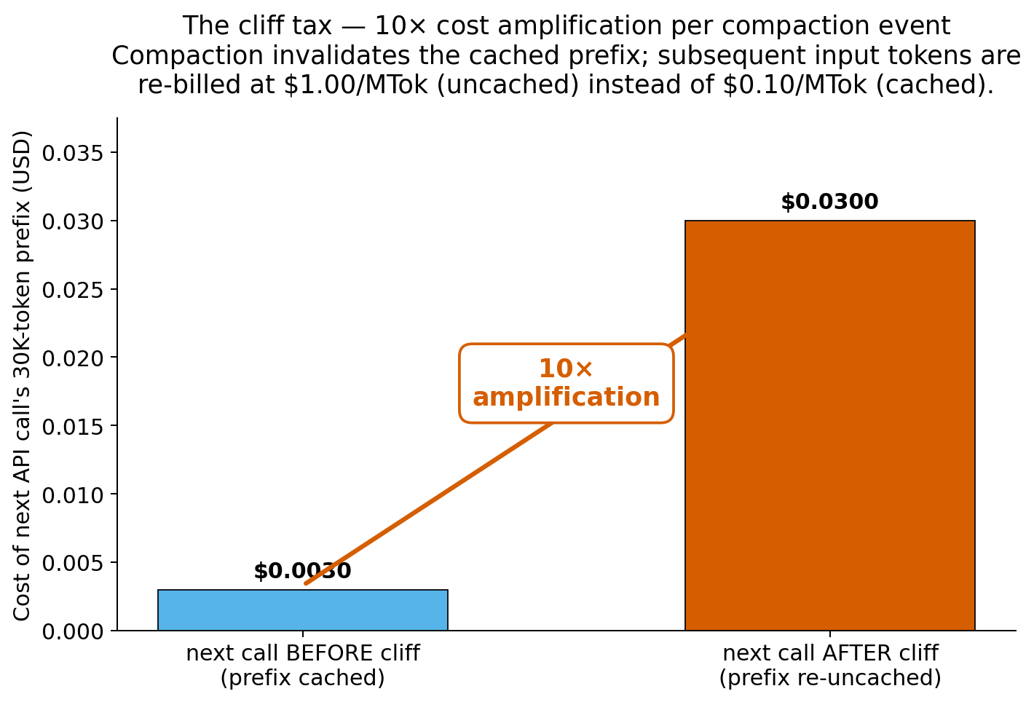
Cliff tax — 10× cost amplification per compaction event
$0.10/MTok cached vs $1.00/MTok uncached. One cliff fires the difference for the rest of the trajectory.
AdaptiveCache · Vlad Cainamisir · Harvard
Backup 18 / 18

