Slide 1
ADAPTIVECACHE
Compacting an AI agent's
working memory:
12 ways to drop old data
What we learned from running 12 strategies on real coding and customer-service tasks.
Vlad Cainamisir · Harvard · AdaptiveCache project

Slide 2
WHAT WE RAN
Six months of compaction experiments, in numbers.
500+
12
15K+
3
agent trajectories
compaction strategies
agent steps recorded
benchmarks
500M+
25+
$200+
100+
input tokens
experimental phases
Anthropic API spend
GPU hours (Blackwell + SEAS + Modal)
Compute · Anthropic Claude Haiku 4.5 (API) · Qwen3-30B-A3B on Blackwell + SEAS cluster + Modal
AdaptiveCache · Vlad Cainamisir · Harvard
2 / 28

Slide 3
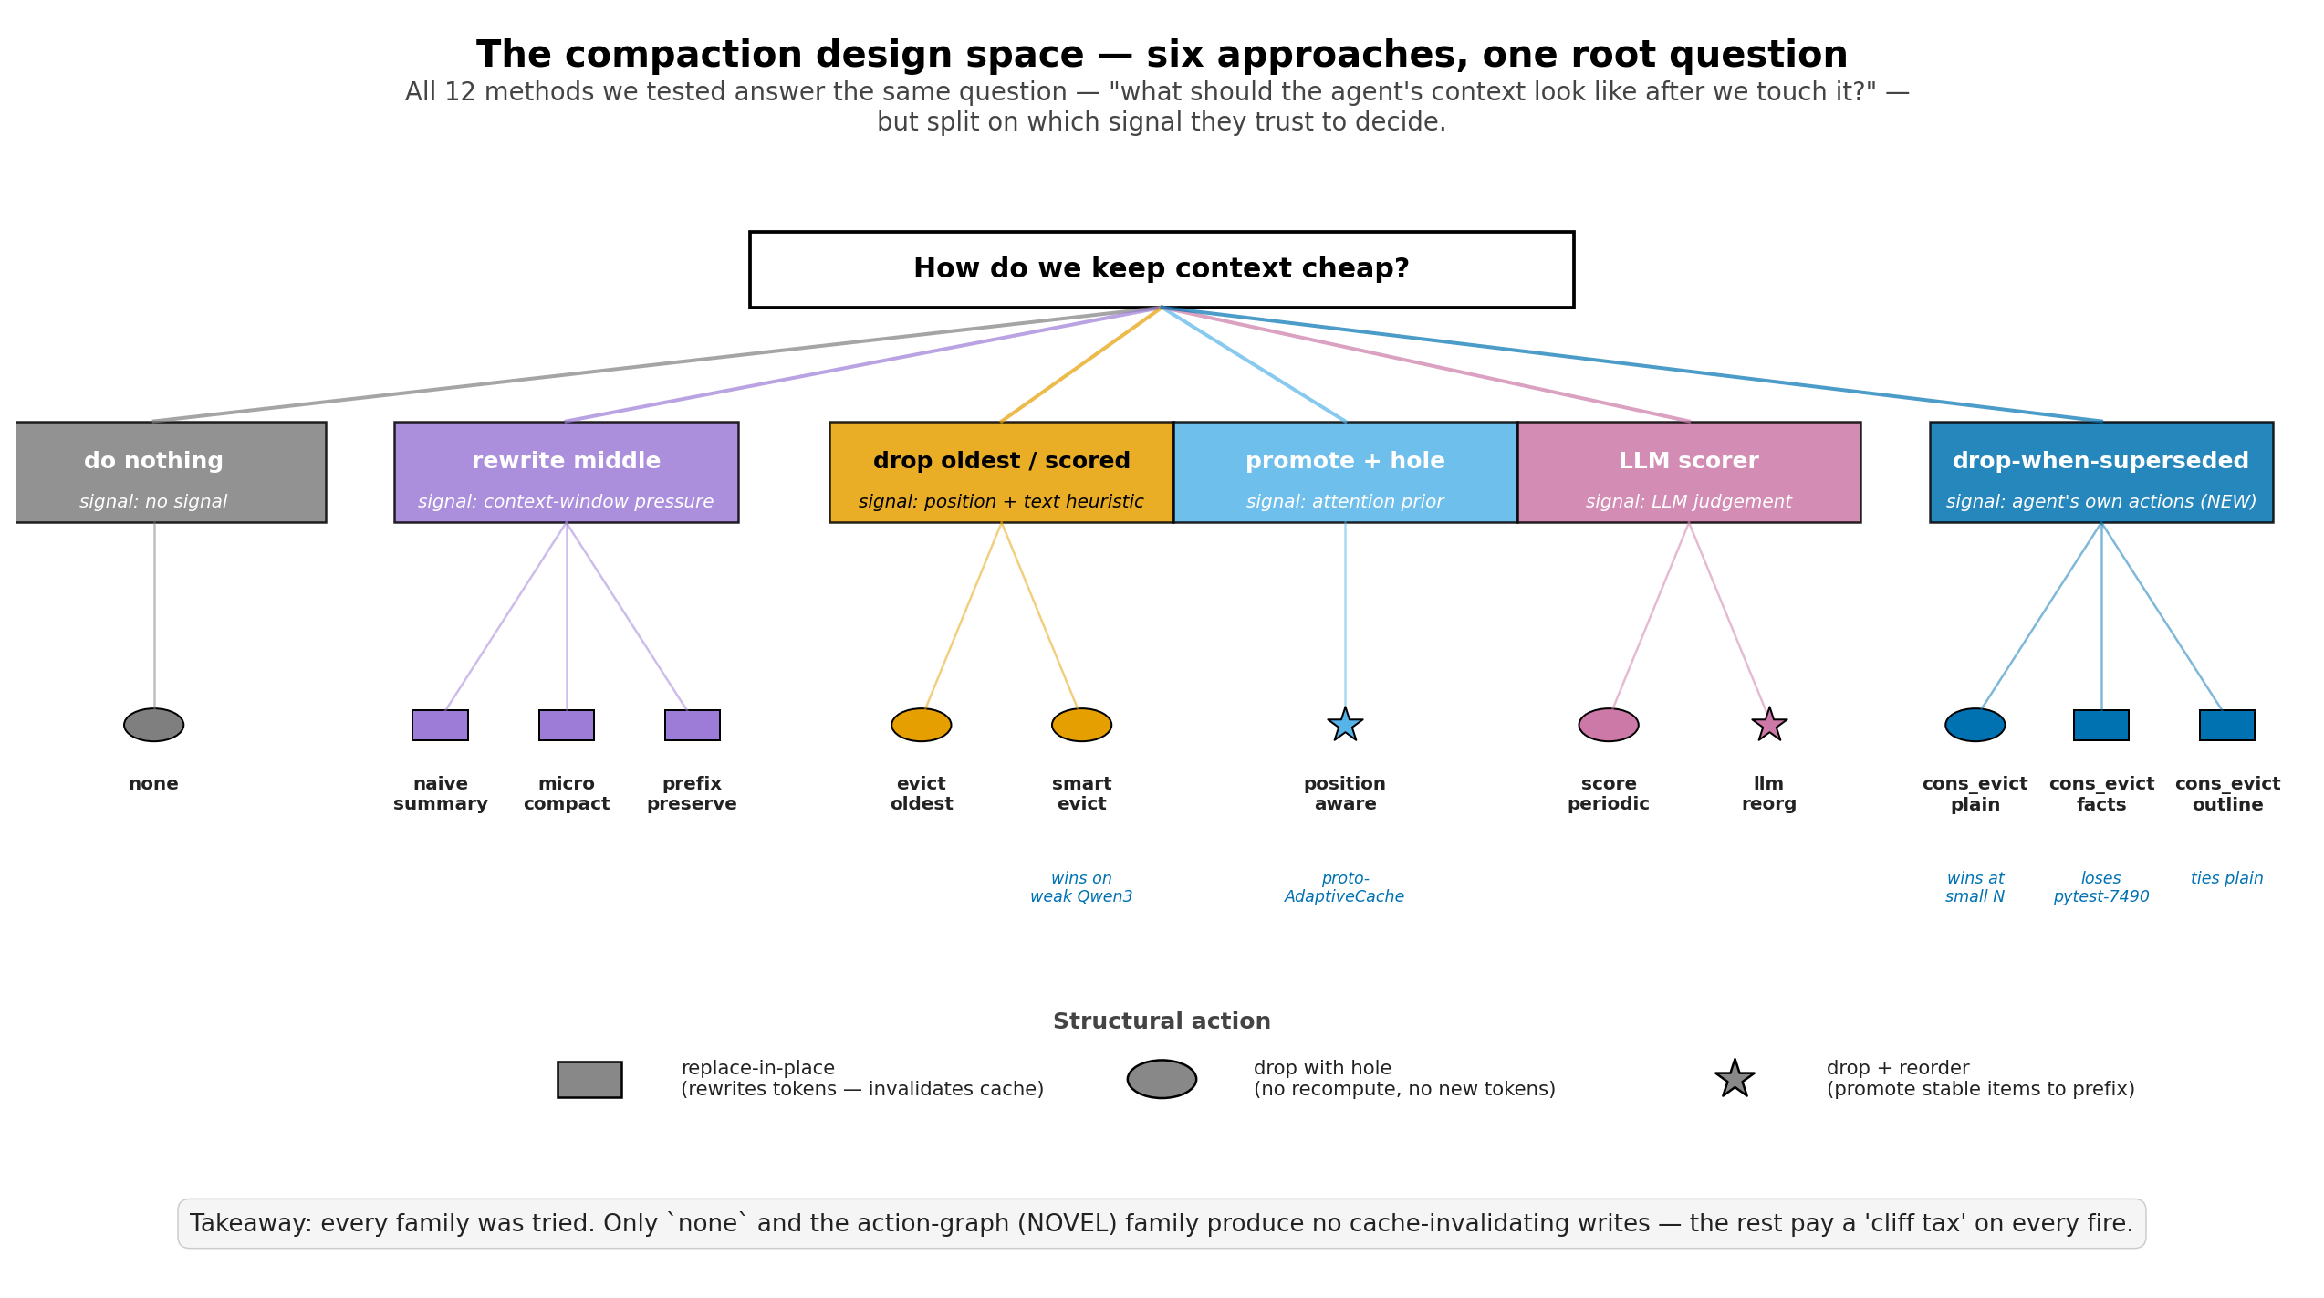
The problem: agent memory grows step by step.
Each tool call (read file, run test, search) adds 100s–1000s of tokens. Eventually we hit the model's limit.
1
Drop old observations
2
Leave a placeholder
3
Pay for the change
Pick which past tool outputs to evict from the running context.
Replace the dropped content with a short marker the agent can still see.
Every rewrite invalidates the prefix cache → input bills uncached at 10× cost.
We tested 12 ways of doing steps 1 + 2. The cost of step 3 decides whether they win.
AdaptiveCache · Vlad Cainamisir · Harvard
3 / 28

Slide 4
The 12 strategies, grouped by family
Six families. They differ on what signal they use to decide which observations to compact.
AdaptiveCache · Vlad Cainamisir · Harvard
4 / 28

Slide 5
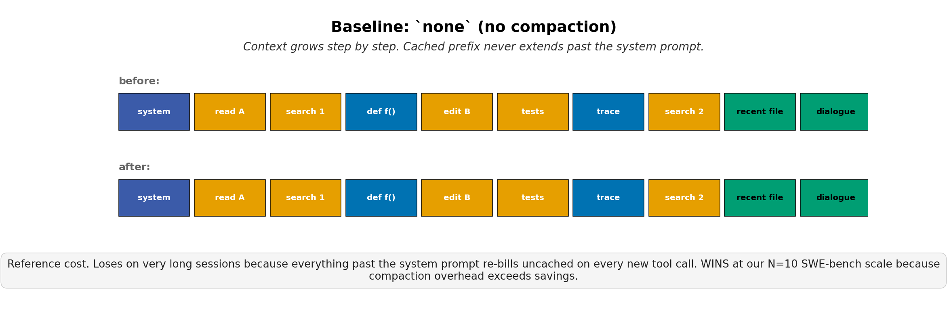
BASELINE
none
Pareto-dominates on N=10 SWE-bench Lite (Haiku 4.5)
84+ trajectories · 20 phases
AdaptiveCache · Vlad Cainamisir · Harvard
5 / 28

Slide 6
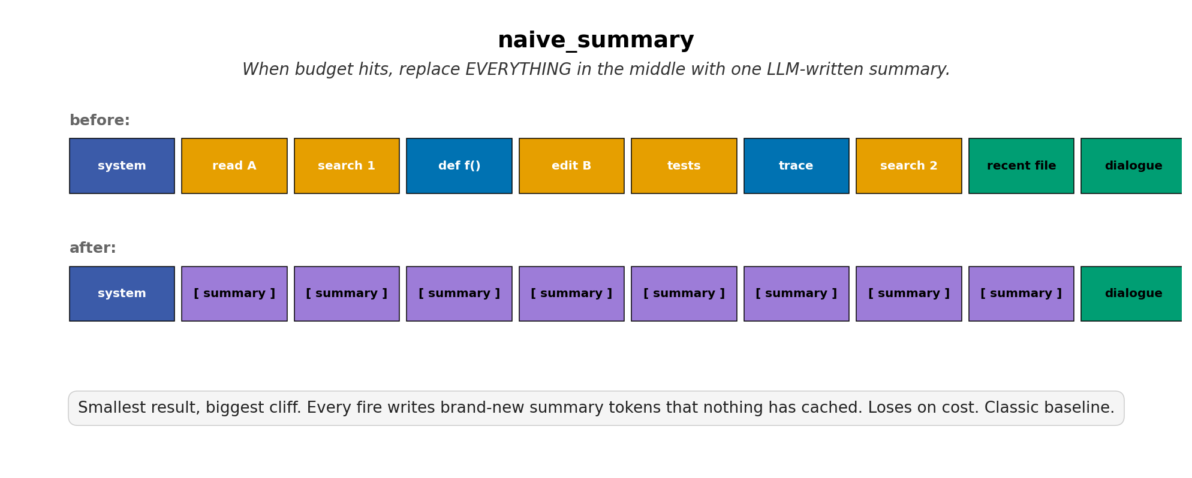
SUMMARIZE
naive_summary
Always loses on cost — every fire writes uncached tokens
tested on τ-bench airline + SWE-bench Lite
AdaptiveCache · Vlad Cainamisir · Harvard
6 / 28

Slide 7
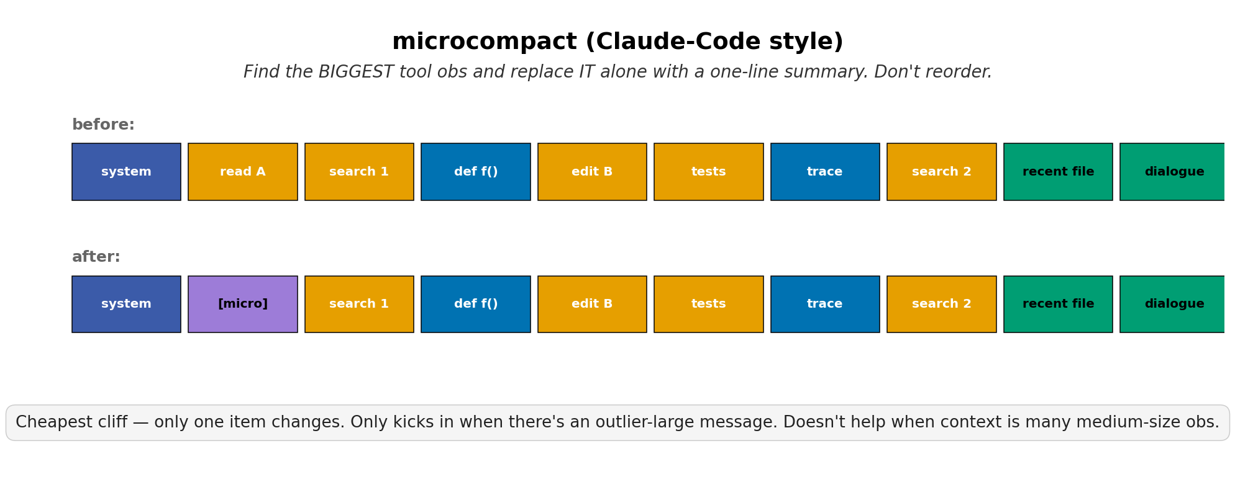
SUMMARIZE
microcompact
Rarely fires — needs an outlier-large observation
10 trajectories · Phase B + C
AdaptiveCache · Vlad Cainamisir · Harvard
7 / 28

Slide 8
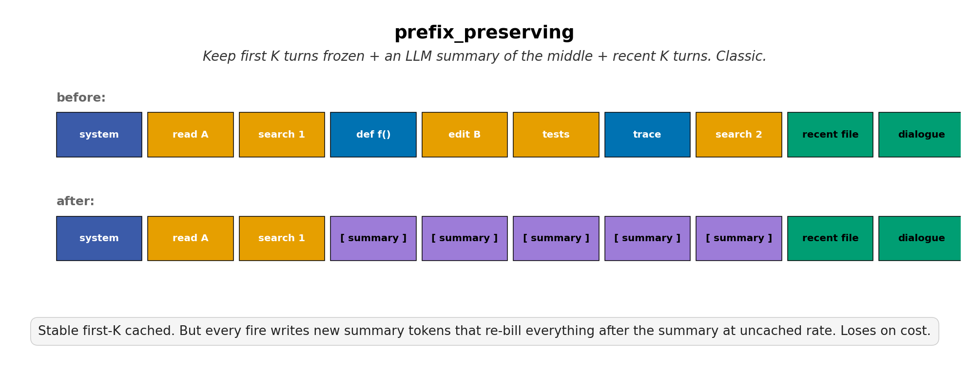
SUMMARIZE
prefix_preserving
Stable cliff cost; loses ~30% on cost vs none
28 trajectories · 7 phases
AdaptiveCache · Vlad Cainamisir · Harvard
8 / 28

Slide 9
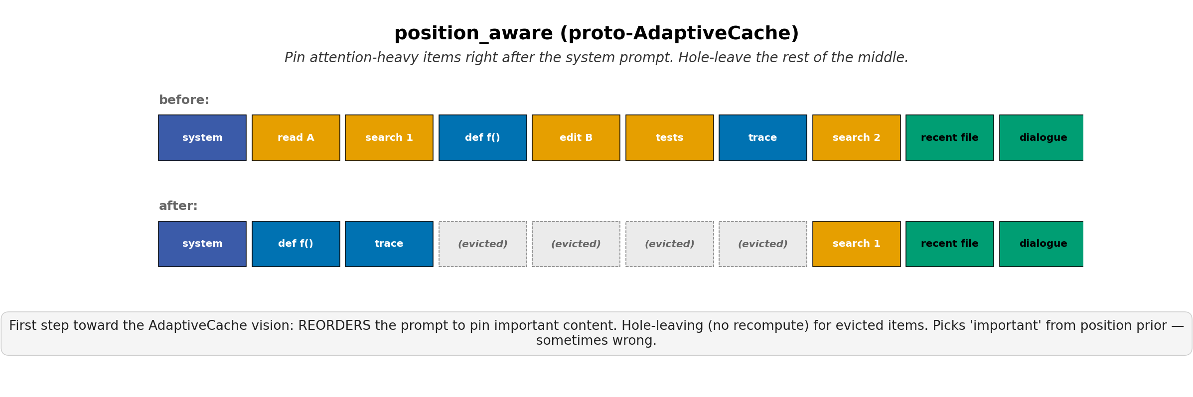
REORDER
position_aware
Proto-AdaptiveCache layout; no cost win at our scale
12 trajectories · Phase A + C
AdaptiveCache · Vlad Cainamisir · Harvard
9 / 28

Slide 10
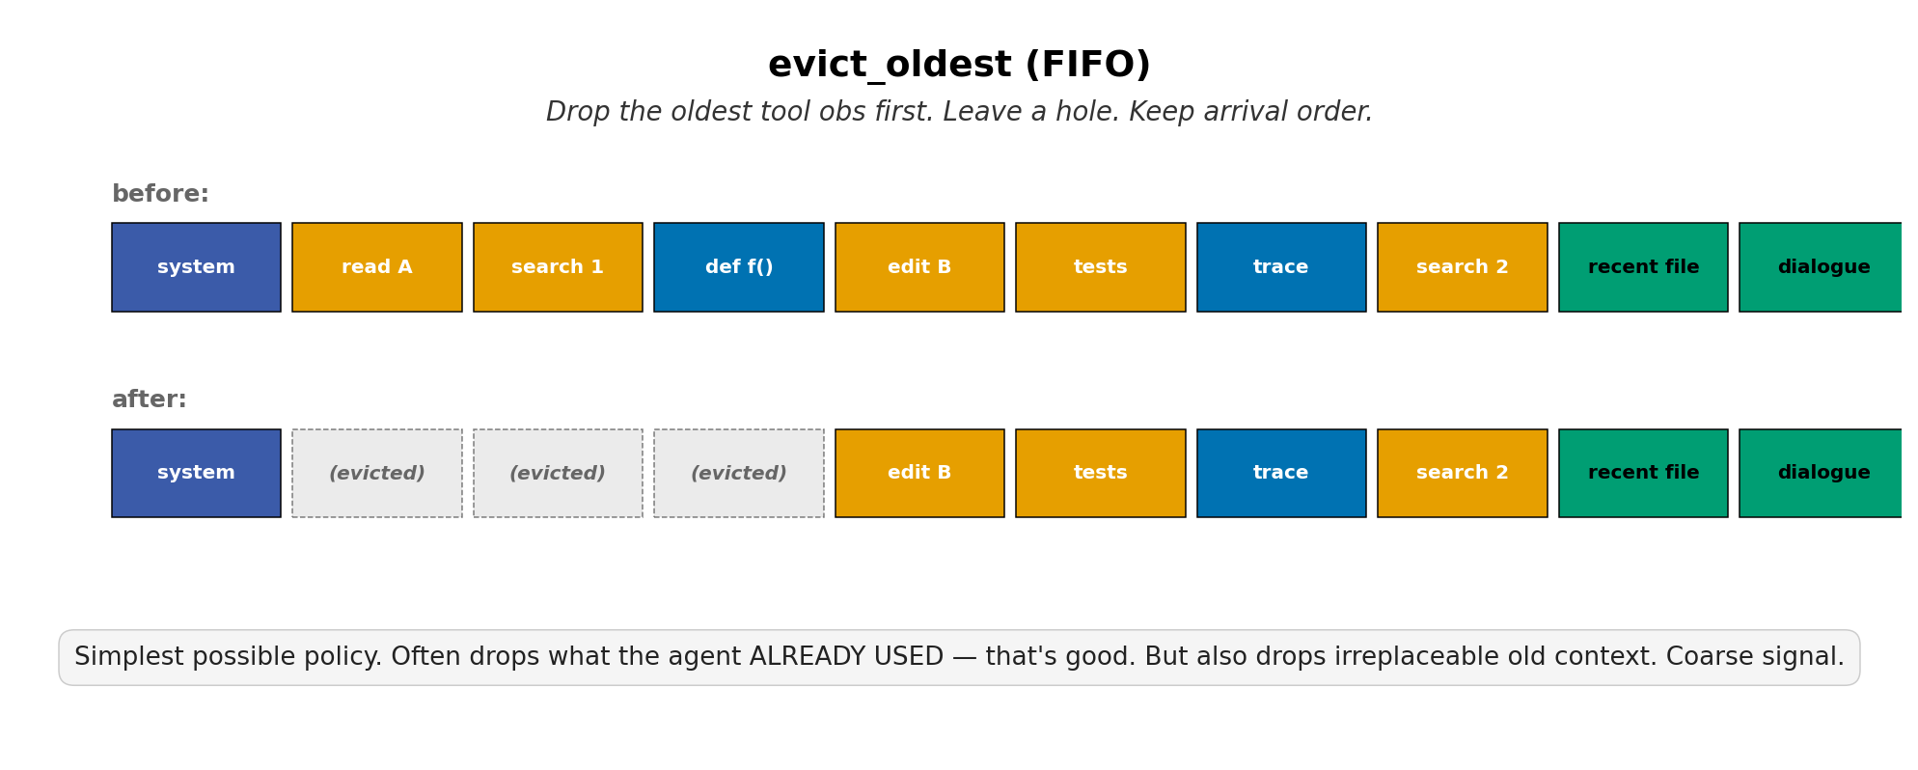
HEURISTIC
evict_oldest
FIFO baseline — drops irreplaceable old context too
6 trajectories · Phase C
AdaptiveCache · Vlad Cainamisir · Harvard
10 / 28

Slide 11
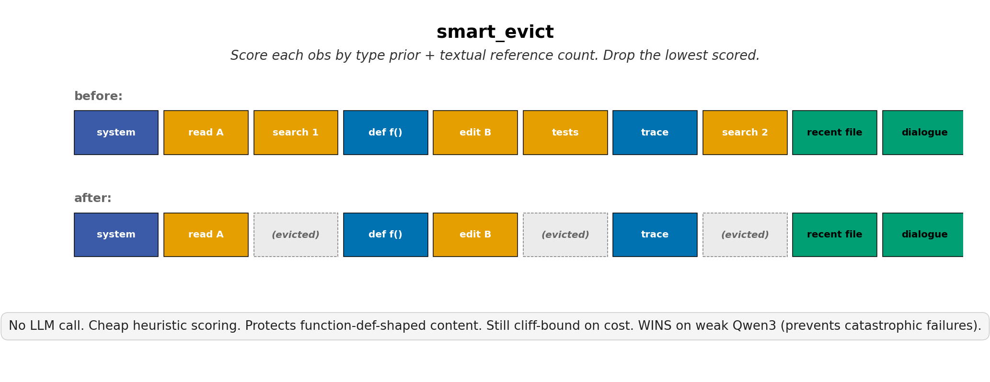
HEURISTIC
smart_evict
WINS on weak Qwen3 — prevents catastrophic OOC failures
59 trajectories · 14 phases
AdaptiveCache · Vlad Cainamisir · Harvard
11 / 28

Slide 12
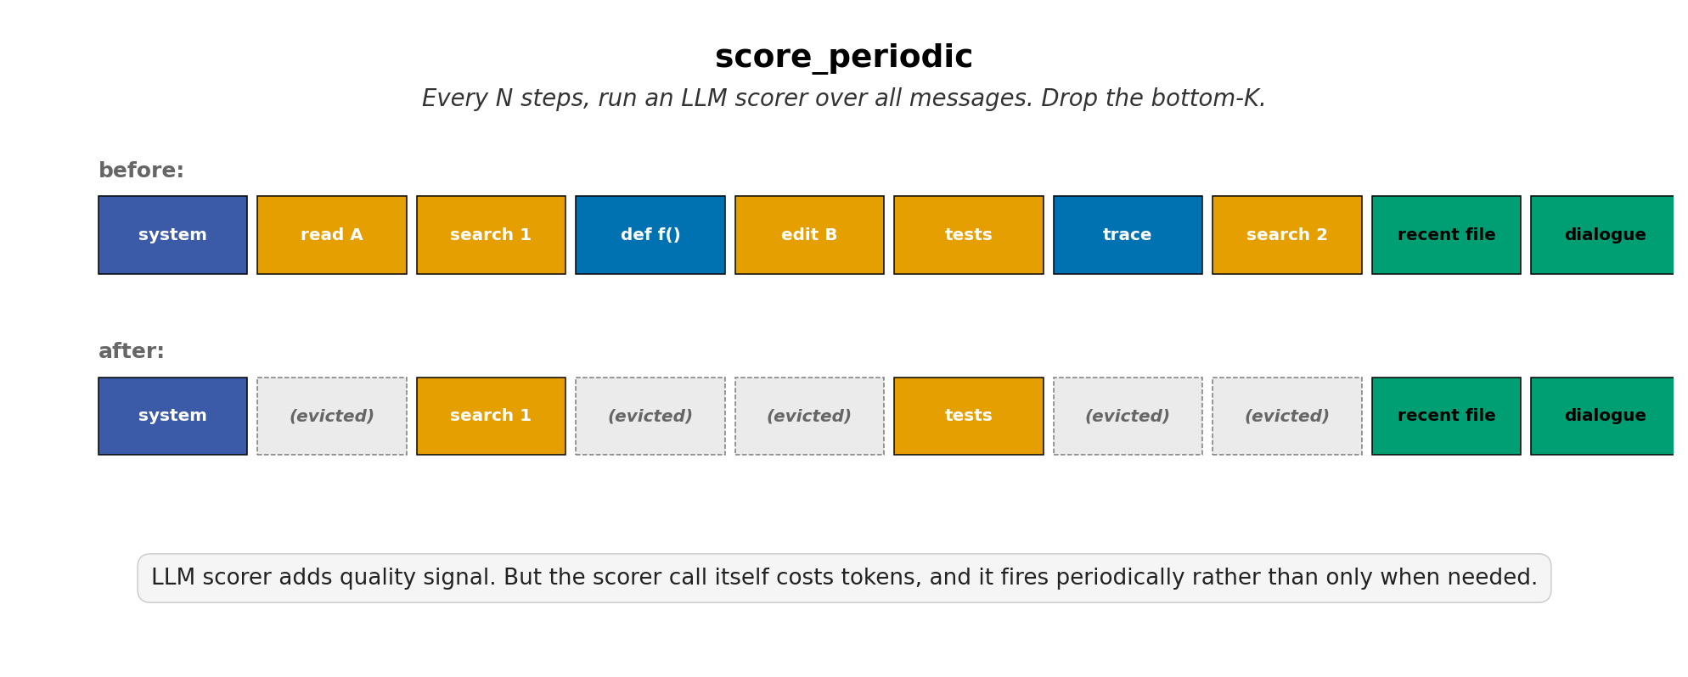
LLM-SCORED
score_periodic
LLM scorer overhead exceeds bytes saved
limited tests · Phase C v8
AdaptiveCache · Vlad Cainamisir · Harvard
12 / 28

Slide 13
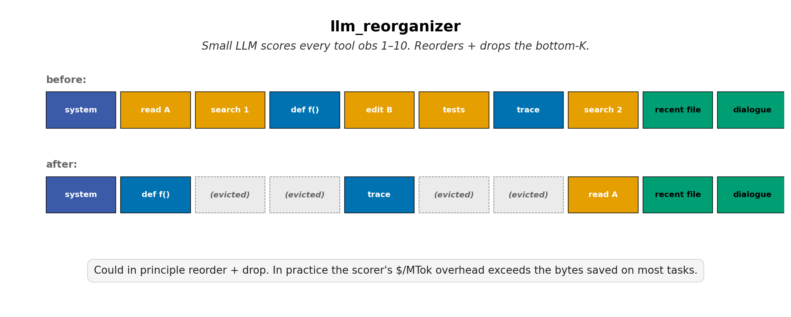
LLM-SCORED
llm_reorganizer
Reorder + score — same overhead problem
30 trajectories · 9 phases
AdaptiveCache · Vlad Cainamisir · Harvard
13 / 28

Slide 14
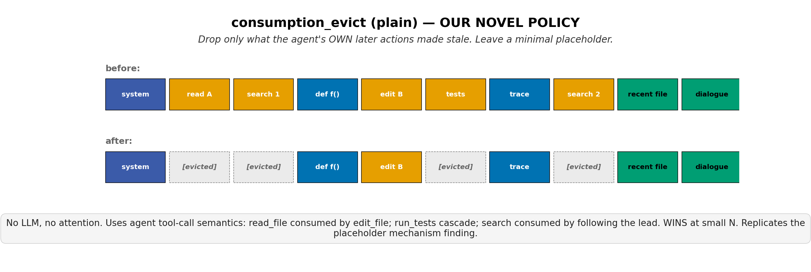
ACTION-GRAPH
consumption_evict_plain
WINS pytest-7490 in 4 edits · ties on retail chain (5/10)
Phase D 2× + Phase E (10 customers)
AdaptiveCache · Vlad Cainamisir · Harvard
14 / 28

Slide 15
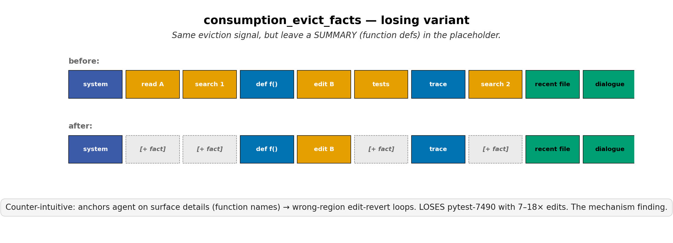
ACTION-GRAPH
consumption_evict_facts
LOSES pytest-7490 — 18 edits, 0/2 success (mechanism finding)
Phase D 2×
AdaptiveCache · Vlad Cainamisir · Harvard
15 / 28

Slide 16
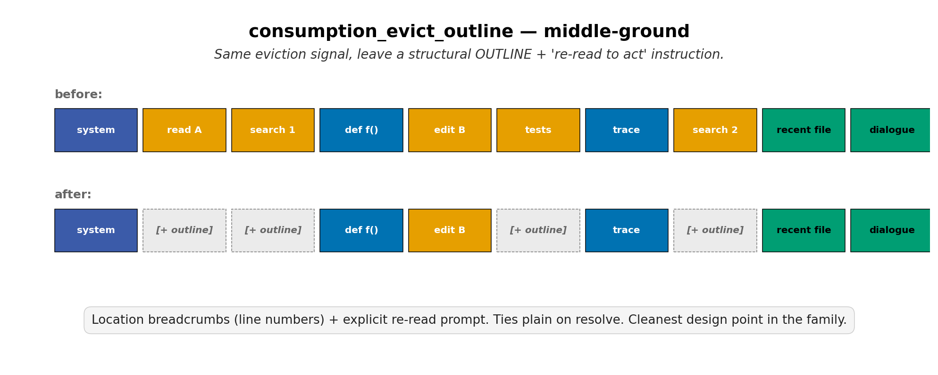
ACTION-GRAPH
consumption_evict_outline
Ties plain on retail chain (5/10) — cleanest design point
Phase E (10 customers)
AdaptiveCache · Vlad Cainamisir · Harvard
16 / 28

Slide 17
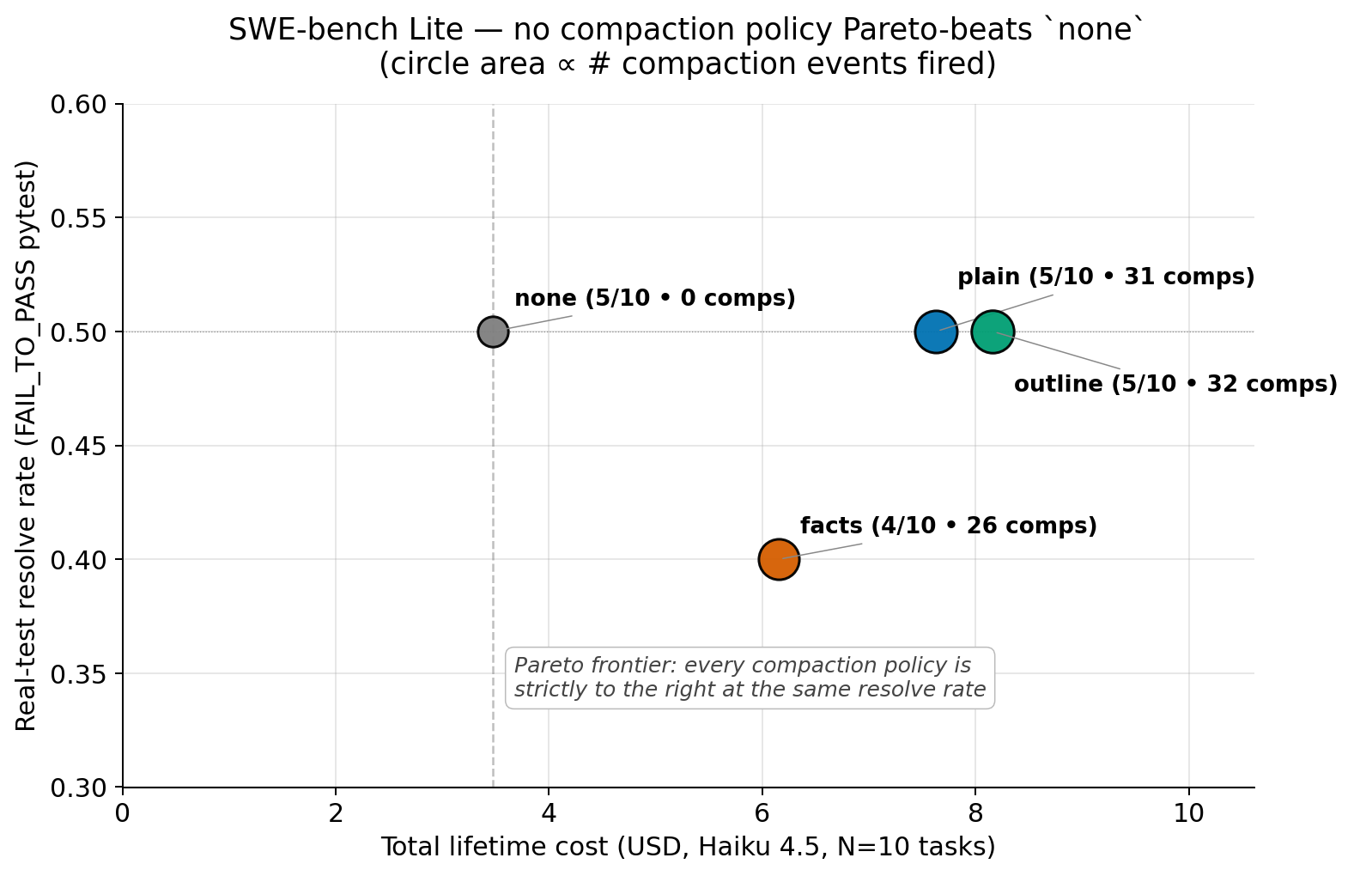
Headline result — none Pareto-dominates every heuristic
N=10 SWE-bench Lite, Haiku 4.5. Compaction policies cluster on the wrong side of the frontier.
$0.10–0.15
new uncached input per cliff
5+ steps
to amortize one cliff back to break-even
2.2×
cheapest compaction policy vs none ($/resolved)
The cliff tax is the dominant cost term. Any policy that fires has to fight it.
AdaptiveCache · Vlad Cainamisir · Harvard
17 / 28

Slide 18
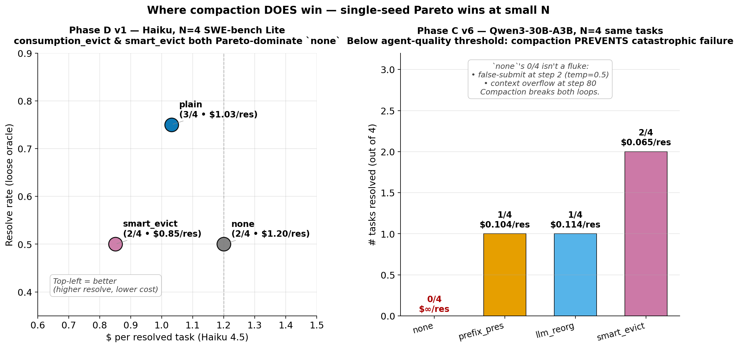
What didn't work — and the one nugget that did
Most of Paper 1 is failure modes. Each told us something. One slice did Pareto-improve.
What didn't work
Where compaction DID win
LLM-reorganizer
Fired 91× across 4 SWE-bench tasks. Still hit context overflow on 3 of 4. Signal fine; cliff cost still wins.
Tighter τ-bench thresholds
Stock τ-bench airline cache already 95% hit (max obs = 953 tok). Nothing to compact.
Action-graph rules don't port
consumption_evict fired 0× on τ-bench retail at chain_size=10. Per-domain tuning required.
Placeholder design
_facts variant anchors agent on wrong region → 18 edits, F2P 0/2. Less is more.
Phase D v1 (Haiku, N=4): consumption_evict 3/4 @ $1.03 vs none 2/4 @ $1.20.
More resolved AND cheaper. Didn't fully replicate at N=10, but the slice is real.
AdaptiveCache · Vlad Cainamisir · Harvard
18 / 28

Slide 19
WHAT WE LEARNED
What you leave behind
matters more than what you remove.
1. On strong agents, no compaction beats every heuristic — the cliff tax dominates.
2. Drop-with-hole (no rewrite) is the only family that avoids the tax.
3. Placeholder design dominates: minimal markers win, summaries anchor.
4. Compaction wins on weak agents (Qwen3) — preventing context overflow.
Thank you. · github.com/vladcainamisir/adaptivecache
AdaptiveCache · Vlad Cainamisir · Harvard
19 / 28

Slide 20
A SECOND TRACK — IN FLIGHT
If we can't beat the cliff,
can we keep the bytes?
Paper 2: KV-pointer recall — offload-and-restore as a cliff-free compaction substitute.
Status: v0 mechanism shipped. v1 recall in flight. Real-test resolve still flat.
This has been the harder of the two tracks.
AdaptiveCache · Vlad Cainamisir · Harvard
20 / 28

Slide 21
The cliff is the wall. So don't change the prefix.
PAPER 2 · EXPLORATORY
Paper 1 said heuristic eviction loses to the cache cliff. Paper 2 asks: keep the bytes — only change the prompt rendering.
Paper 1 finding
Memento (MSR 2024)
Our addition
Cliff tax dominates
Mask, don't delete
Bidirectional masking
Heuristic compaction generates ~$0.10–0.15 of new uncached input per fire. Even good policies lose to no-compaction.
KV blocks stay in memory; positions stay numbered. Cliff still happens, but the masked-out KV → faster attention per step.
Recall the right obs when the agent needs it. v1: re-prefill from obs. v2: keep all KV, recover obs from offload, flip mask. Cost ≈ 0.
Mechanism is novel: nobody has shipped bidirectional KV masking on a production agent loop.
AdaptiveCache · Vlad Cainamisir · Harvard
21 / 28

Slide 22
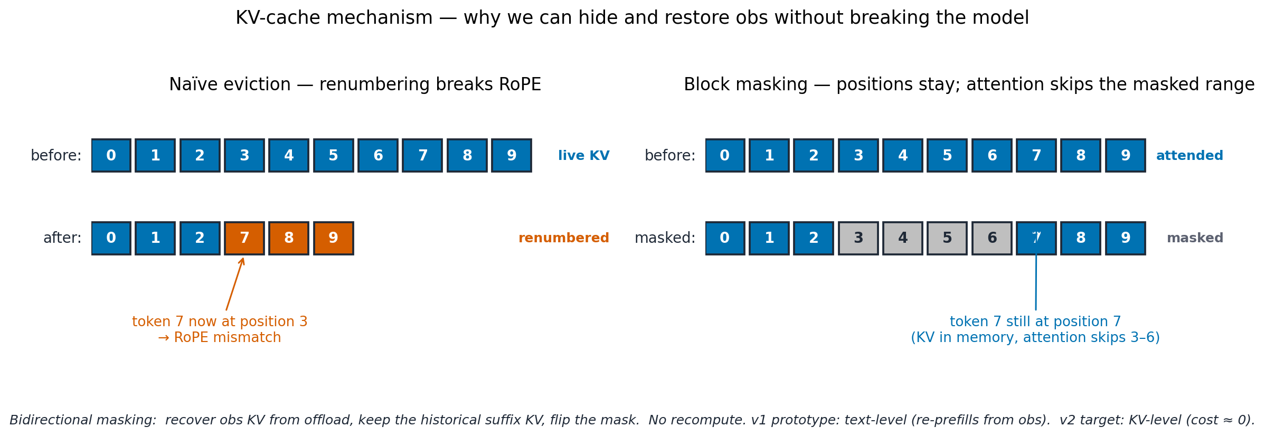
How? Append a summary; don't rewrite the obs.
PAPER 2 · EXPLORATORY
Positions stay coherent (top). Prefix cache: same cliff shape as Paper 1 — Memento's win is downstream of the cliff, not on it (bottom).
Why positions don't break
What about the prefix cache?
· KV indices never renumber — masked positions stay numbered.
· Memento markers go IN THE MIDDLE — same cliff shape as Paper 1.
· RoPE math on subsequent tokens stays consistent.
· Win is downstream: smaller masked context → faster O(N²) attention per step.
· Naïve eviction renumbers and breaks attention; Memento masks and preserves it.
· Lost-in-middle is real: mementos drift into the U-shape low-attention zone — partly motivates content-aware recall.
AdaptiveCache · Vlad Cainamisir · Harvard
22 / 28

Slide 23
Creating a memento — what the writer actually produces
PAPER 2 · EXPLORATORY
Real trace from pytest-dev/pytest-7490, step 6. Haiku-as-writer in v0; an SFT'd model in the principled Paper 2.
1. The tool call + obs
2. The writer summarizes
3. The memento
read_file('testing/test_mark.py')
Haiku 4.5 (v0 placeholder)
791 chars — captures structure
→ 20,000 chars of code
→ SFT'd model in Paper 2
→ replaces the obs in the prompt
import os
import sys
from unittest import mock
import pytest
from _pytest.config import ExitCode
from _pytest.mark import (
EMPTY_PARAMETERSET_OPTION,
MarkGenerator as Mark,
)
from _pytest.nodes import Collector
class TestMark:
@pytest.mark.parametrize(
"attr", ["mark", "param"])
def test_pytest_exists_in_
namespace_all(self, ...):
...
def test_pytest_mark_
notcallable(self, ...):
...
[+ ~30 more methods]
[+ ~600 more lines]
system: "Compress this tool obs
into ≤200 tokens. Preserve
function names, key signals,
what's still actionable."
user:
tool_name: read_file
tool_args: {path: 'testing/
test_mark.py'}
obs: <20,000 chars>
assistant: <791 chars>
testing/test_mark.py: Test file
for pytest marks functionality.
Contains TestMark class with
methods testing mark namespace
(test_pytest_exists_in_namespace_
all, test_pytest_mark_notcallable,
test_mark_with_param, …).
Module-level: test_marked_class_
run_twice (parametrized class
runs); test_ini_markers (ini
config); test_markers_option
(--markers flag); test_strict_
prohibits_unregistered_markers
(--strict-markers); test_mark_
option (-m); test_keyword_
option (-k); test_keyword_
option_considers_mark.
Compaction event: 20,000 chars → 791 chars (96% reduction). The original obs is wrapped with summary markers; the engine masks the obs's KV.
AdaptiveCache · Vlad Cainamisir · Harvard
23 / 28

Slide 24
Retrieving a memento — what recall picks, and why
PAPER 2 · EXPLORATORY
Real trace from step 15 of the embedding-recall run. MiniLM scores the agent's recent reasoning against each memento; highest above threshold wins.
Query — agent's recent context
Candidates — 5 mementos, scored by cosine-sim
0.71
msg[11] — test_mark.py
Last assistant turn (truncated):
PICKED ✓
“Let me check the test for
dynamically adding markers in the
test_mark.py file.”
+ tool_call: read_file(
path='testing/test_mark.py')
Test file for pytest marks functionality. TestMark class with test_pytest_exists_in_namespace_all, test_mark_with_param, …
0.42
msg[23] — _pytest/python.py
pytest test discovery & execution module; pytest_addoption registers marks, pytest_generate_tests parametrize, …
0.31
msg[9] — testing/ dir listing
path:testing/ contains: acceptance_test.py; conftest.py; subdirs: code/, examples/; test_argcomplete.py, test_assertion.py, …
→ embedded by MiniLM (384-dim)
0.18
msg[7] — root dir listing
Headroom check passes:
prompt ≈ 11K, low-water = 14.4K.
Recall is allowed to fire.
Root directory: .coveragerc, .gitattributes, .github/, AUTHORS, CHANGELOG.rst, CITATION, …
0.15
msg[25] — _pytest/nodes.py
Node base class for test collection tree; NodeMeta metaclass warns on direct instantiation; collect/iterations…
v1 effect: prompt re-renders with full obs → re-prefills from the obs onward. v2 target: keep all KV, recover obs from offload, flip mask. Generation continues (next slide).
AdaptiveCache · Vlad Cainamisir · Harvard
24 / 28

Slide 25
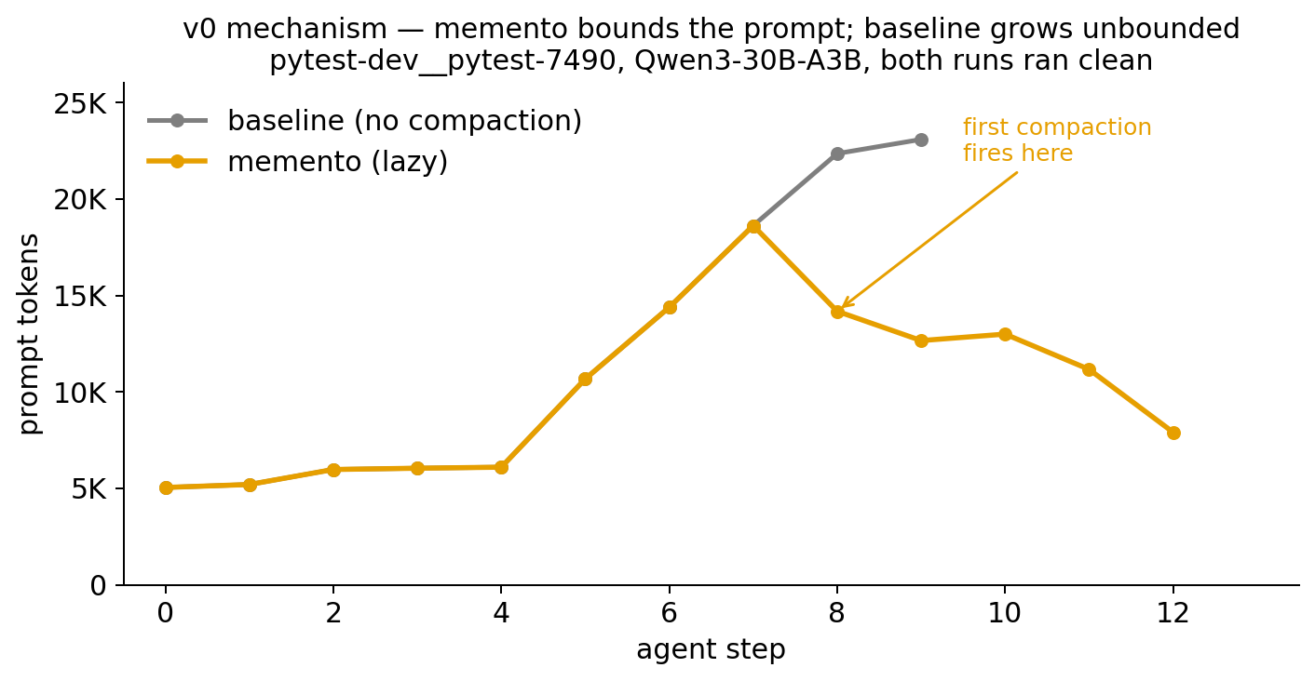
v0 — memento bounds the prompt while baseline grows linearly
PAPER 2 · EXPLORATORY
vLLM 0.13.0 + Memento overlay + lazy policy. Real pytest-7490 agent loop. Both runs clean — no crashes.
-31%
chat wall (13.3s vs 19.3s)
-66%
final prompt (8K vs 23K)
5
compactions fired (lazy policy)
AdaptiveCache · Vlad Cainamisir · Harvard
25 / 28

Slide 26
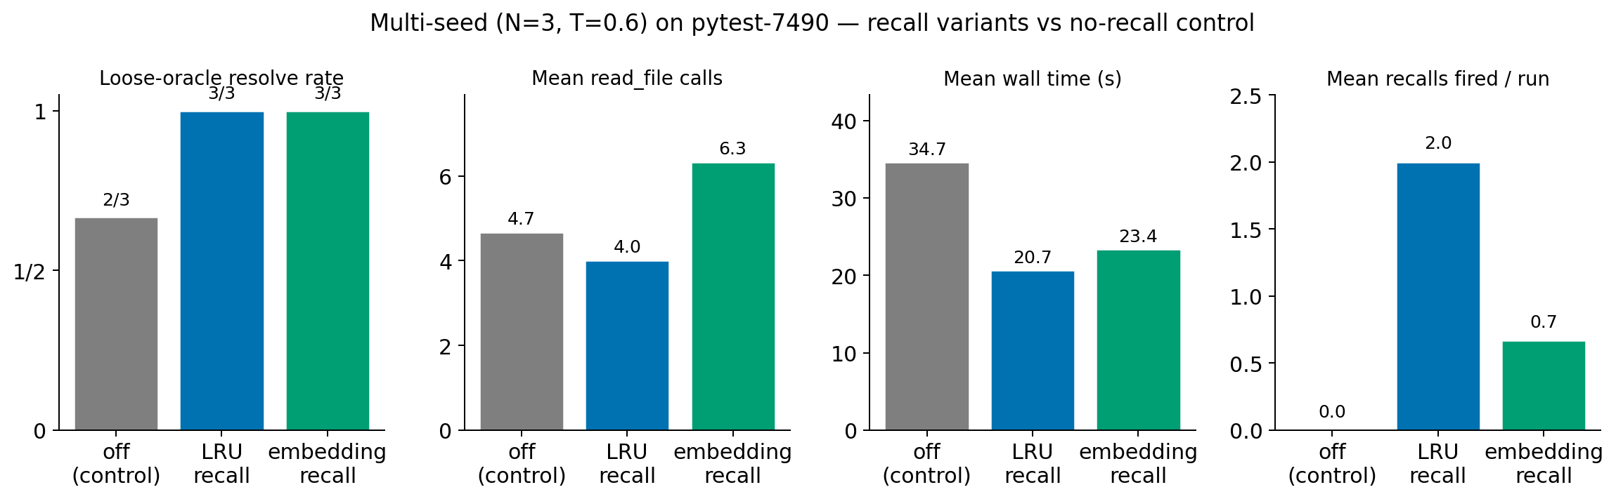
v1 — three recall triggers, head-to-head
PAPER 2 · EXPLORATORY
N=3 seeds · T=0.6 · pytest-dev/pytest-7490 · LRU and embedding both fire correctly. Wall time drops ~40% under either.
What's working:
· Plumbing fires correctly: LRU 2.0 recalls/run; embedding model loads + scores in real time.
· Wall-time and read-count benefit replicates across seeds (~40% faster than no-recall).
· The T=0 single-seed “embedding wins” was noise — multi-seed flips it: LRU narrowly best on this task.
AdaptiveCache · Vlad Cainamisir · Harvard
26 / 28

Slide 27
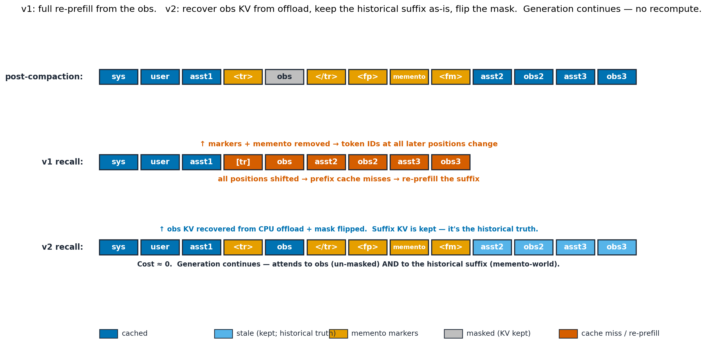
v1 vs v2 — keep the KV, flip the mask, keep going
PAPER 2 · EXPLORATORY
v1 today: re-prefill from the obs. v2 target: obs KV from offload, suffix KV stays as historical truth, mask flipped — generation just continues.
v1 (today): re-prefill from the obs onward.
v2 (target): keep KV; obs from offload; flip the mask.
Cost = obs_len + suffix_len. Bounded prompt size still wins — wall ↓ ~40% over no-recall.
Cost ≈ 0. Suffix KV is the historical truth — agent really did proceed memento-only. New generation sees both.
AdaptiveCache · Vlad Cainamisir · Harvard
27 / 28

Slide 28
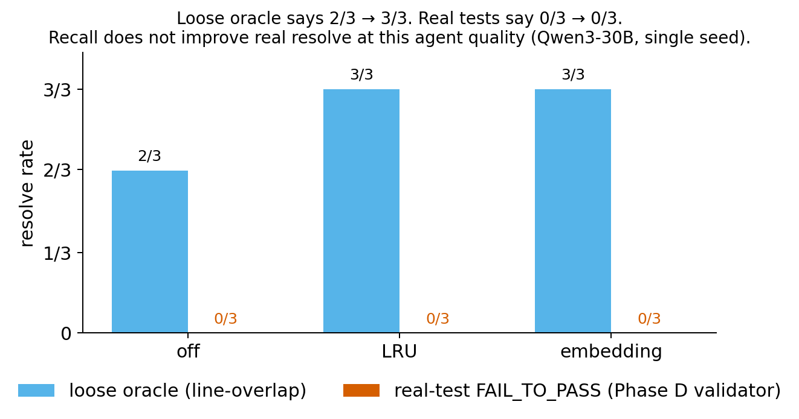
WHAT'S HARD
The mechanism works. The agent doesn't.
The honest read
✓
v0 + v1 plumbing — shipped, validated
✓
Wall time + read count — real benefit
✗
Real-test FAIL_TO_PASS — no improvement
Qwen3-30B at single seed × 20 steps cannot fix pytest-7490 regardless of context strategy.
Next · Haiku-as-agent re-test (Paper 1's strong-agent setup) · attention-driven recall (RQ2 #3) · multi-task expansion
AdaptiveCache · Vlad Cainamisir · Harvard
28 / 28

