Slide 1
Part II.
Two-Person Zero-Sum Games

Slide 2
The Strategic Form of a Game.
The individual most closely associated with the creation of the theory of games is John von Neumann, one of the greatest mathematicians of this century. Although others preceded him in formulating a theory of games - notably ´Emile Borel - it was von Neumann who published in 1928 the paper that laid the foundation for the theory of two-person zero-sum games,
i.e. games with only two players in which one player wins what the other player loses. In Part II, we restrict attention to such games. We will refer to the players as Player I and Player II.

Slide 3
1.1 Strategic Form.
The simplest mathematical description of a game is the strategic form. For a two-person zero-sum game, the payoff function of Player II is the negative of the payoff of Player I, so we may restrict attention to the single payoff function of Player I.

Slide 4
Definition: The strategic form, or normal form, of a two-person zero-sum game is given by a triplet (X, Y,A), where
(1) X is a nonempty set, the set of strategies of Player I
(2) Y is a nonempty set, the set of strategies of Player II
(3) A is a real-valued function defined on X × Y. (Thus,
A(x, y) is a real number for every x ∈ X and every
y ∈ Y.)

Slide 5
The interpretation is as follows. Simultaneously, Player I chooses x ∈ X and Player II chooses y ∈ Y, each unaware of the choice of the other.
Then their choices are made known and I wins the amount A(x, y) from II.
If A is negative, I pays the absolute value of this amount to II.
Thus, A(x, y) represents the winnings of I and the losses of II.

Slide 6
1.2 Example:
Paper-Scissors-Rock
Players I and II simultaneously display one of the three objects: paper, scissors, or rock.

Slide 7
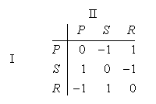
If they both choose the same object to display, there is no payoff. If they choose different objects, then scissors win over paper (scissors cut paper), rock wins over scissors (rock breaks scissors), and paper wins over rock (paper covers rock). If the payoff upon winning or losing is one unit, then the matrix of the game is as follows.

Slide 8
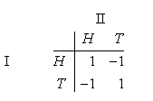
Matching Pennies:
Two players simultaneously choose heads or tails. Player I wins if the choices match and Player II wins otherwise. If the payoff upon winning or losing is one unit, then the payoff matrix of the game is as follow.

Slide 9
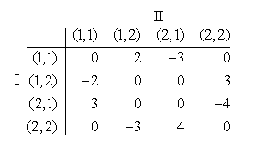
Simplified Morra:
Each of two players show one finger or two fingers, and simultaneously guesses how many fingers the other player will show. If both players guess correctly, or both players guess incorrectly, there is no payoff. If just one player guesses correctly, that player wins a payoff equal to the total of fingers shown by both players. If we let (x,y) be the strategy of showing x finger and guessing y finger, then the payoff matrix of the game is as below.

Slide 10
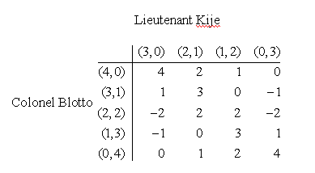
Colonel Blotto Games.
Colonel Blotto has 4 regiments with which to occupy two posts. The famous Lieutenant Kije has 3 regiments with which to occupy the same posts. The payoff is defined as follows. The army sending the most units to either post captures it and all the regiments sent by the other side, scoring one point for the captured post and one for each captured regiment. If the players send the same number of regiments to a post, both forces withdraw and there is no payoff.
Colonel Blotto must decide how to split his forces between the two posts. There are 5 strategies he may employ, namely, X = {(4, 0), (3, 1), (2, 2), (1, 3), (0, 4)}, where (n₁, n₂) represents the strategy of sending n₁ units to post number 1, and n₂ units to post number two. Lieutenant Kije has 4 pure strategies, Y = {(3, 0), (2, 1), (1, 2), (0, 3)}. The payoff matrix is

Slide 11
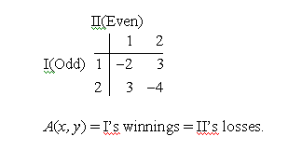
Odd or Even.
Players I and II simultaneously call out one of the numbers one or two. Player I’s name is Odd; he wins if the sum of the numbers if odd. Player II’s name is Even; she wins if the sum of the numbers is even. The amount paid to the winner by the loser is always the sum of the numbers in dollars. To put this game in strategic form we must specify X, Y and A. Here we may choose X = {1, 2}, Y = {1, 2},
and A as given in the following table.

Slide 12

Matrix Games
A finite two-person zero-sum game in strategic form, (X, Y,A), is sometimes called a matrix game because the payoff function A can be represented by a matrix. If X ={x1, . . . , xm} and Y = {y1, . . . , yn}, then by the game matrix or payoff matrix we mean the matrix
In this form, Player I chooses a row, Player II chooses a column, and II pays I the entry in the chosen row and column.
Note that the entries of the matrix are the winnings of the row chooser and losses of the column chooser.

Slide 13
Question: How will the game play out?
This is not an easy question to answer. The first principle that we can agree on is to simplify the game by removing dominated strategies.

Slide 14
Removing Dominated Strategies.
Definition. We say the ith row of a matrix A = (a_{ij}) dominates the kth row if a_{ij} ≥ a_{kj} for all j. We say the ith row of A strictly dominates the kth row if a_{ij} > a_{kj} for all j. Similarly, the jth column of A dominates (strictly dominates) the kth column if a_{ij} ≤ a_{ik} (resp. a_{ij} < a_{ik}) for all i.
Anything Player I can achieve using a dominated row can be achieved at least as well using the row that dominates it. Hence dominated rows may be deleted from the matrix. A similar argument shows that dominated columns may be removed.
We may iterate this procedure and successively remove several rows and columns. (Examples to be given later)

Slide 15
Example from movies
Ronin
Robert Deniro's character, unsure whether "baddies" are hiding in a dark corner, shoots anyway. "Whenever there is any doubt, there is no doubt" he says of his dominant strategy.

Slide 16
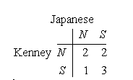
Example: Battle of Bismarck Sea
In the critical stages of the struggle for New Guinea, intelligence reports indicated that the Japanese would move a troop and supply convoy from the port at the eastern tip of New Britain to Lae, which lies just west of New Britain or New Guinea. It could travel north of New Britain, where poor visibility was almost certain, or south of the Island, where the weather would be clear; in either case, the trip would take three days. General Kenney had the choice of concentrating the bulk of his reconnaissance aircraft on one route or the other. Once sighted, the convoy could be bombed until its arrival at Lae. In days of bombing time, Kenney’s staff estimated the following outcomes for the various choices:

Slide 17
For this game the second column is dominated by the first column. The Japanese will remove the second column from his consideration. Kenney, knowing the Japanese’s removal of the second column, will then play the first row. Therefore, <N, N> is the outcome of this game.
In general, we may not be able to remove any strategy or after the removal of some strategies the game matrix is still quite big. The Principle of Removal of Dominated Strategies can only help us to simplify the game matrix somewhat.

Slide 18
Remark: In the above analysis, we used the basic assumption of Common Knowledge.
A fact is common knowledge if everyone knows it, everone knows that everyone knows it, everyone knows that everyone knows that everyone knows it,..., and so on ad infinitum.
你知, 我知, 你知我知, 我知你知, ……..

Slide 19
Sherlock Holmes, pursued by his opponent, Moriaty, leaves London for Dover. The train stops at a station on the way, and he alights there rather than travelling to Dover. He has seen Moriaty at the railway station, recognizes that he is very clever and expects that Moriaty will take a faster special train in order to catch him in Dover. Holmes’ anticipation turns out to be correct. But what if Moriaty had been still more clever, had estimated Holmes’ mental abilities better and had foreseen his actions accordingly? Then, obviously, he would have travelled to the intermediate station. Holmes, again, would have had to calculate that, and he himself would have decided to go on to Dover. Whereupon, Moriaty would again have “reacted” differently. Because of so much thinking they might not have been able to act at all or the intellectually weaker of the two would have surrendered to the other in the Victoria Station, since the whole flight would have become unnecessary.

Slide 20
Once upon a time a time an evil King decided to grant sadistic amnesty to a large group of prisoners, who were kept incommunicado in the dungeons. The King placed a hat on each prisoner; two of these hats were red, the rest white. The King summoned the prisoners and commanded them not to look upward. Thus each prisoner could see the hat of every one of his fellow prisoners, but not his own. The King spoke thus: “Most of you are wearing white hats, but at least one of you is wearing a red hat. Every day from now on you will be brought to here from your solitary confinement. The day that you guess correctly the color of the hat that you are wearing is the day you will go free. If you guess incorrectly, you will be instantly beheaded.”
How many days would it take the two red-hatted prisoners to infer, rationally, the color of their hats?

Slide 21

An honest father tells his two sons that he has placed 10^{n} dollars in one envelope, and 10^{n+1} dollars in the other, where n is chosen with equal probability among integers between 1 to 6. The father randomly hands each son an envelope. The first son looks inside and finds $10,000. He calculates that the other envelope contains either $1,000 or $100,000 with equal probability. The expected amount in the other envelope is then $50,500. The second son finds only $1,000 in his envelope. Again, he calculates that the expected amount of the other envelope is $5,050. The father privately asks each son whether he would be willing to pay $1 to switch envelopes. Both son say yes. The father then tells each son what his brother said and repeats the question. Again, both say yes. The father relays the brothers’ answers and ask each a third time. Again both say yes. But if the father relays the answer and ask a fourth time, the son with $1,000 will say yes, but the son with $10,000 will say no.
Why?

Slide 22
Common knowledge is a phenomenon which underwrites much of social life. In order to communicate or otherwise coordinate their behavior successfully, individuals typically require mutual or common understandings or background knowledge.
If a married couple are separated in a department store, they stand a good chance of finding one another because their common knowledge of each others' tastes and experiences leads them each to look for the other in a part of the store both know that both would tend to frequent. Since the spouses both love cappuccino, each expects the other to go to the coffee bar, and they find one another.
In A Treatise of Human Nature, Hume argued that a necessary condition for coordinated activity was that agents all know what behavior to expect from one another. Without the requisite mutual knowledge, Hume maintained, mutually beneficial social conventions would disappear.

Slide 23
Examples from movies:
Mystery Men
Suggested by Rick Daley
Perhaps even more confusing than the iterative reasoning of common knowledge is the idea reflected in the following scene. If a player is only boundedly rational, and thinks a limited number steps ahead, can we iterate the "I know how many steps ahead you know" reasoning, too? Rick Daley explains the set up for the scene:
"Captain Amazing is losing his sponsors (notably Pepsi) because he can't find any more good fights. So, he decides to sponsor the parole of one of his worst enemies, Casanova Frankenstein, who has spent the last 20 years in an insane asylum. The first thing Casanova does is blow up the asylum. Captain Amazing shows up moments later."
CF: Captain Amazing! What a surprise!
CA: Really? I'm not so sure about that. Your first night of freedom and you blow up the asylum. Interesting choice. I knew you couldn't change.
CF: I knew you'd know that.
CA: Oh, I know that, and I knew you'd know I know you knew.
CF: But I didn't. I only knew you'd know that I knew. Did you know that?
CA: Of course.

Slide 24
Princess Bride
(Review by Mike Shor)
Our hero Westley, in the guise of the Dread Pirate Roberts, confronts his foe-for-the-moment, the Sicilian, Vizzini. Westley challenges him to a Battle of Wits. Two glasses are placed on the table, each containing wine and one purportedly containing poison. The challenge, simply, is to select the glass that does not lead to immediate death.
Roberts: All right: where is the poison? The battle of wits has begun. It ends when you decide and we both drink, and find out who is right and who is dead.
Vizzini: But it's so simple. All I have to do is divine from what I know of you. Are you the sort of man who would put the poison into his own goblet, or his enemy's? Now, a clever man would put the poison into his own goblet, because he would know that only a great fool would reach for what he was given. I'm not a great fool, so I can clearly not choose the wine in front of you. But you must have known I was not a great fool; you would have counted on it, so I can clearly not choose the wine in front of me.
Roberts: You've made your decision then7
Vizzini: Not remotely. Because iocane comes from Australia, as everyone knows. And Australia is entirely peopled with criminals. And criminals are used to having people not trust them, as you are not trusted by me. So I can clearly not choose the wine in front of you.
Roberts: Truly, you have a dizzying intellect.
The scene, beyond providing some comic relief on the theme of common knowledge, also has an important lesson on strategic moves; if the rules of the game may be changed, then the game can be rigged to one player's advantage:
Vizzini: let's drink -- me from my glass, and you from yours.
[allowing Roberts to drink first, he swallows his wine]
Roberts: You guessed wrong.
Vizzini (roaring with laughter): You only think I guessed wrong -- that's what's so funny! I switched glasses when your back was turned. You fool. You fell victim to one of the classic blunders. The most famous is "Never get involved in a land war in Asia." But only slightly less well known is this: "Never go in against a Sicilian when death is on the line."
[He laughs and roars and cackles and whoops until he falls over dead.]
[Roberts begins to rescue Buttercup, the girl over whom this battle was staged in the firstplace]
...
Buttercup: To think -- all that time it was your cup that was poisoned.
Roberts: They were both poisoned. I spent the last few years building up an immunity to iocane powder.
The movie contains several other scenes with game-theoretic themes, including many on bluffing.

Slide 25
We may apply the following two principles to analyze the game.
Equilibrium Principle: Best Responses to each other
做到最好
或 做好呢份工
This principle involves the interactions of the players.
Maximin Principle: Safety First
安全第一
Under this principle, each player only concerns his/her own payoff.

Slide 26
Saddle points.
If some entry aij of the matrix A has the property that
(1) a_{ij} is the minimum of the ith row, and
(2) a_{ij} is the maximum of the jth column,
then we say a_{ij} is a saddle point. If a_{ij} is a saddle point, then Player I can then win at least a_{ij} by choosing row i, and Player II can keep her loss to at most a_{ij} by choosing column j.
<Row i, Column j> is then an equilibrium pair, i.e. BR to each other.

Slide 27
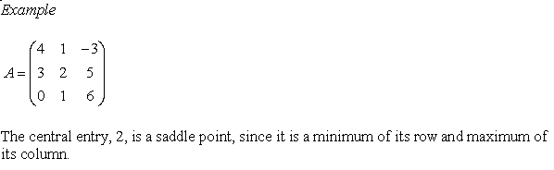
For large m × n matrices it is tedious to check each entry of the matrix to see if it has the saddle point property. We can use the following labeling algorithm to find saddle points.

Slide 28
Labelling Algorithm:
Go through the game matrix row by row. Put a star on the entry that is the minimum of its row.
2. Go through the game matrix column by column. Put a star on the entry that is the maximum of its column.
3. The entries with two stars are saddle points.

Slide 29
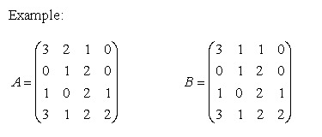
In matrix A, there is no saddle point.
However, if the 2 in position a12 were changed to a 1, then we have matrix B. Here, the minimum of the fourth row is equal to the maximum of the second column; so b42 is a saddle point.

Slide 30
Remark: A game matrix may have several saddle points. However, the values of the saddle points are all equal.

Slide 31
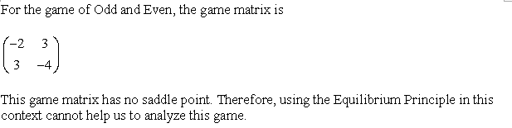

Slide 32
Instead, we will try the Maximin Principle.
Maximin Principle means to find the “risk” for each strategy and then find the strategy with minimum risk.
Using this “safety strategy”, one can guarantee to get at least a certain amount of payoff.

Slide 33
It is achieved by Row 1. If Player I uses Row 1, he can guarantee to get a payoff of -2.

Slide 34


Slide 35
Can we do better?
Suppose Player I flips a fair coin to decide his strategy. If Head appears, he uses Row 1. If Tail appears, he uses Row 2.
Therefore, the worst payoff for this randomized strategy is -0.5.

Slide 36
We should randomize our strategy!

Slide 37
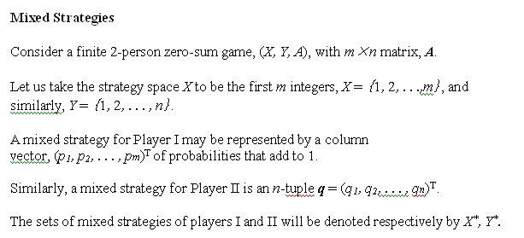

Slide 38


Slide 39
The m-dimensional unit vector e_{k} ∈ X* with a one for the kth component and zeros elsewhere may be identified with the pure strategy of choosing row k.
Remark: X*,Y* are compact convex sets such that the vertices correspond to pure strategies.

Slide 40
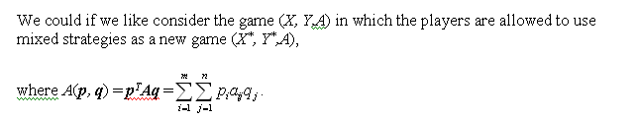
Extension of payoff to mixed strategies:
We may consider the set of Player I’s pure strategies, X, to be a subset of X*.
Similarly, Y may be considered to be a subset of Y*.

Slide 41
Remark:
In this extension, we have made a rather subtle assumption. We assumed that when a player uses a mixed strategy, he is only interested in his average return. He does not care about his maximum possible winnings or losses — only the average.
This is actually a rather drastic assumption.
The main justification for this assumption comes from utility theory.

Slide 42
The basic premise of utility theory is that one should evaluate a payoff by its utility to the player rather than on its numerical monetary value. Utility theory is one of the fundamental contributions of von Neumann and Morgenstern.

Slide 43
Remark:
There are some philosophical issues about using mixed strategies.
Do we really use mixed strategies in real life?

Slide 44
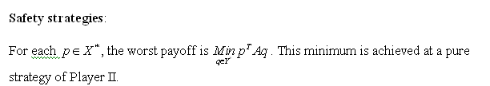

Slide 45



Slide 46
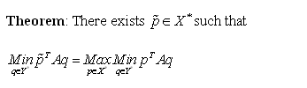


Slide 48
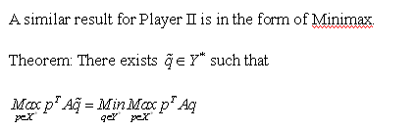


Slide 49


Slide 50



Slide 52



Slide 53
Remark: Because of the Minimax Theorem, the safety strategies are also called the optimal strategies.

