Slide 1
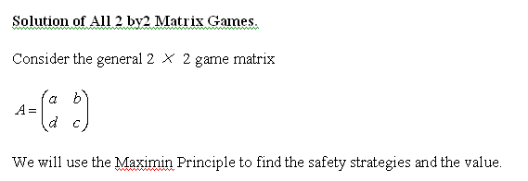

Slide 2
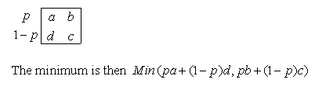
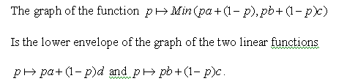

Slide 3


Slide 4




Slide 5



Slide 6



Slide 7
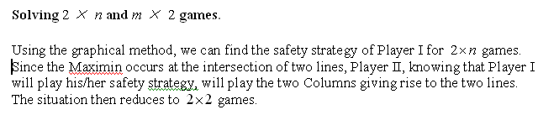

Slide 8


Slide 9
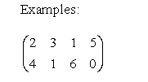
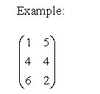

Slide 10
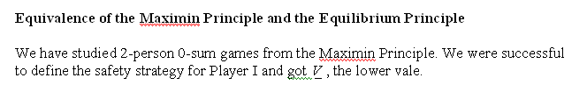

Slide 11


Slide 12




Slide 13
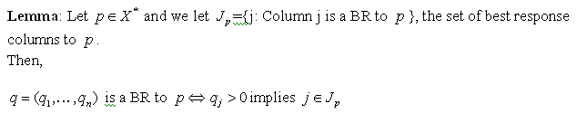
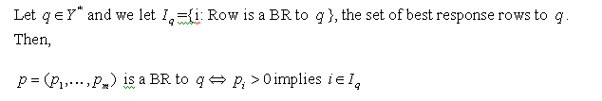

Slide 14
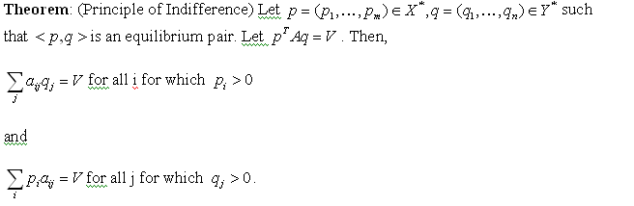

Slide 15
The Principle of Indifference gives the following recipe for a mixed strategy to be the best response to a given strategy:
Find all best response pure strategies
Use only those BR pure strategy to compose your mixed strategy

Slide 16
Equilibrium Principle: BR to each other
Maximin Principle: Safety first
For Player I: Find p so that Min_{q}p^{T}Aq is largest. P is called the Safety Strategy or optimal strategy.
Min_{q}p^{T}Aq is the lower value.
For Player II: Find q so that Max_{p}p^{T}Aq is smallest. Q is called the Safety Strategy or optimal strategy.
Max_{p}p^{T}Aq is the upper value.
Theorem: Maximin=Minimax

Slide 17


Slide 18
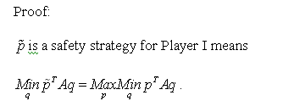


Slide 19

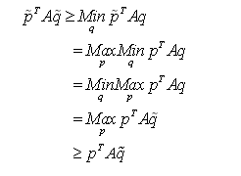

Slide 20


Slide 21


Slide 22







Slide 24
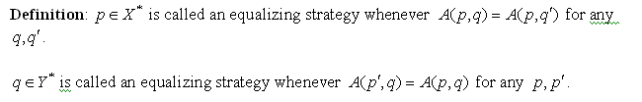

Slide 25
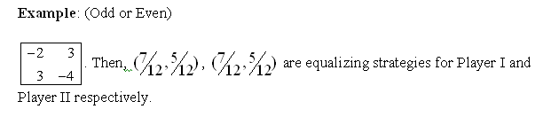

Slide 26
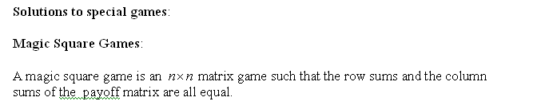
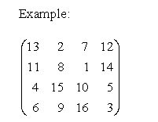


Slide 27


Slide 28
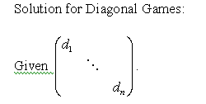



Slide 29
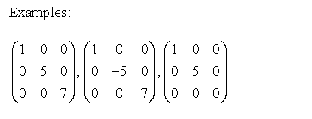

Slide 30
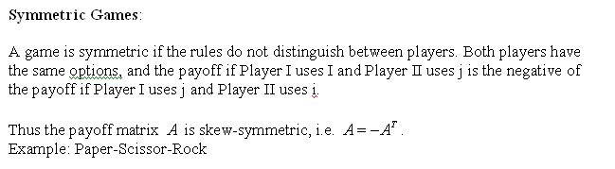

Slide 31
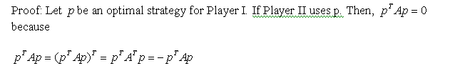

Slide 32



Slide 33
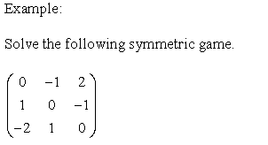

Slide 34
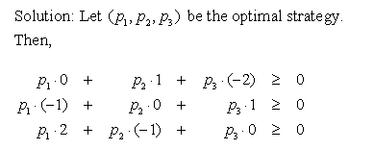
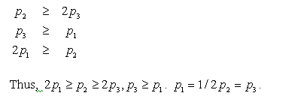


Slide 35
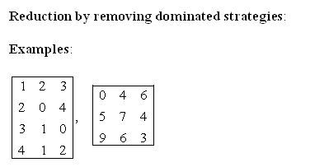

Slide 36
Solving 2-Person 0-sum games by linear programming
The basic problem of linear programming, determining the optimal value of a linear function subject to linear constraints, arise in a wide variety of situations.
In 1939the Russian mathematician L.V. Kantorovich published a monograph entitled “Mathematical Methods in the Organization and Planning of Production”. Kantorovich went unrecognized in the West.
Through the works of Frank Hitchcock and George Stigler and their efforts in World War II, it became clear that a feasible method for solving linear programming problems was needed. Then in 1947 George Dantzig developed the simplex method. John von Neumann recognized the importance of the concept of duality, and the first proof of the Duality Theorem is that of Gale, Kuhn and Tucker.
The simplex method gives an algorithm to go from one vertex to another vertex in searching for the optimal value.

Slide 37
Polynomial time algorithm
In 1979, the Russian mathematician Leonid Khatchian announced a polynomial time algorithm for the resolution of the linear programming problem. The algorithm uses a sequence of ellipsoids to drive to a solution of a linear programming problem.
A polynomial time linear programming algorithm using an interior point method was found by Karmarkar (1984). Arguably, interior point methods were known as early as The media hype accompanying Karmarkar's announcement led to these methods receiving a great deal of attention. However, it should be noted that while Karmarkar claimed that his implementation was much more efficient than the simplex method, the potential of interior point method was established only later. By 1994, there were more than 1300 published papers on interior point methods.

Slide 38
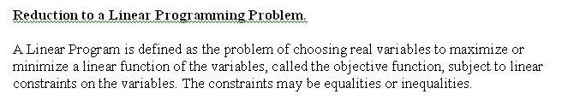

Slide 39


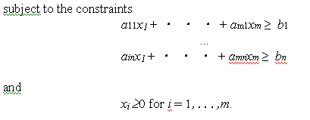

Slide 40

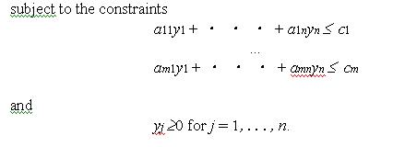

Slide 42



Slide 43

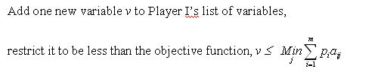

Slide 44

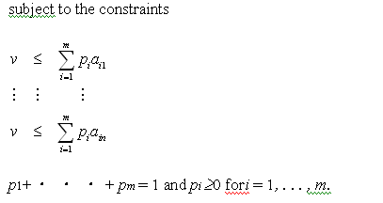

Slide 46

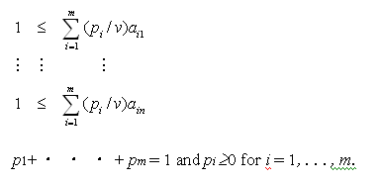



Slide 47
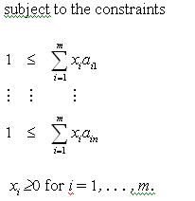

Slide 48
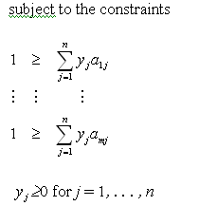


Slide 50
Iterative solution of games by fictious play
Step 1: Player I chooses a pure strategy p₁. Set x₁= p₁. Player II chooses a pure strategy BR to x₁. Call it y₁.
Step 2: Player I, given the history of II’s play, counter a pure strategy BR to y₁. Call it x₂. Player II,given history of I’s play, counter with a pure strategy BR to (x₁ + x₂)/2. Call it y₂.
Step k+1: Player I, given the history of II’s play, counter a pure strategy BR to (y₁+…+y_{k})/k. Call it x_{k+1} Player II, given the history of I’s play, counter with a pure strategy BR to (x₁+…+x_{k+1})/k+1. Call it y_{k+1}.
Julia Robinson proved in 1951 that iterative procedures of this type must converge to the optimal strategies.

