Slide 1


Slide 4


Slide 5


Slide 7


Slide 8


Slide 9



Slide 10


Slide 11


Slide 12
Imperfect recall: example from movie
Memento
Suggested by Larry Blume
One of the most common assumptions made by game theorists is that players have perfect recall - they remember everything that happened in the game up to now. Larry Blume writes "Rubenstein and Piccione convinced us that imperfect recall might be pretty weird. The movie Memento shows how strategies in such a game might have to be implemented. It's a stretch, but my first year graduate students thought you should know."
In the movie, the main character suffers from short-term memory loss, and adopts several unique strategies to remind him of what has so far transpired. Since, without perfect recall, segments of a game are somewhat independent, the movie tells his story backwards.

Slide 13
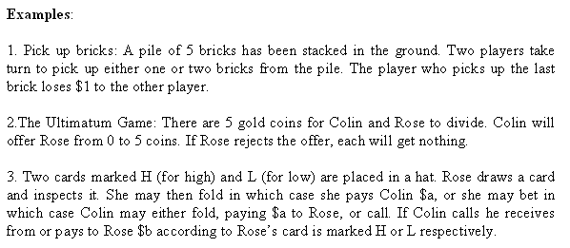

Slide 14
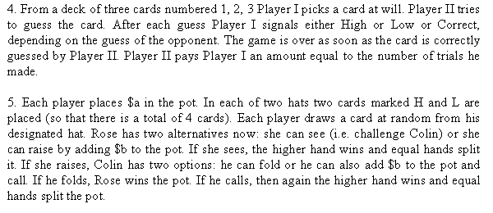

Slide 15
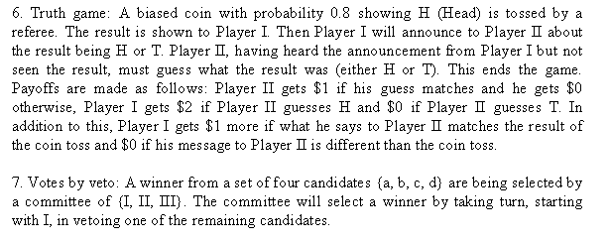

Slide 16
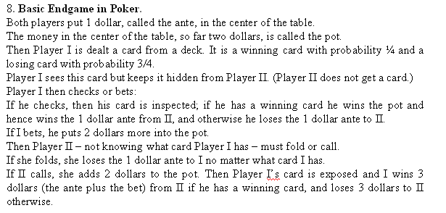

Slide 17




Slide 18



Slide 20


Slide 21



Slide 22
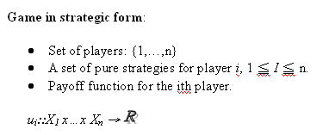

Slide 23
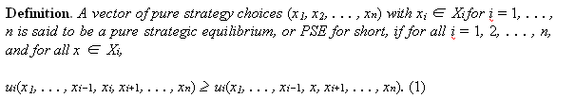


Slide 24

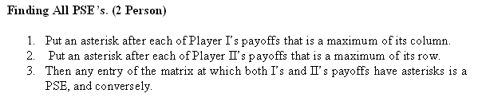


Slide 25



Slide 26


Slide 27


Slide 28


Slide 29




Slide 30
