Slide 1
CG21 HW4 OpenGL Shading Language GLSL
TA 林書廷
Notes:
2021林書廷

Slide 2
Outline
Background
Homework
Score

Slide 3
GLSL
C-style language
Covers most of the features you would expect with such a language.
Control structures (for-loops, if-else statements, etc) exist in GLSL

Slide 4
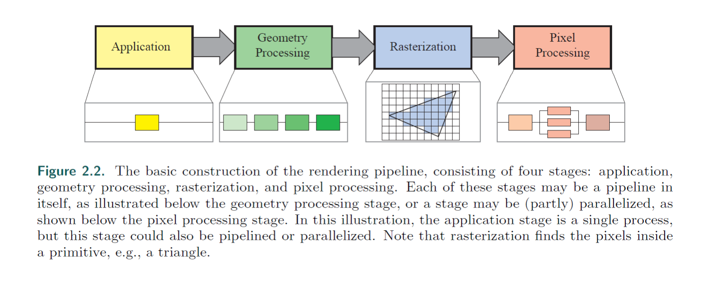
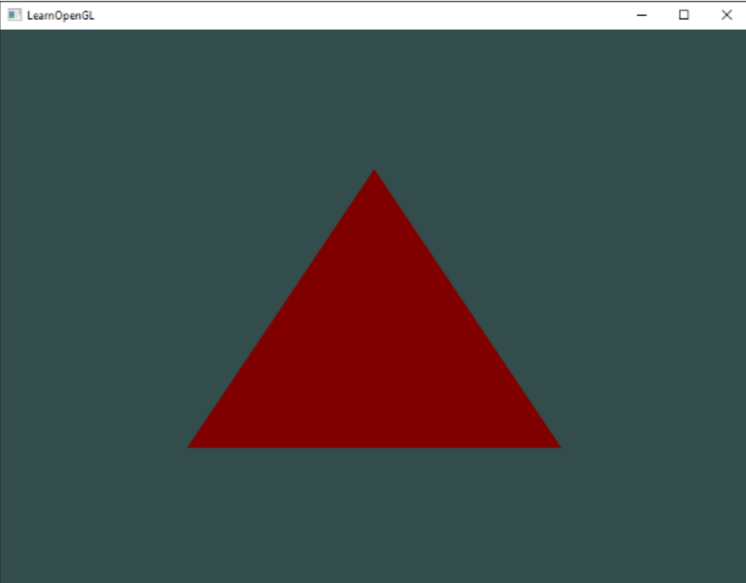
Render Pipeline
glBegin(GL_TRIANGLES);
glColor3f(red);
glVertex3f(v1);
glVertex3f(v2);
glVertex3f(v3);
glEnd();
Reference: Real-Time Rendering Fourth Edition

Slide 5
Relationship between Render Pipeline and GLSL?
Can We Programmable between these two stages?
Reference: Real-Time Rendering Fourth Edition

Slide 6
Yes! We Can
Use Shader
Vertex Shader
Fragment Shader
Reference: Real-Time Rendering Fourth Edition

Slide 7
Shader
A Shader is a user-defined program.
Designed to run on some stage of a graphics processor.
Shaders provide the code for certain programmable stages of the rendering pipeline.
They can also be used in a slightly more limited form for general, on-GPU computation.
Reference: https://www.khronos.org/opengl/wiki/Shader

Slide 8
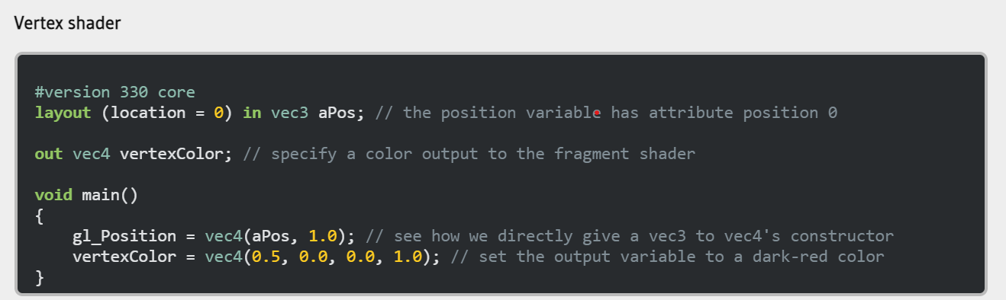
Do some basic

Slide 9
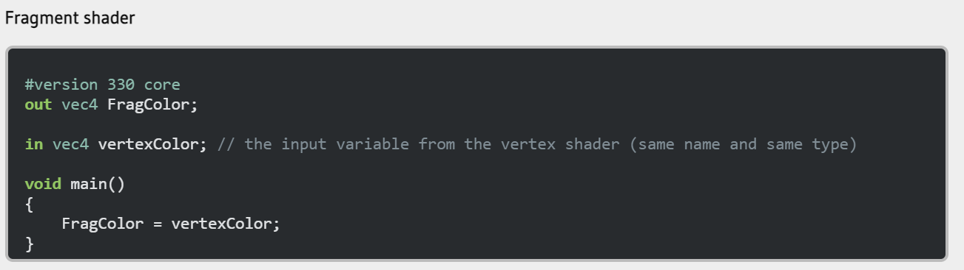
Do some basic

Slide 10
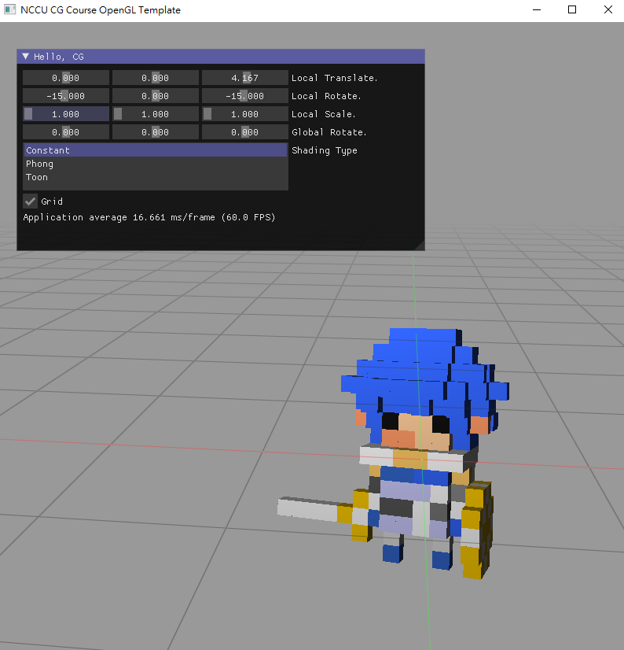
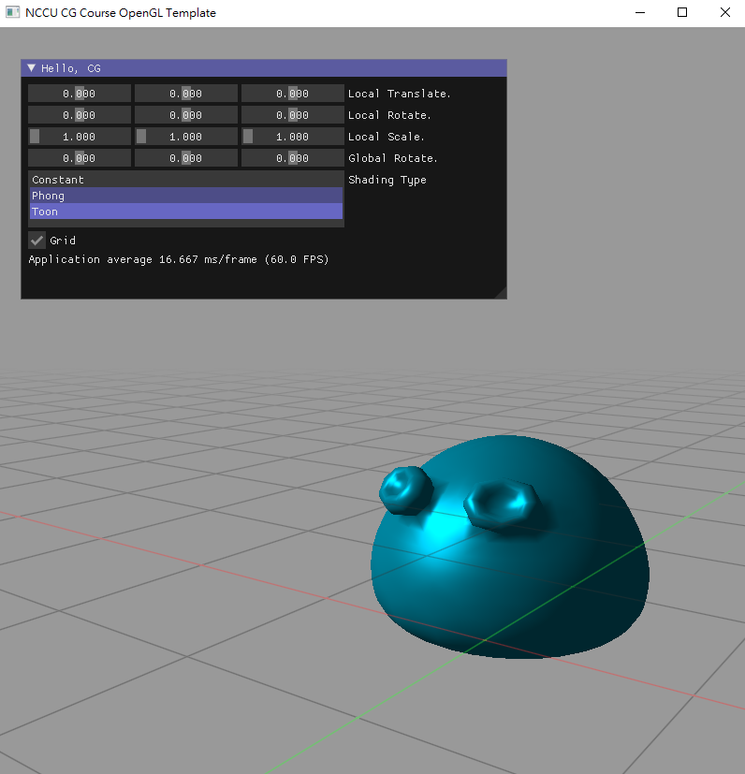
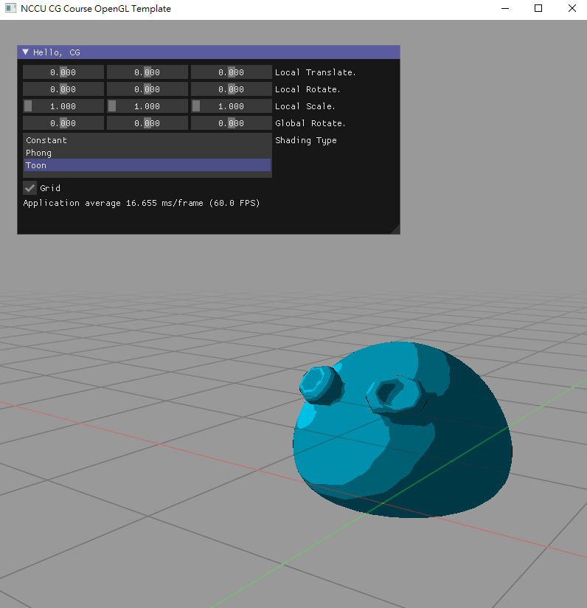
HomeWork

Slide 11
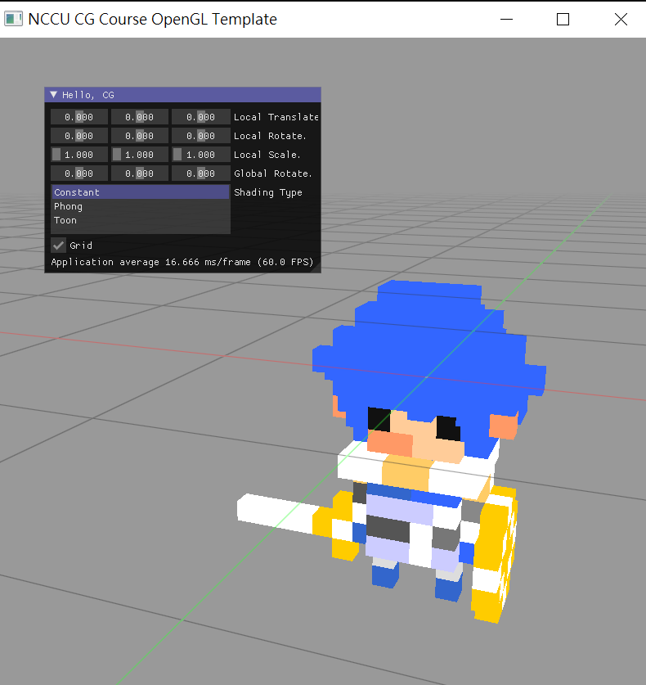
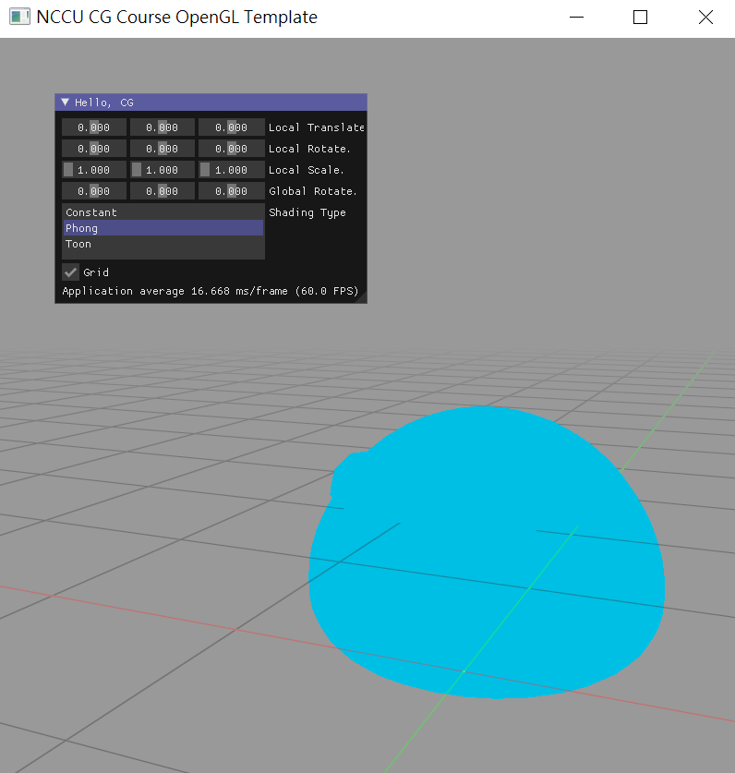

If you build successfully
default setting

Slide 12
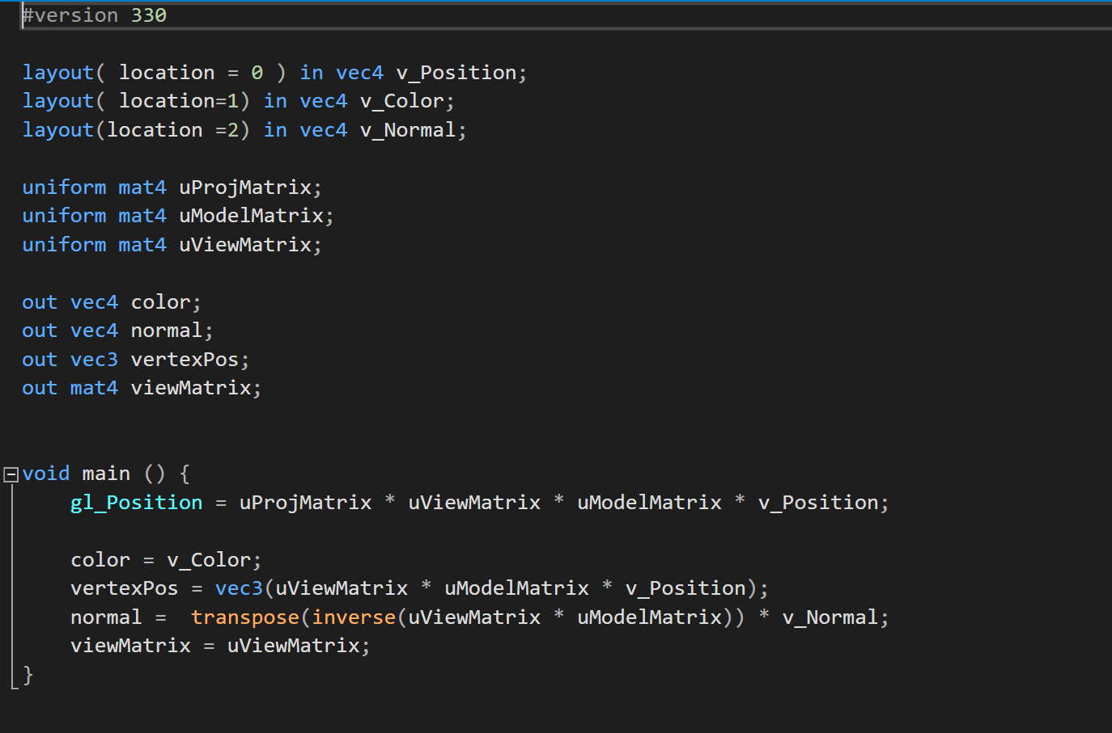
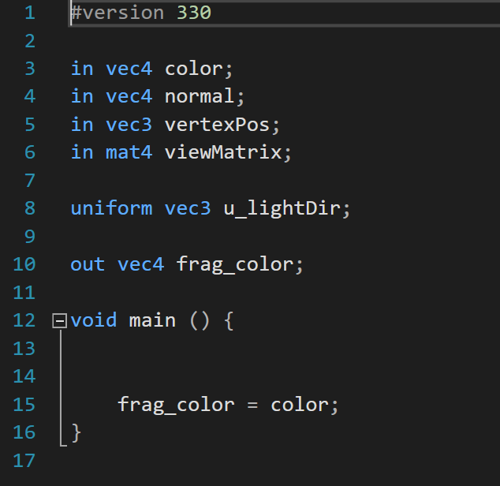
Default Shader

Slide 13
In ,out and uniform
The variable and type of in and out must be the same both in vertex shader and fragment shader!
Vertex Shader
Fragment Shader

Slide 14
Uniform
A uniform is a global Shader variable declared with the "uniform" storage qualifier.
These act as parameters that the user of a shader program can pass to that program. Their values are stored in a program object.
You can picture the uniforms like little bridges between the CPU and the GPU

Slide 15
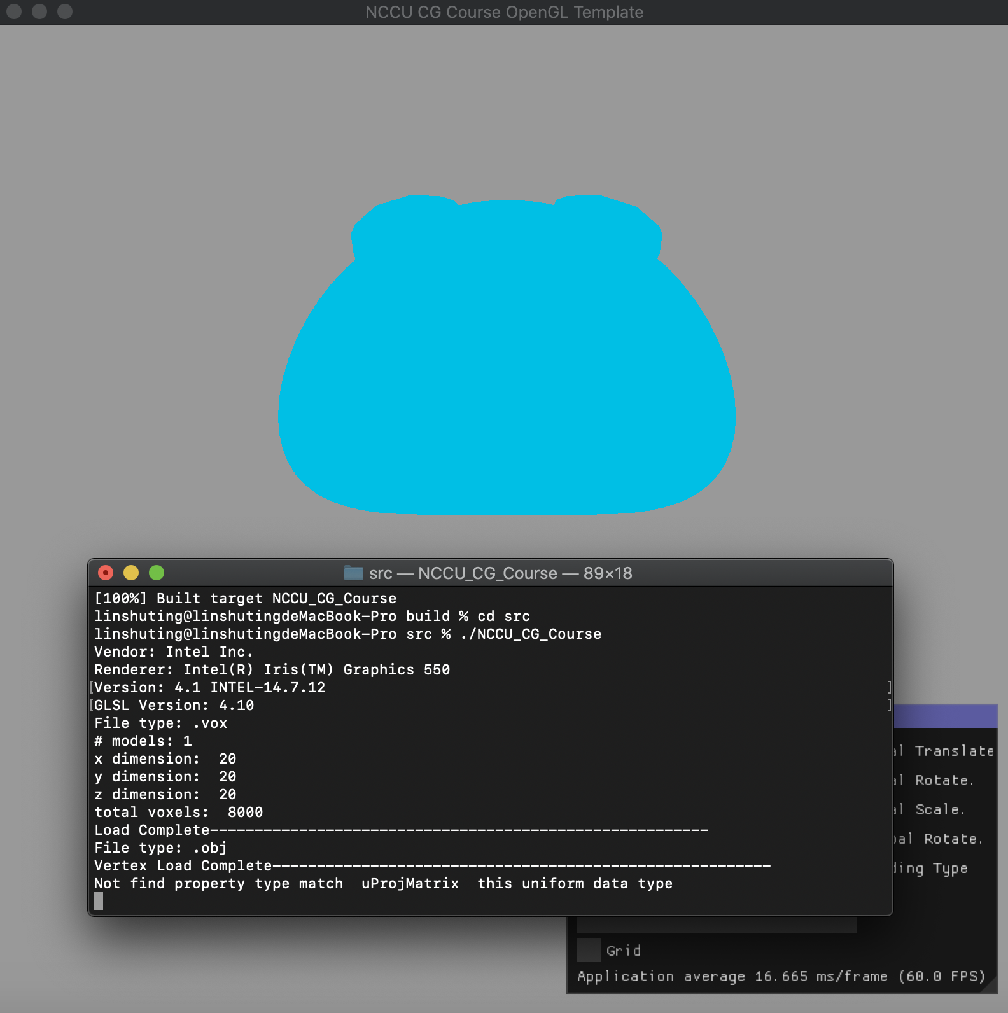
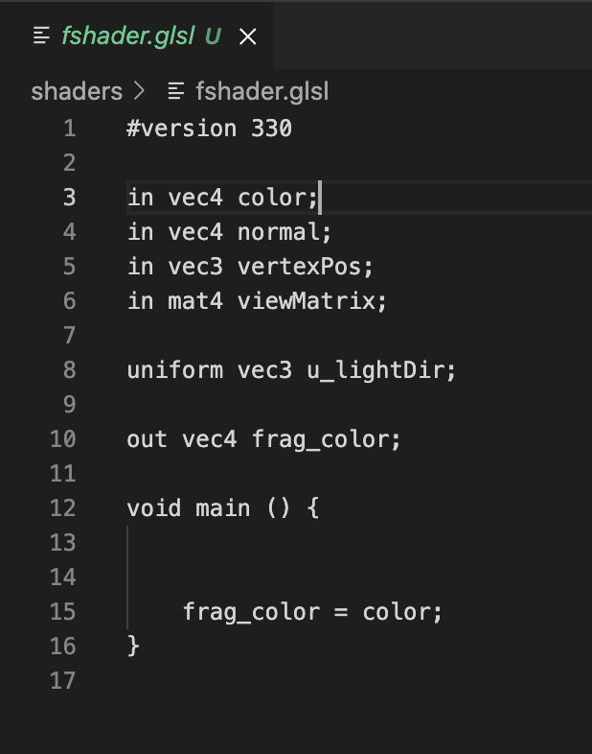
Some issues you may meet in macOS in this homework
Sorry , it’s my bad ,there are some issues about uniform variable in shader that may confused if you use macOS in this homework and will need you to add some codes in main.cpp file to fix this issue.
In default setting , you will see a blue slime if you change shading type to Phong.
This error only appear in macOS ,but not effect the result , don’t worry about that.

Slide 16
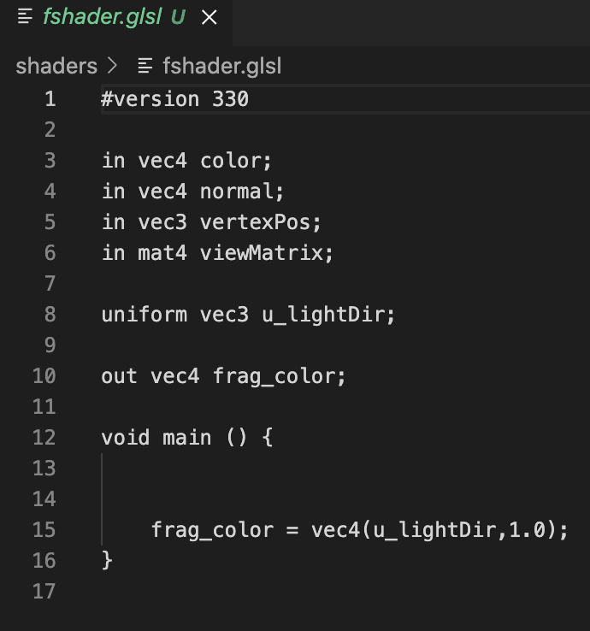
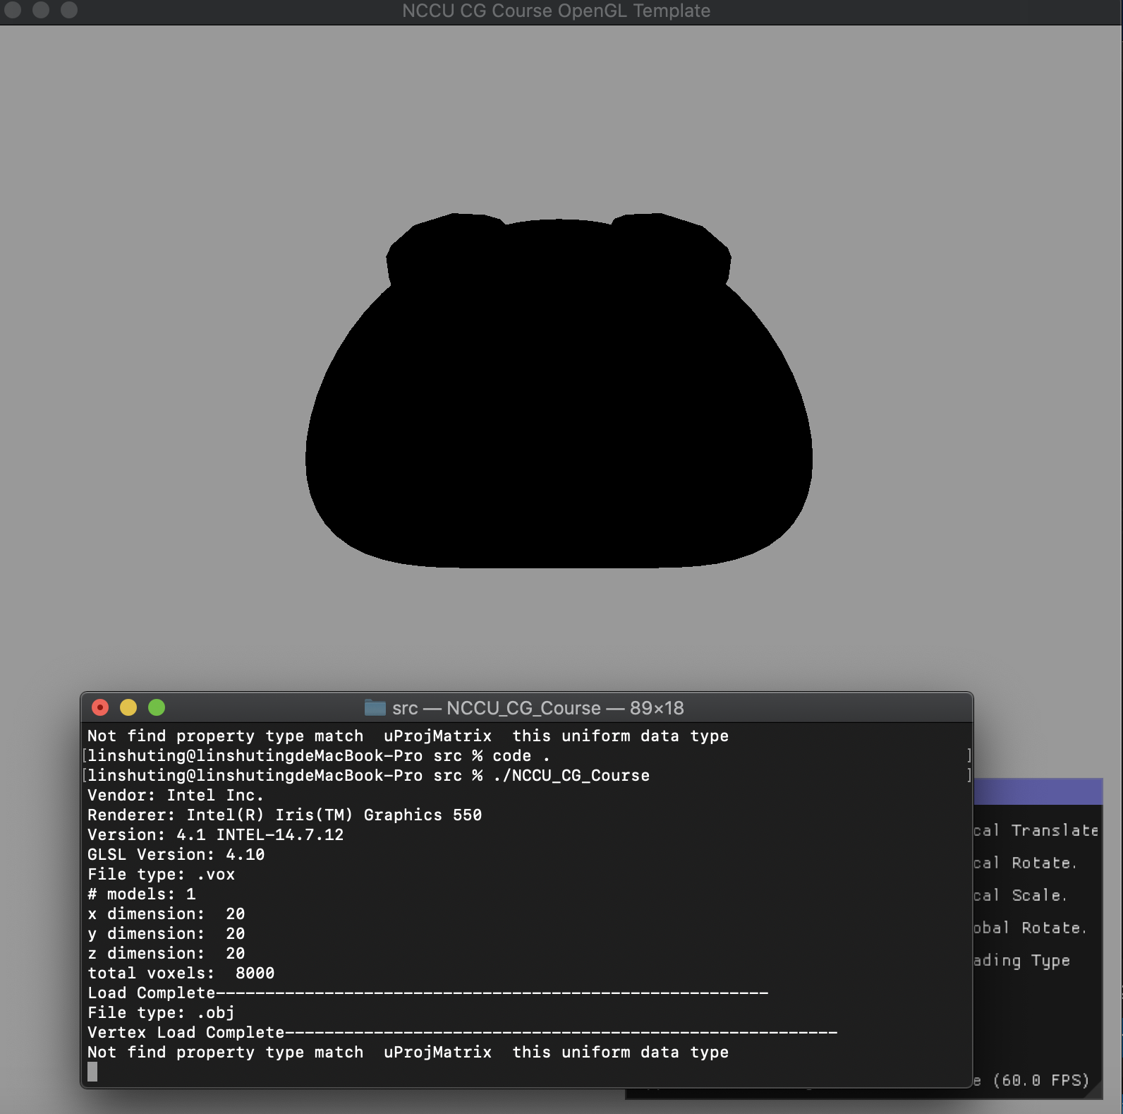
Uniform not be setting properly so it’s value is zero which is black color
In this homework , I declare a uniformConfig class named as uniformInfo in main.cpp file that take the variable name which same as uniform variable in shader and it’s data. This class should be used by renderer class and the renderer class will automatically pass the right value to the uniform variable in shader. However , in macOS , there are some problems that macOS cannot do these stuff correctly so you will need to manually set uniform variable. Still not figure out why these codes cannot work correctly in macOS , but in Windows and Ubuntu , these codes work fine.

Slide 17
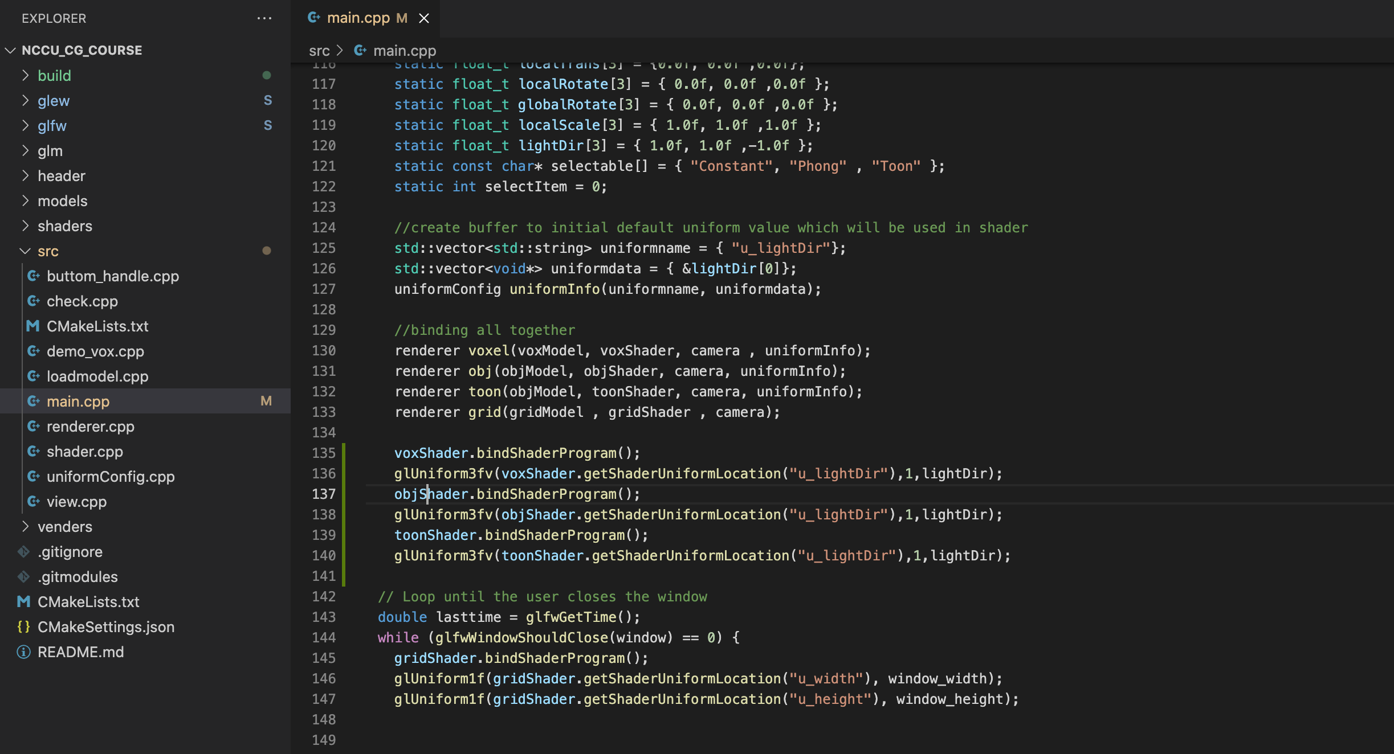
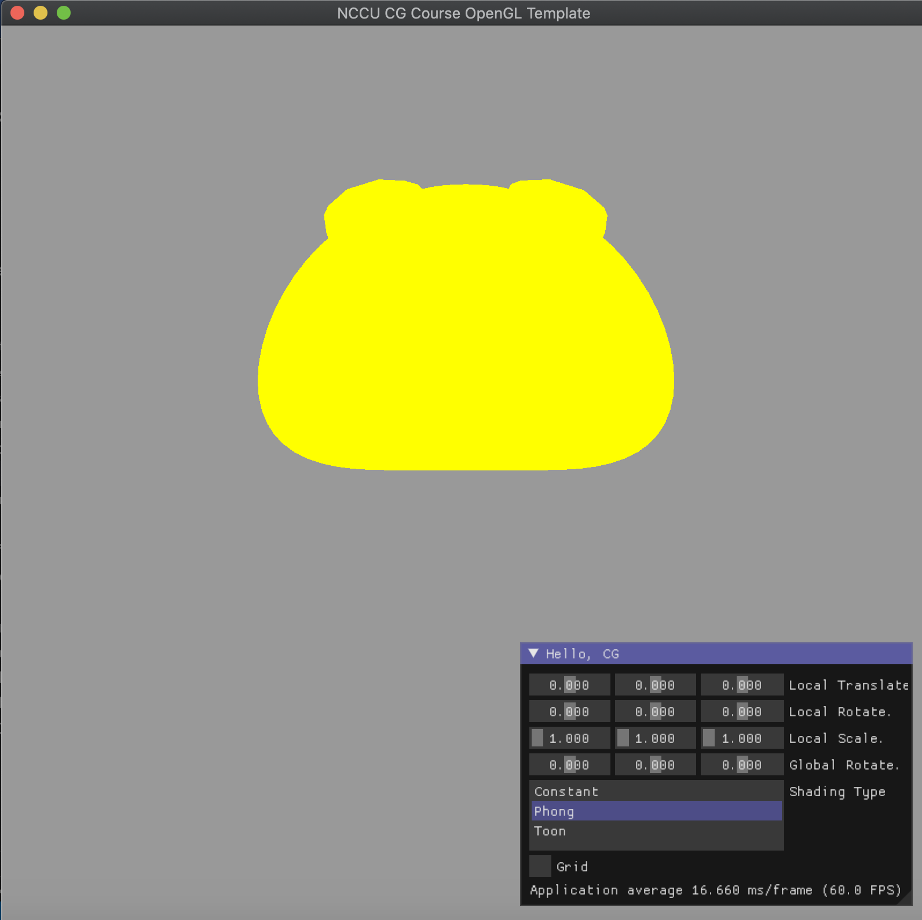
Insert these codes in main.cpp file
If you successfully pass data to uniform variable in shader , then the slime model will turn yellow from black like the picture in right.

Slide 18
Material Properties (CG21-shading-p29)
Material properties match light source properties
Nine absorption coefficients
Diffuse: k_{dr}, k_{dg}, k_{db},
Speculr: k_{sr}, k_{sg}, k_{sb},
Ambient: k_{ar}, k_{ag}, k_{ab}
Shininess coefficient α

Slide 19
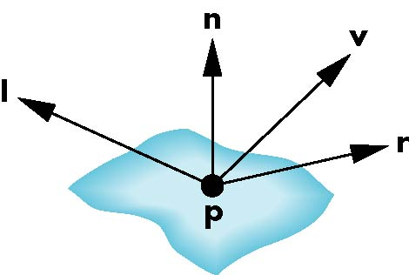
CG21-shading-p30
For each light source and each color component, the Phong model can be written (without the distance terms) as
I = k_{d} I_{d} max(0, l · n) + k_{s} I_{s} (v · r )^{α} + k_{a} I_{a}
For each color component
we add contributions from
all sources
diffuse
specular
ambient
Notes:
Distance ( 1/(a+bd+cd^2) )

Slide 20
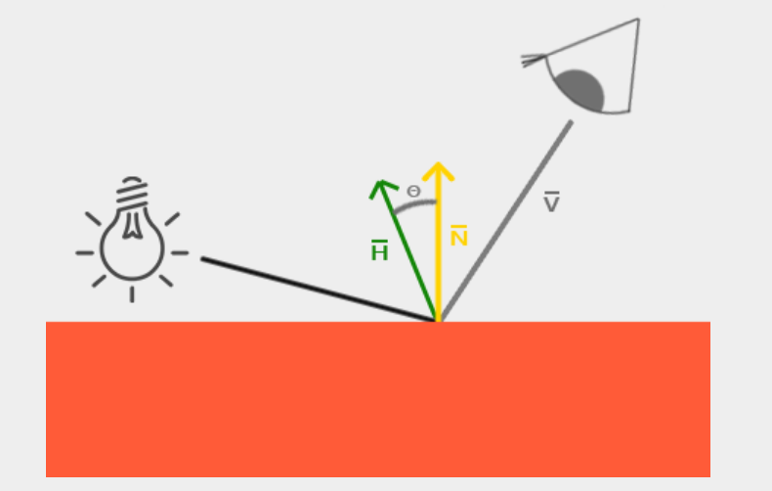
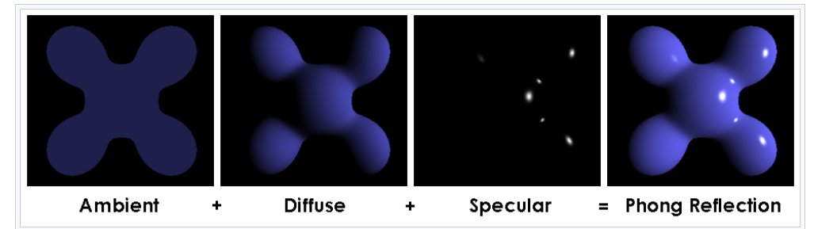
Phong Shading
L
假設光源亮度 Ia=Id=Is = vec3(1, 1, 1)
Ka=0.1*color
Ambient = Ka*Ia
Kd=color
Diffuse=Kd*Id* dot(L,N)
Ks = color
Specular =Ks*Is*…
Reference: https://en.wikipedia.org/wiki/Phong_shading, https://learnopengl.com/Lighting/Basic-Lighting

Slide 21
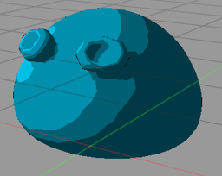
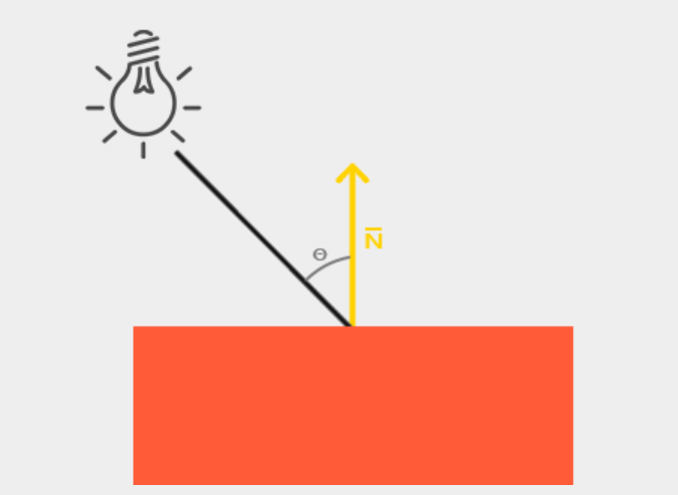
Toon Shading
Intensity = dot(L,N)
Set some thresholds
If(Intensity < threshold1 )
toon= decay_coefficient1*color
If(Intensity < threshold2 )
toon= decay_coefficient2*color
……..
else
toon= color
L

Slide 22
Some Tips
You can download GLSL extension in Visual Studio to let you program shader more efficiently
You can download GLSL snippet in Visual Studio Code to let you program shader more efficiently

Slide 23
Scores
(60%) Implement the Phong Shading
(20%) implement the Toon Shading
Bonus(20%) Add “ks” coefficient in imgui panel to control shading
Please only upload all GLSL files
If you implement the Bonus , upload all GLSL files and main.cpp

Slide 24
Reference
https://www.khronos.org/opengl/wiki/Core_Language_(GLSL)
https://learnopengl.com/Getting-started/Shaders
https://www.khronos.org/opengl/wiki/Shader
https://thebookofshaders.com/03/
https://www.khronos.org/opengl/wiki/Uniform_(GLSL)
https://learnopengl.com/Lighting/Basic-Lighting

