Slide 1
Computer Graphics Ray tracing
Hw Step 1
A simple ray tracer
(single sphere and light source)
Notes:
2021 fall

Slide 2
Outline
Image-ppm
Vec3 class
Ray class -> Primary ray
Sphere
Point light and diffuse shading

Slide 3
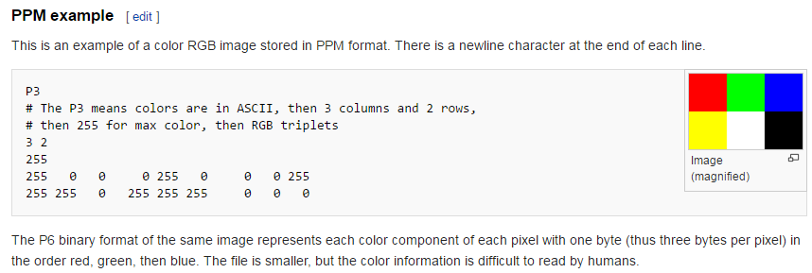
ppm format
Notes:
https://en.wikipedia.org/wiki/Netpbm_format

Slide 4
#include <fstream>
using namespace std;
int main()
{
int width = 200;
int height = 100;
fstream file;
file.open("ray.ppm", ios::out);
file << "P3\n" << width << " " << height << "\n255\n";
for (int j = height - 1; j >= 0; j--) {
for (int i = 0; i < width; i++) {
float r = float(i) / float(width);
float g = float(j) / float(height);
float b = 0.2;
file << int(r * 255) << " " << int(g * 255) << " " << int(b * 255) << "\n";
}
}
return 0;
}
Notes:
C++

Slide 5
vec3
Vec3 for (x, y, z), (r, g, b), …
Operator
vec3 + vec3, vec3 – vec3
scalar * vec3
dot, cross
Length, unit_vector

Slide 6
class vec3 {
public:
vec3() {}
vec3(float e0, float e1, float e2) { e[0] = e0; e[1] = e1; e[2] = e2; }
float x() const { return e[0]; }
float y() const { return e[1]; }
float z() const { return e[2]; }
float r() const { return e[0]; }
float g() const { return e[1]; }
float b() const { return e[2]; }
inline vec3& operator+=(const vec3 &v2);
inline vec3& operator-=(const vec3 &v2);
inline vec3& operator*=(const float t);
inline vec3& operator/=(const float t);
inline float length() const { return sqrt(e[0] * e[0] + e[1] * e[1] + e[2] * e[2]); }
inline float squared_length() const { return e[0] * e[0] + e[1] * e[1] + e[2] * e[2]; }
inline void make_unit_vector();
float e[3];
};
inline float dot(const vec3 &v1, const vec3 &v2) { }
inline vec3 cross(const vec3 &v1, const vec3 &v2) { }
inline vec3 unit_vector(vec3 v) { }
…

Slide 7



Ray
Ray is defined by its origin and a direction vector
$\text{P}\text{(}t\text{)}=O+t\vec{d}$
$$0≤t<∞$$
O
$$\vec{d}$$
P(t)

Slide 8
#ifndef RAYH
#define RAYH
#include "vec3.h"
class ray
{
public:
ray() {}
ray(const vec3& a, const vec3& b) { O = a; D = b; }
vec3 origin() const { return O; }
vec3 direction() const { return D; }
vec3 point_at_parameter(float t) const { … }
vec3 O;
vec3 D;
};
#endif

Slide 9
Camera (Primary Ray)
Ray
Origin point
Direction
Camera
COP
Projection plane
Image size
E.g., 200x100 pixels
(-2, 1, -1)
(u, v)
(-2, -1, -1)
(2, -1, -1)
(0, 0, 0)
Notes:
COP: center of projection

Slide 10
ppm
file << "P3\n" << width << " " << height << "\n255\n";
for (int j = height - 1; j >= 0; j--) {
for (int i = 0; i < width; i++) {
float r = float(i) / float(width);
float g = float(j) / float(height);
float b = 0.2;
file << int(r * 255) << " " << int(g * 255) << " " << int(b * 255) << "\n";
}
}

Slide 11
Primary Rays
(-2, 1, -1)
(u, v)
(-2, -1, -1)
vec3 lower_left_corner(-2, -1, -1);
vec3 origin(0, 0, 0);
vec3 horizontal(4, 0, 0);
vec3 vertical(0, 2, 0);
file << "P3\n" << width << " " << height << "\n255\n";
for (int j = height - 1; j >= 0; j--) {
for (int i = 0; i < width; i++) {
float u = float(i) / float(width);
float v = float(j) / float(height);
vec3 uvcenter = lower_left_corner + u*horizontal + v*vertical;
ray r(origin, uvcenter-origin);
vec3 c = color(r);
file << int(c[0] * 255) << " " << int(c[1] * 255) << " " << int(c[2] * 255) << "\n";
}
}
(2, -1, -1)
(0, 0, 0)
Notes:
For each pixel, generate a primary ray

Slide 12
Simple skybox
vec3 color(const ray& r)
{
vec3 unit_direction = unit_vector(r.direction());
float t= 0.5*(unit_direction.y() + 1.0);
return (1.0-t)* vec3(1, 1, 1) + t* vec3(0.5, 0.7, 1.0);
}

Slide 13

Sphere
vec3 center
float radius
$f\left(p\right)=\left(p−c\right)dot\left(p−c\right)−R^{2}$=0
$\text{Ray}\text{: }\text{P}\text{(}\text{t}\text{)}=O+t\vec{d}$

Slide 14



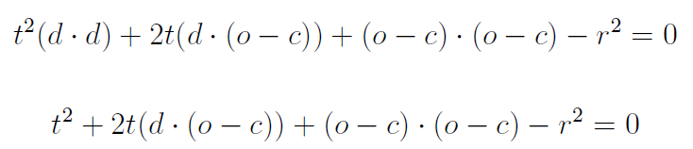

Sphere Intersection
d is unit vector
Notes:
|| u || = (u dot u)^1/2
d is unit vector

Slide 15
bool hit_sphere(const vec3 &center, float radius, const ray& r) {
}
vec3 color(const ray& r)
{
if (hit_sphere(vec3(0, 0, -1), 0.5, r)) {
return vec3(1, 0, 0);
}
vec3 unit_direction = unit_vector(r.direction());
float t= 0.5(unit_direction.y() + 1.0);
return (1.0-t)* vec3(1, 1, 1) + t* vec3(0.5, 0.7, 1.0);
}

Slide 16
Result 60%
Ray-Sphere intersection

Slide 17
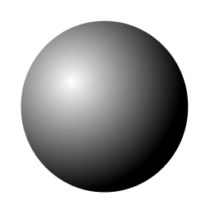
Surface normal
Normal
A vector that is perpendicular to the surface.
C
P
P-C

Slide 18
Normal vector visualization
float hit_sphere(const vec3 &center, float radius, const ray& r) {
…
return t;
}
vec3 color(const ray& r)
{
float t = hit_sphere(…);
if (t > 0.0) {
vec3 N = unit_vector(r.point_at_parameter(t) – center);
return 0.5*vec3(N.x()+1, N.y()+1, N.z()+1);
}
vec3 unit_direction = unit_vector(r.direction());
float t= 0.5(unit_direction.y() + 1.0);
return (1.0-t)* vec3(1, 1, 1) + t* vec3(0.5, 0.7, 1.0);
}

Slide 19
Point light source
vec3 lightsource(1, 1, 0);
N
V
P(t)

Slide 20

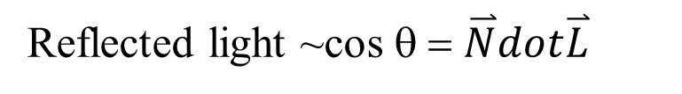
diffuse Surface
d
d
θ
length
d
d/cosθ
intensity
1/d
cosθ / d
Reflected light ~cos θ = $\overset{⃑}{N}dot\overset{⃑}{L}$
$$Lightness= k_{d}Imax(0,\overset{⃑}{N}dot\overset{⃑}{L})$$
N and L must be unit vector

Slide 21
float hit_sphere(const vec3 &center, float radius, const ray& r) {
…
return t;
}
vec3 color(const ray& r)
{
float t = hit_sphere(…);
if (t > 0.0) {
vec3 N = unit_vector(r.point_at_parameter(t) – center);
vec3 L = …;
vec3 I = vec3(1, 1, 1);//intensity of lightsource
return I * … ;
}
vec3 unit_direction = unit_vector(r.direction());
float t= 0.5(unit_direction.y() + 1.0);
return (1.0-t)* vec3(1, 1, 1) + t* vec3(0.5, 0.7, 1.0);
}

Slide 22
shading
lightsource
(-1, 1, 0)
lightsource
(0, 0, 0)
lightsource
(1, 1, 0)

Slide 23
beyond
Multiple lightsource and colorful intensity
Multiple sphere
Ray-plane intersection, Ray-other_surface ….
Anti-aliasing

Slide 24
Reference
Chapter 4 in Fundamentals of Computer Graphics, 4/e.

