Slide 1
Computer Graphics Ray tracing
Step 2
Notes:
2022e
2020 fall

Slide 2
Outline
multiple sphere (at lease 3 big and 6 small sphere)
recursive intersection with refraction and transmission
material attribute (Kd, n_t in Snell’s Law, w_r, ….)
bonus

Slide 3
multiple sphere
vec3 color(const ray& r)
{
float t = hit_sphere(…);
if (t > 0.0) {
vec3 N = unit_vector(r.point_at_parameter(t) – center);
return 0.5*vec3(N.x()+1, N.y()+1, N.z()+1);
}
float t2 = hit_sphere(…);
if (t2 > 0.0) {
vec3 N = unit_vector(r.point_at_parameter(t) – center);
return 0.5*vec3(N.x()+1, N.y()+1, N.z()+1);
}
return skybox(); //When no intersection
}
Problem??

Slide 4
struct hit_record {
float t;
vec3 p;
vec3 normal;
//and more …
};
class hitable {
public:
virtual bool hit(const ray& r, float tmin, float tmax, hit_record& rec) const = 0;
};

Slide 5
class sphere: public hitable {
public:
sphere() {}
sphere(vec3 c, float r) : center(c), radius(r) {};
virtual bool hit(const ray& r, float tmin, float tmax, hit_record& rec) const;
vec3 center;
float radius;
};
bool sphere::hit(const ray& r, float tmin, float tmax, hit_record& rec) const {
//…
}
Why tmin? tmax?

Slide 6
Why tmin/tmax in hit()?
With reflection and refraction

Slide 7
Nearest intersection point
Init
Add all hitable object into a list
intersect() in page 11
hit_record ht[n]
for(all hitable object o) {
o.hit(r, tmin, tmax, ht[i]);
}
Find ht[smallest_index]) with smallest t;
Shading(lightposition, lightintensity, ht[smallest_index]);

Slide 8
float closest_so_far = t_max;
for(all hitable object o) {
o.hit(r, t_min, closest_so_far , ht[i]);
}

Slide 9
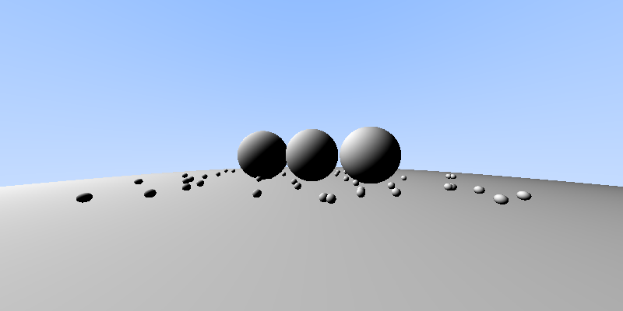
Result with multi-sphere
//camera
vec3 lower_left_corner(-2, -1, -1);
vec3 origin(0, 0, 1);
vec3 horizontal(4, 0, 0);
vec3 vertical(0, 2, 0);
//light
vec3 LightPosition(-10, 10, 0);
vec3 LightIntensity(1.0, 1.0, 1.0);
Notes:
vector<sphere> hitable_list;
…
//objects in the world
hitable_list.push_back(sphere(vec3(0, -100.5, -2), 100));
hitable_list.push_back(sphere(vec3(0, 0, -2), 0.5));
hitable_list.push_back(sphere(vec3(1, 0, -1.75), 0.5));
hitable_list.push_back(sphere(vec3(-1, 0, -2.25), 0.5));
srand(1234);
for (int i = 0; i < 48; i++) {
float xr = ((float)rand() / (float)(RAND_MAX)) * 6.0f - 3.0f;
float zr = ((float)rand() / (float)(RAND_MAX)) * 3.0f - 1.5f;
hitable_list.push_back(sphere(vec3(xr, -0.45, zr-2), 0.05));
}

Slide 10
recursive intersection with refraction and transmission

Slide 11
Recursive Ray Tracer(1/3)
color trace(point p, vector d, int step)
{
color local, reflected, transmitted;
point q;
normal n;
if(step > max) return vec3(0, 0, 0);//black or background
p
d
Notes:
Pseudo code

Slide 12
Recursive Ray Tracer (2/3)
N
p
r
q = intersect(p, d, status);
//if(status==light_source) //return(light_source_color);
if(status==no_intersection) return(background_color);
n = normal(q); //or get from hit_record
r = reflect(q, n);
t = transmit(q, n);
d
q
t
Notes:
Case status==light_source
* Add light_source as small sphere in intersection()

Slide 13
Recursive Ray Tracer (3/3)
local = shading(…);
reflected = trace(q, r, step+1);
transmitted = trace(q, t, step+1);
return(w_l*local
+ w_r*reflected
+ w_t*transmitted);
}
N
p
r
d
assume
Mirror: w_l=0.0f, w_r=1.0f, w_t =0.0f
Plastic: w_l=0.9, w_r=0.6f, w_t =1.0f
q
t
Notes:
Local: contribution from shading in q

Slide 14
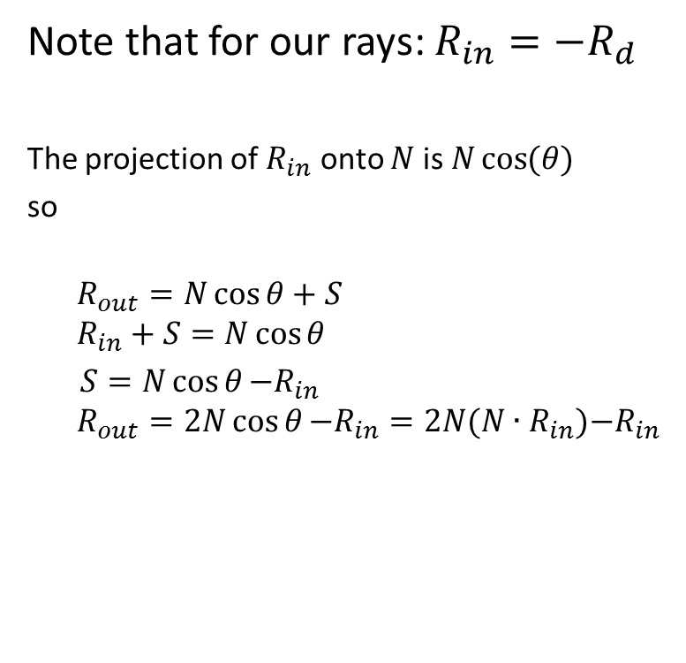
Computing a Reflected Ray
N
S
S
Rin
Rout
Ncosθ
Ɵ
Ɵ
Notes:
http://www.opengl.org/sdk/docs/manglsl/xhtml/reflect.xml

Slide 15
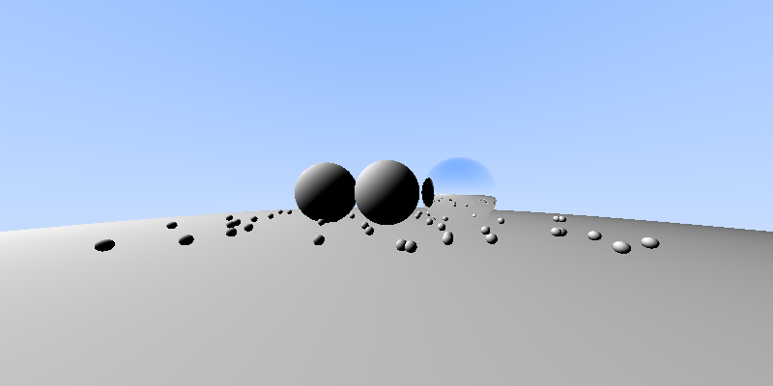
hitable_list.push_back(sphere(vec3(1, 0, -1.75), 0.5f, 1.0f));
Material setting
center
r
w_reflection
return (1.0f-rec_nearest.w_r)*local_color + rec_nearest.w_r*reflected_color;
Notes:
class sphere: public hitable {
public:
sphere() {}
sphere(vec3 c, float r, float w_ri=0.0f, float w_ti=0.0f) : center(c), radius(r), w_r(w_ri), w_t(w_ti) {};
virtual bool hit(const ray& r, float tmin, float tmax, hit_record& rec) const;
vec3center;
floatradius;
floatw_r;
floatw_t;
};

Slide 16
class sphere
class sphere: public hitable {
public:
sphere() {}
sphere(vec3 c, float r, float w_ri=0.0f, float w_ti=0.0f) : center(c), radius(r), w_r(w_ri), w_t(w_ti) {};
virtual bool hit(const ray& r, float tmin, float tmax, hit_record& rec) const;
vec3center;
floatradius;
floatw_r;
floatw_t;
};

Slide 17
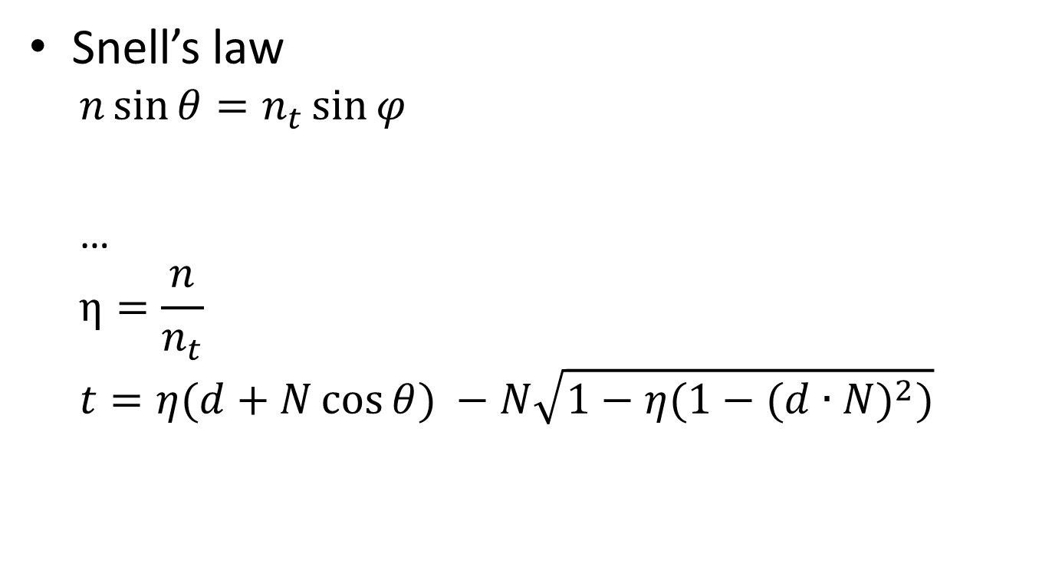

Transformed ray
d
θ
N
θ
r
t
Air: 1
Glass: 1.46
Find the refractive vector and index
https://en.wikipedia.org/wiki/Snell%27s_law
https://en.wikipedia.org/wiki/List_of_refractive_indices
Notes:
https://www.opengl.org/sdk/docs/man4/html/refract.xhtml

Slide 18
Outside / inside

Slide 19
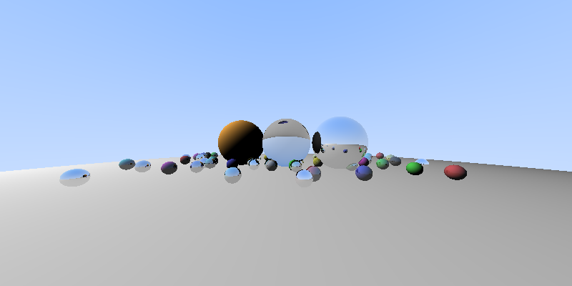
hitable_list.push_back(sphere(vec3(0, 0, -2), 0.5, 0.0f, 0.9f));
w_t
return (1.0f - w_t) *
((1.0f-.w_r) * local_color + rw_r*reflected_color)
+ w_t*transmitted_color;
Notes:
vec3 colorlist[8] = { vec3(0.8, 0.3, 0.3), vec3(0.3, 0.8, 0.3), vec3(0.3, 0.3, 0.8),
vec3(0.8, 0.8, 0.3), vec3(0.3, 0.8, 0.8), vec3(0.8, 0.3, 0.8),
vec3(0.8, 0.8, 0.8), vec3(0.3, 0.3, 0.3) };
//objects in the world
hitable_list.push_back(sphere(vec3(0, -100.5, -2), 100)); //ground
hitable_list.push_back(sphere(vec3(0, 0, -2), 0.5, vec3(1.0f, 1.0f, 1.0f), 0.0f, 0.9f));
hitable_list.push_back(sphere(vec3(1, 0, -1.75), 0.5, vec3(1.0f, 1.0f, 1.0f), 0.9f));
hitable_list.push_back(sphere(vec3(-1, 0, -2.25), 0.5, vec3(1.0f, 0.7f, 0.3f)));
srand(1234);
for (int i = 0; i < 48; i++) {
float xr = ((float)rand() / (float)(RAND_MAX)) * 6.0f - 3.0f;
float zr = ((float)rand() / (float)(RAND_MAX)) * 3.0f - 1.5f;
int cindex = rand() % 8;
float rand_reflec = ((float)rand() / (float)(RAND_MAX));
float rand_refrac = ((float)rand() / (float)(RAND_MAX));
hitable_list.push_back( sphere(vec3(xr, -0.4, zr-2), 0.1, colorlist[cindex], rand_reflec, 0.0f) );
}

Slide 20
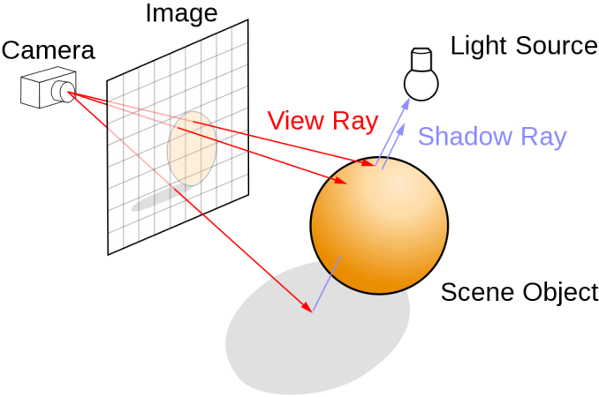
Shadow ray in shading()
color shading(vec3 lightsource, vec3 lightintensity, hit_record ht, vec3 Kd)
{
trace ShadowRay
vec3 color = isOcclude * max(0, N dot L)* I * Kd;
Return color;
}
Ray Tracing Diagram (Henrik / CC BY-SA 4.0)

Slide 21
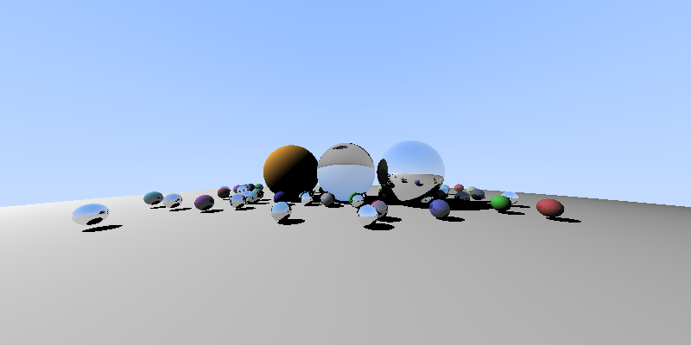
shadow

Slide 22
Bonus
More image format (bmp, png, …)
Easy for debug
Fresnel
Light Attenuation
Speed up

Slide 23
bmp
#define STB_IMAGE_WRITE_IMPLEMENTATION
#include "stb_image_write.h“
…
int width = 200;
int height = 100;
unsigned char *data = new unsigned char[width*height * 3];
for (int j = height - 1; j >= 0; j--) {
for (int i = 0; i < width; i++) {
…
vec3 color = trace(r);
//file << int(color[0] * 255) << " " << int(color[1] * 255) << " " << int(color[2] * 255) << "\n";
int index = ((height -j-1)*width + i) * 3;
data[index + 0] = unsigned char(color[0] * 255);
data[index + 1] = unsigned char(color[1] * 255);
data[index + 2] = unsigned char(color[2] * 255);
}
}
stbi_write_bmp("ray.bmp", width, height, 3, data);
Notes:
https://github.com/nothings/stb/blob/master/stb_image_write.h

Slide 24
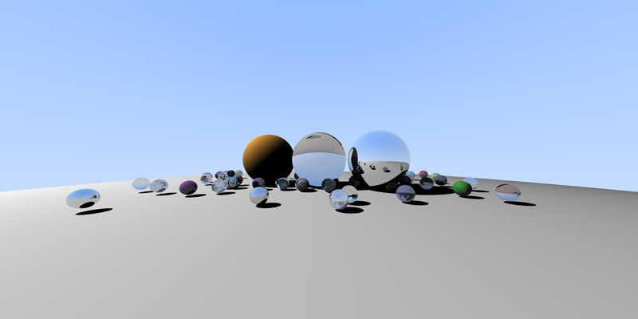
Anti-alias
More transparent sphere
Maxstep =5

Slide 25
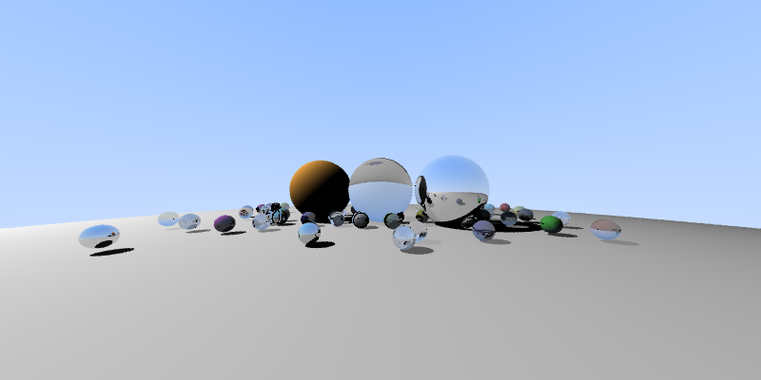
Attenuation in shadowray

Slide 26
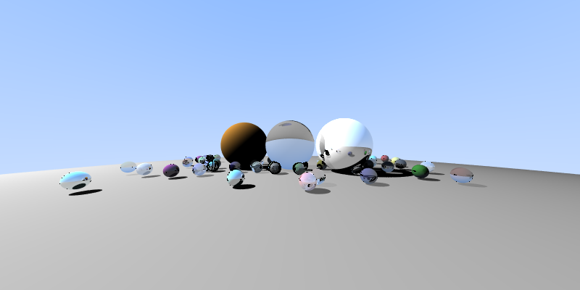
return (1.0f - w_t) *
((1.0f-.w_r) * local_color + rw_r*reflected_color)
+ w_t*transmitted_color;
Clamped color [0, 255]

Slide 27
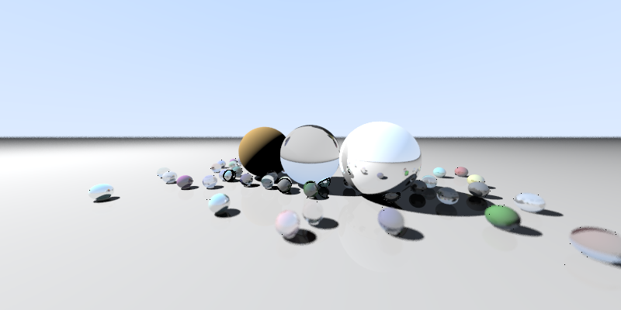
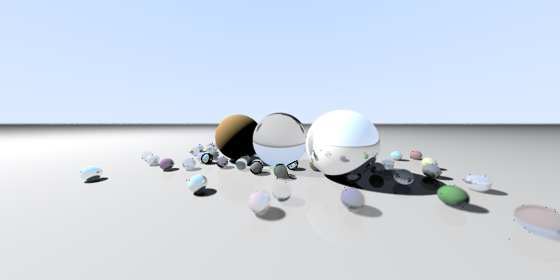

Plane
Camera with depth of field
Shadowray refine

Slide 28
Reference
Chapter 4 in Fundamentals of Computer Graphics, 4/e.
GLSL Functions in https://www.opengl.org/sdk/docs/man4/

