Slide 1
HW3-swgl-1 Transformation & Projection
CG22
NCCU
Notes:
2021 software opengl

Slide 2
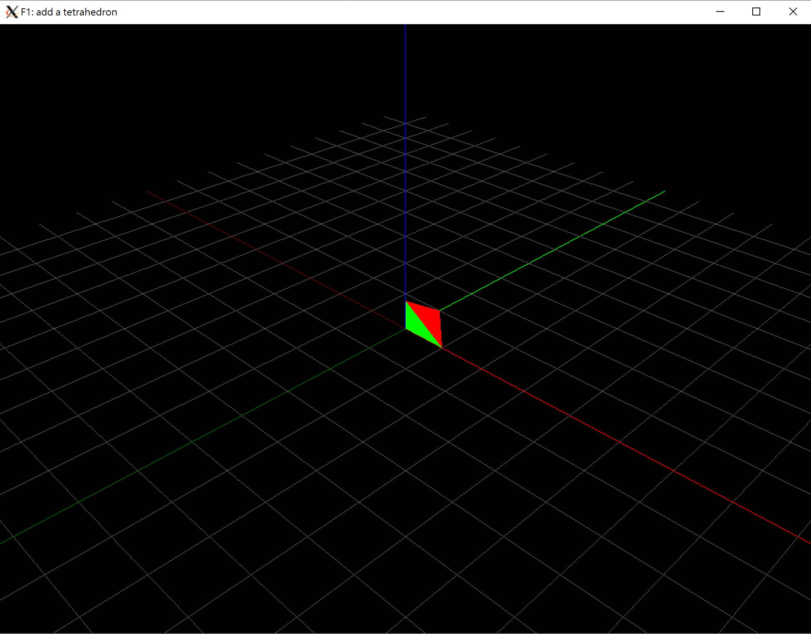
Goal
Implement the transformation & projection functions in main.cpp

Slide 3
STEP 1
transformation

Slide 4
Display()
void Display() {
glClear(GL_COLOR_BUFFER_BIT | GL_DEPTH_BUFFER_BIT);
glMatrixMode(GL_PROJECTION);
glLoadIdentity();
gluPerspective(60, 1, 0.1, 50); glMatrixMode(GL_MODELVIEW);
glLoadIdentity();
gluLookAt(10 * cos(theta), -10 * sin(theta), 10, 0, 0, 0, 0, 0, 1);
DrawGrid(); Draw_Tetrahedron();
}

Slide 5
void Draw_Tetrahedron() {
glBegin(GL_TRIANGLES);
swTriangle(vec3(1, 0, 0), tetrahedron_verts[0], tetrahedron_verts[1], tetrahedron_verts[2], transformMat); swTriangle(vec3(0, 0, 1), tetrahedron_verts[3], tetrahedron_verts[0], tetrahedron_verts[1], transformMat); swTriangle(vec3(0, 1, 0), tetrahedron_verts[2], tetrahedron_verts[3], tetrahedron_verts[0], transformMat); swTriangle(vec3(1, 1, 0), tetrahedron_verts[1], tetrahedron_verts[2], tetrahedron_verts[3], transformMat);
glEnd();
}

Slide 6
Core
void swTriangle(vec3 color, vec3 in_v1, vec3 in_v2, vec3 in_v3, mat4x4 Modelmatrix){
vec4 v1(in_v1.x, in_v1.y, in_v1.z, 1); …
v1 = Modelmatrix * v1; …
glColor3f(color.r, color.g, color.b);
glVertex3f(v1.x, v1.y, v1.z);
glVertex3f(v2.x, v2.y, v2.z);
glVertex3f(v3.x, v3.y, v3.z);
}

Slide 7
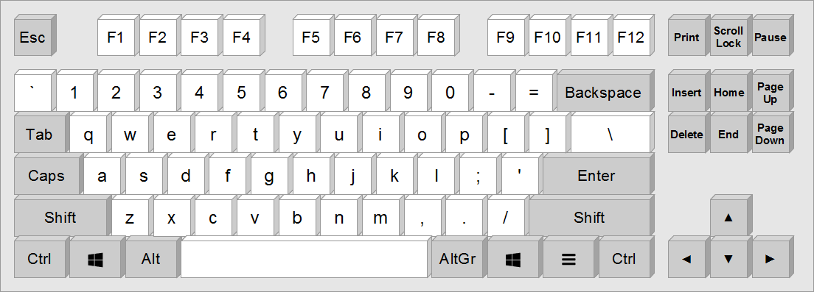
UI
void key_callback(…, int key, …) {
switch (key) {
case ‘q’:
transformMat = swTranslate(1, 0, 0) * transformMat;
break;
T+x
T+y
T+y
R+x
R+y
R+y
S+x
S+y
S+y
T-x
T-y
T-y
R-x
R-y
R-y
S-x
S-y
S-y

Slide 8
Matrix vector mutilation

Slide 9
Step 1: Transformation
Use the matrix and vector lib in glm
Implement following functions
mat4x4 swTranslate(float x, float y, float z)
mat4x4 swRotateX(float angle)
mat4x4 swRotateY(float angle)
mat4x4 swRotateZ(float angle)
mat4x4 swScale(float x, float y, float z)
Notes:
Implement matrix and vector operation
Use the matrix and vector lib in glm
#include <glm/vec3.hpp> // glm::vec3
#include <glm/vec4.hpp> // glm::vec4
#include <glm/mat4x4.hpp> // glm::mat4

Slide 10
Resource
OpenGL 2.1 Reference Pages
https://www.khronos.org/registry/OpenGL-Refpages/gl2.1/
Glm: OpenGL Mathematics
https://glm.g-truc.net

Slide 11
STEP 2
viewing

Slide 12
Display()
void Display() {
glClear(GL_COLOR_BUFFER_BIT | GL_DEPTH_BUFFER_BIT);
glMatrixMode(GL_PROJECTION);
glLoadIdentity();
gluPerspective(60, 1, 0.1, 50); glMatrixMode(GL_MODELVIEW);
glLoadIdentity();
gluLookAt(10 * cos(theta), -10 * sin(theta), 10, 0, 0, 0, 0, 0, 1);
DrawGrid(); Draw_Tetrahedron();
glutSwapBuffers();
}

Slide 13
Step 2: viewing
const bool STEP2 = true;
In display()
//step 2
if (STEP2 == true) {
glMatrixMode(GL_MODELVIEW);
glLoadIdentity();
ViewMat = mat4x4(1);
//todo: swLookAt(10 * cos(theta), -10 * sin(theta), 10, 0, 0, 0, 0, 0, 1); }

Slide 14
//step2: remove glLookAt, compute view matrix
//v1 = View* Modelmatrix * v1;
//
//

Slide 15
STEP 3
projection

Slide 16
Step 3: Projection
const bool STEP3 = true;
In display()
if (STEP3 == true) {
glMatrixMode(GL_PROJECTION);
glLoadIdentity();
glOrtho(0, winWidth, 0, winHeight, -2.0, 2.0);
ProjectionMat = mat4x4(1);
//todo swPerspective(60, 1, 0.1, 50); }

Slide 17
//step3: remove glProjection, compute project matrix
//v1 = Projection * View * Modelmatrix * v1;
//
//
// perspective division
// ...

Slide 18
bonus
Add other models (cube, sphere, obj file)
local/global transformation
Hierarchy (push/pop Current Transformation matrix)
Load/save scene

