Slide 1
Sudoku
108753208 葉冠宏

Slide 2
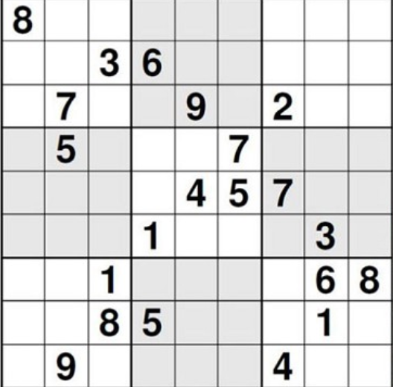
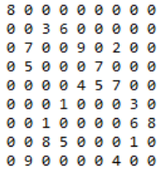
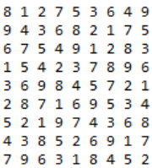
Sudoku Rules
Cell: Each cell can only contain one integer between 1 and 9.
Row:Each row can only contain nine unique integers in the range of 1 to 9.
Column:Each column can only contain nine unique integers in the range of 1 to 9.
Box:Each box can only contain nine unique integers in the range of 1 to 9.

Slide 3
Exact Cover Problem
Problem: Given a collection S of subsets of set X, an exact cover is the subset S* of S such that each element of X is contained is exactly one subset of S*. It should satisfy following two conditions
1.The Intersection of any two subsets in S* should be empty. That is, each element of X should be contained in at most one subset of S*
2. Union of all subsets in S* is X. That means union should contain all the elements in set X. So we can say that S* covers X.

Slide 4
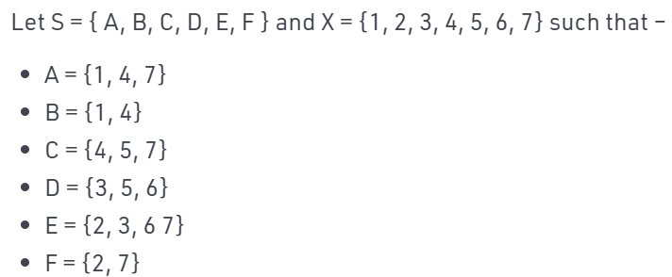
Example:
Then S* = {B, D, F} is an exact cover, because each element in X is contained exactly once in subsets {B, D, F} . If we union subsets then we will get all the elements of X

Slide 5
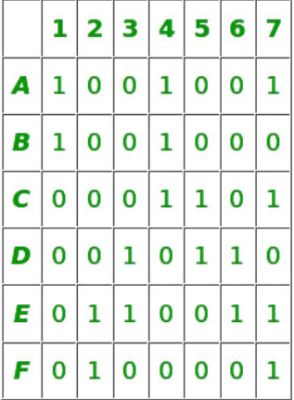
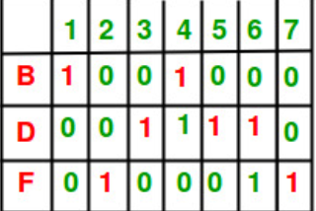
our exact cover is the selection of rows such that each column contains only single 1 among selected rows. So we can see below that each column have only single 1 among selected rows B, D, F.

Slide 6
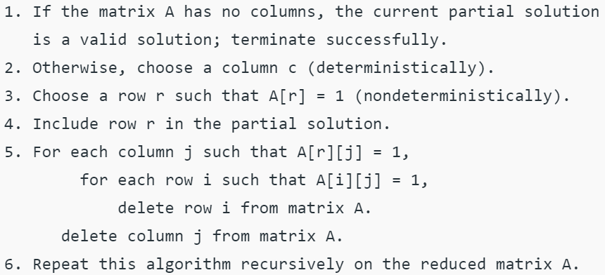
Algorithm X
Non-deterministic choice of r means, algorithm copy itself into sub algorithm. Each sub algorithm inherit original matrix A but reduces it with respect to chosen r.
If chosen column c is entirely zero then there are no sub algorithms and the process terminated unsuccessfully. Knuth suggests that we should choose the column with the minimum number of 1’s in it. If no column left, then we know we have found our solution.

Slide 7
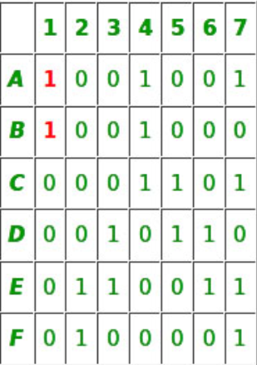
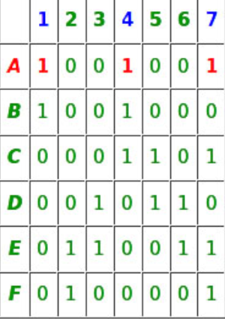
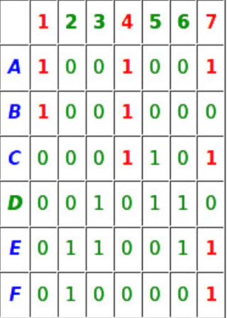
Example
=>
=>
The first column which has minimum number of 1’s in it so we will select it
Rows A and B have 1 at C-1 so they are selected.
Select row A and add it to partial solutions
Row A has 1 in column 1, 4, 7
Column 1 have 1 in row A and B, Column 4 have 1 in A, B and C, Column 7 have 1 in row A, C, E, and F.

Slide 8
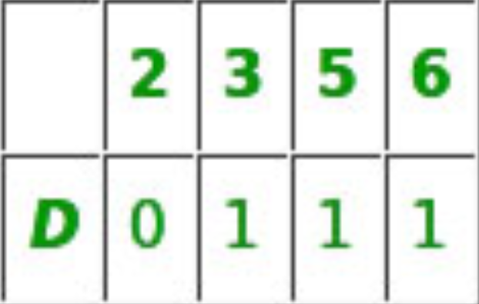
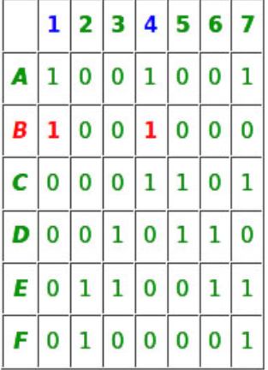
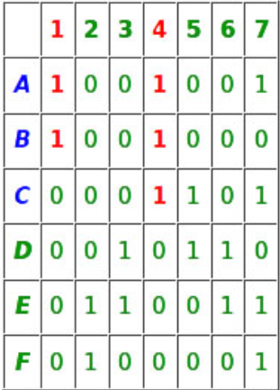
=>
=>
So column 1, 4, 7 and rows A, B, C, E and F should be removed.
Since column 2 have no 1’s in it, our search will terminate here unsuccessfully.
Now our algorithm will backtrack and proceed with row B at second branch.
Select row B and add it to partial solutions
Row B has 1 in column 1 and Column 4
Column 1 have 1’s at row A and B. Column 4 have 1’s in row A, B and C
So Column 1, Column 4 and Row A, B, C will be removed from the matrix.

Slide 9
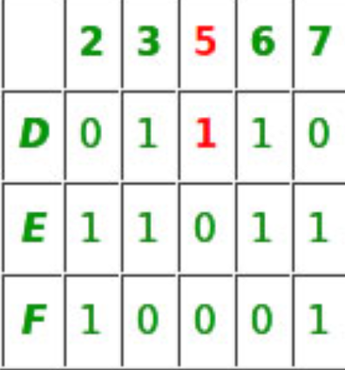
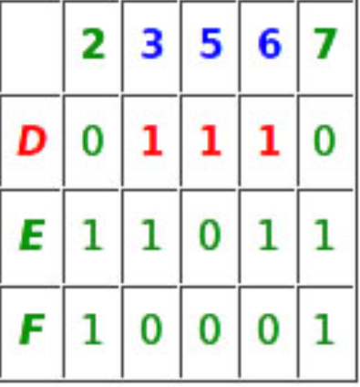
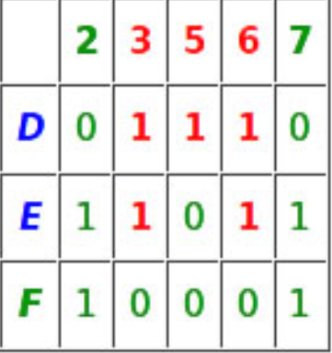
=>
=>
Column 5 has a minimum number of 1’s in it, so it is chosen.
Row D has 1 at Column 5, so it is chosen
Row D is chosen and added to partial solution.
Column 3, Column 5, Column 6 have 1 at row D
At Column3 row D and E have 1, at Column5 row D have 1 and at Column 6 row D, E have 1.
So these rows and columns should be deleted and we left with a matrix having only row F and column 2, 7.

Slide 10
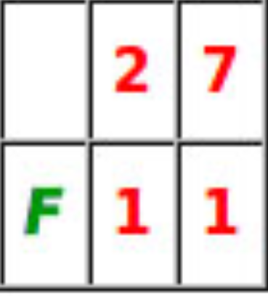
C-2 is the first column having a minimum number if 1’s in it. So it is chosen.
Row F is added to the partial solution
Column 2 and Column 7 have 1 at row F.
So Column 2,Column 7 and row F should be removed.
After removing we will left with an empty matrix so our search can terminate here successfully and we have our exact cover {B, D,F}

Slide 11
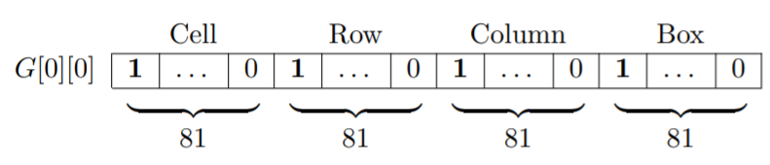
Transform Sudoku into Exact cover problem
Matrix M中會有9x9x4個columns
9x9x9個rows
Consider a grid G with at least 17 clues and with a unique solution. The clues will have an effect on all four constraints since a clue cannot be moved or changed. The relationship between the clues will then decide in which cells in the row, column and box the remaining integers can be placed.
The reduction from the grid G must preserve the constraints in a binary matrix
M. In M there must then exist a selection of rows such that a union between them
covers all columns, otherwise there is no solution.
What makes this reduction possible is having each row in M describing all four
constraint for each cell in G. When a row is chosen from M as part of the solution,
what is actually chosen is an integer which complies with all four constraint for the
cell in G that the row describes.

Slide 12
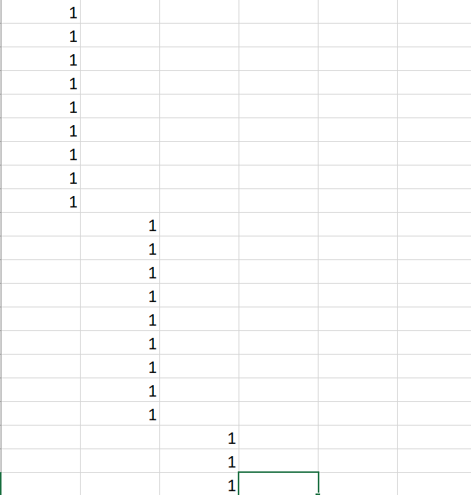
Cell constraint
在cell constraint 這邊，我們對於所有Sudoku 中9x9格有81個column(每一個Sudoku cell 都有一個column)。
Sudoku 每一格(cell) 在matrix M中都會有9 個rows的1(代表那個cell 可以填1~9任一種)，而其每一個cell 的rows 都是如左圖那樣在同一個column。
我們sudoku的cell探討的順序都是從左而右，從上往下。當我們在matrix M要探討下一個cell時，才會前進到下一個column。
因為在exact cover 中，我們要選擇rows 使選擇的row中每一個column都要被選到，(有1)，且那個column只能有一個1。所以這樣可以確保我們sudoku中每一個cell只能填1~9，而且只能填一個數字。
Matrix M總共有9x9x9個rows，因為有9x9個數字要填，而我們每一個cell都可以填1~9。

Slide 13
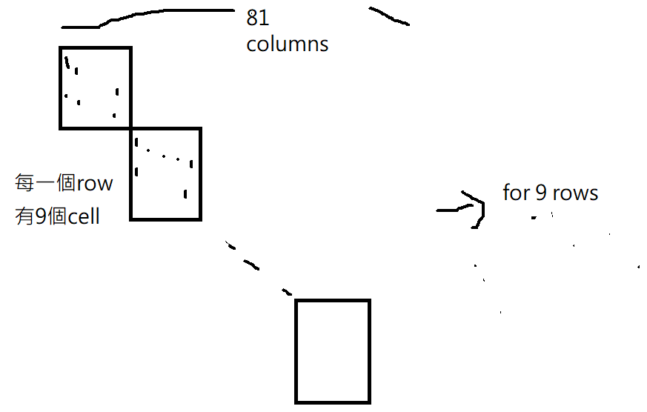
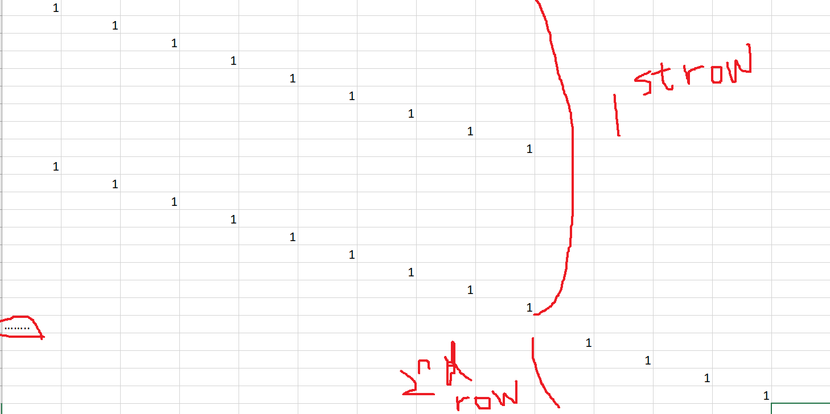
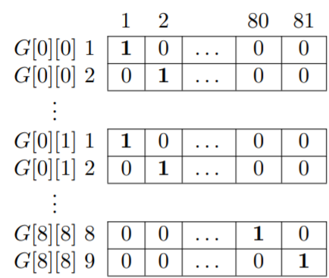
Row constraint
sudoku每一個row中的cells都佔據matrix M 的共同9個column，當到sudoku下一個row時，我們去再佔據下9個column，sudoku總共有9個rows,所以總共會佔據matrix M的81個columns。
Sudoku每一個cell因為有1~9的數字可以填，所以一次佔據9個rows，每個數字在matrix M中都會再前進一個column 去填1 (即呈現diagonal 的樣子)
我們這樣做可以確保在sudoku中每個row的1~9數字每個只會被填一次，因為在matrix M中選擇的row中每一個column 只能有一個1

Slide 14
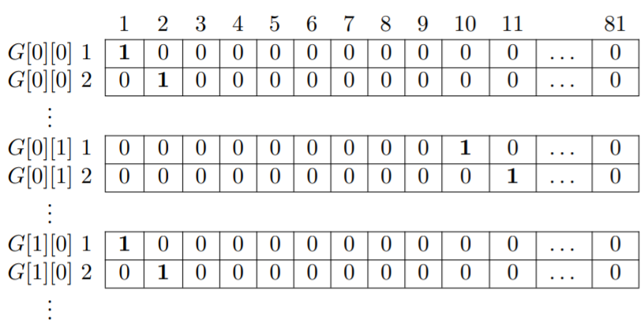
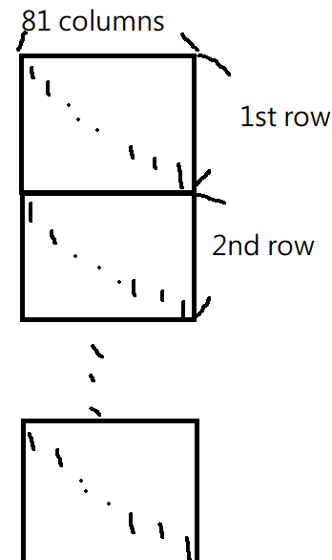
Column constraint
我們sudoku中每一個row佔據matrix M的81個column，不同rows佔據一樣的那81個columns。
你1的排列是呈diagonal 的樣子。每一個cell有1~9的數字可以選，每一個sudoku的row有9個cell，所以總共佔據81個matrix M的columns及81個matrix M的rows。所以sudoku的9個rows共佔據matrix M的81x9個rows。
這樣排合理，因為你可以確保sudoku不同rows的同一個位置(column) 不會被填入相同的數字。

Slide 15
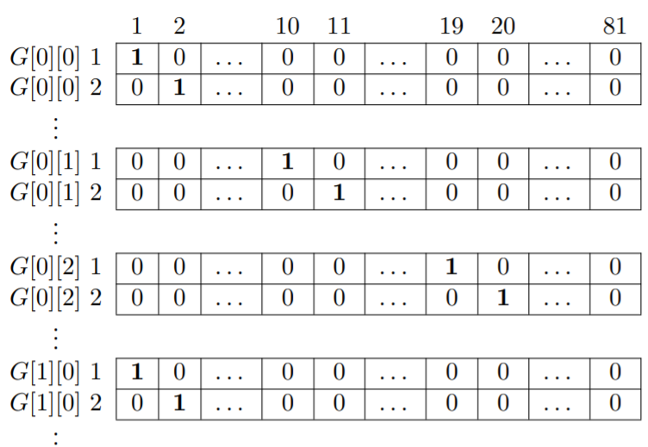
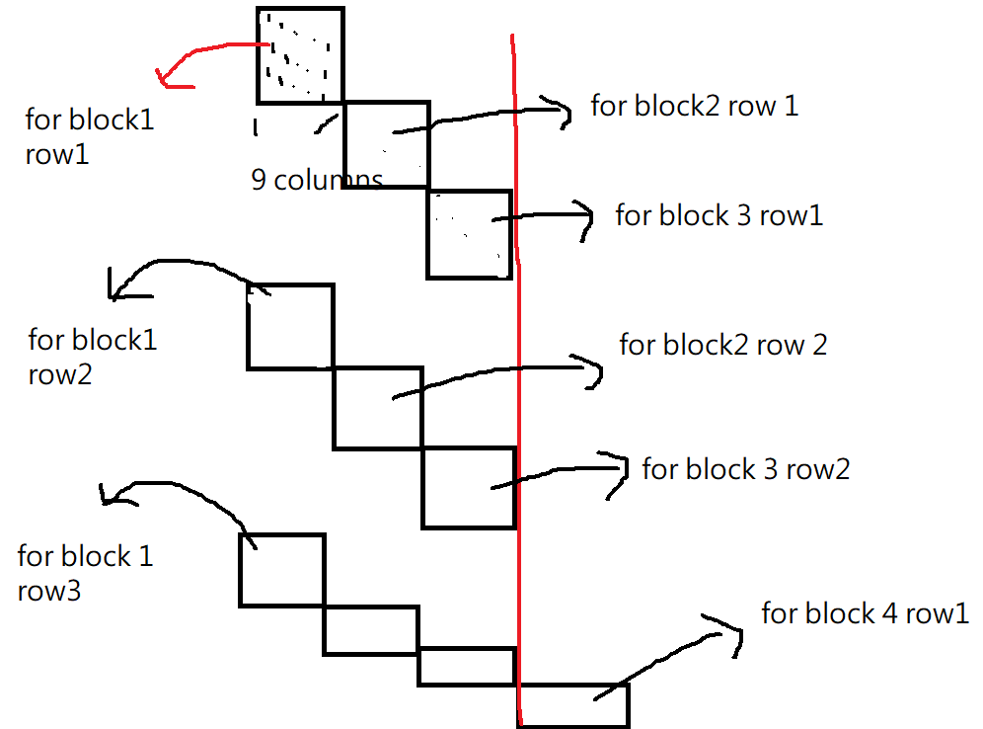
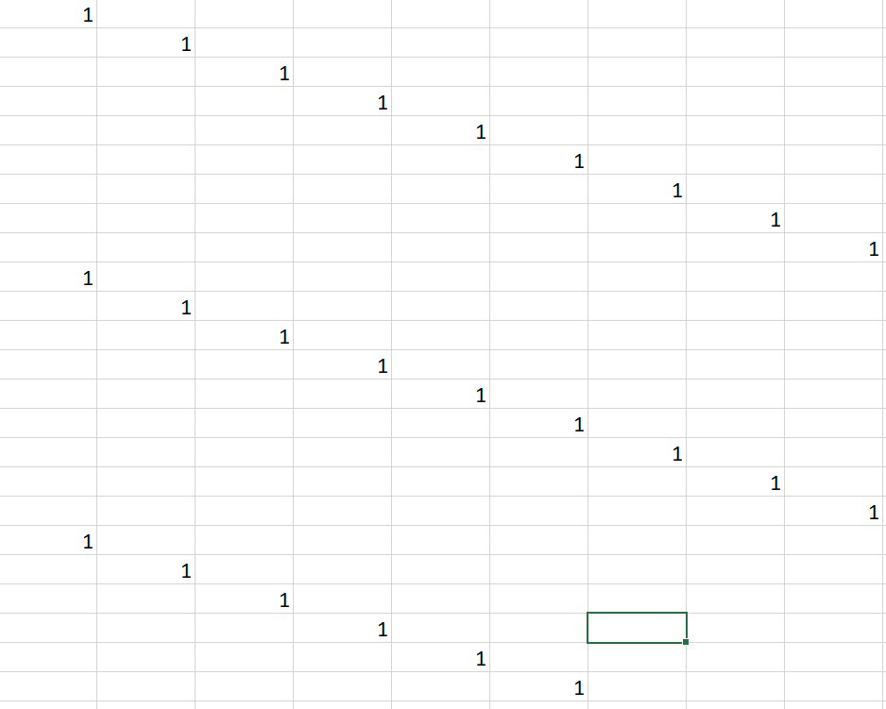
Box constraint

Slide 16
在sudoku 裡面，我們總共可以切成9個blocks。每一個block 裡面有3個row及3個column。
在box constraint裡面同一個block的cell 在matrix M裡面會佔據共同的9個欄位。而每一個sudoku的cell會在matrix M 裡面佔據9個row，1會呈現diagonal狀。當移動到同一個block 的下一個cell時，其也是從那個block 在matrix M的第一個column開始去放1，呈diagonal狀。而當我們移到下一個sudoku的block時，會放在matrix M的下9個column。現在有9個blocks, 所以在matrix M 裡面共佔據81個columns。
但是由於我們sudoku中討論的順序是每個cell 是從左到右，從上往下，所以同一個block 的9個cell是以每一個row 為一組放在連續的27個row(每一個cell佔據9個row)，如圖。
這樣一來，如果你在同一個block 選到相同數字時，在我們執行exact cover 及algorithm X時就會使選到的row中其那個column 會有不只一個1。

Slide 17
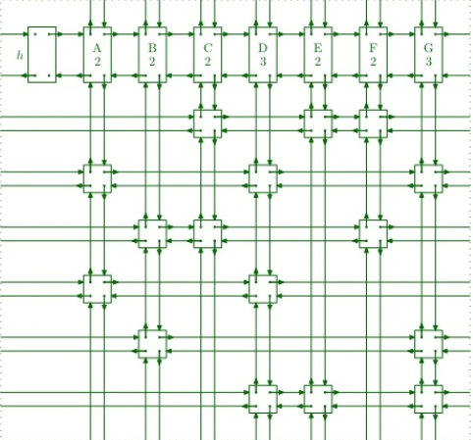
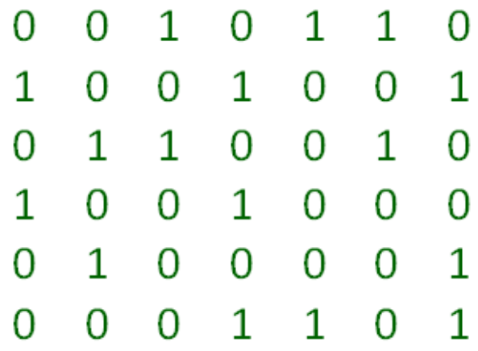
執行-Dancing links的資料結構
把原始的sudoku轉成exact cover 的matrix 之後，我們可以先把題目給定的數字先選定好那些在matrix M 的row。接著去執行algorithm x。
在執行algorithm x時，因為我們需要合併rows和columns，所以我們需要dancing links 的資料結構。可以讓我們去斷開原本的連結。過程中，由於每個node還記錄有原本的連結位置，所以可以結由uncover 回復。
藉由這樣backtracking 的方法，我們可以選擇出81個rows (因為是9x9的sudoku)

Slide 18
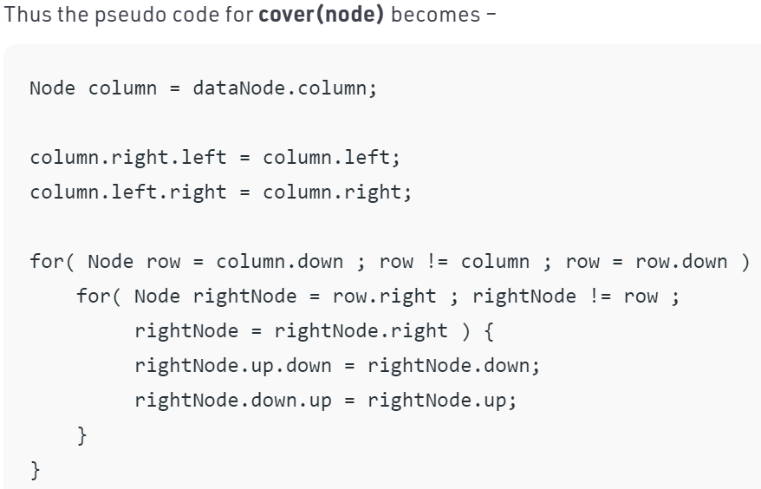
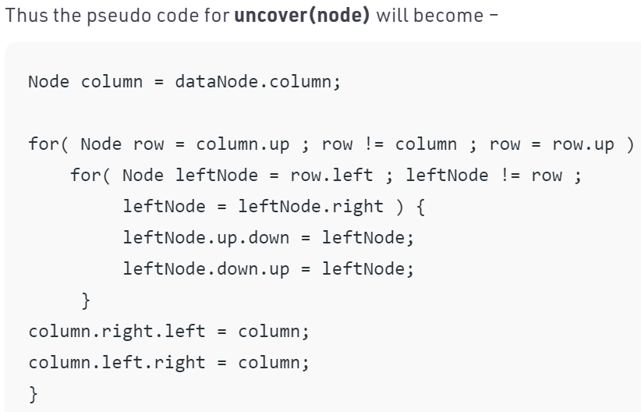
we transform exact cover problem in form of matrix of 0 and 1. Here each “1” in the matrix is represented by a node of linked list and the whole matrix is transformed into a mesh of 4 way connected nodes. Each node contains following fields –
1.Pointer to node left to it
2.Pointer to node right to it
3.Pointer to node above it
4.Pointer to node below it
5.Pointer to list header node to which it belongs
Each column list also includes a special node called “list header node”. This header node is just like simple node but have few extra fields – Column id, Count of nodes in current column

Slide 19
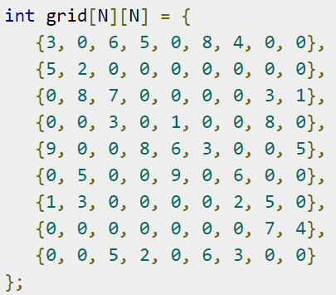
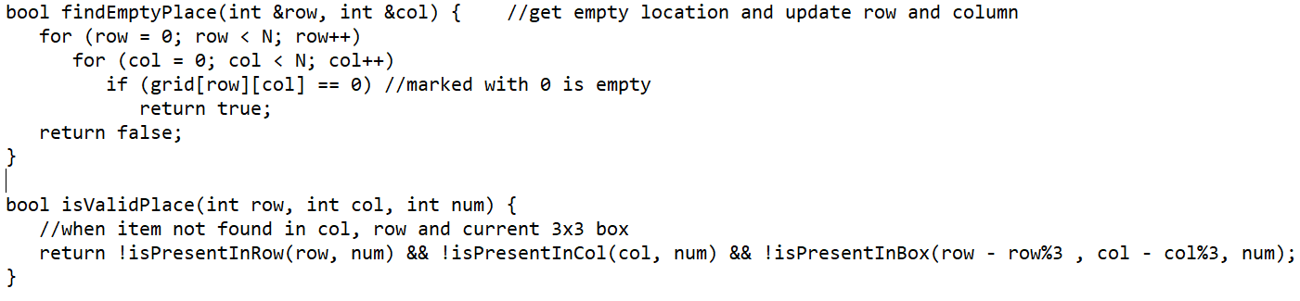
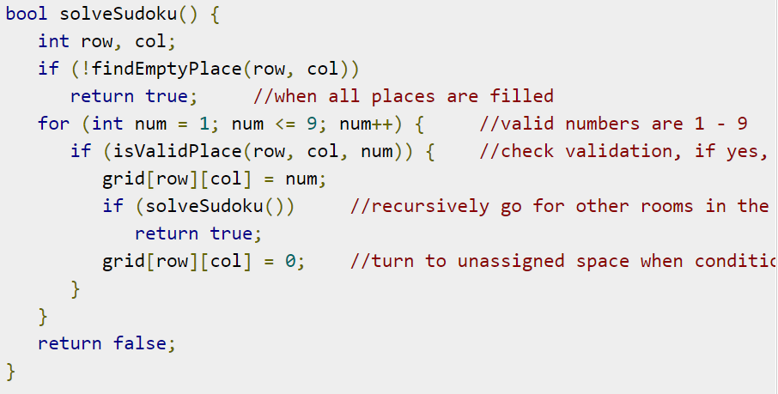
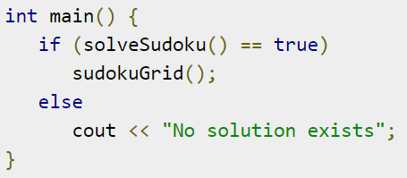
其他方法-brute force

Slide 20
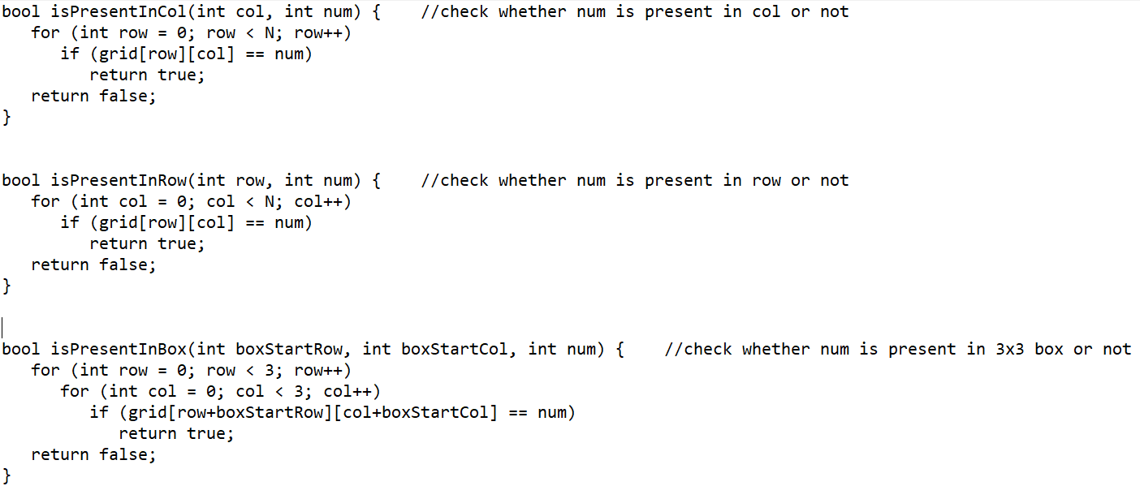
Using the backtracking algorithm, we will try to solve the Sudoku problem. When some cell is filled with a digit, it checks whether it is valid or not. When it is not valid, it checks for other numbers. If all numbers are checked from 1-9, and no valid digit found to place, it backtracks to the previous option.

Slide 21
參考資料
https://www.geeksforgeeks.org/exact-cover-problem-algorithm-x-set-1/
https://www.geeksforgeeks.org/exact-cover-problem-algorithm-x-set-2-implementation-dlx/
https://www.kth.se/social/files/58861771f276547fe1dbf8d1/HLaestanderMHarrysson_dkand14.pdf
https://medium.com/javarevisited/building-a-sudoku-solver-in-java-with-dancing-links-180274b0b6c1
https://www.tutorialspoint.com/Sudoku-Solving-algorithms

