Slide 1
RGHS: Shallow-Water Image Enhancement Using Relative Global Histogram Stretching Based on Adaptive Parameter Acquisition (2018)
系級:資科碩一 葉冠宏 108753208

Slide 2
Introduction
Light absorption ,scattering, water turbidity => underwater image shows low contrast, fuzzy, and color cast.
green and blue lights (shorter wavelength and high frequency) =>
attenuate extraordinarily lower than the red counterpart.
=> deep sea image appears the bluish tone
Under different illuminants, because of the difference of the spectrum distribution, the color performance for the same object will not be the same.

Slide 3


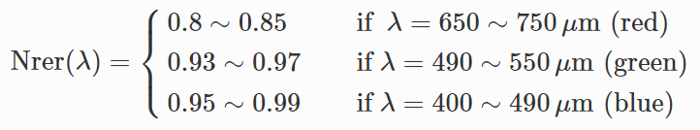
Underwater Model
A well-known haze image function model is often used to approximate the propagation equation of underwater scattering in the background light.
light wavelength λ∈{red,green,blue}
underwater image Iλ(x)
X: pixel point
Jλ(x):scene radiance at point x
tλ(x): the residual energy ratio of after reflecting from point x in the underwater scene and reaching the camera (a function of both λ and the scene–camera distance d(x))
Bλ: the uniform background light

Slide 4
Related work
RayleighDistribution: Underwater image quality enhancement through composition of dual-intensity images and Rayleigh-stretching (2014)
integrated color model (ICM)
unsupervised color correction method (UCM)
=> These methods used the histogram stretching in RGB color model and then saturation-intensity stretching in HSI color model to enhance the contrast of the images and correct color cast.
The output results of these methods do not have significant difference and still exist blue-green illumination, and may bring serious noise to the enhanced image.

Slide 5
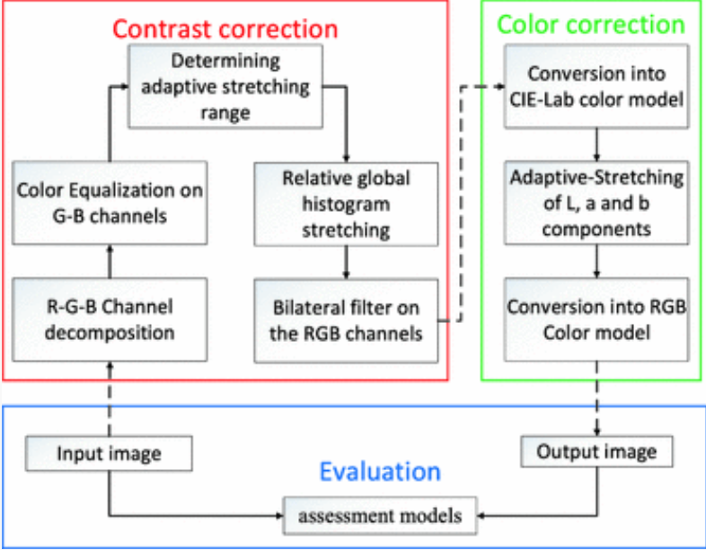
Presented method- RGHS: Shallow-Water Image Enhancement Using Relative Global Histogram Stretching Based on Adaptive Parameter Acquisition (2018)

Slide 6
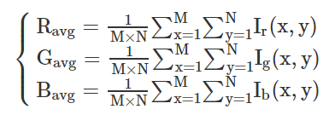
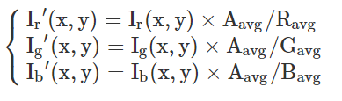

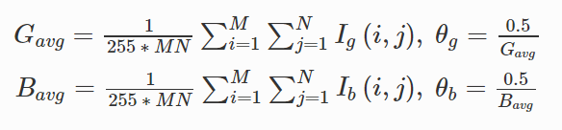
Colour equalization
Based on the UCM model, once the average of one channel is extraordinary low, the channel must multiply with a bigger multiplier, which will cause the wrong pretreatment of image color.
We correct the G and B channels. Here, R channel is not considered because the red light in the water is hard to compensate by simple color equalization, which may bring about red over-saturation.

Slide 7
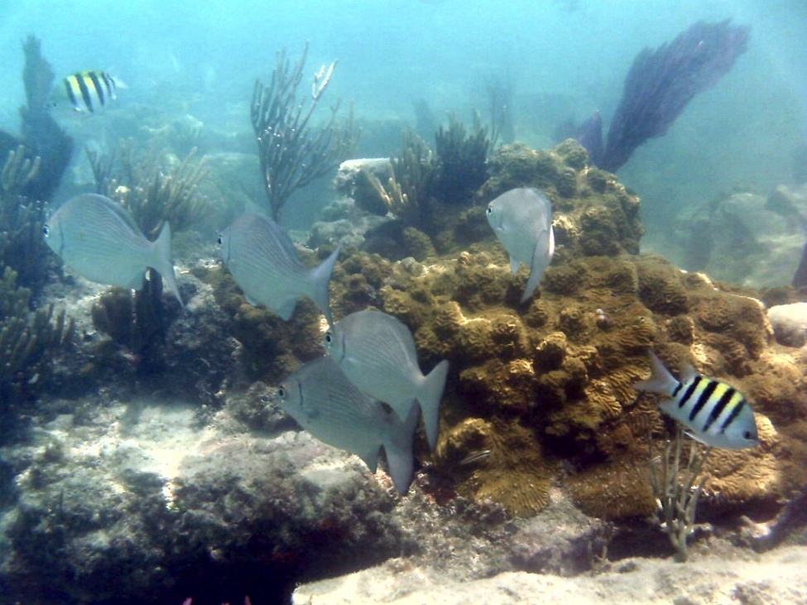
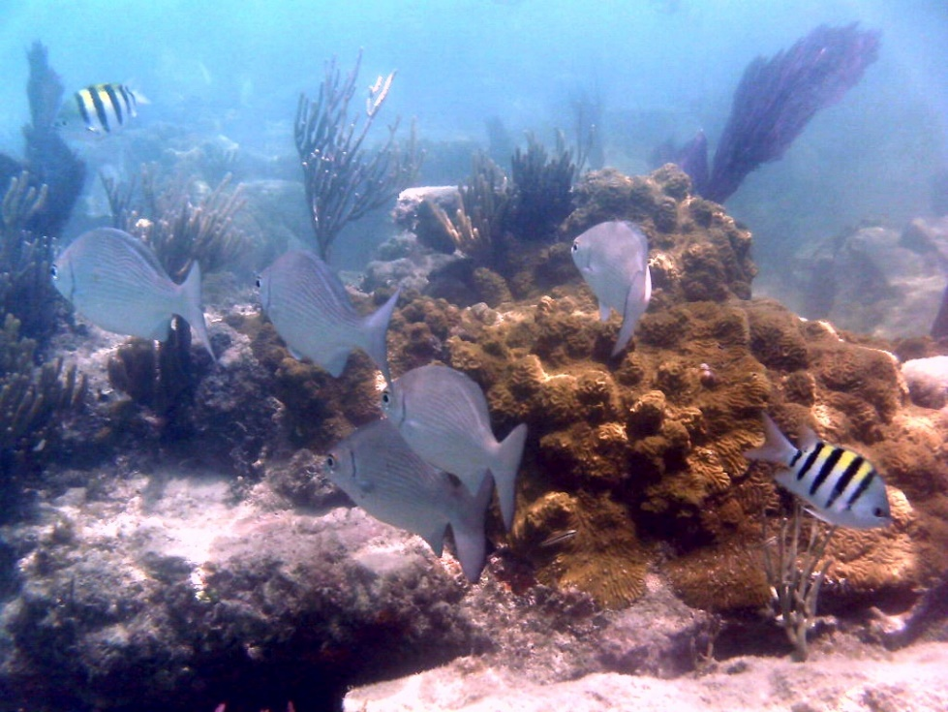
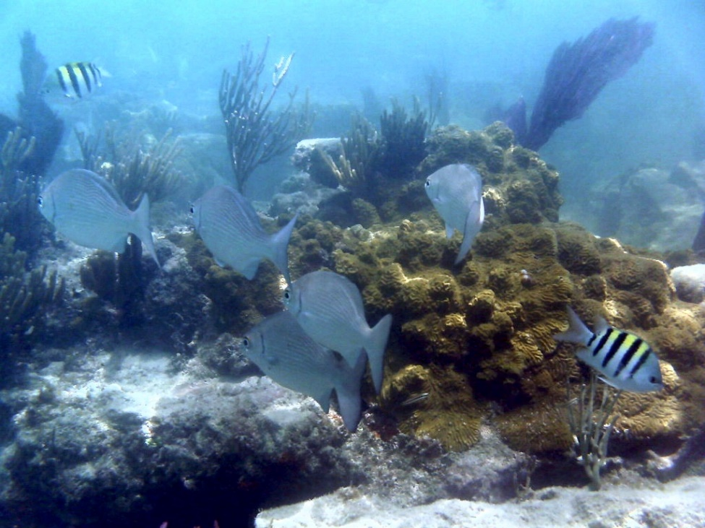
Original colour equalization
Set Aavg as 128(with correction of Red channel)
Set Aavg as 128(without correction of Red channel)

Slide 8

Histogram Stretching-traditional vs our approach
Due to the relative-concentrated distribution and quite low histogram range, underwater images often have low contrast and visibility.
=>Histogram stretching adopted
=>better pixel distribution of the image channels (better contrast).
If we use the same parameters (e.g., 0, 255) for all R-G-B channels of the images, ignoring the histogram distribution characteristics of different channels and in different images. => it may over-stretch or under-stretch certain color channel and damage the details of the original image.
R:[50,150]
G:[70,210]
B:[70,210]

Slide 9

Imax, Imin
From the histogram distribution of various shallow-water images, we can observe that the histogram distribution of R-G-B channel are similar to the variation of Rayleigh distribution
‘a’: mode(peak of R-G-B channel histograms), as a dividing line to separately decide the minimum (left) and maximum (right) intensity level values of the input image in the histogram stretching.

Slide 10
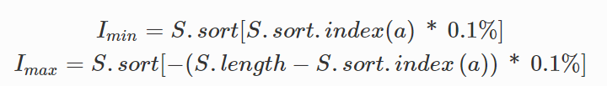
Imax, Imin
S :set of image pixel values for each R-G-B channel,
S.sort: ascending order
S.sort.index(a): the index number of the mode in the histogram distribution
From the peak division line, we separate the pixels which values are in the smallest 0.1% of the total number on the left side and the biggest 0.1% of the total number on the right side from the histogram distribution. (To reduce the impact of extreme values) (if the histogram is not normally distributed, traditional method that removes an equal number of pixels from two tails of the histogram may not be reasonable.)
Imin and Imax are both image and channel-sensitive.

Slide 11


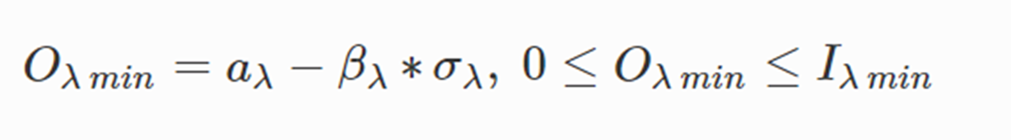
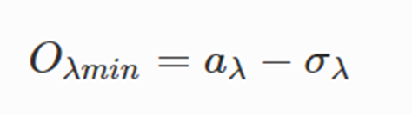
Omin
a :mode in a channel.
βλ≤1.526. βλ∈Z:βλ=1

Slide 12
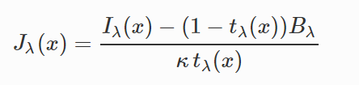



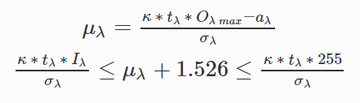
Omax
Because of different degrees of attenuation of the different light bands in the water, we must take separate analysis of RGB channels to calculate.
where κ=1.1 and κ=0.9 are an experiential value for red channel and green-blue channel respectively.
When Jλ(x) achieves the maximum value, Bλ is 0.
tλ(x): 0.83, 0.95, 0.97 for R, G, B channels respectively
When uλ has no integer solution, we set Oλmax to 255.

Slide 13
CIELAB color space stretching
CIELAB was designed so that the same amount of numerical change in these values corresponds to roughly the same amount of visually perceived change.
The adaptive-stretching of ‘L’, ‘a’ and ‘b’ will improve the saturation and brightness of the image to obtain more vivid color.
L* :lightness 0(black)~100(white)
a* :from green (−) to red (+), −128 to +127
b* from blue (−) to yellow (+), −128 to +127

Slide 14

CIELAB color space stretching
‘L’ component: linear slide stretching
=> Range between 0.1% and 99.9% of the value is stretched to range [0,100] . The 0.1% of the lower and upper values are set to 0 and100 respectively.
‘a’ and ‘b’ : apply S-model curve
φ :optimally-experimental value, set to 1.3 in the method
Iχ : input pixels, the closer the values to 0 (gray), the further they will be stretched.
Pχ: output pixels

Slide 15
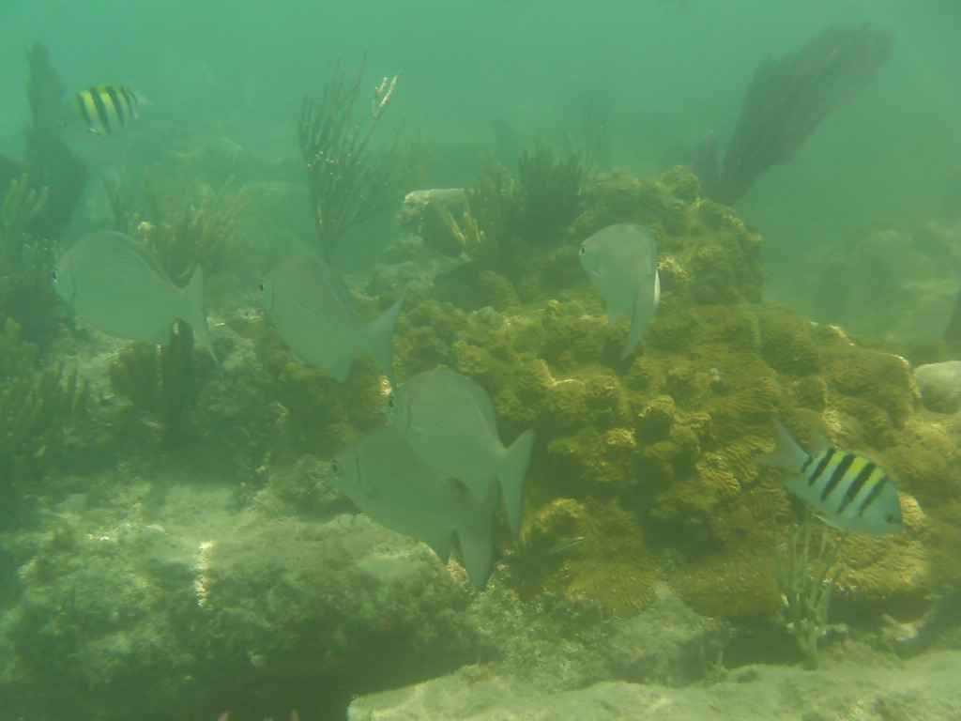
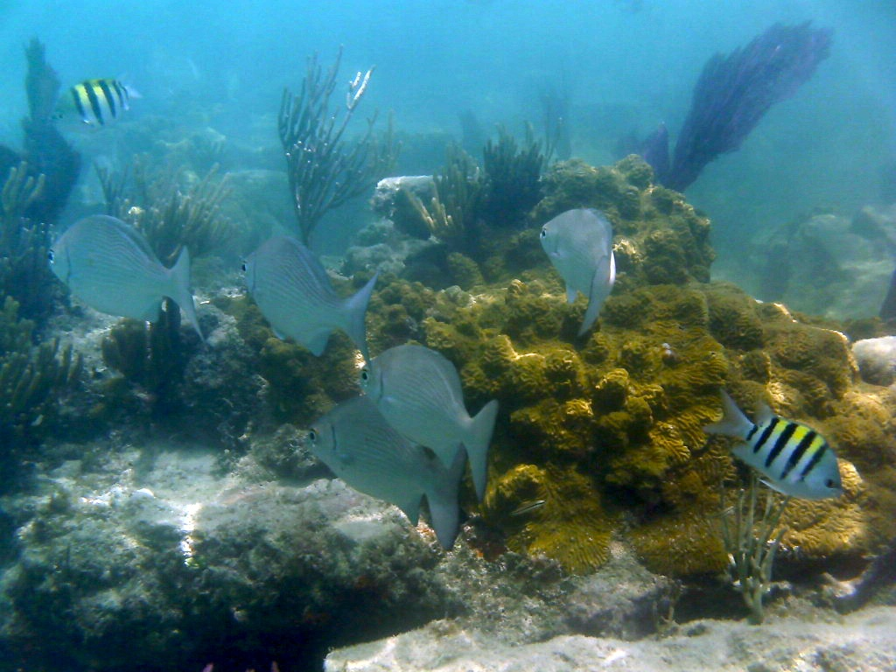
Experimental results
Original image
RGHS

Slide 16
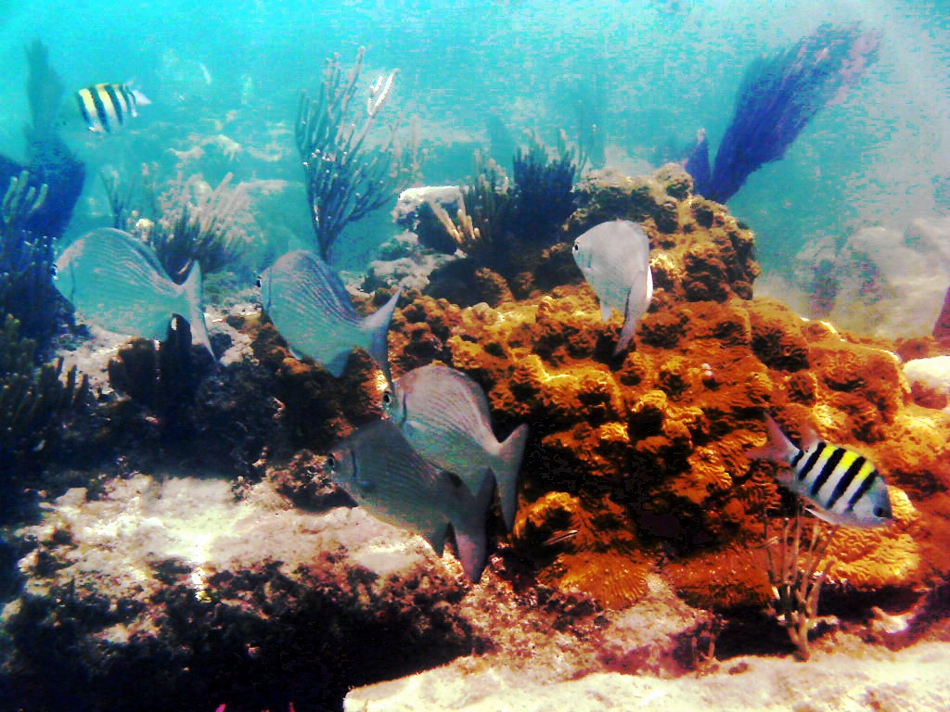
2014 model v.s RGHS
composition of dual-intensity images and Rayleigh-stretching (2014)
Mean squared error:331.5131238301595
RGHS(2018)
Mean squared error:5470.202645068516

Slide 17
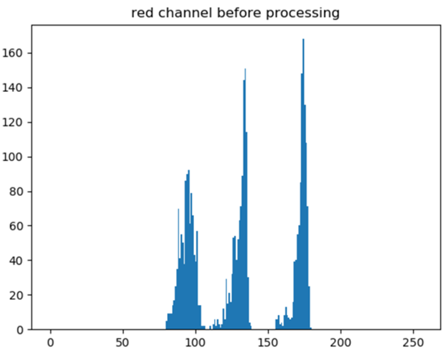
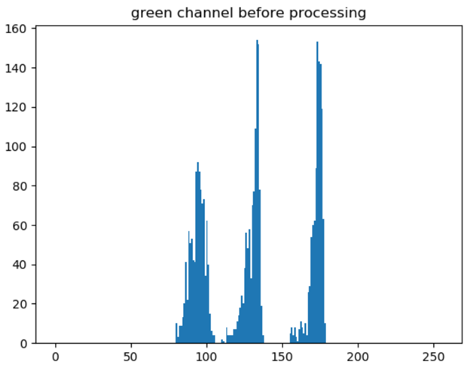
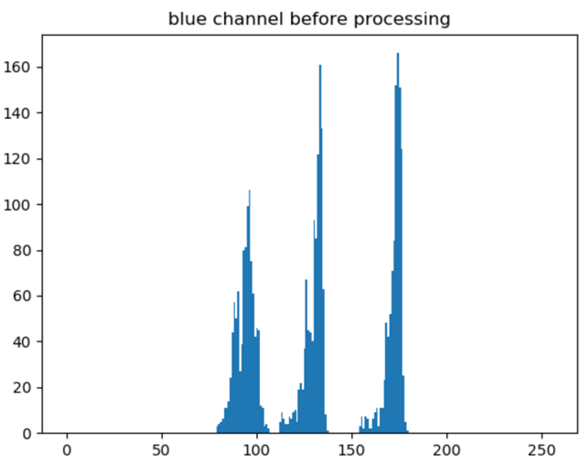
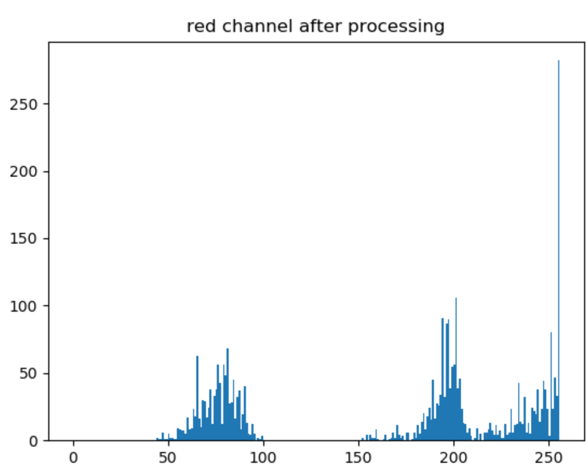
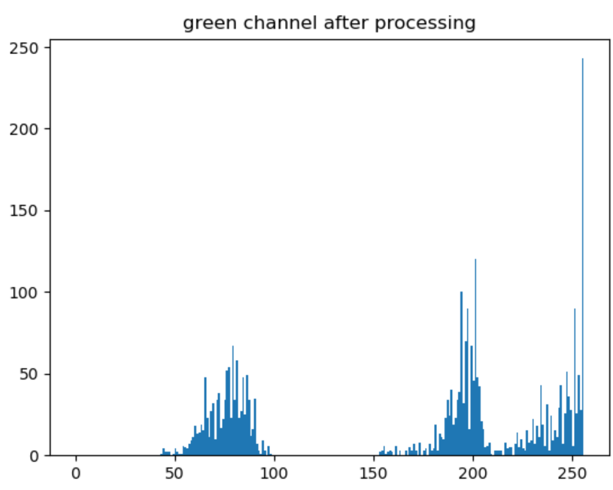
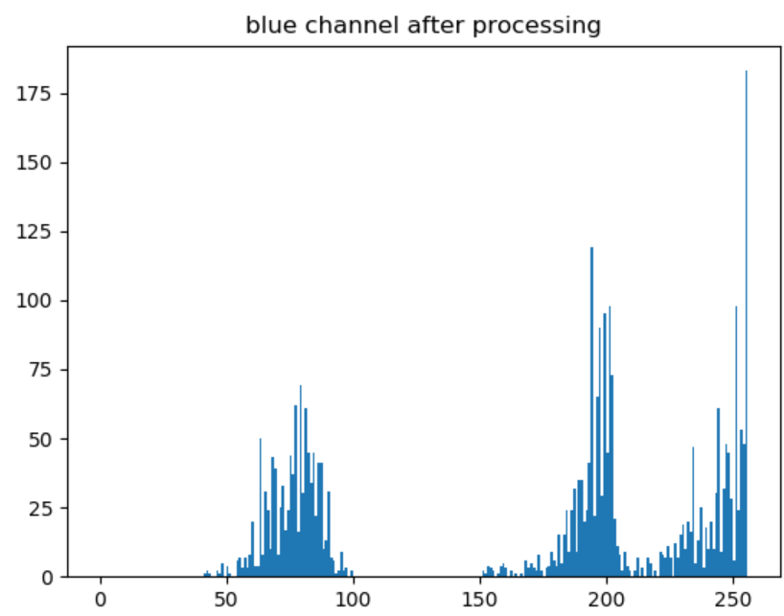
Comparison(histogram before and after processing)-our model

Slide 18



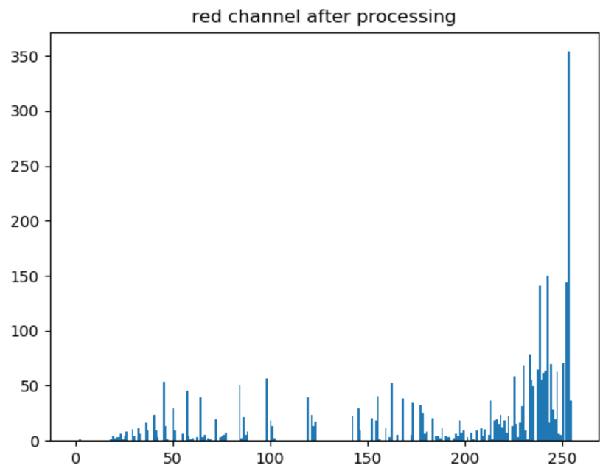
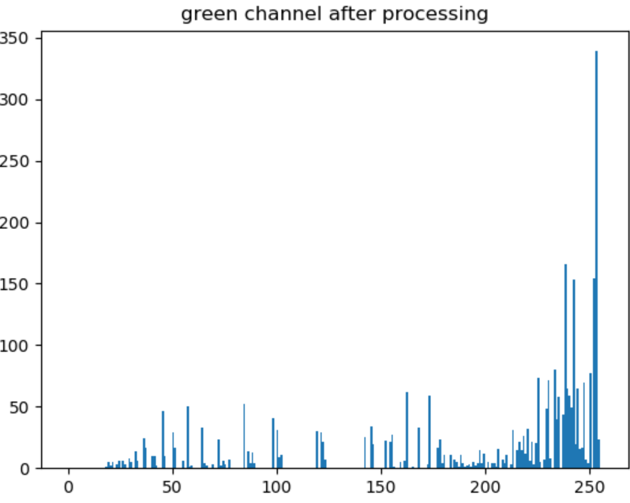
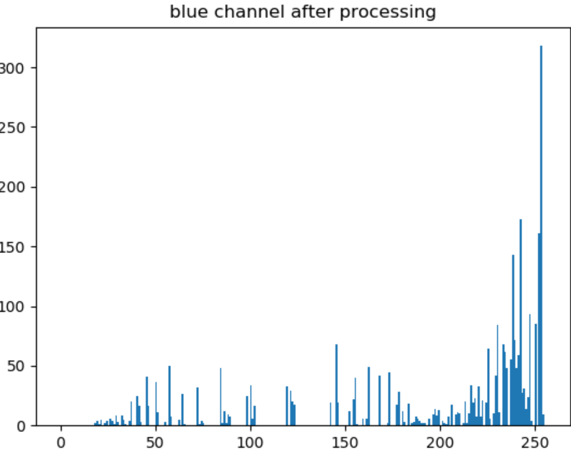
Comparison(histogram before and after processing)-2014 model

Slide 19
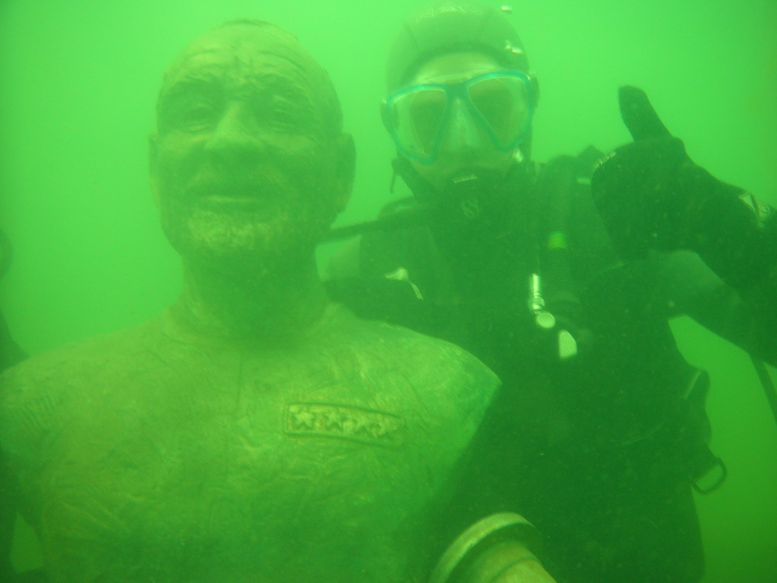
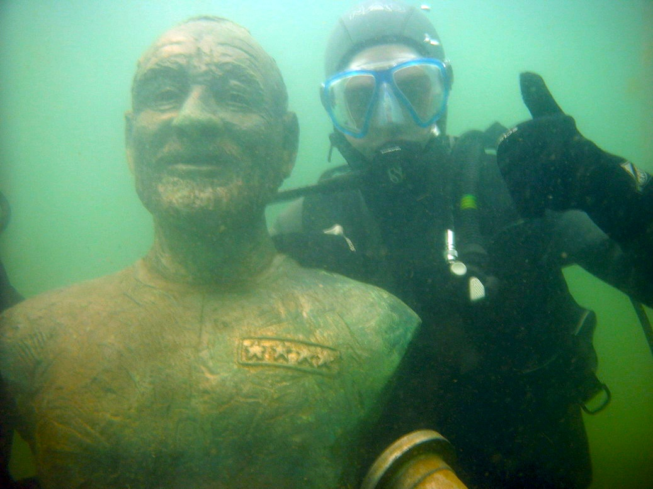
Experimental results
Original image
RGHS

Slide 20
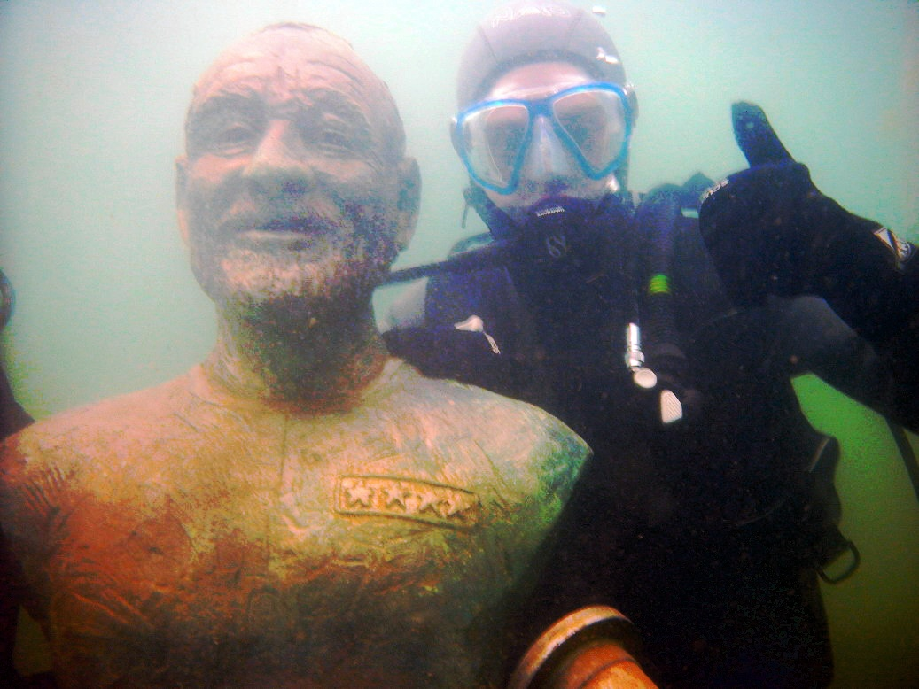
2014 model v.s RGHS
composition of dual-intensity images and Rayleigh-stretching (2014)
Mean squared error:302.31619413326456
RGHS(2018)
Mean squared error:6907.911796477734

Slide 21
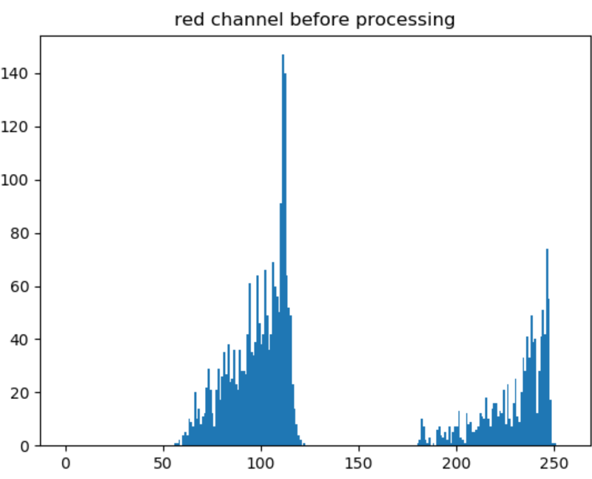
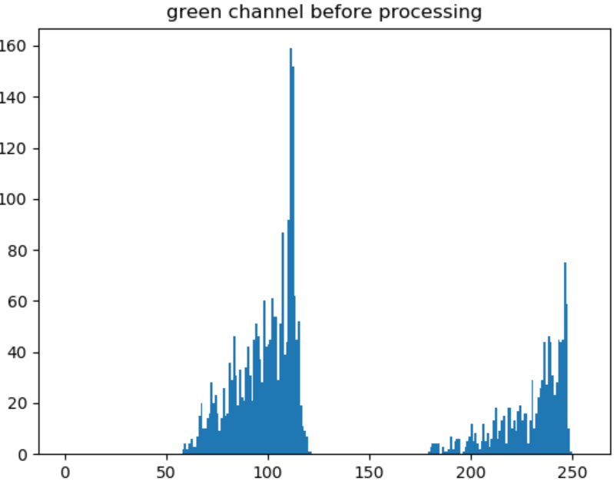
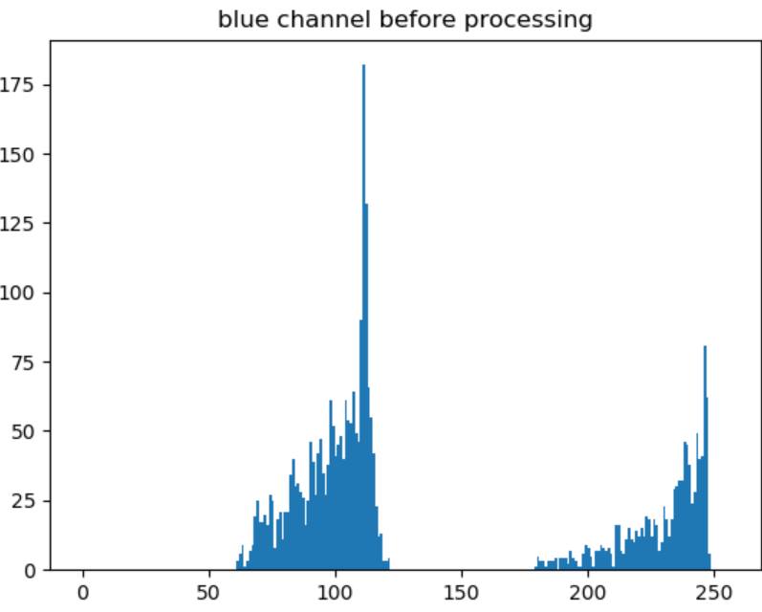
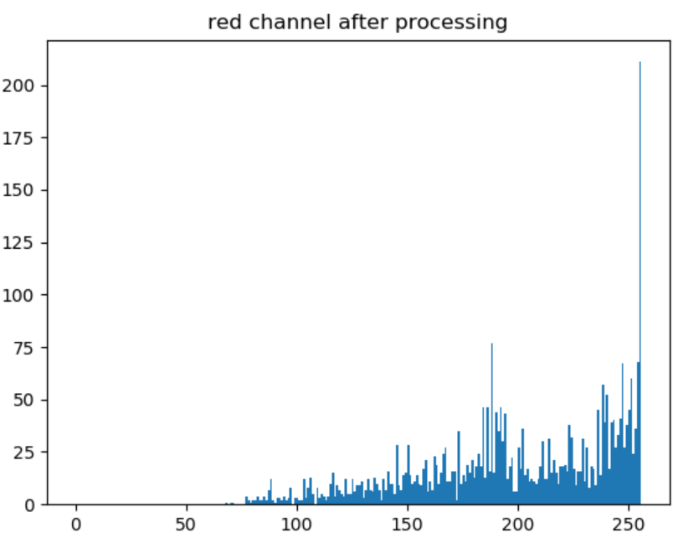
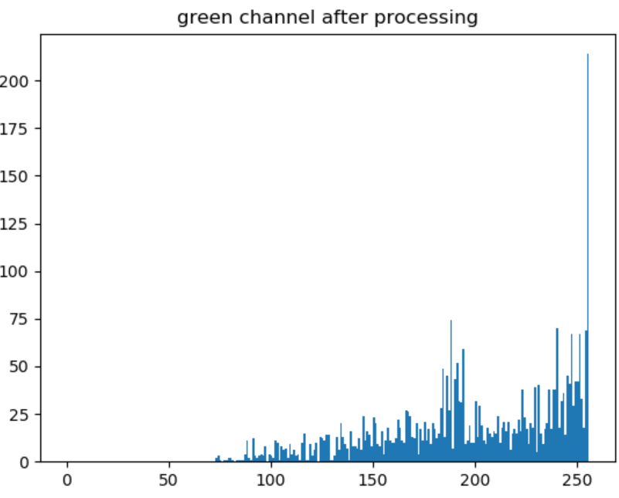
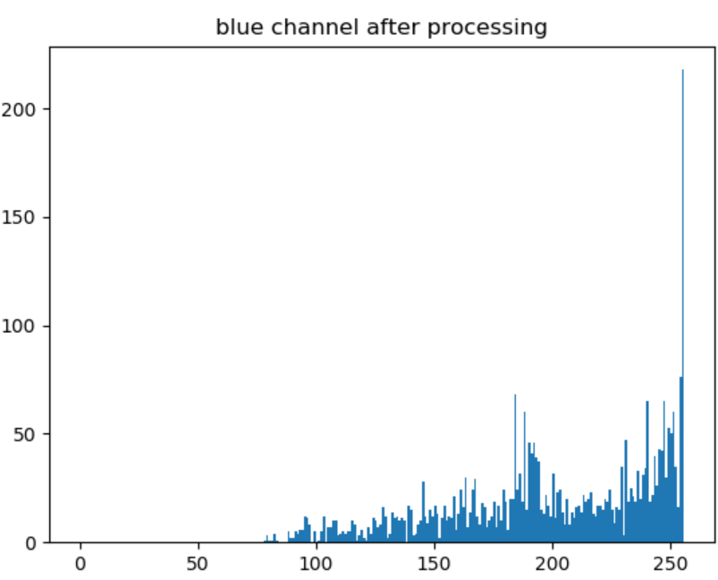
Comparison(histogram before and after processing)-our model

Slide 22
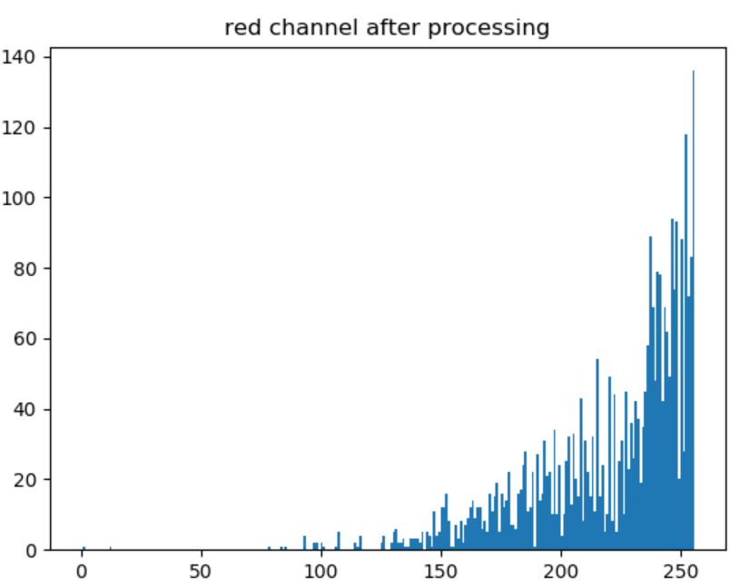
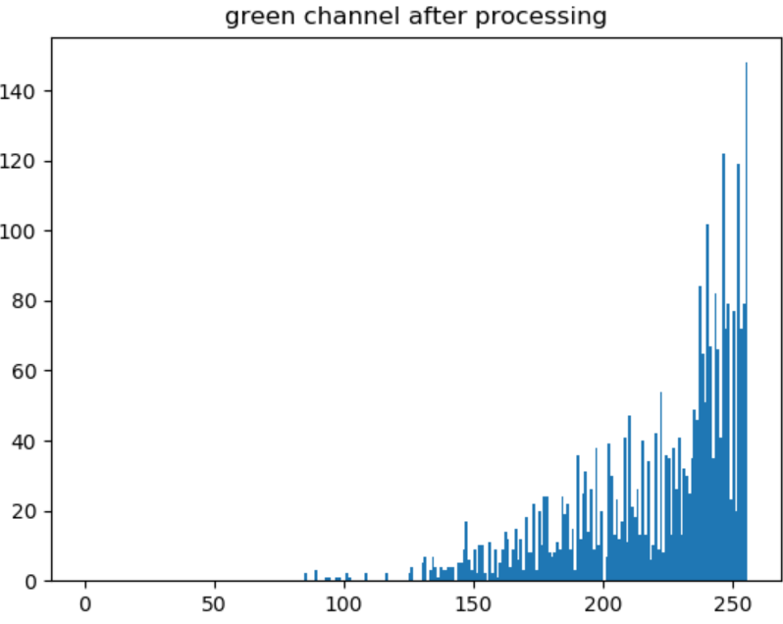
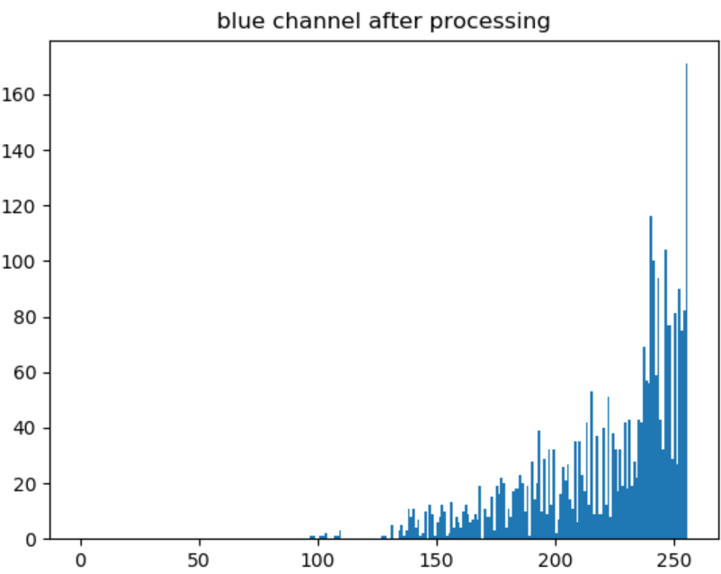
Comparison(histogram before and after processing)-2014 model

Slide 23
Conclusion:
Adaptive parameters have considered both the light transmission and the original image histogram distribution, preserving from overstretching or under-stretching.

Slide 24
Resource
https://xueyangfu.github.io/projects/icip2014.html
https://link.springer.com/chapter/10.1007/978-3-319-73603-7_37#:~:text=Because%20the%20underwater%20images%20are,and%2099.9%25%20of%20the%20histogram.
https://link.springer.com/content/pdf/10.1007%2F978-3-319-73603-7_37.pdf
https://ieeexplore.ieee.org/abstract/document/6269338
https://link.springer.com/article/10.1186/2193-1801-3-757
https://github.com/wangyanckxx/Single-Underwater-Image-Enhancement-and-Color-Restoration

