Slide 1

Soutenance
de Travail
de Maturité
Yves Zumbach
Un jeu vidéo,
de l'esprit à l'écran
Notes:
10 sec

Slide 2
!
Avant de commencer
Notes:
Anglicismes

Slide 3
Introduction
1
Notes:
5 sec

Slide 4
?
Vous avez dit « jeu vidéo »
Notes:
15 sec

Slide 6
Eluria's Chronicles
2
Notes:
5 sec

Slide 7


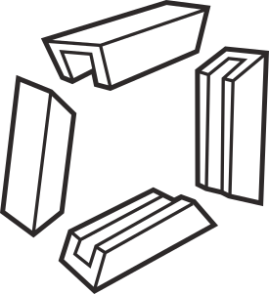



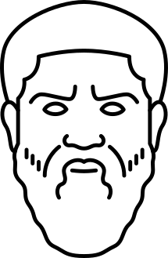

Le jeu vidéo,
Retour aux sources
Novateur
Magique
Divertissant
Réflexion
Critique
Notes:
20 sec

Slide 8
Gameplay
Notes:
7sec

Slide 9

Peace and Love
Notes:
10sec

Slide 10




Ressources
Graines
Énergie verte
%
Naturalité
Notes:
20sec

Slide 11
Thèmes
Notes:
3sec

Slide 12

Nature
Notes:
3sec

Slide 13

Technologie
Notes:
3sec

Slide 14
Lien
F r a
T e r
N e l
Notes:
3 sec

Slide 15

Égalité des sexes
Notes:
3sec

Slide 16
Raisons d'un insuccès
3
Notes:
5 sec

Slide 17
( 1. Dimension du projet )
2. Choix des outils

Slide 18
Contraintes
techniques
Notes:
3sec

Slide 19

1. Logiciels gratuits
( 2. Logiciels libres )
Gratui t
Notes:
10sec

Slide 20
Proof of concept
Notes:
5sec

Slide 21
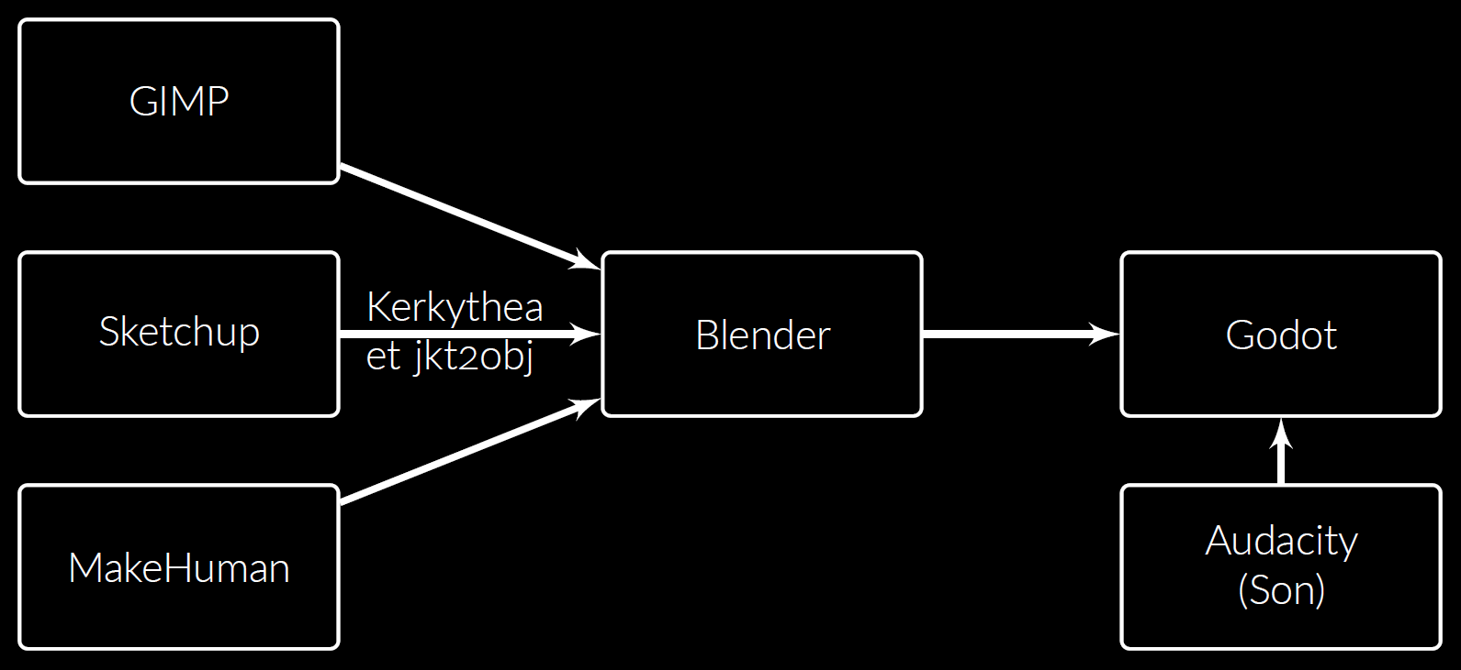
Réaliser une scène 3D
Notes:
40sec

Slide 22
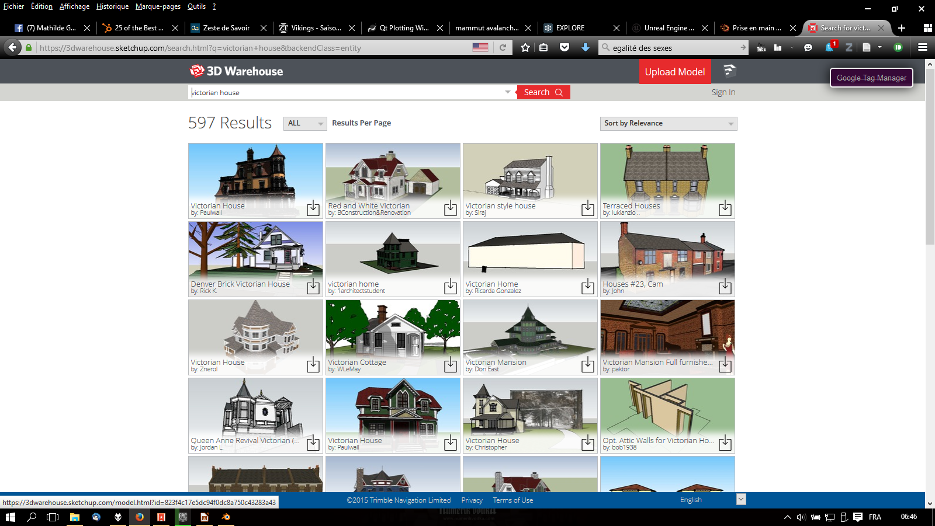

Slide 23
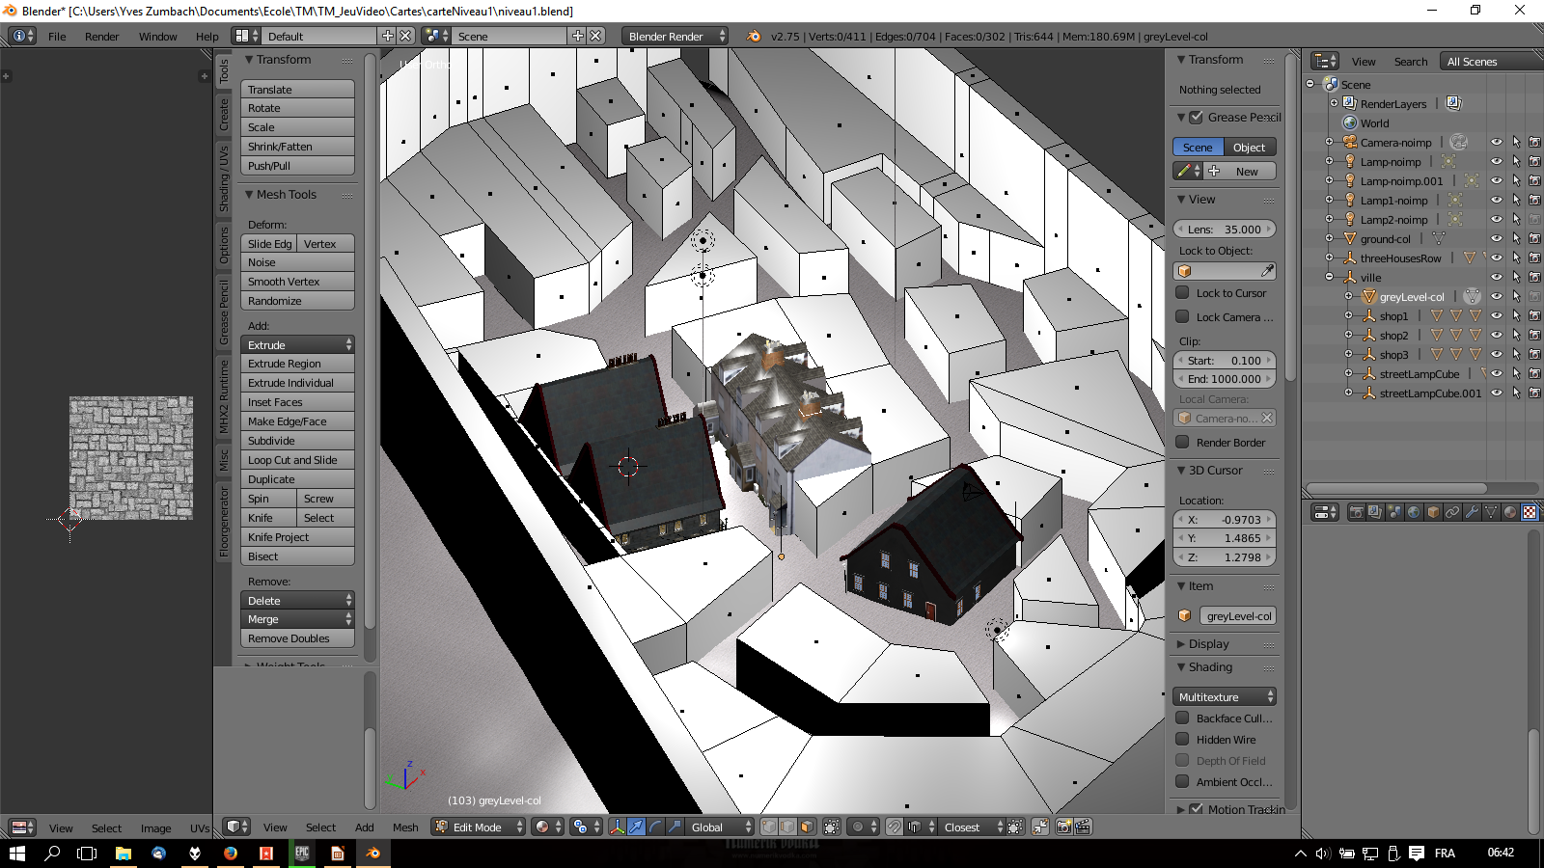

Slide 24
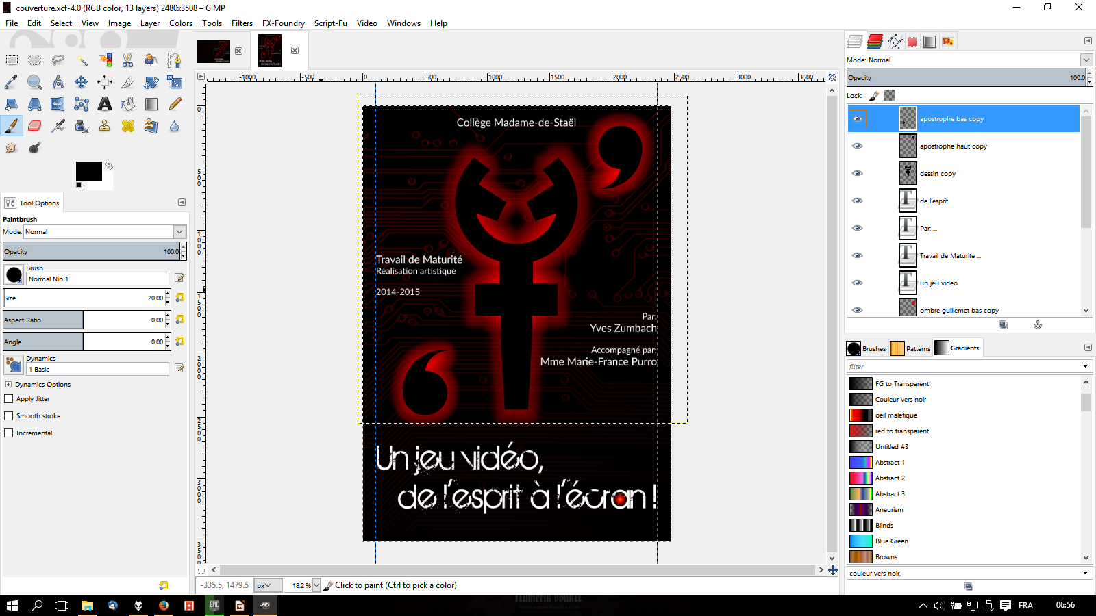

Slide 25
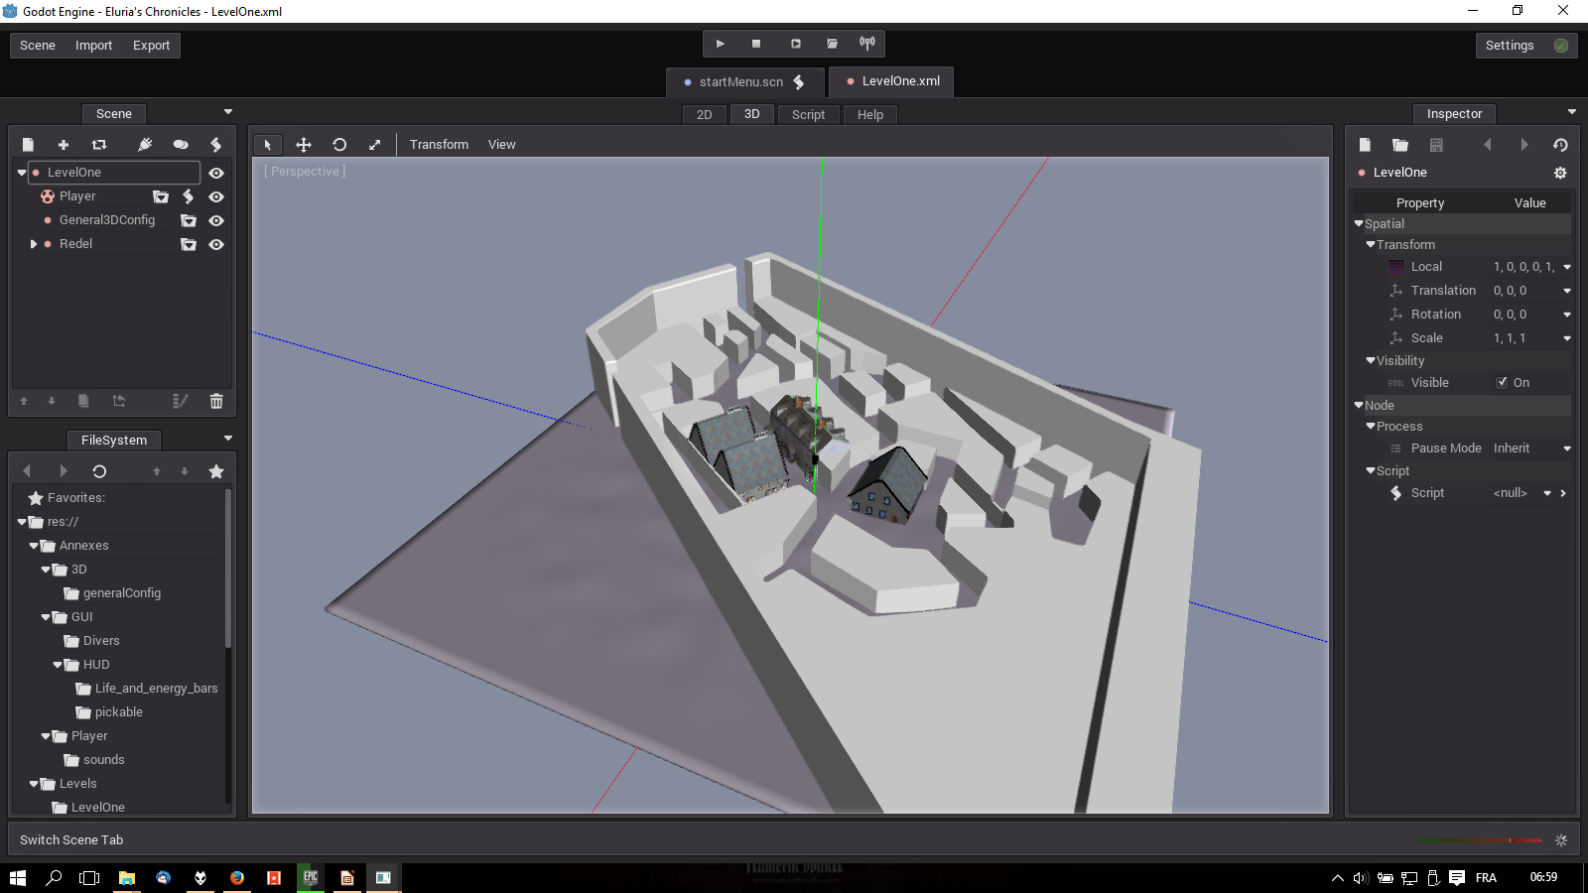

Slide 26
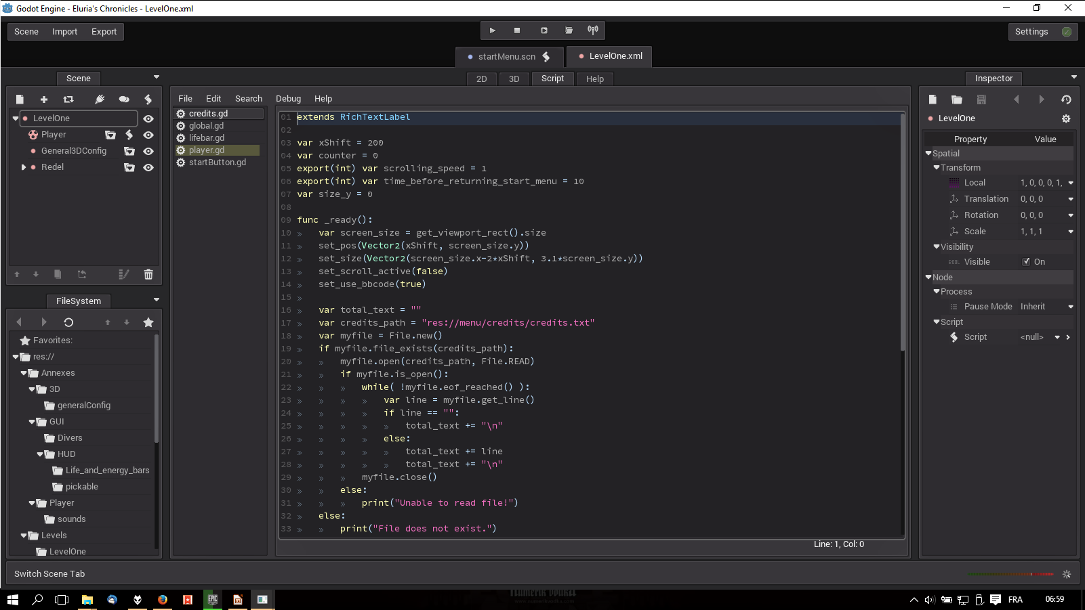

Slide 27
Les problèmes
Notes:
5sec

Slide 28
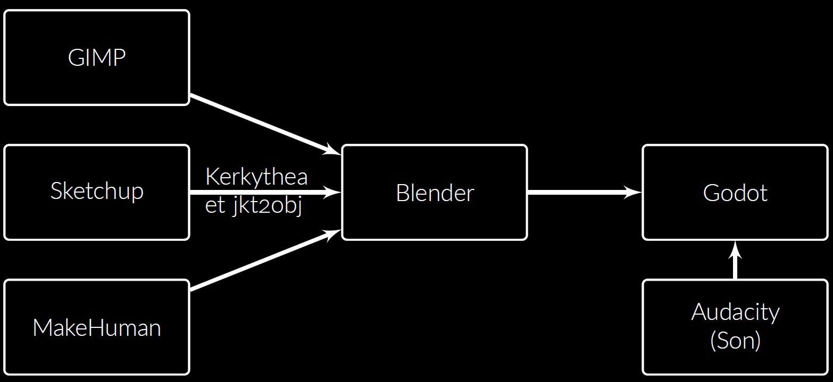
Réaliser une scène 3D
Notes:
40sec

Slide 29
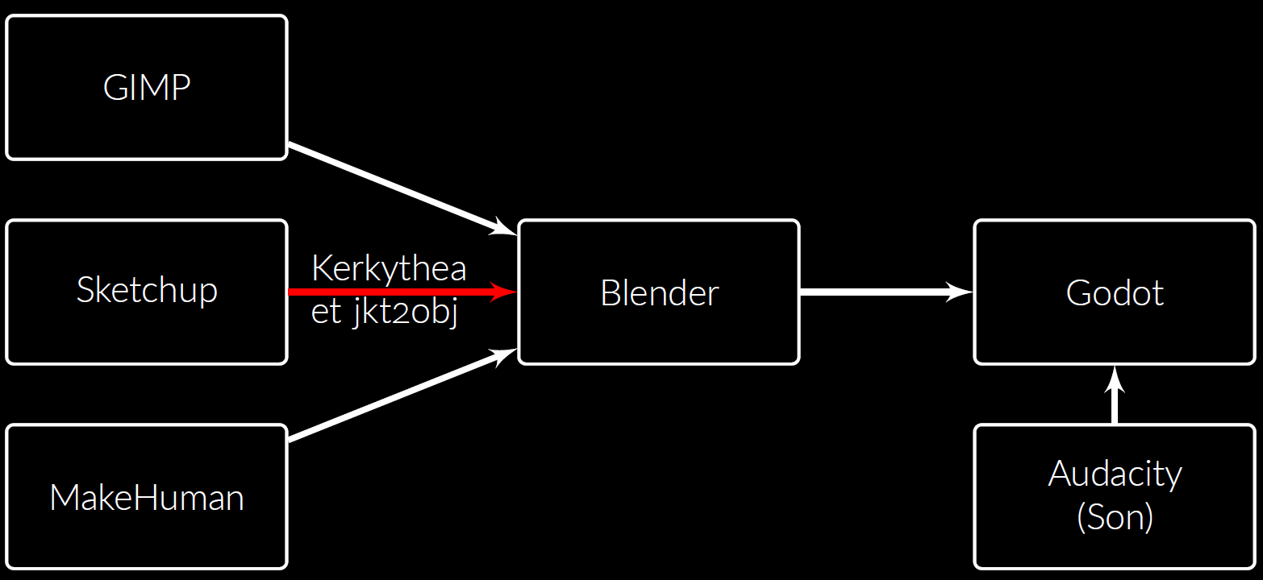
Réaliser une scène 3D
Notes:
40sec

Slide 30
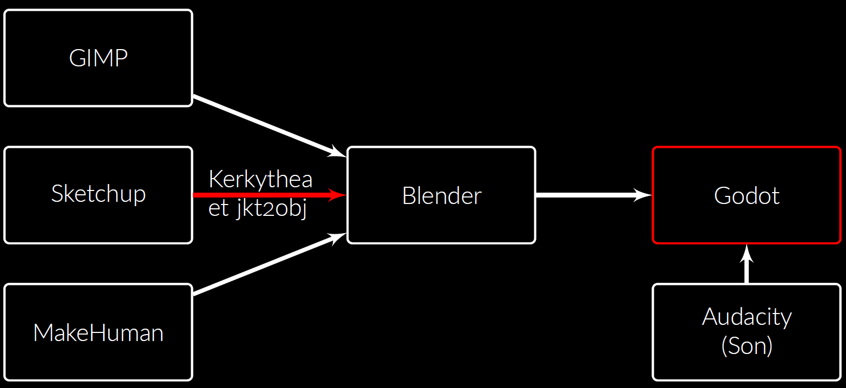
Réaliser une scène 3D
Notes:
40sec

Slide 31
if ray.is_colliding():
var up = state.get_total_gravity().normalized()
var normal = ray.get_collision_normal()
var floor_velocity = Vector3()
var object = ray.get_collider()
if object extends RigidBody or object extends StaticBody:
var point = ray.get_collision_point() - object.get_translation()
var floor_angular_vel = Vector3()
If object extends RigidBody:
floor_velocity = object.get_linear_velocity()
floor_angular_vel = object.get_angular_velocity()
elif object extends StaticBody:
floor_velocity = object.get_constant_linear_velocity()
floor_angular_vel = object.get_constant_angular_velocity()
var transform = Matrix3(Vector3(1, 0, 0), floor_angular_vel.x)
transform = transform.rotated(Vector3(0, 1, 0), floor_angular_vel.y)
transform = transform.rotated(Vector3(0, 0, 1), floor_angular_vel.z)
floor_velocity += transform.xform_inv(point) - point
yaw = fmod(yaw + rad2deg(floor_angular_vel.y) * state.get_step(), 360)
get_node("Yaw").set_rotation(Vector3(0, deg2rad(yaw), 0))
var diff = floor_velocity + direction * walk_speed –
state.get_linear_velocity()
var vertdiff = aim[1] * diff.dot(aim[1])
diff -= vertdiff
diff = diff.normalized() * clamp(diff.length(), 0, max_accel /
state.get_step())
diff += vertdiff
apply_impulse(Vector3(), diff * get_mass())

Slide 32
Une solution ?
Notes:
5sec

Slide 33


Slide 34
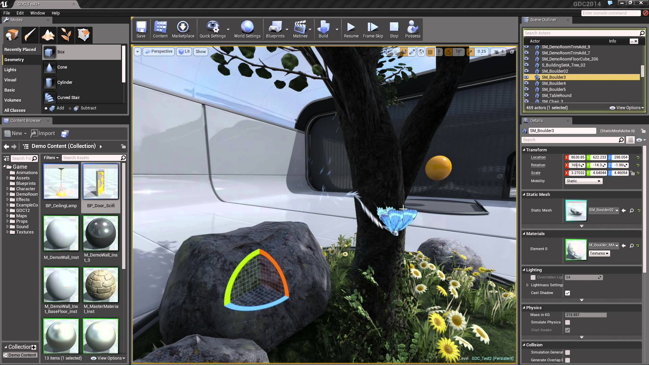

Slide 35
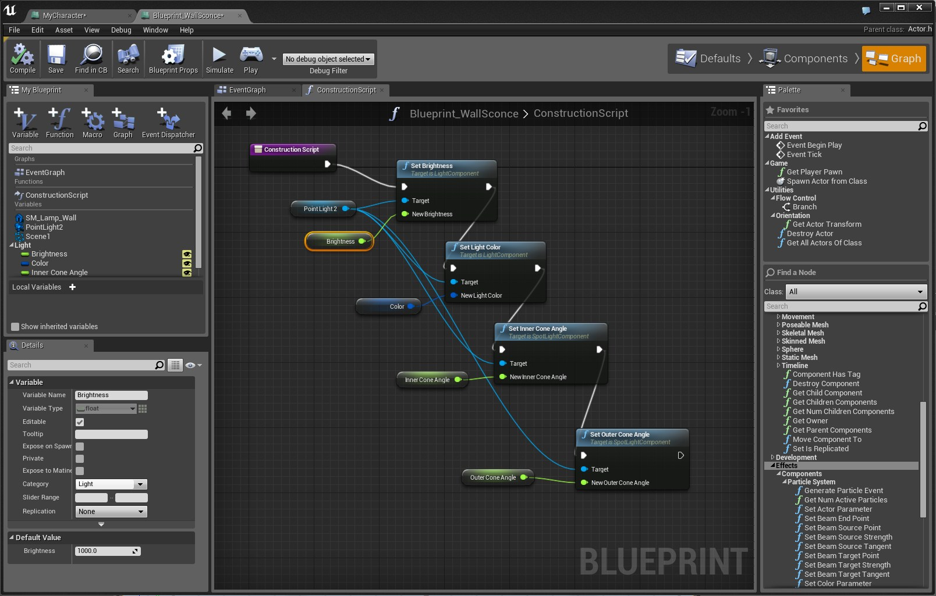

Slide 36
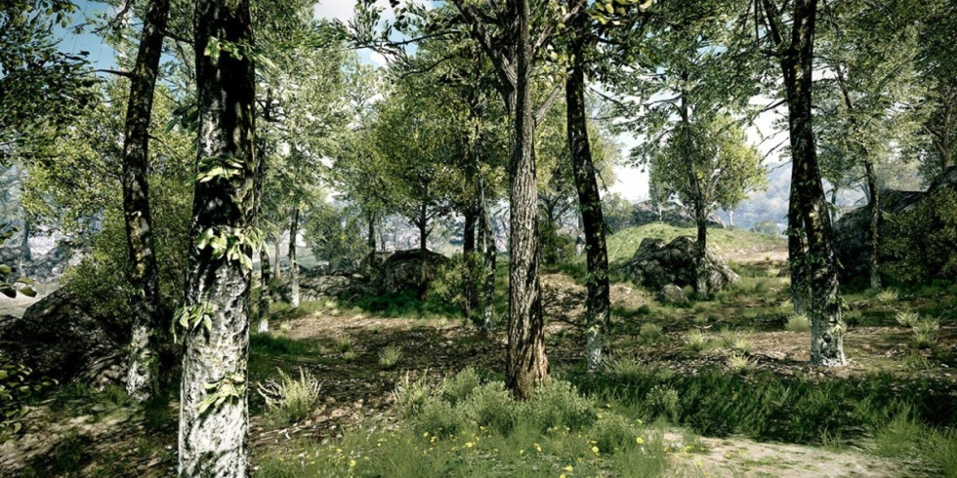

Slide 37
Conclusion
4
Notes:
5 sec

Slide 38


Slide 39
Credits
Plato by Dabid J. Pascual from the Noun Project
Magic Wand by Cognitive Dissonance from the Noun Project
comment by Pham Thi Dieu Linh from the Noun Project
Frame by Chris Gregory from the Noun Project
Question by Syafiqa Fickle from the Noun Project
seeds by Shawn Erdely from the Noun Project
Sustainable Energy by Jens Windolf from the Noun Project
Treasure Chest by Christian Mohr from the Noun Project
Camera by Studio Fibonacci from the Noun Project

