Slide 1
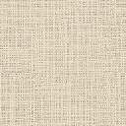
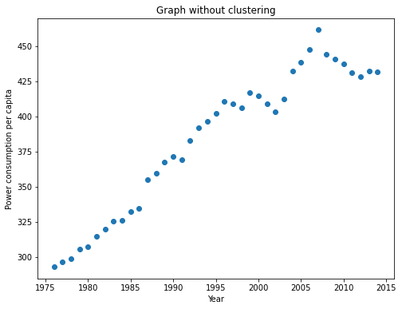
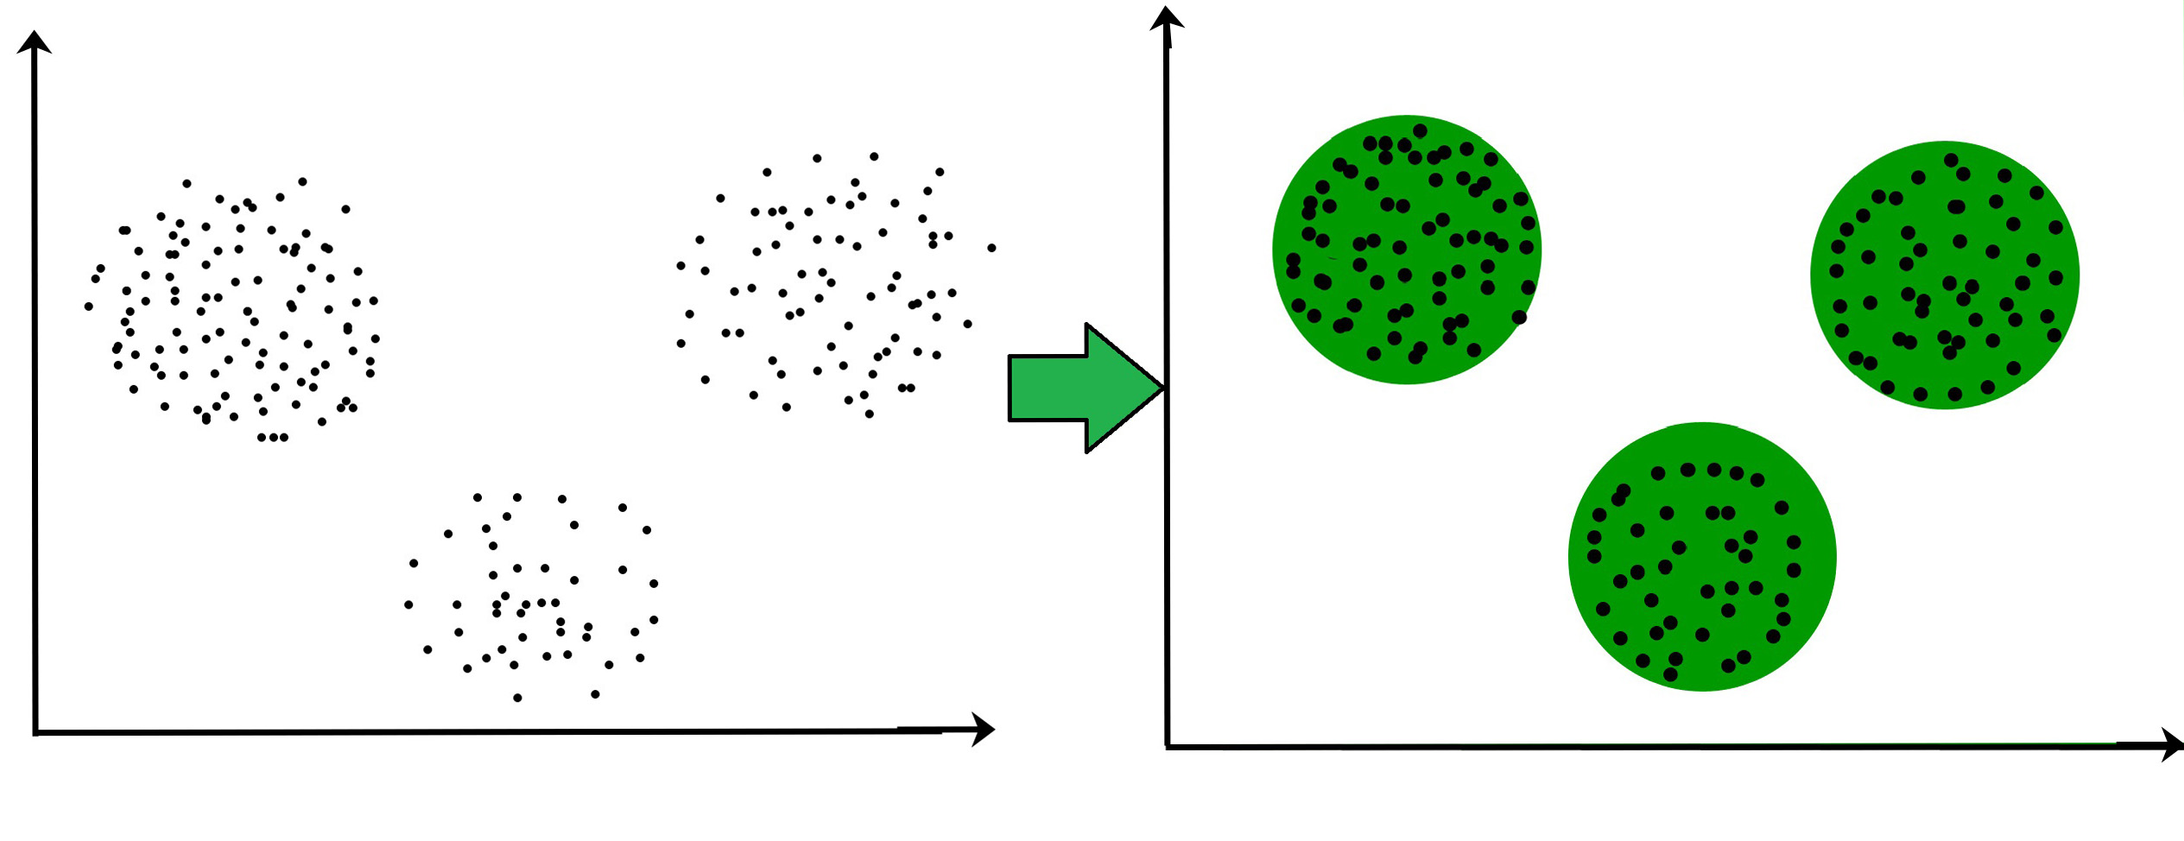
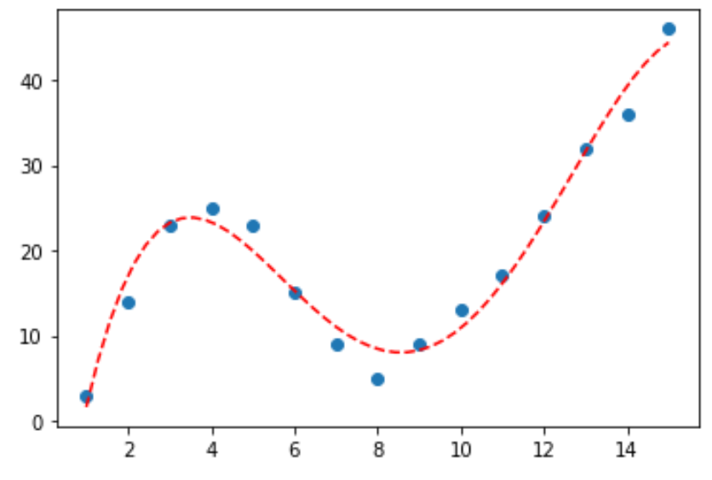
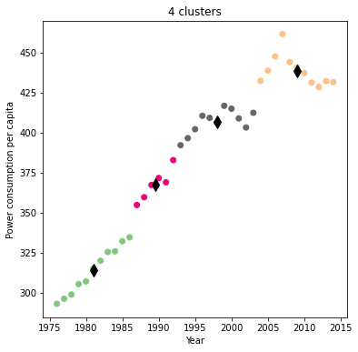
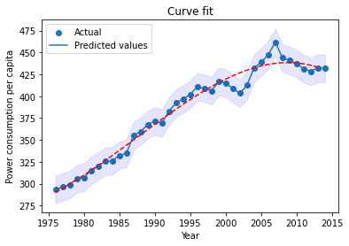
Clustering and Fitting
Harvi Gandhi
Introduction
Clustering is the process of creating the groups in which objects within a group be like one another and different from the objects in the other group. The quality of clustering is depending on the similarity and dissimilarity of the objects. There are different types of clustering techniques. And finding the curve that minimizes a point's vertical (y-axis) deviation from the curve is what is commonly meant by "fitting."
Clustering
In essence, it is a kind of unsupervised learning technique. It is typically used as a method to identify the groups, generative qualities, and significant structures that are inherent in a set of instances. The objective of clustering is to divide the population or set of data points into a number of groups so that the data points within each group are more similar to one another and different from the data points within the other groups. It is essentially a grouping of objects based on how similar and unlike they are to one another.
Methodology
To explain clustering, I have chosen the power consumption data set of Pakistan for the time span of 25 years from world data bank. Then from using pandas library of python, I have plot the graph, which is shown below.
This graph is of power consumption per capita of Pakistan between 1975 to 2015. From this graph it is perfectly visible that power consumption is increasing continuously.
Fig : 1.3 : Scatter graph
Fig : 1.1 :Example of Clustering
After plotting the scatter plot, we can easily plot clustering based graph. To plot cluster graph, there are different types of technique. To explain this combination, we are using k-means clustering. From using pandas library, we can plot the graph.. Here, we have chosen 4 clusters. According to centroids of the cluster, the data are placed into the different clusters. The black diamond label in the graph is the centroids of the clusters.
Fitting
Find the model that best captures the data given a dataset made up of a collection of points is called as fitting. We frequently have a dataset with data that generally follow a path, but because each data point has a standard deviation, they are dispersed along the line of best fit. There are different kind of fits available such as polynomial, line fit, exponential, logistic functions, etc.
Now, we have to find the best fit for the data which could be the line fit or polynomial fit or sin fit. From observing the graph, its visible that polynomial would be great fit to choose.
Finding the values for a dataset through which a specific set of explanatory variables may accurately describe another variable is the aim of curve-fitting.
Fig : 1.2 :Example of curve fit
Fig : 1.4 : Clustered graph
Fig : 1.5 : Curve fit graph
Conclusion
To conclude this, clustering is the method to group similar kind of data from the data set which is useful for in the data science to find the patterns or to predict the future about particular field and fitting will show us that how accurate the data is. From the above example we can predict the future that the power consumption will increase in the future.
GitHub Link: https://github.com/Harvi05/ADSPoster/blob/main/clusteringFitting.py

