Slide 1
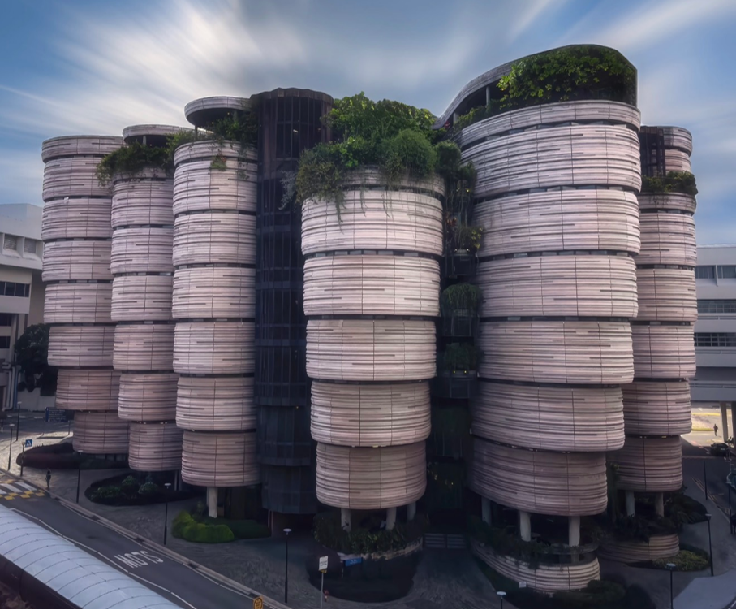

EE6008
WEEKLY PRESENTATION
Human Pose Analytics
Using Artificial Intelligence
Instance-Preserving Pose Representation
WEEK 4
Group 14
Week ending · 2026-09-15
Notes:
This presentation introduces our Week 3 research framing and early technical findings. Our specific direction is instance-preserving pose representation for multi-person action recognition.

Slide 2
Weekly Progress – Baseline & Training Preparation
EE6008 · HUMAN POSE GROUP PROJECT
THIS WEEK
Four workstreams moved from baseline selection to deployment preparation
B
D
T
S
Baseline
Finalized
Data
CTR-GCN ready
Training Setup
Adaptation defined
Server
Deployment started
BASELINE
DATA
TRAINING
DEPLOYMENT
EE6008 · WEEKLY REPORT
01
Notes:
Weekly overview only. Detailed explanations are reserved for the oral presentation.

Slide 3
Final Baseline Structure
EE6008 · HUMAN POSE GROUP PROJECT
Skeleton-based Action Recognition
CTR-GCN
PoseC3D
Graph-based
Heatmap-based
Graph · Joint & Bone · Two-stream
Pose Heatmap · 3D CNN
Action Prediction
EE6008 · WEEKLY REPORT
02
Notes:
Baseline structure: CTR-GCN and PoseC3D.
Source: project work summary supplied by the user.

Slide 4
Dataset Preparation
EE6008 · HUMAN POSE GROUP PROJECT
CTR-GCN
PoseC3D
NTU RGB+D 120 – Interaction26
✓ Preprocessing Completed
13,072 TRAIN
11,660 TEST
● Preprocessing In Progress
Raw Skeleton
Skeleton Data
Official CSub Split
Interaction26
Pose / Heatmap Preparation
Train / Validation / Test
PoseC3D Input
Ready for CTR-GCN Training
Validation comes from the original training split. The official test set remains unchanged.
Initial pose and heatmap preparation is underway
EE6008 · WEEKLY REPORT
03
Notes:
CTR-GCN counts: Train 13,072; Test 11,660.
Validation indices are drawn only from the original training membership.
Sources: E:/humanPose/reports/NTU120_INTERACTION26_SUBSET_REPORT.md; E:/humanPose/processed/skeletonx/ntu120_interaction26/ntu120csubinteraction26_train_val_split_summary.json

Slide 5
CTR-GCN Training Adaptation
EE6008 · HUMAN POSE GROUP PROJECT
ORIGINAL PIPELINE
REQUIRED ADAPTATION
Interaction26 Dataset
Dataset
+
Train / Validation Split Index
Original Feeder
+
Adapted Feeder
VALIDATION
SPLIT
Train / Test
Train / Validation / Test
CTR-GCN Training
New feeder logic and YAML configuration are required for the new Train/Validation setup.
Split Index · 26 Classes · Two-stream · Training Config
EE6008 · WEEKLY REPORT
04
Notes:
The original feeder supports train and test selection. The new protocol adds train and validation membership through indices, so the project needs an adapted feeder and corresponding YAML configuration.
Source: E:/humanPose/docs/CTRGCN_NPZ_FEEDER_ADAPTATION_PLAN.md

Slide 6
Baseline Task Allocation
EE6008 · HUMAN POSE GROUP PROJECT
BASELINES
CTR-GCN
PoseC3D
CTR-GCN Original Weight Test
CTR-GCN Two-stream Training
PoseC3D Original Weight Test
PoseC3D Subset Training
Baseline verification
Interaction26 retraining
Baseline verification
Interaction26 retraining
Member 1
Member 2
Member 3
Member 4
Four independent baseline deliverables
EE6008 · WEEKLY REPORT
05
Notes:
No verified member names were available in the supplied project materials, so the allocation uses Member 1 through Member 4 as requested.

Slide 7
Experiment & Evaluation Development
EE6008 · HUMAN POSE GROUP PROJECT
Unified Evaluation
Experiment 3
Identity / Person-slot Swap
Experiment 4
Asymmetric Interaction Analysis
CTR-GCN + PoseC3D
Person A Person B
26 Interaction Classes
Top-1 Accuracy
SWAP
Macro-F1
Symmetric
Asymmetric
Per-class Recall
Person B Person A
Confusion Matrix
Prediction Consistency
Mean Recall Comparison
Sequence Swap · Temporal Disruption · TV Distance
Experiments 1 & 2 are integrated into the cross-model evaluation pipeline
EE6008 · WEEKLY REPORT
06
Notes:
Status supplied by the user: unified metrics, Experiment 3 swap transformation and consistency measurement, and Experiment 4 grouping and mean-recall comparison are implemented.

Slide 8
Training Platform & Deployment
EE6008 · HUMAN POSE GROUP PROJECT
FINAL TRAINING PLATFORM
School Lab Server
School Laboratory GPU Server
Provided by our mentor
3 × RTX 3090
GPU
3 × NVIDIA RTX 3090
Dedicated Group Account
Project GPU allocation
/mnt/data/6008/
Dedicated Project Folder
Dedicated group account and project workspace
Baseline Training
● Dataset Upload — In Progress
● Code Deployment — In Progress
EE6008 · WEEKLY REPORT
07
Notes:
The project guide records three RTX 3090 GPUs and the dedicated workspace /mnt/data/6008/.
Source: E:/humanPose/docs/NTU_SERVER_CTRGCN_GUIDE.md
No credentials, IP address, password, or private key appear on this slide.

Slide 9
Next Steps
EE6008 · HUMAN POSE GROUP PROJECT
BEFORE RECESS WEEK
PARALLEL WORK
4 Members
Baseline Implementation
Experiments
Complete Assigned Baseline Tasks
Final Report Writing
Baseline Implementation
& Initial Results
1. Complete the four assigned baseline tasks before Recess Week
2. Start drafting the Final Report in parallel with baseline implementation
Target: Baseline implementation completed before Recess Week
EE6008 · WEEKLY REPORT
08
Notes:
Target: complete baseline implementation before Recess Week while experiments and final report drafting continue in parallel.

