Slide 1


EE6008
WEEKLY PRESENTATION
Human Pose Analytics
Using Artificial Intelligence
Instance-Preserving Pose Representation
WEEK 3
Group 14
Week ending · 2026-09-01
Notes:
This presentation introduces our Week 3 research framing and early technical findings. Our specific direction is instance-preserving pose representation for multi-person action recognition.

Slide 2
Weekly Snapshot & Milestone
WEEKLY TAKEAWAY
PROJECT STATUS
{{KEY_MESSAGE}}
State the one result or decision the supervisor should remember.
{{STATUS}}
ON TRACK · AT RISK · BLOCKED
CURRENT MILESTONE · EVIDENCE · BLOCKER · NEXT CHECKPOINT
{{MILESTONE}}
Evidence completed: … | Current blocker: … | Next checkpoint: …
Kick-off
Data
Baselines
IP Module
Experiments
Final Report
EE6008 · HUMAN POSE ANALYTICS
{{SOURCE}}
{{PAGE_NUM}}

Slide 3
Technical Progress
THIS WEEK
PIPELINE / ARCHITECTURE / IMPLEMENTATION EVIDENCE
TECHNICAL TAKEAWAY
{{TECHNICAL_PROGRESS}}
Completed · In progress · Blocked Include the concrete output, not only the activity.
{{CONTENT_AREA}}
Recommended: module diagram, interface contract, training pipeline, code evidence, or data-flow change.
{{KEY_FINDING}}
Why it matters:
What changed in the design, evidence, or next decision?
EE6008 · HUMAN POSE ANALYTICS
{{SOURCE}}
{{PAGE_NUM}}

Slide 4
Experimental Evidence
ONE-LINE RESULT
{{KEY_MESSAGE}}
EVIDENCE · BASELINE · CONTROL · METRIC
KEY FINDINGS
{{CONTENT_AREA}}
Insert one chart, table, confusion matrix, or controlled comparison. Label the baseline, evaluation split, metric, and uncertainty.
{{FINDINGS}}
1 · What changed versus baseline? 2 · Which class or case still fails? 3 · What experiment comes next?
EE6008 · HUMAN POSE ANALYTICS
{{SOURCE}}
{{PAGE_NUM}}

Slide 5
Risks & Decisions
RISK / BLOCKER
IMPACT ON SCOPE, EVIDENCE, OR TIMELINE
{{RISKS}}
Describe the failure mode, trigger, and evidence.
{{IMPACT}}
Quantify delay, compute cost, metric risk, or lost scope.
MITIGATION / OWNER / CHECK DATE
DECISION OR SUPPORT NEEDED
{{MITIGATION}}
Owner: … | Check date: … | Fallback: …
{{DECISION_NEEDED}}
State the choice, approver, and latest useful date.
EE6008 · HUMAN POSE ANALYTICS
{{PAGE_NUM}}

Slide 6
Next-Week Commitments
DELIVERABLE 1 · BUILD
OWNER · DUE DATE · SUCCESS CHECK
1
{{NEXT_ACTION_1}}
Output: code, dataset, or runnable module.
{{OWNER_AND_DEADLINE}}
Owner: … Due: … Success check: observable output or agreed metric threshold.
DELIVERABLE 2 · VALIDATE
2
{{NEXT_ACTION_2}}
Output: metric table, control, or ablation result.
DELIVERABLE 3 · DOCUMENT
3
{{NEXT_ACTION_3}}
Output: updated figure, notes, or report section.
EE6008 · HUMAN POSE ANALYTICS
{{PAGE_NUM}}

Slide 7
Open Canvas
EE6008 · HUMAN POSE ANALYTICS
{{SOURCE}}
{{PAGE_NUM}}

Slide 8
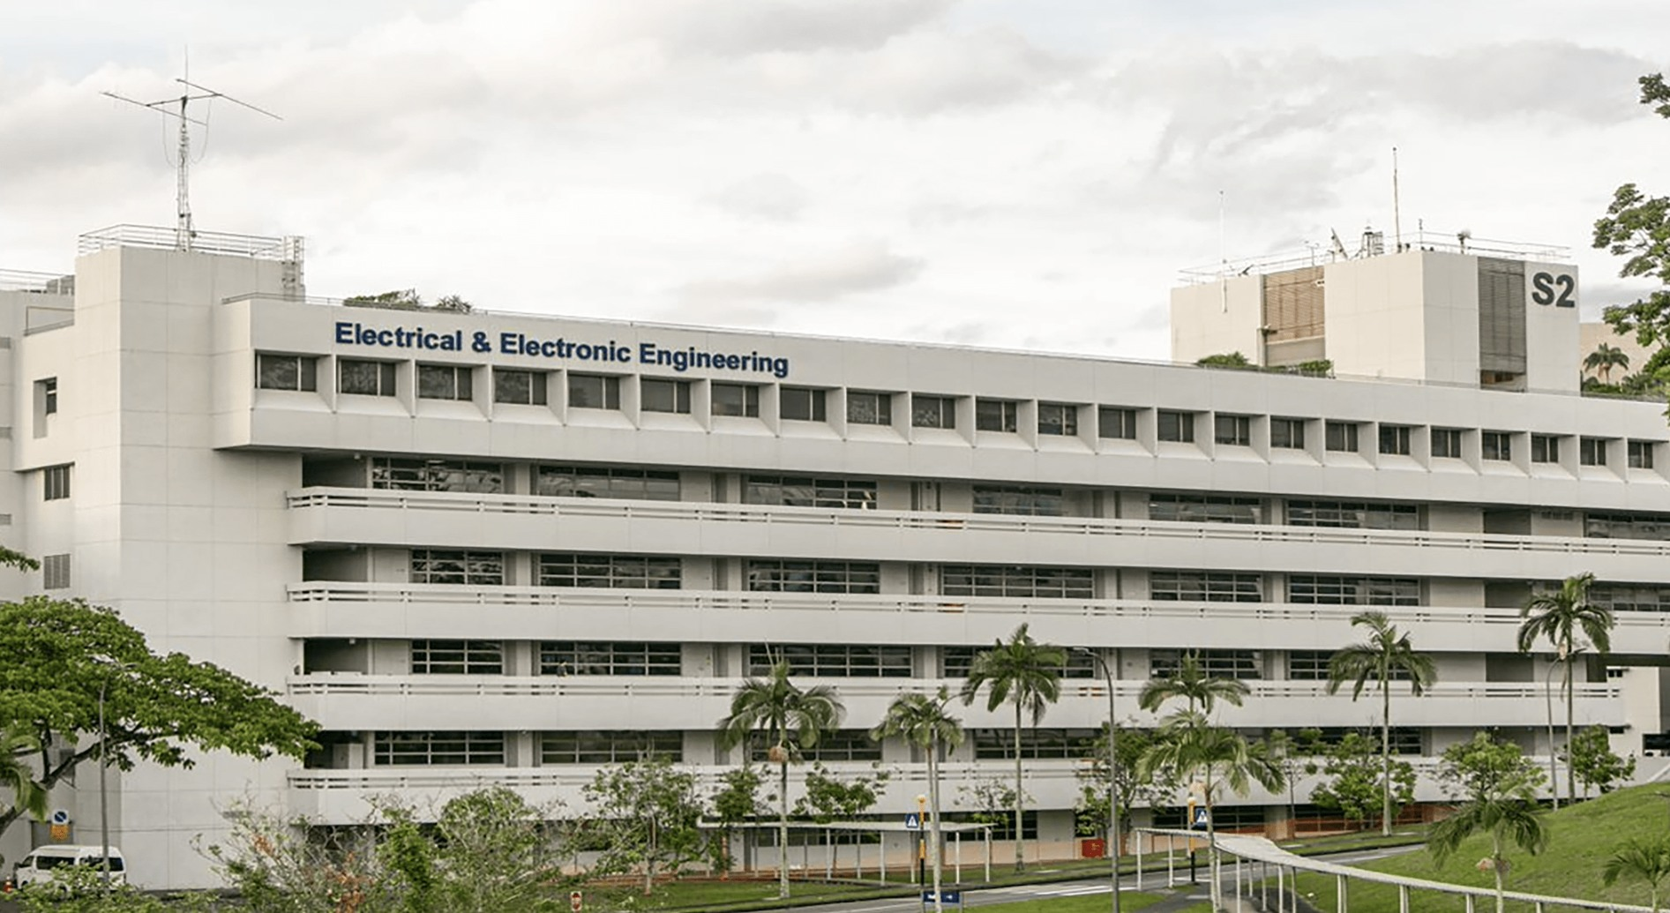
Single-Image Story
IMAGE DESCRIPTION
{{IMAGE_DESCRIPTION}}
What does the image show?
Why is it relevant this week?
What should the audience notice?
TIP
Use one annotated result, system overview, qualitative example, or implementation photograph.
EE6008 · HUMAN POSE ANALYTICS
{{SOURCE}}
{{PAGE_NUM}}

Slide 9
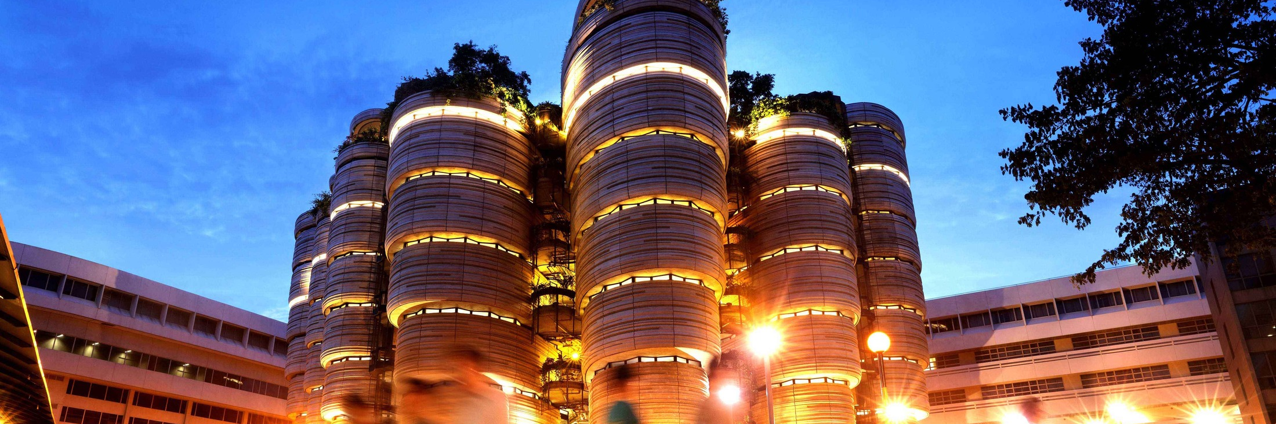


Multi-Image Story
USE 2–4 IMAGES
{{CAPTION_1}}
{{CAPTION_2}}
{{CAPTION_3}}
{{CAPTION_4}}
EE6008 · HUMAN POSE ANALYTICS
{{SOURCE}}
{{PAGE_NUM}}

Slide 10
EE6008 · HUMAN POSE ANALYTICS
Thank You
EE6008 · HUMAN POSE ANALYTICS

