Slide 1
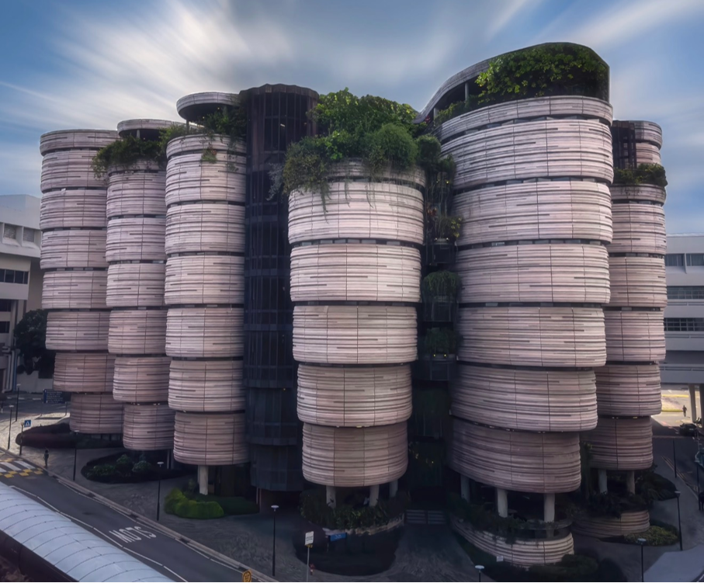

EE6008
WEEKLY PRESENTATION
Human Pose Analytics
Using Artificial Intelligence
Instance-Preserving Pose Representation
WEEK 3
Group 14
Week ending · 2026-09-01
Notes:
This presentation introduces our Week 3 research framing and early technical findings. Our specific direction is instance-preserving pose representation for multi-person action recognition.

Slide 2
Weekly Snapshot & Milestone
Key Message
State the one result or decision the supervisor should remember.
Status
ON TRACK · AT RISK · BLOCKED
Milestone
Evidence completed: … | Current blocker: … | Next checkpoint: …

Slide 3
Technical Progress
Technical Progress
Completed · In progress · Blocked Include the concrete output, not only the activity.
Content Area
Recommended: module diagram, interface contract, training pipeline, code evidence, or data-flow change.
Key Finding
Why it matters:
What changed in the design, evidence, or next decision?

Slide 4
Experimental Evidence
Key Message
Content Area
Insert one chart, table, confusion matrix, or controlled comparison. Label the baseline, evaluation split, metric, and uncertainty.
Findings
1 · What changed versus baseline? 2 · Which class or case still fails? 3 · What experiment comes next?

Slide 5
Risks & Decisions
Risks
Describe the failure mode, trigger, and evidence.
Impact
Quantify delay, compute cost, metric risk, or lost scope.
Mitigation
Owner: … | Check date: … | Fallback: …
Decision Needed
State the choice, approver, and latest useful date.

Slide 6
Next-Week Commitments
Next Action 1
Output: code, dataset, or runnable module.
Owner And Deadline
Owner: … Due: … Success check: observable output or agreed metric threshold.
Next Action 2
Output: metric table, control, or ablation result.
Next Action 3
Output: updated figure, notes, or report section.

Slide 7
Open Canvas

Slide 8
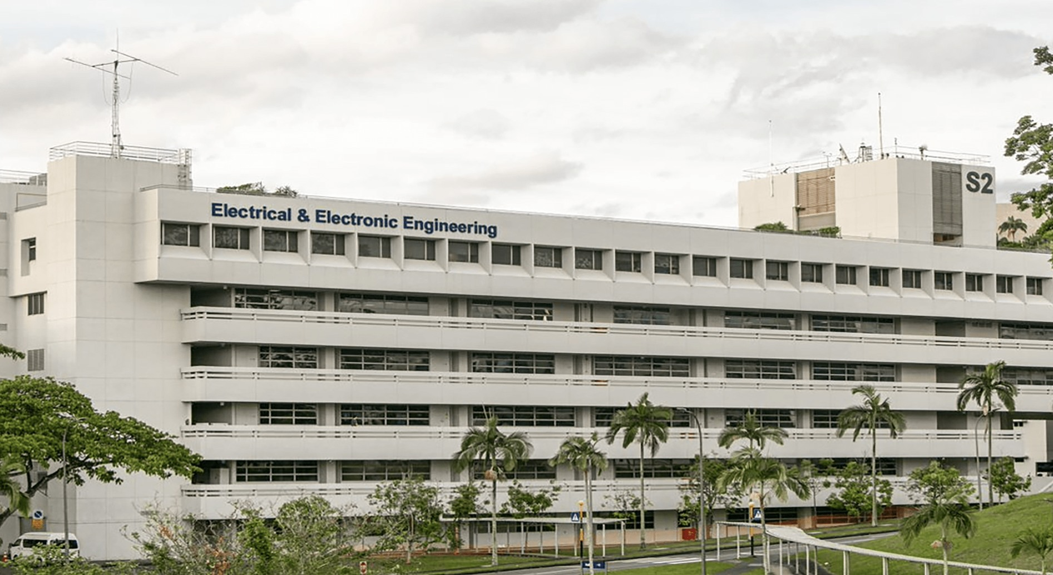
Single-Image Story
Image Description
What does the image show?
Why is it relevant this week?
What should the audience notice?
TIP
Use one annotated result, system overview, qualitative example, or implementation photograph.

Slide 9
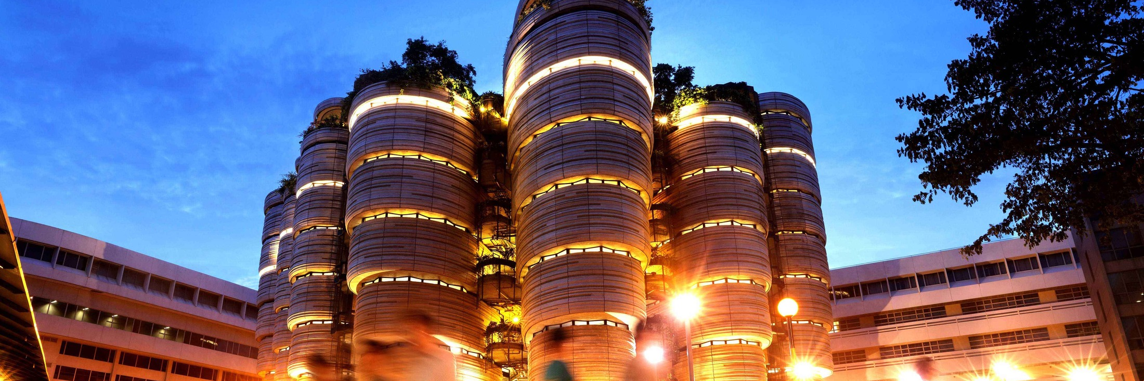
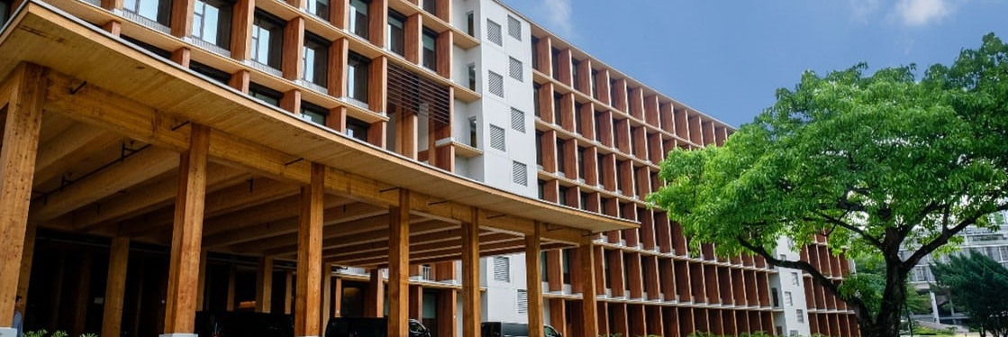

Multi-Image Story
Caption 1
Caption 2
Caption 3
Caption 4

Slide 10
Thank You

