Slide 1


EE6008
WEEKLY PRESENTATION
Human Pose Analytics
Using Artificial Intelligence
Instance-Preserving Pose Representation
WEEK 3
Group 14
Week ending · 2026-09-01
Notes:
This presentation introduces our Week 3 research framing and early technical findings. Our specific direction is instance-preserving pose representation for multi-person action recognition.

Slide 2
Weekly Snapshot & Milestone
WEEKLY TAKEAWAY
PROJECT STATUS
Direction fixed
Preserve person identity before multi-person fusion
ON TRACK
Scope defined
CURRENT MILESTONE · EVIDENCE · BLOCKER · NEXT CHECKPOINT
Week 3 · Data + baseline setup
NTU120 audit complete → identity-aware loader next
Kick-off
Data
Baselines
IP Module
Experiments
Final Report
EE6008 · Instance-Preserving Pose Representation
2
Notes:
The project direction is now fixed around preserving person identity before multi-person fusion. Week 3 is on track: the interaction subset has been audited, and the next checkpoint is an identity-aware loader plus a reproducible baseline.

Slide 3
The Problem: Identity Is Lost During Fusion
FUSED REPRESENTATION
LOST INFORMATION
People are merged before classification
• Person-specific motion is blurred
• Roles become ambiguous
• Who performed each motion
• Relative inter-person geometry
• Role-specific movement
WHY IT MATTERS
RESEARCH QUESTION
Role-asymmetric actions depend on who does what
Fused representations may erase this distinction
Can identity + relative geometry improve recognition?
EE6008 · Instance-Preserving Pose Representation
3
Notes:
The problem is simple: common multi-person pose pipelines fuse people before the model has preserved who performed each motion. This can remove person identity, relative geometry, and role-specific information. The loss is especially important when two people perform different roles in the same action.

Slide 4
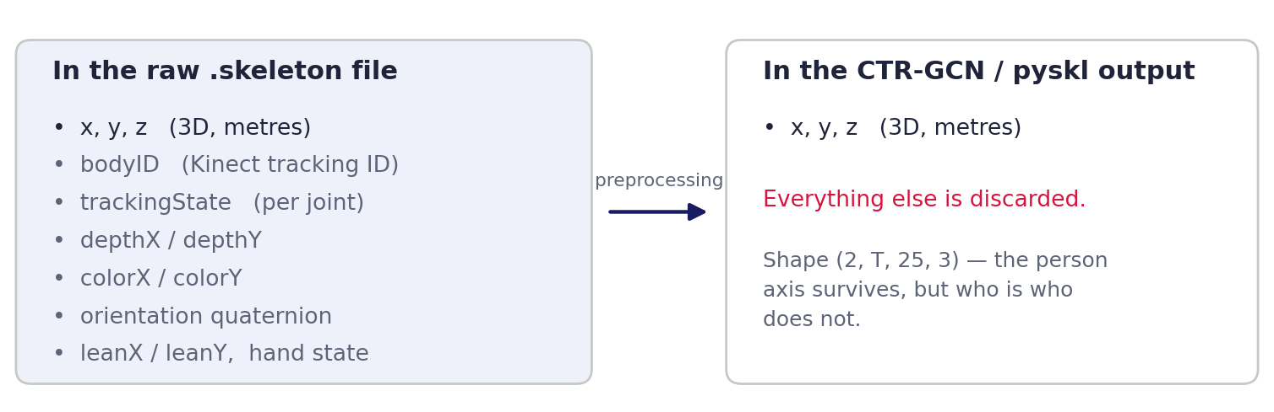
Expected Goal
EXPECTED GOAL
Preserve identity before fusion
PROPOSED REPRESENTATION
EVIDENCE
M1 · independent person streams
M2 · + relative displacement, distance, velocity Backbone largely unchanged
Better role-sensitive recognition
Parameter-conscious ablations Identity-swap sensitivity
EE6008 · Instance-Preserving Pose Representation
4
Notes:
Our goal is to preserve each person's motion before fusion without materially increasing backbone complexity. M1 keeps independent person streams, and M2 adds relative displacement, distance, and velocity. Controlled comparisons will test whether any gain comes from representation design rather than additional parameters.

Slide 5
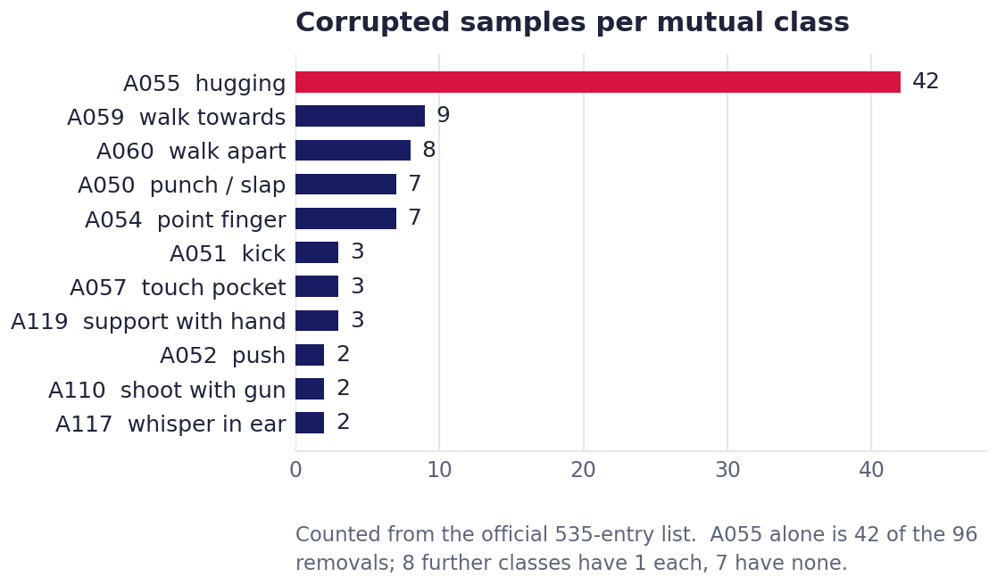
Scoping the Interaction Subset
THIS WEEK
PIPELINE / ARCHITECTURE / IMPLEMENTATION EVIDENCE
TECHNICAL TAKEAWAY
NTU RGB+D 120 dataset audit
Completed · format, splits, cleaning Planned · parser that keeps bodyID
26 mutual classes · 24,732 clips
A050–A060 + A106–A120
X-Sub · 53 / 53 | X-Set · even / odd
Skeleton-only · 10.3 GB
Identity lost
bodyID + trackingState dropped
Plan: retain both
EE6008 · Instance-Preserving Pose Representation
5
Notes:
With the problem and goal defined, we scoped the NTU RGB+D 120 mutual-interaction subset. The audit covers twenty-six classes and preserves the official Cross-Subject and Cross-Setup logic. The next data step is a parser that retains body identity and tracking state.

Slide 6
What the Raw File Still Holds
ONE-LINE RESULT
Raw file vs. preprocessed output
EVIDENCE · BASELINE · CONTROL · METRIC
KEY FINDINGS
The .skeleton file carries more than coordinates
Per body: bodyID, trackingState, lean, hand state Per joint: 3D / 2D positions, orientation, reliability
Three issues
• bodyID merging • A106–A120 missed • subset inconsistency
EE6008 · Instance-Preserving Pose Representation
6
Notes:
The raw skeleton files contain much more than joint coordinates. They include body identity, tracking state, per-joint reliability, and multiple coordinate and orientation fields. Our code review found that common preprocessing can merge identities and can also miss checks for action IDs above one hundred.

Slide 7
Paper Review & Baseline Recommendation
CTR-GCN · ICCV 2021
SKELETONX · IEEE TMM 2025
Strong GCN Backbone
• Dynamic joint topology
• Person slots encoded separately
• Final mean pooling removes the distinction
Data-Efficient Framework
• Uses a GCN backbone
• Cross-sample feature aggregation
• Performer ID ≠ within-clip identity.
RELATIONSHIP TO OUR PROJECT
BASELINE RECOMMENDATION
Shared research gap
• No explicit within-clip identity
• No explicit cross-person geometry
• No explicit role-aware modelling
Main · SkeletonX
Control · PoseC3D Fallback · CTR-GCN
EE6008 · Instance-Preserving Pose Representation
7
Notes:
These data findings connect directly to the baseline choice. SkeletonX is our main development baseline, while PoseC3D is the representation-level control for multi-person heatmap fusion. CTR-GCN remains the fallback if the SkeletonX environment cannot be stabilized early.

Slide 8
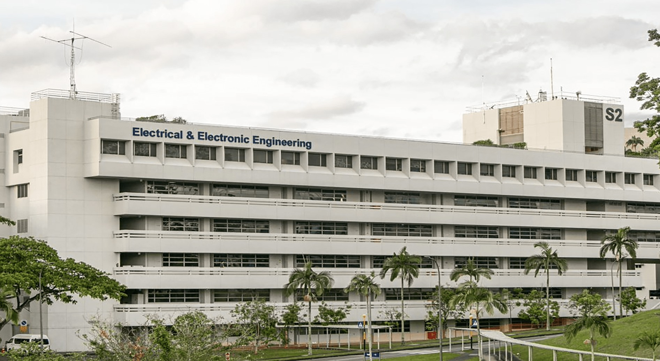
EE6008 · GROUP 14
Thank You
EE6008 · Instance-Preserving Pose Representation
Notes:
In summary, we are testing whether preserving person identity and relative geometry improves multi-person interaction recognition under controlled baselines. Thank you, and we welcome questions.

