Slide 1
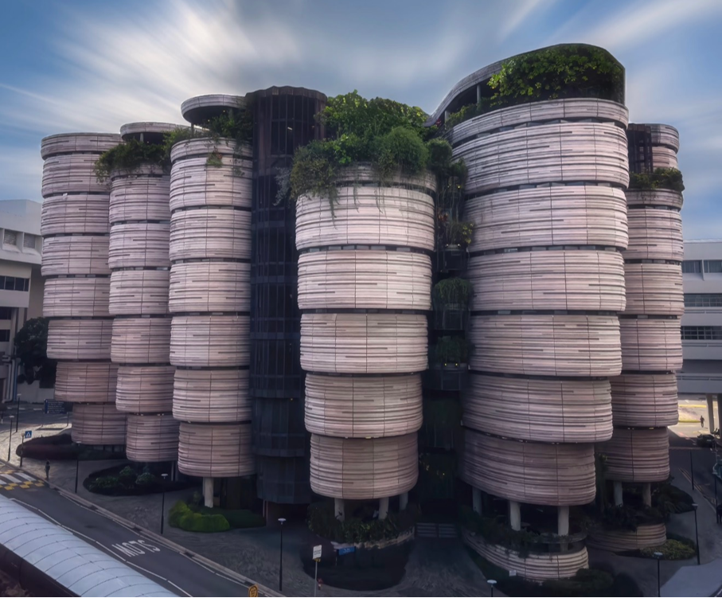

EE6008
WEEKLY PRESENTATION
Human Pose Analytics
Using Artificial Intelligence
Instance-Preserving Pose Representation
WEEK 4
Group 14
Week ending · 2026-09-08
Notes:
This presentation introduces our Week 3 research framing and early technical findings. Our specific direction is instance-preserving pose representation for multi-person action recognition.

Slide 2
Weekly Snapshot & Milestone
WEEKLY TAKEAWAY
PROJECT STATUS
{{KEY_MESSAGE}}
State the one result or decision the supervisor should remember.
{{STATUS}}
ON TRACK · AT RISK · BLOCKED
CURRENT MILESTONE · EVIDENCE · BLOCKER · NEXT CHECKPOINT
{{MILESTONE}}
Evidence completed: … | Current blocker: … | Next checkpoint: …
Kick-off
Data
Baselines
IP Module
Experiments
Final Report
EE6008 · HUMAN POSE ANALYTICS
{{SOURCE}}
{{PAGE_NUM}}

Slide 3
Technical Progress
THIS WEEK
PIPELINE / ARCHITECTURE / IMPLEMENTATION EVIDENCE
TECHNICAL TAKEAWAY
{{TECHNICAL_PROGRESS}}
Completed · In progress · Blocked Include the concrete output, not only the activity.
{{CONTENT_AREA}}
Recommended: module diagram, interface contract, training pipeline, code evidence, or data-flow change.
{{KEY_FINDING}}
Why it matters:
What changed in the design, evidence, or next decision?
EE6008 · HUMAN POSE ANALYTICS
{{SOURCE}}
{{PAGE_NUM}}

Slide 4
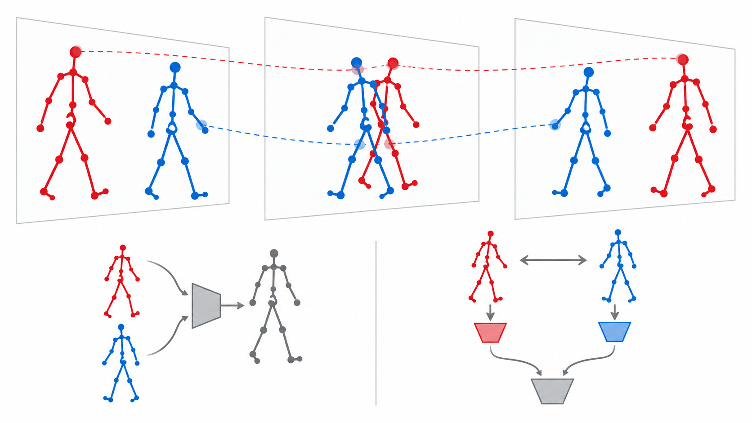
What identity means in our project
Anonymous instance continuity — not personal identification
IDENTITY IN OUR TASK
• Same skeleton track ↔
same person across frames
• Stable person-specific motion trajectories
• Separate person streams before fusion
NOT THE GOAl
• Face or name recognition
• Fixed roles for P1/P2
• SkeletonX performer ID across clips
Early pooling: motion source lost
Preserve trajectories before fusion
Keep the final prediction invariant to person order
Separate streams + relative relations
EE6008 · HUMAN POSE ANALYTICS
{{PAGE_NUM}}

Slide 5
CTR-GCN compatible NTU Data Preprocessing
From Raw Kinect Skeleton Data to Trainable NPZ Files
1
2
3
4
5
RAW SOURCES
SPLITS
TRAJECTORIES
NORMALIZE
OUTPUT + QA
.skeleton files
official missing lists
manifest.csv
XSub / XView / XSet
parse bodyID
filter and slot assignment
joint-2 translation
zero restore and padding
NPZ export
validate and audit
Final output
Training Interface
56,578
113,945
4
24,732
Offline Storage
NTU60 samples
NTU120 samples
Full split NPZ
Interaction-26
(N, 300, 150) · float32
CS / CV
CSub / CSet
0 overlap
13,072 / 11,660
Feeder runtime
(N, 3, 64, 25, 2)
All pass manifest、label、NaN/Inf、zero-only and layout validation
EE6008 · HUMAN POSE ANALYTICS

Slide 6
Multi-person audit
Interaction-26 · 24,732 samples · bodyID used for Quality Auditing Only
Conclusion: 96.7% of samples ultimately retain two persons; limited filtering, trajectory merging, and slot switching may weaken person-identity continuity.
Potential Issues
Final Person Slots
Two Persons： 23,917 · 96.7%
Single Person: 815 · 3.3%
1
Motion ranking determines person 0 / 1 and does not represent semantic identity.
>2 raw body IDs
1,224
2
Non-overlapping trajectories may be merged into the same slot, potentially causing Body ID switches.
removed trajectories
782
3
Additional trajectories overlapping with both occupied slots may be discarded.
4
The final NPZ does not preserve the original Body IDs, preventing direct identity tracing
unassigned trajectories
509
non-overlap merging
94
Possible Solutions
1
Keep the official-compatible baseline as the control.
slot bodyID switches events
95
2
Evaluate results separately by switch / merge / >2-trajectory cases.
3
Build a separate identity-aware data variant for comparison without replacing the baseline.
EE6008 · HUMAN POSE ANALYTICS

Slide 7
Baseline Selection
THIS WEEK
WHY IT CANNOT SERVE AS OUR BACKBONE
TECHNICAL TAKEAWAY
SkeletonX reviewed
Mentor suggested SkeletonX as our starting point. We went through the paper and the released code: sample pairing, decoupled pooling, the loss set, the feeders and both evaluation settings. Finding: it is a training strategy that wraps a backbone — not a backbone, and therefore not a baseline on its own.
A strategy, not a network
Its own experiments plug the same pipeline into several backbones to show the gain transfers.
Two different "identities"
Why it matters:
SkeletonX "subject" = who performed the clip. A sample-level attribute, separated so the prediction does not depend on who performs it. Ours = who is who inside a single sequence, i.e. the role each person plays in the interaction. Same word, different problem. So it is related work, not our baseline.
SkeletonX · training strategy
plugs into
ST-GCN
CTR-GCN
TCA-GCN
our backbone and baseline
The backbone is an argument to the method, so
"SkeletonX" alone does not define a runnable system.
EE6008 · HUMAN POSE ANALYTICS
SkeletonX · IEEE TMM 2025 · arXiv:2504.11749
05

Slide 8
CTR-GCN Baseline · Setup
BASELINE DEFINITION
CTR-GCN · joint stream only · NTU RGB+D 120 mutual subset (26 classes) · X-Sub
CODEBASE · DATA · TRAINING · EVALUATION
KEY FINDINGS
Repository already mapped
main.py (train / test entry) · config/ (per-dataset yaml) · model/ (CTR-GCN) · feeders/ (data loading) graph/ (skeleton topology) · data/ (preprocessing scripts) · ensemble.py (multi-stream late fusion)
Reproduction risks
1 · Headline numbers use four- stream fusion; single stream is lower. We state which we ran. 2 · ensemble.py aligns streams by row index, not sample name. Test order must never change. 3 · No official mutual subset — our filter rule goes in report.
data/
.skeleton → denoise
→ .npz
feeders/
joint | bone
joint-mot. | bone-mot.
model/ + main.py
CTR-GCN, SGD+Nesterov
65 epochs, lr 0.1
ensemble.py
weighted late fusion
0.6 / 0.6 / 0.4 / 0.4
Week 4: joint only
Four-stream fusion is how CTR-GCN reports its SOTA numbers; we defer it and state the
single-stream setting explicitly so our results stay internally comparable.
EE6008 · HUMAN POSE ANALYTICS
CTR-GCN · Chen et al., ICCV 2021
06

Slide 9
Where the person axis disappears
Both methods act
at this one step
GCN backbone
pool T · V · M → vector
FC classifier
CTR-GCN · OUR BASELINE
SKELETONX · RELATED WORK
OUR QUESTION
x = x.view(N, M, c_new, -1)
x = x.mean(3).mean(1)
return self.fc(x)
x = ST_DecoupleNet(x)
mean over T -> F_s "subject"
mean over V -> F_t "action"
M is where instance identity lives.
Averaging over M is a symmetric
operation: swap the two people and
the pooled vector is unchanged.
So "A punches B" and "B punches A"
cannot be told apart at this point,
by construction.
Next: measure how much identity even
survives preprocessing (ID switches),
then decide what to do at this step.
mean(3) collapses time and joints.
mean(1) collapses M, the person axis.
Each person is encoded separately, then
the two feature vectors are averaged.
The network never compares them.
The same step, replaced by a learnable
pooling that splits the feature in two.
It separates who from what — but "who"
means which performer recorded the clip.
Still one label per sample.
EE6008 · HUMAN POSE ANALYTICS
CTR-GCN model/ctrgcn.py · SkeletonX model/stdecouple.py
07

Slide 10
Risks & Decisions
RISK / BLOCKER
IMPACT ON SCOPE, EVIDENCE, OR TIMELINE
{{RISKS}}
Describe the failure mode, trigger, and evidence.
{{IMPACT}}
Quantify delay, compute cost, metric risk, or lost scope.
MITIGATION / OWNER / CHECK DATE
DECISION OR SUPPORT NEEDED
{{MITIGATION}}
Owner: … | Check date: … | Fallback: …
{{DECISION_NEEDED}}
State the choice, approver, and latest useful date.
EE6008 · HUMAN POSE ANALYTICS
{{PAGE_NUM}}

Slide 11
Next-Week Commitments
DELIVERABLE 1 · BUILD
OWNER · DUE DATE · SUCCESS CHECK
1
{{NEXT_ACTION_1}}
Output: code, dataset, or runnable module.
{{OWNER_AND_DEADLINE}}
Owner: … Due: … Success check: observable output or agreed metric threshold.
DELIVERABLE 2 · VALIDATE
2
{{NEXT_ACTION_2}}
Output: metric table, control, or ablation result.
DELIVERABLE 3 · DOCUMENT
3
{{NEXT_ACTION_3}}
Output: updated figure, notes, or report section.
EE6008 · HUMAN POSE ANALYTICS
{{PAGE_NUM}}

Slide 12
Open Canvas
EE6008 · HUMAN POSE ANALYTICS
{{SOURCE}}
{{PAGE_NUM}}

Slide 13
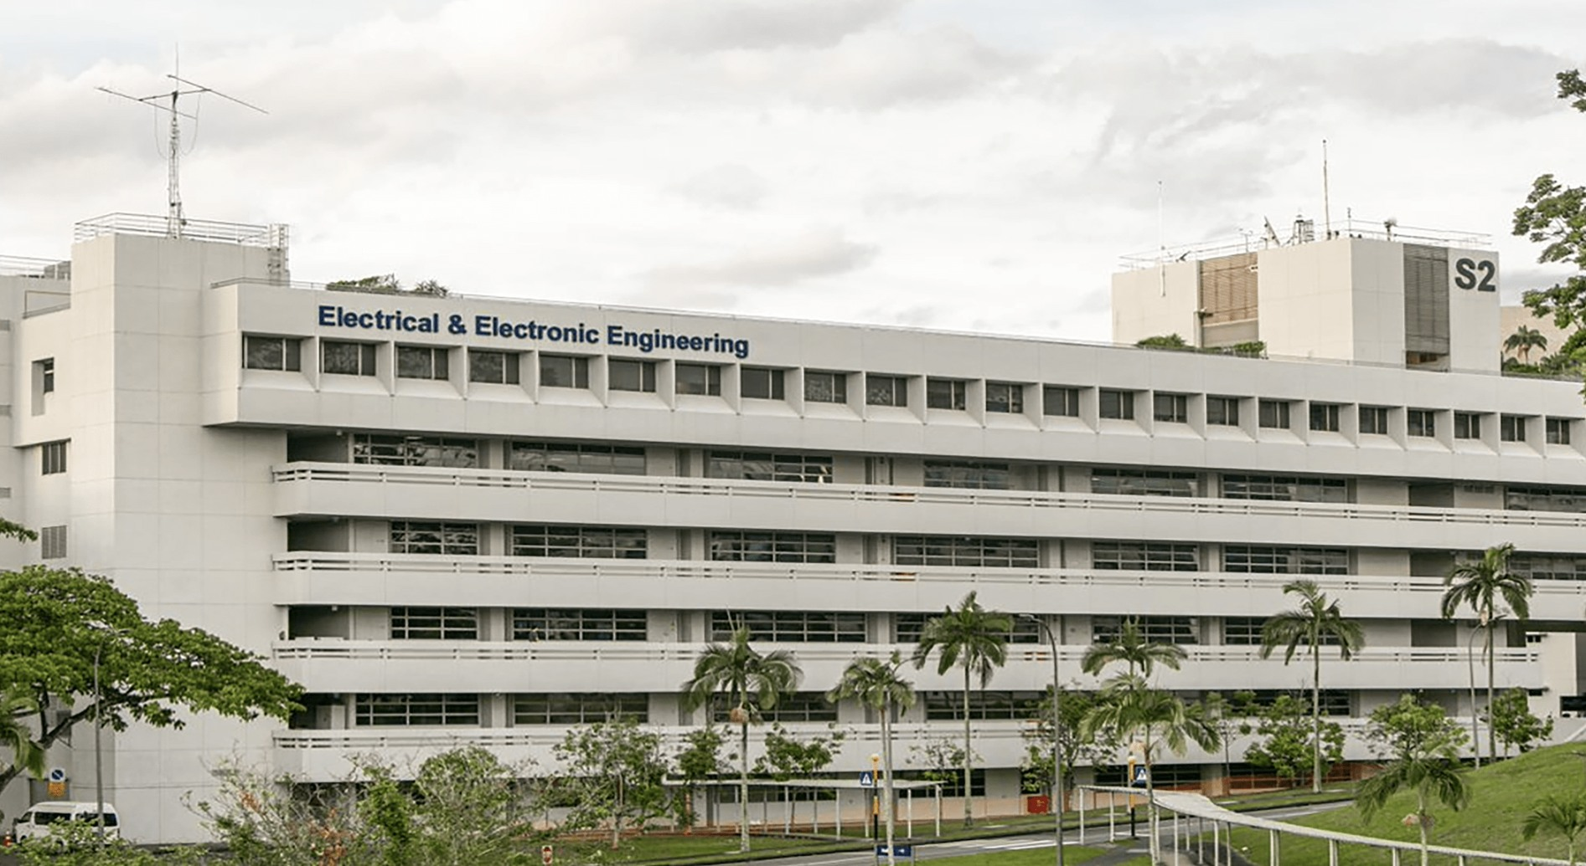
Single-Image Story
IMAGE DESCRIPTION
{{IMAGE_DESCRIPTION}}
What does the image show?
Why is it relevant this week?
What should the audience notice?
TIP
Use one annotated result, system overview, qualitative example, or implementation photograph.
EE6008 · HUMAN POSE ANALYTICS
{{SOURCE}}
{{PAGE_NUM}}

Slide 14
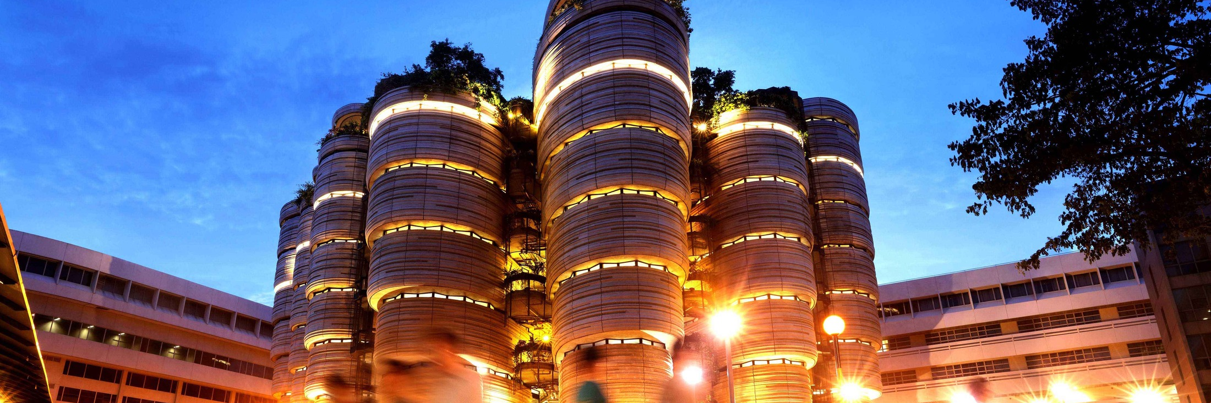

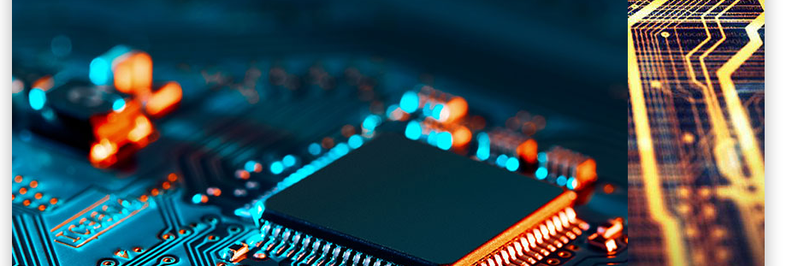
Multi-Image Story
USE 2–4 IMAGES
{{CAPTION_1}}
{{CAPTION_2}}
{{CAPTION_3}}
{{CAPTION_4}}
EE6008 · HUMAN POSE ANALYTICS
{{SOURCE}}
{{PAGE_NUM}}

Slide 15
EE6008 · HUMAN POSE ANALYTICS
Thank You
EE6008 · HUMAN POSE ANALYTICS

