Slide 1
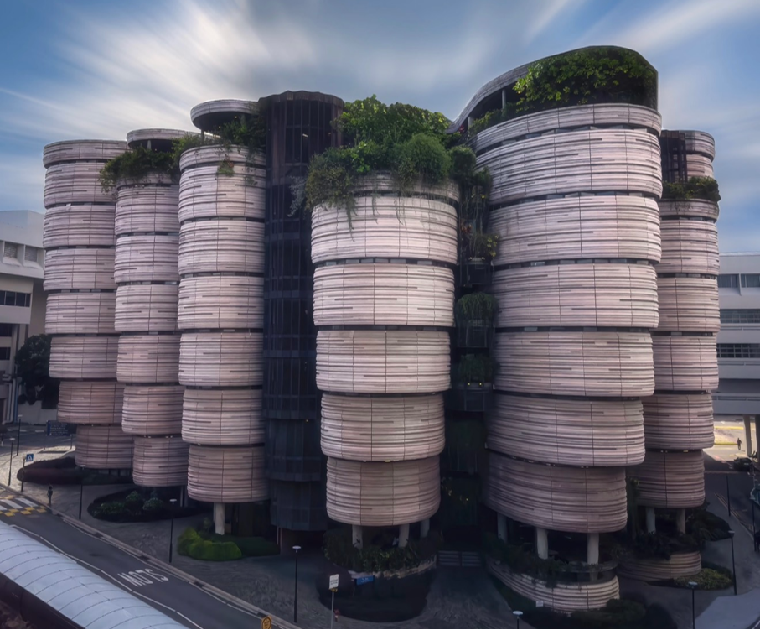

EE6008
WEEKLY PRESENTATION
Human Pose Analytics
Using Artificial Intelligence
Instance-Preserving Pose Representation
WEEK 6
Group 14
Week ending · 2026-09-29
Notes:
This presentation introduces our Week 3 research framing and early technical findings. Our specific direction is instance-preserving pose representation for multi-person action recognition.

Slide 2
Weekly Progress – Baseline Reproduction
EE6008 · HUMAN POSE GROUP PROJECT
THIS WEEK
Two baselines reproduced on NTU RGB+D 120 Interaction-26 (CSub)
01
CTR-GCN
02
[Baseline 2]
Graph-based · joint + bone two-stream
[Method · key setting]
✓ Reproduced · 3 seeds × 2 streams
[Status]
91.20 ± 0.17
[Result]
Fused test Top-1 (%), mean ± std over 3 seeds
[Metric and protocol]
Details → pages 02 – 04
Details → pages 05 – 07
EE6008 · WEEKLY REPORT
01
Notes:
Weekly overview only. Detailed explanations are reserved for the oral presentation.

Slide 3
CTR-GCN · Setup & Headline Result
EE6008 · HUMAN POSE GROUP PROJECT
SETUP
91.20 ± 0.17
Fused test Top-1 (%)
3 seeds · range 0.30 pp
Top-5 98.84 ± 0.03
Data
NTU-120 Interaction-26, CSub
11,764 train · 1,308 val · 11,660 test
Streams
Joint and bone, trained separately
Fused by 1 : 1 score sum
TEST TOP-1 PER RUN (%)
● one seed ━ mean
Recipe
Official CTR-GCN config, unchanged
65 epochs · lr 0.1 · steps at 35 / 55
91
90
+2.4 – 2.7 pp
over the better stream
Runs
3 seeds × 2 streams = 6 full trainings
≈ 1 h 55 min each on 2 × RTX 3090
89
Protocol
Checkpoint chosen on validation
Test set evaluated once per run
88
Joint
Bone
Fusion
88.28 ± 0.20
88.57 ± 0.40
91.20 ± 0.17
EE6008 · WEEKLY REPORT
02
Notes:
Baseline structure: CTR-GCN and PoseC3D.
Source: project work summary supplied by the user.

Slide 4
CTR-GCN · What Three Seeds Tell Us
EE6008 · HUMAN POSE GROUP PROJECT
1
Joint ≈ bone
2
Fusion is the gain
3
Noise floor
88.28 vs 88.57
+2.4 – 2.7 pp
0.30 pp
The ranking flips across seeds: joint wins once, bone twice.
Bone's 0.29 pp edge comes from seed 2 alone — without it, 88.29 vs 88.34.
Our earlier single-run claim that joint beats bone does not hold.
Over the better single stream, in every seed — and the most stable: std 0.17 vs 0.20 / 0.40.
Per class, the gain tracks how often the two streams disagree (r = 0.62), not which one is more accurate (r = −0.10).
The fused range across seeds. A change smaller than this cannot be told apart from seed noise.
Compare means over seeds, not single runs. Per class the floor is far higher: 2σ = 0.42 – 3.97 pp.
LIMITS
Augmentation randomness is identical across seeds (worker_init_fn in the original CTR-GCN), so the measured variance is a lower bound.
Validation accuracy runs 5 – 6 pp above test; it is used only to rank runs and pick checkpoints.
EE6008 · WEEKLY REPORT
03
Notes:
CTR-GCN counts: Train 13,072; Test 11,660.
Validation indices are drawn only from the original training membership.
Sources: E:/humanPose/reports/NTU120_INTERACTION26_SUBSET_REPORT.md; E:/humanPose/processed/skeletonx/ntu120_interaction26/ntu120csubinteraction26_train_val_split_summary.json

Slide 5
CTR-GCN · Per-class Accuracy & Confusions
EE6008 · HUMAN POSE GROUP PROJECT
LOWEST 8 CLASSES · FUSED, 3-SEED MEAN (%)
MOST FREQUENT CONFUSIONS · % OF TRUE CLASS
Hit with object → Wield knife
9.57%
Hit with object → Punch / slap
9.45%
Wield knife → Hit with object
8.16%
Shoot with gun → Point finger
7.42%
Shoot with gun → Take a photo
6.67%
Give object → Exchange things
5.07%
Red = mutual pair: Hit ↔ Knife, Knife ↔ Gun, Give ↔ Exchange.
The same structure appears in all three seeds.
EFFECT OF FUSION PER CLASS
5 classes improve beyond their own 2σ threshold (+3.5 to +4.2 pp): knock over, grab stuff, point finger, shoot with gun, pat on back.
No class gets significantly worse — the three drops reported in V1 are within noise.
The three lowest are all attacks with a hand-held object.
Other 18 classes: 91.96 – 99.88 %.
EE6008 · WEEKLY REPORT
04
Notes:
The original feeder supports train and test selection. The new protocol adds train and validation membership through indices, so the project needs an adapted feeder and corresponding YAML configuration.
Source: E:/humanPose/docs/CTRGCN_NPZ_FEEDER_ADAPTATION_PLAN.md

Slide 6
[Title]
EE6008 · HUMAN POSE GROUP PROJECT
EE6008 · WEEKLY REPORT
05
Notes:
No verified member names were available in the supplied project materials, so the allocation uses Member 1 through Member 4 as requested.

Slide 7
[Title]
EE6008 · HUMAN POSE GROUP PROJECT
EE6008 · WEEKLY REPORT
06
Notes:
Status supplied by the user: unified metrics, Experiment 3 swap transformation and consistency measurement, and Experiment 4 grouping and mean-recall comparison are implemented.

Slide 8
[Title]
EE6008 · HUMAN POSE GROUP PROJECT
EE6008 · WEEKLY REPORT
07
Notes:
The project guide records three RTX 3090 GPUs and the dedicated workspace /mnt/data/6008/.
Source: E:/humanPose/docs/NTU_SERVER_CTRGCN_GUIDE.md
No credentials, IP address, password, or private key appear on this slide.

