Slide 1
REDROB HACKATHON
Ranking Candidates the Way
a Great Recruiter Would
A hybrid scoring system that reads career history as evidence and treats
listed skills as claims that need corroboration — built and validated against
the full 100,000-candidate pool, entirely offline.
Harya | Intelligent Candidate Discovery & Ranking Challenge

Slide 2
THE TRAP
Keyword counting is the wrong answer —
and the dataset proves it
What the JD says, in its own words:
The bundle's own sample_submission.csv:
“The ‘right answer’ is not ‘find candidates whose skills section contains the most AI keywords.’ That’s a trap we’ve explicitly built into the dataset.”
“A candidate who has all the AI keywords listed as skills but whose title is ‘Marketing Manager’ is not a fit, no matter how perfect their skill list looks.”
Rank 1: HR Manager, 6.1 yrs, “9 AI core skills”
Rank 4: Content Writer, 8.3 yrs, “8 AI core skills”
Rank 6: Graphic Designer, 10.4 yrs, “9 AI core skills”
We checked: this is the format reference, and it's a pure keyword-stuffing ranker — exactly the failure mode the JD warns against, sitting in the bundle as a cautionary example.
2

Slide 3
ARCHITECTURE
Three layers: fit, availability, and disqualifiers
1
2
3
Feature Extraction
Scoring
Reasoning
features.py
scoring.py
reasoning.py
Skill trust scores (endorsements × duration), career_relevance_score read from FREE TEXT career history, trap flags (honeypot, consulting-only, title-chaser, pure-research)
base_fit_score (skills × corroboration + career + experience + seniority + location + education) × behavioral_multiplier × trap_penalty_multiplier
Fact-gated clause templates compose a 1-2 sentence justification from the SAME features used in scoring — nothing invented, varied phrasing
candidates.jsonl(.gz) → extract_features() → score_candidate() → generate_reasoning() → outputs/submission.csv
3

Slide 4
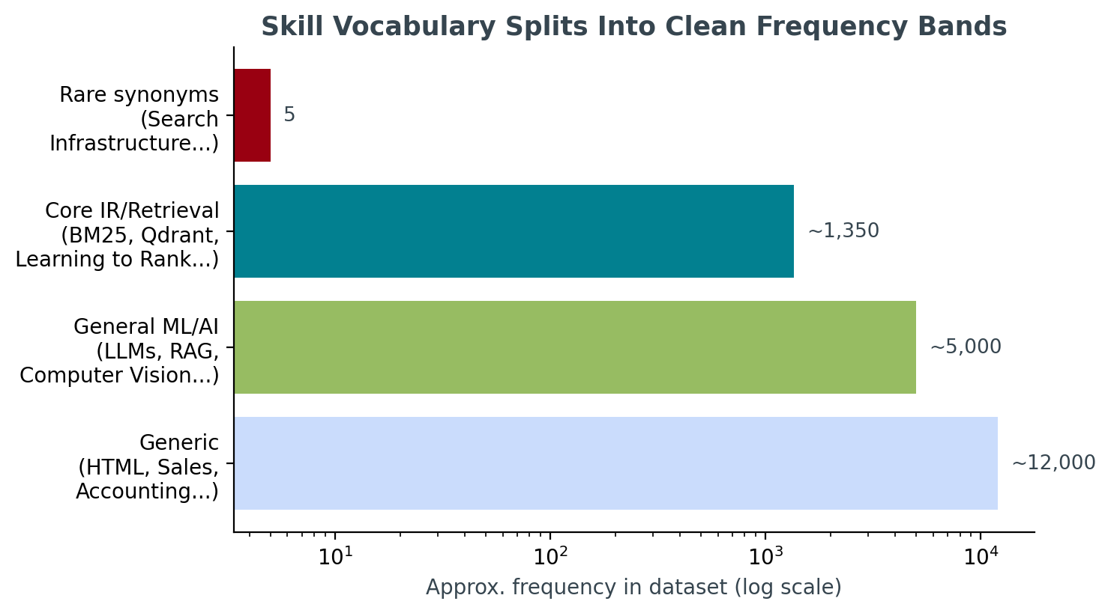
GROUNDED IN DATA, NOT ASSUMPTION
The skill vocabulary itself reveals the taxonomy
What this told us:
Generic skills (HTML, Sales, Accounting...) appear ~12,000× — irrelevant to this JD.
General ML/AI skills (LLMs, RAG, CV...) appear ~5,000× — relevant but not the JD's specific ask.
Core IR/retrieval skills (BM25, Qdrant, Learning to Rank...) appear ~1,350× — exactly the JD's “things you absolutely need.”
A handful of rare synonyms (“Search Infrastructure”, “Ranking Systems”) appear <10× — read as deliberately planted plain-language alternatives.
4

Slide 5
THE KEY MECHANISM
Skills are claims. Career history is evidence.
What we found during testing: CAND_0000021
14.5-year Project Manager at Wipro. Skills list: Recommendation Systems, Embeddings, Vector Search — each with plausible endorsement counts (3–4) and durations (13–18 months). Every career_history entry: brand design, mechanical engineering, sales, customer support. Zero ML/AI work, ever.
The fix: skill–career corroboration gate
Skill substance is only counted at full value if career_relevance_score (computed independently, purely from career_history TEXT) clears a threshold. Below it, claimed skills are discounted to as little as 25% of their trust-weighted value — endorsement/duration numbers can look reasonable on a hobbyist's skill entry, but the career narrative can't fake substance the same way.
Verified impact: this candidate's rank moved from #8 of 50 to outside the top 100 of 100,000.
5

Slide 6
NAMED DISQUALIFIERS
Every JD-named trap, operationalized
Honeypots
“Expert”/“advanced” proficiency claimed with ≤3 months' use, or ≥8 simultaneous “expert” skills.
21/21 matches in EDA were off-domain titles (HR, Accounting, Civil Engineer) — consistent with a planted signature.
Consulting-only
EVERY company in career_history (not just current) is TCS/Infosys/Wipro/Accenture/Cognizant/Capgemini/HCL.
JD explicitly exempts candidates currently at one of these firms with prior product-company experience — our check honors that.
Title-chasers
≥ 3 roles with average tenure < 18 months.
32 AI-titled candidates matched this pattern in the full pool during EDA.
Pure research
Every role title is research-only AND no production-deployment language anywhere in career text.
Both conditions required, so a Research Scientist who later shipped something isn't penalized.
6

Slide 7
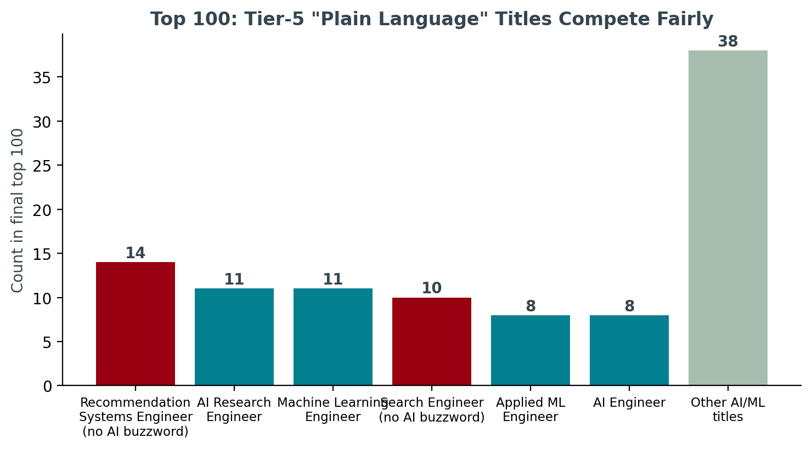
CATCHING WHAT KEYWORD-MATCHING MISSES
“Tier 5” candidates compete fairly in the final top 100
Why this matters:
career_relevance_score is computed purely from career_history description text — never from the title field. It scans for production/eval/scale language (shipped, NDCG, p95, QPS) and IR domain terms (retrieval, ranking, embeddings, click-through).
This is what lets a “Search Engineer” or “Recommendation Systems Engineer” — titles with zero AI buzzwords — outrank a generic “ML Engineer” whose actual work history is thin.
24 of the final top 100 carry no AI/ML buzzword in their title.
7

Slide 8
AVAILABILITY MATTERS, NOT JUST FIT
A perfect-on-paper ghost is, for hiring, not available
Six signals feed the multiplier:
Why a multiplier, bounded [0.55, 1.10] — not an additive term:
Recency of last_active_date (32% weight)
Recruiter response rate (28%)
Open-to-work flag (14%)
Profile completeness (12%)
Interview completion rate (8%)
Email/phone verification (6%)
The JD says “down-weight appropriately,” not “disqualify.” A multiplier lets engagement meaningfully move a candidate without letting it single-handedly override a genuinely strong fit — a great-but-ghosted candidate still outranks a mediocre, highly-responsive one if the underlying fit gap is large enough.
base_fit_score × behavioral_multiplier × trap_penalty_multiplier = final score
8

Slide 9
STAGE 4 REVIEW READINESS
Reasoning text: fact-gated, varied, rank-consistent
No LLM calls at ranking time (banned by the compute budget). Instead, every reasoning clause is conditioned on a real boolean/numeric feature from the candidate's own profile, with phrasing variants chosen by a seeded RNG.
Rank 7 • Score 0.9544
“Senior NLP Engineer (7.8 yrs) at Niramai: career history shows shipped production systems, built evaluation/NDCG-style rigor, operated at real scale directly in ranking/retrieval work; 9 core IR/retrieval skills backed by real endorsements and tenure, not just listed; 7.8 yrs experience sits in the JD's target band.”
Rank 100 • Score 0.8634
“2.8-yr NLP Engineer, currently at Meesho: career history shows shipped production systems, built evaluation/NDCG-style rigor directly in ranking/retrieval work; 7 core retrieval-relevant skills with credible endorsement/tenure backing; however only 2.8 yrs experience, below the JD's 5-9 yr band.”
Both real strengths AND honest concerns, stated with specific facts (years, company, skill counts, signal values) — exactly what submission_spec.md Section 3 checks for.
9

Slide 10
HONEST ENGINEERING, NOT PASTE-AND-PRAY
A bug we caught: reasoning that contradicted the score
What we saw while reading ranks 88–100 manually:
Rank 91, score 0.8689 (near the top of an already-curated top 100): “...only marginal signal for this JD; included as lower-confidence filler.” The candidate actually had 5 real strengths and zero concerns — the text was simply wrong.
Root cause and fix:
The original code branched its tone on RANK NUMBER (“if rank > 70, lead with a concern”) — but rank position in a curated top 100 isn't a reliable signal of quality; it just means 90 peers scored higher. Fixed by branching on actual strengths/concerns CONTENT instead. Verified by regenerating and re-reading the same rows.
Full writeup with before/after: DEVELOPMENT_LOG.md in the repo.
10

Slide 11
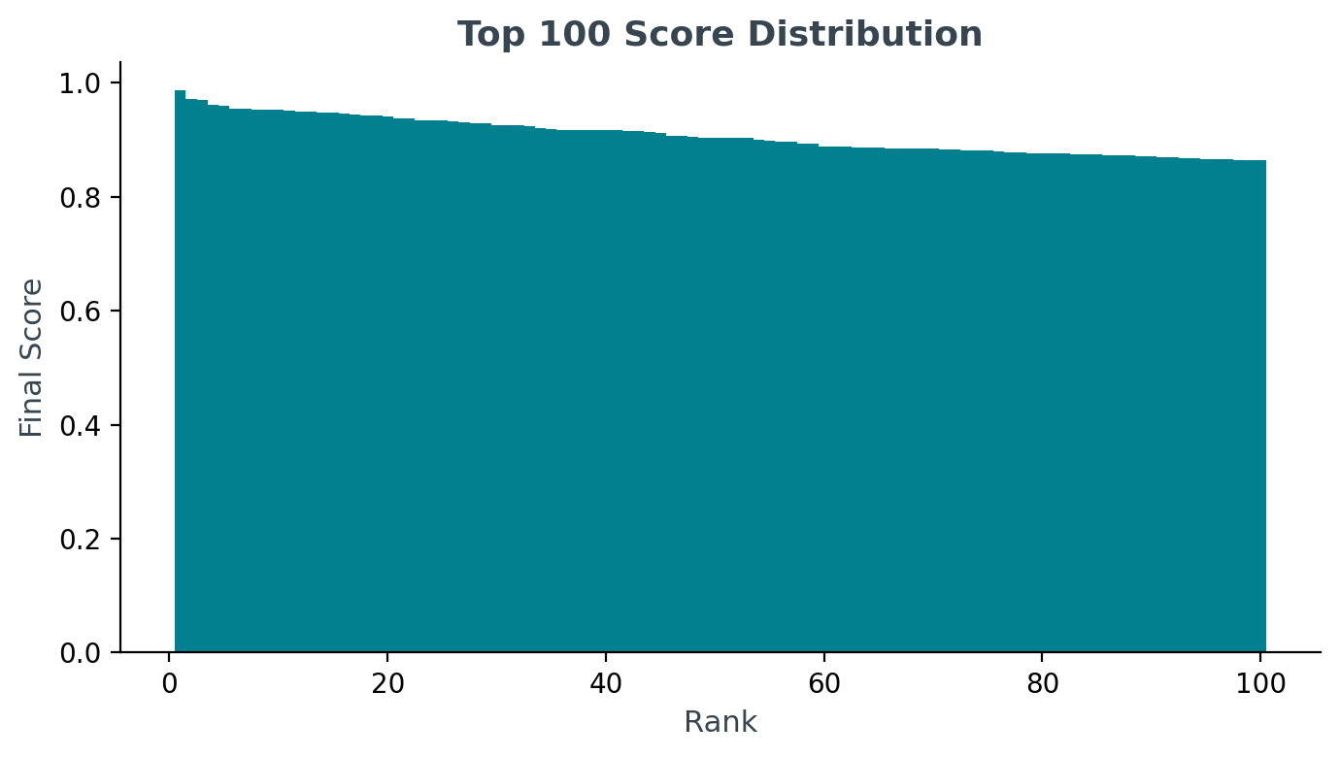
FINAL NUMBERS
Results on the full 100,000-candidate pool
0%
0
0
24
Honeypot rate in top 100
Consulting-only careers in top 100
Off-domain titles in top 100
“Tier 5” plain-language titles in top 100
limit: ≤10%
JD-named disqualifier
HR, Accounting, Sales, etc.
Search/Recsys Engineer
Compute footprint (full 100K pool):
Runtime: ~51–61 seconds
Peak RAM: ~1.8 GB
CPU-only, zero network calls
Pure Python stdlib (no model weights, no embedding service)
11

Slide 12
HONEST LIMITATIONS
career_relevance_score is a term-density heuristic over career text, not a learned semantic model — it can miss novel phrasings of the same work.
current_role_codes / is_pure_research are inferred from title and description patterns; the dataset has no ground-truth “last wrote code” field.
Honeypot detection catches the specific “expert-with-near-zero-duration” signature found during EDA — not guaranteed to catch every one of the ~80 honeypots described in the README.
github.com/Harya018/redrob-ranker
rank.py → src/{config,features,scoring,reasoning}.py → outputs/submission.csv
README.md (architecture) · DEVELOPMENT_LOG.md (bugs found+fixed) · tests/ (12 unit tests) · sandbox/app.py (Streamlit demo)
Built and validated end-to-end against the full 100,000-candidate pool with Claude as a development collaborator — declared honestly in submission_metadata.yaml.

