Slide 1

SAMSUNG PRISM
Generative AI
Hackathon
3rd Edition 2026 – 27
Theme ID - Theme 05 — Interruptible Real-Time Agents
Team Name - CodeStorm
College Name - SRM institute of science and technology kattankulathur
Member Name & Email 1- Guna k
Member Name & Email 2- Harya C R
Member Name & Email 3- Rohit Kumar R
Member Name & Email 4- Prashansa Sarangi
Submission Github link - https://github.com/Harya018/samsung-prism-Hackathon
Notes:
Hello, and thanks for having us. We built an interruptible real-time voice agent for Theme 05 and tested it on Full-Duplex-Bench v3. Items in red are still to be filled in before submission: team name, college and member details.

Slide 2
Theme
Real people interrupt, hesitate and correct themselves mid-sentence.
Half-duplex assistants (listen → think → speak) break when they do.
Goal: a voice agent that stays responsive, works asynchronously and recovers cleanly.
Never act on a stale value. Never repeat a state-changing action.
Evaluated on Full-Duplex-Bench v3: 100 real recordings, 12 speakers, 5 disfluency types.
12 mock tools across 4 domains, with chained calls of 1–3 steps.
Notes:
People correct themselves mid-sentence, and a listen-think-speak pipeline locks in the wrong value. Our goal is an agent that stays responsive, works asynchronously and never acts on a stale value or repeats a state-changing action. The benchmark has 100 real recordings from 12 speakers, 5 disfluency types and 12 mock tools across 4 domains.

Slide 3
Existing Solutions & Gaps
Published FDB-v3 results (paper, arXiv 2604.04847)
System | Tool-sel | Pass@1 | Self-corr Pass@1 | Interrupt
GPT-Realtime | 0.876 | 0.600 | 0.588 | 13.5%
Gemini Live 2.5 | 0.786 | 0.490 | 0.471 | 14.1%
Gemini Live 3.1 | 0.817 | 0.540 | 0.353 | 19.2%
Cascaded (Whisper→GPT-4o→TTS) | 0.803 | 0.450 | 0.176 | 33.0%
Gaps
Every system fails on over 40% of self-correction scenarios.
Models commit tool arguments before the correction arrives, then can't roll back.
Strict scoring: any extra tool call fails the scenario.
Notes:
These are the published results from the FDB-v3 paper. Self-correction is the weak spot: even the best system passes only 58.8% of those scenarios. The cause is that models commit tool arguments before the correction arrives. Scoring is strict, so firing a call and fixing it later still fails.

Slide 4
Our Solutions & Architecture Diagram
User speech
LiveKit room
Gemini Live 2.5
native audio: listen, reason, speak
Why it works
Stale calls never reach the tool, so never count as extra calls.
Resolver only blocks corrected-away values. It never invents one.
Repeats: same-state repeats are refused; the original result is returned.
proposed tool call
COMMIT GATE
400 ms debounce buffer
Newer same-tool call wins
Block-only resolver
Idempotency: no repeated actions
Type-coercion guard
Instructions layer
Last value wins
No premature speech
Mock tools → result → spoken answer
Notes:
Read the diagram left to right: speech comes in through LiveKit to Gemini Live, which listens, reasons and speaks natively. Every tool call it proposes goes through our commit gate, which holds it for 400 ms, lets a newer same-tool call replace it, blocks corrected-away values and refuses repeats. So stale calls never reach the tools, and the resolver can only block a value, never invent one.

Slide 5
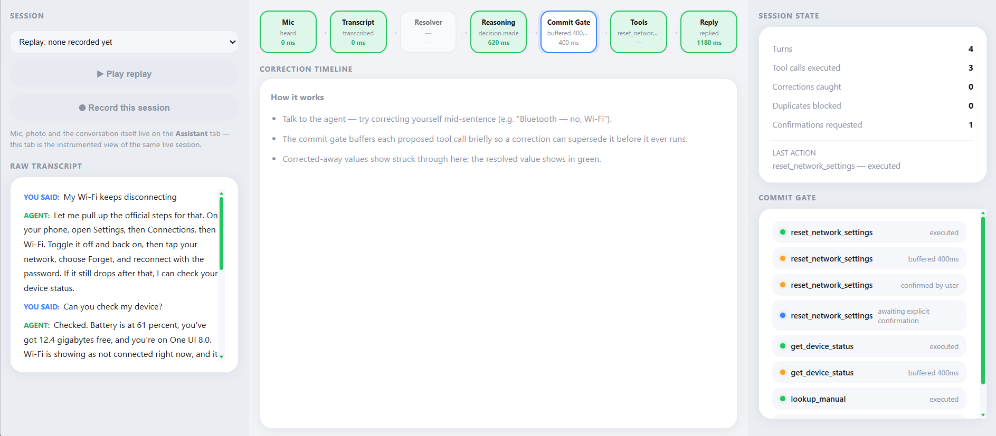
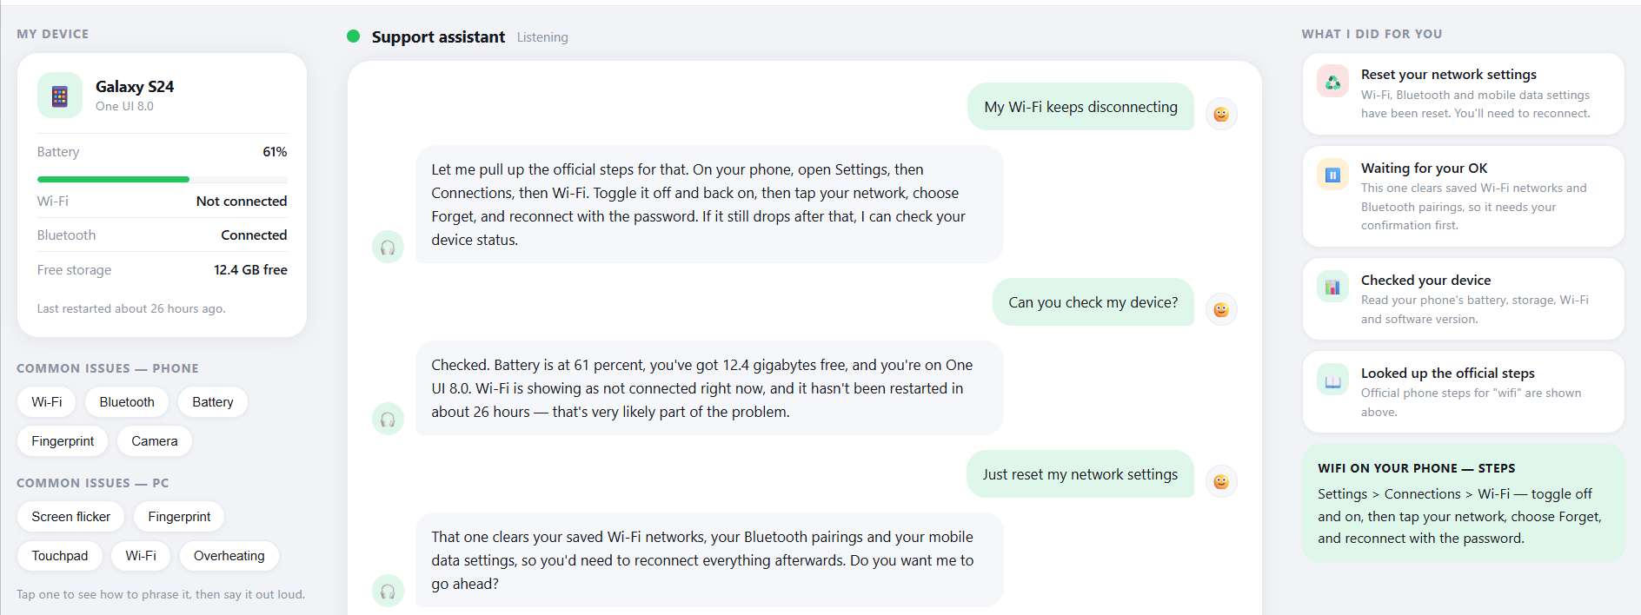
Demo & Product Walkthrough
Video:
1. Benchmark interruption: user corrects a value mid-sentence; only the corrected call runs.
2. Extension: voice device-troubleshooting with one photo sent mid-conversation.
3. Safety: risky action (network reset) needs spoken confirmation first.
4. Dashboard: Results, Explorer, Architecture and Live tabs, with trace replay.
Demo video link: https://drive.google.com/file/d/1kqbIyN5YhHlZWFFSIaKNAARn_bSJXXYZ/view?usp=drivesdk
Notes:
Start the video here: it runs about 3 to 5 minutes. First show a benchmark clip where the user corrects a value mid-sentence and only the corrected call runs. Then the device-troubleshooting extension with a photo, the spoken confirmation before a risky action, and a quick tour of the dashboard with trace replay.

Slide 6
Tools and tech stack used
Voice model: Gemini 2.5 Flash native audio via Live API
Framework: LiveKit Agents (Python) + LiveKit Cloud
Benchmark: Full-Duplex-Bench v3 (commit 3e799c4, 6 patches), NVIDIA NeMo scoring
Our code: commit gate, resolver, instructions layer, extension agent, dashboard
Reproducibility: one-command scripts/run_fdb_v3.sh, fresh-clone Docker test, pinned versions
Testing: pytest; self-written disfluency examples only (no benchmark answers)
Notes:
The voice model is Gemini 2.5 Flash native audio through the Live API, running on LiveKit Agents. We pinned Full-Duplex-Bench v3 to one commit with six documented patches and use its own NeMo pipeline for scoring. Everything reproduces with one script, and it was tested in a fresh-clone Docker container.

Slide 7
Impact & Use case
Where interruptions matter
In-car assistants, customer support, smart-home and phone assistants.
Our extension: voice device-troubleshooting assistant
User describes the problem by voice and can send one photo.
Agent runs diagnostic tools while the conversation continues.
Mid-sentence corrections (“Wi-Fi — no, Bluetooth”) retarget the diagnosis.
Risky actions (reset network settings) need an explicit spoken “yes”.
Impact
Fewer wrong actions and no duplicate changes, so users trust it more.
Notes:
Interruptions matter anywhere people talk to a device while doing something else: cars, support lines, smart homes and phones. Our extension is a troubleshooting assistant that runs diagnostics while you keep talking, retargets when you correct yourself, and asks for a spoken yes before anything risky. The payoff is fewer wrong actions and no duplicate changes.

Slide 8
Innovation highlights, results and limitations
Metric | Ours | Gemini Live 2.5 (paper)
Tool selection | 86.4% | 78.6%
Turn-take rate | 99.0% | 92.0%
Interruption rate ↓ | 5.1% | 14.1%
Latency ↓ | 11.9 s | 7.26 s
Arg accuracy / Pass@1 | 42.3% / 29.0% (strict exact-match) | 59.3% / 49.0% (LLM judge)
Arg accuracy and Pass@1 use stricter exact-match scoring, so they aren’t directly comparable. Organizers re-score with the LLM judge.
Highlights
Lowest interruption rate of any published system.
Best turn-take among native voice models.
Limitations
Higher latency.
Corrections made after a long pause.
1/100 silent session (provider flake).
Notes:
This is our full 100-recording run against the same model in the paper. Run ID: [FILL: run ID from results/OVERNIGHT_REPORT.md]. Tool selection, turn-take and interruption rate are clearly better, but latency is worse. Be upfront that argument accuracy and Pass@1 use strict exact-match, so they are not directly comparable to the paper’s LLM-judge numbers.

Slide 9
What’s next
Provisional vs confirmed commits: hold values until the turn truly ends.
Audio-based end-of-turn detection: avoid committing during mid-sentence pauses.
Latency: thinking-budget tuning and key-information-first answers.
Schema-driven argument normalisation: dates, currencies, IDs.
More use cases: in-car destination change, Samsung SmartThings control.
Indian languages and code-switching: Hindi, Tamil.
Notes:
Our biggest next step is separating provisional from confirmed commits, backed by audio-based end-of-turn detection so we don’t commit during a mid-sentence pause. We also want to cut latency and normalise arguments like dates and currencies from the tool schema. Longer term: in-car and SmartThings use cases, and Hindi and Tamil with code-switching.

Slide 10
Brownie points slide( differentiation)
Fixed real benchmark-harness bugs, each documented as a patch:
Crash on CPU-only machines
Plugin loading error with the current LiveKit version
Re-scoring mode silently reporting zero tool calls
Docker fresh-clone test caught a reproduction deadlock before submission.
Explicit per-agent dispatch: benchmark and demo runs can’t contaminate each other.
Honest reporting:
Invalid runs retracted, not reported
Exact-match numbers labelled as such
Integrity slip disclosed in the AI usage log
Safety by design: resolver can block values but never invent them.
Notes:
What sets us apart is rigour. We found and patched three real bugs in the benchmark harness, and our fresh-clone Docker test caught a reproduction deadlock before submission. We report honestly: invalid runs were retracted, exact-match numbers are labelled, and an integrity slip was disclosed in our AI usage log. And the resolver’s safety guarantee holds by design: it can block, never invent.

Slide 11
Thank you
Organised by the Language AI Team and the PRISM Team, Samsung R&D Institute India
Notes:
Closing slide. Add the Google Form URL and a contact email before sharing. Edition 2 organising team for reference: Language AI - Sourabh Tiwari, Gaurav, Sanjeeth Pothireddy, Gorang Maniar; PRISM - Binny Lakra, Prakhar Chandrakar, Vishu Kumar; Kick-off and mentors - Giridhar Jakki, Deepraj Prabhakar Patkar (Language AI), Srimanu Prasad Nagaraju, Ashish Kumar (Tech Strategy).

