Slide 1
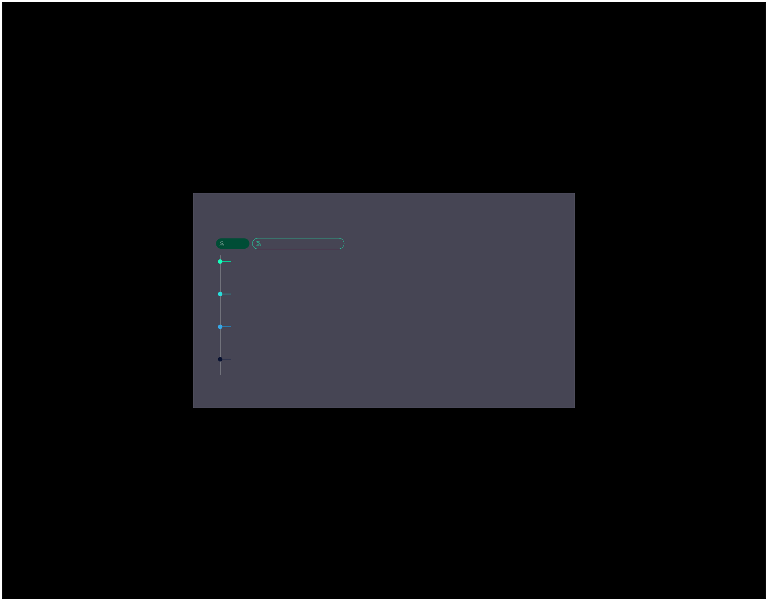


Problem Stattement : Banking Simulation — C Programming Project
GROUP 15
FOP (FOUNDATION OF PROGRAMMING)
Om Sahu (Leader)
PRN: 1262251291
Haryaksh Laad
PRN: 1262253392
Manjot Singh Narula
PRN: 1262253096
Smit Taware
PRN: 1262252615

Slide 2



Bank Account Simulation Using C
Designing a C program to simulate fundamental banking operations.
Core Banking Functions
Users can easily deposit, withdraw, and check their
balance.
System Navigation
The program provides a clear option to exit the system gracefully.

Slide 3

Project Objectives
1
Practical Implementation
Understand real-world application of C programming concepts.
2
Simulate Banking Operations
Mimic basic financial transactionsin a controlled environment.
3
Conditional Statements
Mastering if-else logic for dynamic program flow.
4
Looping Concepts
Apply iterative structures for repeated actions.
5
Logical Thinking
Enhance problem-solving skills through structured design.

Slide 4

Key ‘C’ Concepts Utilised
Data Types
Arithmetic Operators
Relational Operators
Variables
Storing dynamic data within the program.
Using int and float for numerical values.
Performing calculations like addition and subtraction.
Making comparisons
between values.
Conditional Statements
Switch Case
Loops
Utilising while loops for repetitive tasks.
Implementing if-else for decision- making.
Handling multiple choices
efficiently.

Slide 5




Aim of the Project
Learn C fundamentals
Apply logic to real life
Variables, control flow, input/output 4
Translate everyday banking tasks into
program steps
core building blocks
Boost problem-solving
Simulate basic operations
Design decisions, stepwise logic, and
Deposit,Withdraw ,Balance enquiry.
testing

Slide 6


Advantages of the Project
Easy to implement
Strengthens logic
Minimal syntax, no advanced features — ideal for beginners
Branching and loops to
handle deposit/withdraw
flows
1
2
3
4
Real-world relevance
Solid foundation
Show show programs model everyday tasks like banking
Prepares students for arrays
and functions later

Slide 7





Program Algorithm: Step-by-Step
“A logical flow to guide the banking simulation.”
Start
Initialize Account Balance
Display Menu and Get User Choice
Process Transaction
(Deposit/Withdraw/Check)
Repeat Until User
Selects Exit
End

Slide 8


Program Flowchart
“Visualising the journey through our bank simulation”.
Process Action
Deposit,withdraw,check, or exit
User Choice?
Decide next action
Display Menu
Showdeposit,withdraw, check, exit
Initialize Balance
Set starting funds

Slide 9

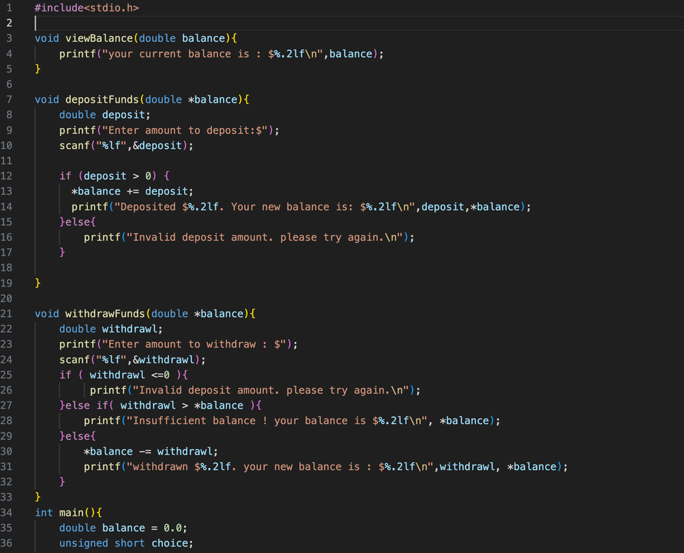
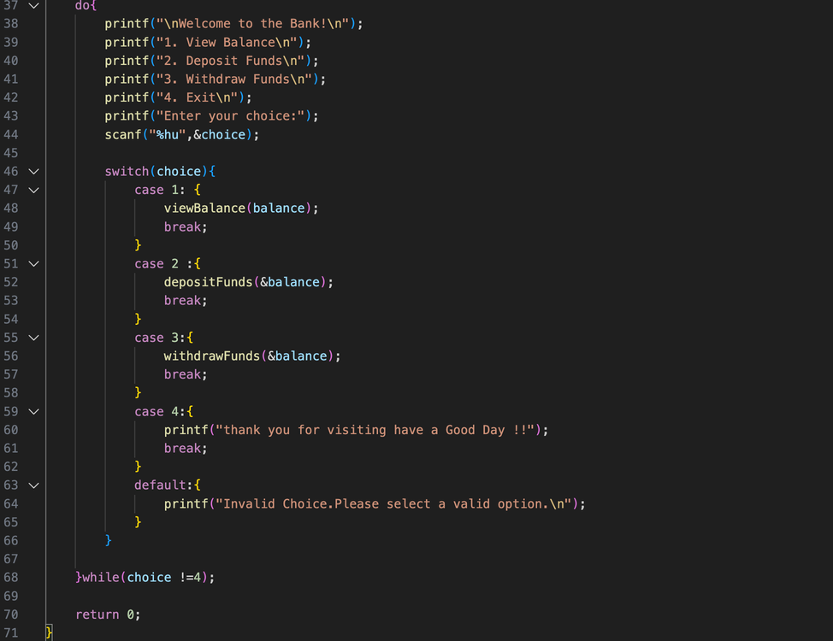
Bank Simulation: C Code

Slide 10
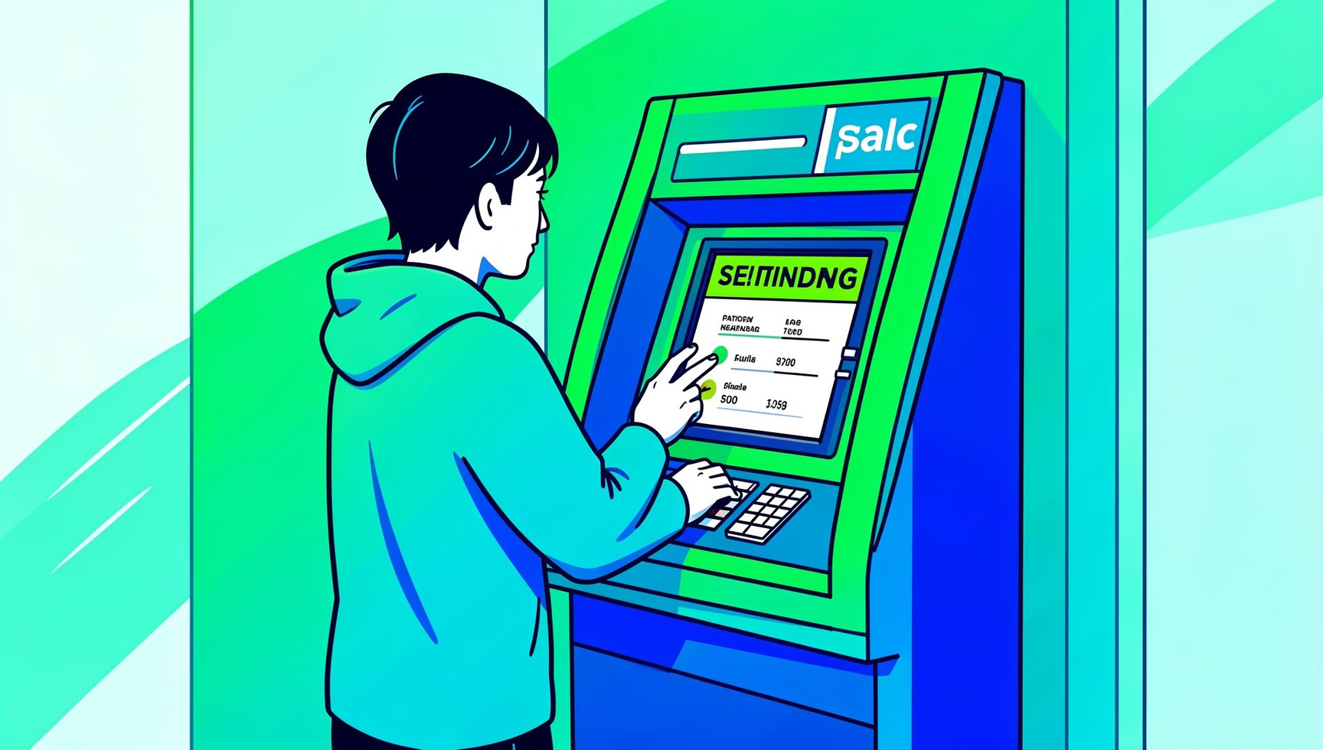
Sample Output & Conclusion
“Sample Interaction”
“This interaction demonstrates a successful deposit, reflecting the program's functionality.”
Conclusion :
Successfully implemented bank account simulation in C.
Applied fundamental C programming concepts effectively.
Enhanced logical thinking through loops and conditional structures.

Slide 11
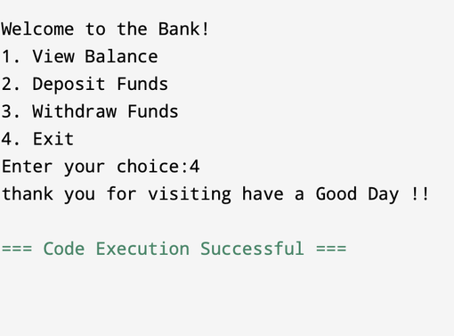
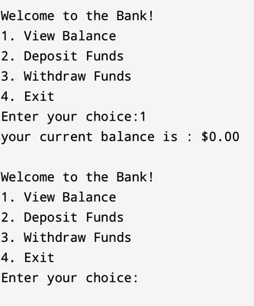
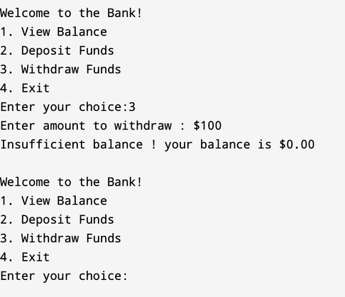
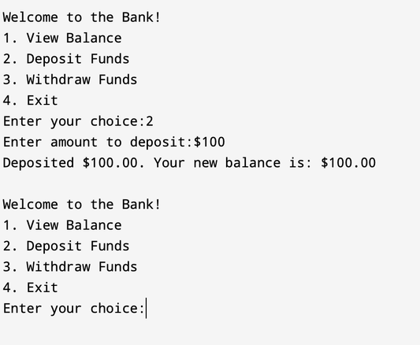
OUTPUT :

Slide 12
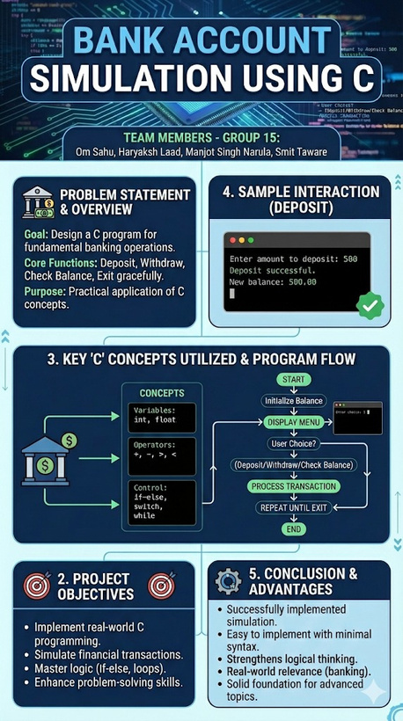
P
O
S
T
E
R
P
O
S
T
E
R
P
O
S
T
E
R

Slide 13

Thank You !!

