Slide 1
Smart Collaboration And Career Guidance System
Team:CM17
Members:
M. Harya Vardhan (Y22ACM449)
V. Sudheer (Y22ACM477)
N. Suresh Reddy (Y22ACM457)
Project Guide: Mr. N. Srinivasa Rao
Asst Professor

Slide 2
Table of contents
1.Abstract
2.Existing System
3.Proposed System
4.Design
5.Implementation
6.Results
7.Conclusion

Slide 3
Abstract
Students and professionals today often struggle with navigating complex career paths, finding quality mentorship, and studying effectively in isolated environments. Traditional learning systems lack personalized guidance, real-time peer interactions, and direct access to industry experts, frequently leading to skill gaps and uninformed career choices.
To address this, we propose the Smart Collaboration and Career Guidance System, a unified web-based platform bridging academic learning and professional development. It features an intelligent AI Career Bot for personalized roadmaps and answers to career queries. The system also integrates a secure, interactive mentorship module allowing users to easily connect and schedule sessions with experienced professionals.
Furthermore, to enhance communal learning, the platform offers dynamic study rooms for targeted, peer-to-peer collaboration and knowledge exchange. By combining intelligent virtual counseling, expert mentorship access, and real-time interaction, this ecosystem transforms traditional learning models, empowering users to build robust skills and make confident career decisions.
Keywords: Career Guidance, AI Chatbot, Collaborative Learning, Mentorship Platform, Interactive Study Rooms.

Slide 4
Existing System
Scattered Platforms: Users must juggle multiple, disjointed applications for studying, networking, and career counseling, leading to an inefficient experience.
Generic Career Advice: Current systems provide static, one-size-fits-all recommendations that fail to analyze individual skills or adapt to modern industry demands.
Isolated Learning Environments: Traditional online education largely lacks real-time peer-to-peer interaction, collaborative study rooms, and community engagement.
Difficult Mentorship Access: Finding, verifying, and connecting with quality industry experts is challenging and lacks a streamlined scheduling or secure payment system.
Absence of Intelligent Guidance: Existing tools rarely leverage Artificial Intelligence to provide instant, responsive, and personalized career roadmapping.

Slide 5
Proposed System
Unified Platform Ecosystem: Seamlessly combines AI career guidance, expert mentorship scheduling, and peer study rooms into one cohesive web application.
AI-Powered Career Bot: Leverages intelligent analytics to deliver instant, personalized career roadmaps and immediately detailed answers to specific queries.
Interactive Collaboration Rooms: Provides dynamic, topic-specific virtual spaces that encourage real-time, peer-to-peer studying and knowledge exchange.
Expert Mentorship Module: Facilitates easy discovery, direct messaging, and secure connection with verified industry professionals for one-on-one guidance.
Secure Integrated Payments: Streamlines the process of booking premium mentorship sessions via a safe, built-in payment gateway.

Slide 6
Future Scope
Real-time Video & Audio: Upgrading the interactive study rooms with integrated video conferencing, live audio chats, and collaborative digital whiteboards.
Advanced AI Features: Expanding the Career Bot capabilities to include automated resume parsing, mock interview simulations, and cover letter generation.
Native Mobile Application: Deploying dedicated iOS and Android mobile apps to give users seamless, on-the-go access to mentorship and study tools.
Corporate Partnerships: Creating direct integrations with enterprise companies for exclusive job placements, internships, and live project collaborations.
Global Mentorship Scaling: Expanding the mentor network internationally by introducing multi-language support and cross-border networking opportunities.

Slide 7
Design
Client Interface (Frontend): Developed with modern React.js, featuring a highly responsive, dynamic UI with smooth micro-animations and an intuitive user experience.
API Core (Backend): Built upon a robust, scalable Python framework designed to handle real-time routing, secure JWT authentication, and complex business logic.
Intelligent AI Layer: Centralized AI Engine utilizing Natural Language Processing (NLP) to deeply analyze user queries and autonomously generate personalized career roadmaps.
Database Management (Data Layer): Powered by an optimized Relational Database (PostgreSQL) architected to securely manage profiles, mentorship connections, and dynamic study room states.
Integration & Security Protocols: Features end-to-end encrypted payment gateways for mentorship bookings and strict role-based access controls to protect sensitive student data.

Slide 8
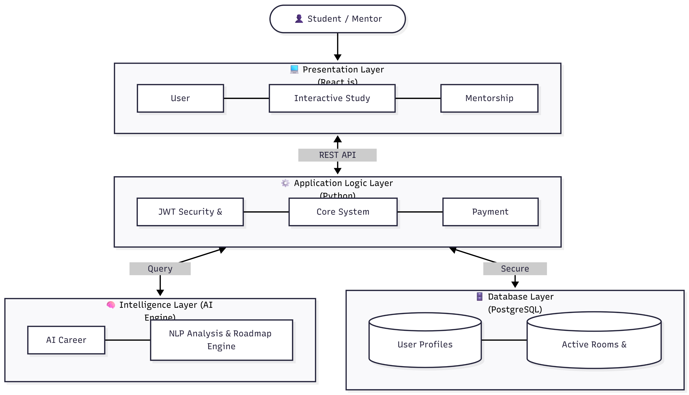

Slide 9
Implementation
Hardware Requirements:
Minimum: Intel i3/AMD Ryzen 3, 4GB RAM.
Recommended: Intel i5/AMD Ryzen 5 or higher, 8GB+ RAM.
Operating System Environment: Compatible with Windows 10/11, macOS, and Linux, ensuring cross-platform development ease.
Development Tools & IDE: Developed primarily using Visual Studio Code (VS Code), leveraging extensions for Python, React, and database management.
Version Control: Automated source code management and collaborative teamwork maintained via Git and GitHub.
Deployment Platforms:
Frontend Deployment: Hosted on Vercel (vercel.json configured) for extremely fast global content delivery and continuous integration.
Backend Deployment: Hosted on Render (or similar cloud infrastructure), providing a stable environment for Python API execution.

Slide 10
Frontend Implementation & Libraries
Technology Stack (What we used): Built entirely on React.js using the Vite build tool.
How it was implemented:
Component-Based Architecture: The user interface is broken down into reusable components (e.g., CareerBotTab.jsx, CreateRoomTab.jsx, PaymentModal.jsx) ensuring code maintainability.
Vite Integration: Used to drastically significantly improve local server startup speeds and bundle sizes compared to traditional React apps.
State Management: Utilized React Hooks (useState, useEffect) to manage dynamic data such as active study rooms, active chats, and mentor availability without needing heavy external libraries.
Styling Engine: Hand-coded Vanilla CSS (index.css) utilizing modern UI practices (like glassmorphism and keyframe animations) to create a highly premium, engaging visual aesthetic without the bloat of heavy CSS frameworks

Slide 11
Backend Implementation & API Architecture
Technology Stack (What we used): A robust Python framework (Flask/FastAPI) utilizing a standard Model-View-Controller (MVC) file structure.
How it was implemented:
Modular Routing: The backend is split into dedicated routes (user_routes.py, room_routes.py, payment_routes.py) and controllers, keeping the API logic extremely organized and scalable.
JWT Security: JSON Web Tokens (JWT) are generated upon login, ensuring that every request to join a room or message a mentor is strictly authenticated and validated.
Payment Gateway APIs: Integrated secure third-party payment processing logic (payment_controller.py) to handle transactions safely between students and premium mentors.
Interactive Web Sockets / Polling: APIs designed to handle real-time or near-real-time updates necessary for live chat routes (chat_routes.py) and interactive room lobbies.

Slide 12
Database Management & AI Integration
Database Stack (What we used): PostgreSQL configured with an Object-Relational Mapper (ORM) system in Python.
Database Implementation:
Schema Design: Wrote raw SQL (pgadmin_schema_setup.sql) and Python models (models.py) to define strict relationships between Users, Study Rooms, and Mentorship Connections.
Version Controlled Migrations: Utilized database migration scripts (migrate.py) to safely update database tables without destroying existing user records in production.
AI Engine Stack (What we used): Deep Integration with Large Language Model APIs (e.g., OpenAI / Gemini) for the virtual Career Bot.
AI Implementation:
Custom Prompting: Built dedicated AI service logic (ai_bot.py) that feeds context (such as user skills and career_docs.txt) into the LLM logic, ensuring the Bot's responses are specifically aligned with career guidance, not just general chat.

Slide 13
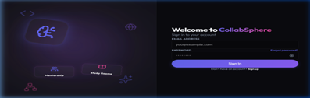
Results
1. Secure Login and Registration Portal
The authentication screen provides a split-screen layout combining platform branding with a clean login form. Users can securely sign in or register with email and password credentials protected by JWT-based session management.
Figure 9.1: User Authentication Interface

Slide 14
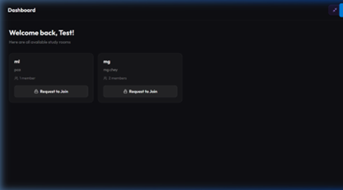
2. Centralized Study Room Hub
The student dashboard displays all available study rooms with member counts and join options. Students can browse and request access to subject-specific collaborative spaces from a single centralized interface.
Figure 9.2: Centralized Study Room Hub

Slide 15
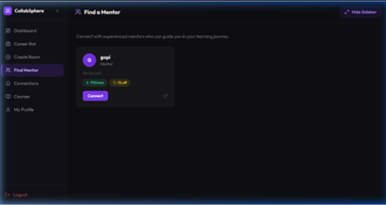
3. Mentor Exploration and Connection Interface
The Find Mentor module lists registered mentors with their profiles, per-minute pricing, and available discounts. Students can initiate a connection request directly from the card, triggering a mentor approval workflow.
Figure 9.3: Mentor Discovery Model

Slide 16
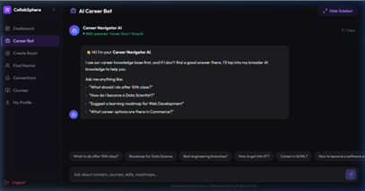
4. Intelligent Career Navigator Chatbot
The Career Navigator AI bot combines a curated career knowledge base with the Grok AI API to answer student queries on career paths, learning roadmaps, and skill development. The interface supports both free-form input and quick-prompt suggestions.
Figure 9.4: Ai Career Bot

Slide 17
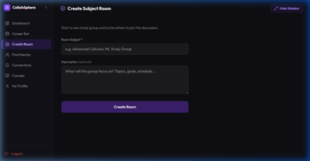
5. Collabrative Study Room Creation
The Create Room panel allows students to form subject-based study groups by entering a topic and optional description. Once created, the room becomes discoverable and joinable by other students on the platform.
Figure 9.5: Create Study Room

Slide 18
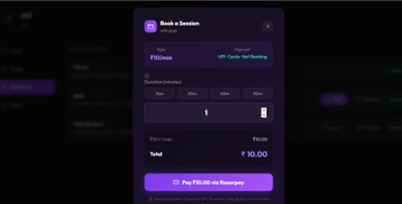
6. Payment to Mentors
Student can connect to mentor and get there benfits once they pay the charge of mentor
Figure 9.6: payment using razorpay

Slide 19
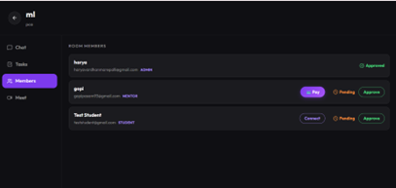
7. Availability of Room
They can use the following like chat,tasks,members,meet in the room.
Figure 9.7: In room features

Slide 20
Conclusion
In academic and professional environments, students and teams lack an integrated system that supports effective collaboration, structured knowledge sharing, and personalized AI career guidance. Existing platforms provide only basic communication tools or generic career suggestions, while knowledge remains scattered and does not support intelligent retrieval.To overcome these limitations, this project aims to develop an AI-driven team collaboration platform that centralizes knowledge, enables intelligent semantic retrieval, and provides personalized AI career guidance and adaptive learning recommendations within a unified and scalable system.

Slide 21
Thank you
Ready to Answer the Queries

