Slide 1
FAMOUS PLACES 2024
Dashboard Overview & Key Insights
A comprehensive analysis of the world's most visited tourist destinations
March 3, 2026

Slide 2
Executive Summary
340M
$18B
30
17
Annual Visitors
Tourism Revenue
Destinations
UNESCO Sites
Dashboard Highlights:
Three-page interactive dashboard covering Overview, Financial Performance, and Visitor Insights
Comprehensive analysis of 30 world-famous destinations across 14 countries and 10 regions
Interactive navigation panel enabling seamless transition between analytical views
Dark modern theme optimized for executive presentations

Slide 3
Page 1: Overview
WHERE ARE THE FAMOUS PLACES AND HOW POPULAR ARE THEY?
Key Performance Indicators
Visual Components
• Total Visitors (340M)
Global Distribution Map
• Total Revenue ($18B)
Top 10 Most Visited Places
• Total Places (30)
• UNESCO Sites (17)
Top 5 Countries by Places
• Avg Visitors per Place (11.33M)
Visitors by Region

Slide 4
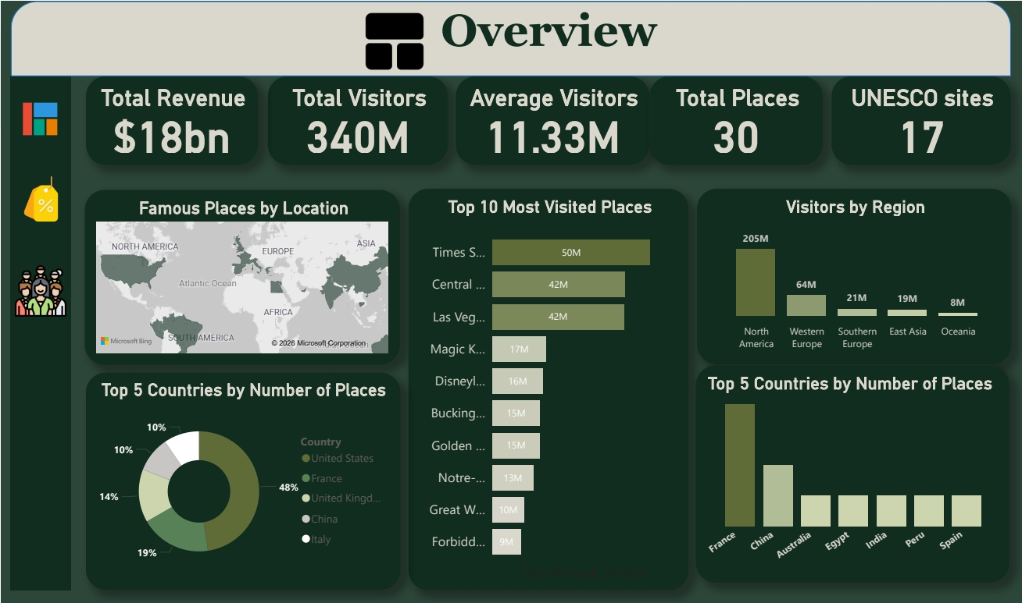

Slide 5
Page 2: Financial Performance
WHERE IS REVENUE GENERATED AND WHAT PRICING WORKS?
Key Performance Indicators
Visual Components
• Total Revenue ($18B)
Revenue by Type (Treemap)
• Avg Revenue per Visitor ($52)
Revenue by Region (Bar Chart)
• Avg Entry Fee ($25)
Entry Fee vs Visitors (Scatter)
• Free Attractions (9)
Free vs Paid Split (Donut)
• Paid Attractions (21)
Top 10 Revenue Generators

Slide 6
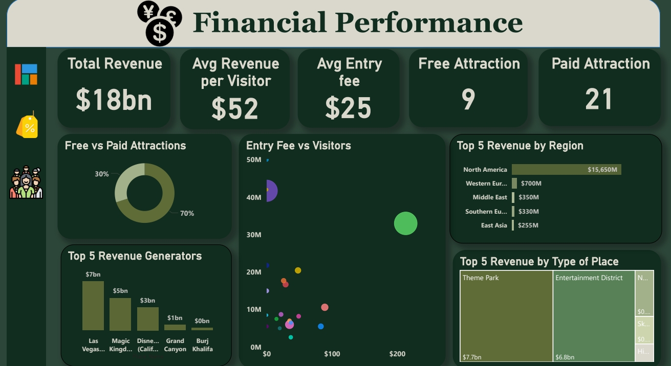

Slide 7
Page 3: Visitor Insights
HOW DO VISITORS EXPERIENCE THESE DESTINATIONS?
Key Performance Indicators
Visual Components
• Total Visitors (340M)
Visitors by Type (Column Chart)
• Avg Visit Duration (3.2 hours)
Avg Duration by Type (Line)
• UNESCO Visitors (subset)
UNESCO vs Non-UNESCO by Region
• Non-UNESCO Visitors (subset)
Top 10 by Visit Duration (Funnel)
Detailed Place Information (Table)

Slide 8
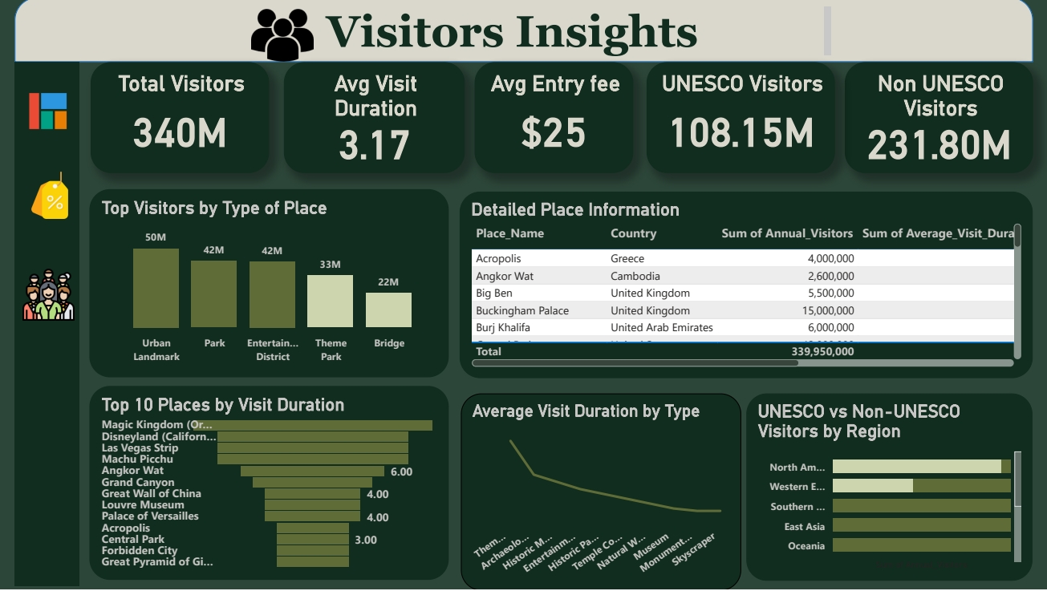

Slide 9
Key Insights
🌎
Geographic Concentration
North America dominates with 10 of 30 famous places. The United States alone contains the highest number of world-renowned destinations.
💰
Revenue Power Players
Las Vegas Strip generates $6.8B in revenue—more than entire regions combined. Theme parks and entertainment districts create exceptional value.
1 of 2

Slide 10
Key Insights
🎯
Pricing Sweet Spot
Moderate pricing ($20-50) achieves strong revenue without significant visitor decline. Premium pricing above $70 substantially limits volume.
⏱️
Engagement = Revenue
Multi-experience destinations achieve 8-10 hour visits vs 1-2 hours for monuments. Extended engagement correlates with higher revenue per visitor.
2 of 2

Slide 11
Strategic Recommendations
Development & Expansion
Revenue Optimization
Invest in underrepresented regions (Africa, South America) to capture untapped markets
Focus on creating extended-engagement destinations (6+ hours)
Combine UNESCO heritage with modern amenities
Implement dynamic pricing ($30-50 sweet spot)
Benchmark against North American operational excellence
Create integrated experiences that maximize visitor engagement

Slide 12
Technical Specifications
Data Model
Design Specifications
Data Source: world_famous_places_2024.csv
30 destinations across 13 columns
No missing values—clean dataset
Dark theme with purple/teal accents
Interactive navigation panel
Optimized for executive presentation
Key DAX Measures
Total Visitors, Total Revenue, Total Places, UNESCO Sites Count
Avg Revenue per Visitor = DIVIDE([Total Revenue], [Total Visitors])
Free/Paid Attractions = CALCULATE(COUNTROWS, Entry_Fee condition)

Slide 13
FAMOUS PLACES 2024
Dashboard Ready for Stakeholder Review
340M annual visitors • $18B tourism revenue • 30 iconic destinations

