Slide 1
Workshop
Terraform Basics

Slide 2
Workshop – Terraform Basics
Agenda
Intro & Format
Scenario
Code!

Slide 3
Workshop – Terraform Basics
Intro & Format
What is Terraform?
Tool for building, changing, and versioning infrastructure safely and efficiently
Provisioning vs configuration management
Procedural vs Declarative
Why?
Immutable Infrastructure
Automation
Independence
Speed
How does it do that?
Configuration files describe the components needed (desired state)
Generates execution plan to reach the desired state
Executes execution plan to build the described infrastructure

Slide 4
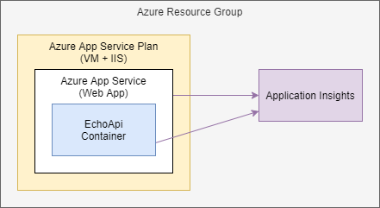
Workshop – Terraform Basics
Scenario
Basic echo application
Deploy EchoApi image to Azure App Service
Monitor application with App Insights

Slide 5
Code!

Slide 6
Thank you!

