Slide 1
Topic:
Missing Value Imputation in a Data Matrix Using the Regularized Singular Value Decomposition
NLA 2023
Team:
1) Daniyal Asif
2) Hasaan Maqsood
3) Anwar Shamim
19 December 2023

Slide 2
Problem Statement:
Issue: Prevalence of incomplete datasets in statistical analysis.
Challenges: Limitations of traditional imputation techniques.
Consequences: Inadequate imputation affects data integrity.
Demand: Need for an advanced, reliable imputation method.

Slide 3
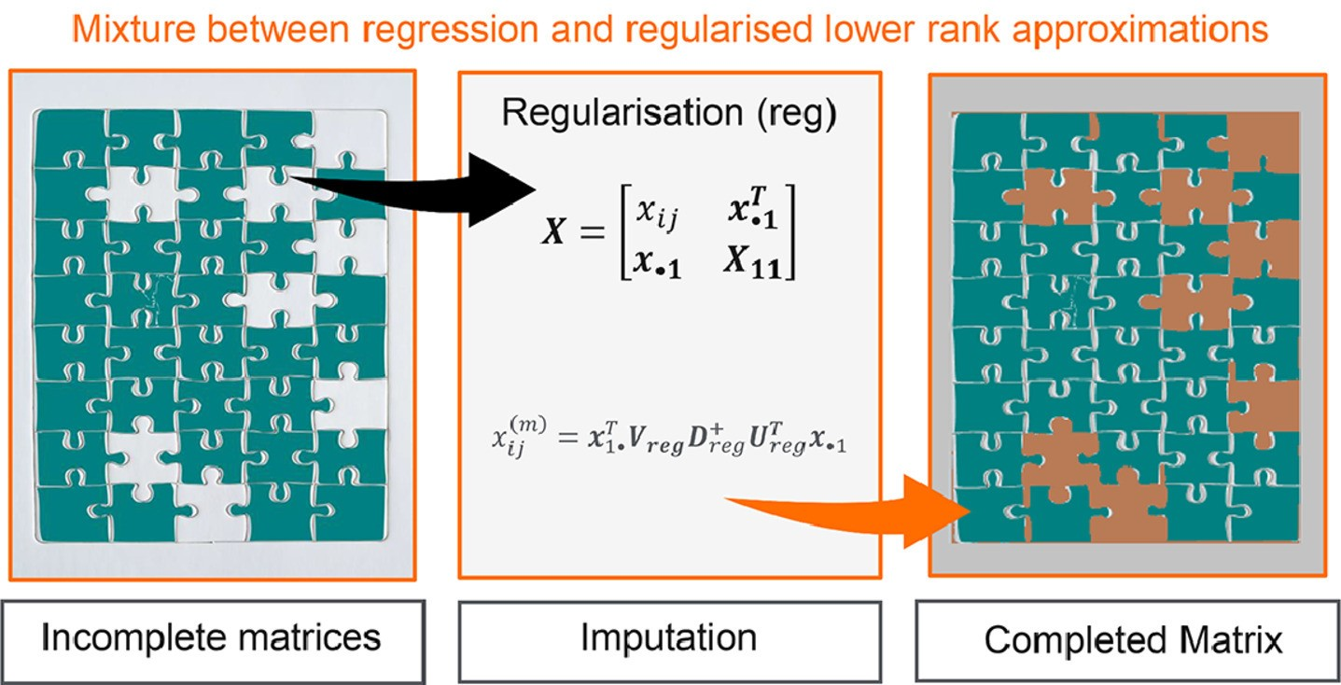
Proposed Solution:
Solution: GabrielEigen Imputation System
Method: Combines regression with lower rank approximations
Innovation: Regularised Singular Value Decomposition
Benefits: Improves imputation quality, reduces overfitting
Applicability: Suitable for various multivariate data matrices

Slide 4
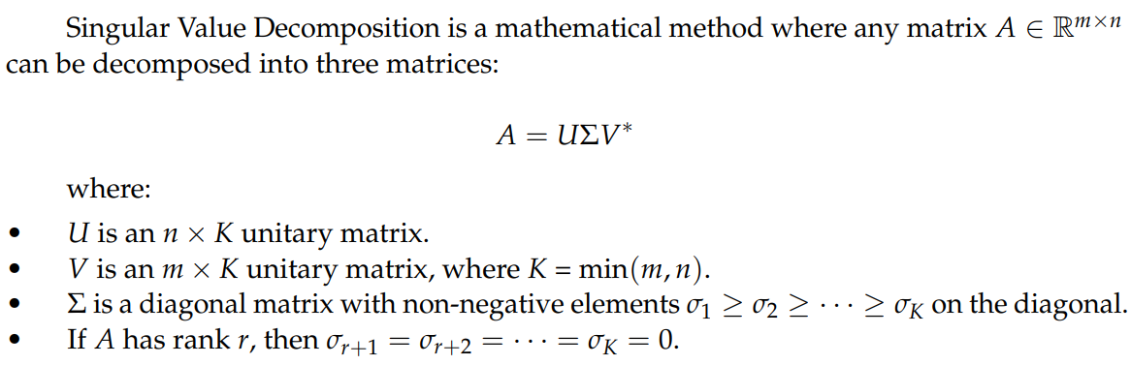
Singular Value Decomposition

Slide 5
GabrielEigen Method
García-Peña et al. introduced GabrielEigen, an imputation method that combines regression with lower rank approximations for matrix structured datasets, without relying on distributional or structural assumptions. It leverages Gabriel’s cross-validation approach and SVD eigenvectors and eigenvalues to derive lower rank approximations.

Slide 6
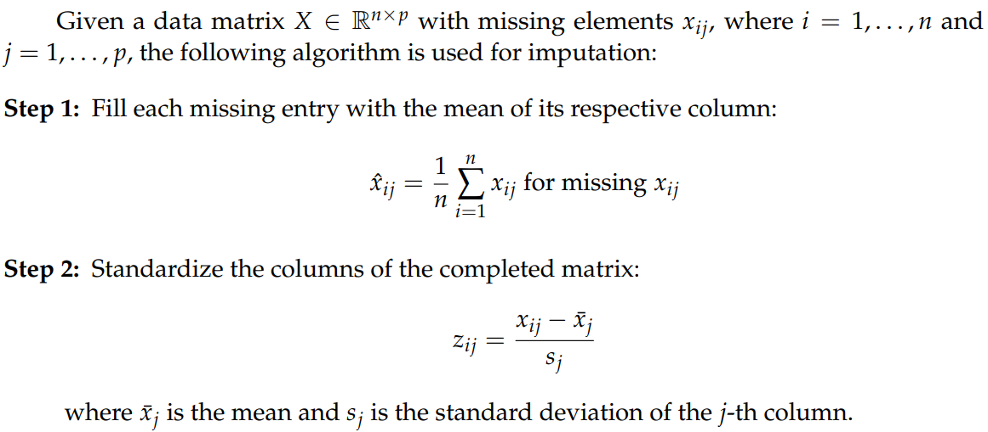
Algorithm

Slide 7
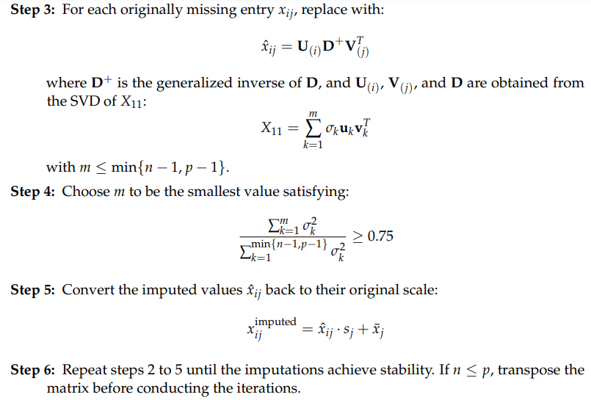

Slide 8
Regularized Version of the GabrielEigen
Regularization is employed to prevent overfitting, ensuring higher quality imputations and more reliable parameter estimation. To enhance the original GabrielEigen imputation system, a regularized Singular Value Decomposition is used, effectively creating a regularized version of the method.

Slide 9
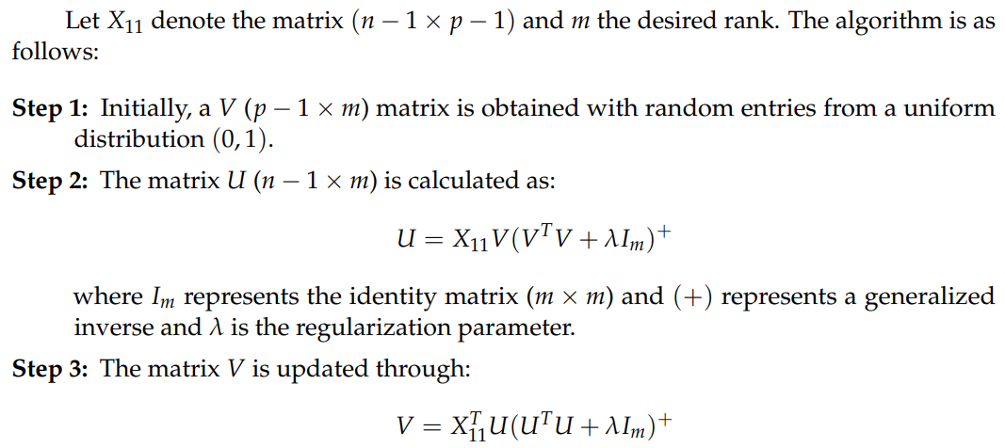
Algorithm

Slide 10
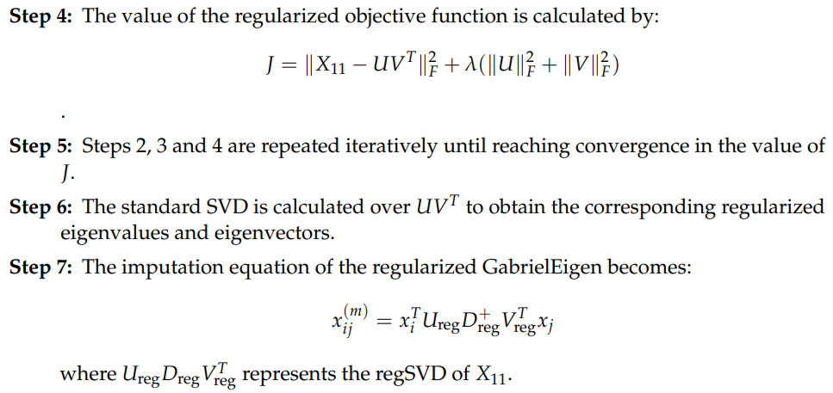

Slide 11
Validation
Utilized Kaggle's datasets for Breast and Prostate cancer.
Introduced missing values randomly at 5%, 15%, and 30% ratios.
Varied lambda values for comprehensive analysis.
Evaluation Metrics including mean absolute error and correlation coefficient used..

Slide 12
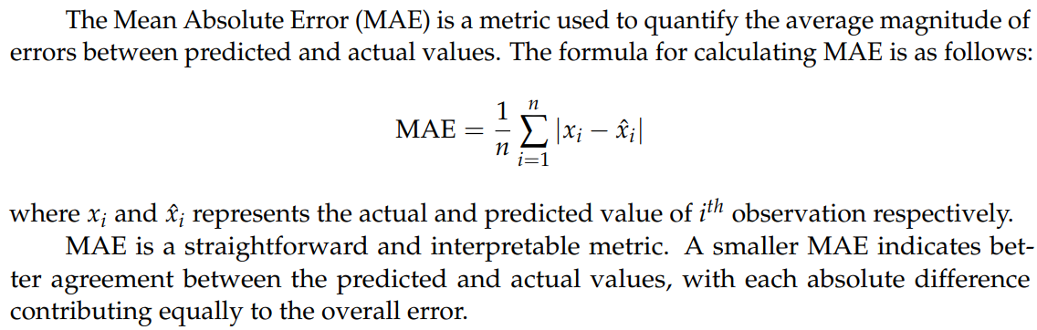
Mean Absolute Error

Slide 13
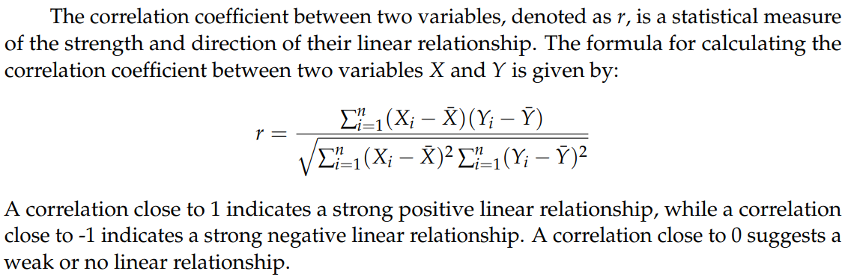
Correlation Coefficient

Slide 14

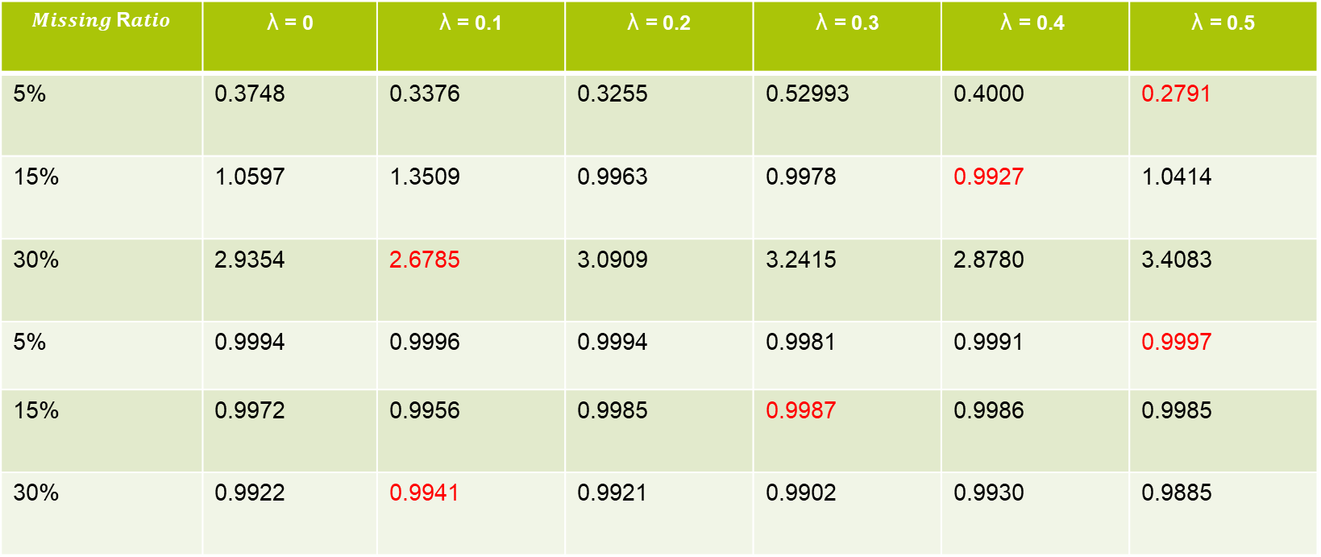
In red, the minimised values of the statistics by regularised GabrielEigen in each percentage considered. λ=0 represents the original GabrielEigen.
In red, the minimised values of the statistics by regularised GabrielEigen in each percentage considered. λ=0 represents the original GabrielEigen.
Summary of study on the breast cancer dataset
$Missing$R$atio$ | $\text{λ}$ = 0 | $\text{λ}$ = 0.1 | λ = 0.2 | λ = 0.3 | $$\text{λ} \text{= 0.}\text{4}$$ | λ = 0.5
5% | 0.3748 | 0.3376 | 0.3255 | 0.52993 | 0.4000 | 0.2791
15% | 1.0597 | 1.3509 | 0.9963 | 0.9978 | 0.9927 | 1.0414
30% | 2.9354 | 2.6785 | 3.0909 | 3.2415 | 2.8780 | 3.4083
5% | 0.9994 | 0.9996 | 0.9994 | 0.9981 | 0.9991 | 0.9997
15% | 0.9972 | 0.9956 | 0.9985 | 0.9987 | 0.9986 | 0.9985
30% | 0.9922 | 0.9941 | 0.9921 | 0.9902 | 0.9930 | 0.9885
Correlation Mean absolute error

Slide 15
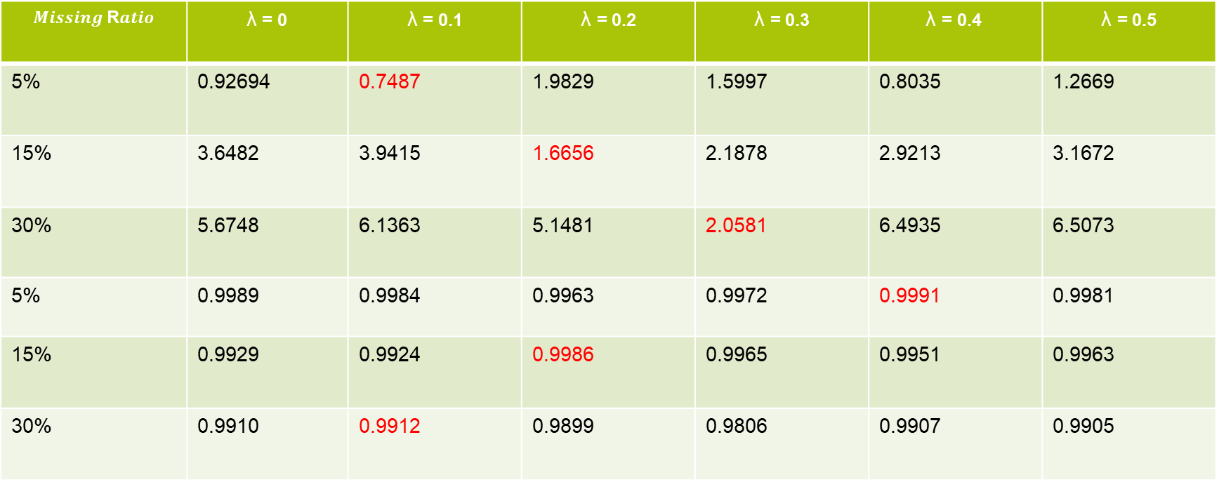
Summary of study on the prostate cancer dataset
$Missing$R$atio$ | $\text{λ}$ = 0 | $\text{λ}$ = 0.1 | λ = 0.2 | λ = 0.3 | $$\text{λ} \text{= 0.}\text{4}$$ | λ = 0.5
5% | 0.92694 | 0.7487 | 1.9829 | 1.5997 | 0.8035 | 1.2669
15% | 3.6482 | 3.9415 | 1.6656 | 2.1878 | 2.9213 | 3.1672
30% | 5.6748 | 6.1363 | 5.1481 | 2.0581 | 6.4935 | 6.5073
5% | 0.9989 | 0.9984 | 0.9963 | 0.9972 | 0.9991 | 0.9981
15% | 0.9929 | 0.9924 | 0.9986 | 0.9965 | 0.9951 | 0.9963
30% | 0.9910 | 0.9912 | 0.9899 | 0.9806 | 0.9907 | 0.9905
Correlation Mean absolute error

Slide 16
Conclusion
A generalization of the GabrielEigen imputation method has been proposed using regularized SVD.
The regularized version is flexible and can be applied to any data matrix, making it suitable for non-parametric imputation for multivariate data.
The method proved to be quite adaptable across different types of interaction, matrix dimensions, and percentages of missing data.
The method has potential for use with methodologies for obtaining robust and multiple imputations.

Slide 17
Future Research
Exploring different mechanisms of data absence and their impact on the proposed method.
Investigating the effects of various probability distributions on the efficiency and effectiveness of the method.
Further research on the optimal choice of the regularization parameter, particularly in different data scenarios.
Integrating the proposed methodology with existing robust and multiple imputation methods to enhance its applicability and effectiveness.

Slide 18
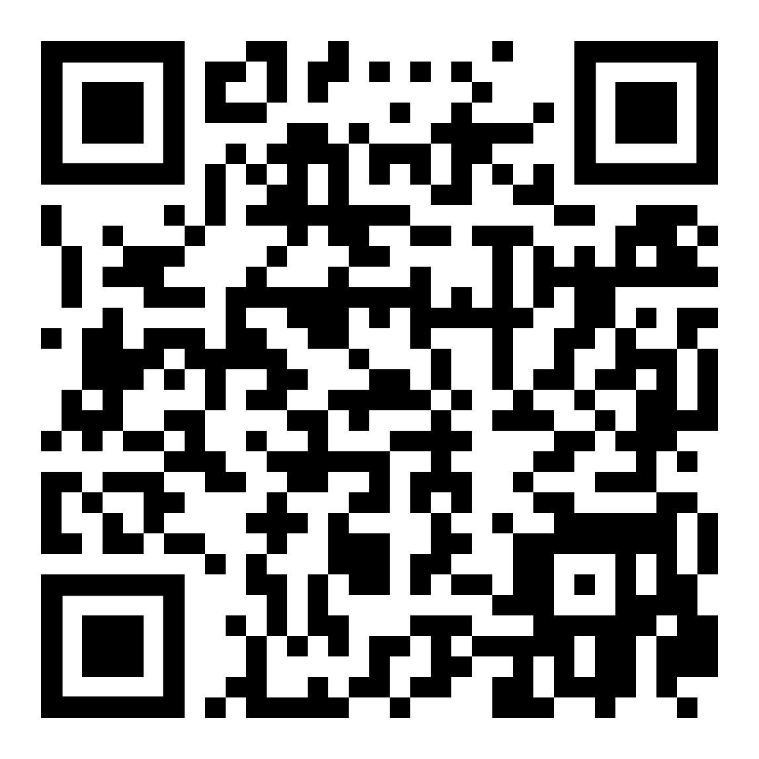
Thank you for your attention
Questions?
Daniyal Asif; conceptualization, software, validations, project administration, supervision, visualization, writing—original draft.
Hassan Maqsood; conceptualization, software, visualization, and writing—original draft.
Anwar Shamim; conceptualization, software and writing—original draft.

