Slide 1






AI-Driven Genomic Variant Analysis Tool
Notes:
DxVar Presentation.pptx

Slide 2
Our Team
Students | Wahaj Ahmed
 | Yaman Masad
 | Hasan Alhussein
 | Omar Yousef
 | Huda Bamatraf
Faculty Advisor & PI | Dr. Halima Alnaqbi
Co-advisor and Academic Mentor | Dr. Nour al dain Marzouka
Industry Mentor | Dr. Tiago Magalhaes
Research Assistant | Faris Mahmoud
Notes:
DxVar Presentation.pptx

Slide 3
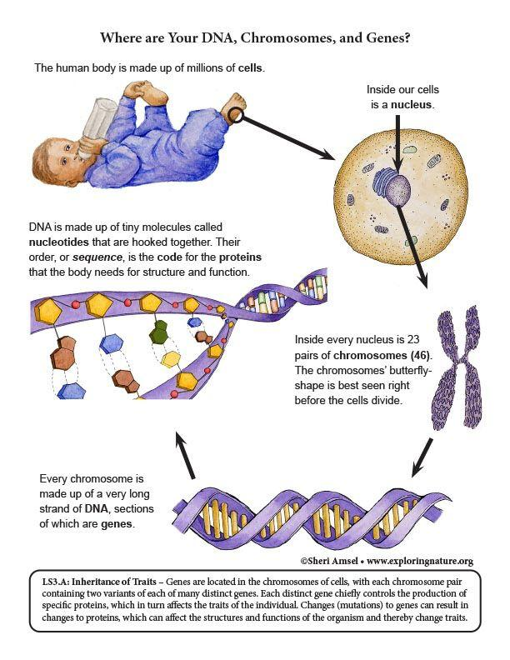
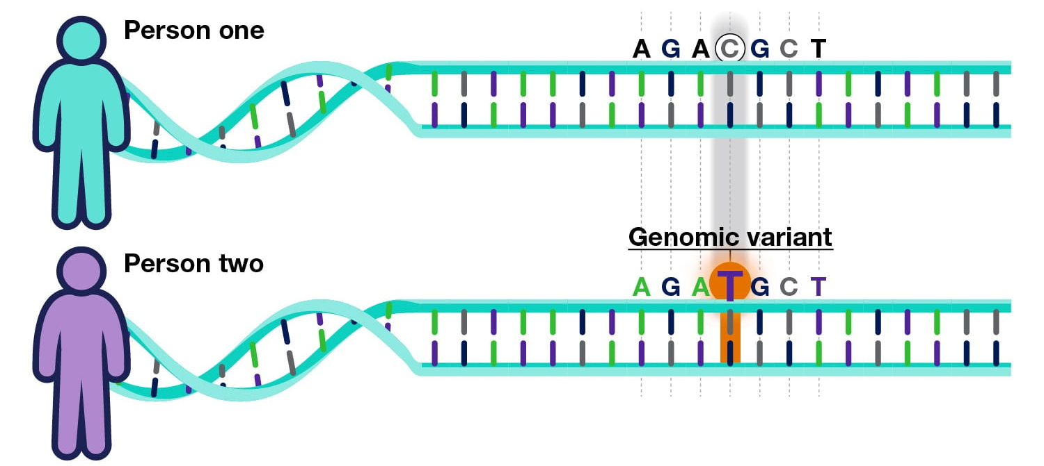
What are Genomic Variants?
Genetic Variant: Differences in DNA sequences when compared to a reference standard/genome.
Nucleus
Common Variants:
Single Nucleotide Polymorphisms (SNPs)
Structural Variants (SVs)
Insertions and deletions (indels)
Human body
Human genome:
- 99.9% identical
- 0.1% different
Chromosome
Nucleotides:
Cytosine
Guanine
Adenine
Thymine
Gene
How do we know which variant is responsible for causing a disease?
DNA
Variant Prioritization
Notes:
Its essential to note that NOT every gene mutation is harmful or disease-causing. It could be neutral or even advantageos in some cases.
This left the genetics community with a need to help categorize genetic changes and also help clearly communicate whether certain genetic mutations are harmful or just simply exist without impacts.
So, let’s revisit: what is a gene mutation?
Main type of variants: snps, indels, structural varainats
These variations, or differences in the DNA sequence, are what make each of us unique, contribute to susceptibility to certain diseases, and influence our response to the environment.

Slide 4
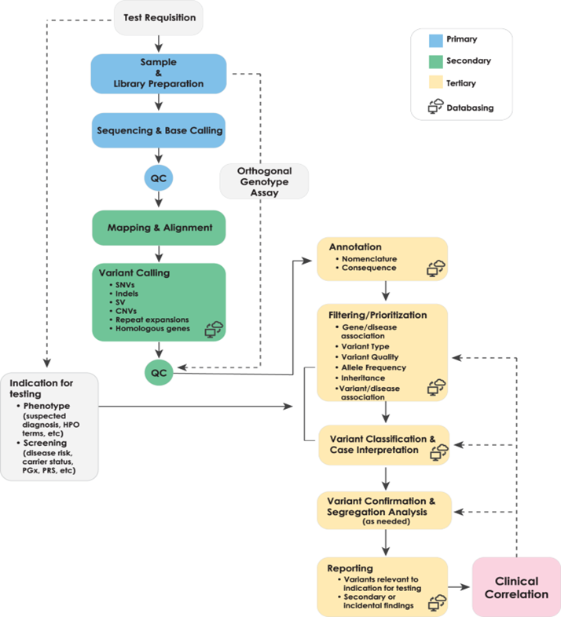

Problem Statement
Tertiary Analysis Challenges:
Time (Manual Analysis):
Up to 7 hours per case
Cost (Commercial Solutions):
Hundreds of dollars per analysis
Data Privacy (Online Tools):
Potential privacy and accessibility concerns with closed-source platforms

Slide 5

Variant Prioritization
What is it?
Variant prioritization: the process of ranking genetic variants based on their likelihood of being disease-causing.
Criteria used?
Tool | Key Features
Exomiser | variant pathogenicity with phenotype-genotype links
LIRICAL | Uses likelihood ratios to assess phenotype-genotype fit
AMELIE | Literature-based phenotype-to-gene ranking
PhenIX | Prioritizes based on phenotype ontology and variant severity
Phenotype Matching
Pathogenicity Scores
Allele Frequency
Inheritance Mode
Gene-Disease Associations
Notes:
Phenotype Matching 🧾: Does the variant match the patient's clinical features (HPO terms)?
Pathogenicity Scores ☣️: Predictions from tools like REVEL, SIFT, PolyPhen.
Allele Frequency 📊: Rare variants (e.g., from gnomAD) are more suspect in rare diseases.
Inheritance Mode 👪: Variant fits expected genetic inheritance pattern (dominant, recessive, etc.).
Gene-Disease Associations 📚: Verified links from databases like OMIM, ClinGen, HGMD.

Slide 6
Project Goals
Develop
Utilize
01
Exomiser and AI-assisted re-ranking to link phenotypes to the most likely causative genetic variants.
an AI-powered pipeline (DxVar) to improve variant prioritization for rare disease diagnosis
02
04
Extract
Create
phenotypic data (HPO terms) from unstructured clinical notes using LLMs like LLaMA3
03
a user-friendly interface for clinicians to review and interpret variant-disease associations interactively.
Notes:
Mention 70B param model

Slide 7
An AI-driven tool that integrates-bioinformatics databases and tools for genetic variant interpretation and prioritization.

Slide 8
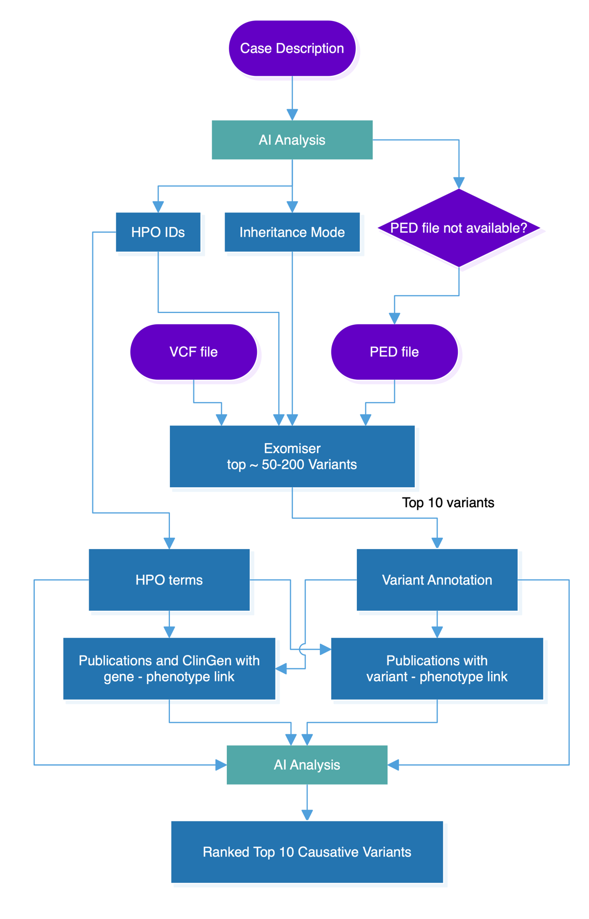

Pipeline Flowchart
I. Phenotype Extraction & Exomiser Input Preparation
II. Variant Prioritization via Exomiser
III. AI Assisted Re-Ranking of Variants
​
Notes:
Introduce what HPO terms are and why they are important

Slide 9
Results – HPO Terms Extraction
All tested AI models/ tools struggle with HPO term extraction
However, we noticed that it has limited effected on the next steps in our pipeline
​

Slide 10
Results – Variant Prioritization
AI Enhancement
​
Notes:
Check actual percentage based on cases for exomiser alone or use reference (exomiser source)

Slide 11
Achievements
Successfully integrated phenotype extraction, variant prioritization, and AI-based re-ranking in a complete diagnostic pipeline.
AI re-ranking consistently placed the correct variant first in all 76 analyzed cases.
1
2
Developed an intuitive Streamlit-based UI with AI-generated summaries and linked literature support.
Open-source deployment on GitHub and live demo available locally.
3
4

Slide 12
Novelty and Findings
Unique AI-Integrated Approach: Combines AI LLM model with established genomic tools to enhance accuracy.
Fast, Accurate, and Scalable: Deployed a fully automated system that ranks variants end-to-end.
HPO Terms – Limited Impact: In our platform, Human Phenotype Ontology currently has only a minimal effect on how variants are prioritized, unlike in other tools.
First variant analysis tool that supports Arabic input and output
Notes:
Reword last point to be clearer

Slide 13
Demo
DxVar in Action: Full Variant Ranking in <4 Minutes
https://www.youtube.com/watch?v=48dp_LuwO00
​

Slide 14
Future Directions
Enhance accuracy of clinical phenotype extraction
Full cloud web deployment
Larger Validation Datasets
Support for Structural and Copy Number Variants
Collaboration with clinical partners
Benchmark with smaller AI models (ex: 8B Llama)

Slide 15
Acknowledgments

