Slide 1
Js Dom Section 1. Getting started

Slide 2
Contents
Section 2. Selecting elements
getElementById
getElementByName
Section 3. Traversing elements
Get the parent element
Get child elements
Get siblings of an element

Slide 3
Contents
Section 4. Manipulating elements
innerHTML
After()
Before()
Append()
removeChild()
Section 5. Working with Attributes
JavaScript setAttribute() Method

Slide 4
Contents
Section 7. Working with Events
JavaScript events
Page load events
JavaScript Mouse Events
JavaScript Keyboard Events

Slide 5
Contents
Section 8. Scripting Web Forms
JavaScript Handling change Event
JavaScript Form
For input event
For radio button
For select element
For checkbox
JavaScript Dynamically Add & Remove Option

Slide 6
Section 2. Selecting elements getElementById() – select an element by id. getElementsByName() – select elements by name. getElementsByTagName() – select elements by a tag name. getElementsByClassName() – select elements by one or more class names. querySelect() – select elements by CSS selectors.

Slide 7

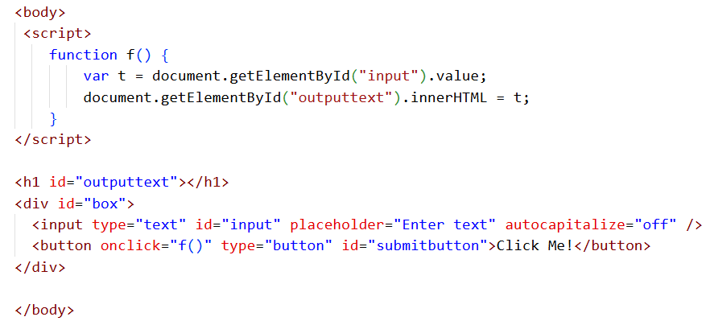
Get Element By Id:

Slide 8
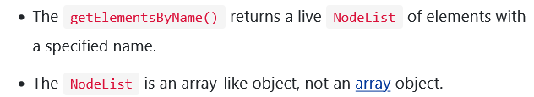
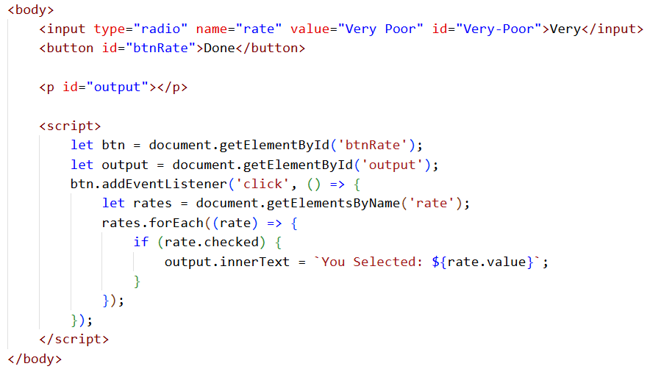
Get Element By Name:

Slide 9
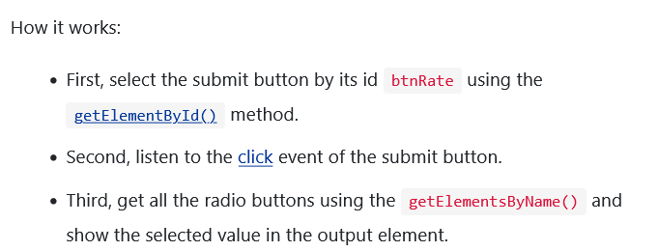
Get Element By Name Multiple Radio Button:

Slide 10
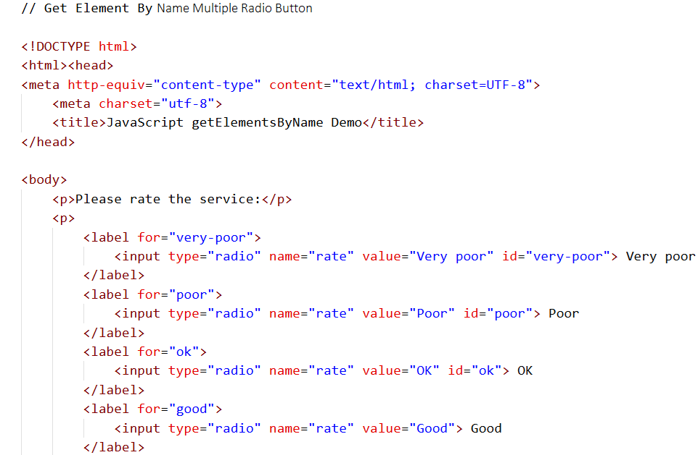

Slide 11
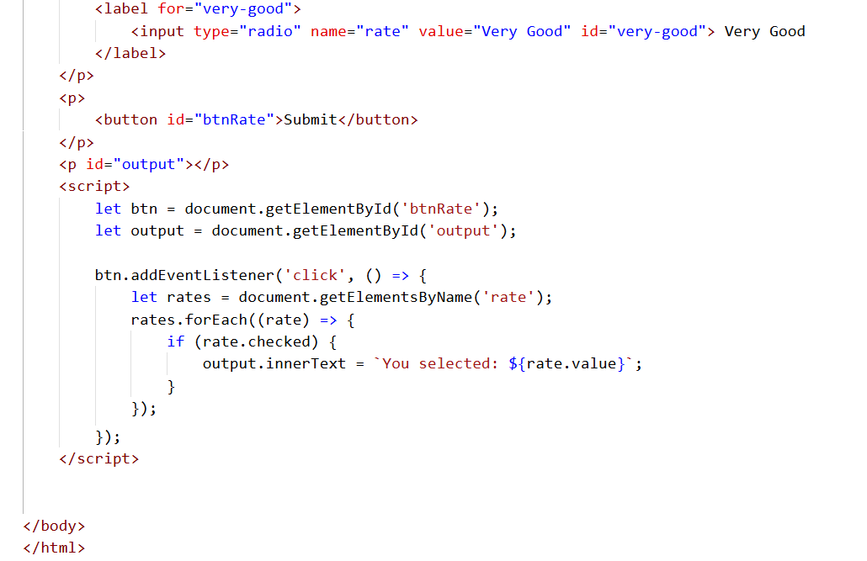

Slide 12
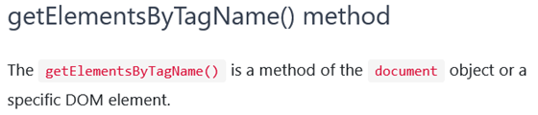
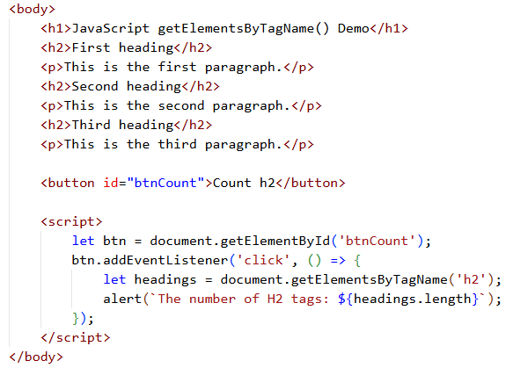
Get Element By Tag Name:

Slide 13
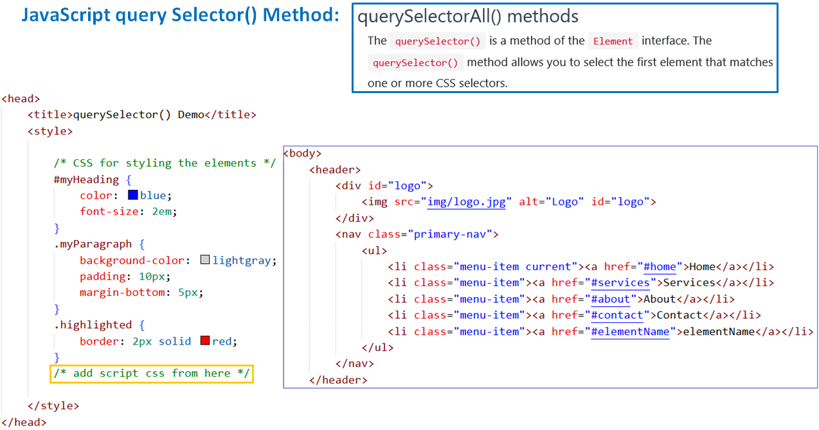

Slide 14
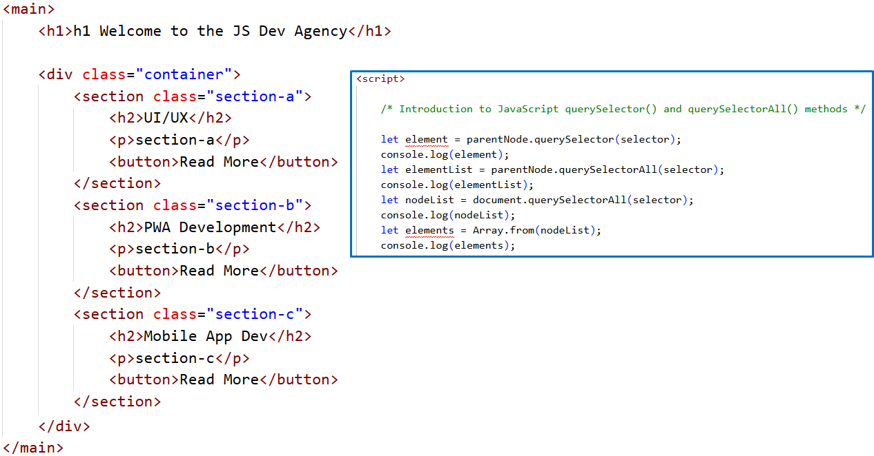

Slide 15
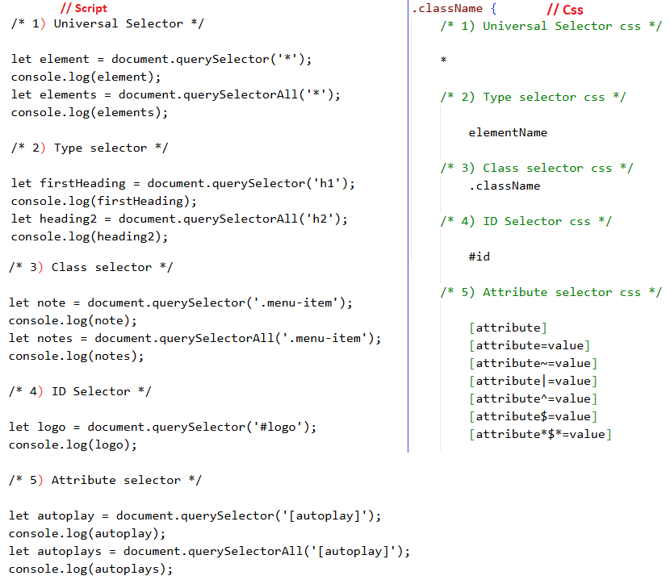

Slide 16
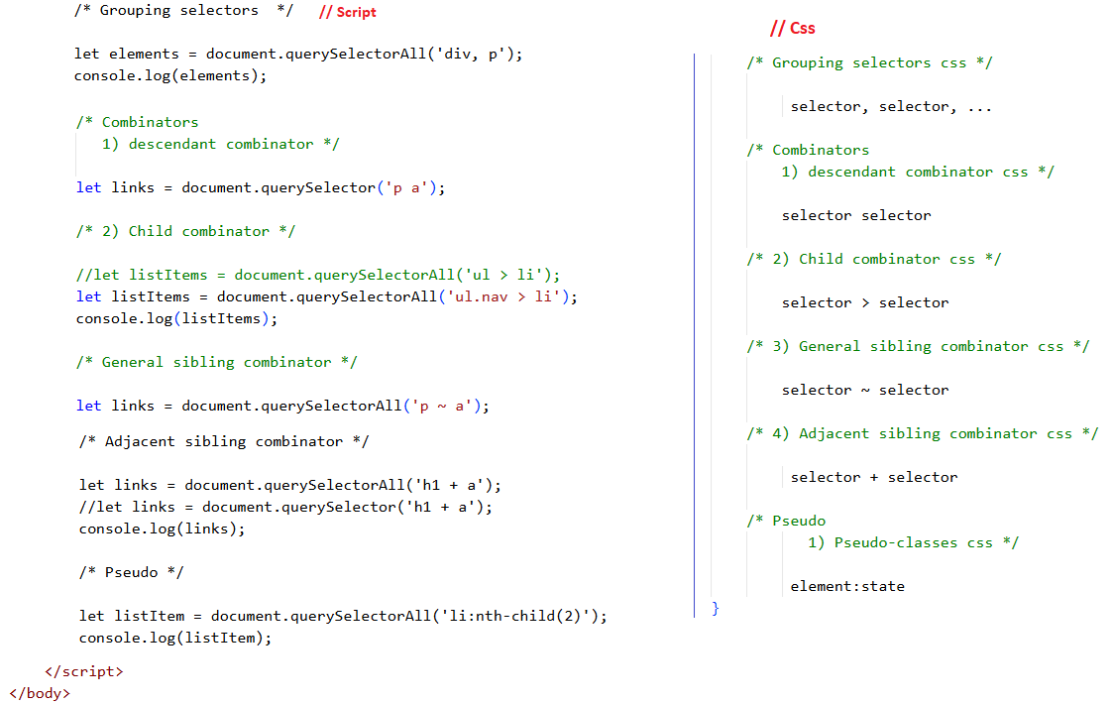

Slide 17
Section 3. Traversing elements Get the parent element – get the parent node of an element. Get child elements – get children of an element. Get siblings of an element – get siblings of an element.

Slide 18
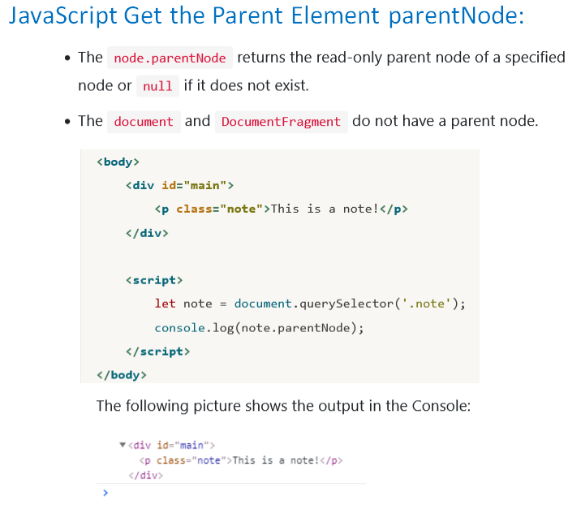

Slide 19
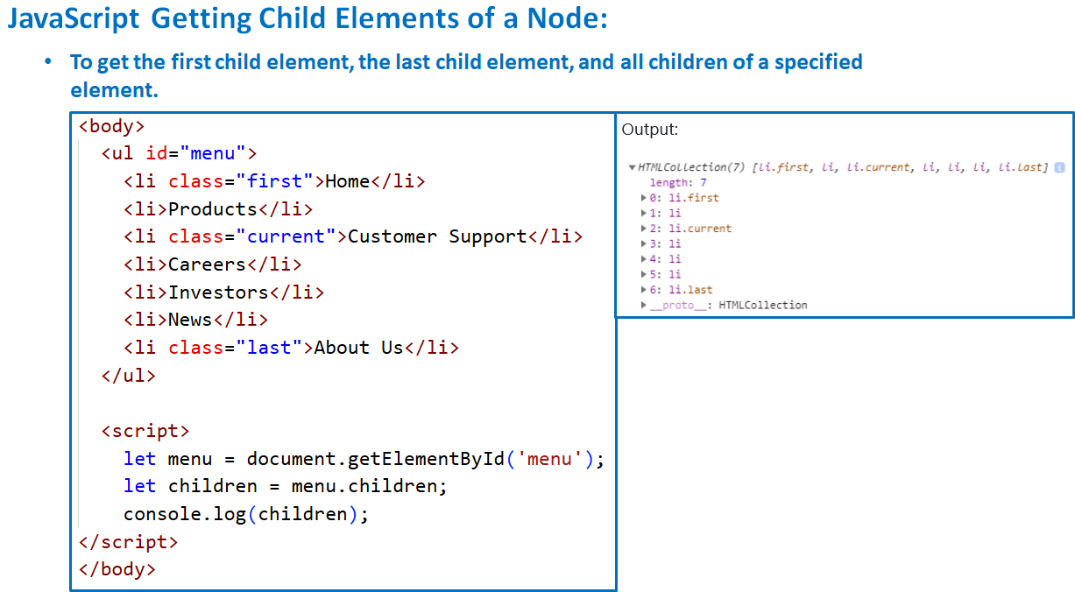

Slide 20
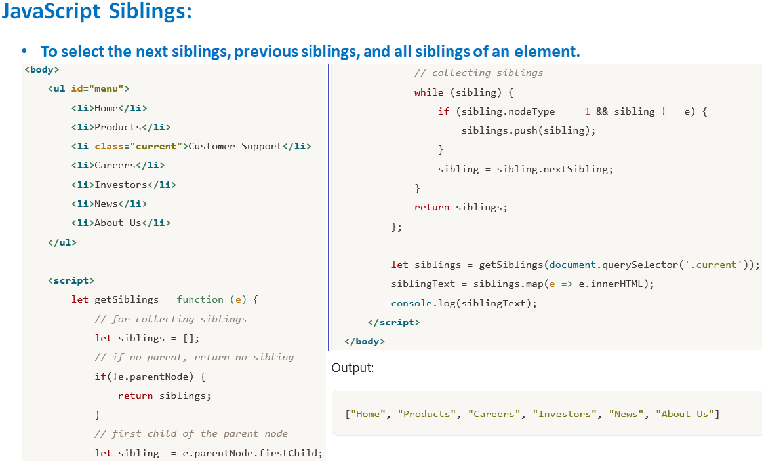

Slide 21
Section 4. Manipulating elements:
innerHTML
after()
append()
removeChild()
insertBefore()

Slide 22
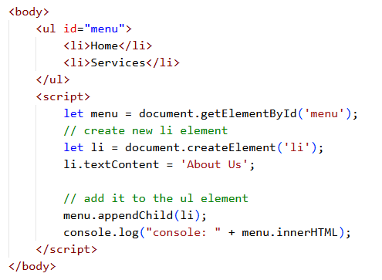
JavaScript innerHTML:

Slide 23
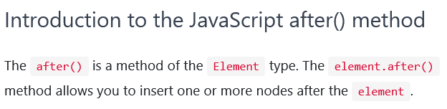
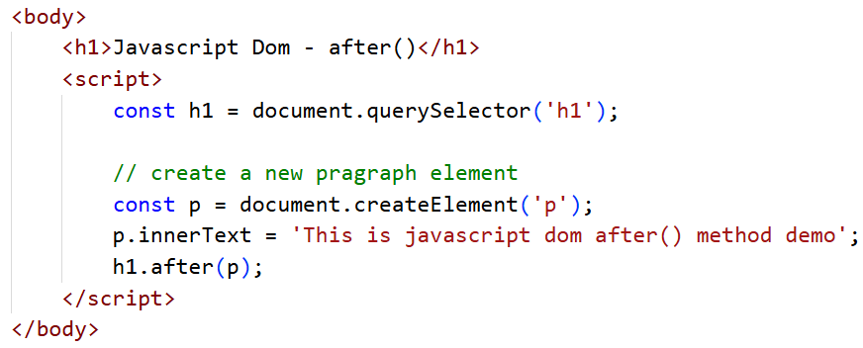
JavaScript after() Method:

Slide 24
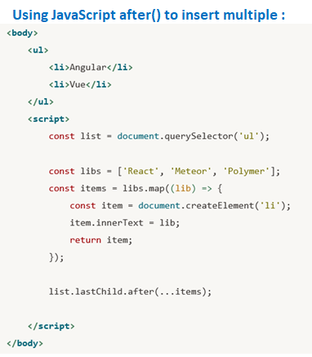
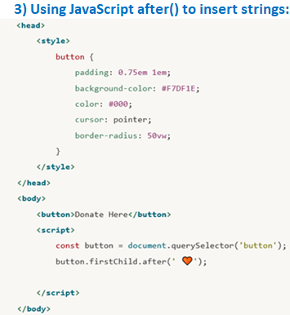

Slide 25
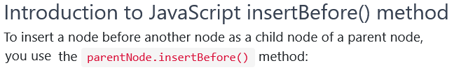
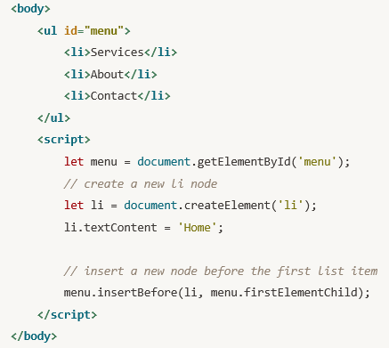
JavaScript before Method:

Slide 26
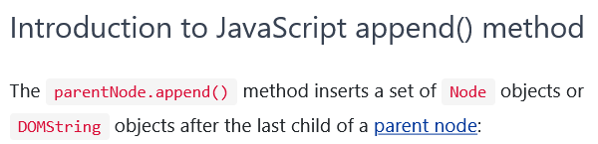
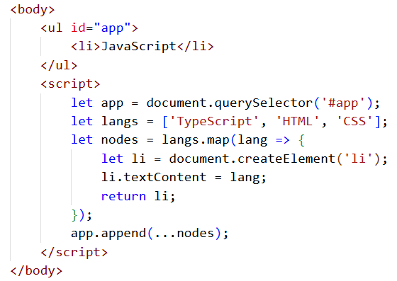
Append:

Slide 27
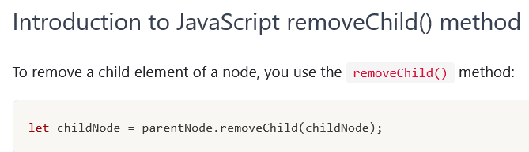
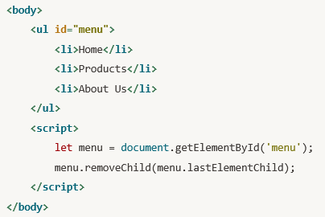
JavaScript removeChild() Method:

Slide 28
Section 5. Working with Attributes JavaScript set Attribute() Method

Slide 29
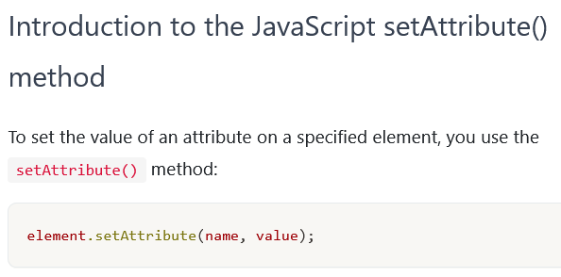
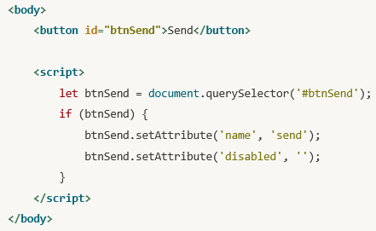
JavaScript setAttribute() Method:

Slide 30
Section 7. Working with Events
JavaScript events
Page load events
JavaScript Mouse Events
JavaScript Keyboard Events

Slide 31
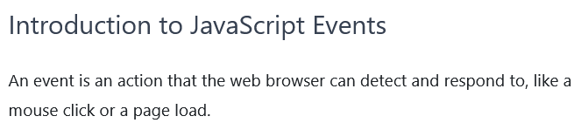
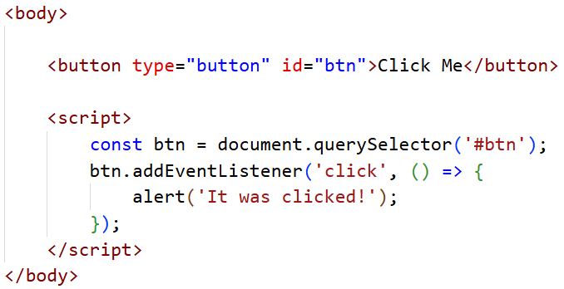
JavaScript events:

Slide 32
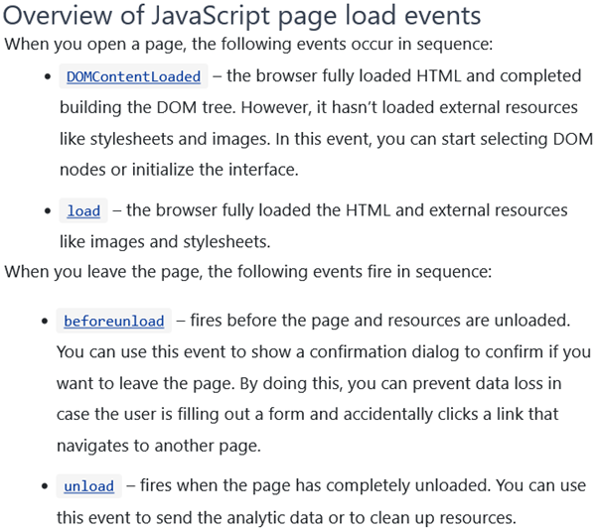
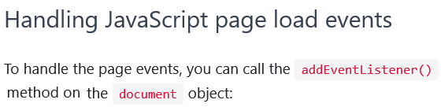
JavaScript Page Load Events:

Slide 33
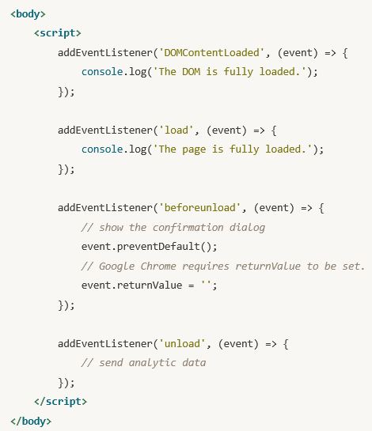
JavaScript Page Load Events:

Slide 34
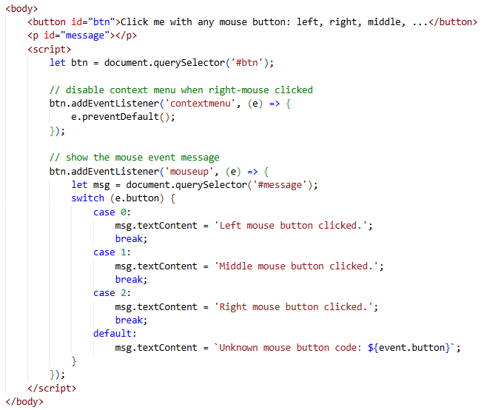
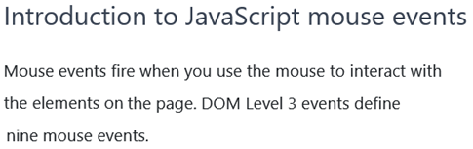
JavaScript Mouse Events:

Slide 35
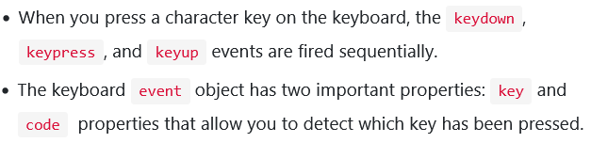
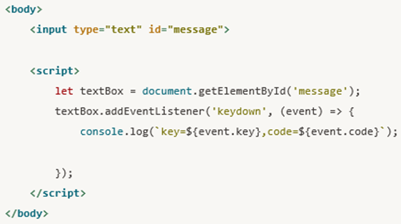
JavaScript Keyboard Events:

Slide 36
Section 8. Scripting Web Forms
JavaScript Handling change Event
JavaScript Form
For input event
For radio button
For select element
For checkbox
JavaScript Dynamically Add & Remove Option

Slide 37
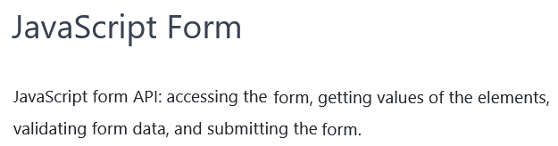
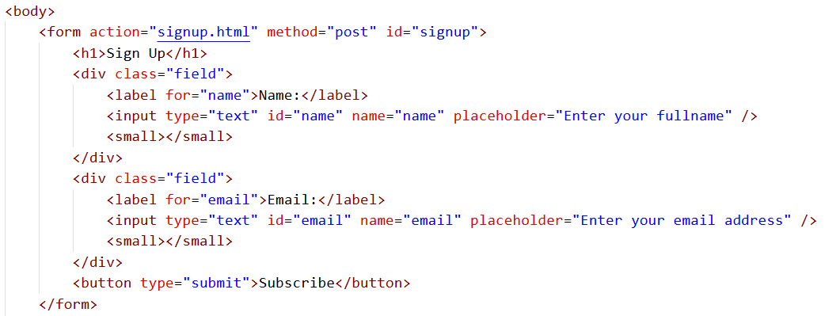
JavaScript Form:

Slide 38
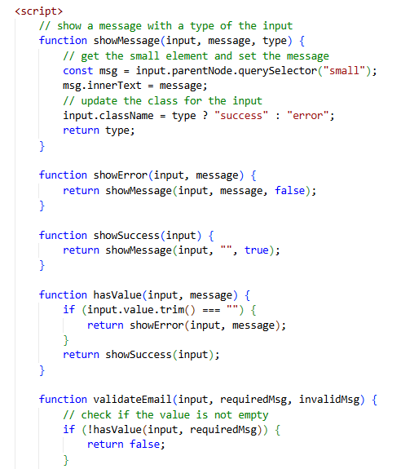

Slide 39
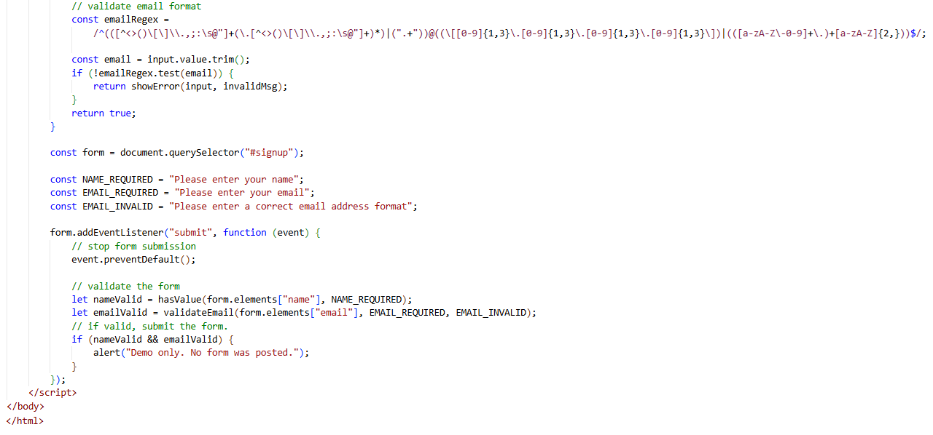

Slide 40
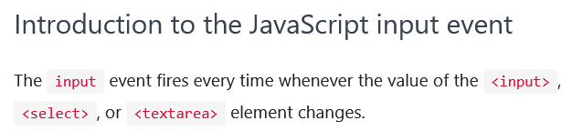
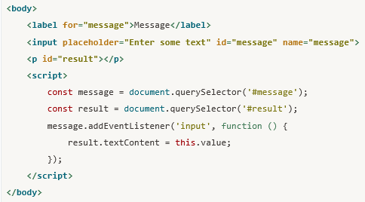
JavaScript input Event:

Slide 41
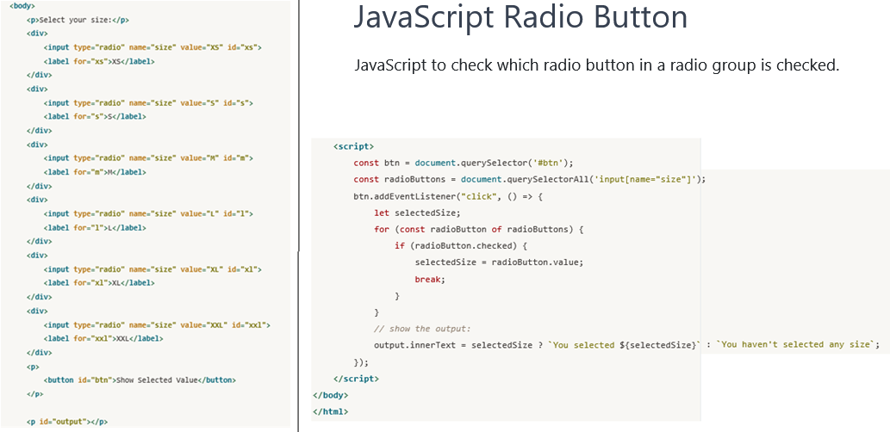
JavaScript Radio Button:

Slide 42
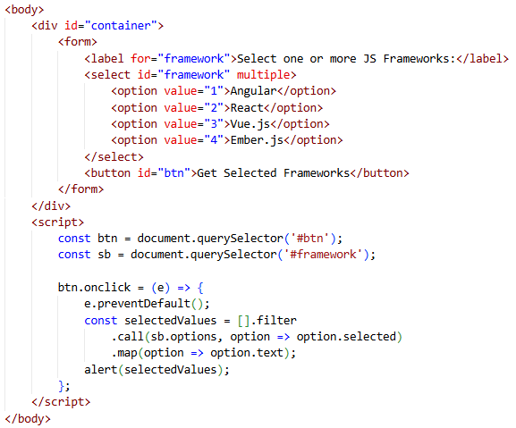
JavaScript select Element:

Slide 43
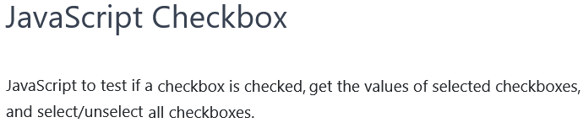
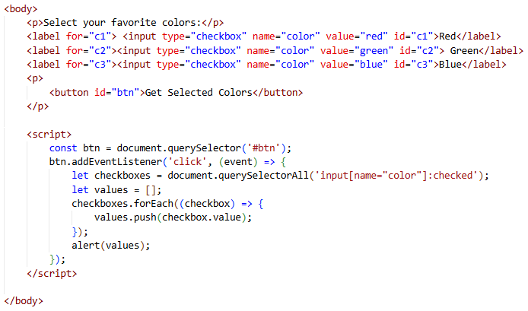
JavaScript Checkboxes:

Slide 44
