Slide 1
Phys102 Capacitors
Key Points
Capacitors
Determination of Capacitance
Capacitors in Series and Parallel
Electric Energy Storage
Dielectrics
Fatemeh Mirekhtiary

Slide 2
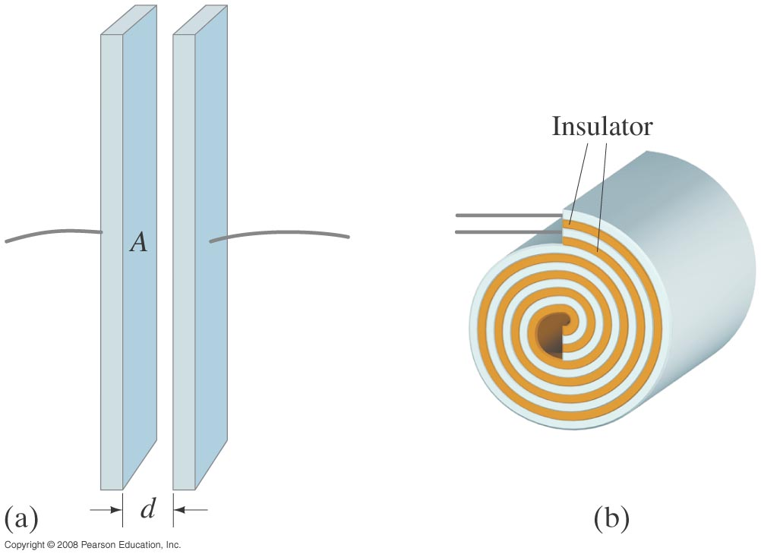
A capacitor consists of two conductors that are close but not touching. A capacitor has the ability to store electric charge.
Notes:
Figure 24-1. Capacitors: diagrams of (a) parallel plate, (b) cylindrical (rolled up parallel plate).

Slide 3
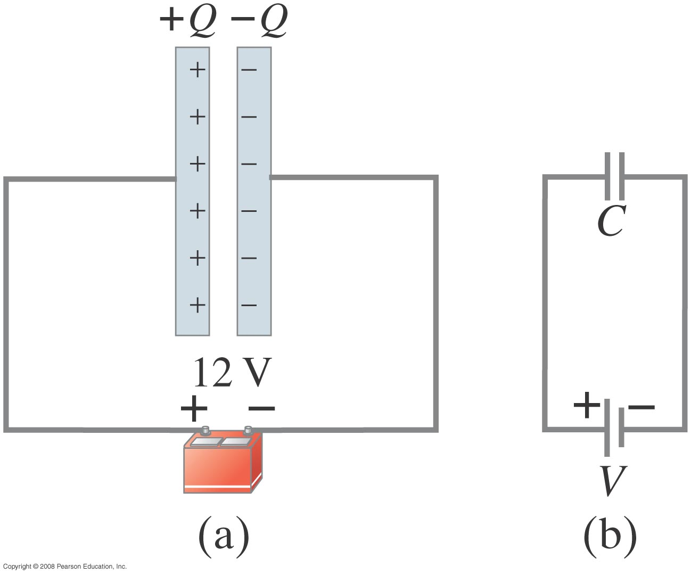
Parallel-plate capacitor connected to battery. (b) is a circuit diagram.
Notes:
Figure 24-2. (a) Parallel-plate capacitor connected to a battery. (b) Same circuit shown using symbols.

Slide 4
Capacitors
When a capacitor is connected to a battery, the charge on its plates is proportional to the voltage:
The quantity C is called the capacitance.
Unit of capacitance: the farad (F):
1 F = 1 C/V.

Slide 5
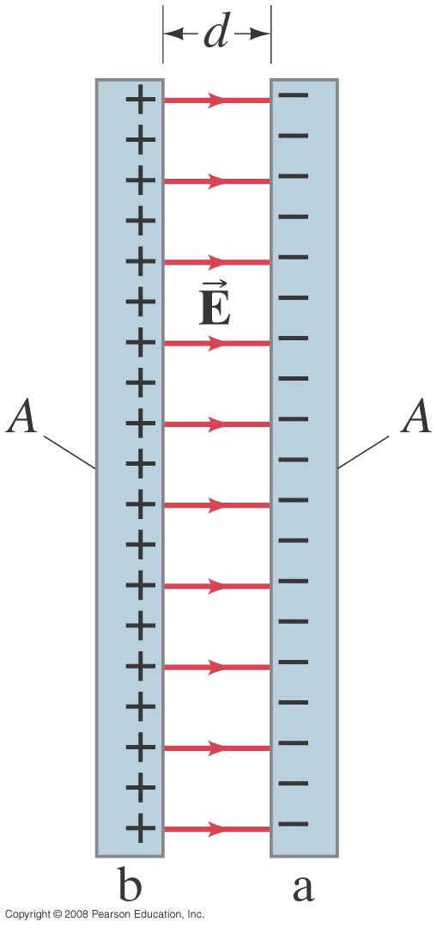
Determination of Capacitance
For a parallel-plate capacitor as shown, the field between the plates is
E = Q/ε₀A.
The potential difference:
V_{ba} = Ed = Qd/ε₀A.
This gives the capacitance:
Notes:
Figure 24-4. Parallel-plate capacitor, each of whose plates has area A. Fringing of the field is ignored.

Slide 6
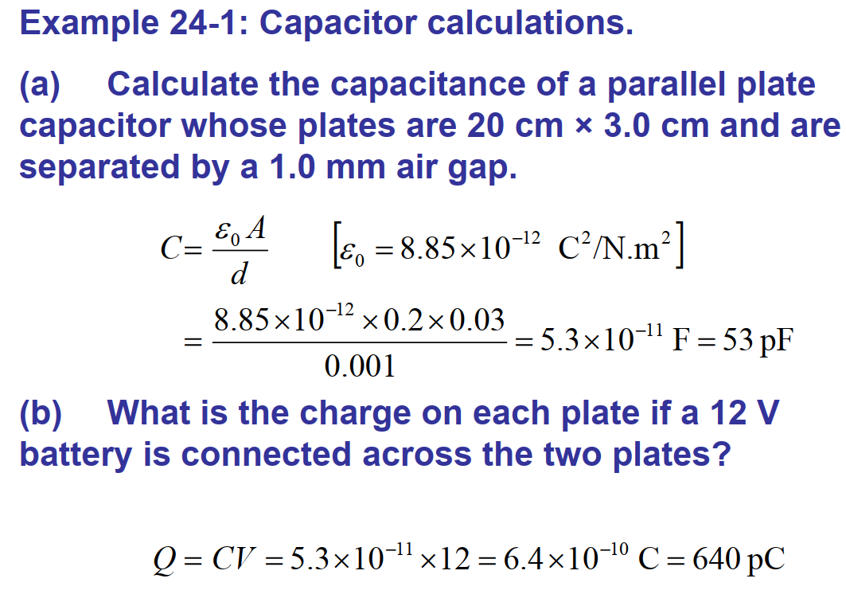
Notes:
Solution: a. C = 53 pF.
b. Q = CV = 6.4 x 10⁻¹⁰ C.
c. E = V/d = 1.2 x 10⁴ V/m.
d. A = Cd/ε₀ = 10⁸ m².

Slide 7
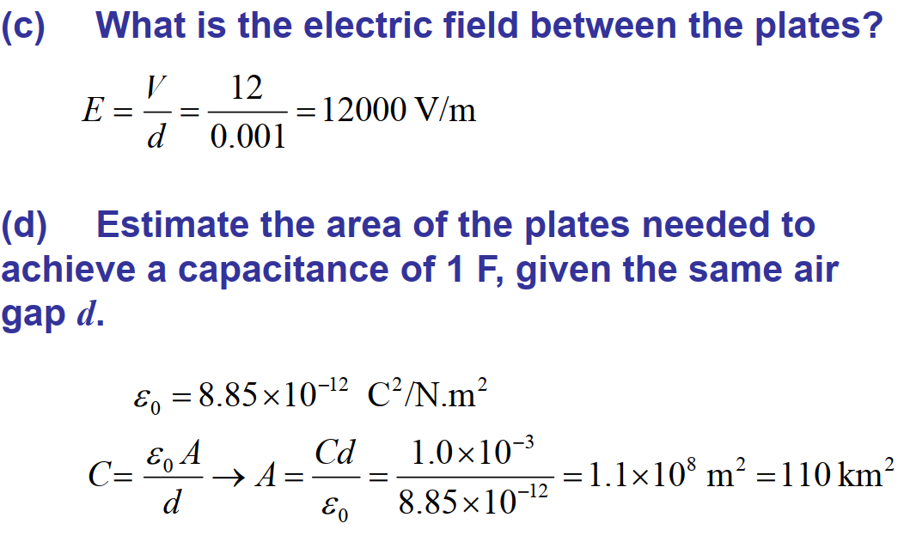

Slide 8
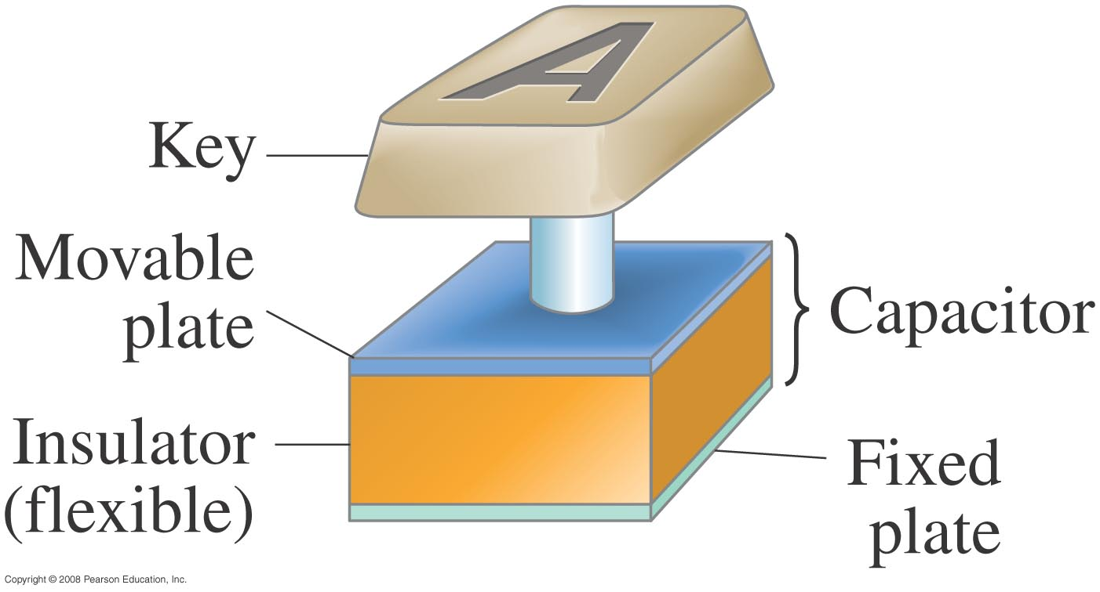
Capacitors are now made with capacitances of 1 farad or more, but they are not parallel-plate capacitors. Instead, they are activated carbon, which acts as a capacitor on a very small scale. The capacitance of 0.1 g of activated carbon is about 1 farad.
Some computer keyboards use capacitors; depressing the key changes the capacitance, which is detected in a circuit.
Notes:
Figure 24-5. Key on a computer keyboard. Pressing the key reduces the capacitor spacing thus increasing the capacitance which can be detected electronically.

Slide 9
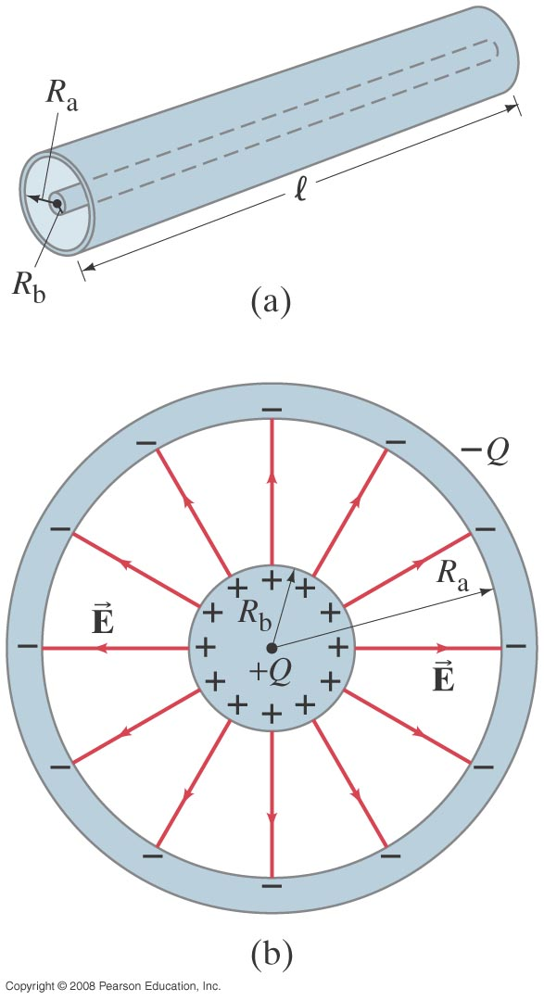
Example: Cylindrical capacitor.
A cylindrical capacitor consists of a cylinder (or wire) of radius R_{b} surrounded by a coaxial cylindrical shell of inner radius R_{a}. Both cylinders have length l which we assume is much greater than the separation of the cylinders, so we can neglect end effects. The capacitor is charged (by connecting it to a battery) so that one cylinder has a charge +Q (say, the inner one) and the other one a charge –Q. Determine a formula for the capacitance.
Notes:
Figure 24-6. (a) Cylindrical capacitor consists of two coaxial cylindrical conductors. (b) The electric field lines are shown in cross-sectional view.
Solution: We need to find the potential difference between the cylinders; we can do this by integrating the field (which was calculated for a long wire already). The field is proportional to 1/R, so the potential is proportional to ln R_{a}/R_{b}. Then C = Q/V.

Slide 10
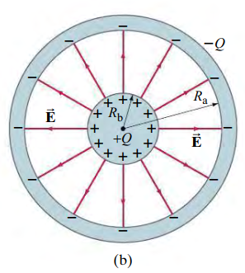
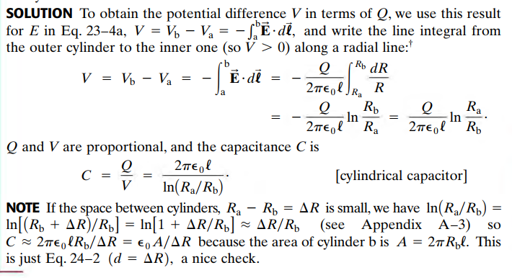

Slide 11
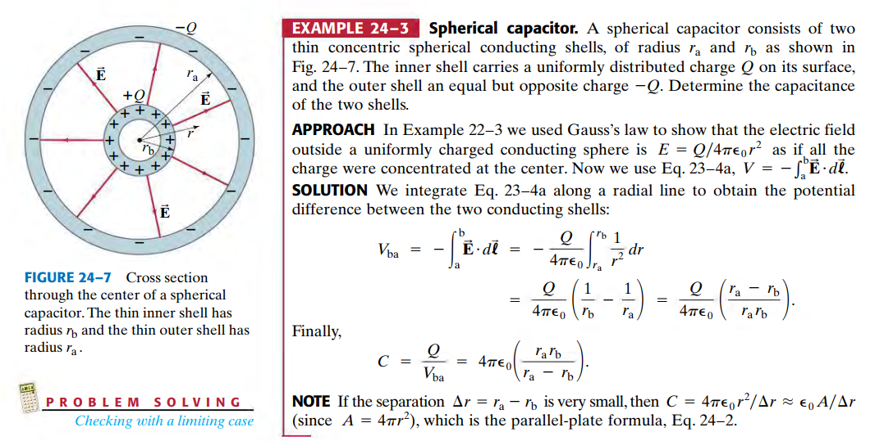

Slide 12
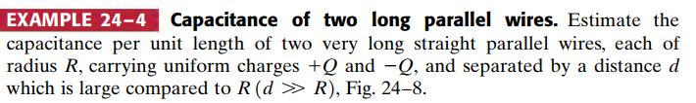
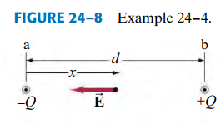
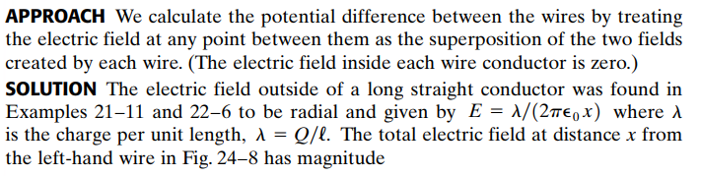

Slide 13

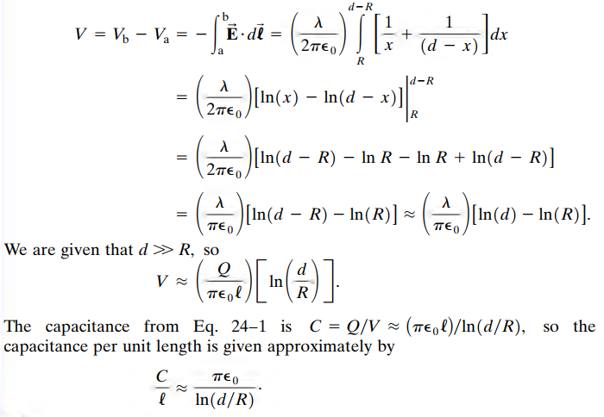

Slide 14
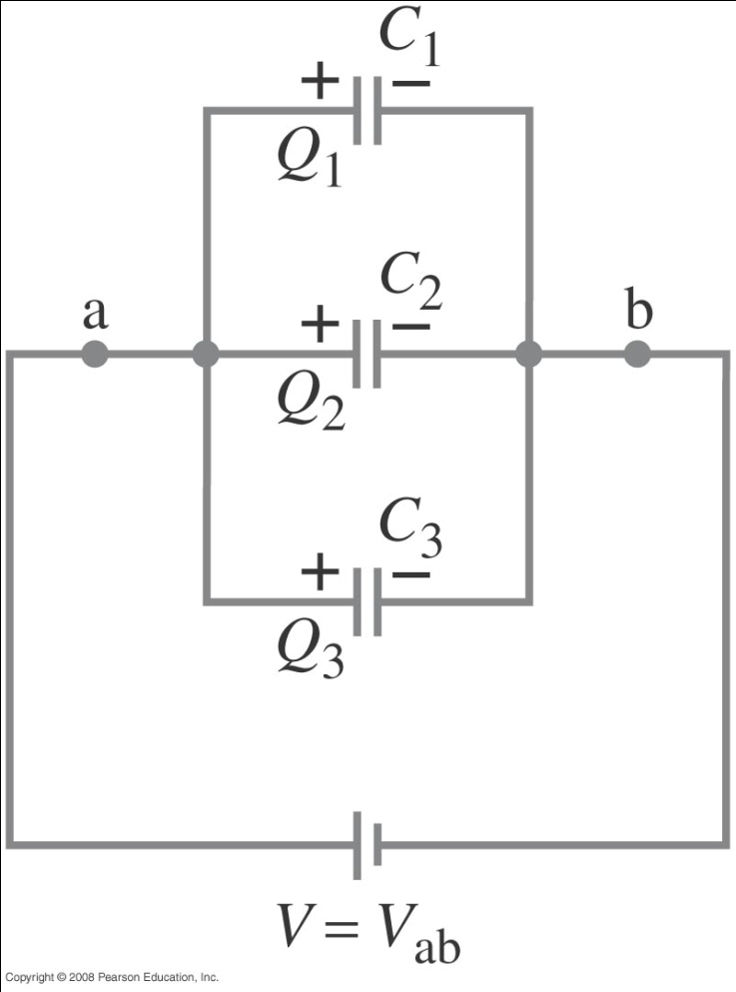
Capacitors in Series and Parallel
Capacitors in parallel have the same voltage across each one. The equivalent capacitor is one that stores the same charge when connected to the same battery:
Notes:
Figure 24-9. Capacitors in parallel: C_{eq} = C₁ + C₂ + C₃ .

Slide 15
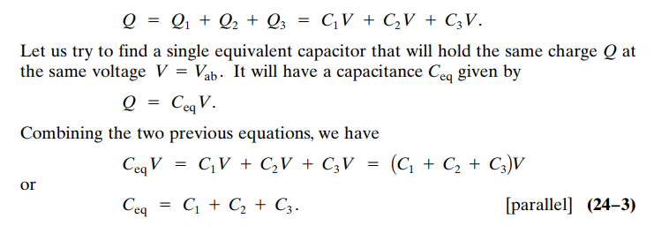
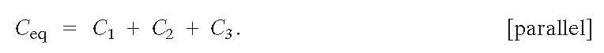

Slide 16
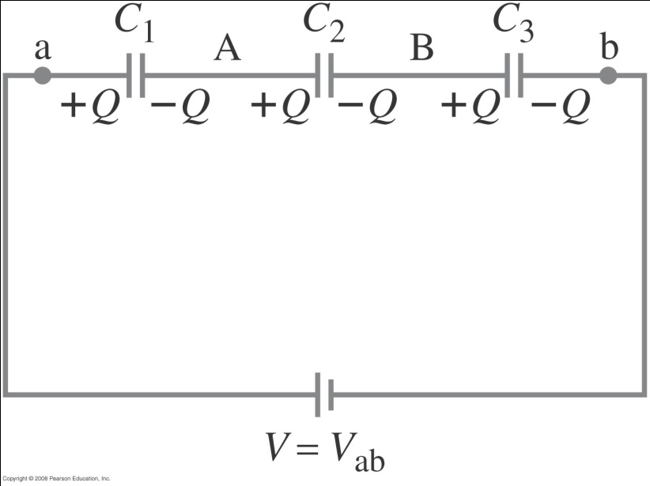
Capacitors in Series
Capacitors in series have the same charge. In this case, the equivalent capacitor has the same charge across the total voltage drop. Note that the formula is for the inverse of the capacitance and not the capacitance itself!
Notes:
Figure 24-10. Capacitors in series: 1/C_{eq} = 1/C₁ + 1/C₂ + 1/C₃.

Slide 17
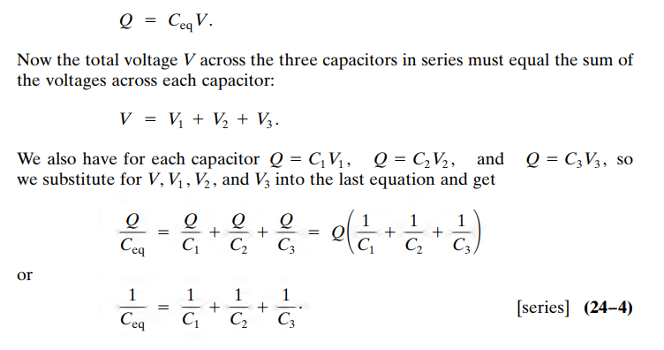
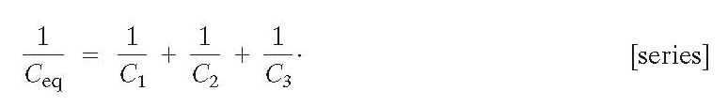

Slide 18
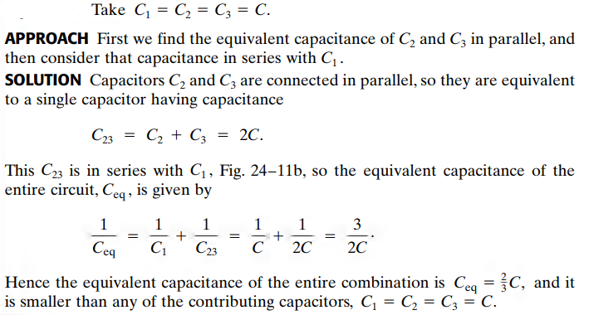
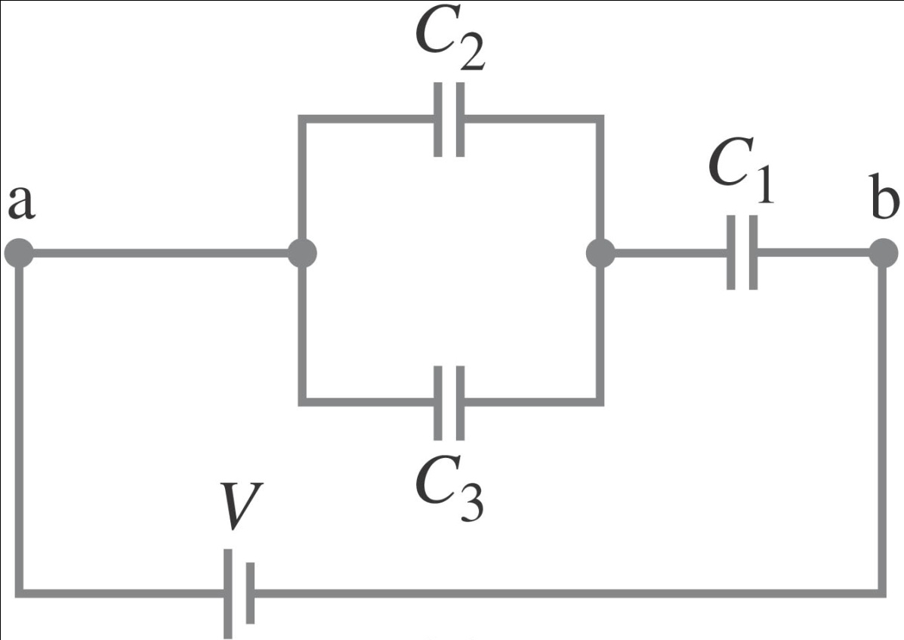
Example: Equivalent capacitance.
Determine the capacitance of a single capacitor that will have the same effect as the combination shown.
Notes:
Solution: First, find the equivalent capacitance of the two capacitors in parallel (2C); then the equivalent of that capacitor in series with the third (2/3 C).

Slide 19
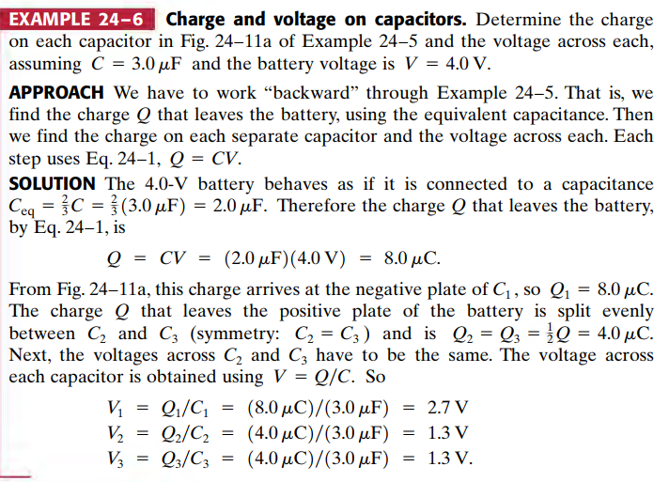
Example: Charge and voltage on capacitors.
Determine the charge on each capacitor and the voltage across each, assuming C = 3.0 μF and the battery voltage is V = 4.0 V.
Notes:
Solution: First, find the charge on C₁ from Q = CV_{eq}. This charge is split equally between C₂ and C₃. Now we can calculate the voltages across each capacitor, using V = Q/C.

Slide 20
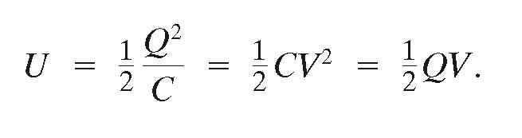
Electric Energy Storage
A charged capacitor stores electric energy; the energy stored is equal to the work done to charge the capacitor:

Slide 21
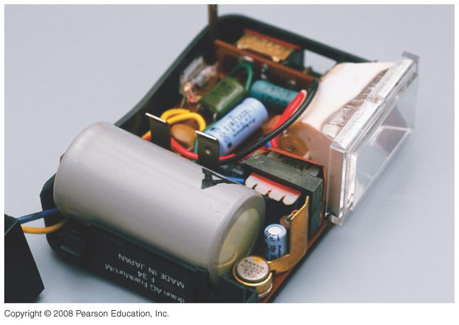
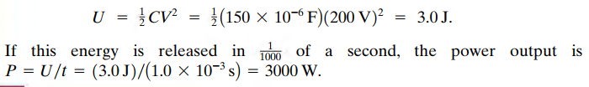
Electric Energy Storage
Example: Energy stored in a capacitor.
A camera flash unit stores energy in a 150-μF capacitor at 200 V. (a) How much electric energy can be stored? (b) What is the power output if nearly all this energy is released in 1.0 ms?
Notes:
Solution: a. U = ½ CV² = 3.0 J.
b. P = U/t = 3000 W.

Slide 22
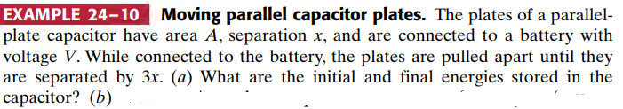
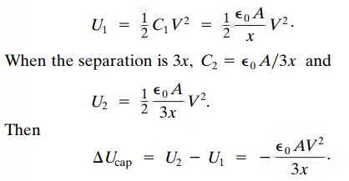
Notes:
Solution: Increasing the plate separation decreases the capacitance, but the charge remains the same. Therefore the energy, U = ½ Q²/C, doubles.

Slide 23
Electric Energy Storage
The energy density, defined as the energy per unit volume, is the same no matter the origin of the electric field:
For a parallel-plate capacitor:
The sudden discharge of electric energy can be harmful or fatal. Capacitors can retain their charge indefinitely even when disconnected from a voltage source – be careful!

Slide 24
Dielectrics
A dielectric is an insulator, and is characterized by a dielectric constant K.
Capacitance of a parallel-plate capacitor filled with dielectric:
Using the dielectric constant, we define the permittivity:

Slide 25
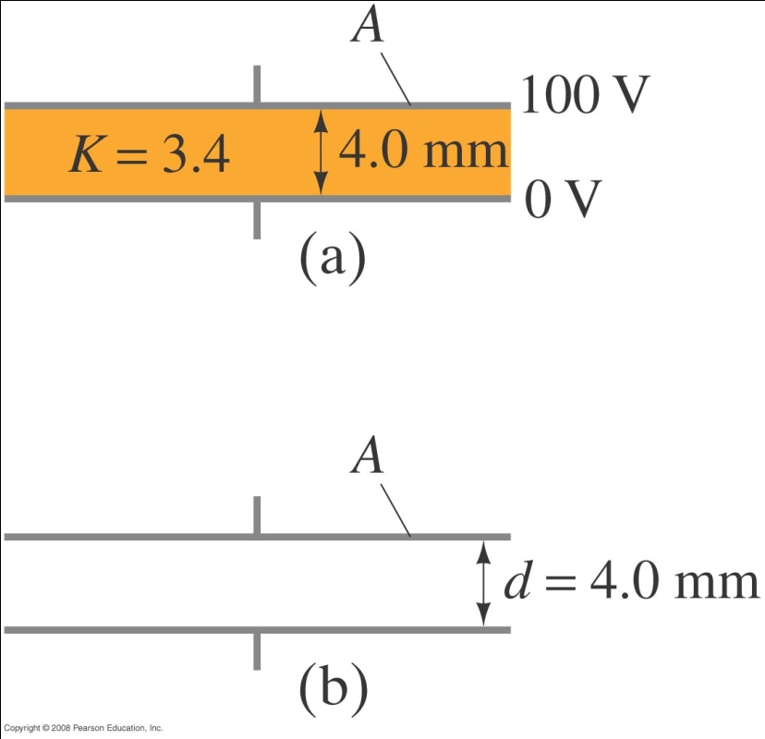
Dielectrics
Example: Dielectric removal.
A parallel-plate capacitor, filled with a dielectric with K = 3.4, is connected to a 100-V battery. After the capacitor is fully charged, the battery is disconnected. The plates have area A = 4.0 m² and are separated by d = 4.0 mm. (a) Find the capacitance, the charge on the capacitor, the electric field strength, and the energy stored in the capacitor. (b) The dielectric is carefully removed, without changing the plate separation nor does any charge leave the capacitor. Find the new values of capacitance, electric field strength, voltage between the plates, and the energy stored in the capacitor.
Notes:
Solution: a. C = Kε₀A/d = 3.0 x 10⁻⁸ F. Q = CV = 3.0 x 10⁻⁶ C. E = V/d = 25 kV/m. U = ½ CV² = 1.5 x 10⁻⁴ J.
B. Now C = 8.8 x 10⁻⁹ F, Q = 3.0 x 10⁻⁶ C (no change), V = 340 V, E = 85 kV/m, U = 5.1 x 10⁻⁴ J. The increase in energy comes from the work it takes to remove the dielectric.

Slide 26
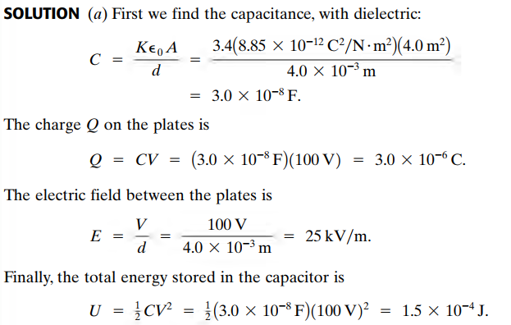

Slide 27
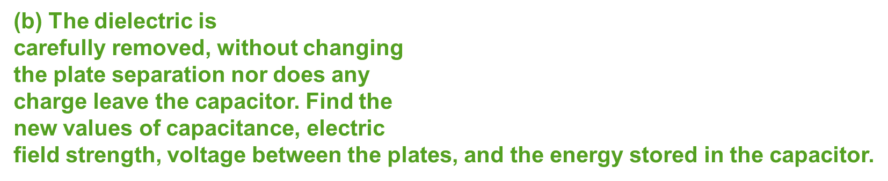
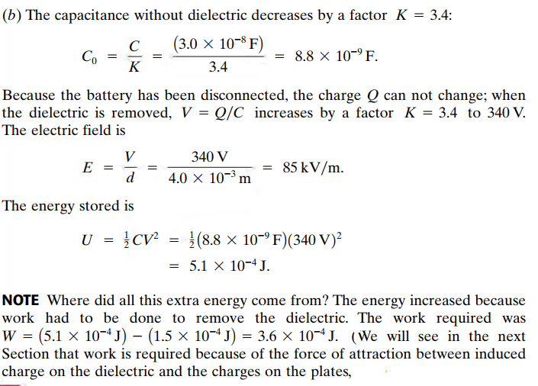

Slide 28
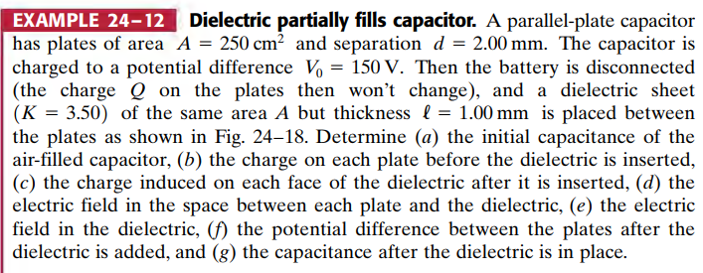
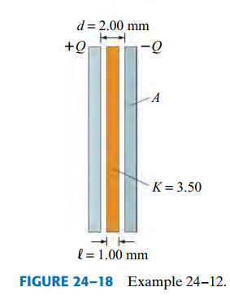

Slide 29



Slide 30
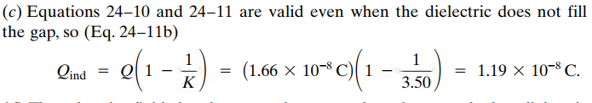
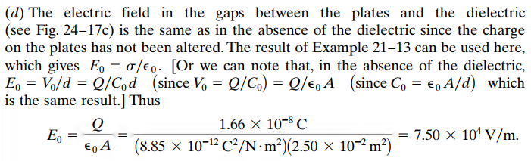


Slide 31
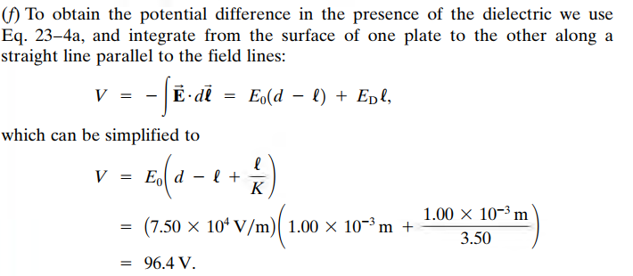


Slide 32

THANK YOU FOR YOUR ATTENTION

