Slide 1

Stack Overflow Developer Survey
MD HASANUZZAMAN DATA SCIENTIST

Slide 2



OUTLINE
Executive Summary
Introduction
Methodology
Results
Visualization – Charts
Dashboard
Discussion
Findings & Implications
Conclusion
Appendix

Slide 3

EXECUTIVE SUMMARY
Objective of Data Contextualization and Analysis
Description of the Methodology Used
Data Collection Process
Data Processing and Evaluation
Data Representation Through Visuals
Interpretation and Discussion of Findings
Summary and Final Insights

Slide 4

INTRODUCTION
Stack Overflow’s annual Developer Survey is one of the most extensive and detailed studies of programmers worldwide.
The results may not fully reflect the entire developer community.
It includes insights from nearly 90,000 developers.
Identifies trends to forecast the future direction of the developer community.
Provides a profile of developers from different regions and backgrounds.

Slide 5

METHODOLOGY
Gather survey data and examine its content.
Perform web scraping to collect data.
Use APIs for data access.
Utilize the `requests` library to retrieve data
Conduct data wrangling to clean and organize data.
Perform exploratory data analysis (EDA).
Analyze data distribution and identify patterns.
Manage and handle outliers.
Explore correlations between variables.
Create data visualizations to highlight distributions, relationships, composition, and comparisons.
Develop interactive dashboards to present insights.

Slide 6
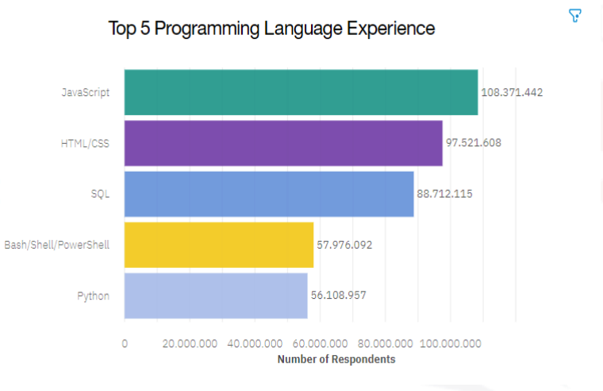
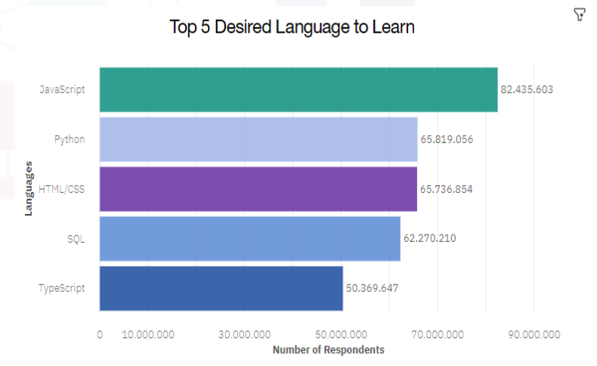
PROGRAMMING LANGUAGE TRENDS
Current Year
Next Year
<Bar chart of top 10 programming languages for the current year goes here.>
< Bar chart of top 10 programming languages for the next year goes here.>

Slide 7
PROGRAMMING LANGUAGE TRENDS - FINDINGS & IMPLICATIONS
Findings
JavaScript continues to dominate as the top language.
Python is the fastest-growing language.
Swift remains a high-paying language
Implications
JavaScript's popularity paves the way for developers to switch to TypeScript.
Increased demand for Python developers
Companies may prioritize hiring Swift developers

Slide 8
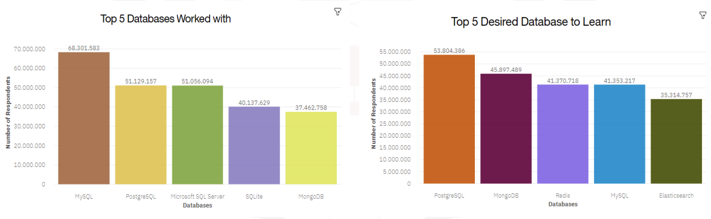
DATABASE TRENDS
Current Year
Next Year
< Bar chart of top 10 databases for the current year goes here >
< Bar chart of top 10 databases for the next year goes here.>

Slide 9
DATABASE TRENDS - FINDINGS & IMPLICATIONS
Findings
MySQL is the most popular database.
Decreased interest in Microsoft SQL Server.
Increasing interest in PostgreSQL and MongoDB.
Implications
MySQL continues to dominate the database market.
Microsoft SQL Server may face market challenges.
PostgreSQL and MongoDB are becoming more preferred.

Slide 10

DASHBOARD

Slide 11
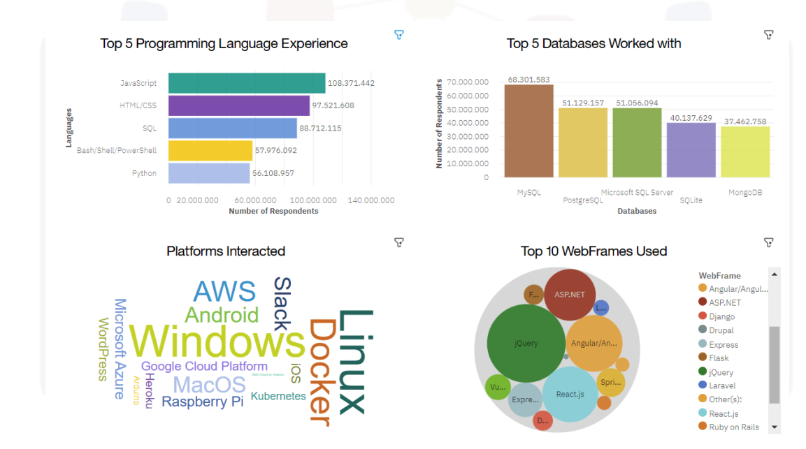
DASHBOARD TAB 1

Slide 12
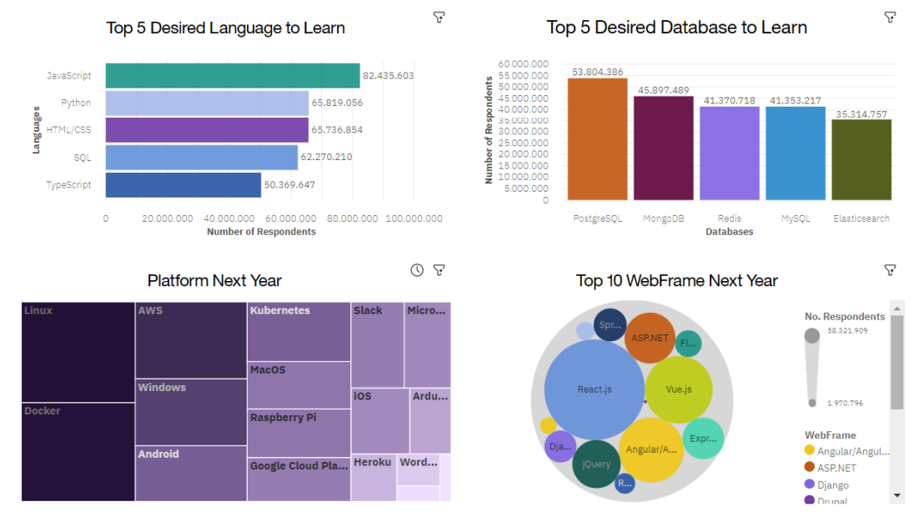
DASHBOARD TAB 2

Slide 13
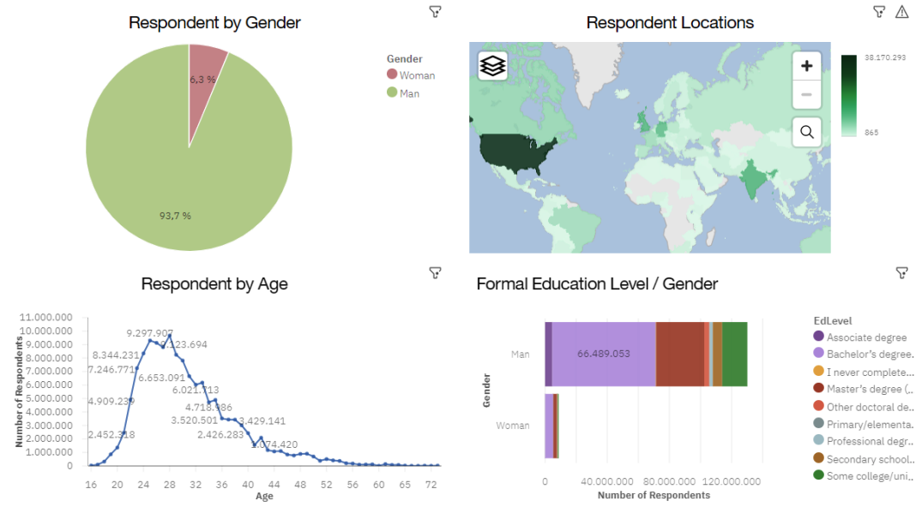
DASHBOARD TAB 3

Slide 14
DISCUSSION

Slide 15
OVERALL FINDINGS & IMPLICATIONS
Findings
JavaScript is widely used, and TypeScript is growing in popularity.
Over 90% of developers are young and male.
Most developers are located in developed countries.
Implications
Web frameworks for JavaScript and TypeScript are seeing increasing adoption.
Developer demographics are showing a gender and age skew.
There is a geographical concentration of developers in wealthier nations.

Slide 16

CONCLUSION
Developers have unique characteristics.
Analysing trends in tools and languages provides valuable insights.
There's a need to improve access to the job market in developing countries.
The developer community is predominantly concentrated in developed countries, with a younger, male-dominated demographic.

Slide 17

APPENDIX
Include any relevant additional charts, or tables that you may have created during the analysis phase.

Slide 18
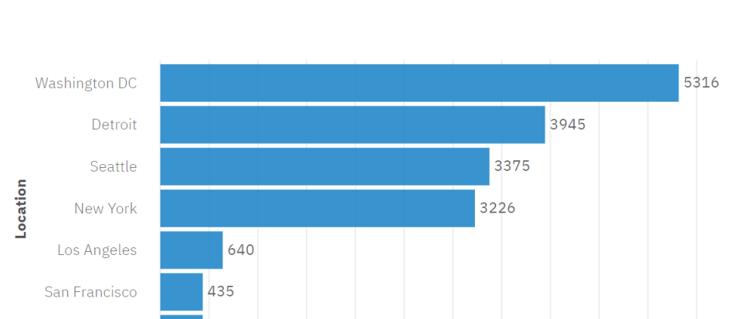
JOB POSTINGS

Slide 19
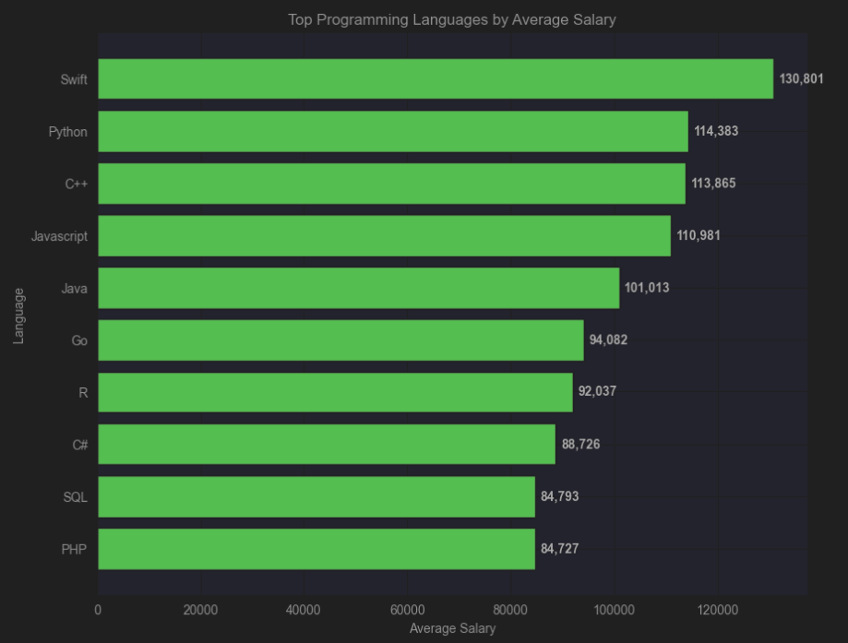
POPULAR LANGUAGES

