Slide 1

Here you will get the wifi password that are saved in your laptops it will help you to find out the password that are saved in your laptops and and when ever you forget the built-in password you will get through this for that you have to install python where you will write the code and get your built-in password easily

Slide 2

import tkinter
from tkinter import*
def kk():
Subprocess Modules
It allows you to spawn new processes,connect to their input/output/error pipes and obtain their return codes.This module intends to replace several older modules and functions
Use of This module In this process
First import subprocess, this is the module we will use to interact with the cmd.
Code
import subprocess

Slide 3
Netsh,wlan,show,profiles
If you type netsh wlan show profiles in cmd, you will be shown the profiles for wifi connections your computer has stored. If you then type netsh wlan show profile {Profile Name} key=clear , the output provided will contain the network key which is the WiFi password.
Use of This Step In this process
Next, get the output for the command "netsh wlan show profiles" using subprocess.check_output().
Then decode the output with utf-8 and split the string by a newline character to get each line in a separate string.
Code:
data=subprocess.check_output(['netsh','wlan','show','profiles']).decode('utf-8',errors='backslashreplace').split('\n')

Slide 4
Use of This Step In this process
We have a list of strings, we can get lines that only contain "All User Profile".
With these lines we then need to split it by a ':', get the right hand side and remove the first and last character
Code
profiles=[i.split(':')[1][1:-1] for i in data if 'All User Profile'in i]

Slide 5
Use of This Step In this process
Now that the variable a contains the WiFi profile names, we can get the output for the command "netsh wlan show profile {Profile Name}key=clear“
using subprocess.check_output() again for a particular profile while looping through all profiles.
Code
for i in profiles:
try:
results=subprocess.check_output(['netsh','wlan','show','profile',i,'key=clear']).decode('utf-8',errors='backslashreplace').split('\n')

Slide 6
Use of This Step In this process
Now we should have a list containing one string which is the particular profiles key.
Here you could just use a simple print statement but I have just formatted it a bit.
Now put a input call at the end of the script outside the loop so that when the script is run it will not immediately stop when results are displayed.
Code
try:
print('{:<30}| {:<}'.format(i,results[0]))
except IndexError:
print("{:<30}| {:<}".format(i, ""))
except subprocess.CalledProcessError:
print('{:<30}| {:<}'.format(i,'ENCODING ERROR'))

Slide 7


Slide 8

Use of This Step In this process
Now making a button whenever you click on the button its will gives you an output
root=tkinter.Tk()
Giving title
root.title("Get Wifi Password")
Its will fix the size of the window
root.resizable(width=False, height=False)
Height and width
root.geometry('600x350')
Putting Image on Button
photo=PhotoImage(file='3.png')
Title
label_display =Label(root, text="Click On the Image to get built-in Password",font=('chiller',30,'bold')).grid()
Button
btn=Button(root,image=photo,command=kk,border=0,height=300,width=350).place(x=80,y=50)

Slide 9
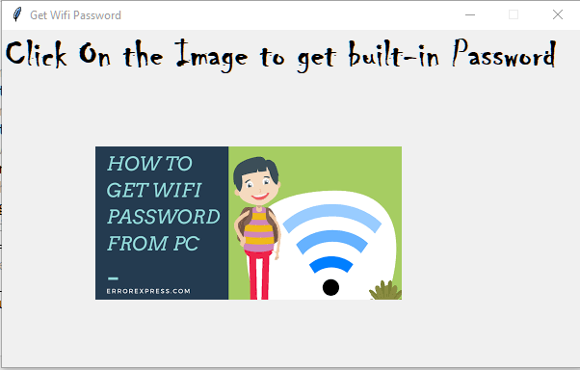
Output

