Slide 1
Defination Of Soil
Soil is the mixture of organic matter, minerals, gases, liquids, and organisms that covers most land.
It forms the outermost layer of the earth surface which is known as Pedosphere.

Slide 2
Classification
Soil is classified into four types:
Sandy soil
Silt Soil
Clay Soil
Loamy Soil
Sandy Soil
It consists of small particles of weathered rock.
These are one of the poorest types of soil for growing plants.

Slide 3
Silt Soil
Made up of rock and other mineral particles, which are smaller than sand and larger than clay.
Holds water better than sand.
It is more fertile compared to the other three types of soil.
Clay Soil
This soil are tightly packed together with very little or no airspace.
It has very good water storage qualities and thus which does not drain well.

Slide 4
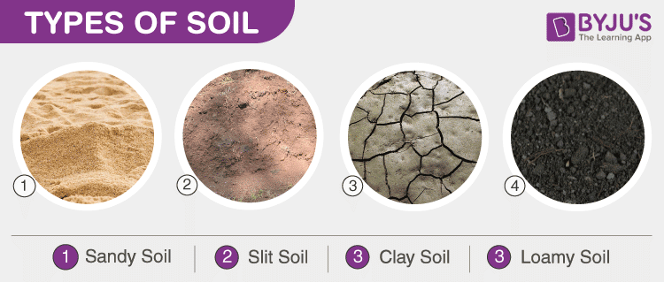
Loamy Soil
It is a combination of sand, silt and clay.
It has the ability to retain moisture and nutrients.
This soil is also referred to as agricultural soil.

Slide 5
General soil types of Bangladesh
1. Calcareous Alluvium
2. Noncalcareous Alluvium
3. Calcareous Brown
4. Calcareous Grey
5. Calcareous Dark Grey
6. Noncalcareous Dark Grey
7. Noncalcareous Brown
8. Noncalcareous Dark Grey
9. Black Terai Soil
10. Acid Basin Clay
11. Acid Sulphate Soil
12. Peat
13. Grey Piedmont Soil
14. Brown Piedmont Soil
15. Brown Hill Soils
16. Shallow Red Brown Terrace Soil
17. Deep Red Brown Terrace Soil
18. Brown Mottled Terrace Soil
19. Shallow Grey Terrace Soil
20. Deep Grey Terrace Soil
21. Grey Valley Soil

Slide 6
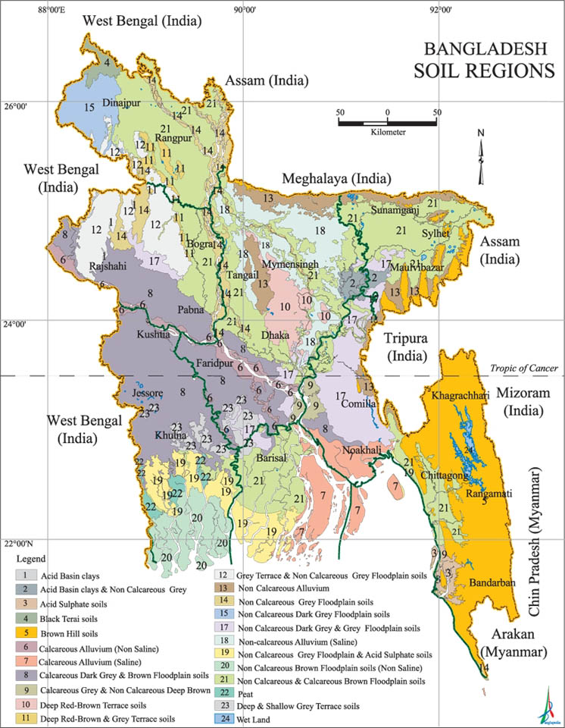

Slide 7
Seven Soil Tracts Of BD
(1) Madhupur Tract or Red Soil Tract,
(2) Barind Tract,
(3) Tista Silt,
(4) Brahmaputra Alluvium,
(5) Gangetic Alluvium,
(6) Coastal Saline Tract, and
(7) Hill Tracts.

Slide 8
