Slide 1
Introduction to Algorithm Design
Lecture Notes 7

Slide 2
ROAD MAP
Transform And Conquer
  Instance simplification
  Representation change
  Problem reduction

Slide 3
Transform And Conquer
Transform and conquer technique is based on idea of transformation
This method works in two stages
  Transformation stage
    The problem is modified to another problem
      more amenable to solution
  Conquering stage
    It is solved

Slide 4
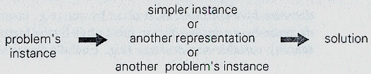
Transform And Conquer Strategy
Instance simplification
  Transformation to a simplier instance problem
Representation change
  Transformation to a different representation of same instance
Problem reduction
  Tranformation to an instance of a different problem for which an algorithm is already available

Slide 5
ROAD MAP
Transform And Conquer
  Instance simplification
    Presorting
      Element Uniqueness
      Computing Mode
      Searching
    Gaussian Elimination
  Representation change
  Problem reduction

Slide 6
Presorting
Presorting is an old idea in computer science
Many questions about a list are easier to answer if the list is sorted
Efficiency of sorting algorithms is important
  The benefits of a sorted list should more than the time spend for sorting.
  Otherwise, use unsorted list directly
We will assume that lists are implemented as arrays

Slide 7
Sorting
We discussed three elementary sorting algorithms
  Selection sort
  Buble sort
  Insertion sort
  These algorithms are quadratic in worst and average case
Also discussed two advanced algorithms
  Merge sort
    Ө(nlogn) in worst and average case
  Quick sort
    Ө(nlogn) in average case
    Ө(n²) in worst case
Are there faster algorithms ?
  There is no general comparison-based sorting algorithm can have better efficiency than Θ(nlogn)

Slide 8
Element Uniqueness
Example 1 : Checking element uniqueness in an array
  Brute force algorithm compare pairs of array’s elements until either two equal elements were found or no pairs were left
  Its worst case efficiency was Θ(n²)
  Alternatively, what can we do ?

Slide 9
Element Uniqueness
Approach :
1. sort the array
2. check only its consecutive elements
If the array has equal elements, a pair of them must be next to each other

Slide 10
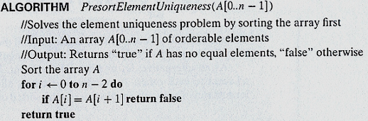
Element Uniqueness
What is the running time of the algorithm ?

Slide 11
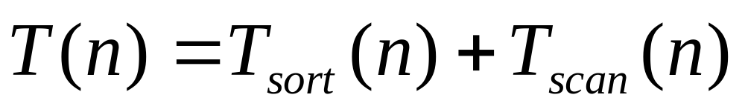
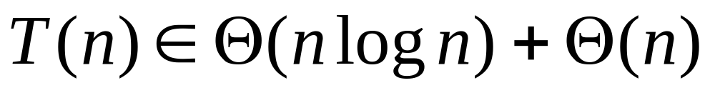
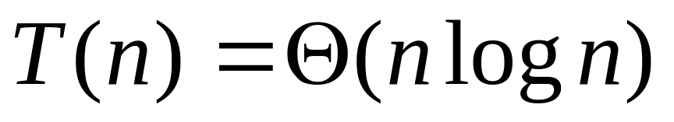
Element Uniqueness
Analysis :
More efficient than brute-force algorithm

Slide 12
Computing Mode
Example 2 : Computing mode
A mode is value that occurs most often in a given list of numbers
For 5,1,5,7,6,5,7 the mode is 5
  In brute-force approach
    Scan the list
    Compute the frequencies of all distinct values
    Find the value with largest frequency
  How to implement this idea?

Slide 13
Computing Mode
Method:
  Store values already encountered, along with their frequencies in a separate list
  On each iteration, the ith element of original list is compared with values encountered
  If a matching value is found, its frequency is incremented
  Otherwise, current element is added to the list of distinct values seen so far with a frequency of 1
  What about analysis?

Slide 14

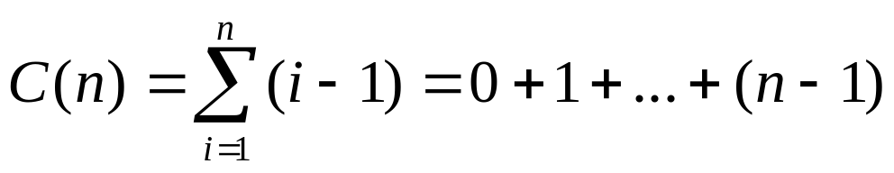
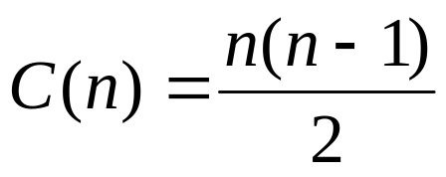
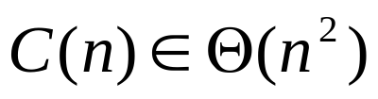
Computing Mode
Number of comparisons depends on the input.
  In the best case: (all the elements are same)
  In worst case: (all the elements are different)
What can we do as an alternative ?

Slide 15
Computing Mode
Approach :
1. Sort the input
    Then all equal values will be adjacent to each other
2. Find the longest run of adjacent equal values in the sorted array

Slide 16
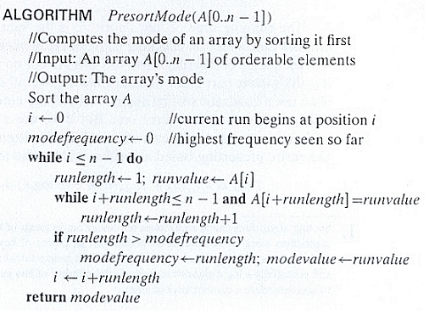
Computing Mode

Slide 17
Computing Mode
Analysis :
  Running time of algorithm depends on the time spent on sorting
    remainder of the algorithm takes linear time (why ?)
  So, with an Θ(nlogn) sort, worst case efficiency will be Θ(nlogn)

Slide 18
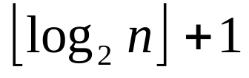
Searching Problem
Example 3 : Searching Problem
  Searching for a given value v in a given array of n sortable items
  Brute force solution is sequential search
    needs n comparisons in worst case
  If the array is sorted, we apply binary search
    requires only comparisons in worst case

Slide 19
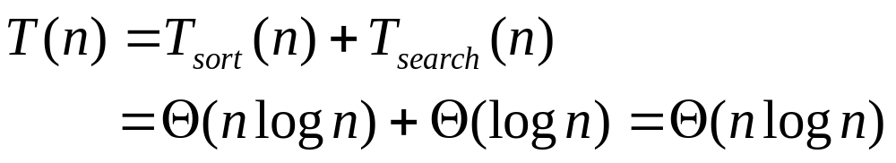
Searching Problem
Assume the most efficient Θ(nlogn) sort is used
Total running time in worst case and also average case will be
Worst than sequential search!...
What if the search will be done several times?...

Slide 20
Presorting
Discussion:
  Geometric algorithms dealing with sets of points use presorting in one way or another
    Presorting is used in divide and conquer for closest pair problem and convex-hull problem
  Some problems for directed acyclic graphs can be solved more easily after topologically sorting the digraph
    Finding the shortest and longest paths

Slide 21
ROAD MAP
Transform And Conquer
  Instance simplification
    Presorting
    Gaussian Elimination
      Solving Linear System of Equations
      LU Decomposition
      Computing a Matrix Inverse
      Computing a Determinant
  Representation change
  Problem Reduction

Slide 22
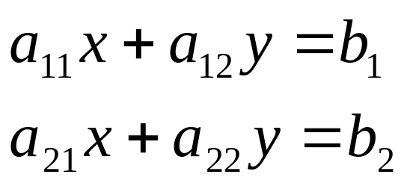
Solving Linear System of Equations
A system of two linear equations in two unknowns
The system has a unique solution
  unless the coefficients of one equation are proportional to the coefficients of the other

Slide 23
Solving Linear System of Equations
To find the solution
  Express one of the variables as a function of the other
  Substitute the result into the other equation
    yielding a linear equation
  Solve it to find the value of the first variable.
  Use the solution to find the value of the second variable.
What if the number of variables is large!

Slide 24
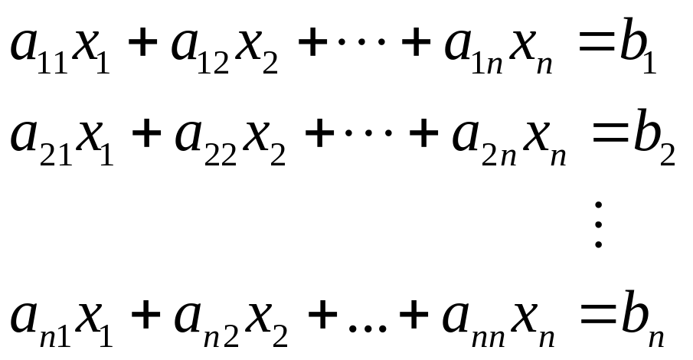
Solving Linear System of Equations
In many applications, we need to solve a system of n equations in n unknowns
Such a system can be solved by generalizing the substitution method
  However, the resulting algorithm would be extremely cumbersome

Slide 25
Solving Linear System of Equations
  Gaussian elimination is an elegant algorithm to solve systems of linear equations
  This method is named after Carl Frederich Gauss
  Idea of Gaussian elimination is to tranform a system of n linear equations in n unknowns to an equivalent system
    with an upper triangular coefficient matrix
      a matrix with all zeros below its main diagonal
  Mathematical formulation is as follows:

Slide 26
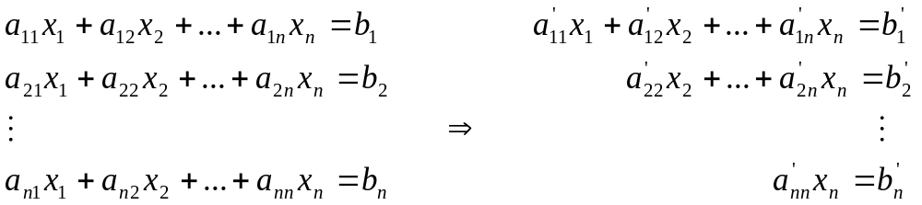
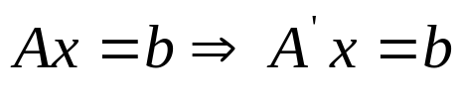
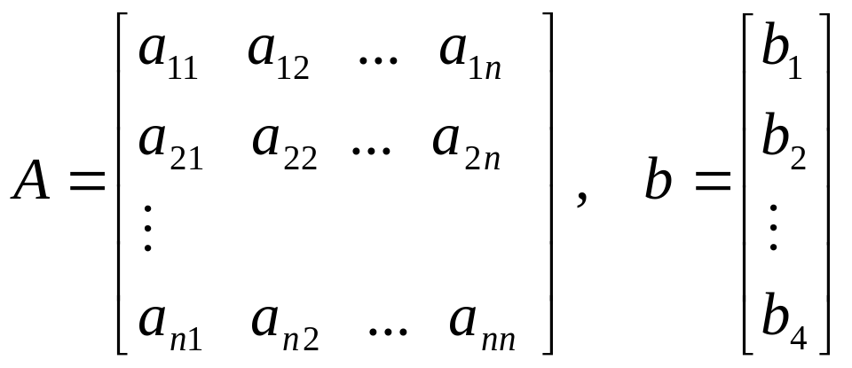
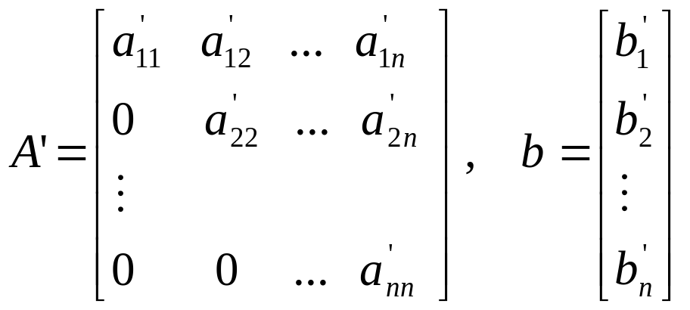

Slide 27
Gaussian Elimination
  What is the use of such a transformation?
  Easier to solve upper-triangular system by back-substitution
    Solve the last equation to find the value of x_{n}
    Substitute x_{n} into the next to last equation and find the value of x_{n-1}
    Continue similarly until the first equation
    For the first equation, substitute the values of the last n-1 variables into the first equation and find the value of x₁

Slide 28
Gaussian Elimination
  How to transform a system to an equivalent upper-triangular system?
  Perform a series of operations
    Exchange two equations
    Replace an equation with its nonzero multiple
    Replace an equation with a sum or difference of this equation and some multiple of another equation
  These operations do not change the solution of the system

Slide 29
Gaussian Elimination
  How to use operations for a transformation?
  Idea:
    Use a₁₁ as a pivot
    In each equations except the first, make the coefficient of x₁ to be zero.
      Perform the last operation on equations i with multiple of a_{i1}/a₁₁
    Do the same for all coefficient on the diagonal.

Slide 30
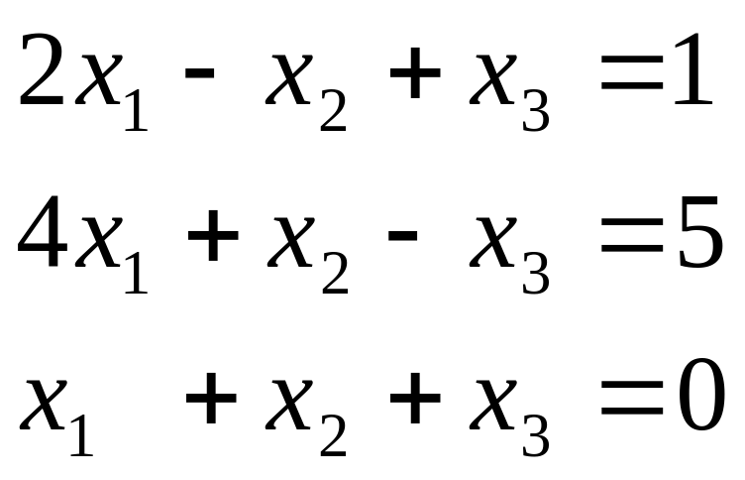
Gaussian Elimination
Example :
Solve the system by Gaussian elimination

Slide 31
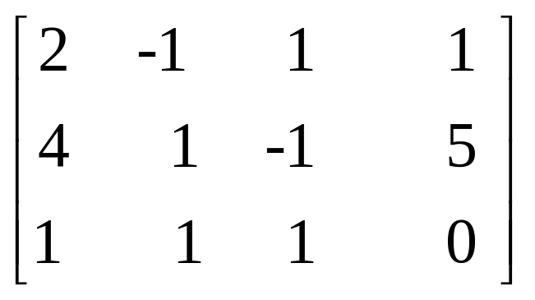
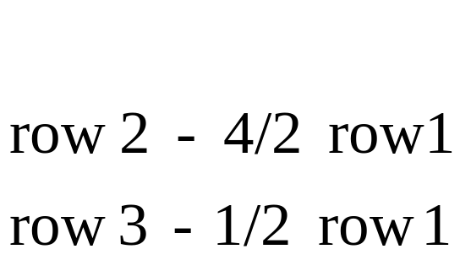
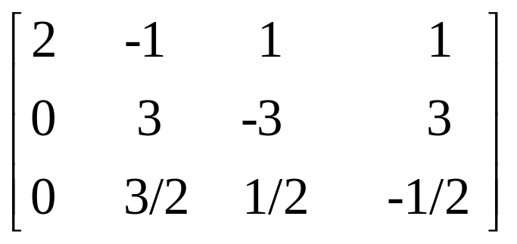
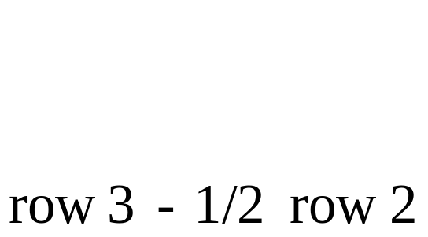
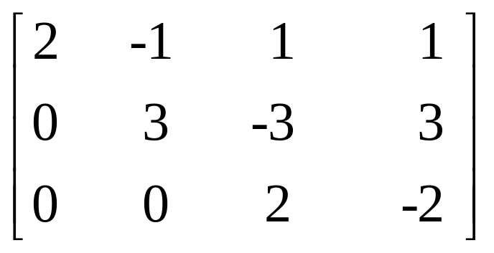

Slide 32
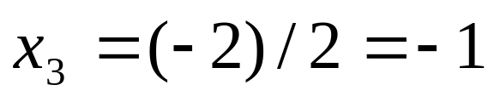
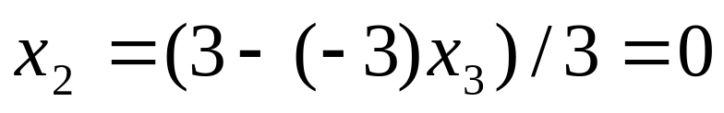
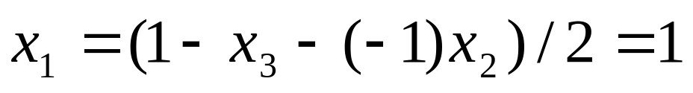
Use back-substitution to solve the system

Slide 33
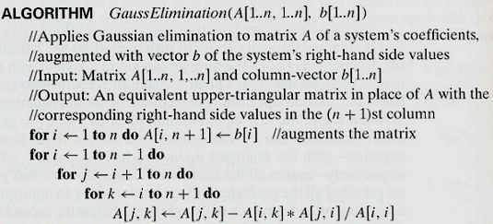
Gaussian Elimination

Slide 34
Gaussian Elimination
Observations:
  What if A[i,i]=0
    Can not use the ith row as a pivot
      Division by zero
    Solution: change the ith row with some row below it has a nonzero coefficient in the ith column
  What if A[i,i] is too small
    Round-off error because of division by a small value
    Solution: change the ith row with a row with largest absolute value of the coefficient in the ith column
  This modification is called partial pivoting

Slide 35
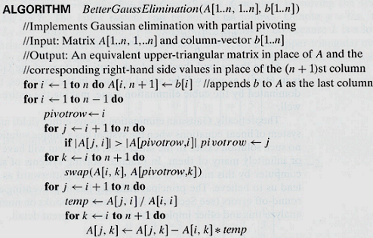
Gaussian Elimination

Slide 36
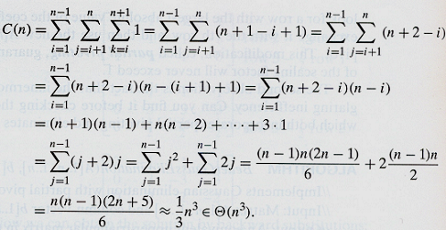
Gaussian Elimination
Analysis :
  by assuming multiplication as the basic operation

Slide 37
LU Decomposition
Gaussian elimination provides more than just a solution to a system of equations
It also produces LU decomposition of the coefficient matrix as a useful by-product
What is LU decomposition
  By an example:

Slide 38
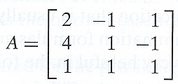
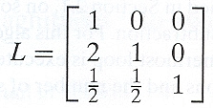
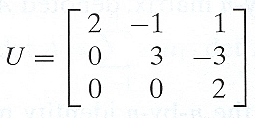
LU Decomposition
consider the lower-triangular matrix L made up of 1’s on its main diagonal and row multiplies used in the Gaussian elimination process
consider the upper-triangular matrix U that was the result of the elimination
The product LU is equal to matrix A

Slide 39
LU Decomposition
Solving the system Ax = b is equivalent to solving the system LUx = b
The latter system can be solved as follows
  Denote y=Ux, then Ly = b
  First solve the system Ly = b
    It is easy because L is a lower-triangular matrix
  Then solve the system Ux = y
    Upper-triangular matrix U to find x

Slide 40



We first solve Ly = b
Its solution is
Solving Ux=y means solving
So the solution is

Slide 41
LU Decomposition
Discussion :
  Once we have the LU decomposition of matrix A, we can solve the systems Ax = b with as many right-hand side vectors b as we want to
    This is a distinct advantage over the classic Gaussian elimination discussed earlier
  LU demcoposition does not require extra memory
    We can store nonzero part of U in the upper triangular part of A
    We can store nontrivial part of L below the main diagonal of A

Slide 42
Computing Matrix Inverse
Definition :
The inverse of an n-by-n matrix A is an n-by-n matrix denoted A⁻¹ such that
AA⁻¹ = I
I is the n-by-n identity matrix
  Matrix with all zero elements except main diagonal elements which are all ones
A matrix inverse can be used to solve a linear system of equations
  Solution of Ax=b is obtained by x=A⁻¹b

Slide 43
Singularity Check
Not every square matrix has an inverse
  When it exists the inverse is unique
If a matrix does not have an inverse, it is called singular
  A matrix is singular iff one of its rows is a linear combination of other rows
The way to check whether a matrix is nonsigular is to apply Gaussian elimination
  Matrix is nonsingular if it yields an upper-triangular matrix with no zero on the main diagonal

Slide 44
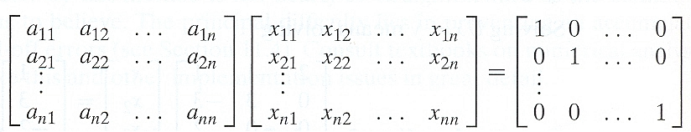
Computing Matrix Inverse
To compute the inverse matrix for a nonsingular n-by-n matrix A we need to find n² numbers
x_{ij}, 1≤i,j≤n such that

Slide 45

Computing a Matrix Inverse
We can find the unknowns by solving n systems of linear equations that have the same coefficient matrix A
  the vector of unknowns x^{j} is the jth column of the inverse
  the right-hand side vector e^{j} is the jth column of identity matrix (1≤j≤n)
We can use LU decomposition to solve above equation for all j values
OR
We can solve these systems by applying Gaussian elimination to matrix A augmented by the n-by-n identity matrix

Slide 46

Computing a Determinant
Definition :
  The determinant of an n-by-n matrix A denoted detA or |A| is a number whose value can be defined recursively as follows :
    If n=1 i.e., n consists of a single element a₁₁
      det A = a₁₁
    For n>1
      det A is computed by formula
s_{j} is +1 if j is odd and -1 if j is even
a_{1j} is the element in row 1 and column j
A_{j} is the (n-1)-by-(n-1) matrix
obtained from matrix A by deleting its row 1 and column j

Slide 47

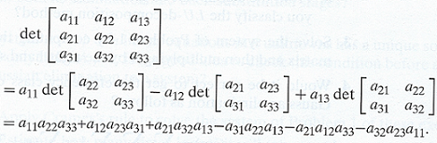
For a 2-by-2 matrix
For a 3-by-3 matrix
What if we need to compute a determinant of a large matrix ?

Slide 48
Computing a Determinant
The algorithm using the recursive definition requires O(n!) time
Gaussian elimination comes to resque again!
  Basic operations used in Gaussian elimination changes the determinant
    Changes the sign
    Multiplied by a constant used in elimination
  The determinant of an upper-triangular matrix is equal to the product of elements on its main diagonal
The determinant of an n-by-n matrix can be calculated in cubic time

Slide 49

Computing a Determinant
Discussion :
  System of n linear equations in n unknowns Ax = b has a unique solution iff the determinant of its coefficient matrix, detA, is not equal to zero
  This solution can be found by formulas called Cramer’s rule
  where A_{j} is obtained by replacing the jth column of A by the column b

Slide 50
Transform And Conquer Strategy
Instance simplification
  Transformation to a simplier instance problem
Representation change
  Transformation to a different representation of same instance
Problem reduction
  Tranformation to an instance of a different problem for which an algorithm is already available

Slide 51
ROAD MAP
Transform And Conquer
  Instance simplification
  Representation change
    Balanced Searched Trees
      AVL Trees
    Heaps and Heapsort
    Horner’s Rule and Binary Exponentiation
  Problem Reduction

Slide 52
Balanced Search Trees
BST is a basic data structure to implement dictionaries.
BST can be considered as an example of representation change
  Transformation over straightforward array implementation
By this transformation, better run time efficiency is obtained
  For insertion, deletion and search operations, logarithmic runtime on average case
  What about worst case?

Slide 53
AVL Trees
BST can be transformed to a balanced tree
  For better worst case efficiency
An AVL tree is a binary search tree in which the balance factor of every node
  Balance factor is defined as the difference between the heights of the node’s left and right subtrees
    is either 0 or +1 or -1

Slide 54
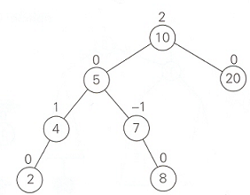
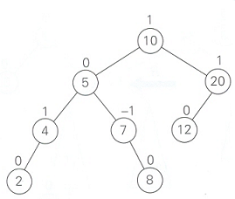
AVL Trees
An AVL tree
Not an AVL tree

Slide 55
AVL Trees
If an insertion of a new node makes an AVL tree unbalanced we transform the tree by rotations
  Single rotation
    Left rotation
    Right rotation
  Double rotation
    Left-right rotation
    Right-left rotation

Slide 56
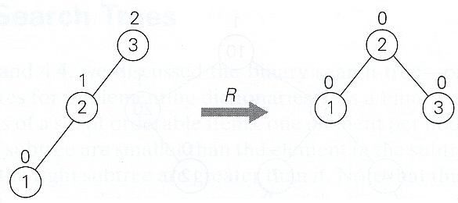
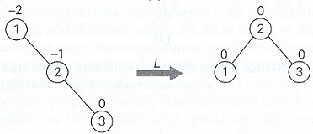
Single R-rotation
Single L-rotation

Slide 57
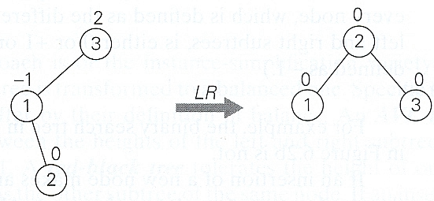
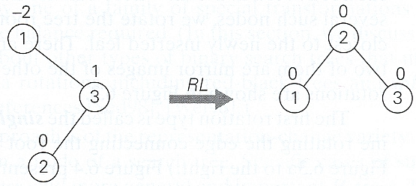
Double LR-rotation
Double RL-rotation

Slide 58
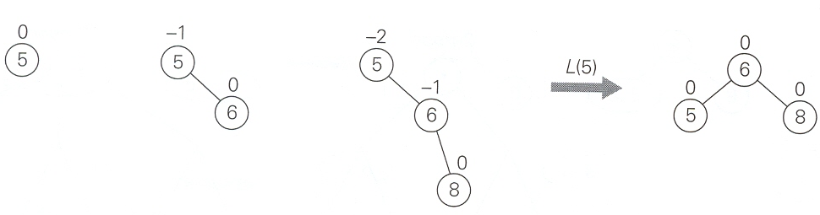
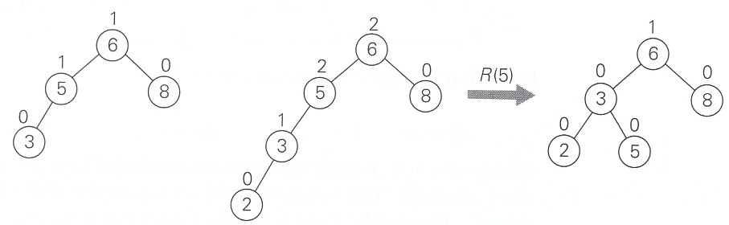
Constructing of an AVL tree for the list 5, 6, 8, 3, 2, 4, 7

Slide 59
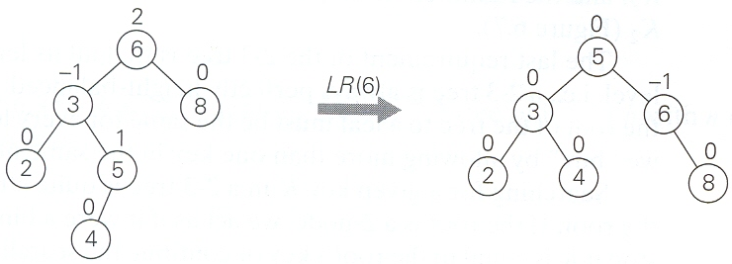
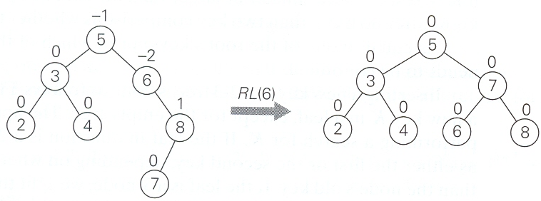

Slide 60
AVL Trees
Analysis :
  Searching and insertion operations are Ө(logn) in worst case
  Searching in an AVL tree requires on average almost the same number of comparisons as searching in a sorted array by binary search
  Deletion operation is more difficult than insertion
    But turns out same efficiency class as insertion

Slide 61
ROAD MAP
Transform And Conquer
  Instance simplification
  Representation change
    Balanced Searched TreesAVL Trees
    Heaps and Heapsort
    Horner’s Rule and Binary Exponentiation
  Problem Reduction

Slide 62
Heaps
  Heap is an important data structure, suitable for implementing priority queues
  Priority queue is a multiset of items with an orderable charecteristics called an item’s priority
    find an item with highest priority
    delete an item with highest priority
    add a new item to multiset
  Heap is representation change over regular list
    Provides efficient algorithms for basic operations
  Heap also serves an important sorting algorithm called heapsort

Slide 63
Heapsort
Heapsort is an interesting two-stage algorithm
  Stage 1 → heap construction
    Construct a heap for a given array
  Stage 2 → maximum deletions
    Apply the root-deletion operation n-1 times to the remaining heap
  As a result the array’s elements are eliminated in decreasing order
  Since under the array implementation, an element being deleted is placed last, the resulting array will be exactly the original array sorted in ascending order

Slide 64
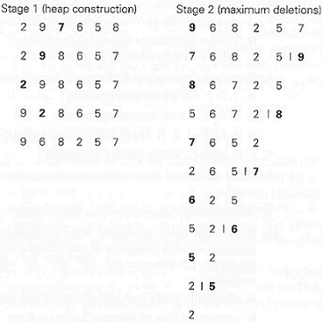
Sorting array 2, 9, 7, 6, 5, 8
by heapsort

Slide 65
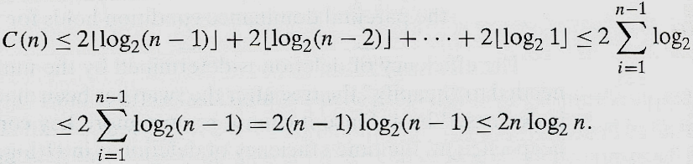
Heapsort
Analysis :
  We know that heap construction stage is O(n)
    Stage 1
  What about stage 2 ?
  For both stages O(n) + O(nlogn) = O(nlogn)

Slide 66
Heapsort
Discussion :
  Average case efficiency is also Ө(nlogn)
    such as mergesort
  Heapsort does not require an extra storage
  Timing experiments on random files show that heapsort runs more slowly than quicksort but it is competitive with mergesort

Slide 67
ROAD MAP
Transform And Conquer
  Instance simplification
  Representation change
    Balanced Searched TreesAVL Trees
    Heaps and Heapsort
    Horner’s Rule and Binary Exponentiation
  Problem Reduction

Slide 68
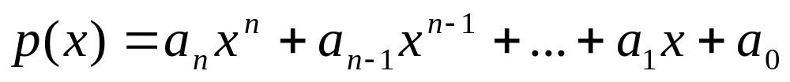
Horner’s Rule
Problem Definition:
Compute the value of a polynomial
at a given point x
Polynomials constitute the most important class of functions
  They posses a wealth of good properties
  Can be used for approximating other types of functions
Manipulating polynomials efficiently is an important problem

Slide 69
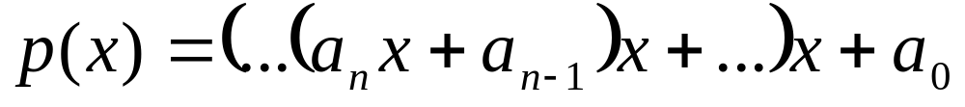
Horner’s Rule
  Horner’s rule provides elegant method for evaluating a polynomial
  It is a good example of representation change technique since it is based on representing P(x) by a formula

Slide 70
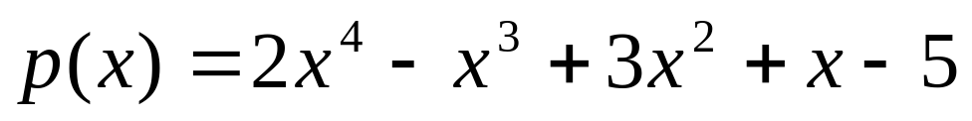
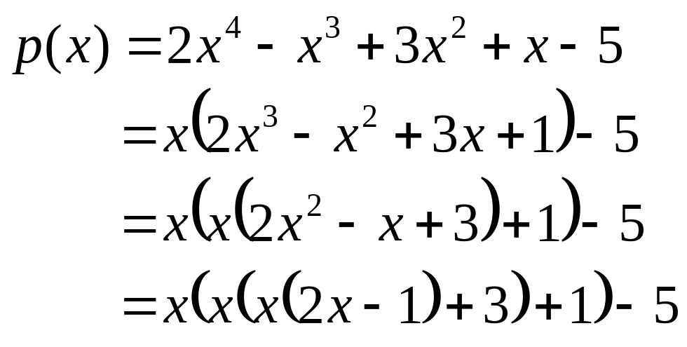
Horner’s Rule
Example :
For example, for the polynomial
we get

Slide 71
Horner’s Rule
The pen-and-pencil calculation can be conveniently organized with a two row table
  First row contains the polynomial’s coefficients listed from the highest a_{n} to the lowest a₀
  Second row is filled from left to right as follows (except its first entry which is a_{n})
    Next entry is computed as the x’s value times the last entry in the second row plus the next coefficient from first row
  Final entry is the value being sought

Slide 72

Horner’s Rule
P(3) = 160
3.2+(-1) →2x-1 at x=3
3.5+3 = 18 → x(2x-1)+3 at x=3
3.18+1 = 55 → x(x(2x-1)+3)+1 at x=3
3.55+(-5) = 160 → x(x(x(2x-1)+3)+1)-5 = p(x)

Slide 73

Horner’s Rule

Slide 74

Horner’s Rule
Analysis :
  Number of multiplications and number of additions
  So how efficient is Horner’s rule ?

Slide 75
Horner’s Rule
Analysis :
  Consider only the first term of a polynomial of degree n : a_{n}x^{n}
  Just computing this term with brute force approach requires n multiplications
    Horner’s rule computes n-1 other terms in addition to this and still uses the same number of multiplications
  So it is an optimal algorithm for polynomial evaluation

Slide 76
Horner’s Rule
Discussion:
  Horner’s rule also has some useful by-products
  The intermediate numbers generated by the algorithm in the process of evaluating P(x) at some point x₀ turn out to be the coefficient to the quotient of the division of P(x) by x-x₀
    While the final result, in addition to being P(x₀) is equal to the remainder of this division of
    P(x) = P’(x) (x-x₀) + P(x₀)
    2x⁴ – x³ + 3x² + x – 5 by x-3
    2x³ + 5x² + 18x + 55 and 160
  This division algorithm is known as synthetic division
    It is more convenient than long division

Slide 77
Exponentiation
Problem Definition :
  Compute a^{n}
  Computing a^{n} in an essential operation in primality-testing and encryption methods
  The brute-force algorithm takes linear time
  Designing other algorithms for computing a^{n} is important
  For example, based on the representation change idea

Slide 78
Binary Exponentiation
  We will consider two algorithms for computing a^{n}
  Both of them exploit the binary representation of exponent n
    One of them processed this processes this binary string left to right
    The second does it right to left

Slide 79
Binary Exponentiation
Let
n = b_{I} … b_{i} … b₀
be the string representation of a positive integer n in binary system
The value of n can be computed as the value of polynomial at x = 2
P(x) = b_{I}x^{I} + … + b_{i}x^{i} + … + b₀
If n = 13 its binary representation is 1101 and
13 = 1.2³ + 1.2² + 0.2¹ + 1.2⁰

Slide 80



Binary Exponentiation
If we compute the value of P(x) with Horner’s rule

Slide 81
Binary Exponentiation
After initializing the accumulator’s value to a,
  the bit string representing the exponent is always square the last value of accumulator
  if the current binary digit is 1, also multiply it by a
These observations lead to left-to-right exponentiation method of computing an

Slide 82

Left-to-right binary exponentiation

Slide 83

Left-to-right binary exponentiation
Example :
  Compute a¹³ by left-right binary exponentiation
    Here n = 13 = (1101)₂
    So

Slide 84

Left-to-right binary exponentiation
Analysis :
Total number of multiplications M(n)
  b is the length of bit string representing exponent n
  b-1 = logn
  So efficiency is Ө(logn)

Slide 85
Left-to-right binary exponentiation
Discussion :
  This algorithm is better efficiency class than brute-force exponentiation
    requires n-1 multiplications

Slide 86
Right-to-left binary exponentiation
Definition:
  Right-to-left binary exponentiation uses same binary polynomial p(2) yielding value of n
  But it does not apply Horner’s rule
    Exploits it differently

Slide 87

Right-to-left binary exponentiation
Thus a^{n} can be computed as the product of terms
  The product of consecutive terms a^{2i}, skipping those for which the binary digit bi is zero
  We can compute a^{2i} by simply squaring the same term we computed for the previous value of i since
  a^{2i} = (a^{2i-1})²
  We compute powers of a right to left (smallest to largest)

Slide 88

Right-to-left binary exponentiation

Slide 89

Right-to-left binary exponentiation
Example :
  Compute a¹³ by right-to-left binary exponentiation
    Here n = 13 = 1101
    So

Slide 90
Right-to-left binary exponentiation
Analysis :
  Efficiency is logaritmic
    Same as left-to-right binary multiplications

Slide 91
Binary Exponentiation
Discussion:
  Both binary exponentiation algorithm discussed reduce somewhat by their reliance on availability of the explicit binary expansion of exponent n

Slide 92
ROAD MAP
Transform And Conquer
  Instance simplification
  Representation change
  Problem Reduction
    Computing The Least Common Multiple
    Counting Paths in A Graph
    Reduction of Optimization Problems
    Linear Programming
    Reduction to Graph Problems

Slide 93

Problem Reduction
Definition:
  Problem reduction is to reduce a problem you need to solve to another problem that you know how to solve
    Find a problem to reduce onto
    Perform reduction
  The reduction worth if the reduction operations and algorithm A takes less time than solving the original problem directly

Slide 94
Least Common Multiple
Definition :
  Computing the least common multiple of two integers m and n is denoted lcm(m,n)
  lcm is defined as the smallest integer that is divisible by both m and n
    lcm (24, 60) = 120
    lcm (11,5) = 55
  It is an important notion in arithmetic and algebra

Slide 95
Computing the Least Common Multiple
Approach :
  Given the prime factorizations of m and n, lcm (m,n) can be computed as the product of all the common prime factors of m and n times the product of m’s prime factors that are not in n times n’s prime factors that are not in m
  24 = 2 . 2 . 2 . 3
  60 = 2 . 2 . 3 . 5
  lcm (24, 60) = (2 . 2 . 3 ) . 2 . 5 = 120

Slide 96
Computing the Least Common Multiple
As a computational procedure, this algorithm has the same drawbacks as middle-school algorithm for computing greatest-common-divisor
How can we design a more efficient algorithm by using problem reduction ?

Slide 97

Computing the Least Common Multiple
Product of lcm(m,n) and gcd(m,n) includes every factor of m and n exactly once
So,
This formula reduces lcm calculation to gcd calculation
gcd(m,n) can be computed with Euclid’s algorithm efficiently

Slide 98
Counting Paths in a Graph
Definition:
  Counting different paths between two vertices in a graph
  It is easy to prove that number of different paths of length k>0 from the ith vertex to the jth vertex of a graph equals the (i,j) th element of A^{k} where A is the adjacency matrix of the graph

Slide 99

Counting Paths in a Graph
a graph its adjacency matrix A its square A²
Elements of A and A² indicate the number of paths of lengths 1 and 2

Slide 100
Counting Paths in a Graph
  So, the problem can be solved with an algorithm for computing an appropriate power of its adjacency matrix
  Problem is reduced to matrix exponentiation
    How to calculate A^{k}

Slide 101
Reduction of Optimization Problems
Problem Definition:
Find a maximum (minimum) of some function,
  maximization (minimization) problem
Suppose that you know an algorithm for maximizing a function, but you want to minimize it
How can you take advantage of the latter ?

Slide 102


Reduction of Optimization Problems
Approach :
  To minimize a function
    we can maximize its negative instead
    get a correct minimal value of the function itself
    change the sign of the answer
is also correct

Slide 103

Reduction of Optimization Problems
Relationship between minimizing and maximizing problems

Slide 104
Reduction of Optimization Problems
Example :
  To find extremum points of a function based on problem reduction
    Find the function’s derivative f’(x)
    Solve the equation f’(x) = 0
    Find the function’s critical points
  Optimization problem is reduced to the problem of solving an equation as the principal part of finding extremum points

Slide 105
Linear Programming
Definition:
  Linear programming is a problem of optimizing a linear function of several variables subject to constraints in the form of linear equations and linear inequalities
  Many problems of optimal decision making can be reduced to an instance of the linear programing problem

Slide 106
Linear Programming
Example 1:
  Consider a university endowment that needs to invest $100 million
  This sum must be split between three types of investments
    stocks, bonds and cash
  Endowment managers expect an annual return of 10%, 7% and 3% for their stock, bond and cash investments
  Since stocks are most risky than bonds, endowment rules require the amount invested in stocks to be no more than one third of the moneys invested in bonds
  In addition, at least 25% of the total amount invested in stocks and bonds must be invested in cash
  How should the managers invest the money to maximize the return ?

Slide 107

Linear Programming
First create a mathematical model of this problem
Let, x, y, z be amounts invested in stocks, bonds and cash
So we can pose the following optimization problem

Slide 108

General Linear Programming Problem
Optimal decision making can be reduced to an instance of the general linear programming problem
Linear programming has proved to be flexible enough to model a wide variety of important applications
  airline crew scheduling
  transportation and communication network planning
  oil exploration and refining
  industrial production optimization

Slide 109
Linear Programming
Classical algorithm for this problem is simplex method
  Worst case efficiency of this algorithm is known to be exponential but performs very well on typical inputs
There exist a few other algorithms
  best known of them is discovered by Narendra Karmarkar
Their polynomial worst case efficiency was proven
  Karmarkar algorithm is competetive with simplex method in empirical tests

Slide 110
Linear Programming
When variables of a linear programming problem are required to be integers, is said to be integer linear programming problems
  known to be much more difficult
  no polynomial time algorithm for solving them is known

Slide 111
Linear Programming
Example 2:
  Let see how knapsack problem can be reduced to a linear programming problem
    Given a knapsack capacity W
    n items of weights w₁, w₂, …, w_{n}
  We consider first the continuous version of the problem
    Any fraction of any given item can be taken into the knapsack

Slide 112



Linear Programming
Example 2:
  Let x_{j}, j = 1, …, n be a variable representing a fraction of item j taken to knapsack
  x_{j} must satisfy the inequality 0≤ x_{j} ≤1
  Then total weight of selected items is
  Their total value is
  So the knapsack problem can be posed as the following linear programing problem

Slide 113

Linear Programming
In the discrete (0 or 1) version of knapsack problem
  either to take an item entirely or not to take it
  we have the following integer linear programming problem
this minor modification makes a drastic difference on the complexity
discrete version seems to be easier, but actually more complicated

Slide 114
Reduction to Graph Problems
Many problems can be solved by a reduction to one of the standart graph problems
  Vertices typically represent possible states of the problem
    One is initial state, another is final state
  Edges indicate permitted transmissions among states
  Such a graph is called state-space-graph
The transformation reduces the problem to question about a path from the initial-state vertex to a goal-state vertex

Slide 115
Reduction to Graph Problems
Example :
  Consider river-crossing puzzle problem
  A peasant finds himself on a river bank with a wolf, a goat and a head of cabbage
  He needs to transport all three on the other side of the river in his boat.
  However, the boat has room only peasant himself and one other item
  In his absence the wolf would eat the goat, the goat will eat the cabbage
  Find a way for the peasant to solve his problem or prove that it has no solution

Slide 116

P,w,g,c stand for peasant, wolf, goat and cabbage
| | represent the river
The edges are labeled by indicating the boat’s occupants for each crossing
We are inretested in finding a path from the initial-state vertex, Pwgc || to the final state ||Pwgc
State-space graph for the peasant, wolf, goat and cabbage puzzle

Slide 117
Reduction to Graph Problems
It is easy to see that there exist two distinct simple paths from initial state vertex to final state vertex
  What are they ?
If we find them by applying breadth-first search, we get a formal proof that these paths have the smallest number of edges possible
This puzzle has two solutions, each of which requires seven river crossings

Slide 118
Reduction to Graph Problems
Discussion:
  Generating and investigating state-space graphs are not always a straightforward task such as in the given example
  To get a better appreciation of them, consult books on AI (artificial intelligence)

Slide 119
Problem Reduction
Discussion:
  Plays a central role in theoretical computer science
    where it is used to classify problems according to their complexity
  The practical difficulty is finding a problem to which the problem at hand should be reduced
  If we want our efforts to be of practical value, we need our reduction-based algorithm to be more efficient than solving the original problem directly

